Slide 1


Lions Clubs International
MyLCI Quick Reference Guide

Slide 2

New Club Application Process
Congratulations on taking the first steps in forming a new club. This guide will provide you with step-by-step instructions on completing the new club application process.
This guide will include:
Naming of a club
Who can process the application
The application stage process
Club Charter approval process
Club chartering tips
2

Slide 3
aa
Application Submission
New Club Application Submission:
Choosing a name
The first step in the application process is choosing a name. The following guidelines will help to support your name choice.
A proposed Lions Club or club branch must be known by the actual name of the “municipality” or it’s equivalent governmental subdivision in which it is located.
Campus clubs can use the college or university name as its “municipality.
“Distinguishing designation” for clubs located in the same municipality may be any name which clearly identifies the club from other clubs. Distinguishing designation will be added after the municipality. Ex. Oakbrook Sight Lions Clubs
“Host Club” shall be title for parent club in municipality
Lions Clubs cannot be named after living individuals
No Lions Club may add “International” as a distinguishing designation to its name
If including a company’s name, documentation must be provided by company prior to club approval
3

Slide 4
Charter Application Process
4

Slide 5
aa
Application Submission
New Club Application Submission: District Application Process
The information below provides details on who can process the new club application on the district and club level.
Application Entry | Charter Member Entry | Guiding Lion Entry | Application Approval | Club Payment through MyLCI
District Governor | District Governor | District Governor | District Governor | New Club Treasurer
Coordinating Lion | Coordinating Lion | Coordinating Lion | Coordinating Lion
District GMT Coordinator | District GMT Coordinator
Sponsoring Club President | Sponsoring Club President
Sponsoring Club Secretary | Sponsoring Club Secretary
 | New Club President
 | New Club Secretary
5

Slide 6
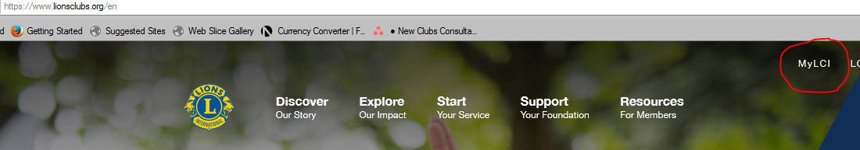
aa
Application Submission
New Club Application Submission: MyLCI
New Club Charter Applications are submitted online through MyLCI. The following steps should be taken for new club application submission.
Step 1: Log In to MyLCI. You can access MyLCI through the www.lionsclubs.org website and click on the MyLCI tab in the top panel
6

Slide 7

aa
New Club Application Submission: MyLCI
Step 2 : Universal Log In Page:
You will be directed to the Lions Club International Universal Log in page. Choose the GO Button under “MyLCI Tools for Lion Leaders”.

Slide 8
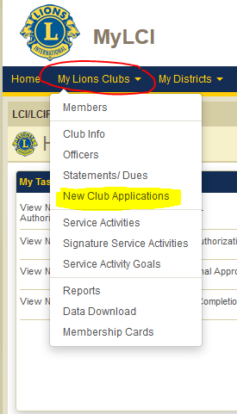

aa
Application Submission
New Club Application Submission: MyLCI
Step 3: Click on the “My Lions Clubs” Tab and click on the new club applications from the dropdown. Click on the add club button.
Tip: To access the new club throughout the process use this step.

Slide 9
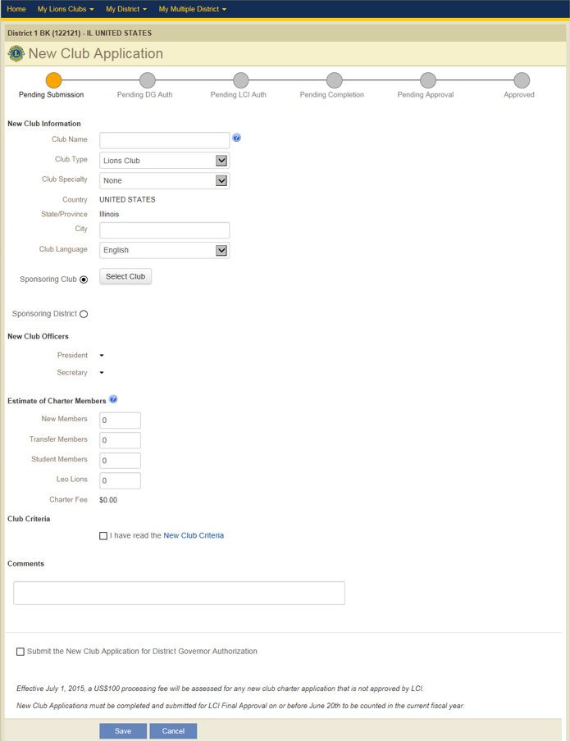
aa
New Club Application Submission: MyLCI
Application Submission
Step 4: Pending Submission- Enter all of the listed information. Be sure to click the club criteria, submit to District Governor, and the save button to move the application to the next stage.
Application Stages
The application is made up of 6 simple sections:
New Club Information
Sponsoring Club
New Club Officers
Estimate of Charter Members
Club Criteria
Comments
New Club Criteria Box
District Governor Approval Box
Save Button for submission

Slide 10
Charter Application Steps
You have started the new club application.
There are several steps to getting the club chartered.
This information will serve as a guide to assist in the following:
Application stages
New Club Application dashboard
Entering new or transfer members
10
Notes:
Speaker notes.
Reading the message off the screen can set this section up well. Preparing the for the chartering application should not take place until officers have been decided.

Slide 11
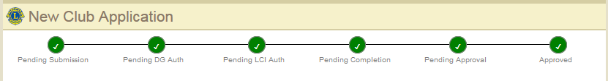
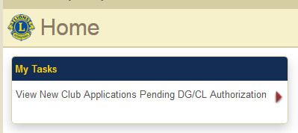
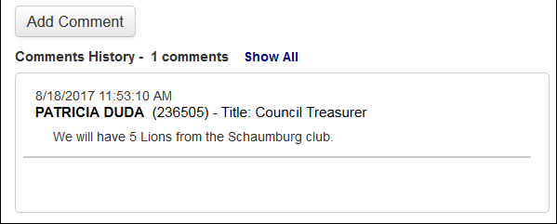
aa
Application Submission
New Club Application Submission: MyLCI
New Club Application Approval Steps. There are six steps.
Application Tips
The application is not final until submitted for
Pending Approval
Communication and visibility throughout the process
  Notification emails
  Tasks in Home page task panel
  Comments

Slide 12
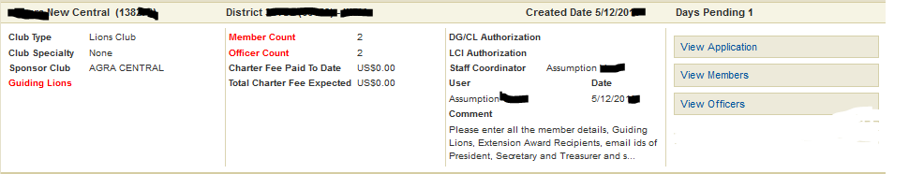
aa
Application
Dashboard
New Club Application Dashboard Information
The information below will appear on the sponsoring club/districts dashboard and was designed to keep the sponsoring club and district informed during the chartering process.
Authorizations: DG/CL authorization required to move app for LCI review. LCI Authorization- initial review process of application by LCI Staff
Counts: Member & Officer count can be entered once LCI Authorizes.
Club Name & Number
District & Country
Date entered in MyLCI
Days Pending
Update application
Add/Drop members
Add/Drop Officers
Guiding Lion:
District Governor must submit to complete application
Charter Fees: Charter fees will be based on membership count. Charter fees can be paid at LCI Final Approval.
Staff Coordinator: LCI staff member that will support the application through chartering.

Slide 13
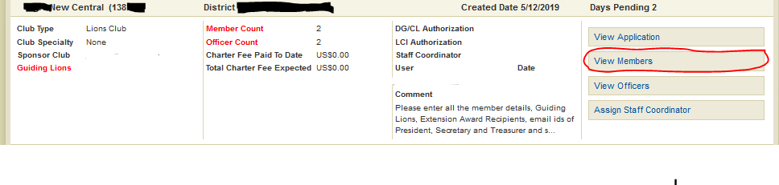
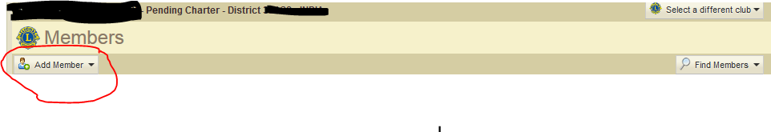

aa
Adding New Members
New Club Application Submission:
Pending completion Stage Adding Members
Once the application has been reviewed for LCI Authorization, it moves to Pending Completion Stage. In this stage members are added and Guiding Lion information is entered.
Step 1
Step 1: Click on the view member tab.
Step 2: Click on the “add member” a member drop down
Step 3: Choose New Member or Transfer member
Step 2
Step 3

Slide 14
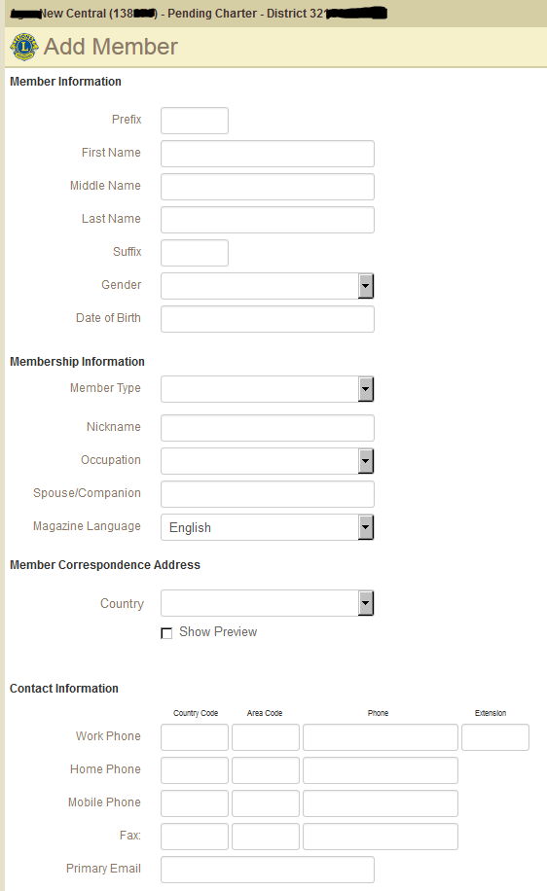
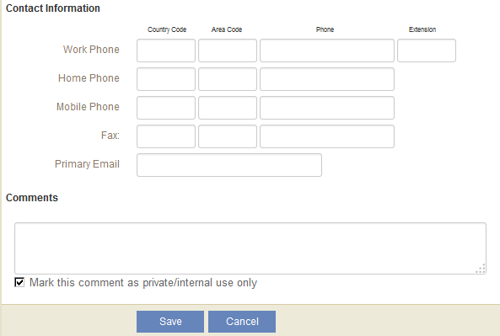
New Club Application Submission: Adding Members
Member information
Step 1: Enter in all member information
Step 2: Enter Membership information.
Step 3: Enter contact information. Email addresses are very important to help with communication from head quarters
Step 4: Enter comments if needed and click save to add to club record.
Membership Information
Contact information
Save and submit

Slide 15
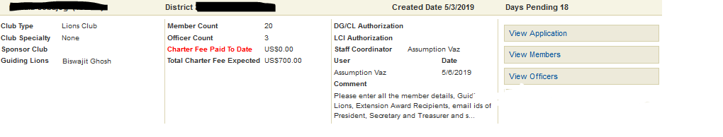
aa
LCI Final Approval
New Club Application Submission: LCI Final Approval Stage
Once the members have been added and the Guiding Lion entered, the application moves to LCI Final Approval . This is the final stage before the club is chartered.
During this stage the following will take place:
Final confirmation of all members status by LCI Coordinator.
District enters Guiding Lion if not entered
District or Sponsoring club submits final payment.

Slide 16
aa
Chartering
New Club Application Submission: Chartering
Congratulations!!! The application process is complete, and the club is now chartered. The following steps will be completed for the newly chartered club.
Chartering materials will be sent to the District Governor
Charter materials include: Charter Member Pins, Charter Member Certificates, Charter Certificate, Sponsor Patch, and Letter from International President
The new club charter night should be planned with the new club sponsor and Guiding Lion.
New members entering the club within 90 days of the charter date will be considered “charter members”.
Training for new officers should take place with Guiding Lion

Slide 17
aa
Application Submission
New Club Application Submission Tips
Allow time for charter material production and shipping.
To expedite the application process, view comments in MyLCI and follow processing instructions.
Applications need to be completed by June 20th to be considered in the current fiscal year.
New Club Processing Team will monitor the application through the point of chartering.

Slide 18
Club Chartering Support
For questions regarding the new club chartering process email newclubs@lionsclub.org.
18

Slide 19
Thank you
© 2019 Lions Clubs International
Updated 10/2021 EN
19
Notes:
Speaker Notes-
At the end of the presentation you can remind club members that the club will meet frequently (the club should determine before the meeting ends) until the club has been chartered. The club should decide during the organizational meetings the day of the week, time and location should be decided. If there are questions, please feel free to contact the LCI Program staff at membership@lionsclubs.org.

