Slide 1


The Global Action Team
Notes:
Presenter note: This presentation is based on standard Global Action Team material. Notes in this presentation are suggested. To make this presentation more effective, you are encouraged to make it your own by providing personal stories and real examples from your area.
If you have any questions, please do not hesitate to contact the Global Action Team staff by emailing: GAT@lionsclubs.org
------------------------------------------------
Today, I am here to talk to you about the Global Action Team. Some of you may have heard about this LCI initiative.
I want you to think for a minute how Lions Clubs International impacted your life? What happened that made you want to become – and remain – a Lion or a Leo. (pause for a brief period) Did you want to make your community a better place? Were you helped by a Lion or Leo previously and now want to give back? Did you join because you were looking for fun and fellowship?
Let me share with you my story of why I became a Lion. (Tie in a feeling of action in your story)
Every Lion and Leo likely has a story that was inspired by an action that left an impression on him or her which was why they joined when invited.

Slide 2

The Global Action Team in action
The Global Action Team aims to enhance the service of Lions internationally and to help more people than ever before.
To accomplish this, we’re calling on Lions to take on an even bigger role their club and community.
Notes:
As Lions, we’ve done an incredible amount of good in this world, but in order to expand our association and our service, we need to take action. We need to ensure that all of our Lions and Leos have the skills, knowledge and resources available to help them provide impactful service.
The Global Action Team is here to support and motivate our clubs and districts to take action.
Who here is proud to be a Lion? (Ask to raise their hand or stand up). Keep your hand up if you are proud of the work that your clubs does? (make comment if hands remain or if hands decrease)
If your hands went down, you probably feel that your club can be doing more, right? Can be more actionable? Can make a bigger impact in your community, in peoples lives, right?
Even if we feel our clubs are doing a good job, there is always room for improvement. (Share a personal story of a club that pushed themselves to be more actionable and their results)

Slide 3

Support is All Around You
Bringing together the best of Lions
Global Action Team
LEADERSHIP [GLT]
MEMBERSHIP [GMT]
SERVICE [GST]
Notes:
The Global Action Team works collaboratively on Leadership Development, Membership and Service initiatives. These positions have been created at the club level up through the Multiple District, with all of Lions’ leadership positioned to support the club.
All are equally important. We can’t have one without the other, which makes them all one team. In order to make an impact, we have to take action.

Slide 4



Notes:
Think of the association as a machine. It is created of different parts and gears, each club is a gear, as is each district, each area. But Motion is needed; a purpose, direction, and capability to do something. And the clubs are where that movement must begin.

Slide 5
SERVICE
Notes:
Lets start by inputting a goal. Service. Lions are here to serve, it is what drives them. It is their motivation.

Slide 6
SERVICE
MEMBERSHIP
Notes:
In order to serve, Lions must have the membership to sustain their service. Fulfill that need and we’re one step closer.

Slide 7
SERVICE
MEMBERSHIP
LEADERSHIP
Notes:
But no machine works without leadership. Members must grow into the leaders that guide the service projects that bring in new members. And from these new members, potential leaders emerge.

Slide 8
SERVICE
Clubs Drive Our Association
MEMBERSHIP
LEADERSHIP
INTERNATIONAL
DISTRICT
CLUBS
Notes:
When all three areas function at full capacity, the gears begin to move. The clubs create action in the district which, in turn drives the association. The GAT exists when the clubs are in motion.

Slide 9



District Governor
Multiple District GAT
Goal
Working Together
Action
To ensure that Lions Clubs International impacts 200 million lives through service, reaches 1.7 millions Lion and Leo members and provides learning opportunities to 500,000 members by the year 2020.
LCI Staff
Specialists
CA GAT Team
Notes:
It not only takes each branch of the Global Action team working together, but also each member. To help the Global Action Team thrive, it is important for leaders and Lions alike to take consistent action within their clubs, communities and districts and to understand how to utilize the GAT at multiple levels.

Slide 10

Global Action Team
Ambassadors
Past International Presidents
International Board of Directors
Past International Directors
Past District Governors
Executive Officers
Global Action Team Chairperson
GAT
Constitutional Area & Regional Area Leadership
GAT
Area Leadership
Multiple District Global Action Team Chairperson (Council Chairperson)
GLT
Multiple District Coordinator
GMT
Multiple District Coordinator
GST
Multiple District Coordinator
District Global Action Team Chairperson (District Governor)
GLT
District Coordinator
GMT
District Coordinator
GST
District Coordinator
Region and Zone Chairpersons
Club Global Action Team Chairperson (Club President)
GLT
First Vice President/Leadership Chairperson
GMT
Membership Chairperson
GST
Service Chairperson

Slide 11
Role of the District Governor in the GAT
The district governor is the chairperson of the district GAT.
They initiate the planning, development and execution of your district’s goals by engaging the Global Action Team.
They are the driving force in the district.
Working with the GAT turns goals into action!
Notes:
Unifying GAT Leadership at the upper levels allows the GAT to shift its focus to the district governors. As chairpersons of the Global Action Team within their districts, district governors have the ability to mobilize their team and their clubs to even greater action than they could accomplish on their own.

Slide 12
Global Action Team Focuses
1
Supporting districts to achieve their annual goals and monitoring progress.
2
Reinforce club level communications through the zone chairs to provide initiatives, resources and suggested activities.
3
Support LCI divisions by creating a formal feedback loop between clubs and LCI.
4
Share the success stories of clubs and districts with Lions around the world!
Notes:
To go along with the new team, a new series of focuses has also been implemented with one ultimate goal: to reach and support the districts and, by extension their clubs.
You may notice that the first focus mentions annual district goals.

Slide 13
Assisting in Achieving District Goals
1
The GAT helps district governors in achieving their goals by creating a unified approach to all key areas of Lions.
By leveraging the GAT in the achievement of District Goals, districts & clubs will:
Foster positive membership growth
Increase Lion’s visibility through impactful service
Build strong and innovative leaders within the districts.
Notes:
District governors are the chairpersons of the Global Action Team at the district level, and they are the driving force for success in our districts. Their goals are what their Global Action Team members are working towards, and therefore the GATs number one priority will be supporting them as they progress towards those goals.

Slide 14

The Role of the Zone Chair
2
District GAT
Zone Chairs
Club
Club
Club
Club
Club
Notes:
Our second focus is about communication with the club level. How many of you receive communications from LCI Headquarters? (show of hands) You may notice that there is quite a bit of valuable information being sent out every day. It’s a lot to keep track of and a lot of work to ensure that every communication reaches every person that may need access to it.
Facilitating communication is an important, but often overlooked responsibility of the Global Action Team. This year, we are activating the role of the Zone Chairperson within the Global Action Team. By involving them in communicating the districts goals, progress and other vital information, we are creating a direct conduit to each club within each district.
Zone Chairs will be the key points of focus for LCI and the District Governors to receive and share information with the GAT at the club level.
A streamlined exchange of information and ideas among multiple district, district, zone, and club leadership with the ultimate purpose of taking action to achieve goals and enable club and district success.

Slide 15
Support
Feedback & Support
3
Assist in removing obstacles and leverage the GAT network to achieve new possibilities
Provide feedback on projects, training and membership outreach events
CA
GAT Team
Clubs
District Governor
Zone Chair
GAT
Staff
Specialists
Notes:
The feedback that the Zone Chairperson brings back from the clubs to their districts is equally important as the information that they brought from the districts to the clubs. The GAT cannot assist in the service of Lions if it does not know where the difficulty lies in serving. This brings us to the third focus of the GAT.
Feedback should be sent from the Club through the Zone Chairperson, to the District Governor, and when necessary, up to Area Leaders and LCI Headquarters to ensure that changes are being made that help our clubs and our districts.

Slide 16
GAT Success Stories
4
Goal
The GAT message of success is best shared through storytelling,
particularly stories that focus on a one-team approach and that highlight how each pillar of the team contributes to the other.
To ensure that Lions Clubs International impacts 200 million lives through service, reaches 1.7 millions Lion and Leo members and provides learning opportunities to 500,000 members by the year 2020.
Sharing GAT success stories will:
Show the significance and impact of the GAT
Inspire Lions to take action in their communities
Educate on how Lions accomplished the goal
Notes:
This feedback doesn’t only include the problems and struggles you face. We also want to know about your successes, the fourth and final focus of the GAT. We want to share our stories with each other so that we can replicate our success all across the world. For instance,
(Share a meaningful success story you were involved in / witnessed/ or heard of where a substantial impact was made because of the GAT or one of its focuses.)

Slide 17
GAT District Funding
USD $500 is available for each district with the submission of a GAT success story.
One submission per district.
Who:
Any district GAT member (District Governor, GLT, GMT, GST Coordinator) or the Cabinet Secretary.
When & Where:
Submissions will be accepted through the GAT’s District Funding Page through March 31, 2020.
Notes:
To support our focus on success stories, we are introducing a new program: GAT District Funding. We will be offering each district US $500 for the 2019-2020 fiscal year when they submit a GAT Success Story through our website.
In order to qualify for the funding, any District GAT member or the District’s Cabinet Secretary needs to submit a story to this webpage.
To be considered a complete submission, the stories should involve the district’s GAT, take place after July 1, 2017 and do one of the following:
Show and impact as a result of action
Inspire the reader to do something
Show an action that the reader can take
Allow the reader to learn something

Slide 18
Action = Impact
To help the Global Action Team thrive, it’s important for club leaders and Lions to take consistent action within their clubs and communities.
Notes:
Ultimately, we, as Lions, know that we cannot make an impact on the world if we do not take action. Lets take a closer look at some additional resources and programs within the GAT that may be helpful to you and your district.

Slide 19
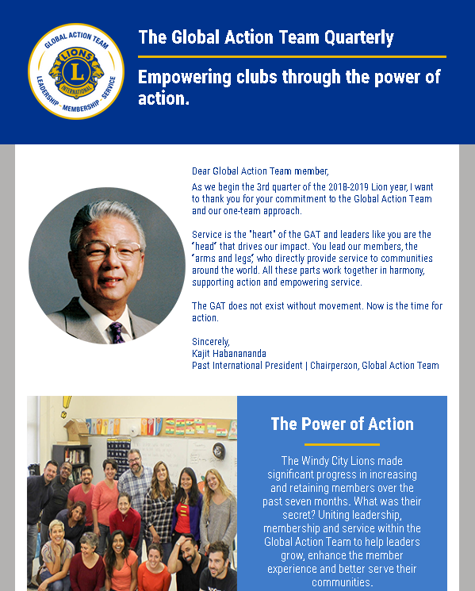
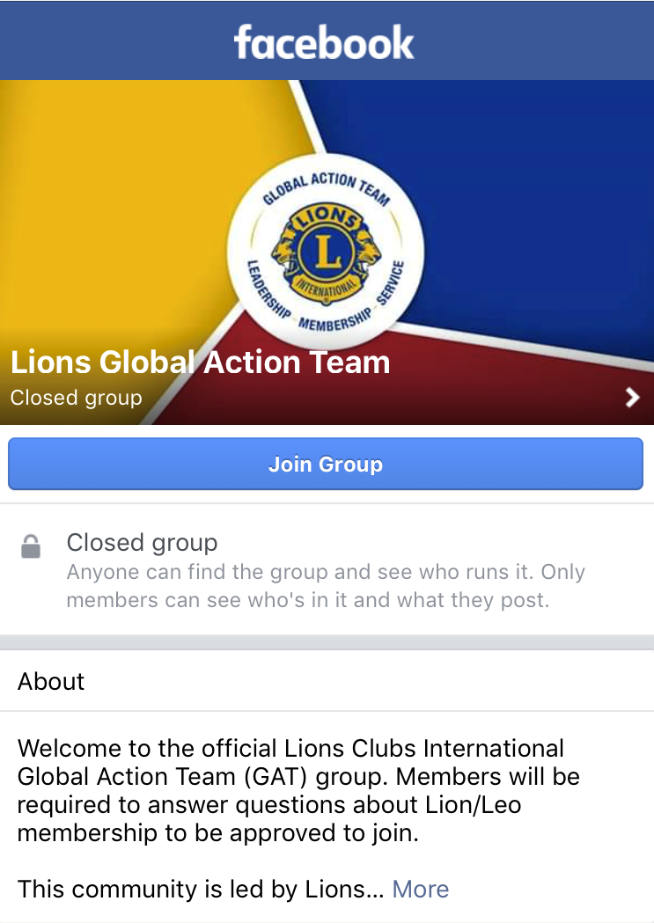
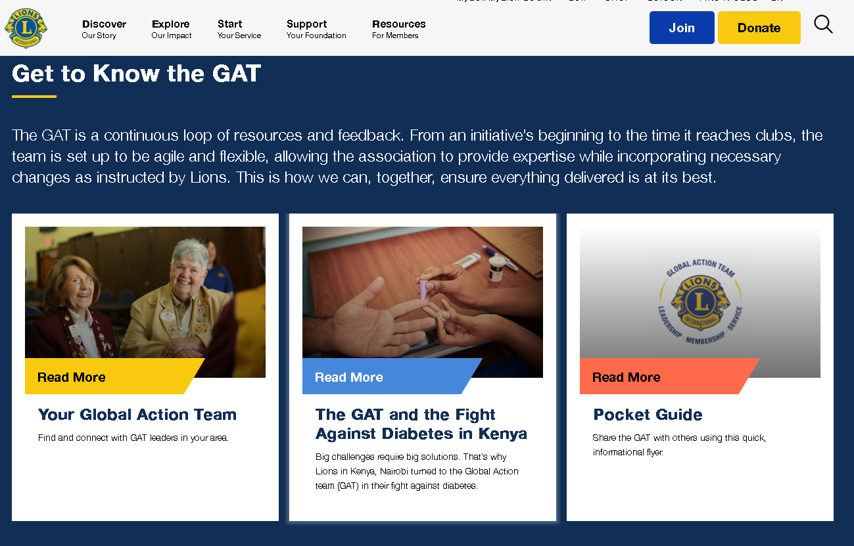
Global Action Team Communications
Newsletter
Landing Page
Facebook
Notes:
The GAT uses many means of communicating with its districts and clubs outside of informational emails.
The GAT Newsletter is sent to GAT members quarterly and contains a variety of resources, stories and updates.
The GAT Landing Page contains all of the important links and resources that your GAT members may need to access
And the GAT Facebook group has updates from LCI Staff and Lions around the world about what is going on in the Lions’ universe along with reminders of things you may need to know. This group is open to all Lions, so encourage your GAT and your Lions to join today!

Slide 20
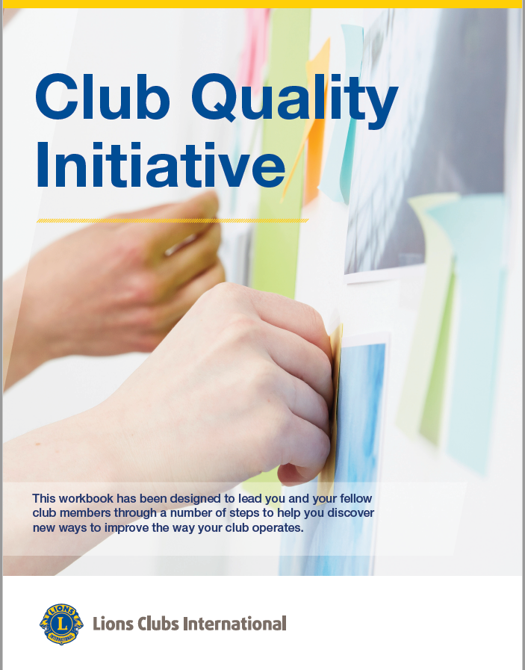

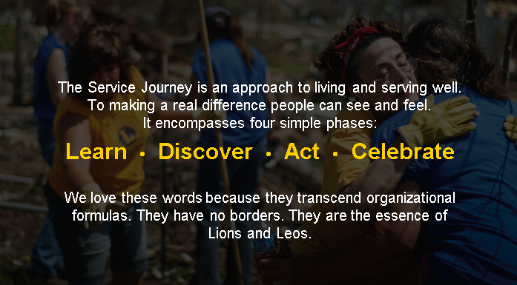
Empower Your Districts & Clubs
Club Quality Initiative
Service Journey
e-Books
Notes:
There also are a wide variety of online resources available to you. They can be found on the LCI webpage by searching for the title of the resource or “Global Action Team.” Here are some of the most impactful resources we offer:
The Club Quality Initiative helps clubs identify opportunities for improvement, gives them tips on involving their entire club, and guides clubs in the implementation of the resource
The Service Journey is meant to help kick-start your service. It also includes helpful tool kits for service projects.
The Leadership eBooks are a great form of leadership training. They include guides on the roles and responsibilities of various leadership positions.

Slide 21
GAT Funding Opportunities
GAT District Funding
Any District GAT Member
or Cabinet Treasurer
Membership Development Grants
District Governor
Leadership Development MD/District Grant
Multiple District & District GLT Coordinators
Leadership Development Institutes Grant Program
Multiple District, Single District GLT Coordinators, & Undistricted Provisional District/Region/Zone Coordinating Lions
Notes:
The Global Action Team and its neighboring divisions also offer several funding opportunities. The Funding Opportunities here detail who is eligible to apply for & receive each funding type. To find further information on each grant including processes and applications, visit Lionsclubs.org. Each grant can be found by using the search function and typing the grant name.

Slide 22


Campaign 100: LCIF Empowering Service
Goal
To ensure that Lions Clubs International impacts 200 million lives through service, reaches 1.7 millions Lion and Leo members and provides learning opportunities to 500,000 members by the year 2020.
SM
Notes:
Lastly, we can’t forget about LCIF
LCIF is your Foundation - supporting the efforts of Lions clubs and partners in serving communities locally and globally, giving hope and impacting lives through humanitarian service projects and grants. LCIF makes Lion service possible!
Last year, LCIF embarked upon Campaign 100: LCIF Empowering Service. Through Campaign 100, LCIF will increase our service impact in vision, youth, disaster relief, and humanitarian causes; fight diabetes; and expand our impact to include hunger, the environment, and childhood cancer. In short, Campaign 100 will allow Lions to bring more help and hope than ever before—empowering service for generations to come.
As GAT leaders, we call upon you to help advocate for LCIF and Campaign 100. Our communities are in need – but together, through Campaign 100, with our Foundation, we can and we will do our part to make more service possible.

Slide 23

It’s Time For Action
The success of the Global Action Team depends on the involvement of Lions. You have the power to turn your club’s plans into action.
Contact:
GAT@lionsclubs.org
Notes:
It’s time for action. Will you take action in your clubs? Will you go above and beyond to make a meaningful impact in you communities? Will you work to keep your members happy and coming back? To develop leaders to take on new projects? I know you can do it!
The Global Action Team is ready to help all members and clubs serve their communities! Reach out to your Global Action Team staff at LCI for further information and resources.

Slide 24
Thank You

