Slide 1
Getting Started on Social Media
Facebook: The Basics

Slide 2
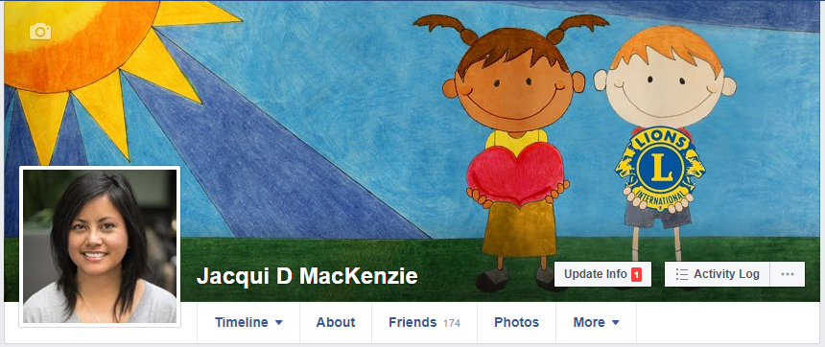
Profile vs Page vs Group
Profile
Held under an individual’s name
One profile per person
Share personal stories, photos and interests
A profile is your way to connect with friends, family and Lions members

Slide 3
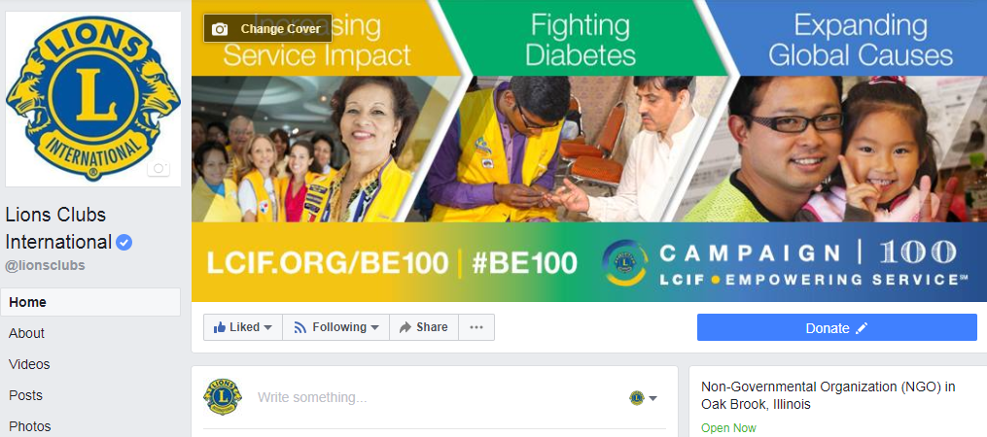
Profile vs Page vs Group
Page
Must be created/managed by individuals with FB profile
Used by businesses, organizations, brands and public figures (and Lions clubs!)
Share Lions and community news, updates, events and branded content
A page is your club’s way to connect with the members, potential members, the community and the public

Slide 4

Profile vs Page vs Group
Group
Provides a community for certain people with shared interests
Can be created for any topic or interest
Should remain focused with clear guidelines and daily moderation
Options include Public, Closed or Secret
TIP: Increase engagement and visibility by having a profile, a page AND a group!

Slide 5
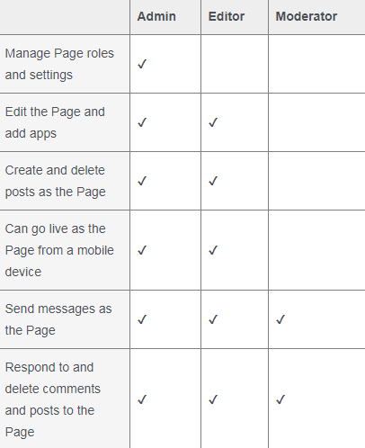
Posting: Who, When, What
Who
Marketing Communication Chairperson + All = Team Effort!
Add multiple Page Roles - admins and editors
Encourage members to take photos at service projects and events
TIP: Create an easy hashtag for your club that members and the community can use across all social channels - especially useful for Twitter and Instagram

Slide 6
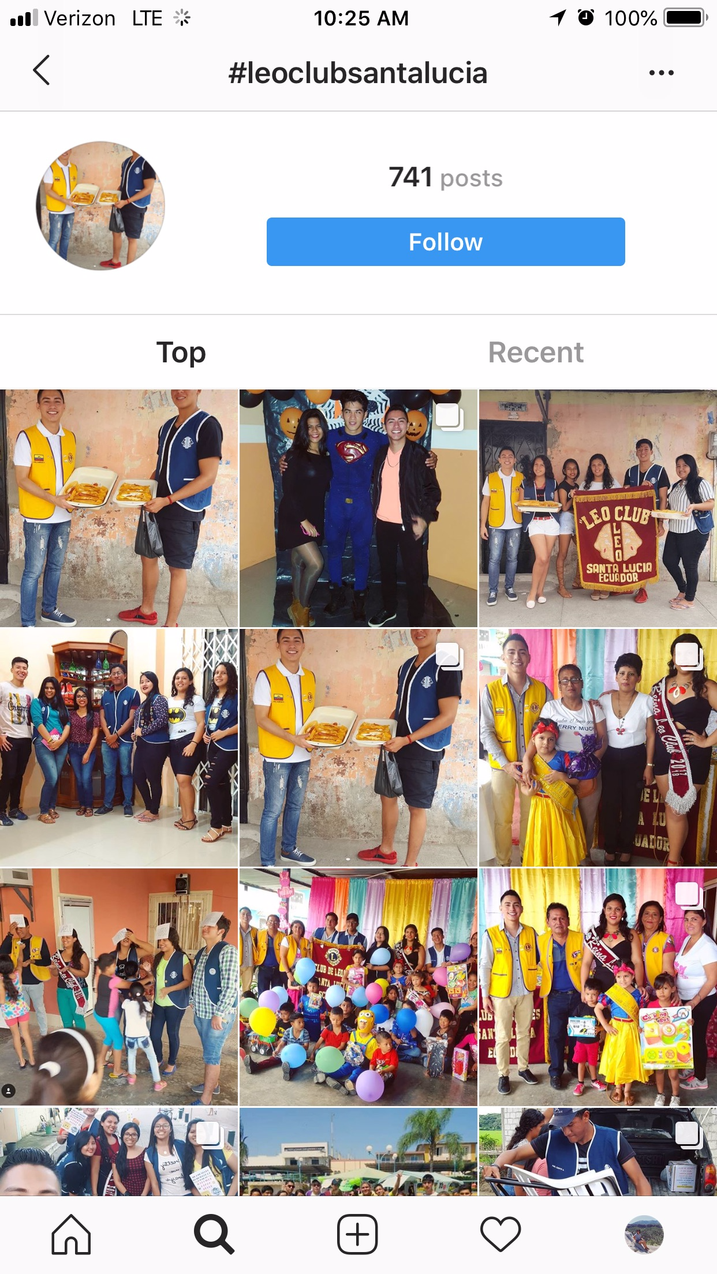
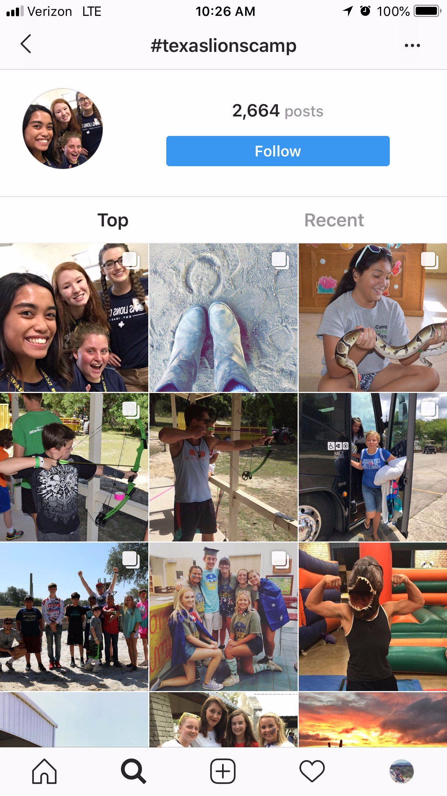
TIP: Create a simple and unique hashtag

Slide 7
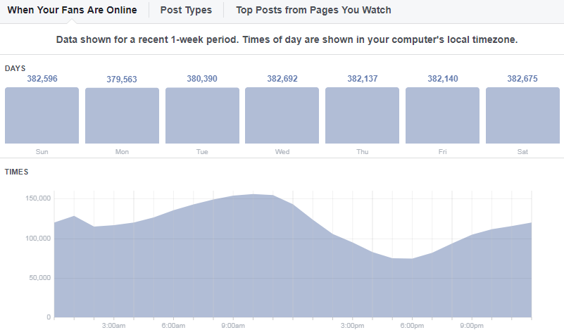
Posting: Who, When, What
When
Best time to post on Facebook is 12 PM. - 3 PM Monday, Wednesday, Thursday and Friday. Saturday and Sunday from 12 PM – 1 PM. (Hootsuite)
Ideally, post once per day but if resources/content are stretched thin, just be CONSISTENT
ENGAGEMENT is key – social media is a tool to CONNECT. Comment, reply, explore, discover and reach out.

Slide 8
Posting: Who, When, What
What
Photos, photos, photos
Videos - try going LIVE!
Events - invite your community
Community news
Member stories
Beneficiary stories

Slide 9

Instagram, Twitter, LinkedIn
What about these channels?
Who is your audience?
What can your club effectively manage?
Cross-posting is great, but use auto-posting tools with caution
Consider a club hashtag

Slide 10
Resources
Facebook Help Center
facebook.com/help
Page Roles: https://www.facebook.com/help/1206330326045914/
Insights: https://www.facebook.com/help/794890670645072/
Pages: https://www.facebook.com/help/282489752085908/
Groups: https://www.facebook.com/help/1629740080681586/
Lions SMiLE Facebook page and group
facebook.com/lionssmile/
facebook.com/groups/lionssmile/
Lions New Voices Facebook group
facebook.com/groups/lionsnewvoices

Slide 11
Hands-on Club Social Media
How South Tucson Lions Club
utilizes social media

Slide 12
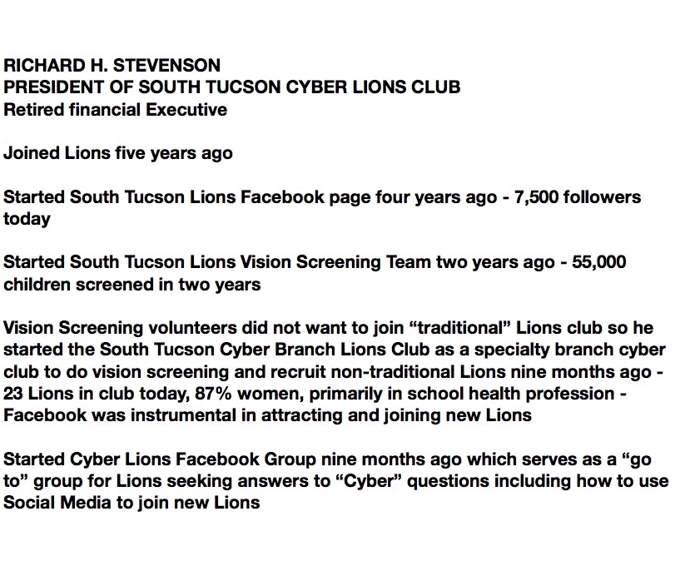
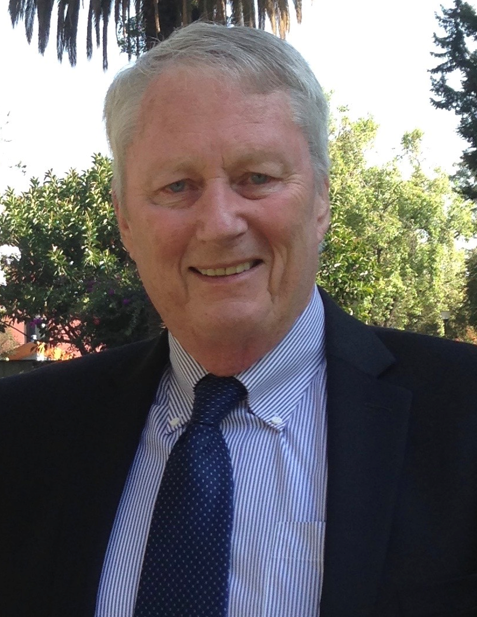
Lion Richard Stevenson

Slide 13
Increase Your Facebook Footprint
Visuals: Be attractive and establish brand
Content: Produce quality content
Followers: Be an active social networker
Notes:
Lion Richard:
I WOULD LIKE TO SHOW YOU HOW TO INCREASE YOUR FACEBOOK FOOTPRINT IN 3 EASY STEPS
IT IS EASY BUT IT TAKES WORK, BUT IT IS AN ANNUITY THAT KEEPS ON WORKING
STEP 1 - BE ATTRACTIVE
Your personal profile & club page should be attractive
Choose good cover/profile photos
Choose domain name to connect to your page
Put domain name on all your brand material
Insure you have contact information visible
STEP 2 - HAVE CONTENT PEOPLE WANT TO SEE
Post regularly with quality content
Use one attractive action photo - edited
Provide a brief description of what, when, where & why
STEP 3 - GAIN FOLLOWERS
Accumulate personal profile friends and invite them to like page/Choose them from your target audience
Get people to see your posts by tagging and shareing posts to other pages
Have your partners share your page/posts
Invite all to “like” your page
Buy targeted ads for specific markets to “like” the page

Slide 14
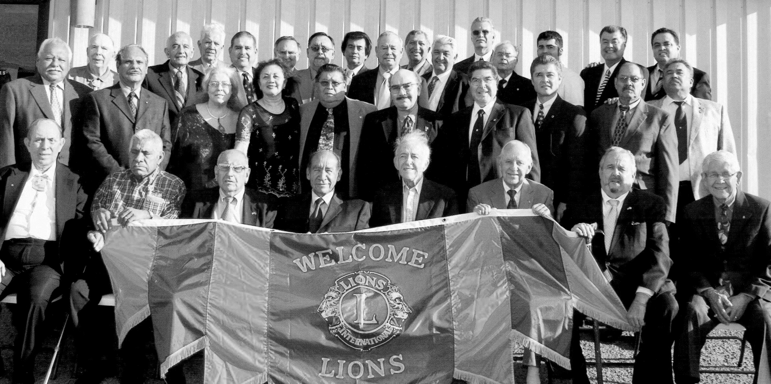
2014
Marketing challenge
Build Brand Image
for 70 year old Hispanic Lions Club
Stop
being the “Best Kept Secret”
Notes:
Lion Richard:
2014 MARKETING CHALLENGE FOR THE SOUTH TUCSON LIONS CLUB
BUILD A BRAND IMAGE FOR A 70 YEAR OLD HISPANIC CLUB
OUR SIGNATURE PROJECTS ARE YOUTH MARIACHI AND CHILDREN’S VISION
STOP BEING THE “BEST KEPT SECRET”, CONNECT WITH OUR COMMUNITY
WE STARTED A CLUB FACEBOOK PAGE WITH AGGRESSIVE POSTING OF CLUB’S ACTIVITIES
MADE FACEBOOK FRIENDS WITH TARGETED PEOPLE INVOLVED WITH OUR COMMUNITY PROJECTS
Mariachis and schools,
school boards,
nurses, etc.
INVITED THEM TO LIKE OUR PAGE
CONNECTED WITH SCHOOL AND MARIACHI FACEBOOK PAGES, SHARED LINKS, FRIENDED FOLLOWERS, REQUESTED THEY DO THE SAME
REQUESTED SCHOOL DISTRICT PHOTOGRAPHERS/VIDEOGRAPHERS TO OUR EVENTS
USED TARGETED ADS TO CONNECT WITH PEOPLE IN OUR COMMUNITY

Slide 15
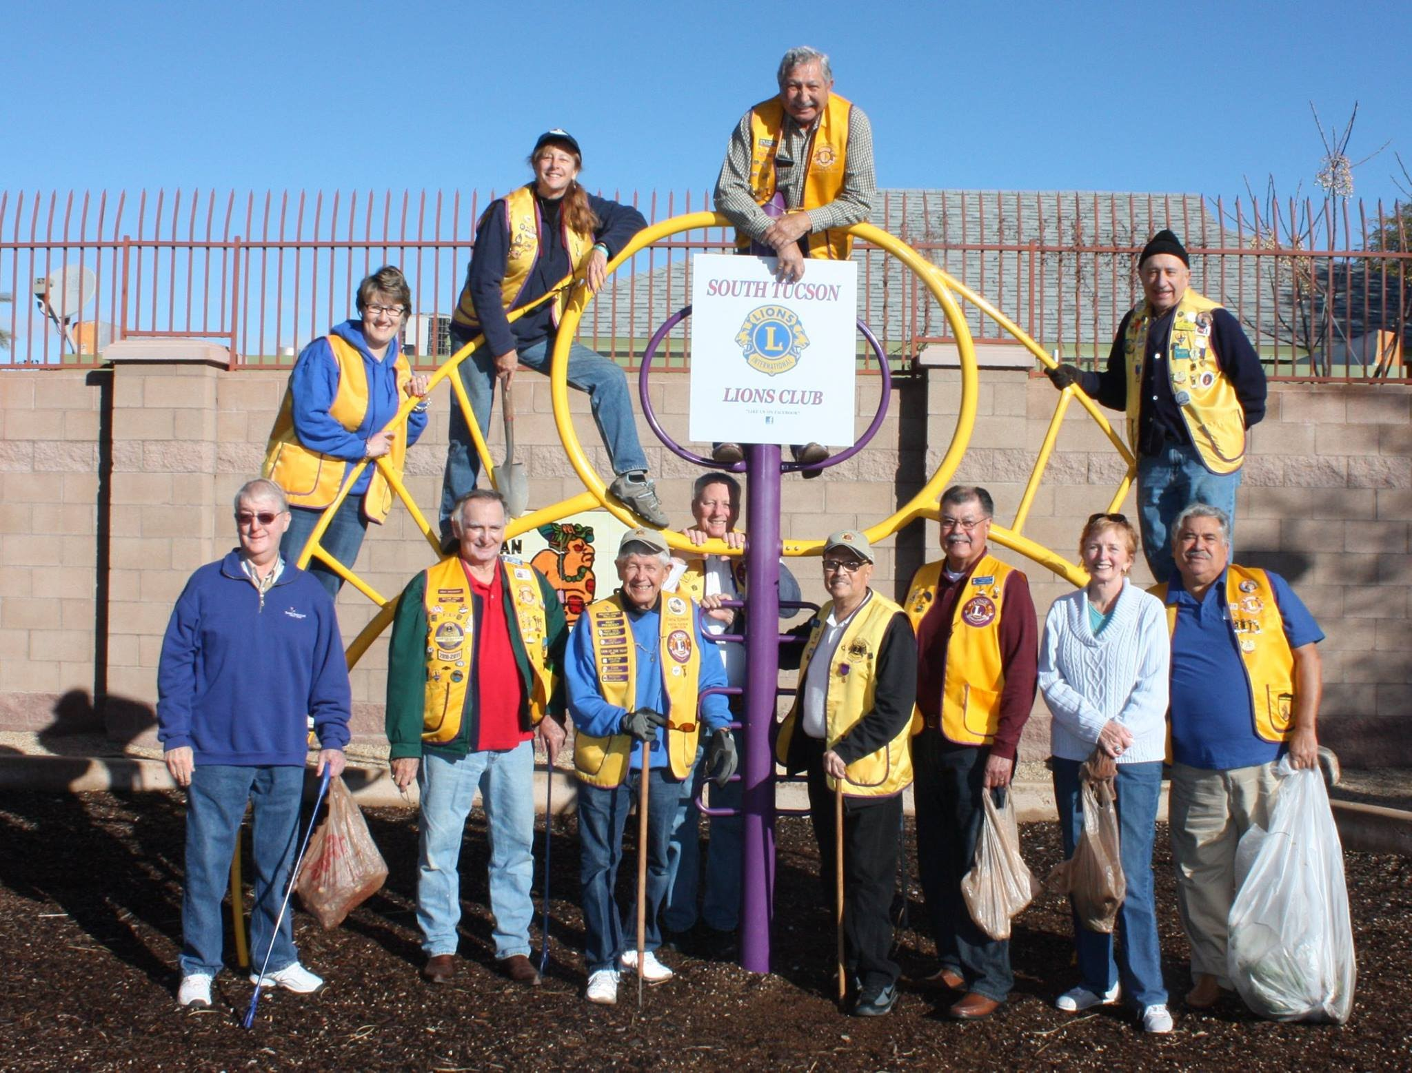
2018
Results
> 7,000 follower
on Facebook
Club brand
well established
Notes:
Lion Richard:
2018 RESULTS
OUR CLUB PAGE HAS 7,300 FOLLOWERS
OUR BRAND IS WELL ESTABLISHED IN OUR COMMUNITY
WE WERE ABLE TO VISION SCREEN OVER 55,000 CHILDREN IN THE LAST TWO YEARS
WE STARTED A NEW CYBER CLUB AND JOINED 21 NEW LIONS LAST YEAR
WE SERVE, AND OUR COMMUNITY KNOWS IT

Slide 16
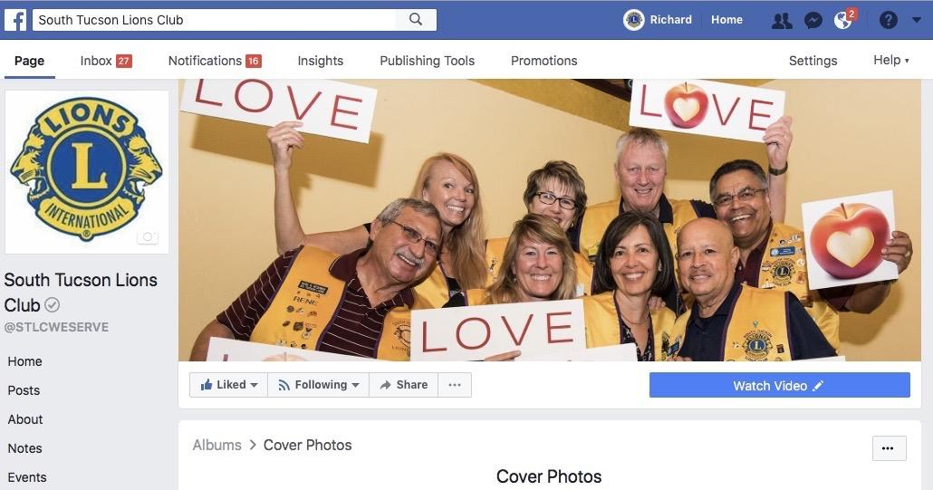
Cover | Profile Photo
Notes:
Lion Richard:
YOU WANT TO HAVE A PAGE THAT PEOPLE WANT TO LOOK AT
CHOOSE ATTRACTIVE COVER PHOTO AND PROFILE PHOTO
INSURE THAT YOUR PERSONAL PROFILE IS ATTRACTIVE AND NOT CONTROVERSIAL

Slide 17
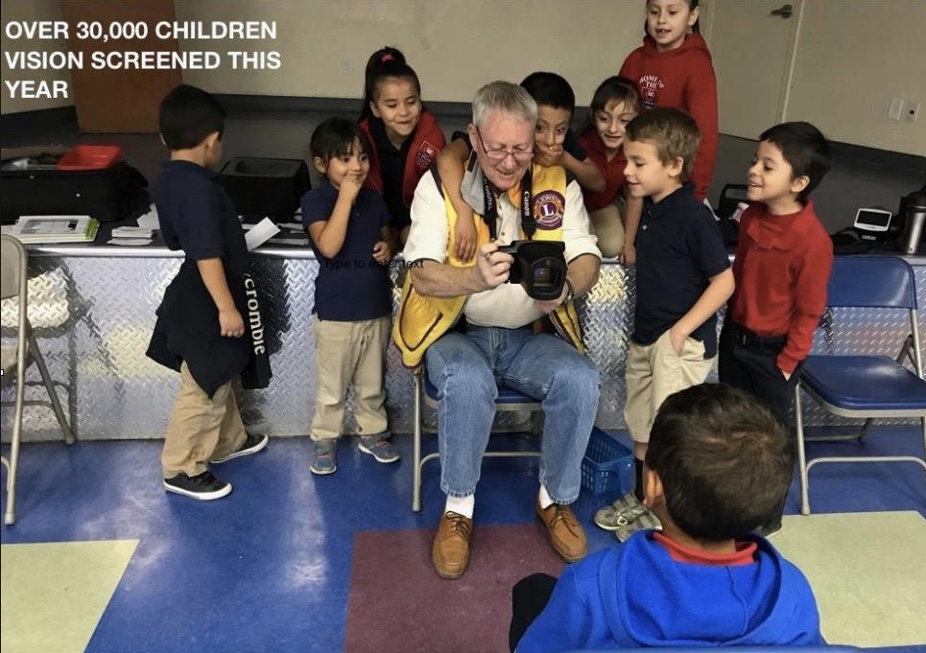
Visuals: Use Action Photos
Notes:
Lion Richard:
POST REGULARLY WITH QUALITY CONTENT
USE ACTION PHOTOS (ONE PHOTO, WELL EDITED)
OUR VISION SCREENING PROJECT

Slide 18
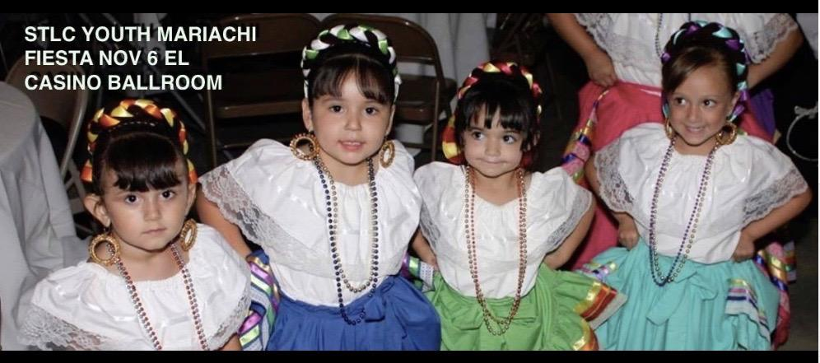
Visuals: Gain Permission
Notes:
Lion Richard:
OUR YOUTH MARIACHI PROJECT – FOLKLORICOS
YOU CAN NEVER HAVE TOO MUCH CUTE, BUT ALWAYS GAIN PERMISSION.
This is especially true for pictures from under age children!

Slide 19
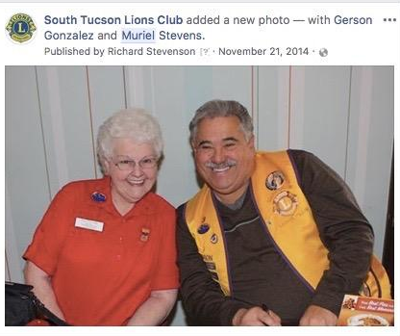
Visuals: Capture Smiles
Notes:
Lion Richard:
TELL PEOPLE YOU ARE GOING TO TAKE A PHOTO TO POST ON THE PAGE
ALWAYS “HAHAHAHAHA” TO GET THOSE SMILES
DON’T USE BAD PHOTOS
TAG YOUR MODELS FOR MAXIMUM COVERAGE
CREATE PHOTOS PEOPLE WANT TO SHARE
THESE ARE TWO PEOPLE WITH LOTS OF FRIENDS WHO WILL LIKE THE PHOTO

Slide 20
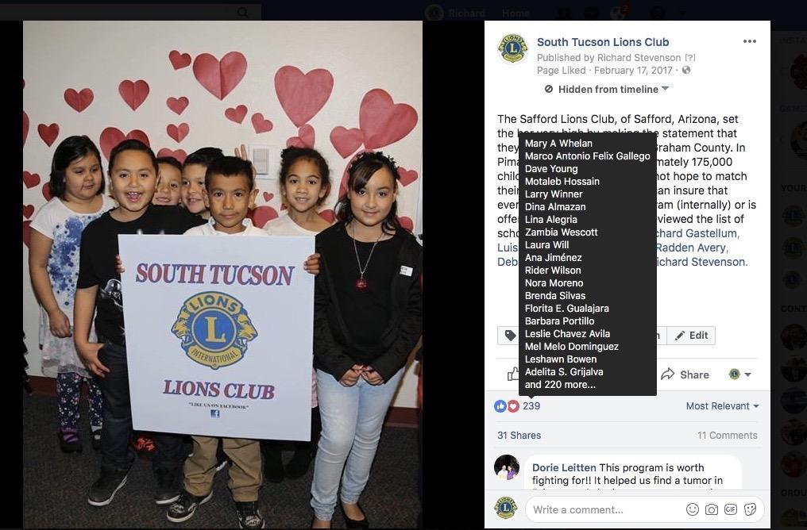
Branding: Include Your Logo
Notes:
Lion Richard:
ALWAYS BRING A SIGN, CONNECT YOUR BRAND TO YOUR PHOTO
Make sure that you connect the scene with your club.
This can be a club sign, Lions logo flag, etc..

Slide 21
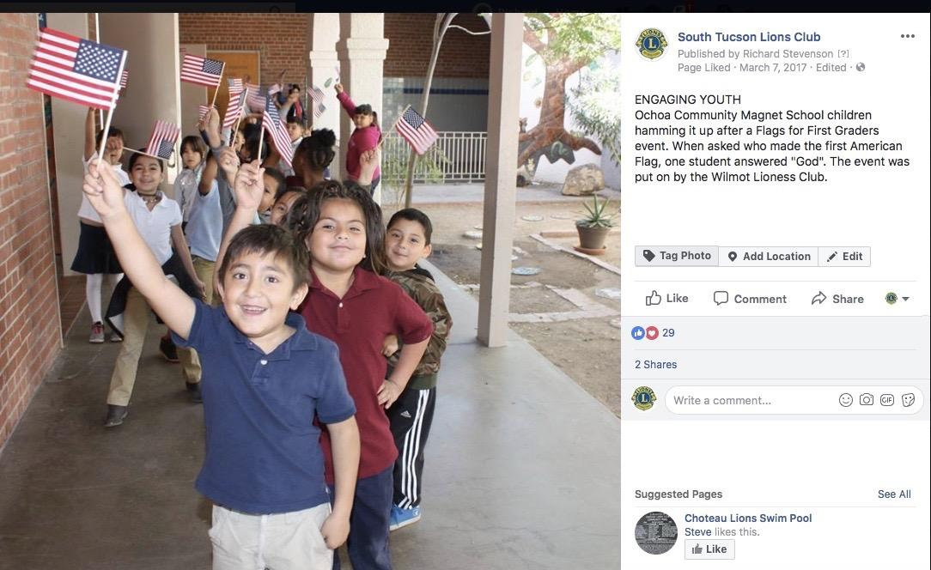
Best Practice: Who, What, How, Why
Notes:
Lion Richard:
TELL THE WHO, WHAT, HOW AND WHY BRIEFLY
HOW IS THE WORLD A BETTER PLACE BECAUSE YOUR CLUB IS THERE?
SHARE YOUR PHOTOS, HAVE YOUR CLIENTS SHARE YOUR PHOTOS
THIS IS THE OCHOA MAGNET SCHOOL WHO SHARED THE PHOTO ON THEIR FACEBOOK PAGE
Good public relations practice applies to analog AND digital world.

Slide 22
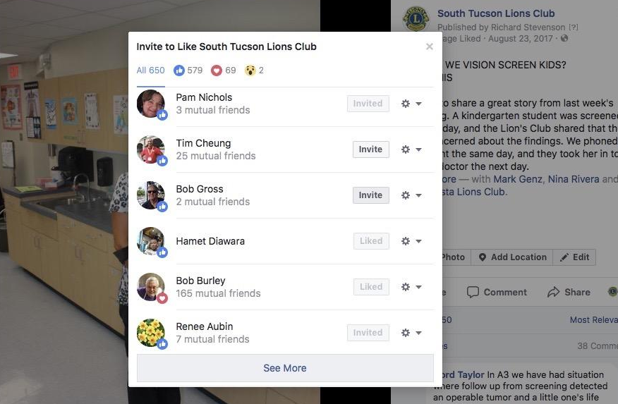
Best Practice: Invite to Like and Follow
Notes:
Lion Richard:
INVITE PEOPLE WHO LIKE POSTS TO “LIKE” THE PAGE
INVITE ALL OF YOUR “FRIENDS” TO LIKE THE PAGE
GET ALL OF YOUR MEMBERS TO LIKE THE PAGE
GET YOUR MEMBERS TO INVITE THEIR FRIENDS TO LIKE THE PAGE

Slide 23
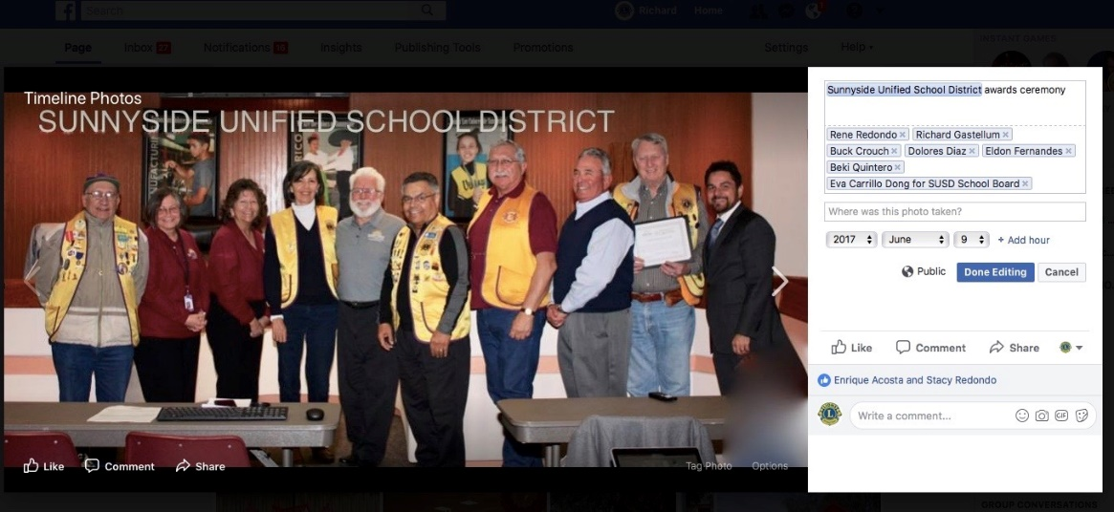
Be Sensible: Tagging
Notes:
Lion Richard:
TAG TO GET MORE EXPOSURE
WHO ARE THESE PEOPLE? HINT, THEY HAVE MANY FOLLOWERS
TAG THEM, WITH THEIR PERMISSION, TO HAVE THEIR FOLLOWERS SEE YOUR PAGE
YOU CAN TAG YOUR OWN LIONS TOO, EVEN IF THEY ARE NOT IN THE PHOTO
HAVE THE SCHOOL DISTRICT SHARE YOUR PHOTO ON THEIR PAGE

Slide 24
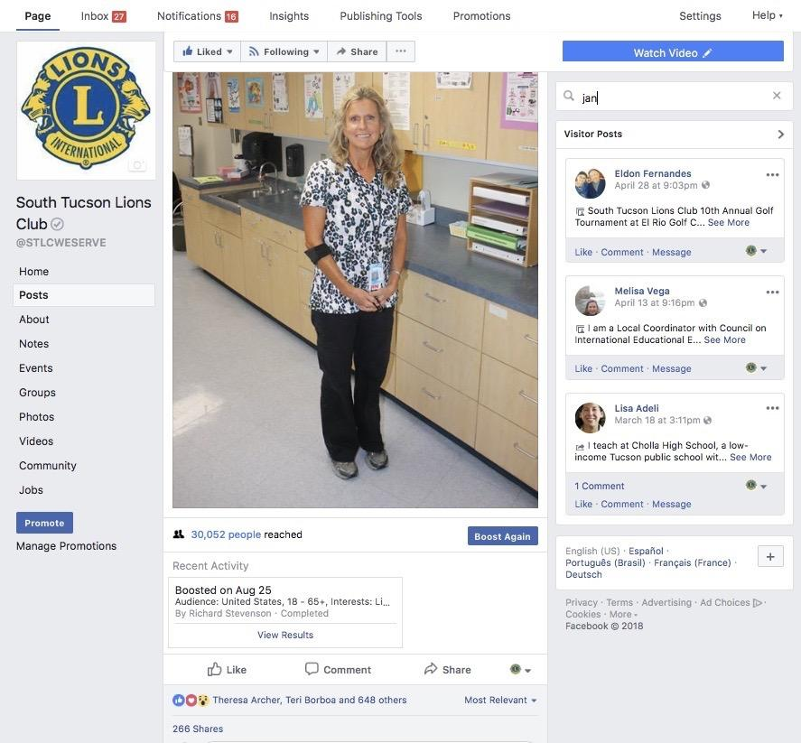
Return on All Your Investments ☺
Notes:
A NURSE THANKED US FOR IDENTIFYING A CHILD AT RISK FROM A VISION SCREENING
I PUT HER PHOTO UP WITH HER THANK YOU NOTE
IT WAS SHARED 266 TIMES AND REACHED 30,000 PEOPLE
INVITE THE ONES WHO ‘LIKED” IT TO LIKE YOUR PAGE

Slide 25
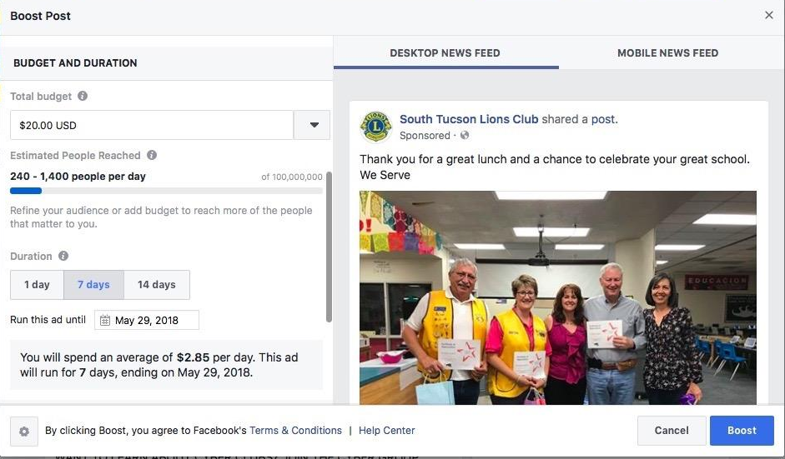
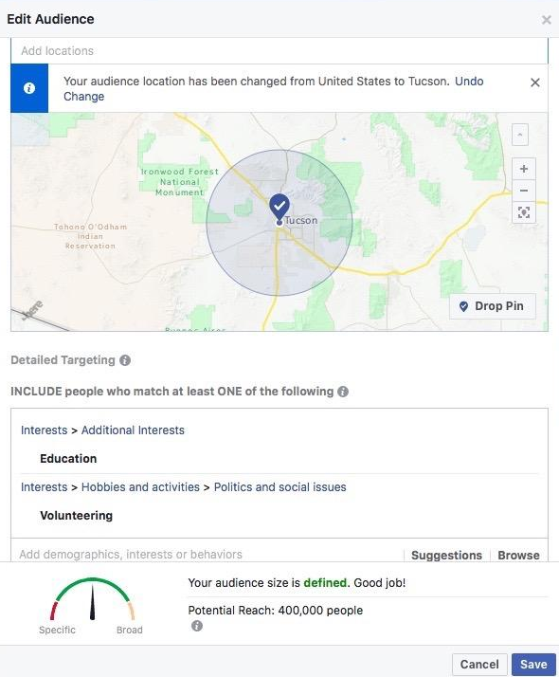
Spare Money? Try Targeted Ads
Notes:
Lion Richard:
PAY FOR TARGETED ADS TO ATTRACT MORE FOLLOWERS
WE CHOSE PEOPLE LOCATED IN TUCSON WHO WERE INTERESTED IN EDUCATION AND MARIACHI
SPEND WISELY

Slide 26
Summary
Increase Your Facebook Footprint in 3 Easy Steps
Step 1: Be attractive
Choose good cover/profile photos
Choose domain name to connect your page
Your personal profile should be attractive
Provide contact information and a short name
Include domain name on all brand material

Slide 27
Summary
Increase Your Facebook Footprint in 3 Easy Steps
Step 2: Produce content that people want to see
Post regularly with quality content
Use one attractive photo (edited if possible)
Provide a brief description of what, when, where and why

Slide 28
Summary
Increase Your Facebook Footprint in 3 Easy Steps
Step 3: Gain followers who will see your posts regularly
Accumulate personal profile friends and invite them to like page
Get people to see your posts by tagging all photos and sharing posts to other pages
Ask partners to share your page/posts
Invite all to "like" your page
Buy targeted ads for specific markets to "like" the page

Slide 29

Thank You
© 2018 Lions Clubs International
XXXX 00/00 EN

