Slide 1
Notes:
I am honored to share with you the Centennial Celebration of Lions Clubs International.

Slide 2
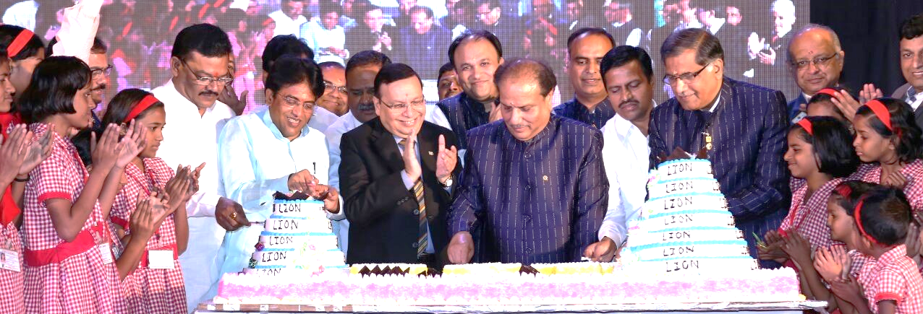
A Lion-size tribute
2014-2015
2015-2016
2016-2017
2017-2018
Notes:
Lions and Leos around the world participated in this grand celebration from July 2014 through June 2018, honoring 100 years of humanitarian service.

Slide 3
Share our story
♦ Touchstone Stories ♦ History Videos ♦ Lions Journey slideshow
Notes:
To preserve our rich history, a series of Touchstone Stories and Lions History Videos were created, along with an online slideshow, the Lions Journey.
Lions shared the stories, from the founding of our organization through our global expansion, with their clubs and their communities.

Slide 4
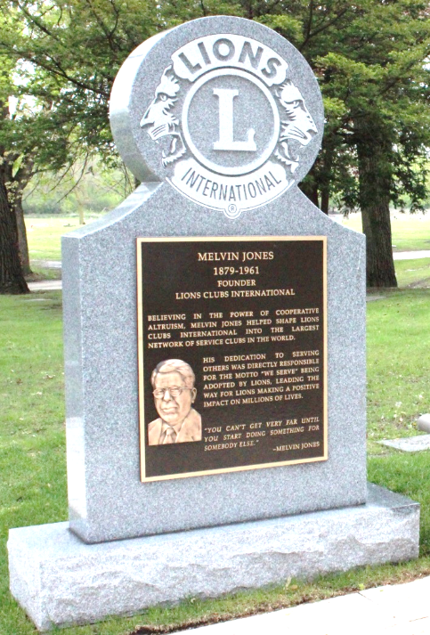
Honor our legacy
♦ Melvin Jones Statue ♦ Melvin Jones Memorial Site
Notes:
Melvin Jones founded Lions Clubs International in 1917.
In his honor, a statue was created for our international headquarters and his memorial site was renovated to be a fitting tribute.

Slide 5
Preserve our heritage
Reflections of the Presidents
♦ Interviews with every International President
Notes:
We interviewed each of our International Presidents to record their insights into the past and future of Lions International.
Key thoughts from each session have been published as the Reflections of the Presidents video series.

Slide 6
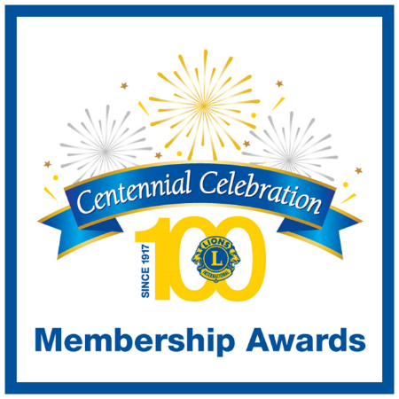
A celebration of service
Notes:
Service is the heart of the Centennial. Throughout the celebration, Lion and Leos:
- Led through service with the Centennial Service Challenge
- Earned Centennial Membership Awards by inviting for impact
- And connected with their communities through Centennial Legacy Projects

Slide 7
Centennial Service Challenge
248,993,525 people served
Notes:
The Centennial Service Challenge placed our motto, We Serve, into action as never before, with a goal of serving 100 million people through youth, vision, hunger, environment and diabetes projects.
Who took up the challenge? {wave}
Not only did we achieve our goal, we more than doubled it, serving over 248 million people! {applause}

Slide 8
Centennial Membership Awards
746,041 Centennial members
Notes:
Our Centennial Membership Awards inspired us to invite new members and start new clubs to grow our organization and extend our mission of service.
Lions Clubs International now has over 700,000 new Centennial members and over 6,600 Centennial clubs to provide even greater benefits to humanity.
Who is a Membership Award winner here? Thank you. {applause}

Slide 9
Community Legacy Projects
31,853 projects reported
Notes:
Our Centennial Legacy Projects have connected us more than ever to our communities. They provide not only real value, but also a visible reminder of the contributions that Lions make.
Who gave a legacy to their community? {wave}
With more than 31,000 Legacy Projects completed, the members of all those communities will continue to benefit for years to come.

Slide 10
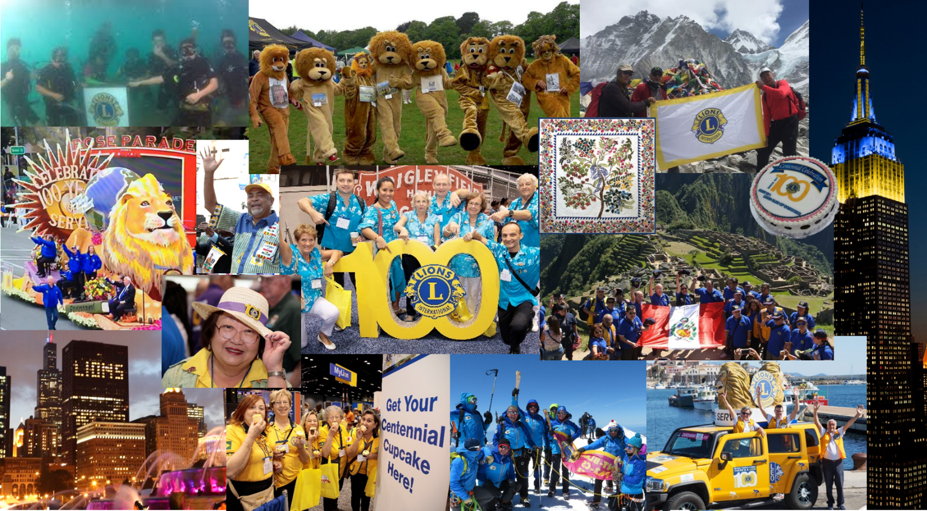
Celebrations worldwide!
Notes:
There’s been plenty of fun, too, as Lions and Leos celebrated from under the sea to the top of Mount Everest and everywhere in between.
We joined parades, crafted a Centennial quilt, baked birthday cakes, wore our Lions gear and waved Lions flags with pride.
Even buildings lit up in honor of Lions Clubs.

Slide 11
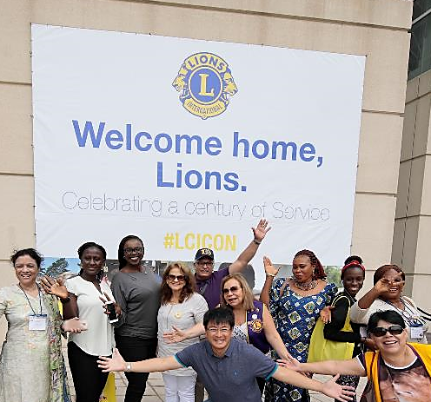
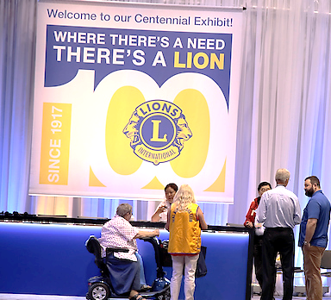
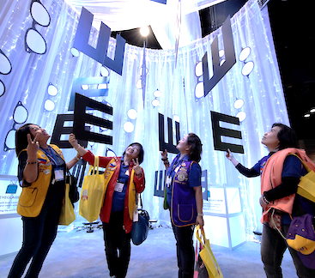
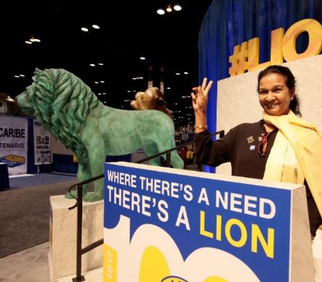
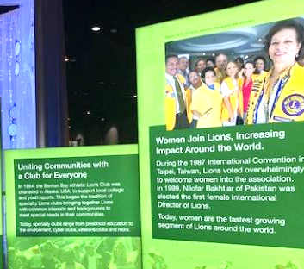
Centennial convention
30,000
Lions and Leos come home
Notes:
Lions and Leos traveled from around the world to Chicago, Illinois, the birthplace of Lions Clubs, for the 100th Lions Clubs International convention.
The convention featured an interactive Centennial exhibit, so attendees could experience the past, present and future of Lions Clubs.
Many of the exhibit pieces will be repurposed at our international headquarters to be enjoyed for years to come.

Slide 12
Centennial banner
♦ 48’ wide and 28’ tall (14.6 m x 8.5 m)
Notes:
Our Centennial banner was constructed with 48 sections individually signed by Lions and Leos throughout our global community.
Who signed the Centennial banner? {wave}
It was magnificent, spanning the main hall at the Centennial Convention, 48 feet wide and 28 feet tall (or 14.6 meters wide and 8.5 meters tall).

Slide 13
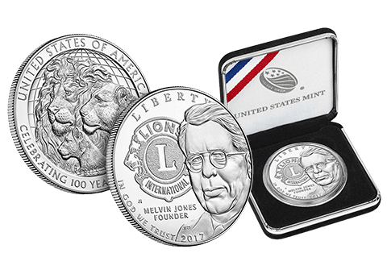
Centennial coin
♦ US$855,540 donated to our Foundation from coin sales
Notes:
A 1 oz. silver Centennial Coin was crafted by the United States Mint. Three of our Past International Presidents participated in a ceremony at the Mint to press the first coins.
Who purchased one of these valuable Centennial keepsakes? {wave}
You should know that your purchase contributed to an $855,000 donation to fund our future humanitarian service.

Slide 14
Centennial stamps
Notes:
Enthusiastic Lions around the globe requested their postal officials to create their very own Lions Centennial Stamp to share our celebration with every delivery.
Aren’t these a wonderful tribute? And great publicity, too!

Slide 15
Social Celebrating
#Lions100
Notes:
Many Lions and Leos marked their stories with the #Lions100 hashtag and shared their Centennial accomplishments across Facebook, Twitter and other social platforms.
Do we have any social Lions or Leos here? {wave} Thank you for sharing!

Slide 16
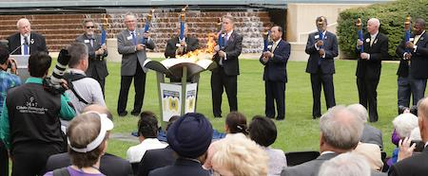
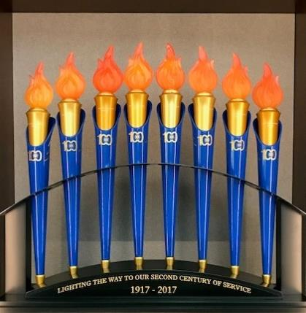
Centennial Torches
♦ Lighting the way to our second century of service
Notes:
Lions and Leos were inspired by our custom Centennial Torches, which traveled in each Constitutional Area and Africa to many local celebrations.
The torches were brought together for a Centennial Cauldron lighting ceremony at the Centennial Convention.
The set is now on display at our international headquarters in a stand with the inscription, “Lighting the way to our second century of service.”

Slide 17
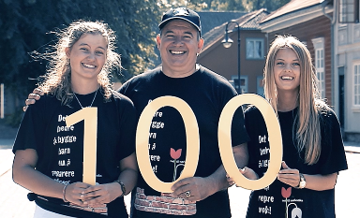
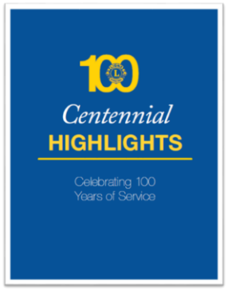
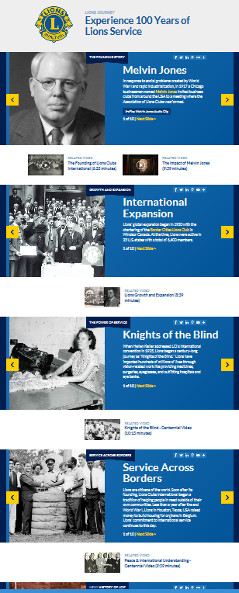
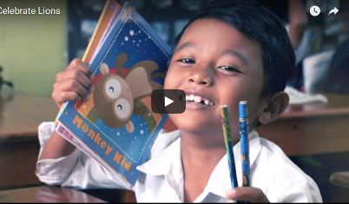
LionsClubs.org archive
A Glimpse of 100 Years video
Centennial Celebration video
Centennial Highlights booklet
Lions History video series
Touchstone Stories
Celebrate Lions video
The Lions Journey slideshow
Reflections of the Presidents video series
Notes:
All of our Centennial activities have produced great resources to share with prospective members, our clubs and communities.
These historic items will be stored on our new LionsClubs.org website, including the Centennial Highlights booklet, the Centennial Celebration summary video and this presentation.

Slide 18
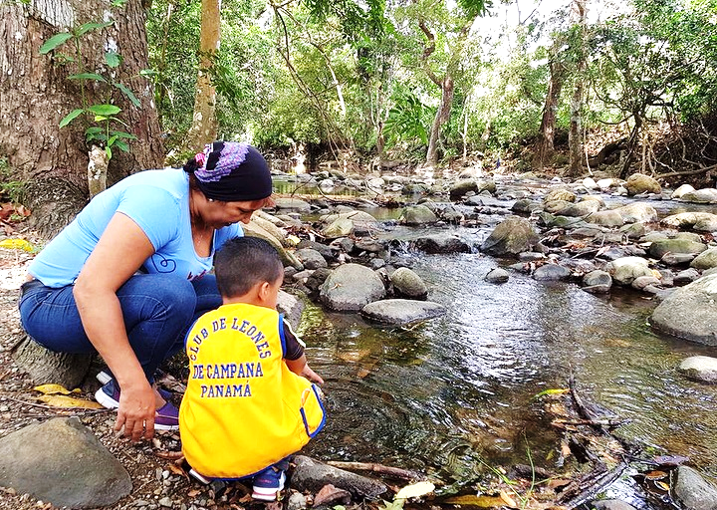
Our next century
Notes:
I’m not sure how many of us will be around for our 200th anniversary, but I imagine Lions opening our Centennial time capsule and being inspired by all we have achieved.
With such a successful celebration, I look to our next century with confidence. Confidence that Lions Clubs International will continue to be the greatest humanitarian organization in the world.

Slide 19
Thank You!
Notes:
Huge thanks for our success to the dedicated contributions of Club Centennial Chairpersons, District and Multiple District Coordinators, the Centennial Action Committee, Executive Officers and all who participated.
You showed the world, “Where there’s a need, there’s a Lion” bigger and brighter than ever before.

