Slide 1
ALL ABOUT LIONS
History
Organization
Service
Notes:
Understanding the history, organization, service, and membership of Lions Clubs International is important for all Lions. Embracing these fundamentals of our organization is what will ensure our future as the largest humanitarian service organization in the world for many years to come.

Slide 2
Historical Highlights
Notes:
Let’s start by taking a trip back in time to review some of Lions Clubs International’s historical highlights.

Slide 3
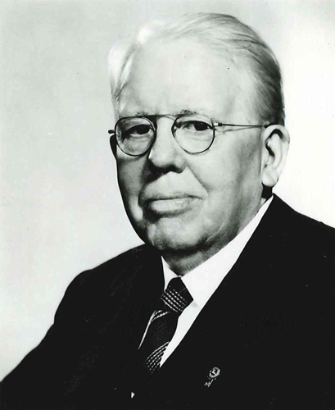
1917
Melvin Jones establishes the Association of Lions Clubs
“You can’t get very far until you start doing something for someone else.”
- Melvin Jones
Notes:
Lions Clubs International began as the dream of Melvin Jones, an American businessman who belonged to a club named the Business Circle of Chicago.
Melvin Jones believed that local business clubs should expand from purely professional concerns to focus on working for the betterment of their communities.
In 1917, he contacted members of similar independent organizations around the country and invited them to a meeting. Most agreed to merge as one association of clubs, and they took the name of the largest group, the Indiana-based Association of Lions Clubs.
The first convention was held in October of that year in Dallas, Texas, USA, where the constitution was adopted and the first president, Dr. W.P. Woods, was elected. Jones was elected secretary, beginning a 44-year career with the organization.
Melvin Jones explained his reasoning for the concept of service to the community with the saying, “You can’t get very far until you start doing something for someone else.”
For over 100 years Lions around the world have proven Jones’ saying to be true by serving local, national, and global communities.

Slide 4

1920
First club chartered in Canada
Notes:
In 1920, the Association of Lions Clubs was established internationally when the first club in Canada was chartered in Windsor, Ontario.
Today, Lions Clubs International has over 1.4 million members in over 200 countries and geographical areas around world.

Slide 5
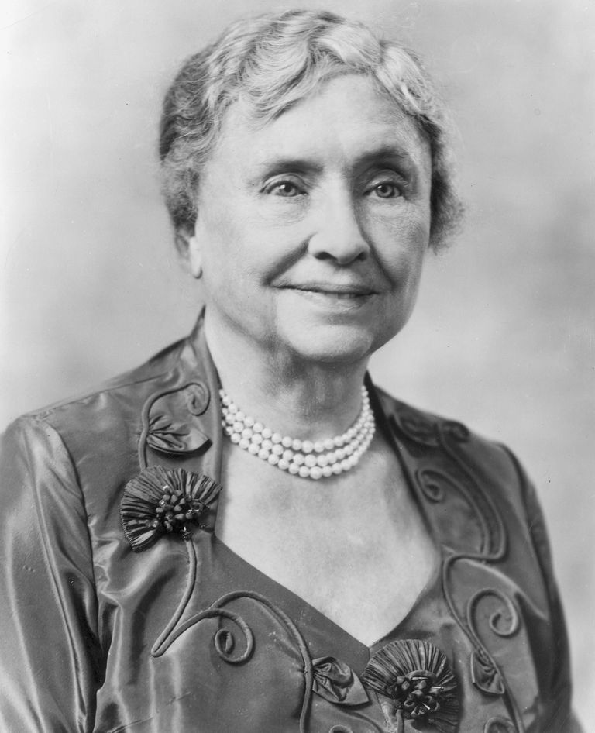
1925
Helen Keller challenged Lions
Lions became “knights of the blind in the crusade against darkness.”
Notes:
Helen Keller was an American author and lecturer, who overcame considerable physical handicaps and served as an inspiration for other disabled people. When she was 19 months old, she was stricken with an acute illness that left her deaf and blind. She overcame these setbacks to earn a college degree with honors.
An early milestone in Lions’ history occurred in 1925 when Helen Keller addressed the organization at the International Convention in Ohio, USA. She challenged Lions to become "knights of the blind in the crusade against darkness."
Since this historic event in 1925, Lions Clubs International has been committed to ridding the world of preventable and reversible blindness and providing services for people who are already blind or visually impaired.

Slide 6
1954
We Serve
Established as the official motto of Lions Clubs International
Notes:
As you know, our organization's motto is “We Serve.” At the International Convention in 1954, this simple phrase, submitted by Lion D.A. Stevenson, was chosen from more than 6,000 suggested mottos.
It symbolizes Lions’ spirit: to help others and to tear away the shrouds of ignorance and distrust that separate one human being from another.
As a dominant Lions’ theme for more than sixty years, “We Serve” is translated daily from words into reality on every continent.

Slide 7

1957
First LEO club chartered
Chris Bunch – LION Managing Editor
Sanjeev Ahuja – Chief of Marketing & Membership
Dan Hervey – Brand & Creative Director
Stephanie Morales – Meetings Manager
Pennsylvania, USA
Leadership, Experience, Opportunity
Notes:
On December 5, 1957 the Glenside Lions Club in Pennsylvania, USA chartered the first Leo club. The concept of junior service clubs gained popularity and, in October 1967, the board of directors of Lions Clubs International adopted the Leo Club Program as an official program of the association. Open to young people ages 12-30, the objective of the Leo Club Program is:
"...to provide the youth of the world (with) an opportunity for development and contribution, individually and collectively, as responsible members of the local, national and international community."
The term Leo stands for Leadership, Experience, Opportunity. Leadership because Leo members acquire skills as project organizers and motivators of their peers. Experience because they discover how teamwork and cooperation can bring about change in their community and the world. Opportunity because Leos develop positive character traits and receive recognition for their contributions.

Slide 8
Leo Club Structure
Sponsoring Lions Club
Leo Club Advisor
Leo Club Board of Directors
Board Committees
Leo Club Members
Alpha
Omega
School-Based
Community-Based
Notes:
Today, the Leo Club Program is stronger than ever and community service remains the cornerstone of the program. There are nearly 7,000 Leo clubs in more than 140 countries and geographic areas.
A Leo club is a sponsored affiliate of a Lions club. These sponsoring Lions helps guide, mentor, and develop young leaders through service. The program is divided into two tracks. Alpha Leo clubs are designed for youth between 12 and 18 years old and focus on the individual and social development of teens. Omega Leo clubs are for young people between the ages of 18 and 30 and focus on the personal and professional development of young adults. Leo clubs can be either based in schools or based in communities.
Sponsoring a Leo club provides a way for Lions to mentor future community leaders and encourage a commitment to community service. Through involvement with a Leo club, Lions can energize and inspire members and even increase the sponsoring club's community exposure, attracting potential members such as young professionals, students, parents and families. Through Leo clubs, Lions have a positive influence on today's youth and young adults, helping them become global citizens and leaders for life.

Slide 9
Established 1968
Notes:
The Lions Clubs International Foundation was established in 1968 with the purpose of funding large-scale Lions humanitarian projects for sight, youth, disability, health, and disaster relief.
Since LCIF began in 1968, it has awarded over US$1 billion in grants to improve the lives of people worldwide. Every dollar donated to LCIF goes toward a grant.

Slide 10

Melvin Jones Fellowship
created
1973
Notes:
In 1973, LCIF created the Melvin Jones Fellowship. This donor recognition award is the Foundation’s highest honor.
The Melvin Jones Fellowship is the backbone of LCIF, providing 70 percent of its revenues. A recognition of humanitarian work, a Melvin Jones Fellowship is given to those who give US$1,000 to LCIF or to people for whom a donation was made by others.

Slide 11
1973
Lions Clubs International welcomes our
One Millionth Member
Notes:
Also in 1973, Lions International welcomes its one millionth member.

Slide 12
1987
Women
become Lions!
Chris Bunch – LION Managing Editor
Sanjeev Ahuja – Chief of Marketing & Membership
Dan Hervey – Brand & Creative Director
Stephanie Morales – Meetings Manager
Notes:
Another historical highlight in the history of Lions Clubs International is the inclusion of women as members in 1987.
Today, women are the fastest growing segment of the association and bring a wealth of ideas, energy, and skills to our organization.
In 2018, Lions elected the first female International President, Gudrun Yngvadottir.

Slide 13

1988
First International Peace Poster Contest
“Peace Will Help Us Grow”
Mustapha El Tawokji
Lebanon
1988-89 Winner
Notes:
In 1988, the International Peace Poster Contest was established for young people around the world to express their artistic visions of peace. Each year, Lions Clubs around the world sponsor the contest in their communities.

Slide 14
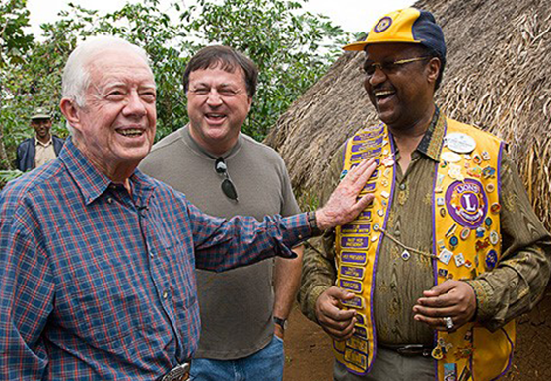
1999
LCIF partners with The Carter Center
to combat river
blindness in Africa and Latin America
Photo credit: Carter Center/L. Gubb.
Notes:
The Carter Center and Lions Clubs International Foundation partnership, called the Lions-Carter Center SightFirst Initiative, was established in 1999. In 2014, former United States President Jimmy Carter spoke at a ceremony to announce an expansion of the initiative:
“For 20 years, the partnership with Lions Clubs International Foundation has been instrumental in supporting the Carter Center’s leadership in the fight against neglected diseases,” said President Carter. “The Lions’ continued financial support will help The Carter Center, local Lions clubs, and other national partners defeat preventable blindness in some of the most affected communities in the world.”

Slide 15
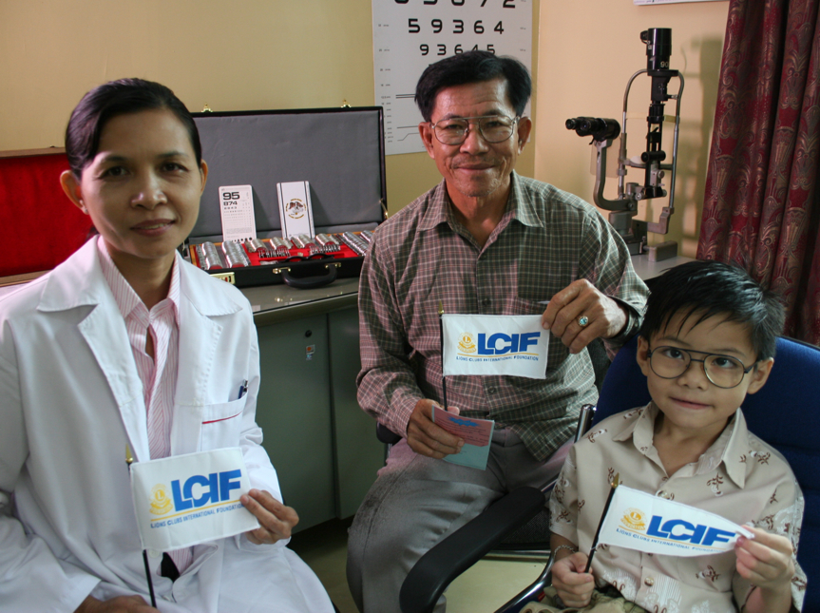
2005
Chris Bunch – LION Managing Editor
Sanjeev Ahuja – Chief of Marketing & Membership
Dan Hervey – Brand & Creative Director
Stephanie Morales – Meetings Manager
Campaign SightFirst II is launched
Notes:
In 2005, the Lions Clubs International Foundation launched Campaign SightFirst II, it’s second major fundraising effort to provide sight services for people around the world. At the 2008 International Convention, it was announced that the campaign had raised US$205 million dollars.

Slide 16
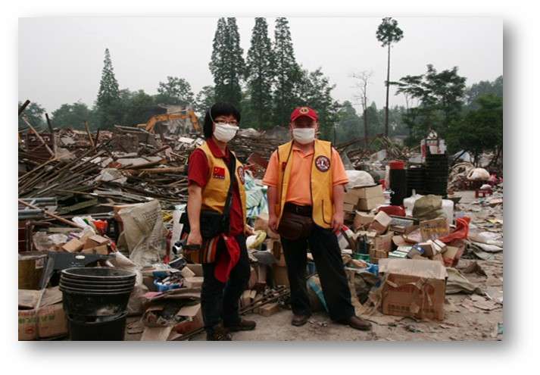
2008
Lions provide China earthquake relief
Chris Bunch – LION Managing Editor
Sanjeev Ahuja – Chief of Marketing & Membership
Dan Hervey – Brand & Creative Director
Stephanie Morales – Meetings Manager
Notes:
In 2008, a devastating earthquake caused massive damage in the Sichuan province of China. In response, Lions in China quickly mobilized to lead relief efforts and provide immediate and long-term aid and support to the thousands of victims affected by the disaster.

Slide 17
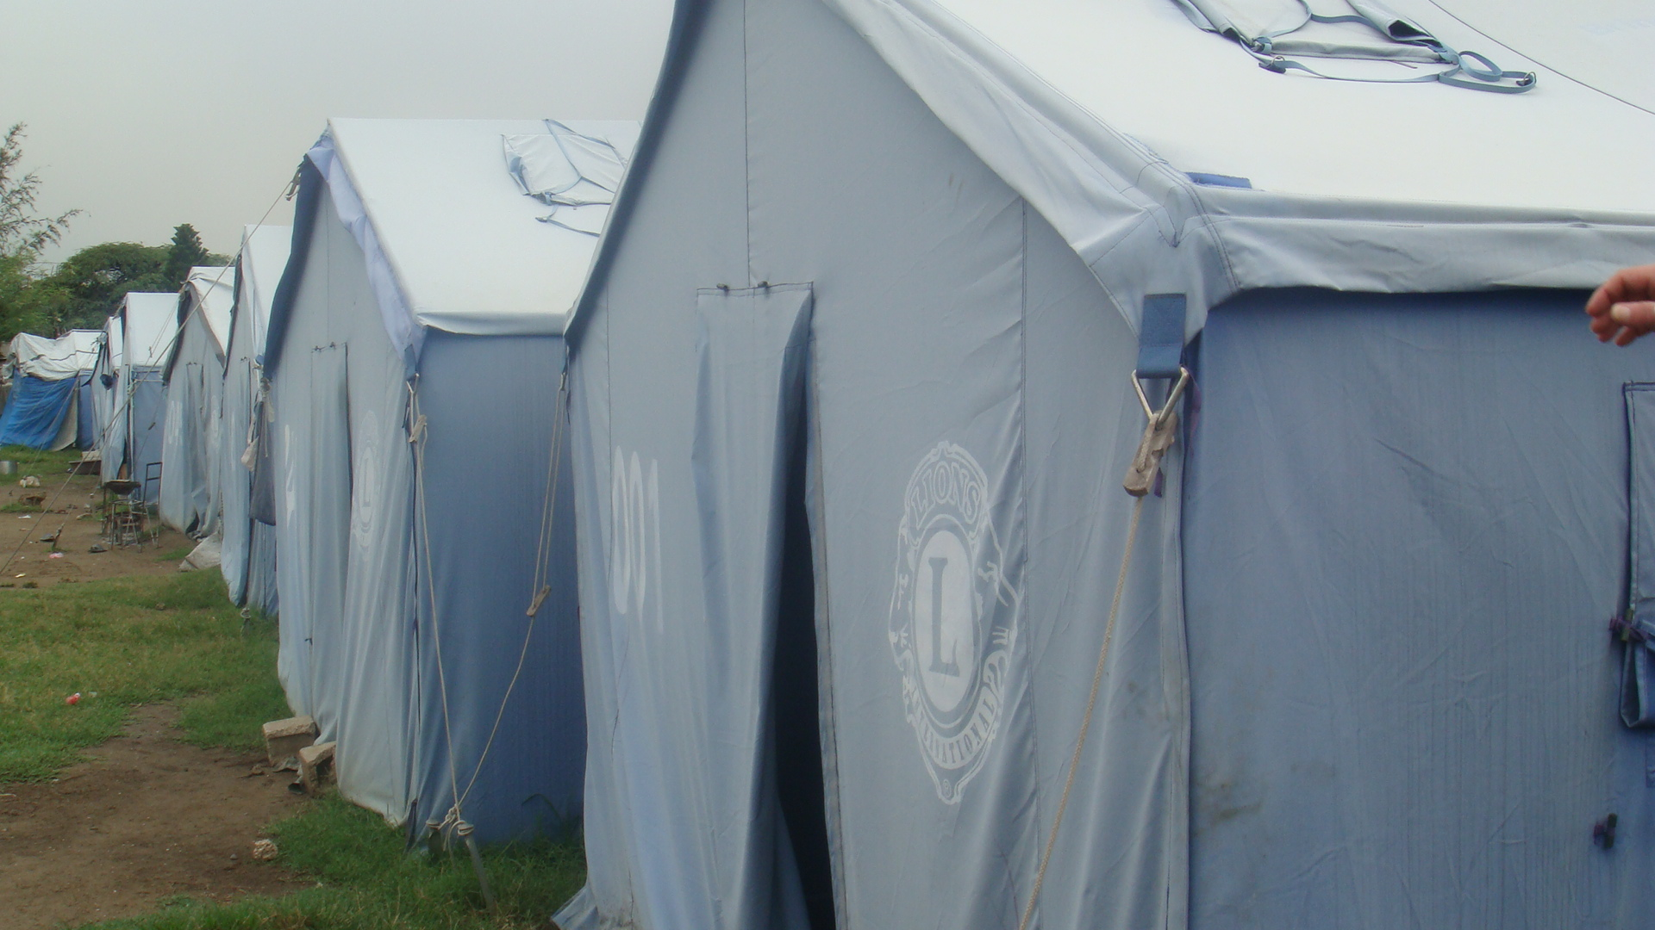
2010
Lions provide earthquake relief in Haiti
Lions “Hope for Haiti” raised US$4.2 million
Notes:
On January 12, 2010, a 7.0 magnitude earthquake devastated the country of Haiti. Lions around the world responded quickly, providing generous donations, services, and aid. Within 3 months, Lions “Hope for Haiti” generated $4.2 million in monetary donations, and Lions continue to support the long-term reconstruction and relief efforts in the area.

Slide 18
2014 - 2018
Centennial Service Challenge
246,000,000 people served -
more than double our goal!
Notes:
For nearly 100 years, Lions served their communities and impacted millions of people around the world. In celebration of our 100th anniversary, we asked Lions around the world to help reach our Centennial Service Challenge goal of serving 100 million people by June 30th, 2018. Not only did we achieve our goal, we more than doubled it, serving over 246 million people!

Slide 19





Lions International announces our
Global Causes
2017
Notes:
In 2017-18, Lions International embarked on a journey to focus on five Global Causes: diabetes, environment, hunger relief, childhood cancer and vision. Lions will continue to focus their service activities on what their community needs; however, Lions International will provide more robust support for these five Global Causes.

Slide 20
2017
Centennial Celebration!
Chris Bunch – LION Managing Editor
Sanjeev Ahuja – Chief of Marketing & Membership
Dan Hervey – Brand & Creative Director
Stephanie Morales – Meetings Manager
Notes:
In June 2017, Lions International celebrated 100 years of service in Chicago, Illinois, USA where the association was founded. Lions traveled from all over the world to commemorate this momentous occasion.
These historical highlights represent only a small fraction of the illustrious history of Lions Clubs International, and you have become a part of that history through your membership.

Slide 21
Organization

Slide 22
Member
Club
Zone
Region
District
Multiple District
International Board
International Headquarters
Lions Organization
Notes:
Another important part of being a Lion is understanding how Lions Clubs International is organized.
The organization of Lions Clubs International begins with you, the member, and with your club. But like all large organizations, there are a number of levels within the organization, each of which supports the others.

Slide 23
Member
Local Organization
Notes:
These concentric circles represent the structure of Lions Clubs International.
At the center of the organization is the Lions club member. Lions club members begin the chain of service that permeates the organization’s structure. Currently there are over 1.4 million Lions.

Slide 24
Member
Club
Local Organization
Notes:
Together Lions members make up the Lions club. Currently there are approximately 46,000 clubs within the association. Club members elect club officers to guide the club as it serves various needs within their community.

Slide 25
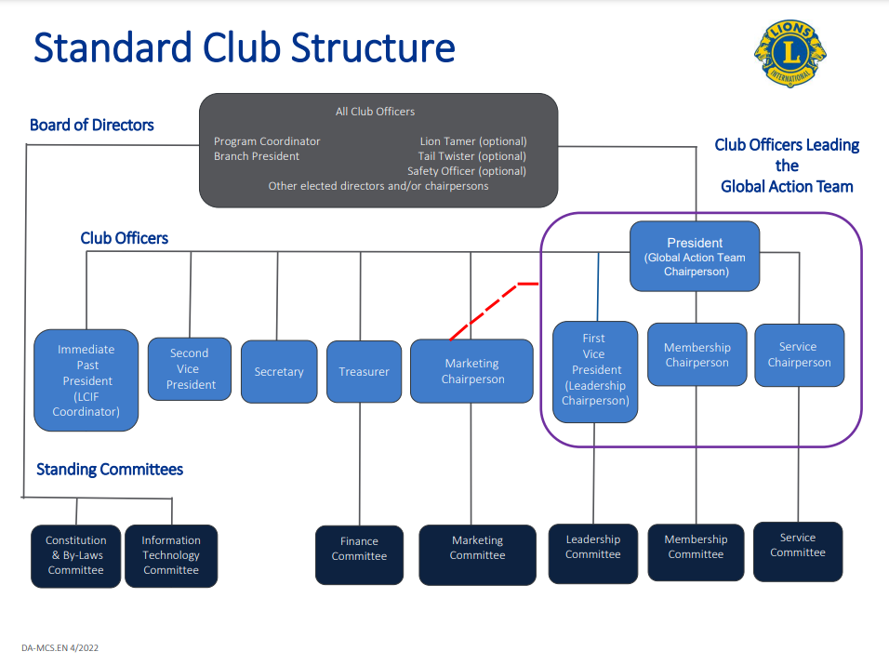
Notes:
Club officers include the president, immediate past president, vice presidents, secretary and treasurer. Also included in the club structure are the Global Action Team chairpersons, marketing chairperson, as well as committee members. Lion tamers and tail twisters are additional roles to hold.
Lion tamers are responsible for the property and paraphernalia of the club such as flags, banners, and gavels.
Some clubs elect a tail twister, who is responsible for promoting harmony, good fellowship, and enthusiasm at club meetings.

Slide 26
Club President
Responsibilities
Chief executive officer of club
Presides at board and club meetings
Chairs the Club Global Action Team
Appoints standing/special committees
Active member of district governor’s advisory committee
Challenges
Inspire members to achieve excellence
Keep members involved and satisfied
Conduct efficient and enjoyable meetings
Notes:
The club president plays a key role in the success and well-being of the club. The president is the ‘chief executive officer’ of the club, presides at meetings of the board and of the club, conducts effective club meetings, chairs the Club Global Action Team, appoints standing and special committees, and is an active member of the district governor’s advisory committee in the zone in which the club is located.
It is important to remember that the club president’s authority depends on the directives of the club’s board of directors.
The club president is challenged to conduct efficient and enjoyable meetings.
The club president also faces the challenge of keeping members involved in club activities and events. Appointing members to committees or other positions within the club is an effective way to increase member involvement. An effective president will inspire members to realize their own potential.

Slide 27
Member
Club
Zone
Local Organization
Notes:
The next ring of the Lions structure is the zone. Zones consist of 4-8 Lions clubs within a geographical area. Delegates of the clubs within the zone may elect a zone chairperson, but it is more common that the district governor appoints Lions to this position.
Zone chairpersons act as advisors, help solve problems, and identify opportunities for their clubs. They also play an active role in organizing new clubs.

Slide 28
Member
Club
Zone
Region
Local Organization
Notes:
Zone chairperson activities are coordinated at the regional level. The region chairperson is responsible for leadership in the region and guides zone chairpersons in their efforts. The position of region chairperson is an optional position within the organizational structure.

Slide 29
Member
Club
Zone
District
Region
Local Organization
Notes:
The next ring in the association is the district. Our association is divided into approximately 750 districts, each led by a district governor team.

Slide 30
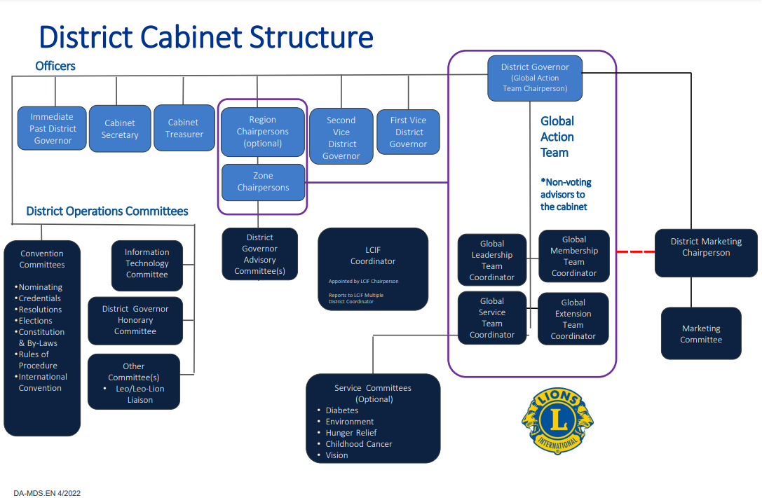
Notes:
The governor leads the district cabinet, which includes the immediate past district governor, the first and second vice district governors, the cabinet secretary-treasurer (or cabinet secretary and cabinet treasurer), Global Action Team district coordinators, and zone and region chairpersons. Some districts have additional members, depending on the individual district’s constitution and by-laws.
Districts are typically made up of at least 35 clubs and 1,250 Lions members in good standing.

Slide 31
District Governor
Responsibilities
Serves as the Global Action Team district chairperson
Administers and promotes membership growth new club development, leadership development, and humanitarian service
Promotes LCIF and service activities
Presides over cabinet, convention and other district meetings
Promotes harmony among the chartered Lions clubs
Other functions and acts as required by the International Board of Directors
Notes:
As the chief administrative officer of the district, the district governor has many responsibilities. They serve as the Global Action Team district chairperson to administer and promote membership growth, new club development, leadership development and humanitarian service to clubs throughout the district.
Additional responsibilities include, but are not limited to, promoting Lions Clubs International Foundation and service activities, presiding over cabinet, convention and other district meetings, supporting the health of clubs in the district and managing district fiscal responsibility.

Slide 32
First Vice District Governor
Responsibilities
Prepares to become district governor
Furthers the purpose of this association
Participates in the cabinet meetings
Helps review the strengths and weakness of the clubs in the district
Participates in planning the district budget
Assists with planning the district convention
Notes:
The first vice district governor, subject to the supervision and direction of the district governor, shall be the chief administrative assistant and representative of the district governor. The first vice district governor will spend a lot of time preparing to become district governor by applying the knowledge he or she learned thus far. They will also be more involved in tasks involving the district governor, like club visits if requested by the district governor, and will work towards being more aware of and using district and club management tools.

Slide 33
Second Vice District Governor
Responsibilities
Assists in the administration of the district
Develops an understanding of club and district policies, procedures as well as programs available
Acts as a representative of Lions International and where appropriate, the district governor
Notes:
The second vice district governor, subject to the supervision and direction of the district governor, shall be an assistant in the administration of the district, and representative of the district governor. They will spend much of their time learning club and district policies, procedures and programs available to both the club and district.
Additionally, they may be asked by the district governor to lead meetings or visit clubs.

Slide 34
Local Organization
Multiple District
Two or more districts
Officers elected at district and multiple district conventions
Notes:
The next ring of support for the Lions member is the multiple district. Multiple districts are formed by two or more districts within a territory defined by the International Board of Directors. Districts within multiple districts are referred to as sub-districts.
Some districts are not part of a multiple district. These stand-alone districts are referred to as single districts.
Annual district and multiple district conventions allow Lions to elect officers, share best practices, sharpen their leadership skills, and enjoy fellowship and fun.

Slide 35
Lions International Organization
International Board of Directors
International President
Immediate Past International President
International First Vice President
International Second Vice President
International Third Vice President
International Directors
International Board Appointees
Lions International Administrative Officers
Notes:
The international organization includes the international president, immediate past international president, international first vice president, international second vice president, international third vice president, international directors, international board appointees and administrative officers, which includes the executive administrator and secretary as well as the treasurer.
The international organization approves policies and procedures for the association
to adhere to as well as programs and initiatives that Lions international staff develop and support.
The international board of directors are elected from eight constitutional areas:
U.S. and Affiliates, Bermuda and Bahamas
Canada
South America, Central America, Caribbean and Mexico,
Europe
Orient and Southeast Asia (OSEAL)
India, South Asia, and Middle East (ISAAME)
Australia, New Zealand, Papua New Guinea, Indonesia and Islands of the South Pacific Ocean
Africa

Slide 36
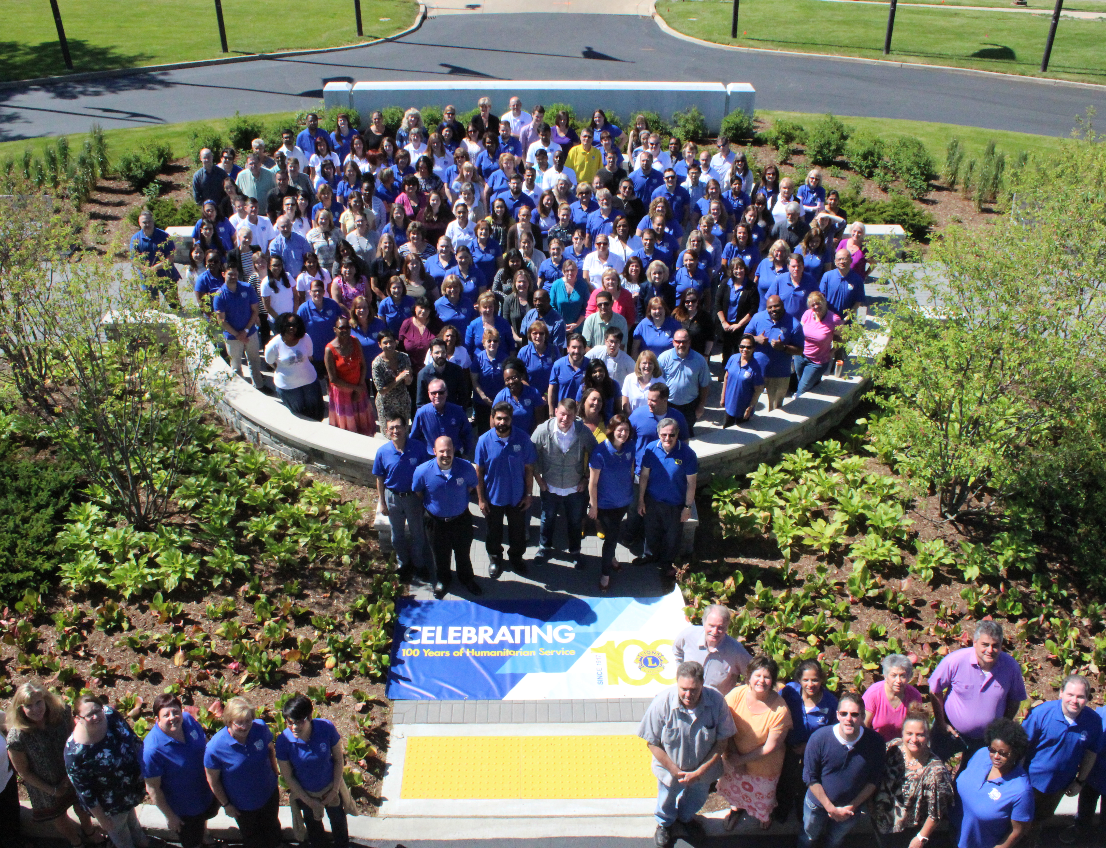
International Headquarters Staff
Regional Offices
  OSEAL (Constitutional Area 5)
  ISAAME (Constitutional Area 6)
All staff support Lions around the world
Notes:
The final component of Lions Clubs International structure is Lions Clubs International Headquarters located in Oak Brook, Illinois, USA, where nearly 300 employees provide resources and support to the 1.4 million Lions club members. There are also two regional offices serving Lions in the OSEAL and ISAAME areas.

Slide 37
Lions Clubs International Foundation
Convention
Membership
Service Activities
Leadership Development
Member Operations and Support
District and Club Administration
Marketing
Legal
Information Technology
Finance
International Headquarters
Notes:
Lions Clubs International Foundation (LCIF): LCIF supports Lions humanitarian efforts worldwide through grants. The Foundation staff work in several departments, including, Humanitarian Initiatives, Global Health Initiatives, New And Emerging Initiatives, Lions Quest, and more.
Lions Clubs International is organized into divisions to support the needs of Lions worldwide.
Convention Division: Works directly with Lions for our annual conventions to handle all of the convention logistics, including the logistics for DGE Seminar. Staff assist with convention travel arrangements, registration and housing.
Membership Division: Works to provide a positive member experience for all members and manages the Leos programs.
Service Activities Division: Manages service programs and initiatives as well as volunteer engagement events, such as the service projects at convention.
Leadership Development Division: Includes the management of Lions international institutes and seminars where Lions are trained in leadership skills. It also is responsible for writing and evaluating the curriculum found in all DGE training, institutes, seminars and online.
Membership Operations and Support Division: This division supports Lions on the Global Action Team (GLT, GMT, GST). It provides support to members through the Member Service Center as well as the Logistics Services department.
District and Club Administration: Is responsible for district and club operations, assisting districts and clubs worldwide with various administrative and procedural needs (in all official languages).
Marketing Division: Manages the Lions International brand and marketing strategy, strategic communications, public affairs and advocacy, as well as E-commerce and consumer products (e.g. club supplies).
Legal Division: Is responsible for Lions Clubs International’s legal operations.
Information Technology Division: Manages and administers network services and is responsible for product engineering, development and management.
Finance Division: Maintains the integrity of the association’s financial and accounting systems and provides financial services to Lions worldwide.

Slide 38
Service

Slide 39
“We Serve”
Five Global Causes
Club and Community Needs Assessment
“Where there’s a need, there’s a Lion”
Diabetes | Childhood Cancer
Environment | Vision
Hunger Relief
Notes:
Now that you have learned more about the history and organization of Lions Clubs International, it is time to learn more about what Lions do best…service!
The five Global Causes of diabetes, environment, hunger relief, childhood cancer and vision are supported in a variety of ways by Lions International; however, Lions are not limited to service projects in those five areas. Clubs can complete the Club and Community Needs Assessment (available at www.lionsclubs.org) to determine what service projects to support in their community. Service projects focused on the needs of the community allow Lions clubs to have a real impact on the lives of those in need.
The motto “We Serve” was officially adopted in 1954; however, Lions clubs have been serving communities since 1917. From creating the first eye bank, to launching youth programs, to disaster relief efforts, Lions are always there to help – “where there’s a need, there’s a Lion”.

Slide 40
All About Lions
History
Organization
Service
Notes:
Understanding the history, organization and service of Lions Clubs International is important for all Lions. It will not only assist in your personal growth as a Lion, but allows you to educate others on the importance of Lions clubs in their community and ensures Lions can continue to serve those in need.

