Slide 1
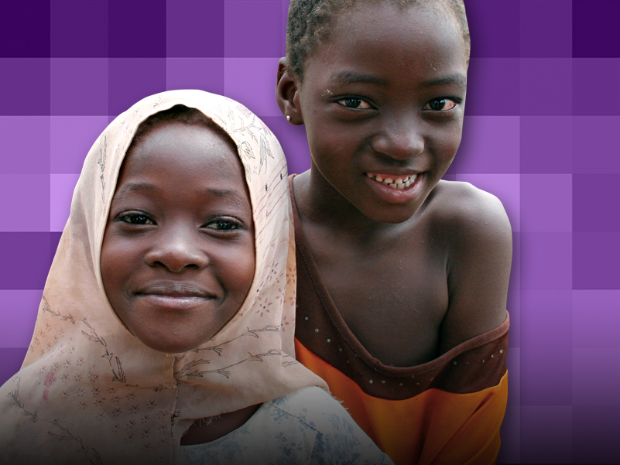


LIONS CLUBS INTERNATIONAL FOUNDATION
Making Measles History:
LCIF Coordinator Orientation

Slide 2
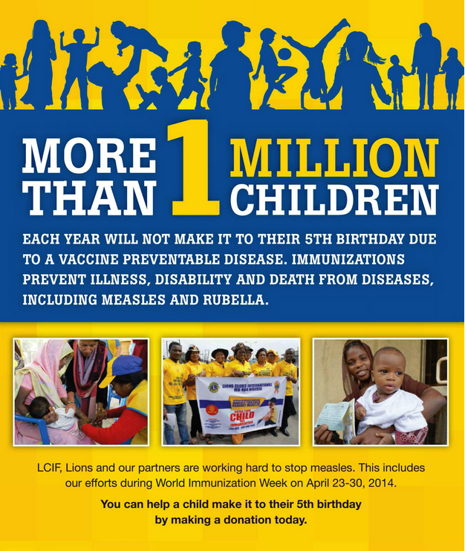
Notes:
More than 1 million children each year will not make it to their 5th birthday due to a vaccine preventable disease. Immunizations prevent illness, disability and death from diseases, including measles and rubella. LCIF and our partners are working hard to stop measles. This includes our efforts during World Immunization Week on April 24-30, 2014. You can help a child make it to their 5th birthday by making a donation today.

Slide 3
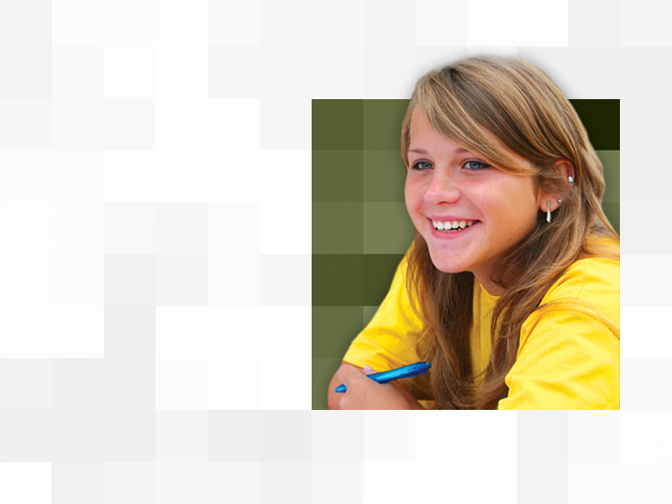
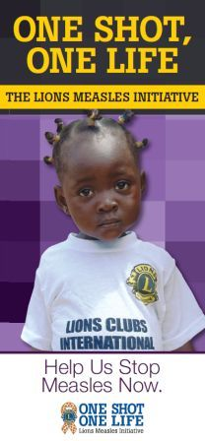

One Shot, One Life
Overview

Slide 4




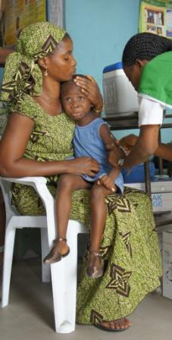
Call to Action!
Measles takes the life of 335 children every day – more than 122,000 a year. And it’s completely preventable.
We as Lions have vowed to continue the fight against it.
Children in communities around the world need your help in order to be protected against measles infections!

Slide 5

Brief History
2010: Partnership with Measles & Rubella Initiative and the Bill & Melinda Gates Foundation to conduct pilot programs in African countries, vaccinating more than 41 million children.
2011: Bill & Melinda Gates Foundation challenge to raise US$10 million for the fight against measles
2012: Lions met and exceeded US$10 million goal; Gates Foundation matched with US$5 million for a total of US$15 million mobilized. These funds, together with other partner support, purchased vaccines provided to more than 200 million children!
We Care. We Serve. We Accomplish.

Slide 6
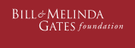


A New Challenge
New partnership with GAVI Alliance
US$30 million by 2017
1:1 match under GAVI Matching Fund
Continuation of Lions efforts to make measles history
US$60M
GAVI Matching Fund Partners

Slide 7

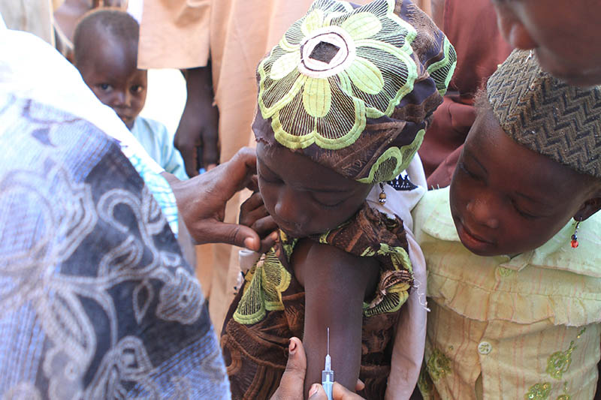
GAVI Alliance
Global Alliance for Vaccines and Immunisation (GAVI)
  Mission: To save children’s lives and protect people’s health by increasing access to immunization in the world’s poorest countries.
We Care. We Serve. We Accomplish.

Slide 8
GAVI Alliance
Lions’ partners in the fight against measles:
  Governments
  WHO, UNICEF, World Bank
  Vaccine Industry
  Bill & Melinda Gates Foundation
  Other nonprofit funders like Comic Relief, la Caixa Foundation, Children’s Investment Fund
GAVI transforms funding from these groups into bulk purchases of vaccines which help to keep prices low and enable distribution to countries most in need of vaccination services
We Care. We Serve. We Accomplish.

Slide 9


VIDEO
Lions and GAVI in Ethiopia
Chairperson Wayne Madden attends vaccination event in Ethiopia.
View this video here: http://www.youtube.com/watch?v=nDyo_mK3rwM

Slide 10
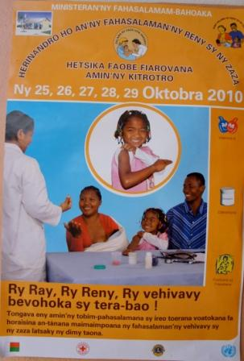
Why Target Measles

Slide 11
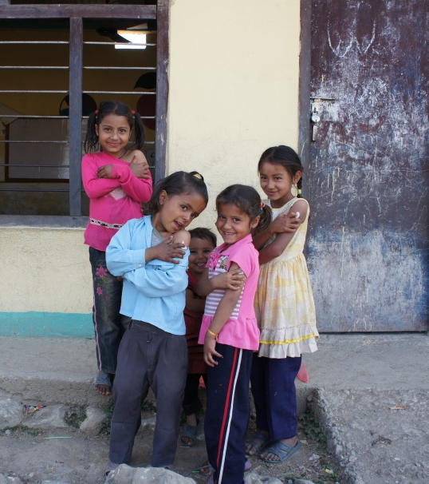
Why Target Measles?
Measles is…
  One of the top five causes of vaccine preventable deaths in the world.
  One of the most contagious diseases; 90% of those without immunity will quickly contract measles when exposed to the virus.
  Easy to prevent – the vaccine costs less than US$1.

Slide 12
VIDEO
What is Measles?
Dr. Samuel Katz, the developer of the measles vaccine, talks about measles.
View this video here: https://www.youtube.com/watch?v=ad_zjxsFUec

Slide 13
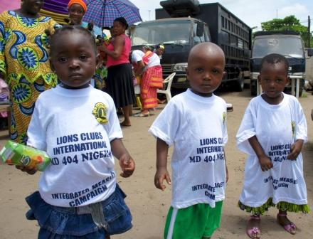

Why Target Measles?
Primary health care and routine immunization strengthened by investment in measles vaccination campaigns.
Measles infection has a significant impact on families, e.g. childcare, hospitalization, loss of work, etc.
Elimination is within reach

Slide 14
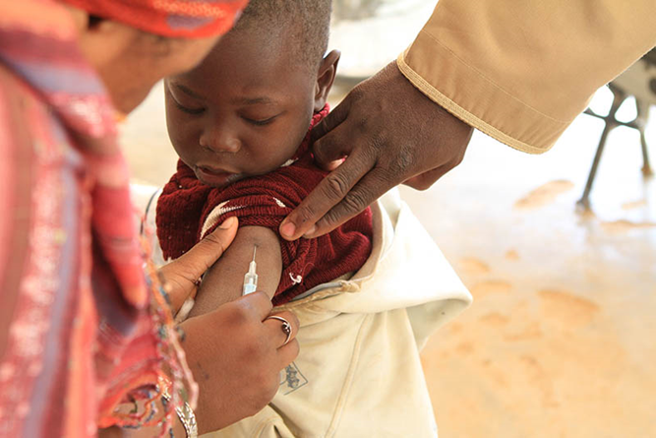
Measles Quiz
  What areas of the world are currently affected by measles?
    Developing countries
    Africa
    Africa, Asia, and Europe
    Every part of the world is affected by measles
We Care. We Serve. We Accomplish.

Slide 15
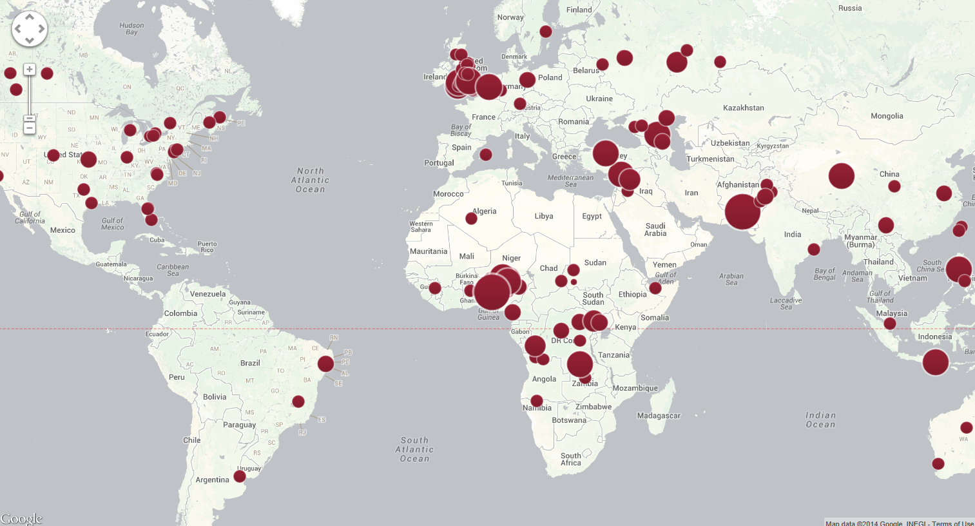
Measles Quiz
D. Measles Affects Every Part of the World
2013 Outbreaks
Notes:
View the map here: http://www.cfr.org/interactives/GH_Vaccine_Map/#map
The dots on this map show all the locations that suffered a major measles outbreak last year. As you can see, every part of the world is affected by measles. Even those areas of the world (such as the Americas and Europe) where measles is thought to be under control can have significant outbreaks if the population does not maintain a high level of vaccination.
Measles was declared eliminated in 2000 in the United States but the disease continues to be imported and spread in unvaccinated populations by residents returning from abroad or from visitors. About half of the measles cases in the United States last year originated in Europe. If your family travels abroad and comes into contact with someone with the measles virus, you will be fine because you have been vaccinated against measles. But what if your child or grandchild who is under the age of one and is too young to receive the vaccination, comes into contact with someone who has the measles virus? The outcome can be deadly. That is why Lions have joined the fight to eliminate measles.

Slide 16
Measles Quiz
Which of these serious side effects can result from a measles infection and lead to lifelong health complications or death in children?
  Blindness from corneal scarring
  Encephalitis
  Pneumonia
  Severe diarrhea
  All of the above
We Care. We Serve. We Accomplish.

Slide 17
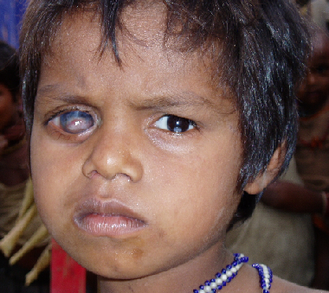
Measles Quiz
E: All of the above
We Care. We Serve. We Accomplish.
Notes:
These complications are most dangerous in areas of the world where children do not have access to adequate medical care, or where they may already be suffering from poor health due to an inadequate diet, poor drinking water, or other diseases.

Slide 18
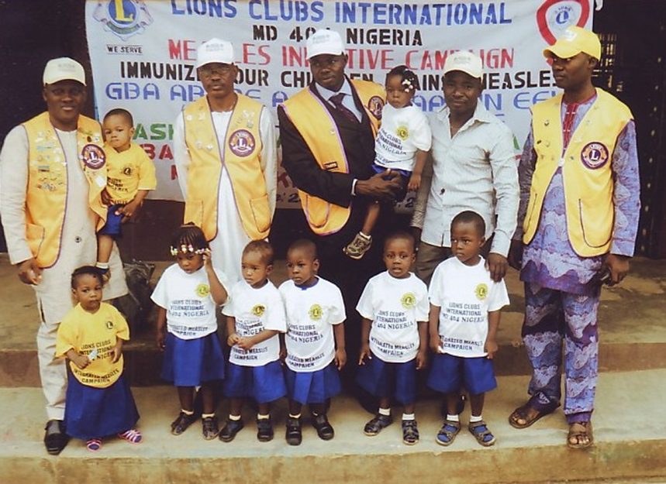
Measles Quiz
True or False:
Measles related deaths have decreased by 78% since 2000.
We Care. We Serve. We Accomplish.

Slide 19
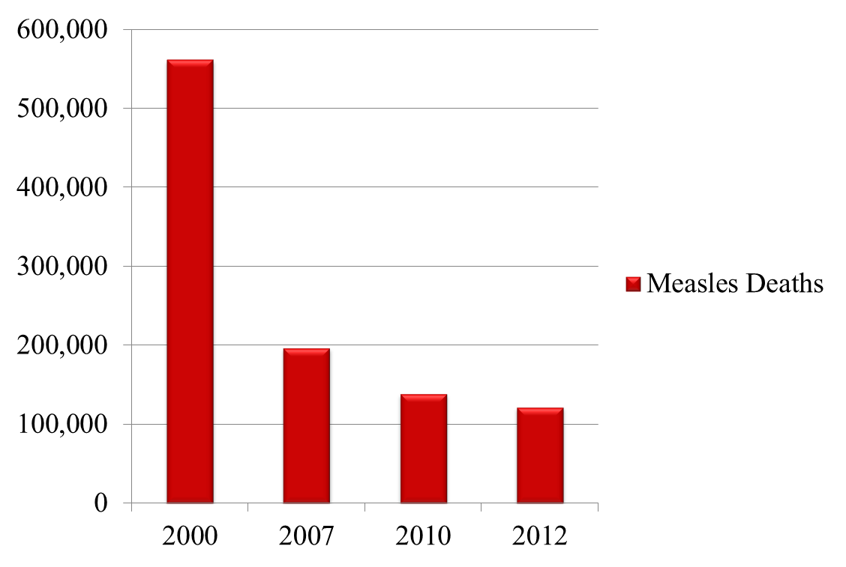
Measles Quiz
True! Global efforts to vaccinate against measles, which started in 2000, led to over 1 billion children being vaccinated and millions of lives being saved.
We Care. We Serve. We Accomplish.

Slide 20
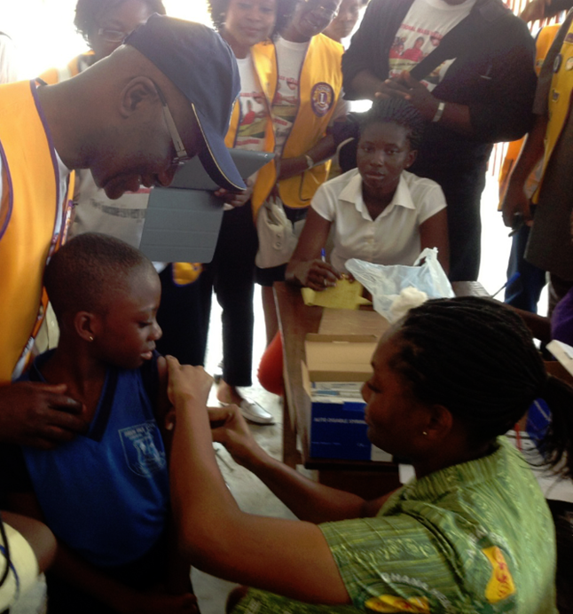
Measles Quiz
How many deaths have been prevented by measles vaccination efforts since 2001?
  2 Million
  3 Million
  7 Million
  13.8 Million
  20 million
We Care. We Serve. We Accomplish.
Notes:
http://www.measlesrubellainitiative.org/measles-news/measles-deaths-reach-record-lows-fragile-gains-toward-global-elimination/

Slide 21
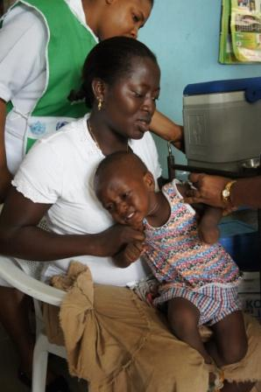
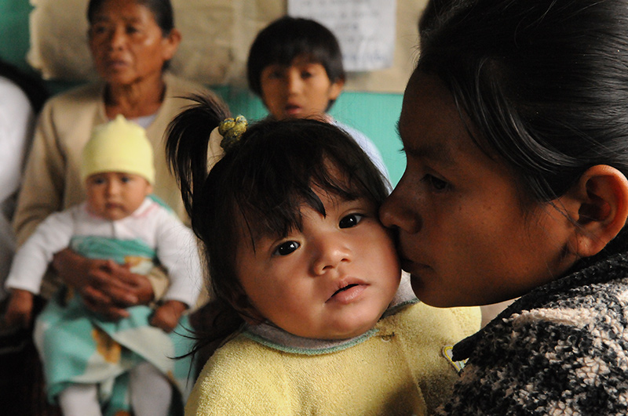
Measles Quiz
D. 13.8 million deaths have been prevented!
We Care. We Serve. We Accomplish.
Notes:
Source: http://www.measlesrubellainitiative.org/measles-news/measles-deaths-reach-record-lows-fragile-gains-toward-global-elimination/

Slide 22

Measles Quiz
  Why must we stay vigilant in our work to combat measles?
    A) Some large populations remain unvaccinated
    B) 5 out of 6 major regions of the world experienced large outbreaks last year
    C) In the Americas (where measles was eliminated as of 2002) imported measles cases continue to be recorded
    D) 122,000 people died from measles in 2012
    E) All of the above

Slide 23
Measles Quiz
    E) All of the above
  “One of the challenges of the fight against measles, and of immunization in general, is that you’ve got to keep at it. You’ve got to be relentless, because children who need to be protected are born every day. You don’t vaccinate once. You do it year after year. As long as you do, children are safe. But when you stop, children die.”
  - William H. Gates, Sr., Co-chair and Trustee of the The Bill & Melinda Gates Foundation
Notes:
http://www.gatesfoundation.org/Media-Center/Speeches/2011/07/Lions-Club-Convention

Slide 24
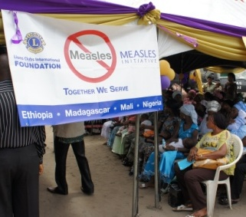
Making Measles History: Lions’ Approach

Slide 25
Global Fund Raising
In addition to the GAVI commitment, LCIF also has annual commitments to support:
Lions’ local immunization efforts
Measles Rubella Initiative
This table shows the annual fund allocation and the total committed:
We Care. We Serve. We Accomplish.

Slide 26
Global Fund Raising
Lions Donations
LCIF
GAVI Alliance
Vaccines to Countries
Health Workers Trained
Lions Mobilize Community
Children Vaccinated – Lives Saved!
We Care. We Serve. We Accomplish.
Notes:
How are Lions' donations to One Shot, One Life used? How are these donations integrated into other aspects of Lions work to combat measles like advocacy and social mobilization?
Generous clubs and Lions support One Shot, One Life by donating funds to LCIF.
Lions also advocate at the national and local level for their governments to invest in immunization services. GAVI leverages broad global financial support from Lions and others to purchase all vaccines at the lowest possible cost. These vaccines are distributed to priority countries that plan vaccination events to address numerous measles outbreaks and limited access to immunization services for families.
Once vaccination events are scheduled, health workers are trained throughout the country. Lions work hard encouraging families to bring their children to be vaccinated. They post flyers, go door to door, organize transportation for families to get to the events, and serve as volunteers during the vaccination days.
The end result of Lions dedication, hard work and generosity is amazing. Millions of children's lives are saved!

Slide 27

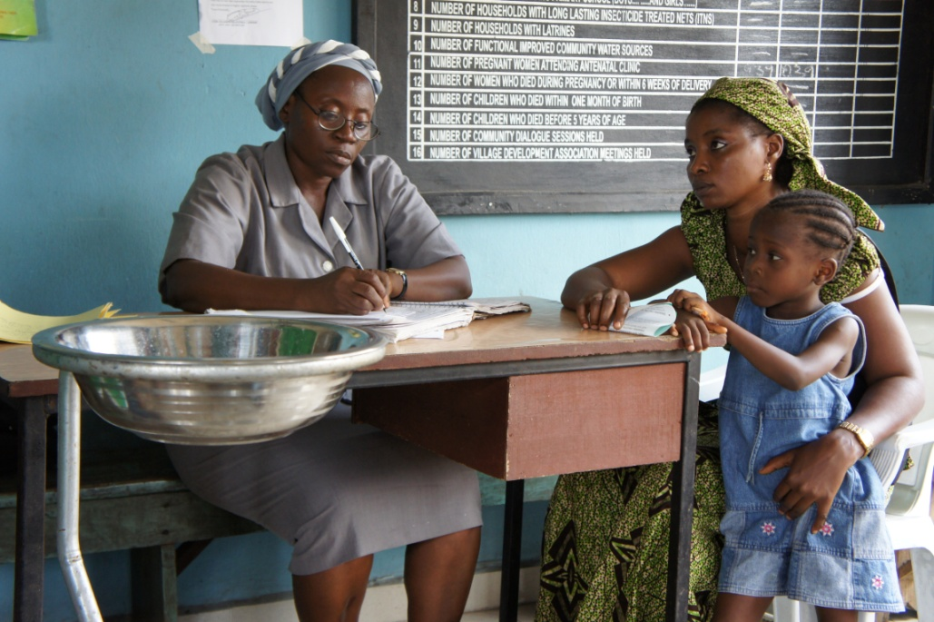
Advocacy
  Lions engage leaders at local and national level to support:
  vaccination coverage through campaigns in areas previously neglected
  creation of routine immunization delivery system
  an improved health infrastructure

Slide 28
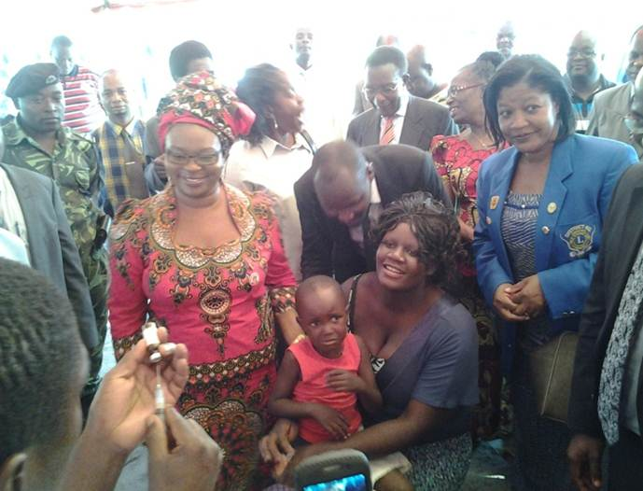
Lions Making Measles History: Malawi
  Nationwide vaccination campaign
  More than 2,000,000 children immunized
  Lions and Leos from 5 clubs played key role in outreach
  Radio announcements
  Floats traveled through urban areas to announce the campaigns
  Volunteered at vaccination centers
Minister of Health, Hon. Gotani Hara (in red) witnessing the first vaccination being administered. Read more on LCIF Blog: http://www.lcif.org/blog/2014/01/15/lcif-week-lions-of-malawi-mobilize-for-measles/#.UyDClPldV8F

Slide 29
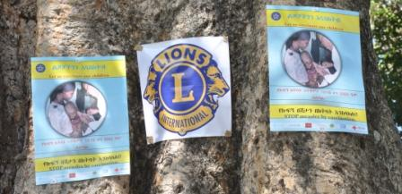
Social Mobilization
Mass Vaccination Campaigns
The process of vaccinating all children in a defined age range in a short period of time, often just a few days or weeks:
    Usually countrywide
    Successful campaigns reach 90% of the children targeted
    Local Ministries of Health must plan and conduct campaigns with technical and financial support from Measles Initiative partners
    Campaigns are excellent for achieving mass immunity in places where routine immunization systems are not yet in place

Slide 30
Social Mobilization
  Common challenges in marginalized communities:
  Low literacy rates (25 – 50%)
  Rural areas have limited access to electricity (for TV, radio)
  Limited access to healthcare services
  Limited government resources
  Limited transportation

Slide 31
Social Mobilization
  Lions are key to the success of vaccination events through their investment in social mobilization:
  TV and radio ads
  Flyers and mobile PA announcements
  Outreach through schools, churches and civil society groups
  Campaign launch events with activities for families
  Creation of an environment of trust and celebration to make families feel welcome

Slide 32
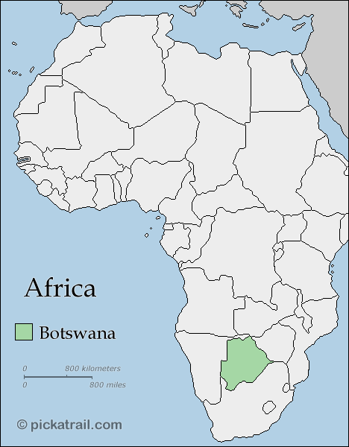
Lions Making Measles History: Botswana
Nationwide vaccination campaign
Almost 200,000 children immunized
Lions played key role in outreach
  Staged shows
  Went door to door
  Transported families
  Organized outreach convoy
We Care. We Serve. We Accomplish.

Slide 33
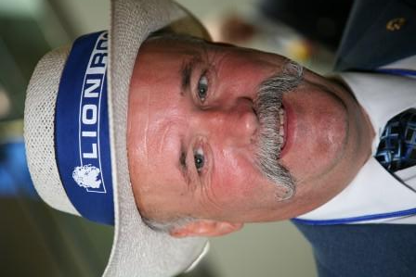
Coordinator Role and Tools

Slide 34


Promotion and Fundraising
  Tell Lions:
    Children's lives are saved and their health care is improved
    The importance of supporting measles control globally
    Our global leadership role with the GAVI Alliance
    Our continued relationship with the Gates Foundation
    How important each Lion’s contribution to One Shot, One Life is today

Slide 35
Balanced Fundraising Strategy
Maintaining balance is critical to raising funds for both our undesignated programs and special initiatives like One Shot, One Life.
How? For example:
Dedicate one month each year to One Shot, One Life promotion
Identify specific clubs or Lions who favor One Shot, One Life; cultivate gifts from them each year
Dedicate just a portion of all funds raised in the district to One Shot, One Life each year
Set a One Shot, One Life goal and develop a plan that is appropriate to the conditions in your district.
Special appeals from LCIF, like The Million Dollar Challenge this April, are designed to support your efforts.
We Care. We Serve. We Accomplish.

Slide 36
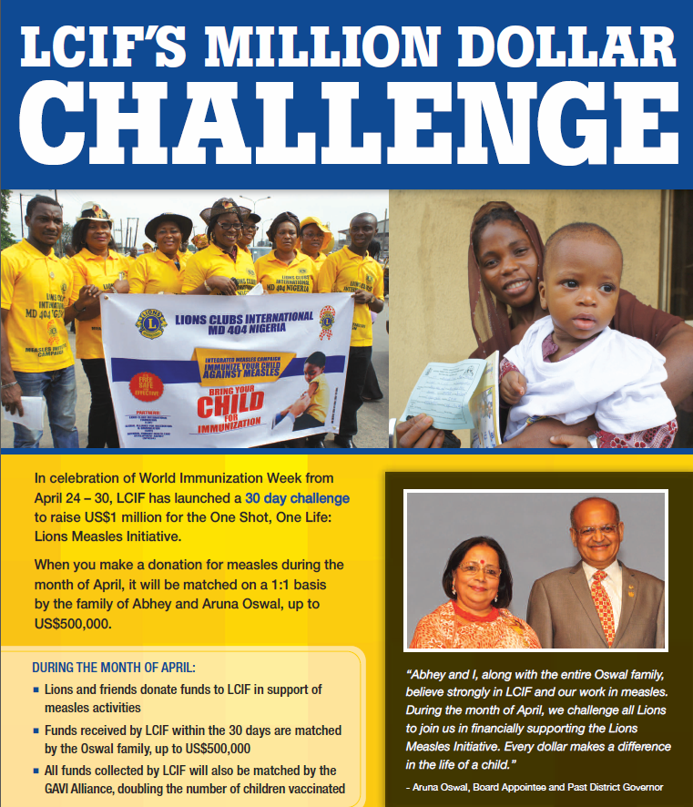
LCIF Million Dollar Challenge: APRIL ONLY
  Quadruple Lions’ Donations:
  In celebration of World Immunization Week, all One Shot, One Life donations received by LCIF during the month of April, will be matched 1:1 by the Oswal family!

Slide 37

Promotional Tools
  Available Now:
  Video of a vaccination campaign in Ethiopia: http://youtu.be/r3CKFOT-ruo
  Million Dollar Challenge Flyer
  Updated PowerPoint presentation for use at club or district events
  Updated One Shot, One Life brochure
    These items may be downloaded and printed locally (please use your MD budget for these expenses) or LCIF development staff can mail copies to you.)
Scheduled during April:
Article in The Lion magazine (many international versions of the magazine will pick up the article in future months)
LCIF Chairperson’s newsletter
LCIF Blog, Facebook and Twitter posts through the month of April

Slide 38
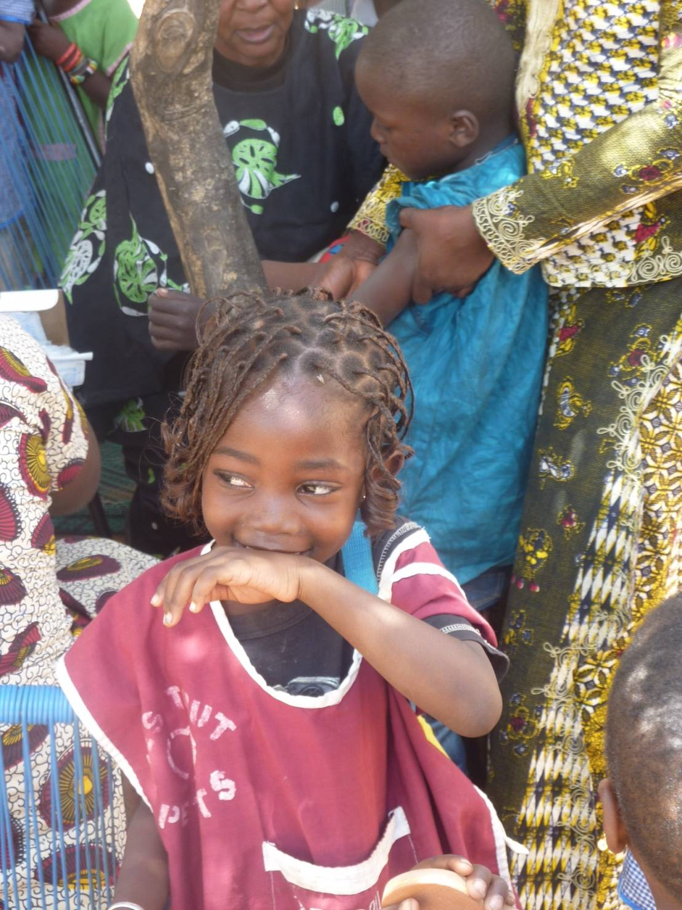
Questions?
Contact: lcifdevelopment@lionsclubs.org
Or call your LCIF development staff counterpart
(Scroll to the bottom of this page for contact information: http://www.lcif.org/EN/about-us/contact-us.php)

Slide 39
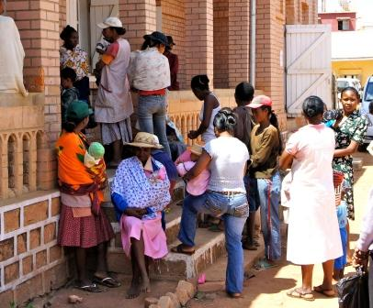
THANK YOU LIONS!
One Shot,
One Life

