Slide 1
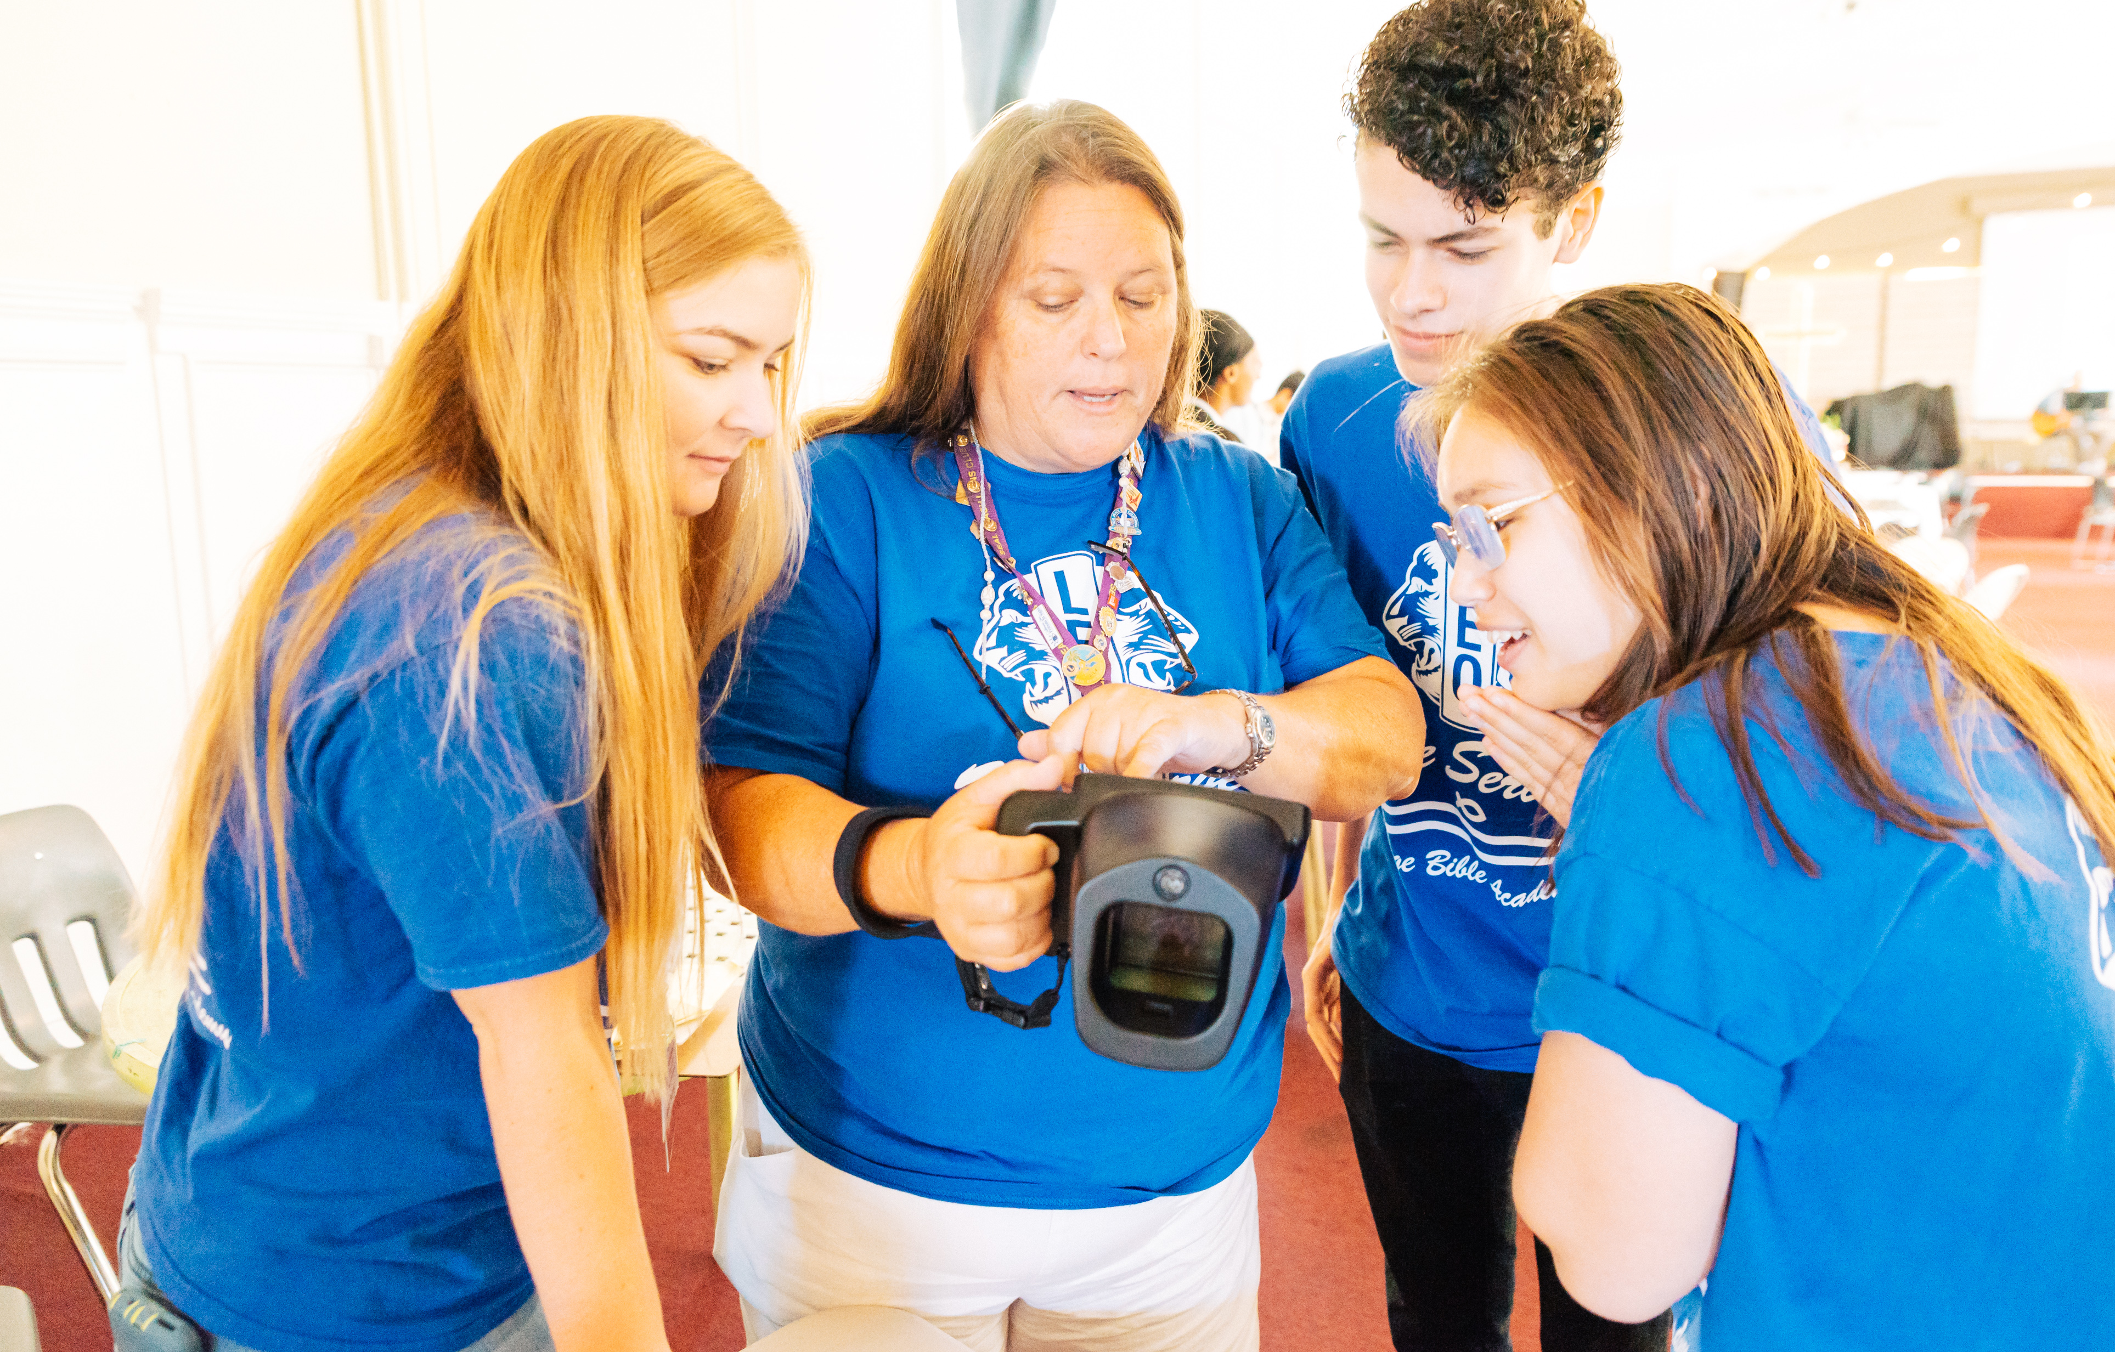
Leo Club Advisor
Training and Orientation
LIONS INTERNATIONAL
1
Notes:
Instructor Note: Lions International designed this orientation and training program for Leo club advisors who are new to the role or have never received formal training about their role as a Leo Club Advisor. While the training will certainly not cover everything related to serving as a Leo club advisor, it provides the basic tools necessary to successfully carry out the duties of the position.
This training should be conducted under the guidance of a Lion trainer, such as a District or Multiple District Leo Chairperson, an experienced Leo Club Advisor who is familiar with resources and policies from LCI, or a Lion who has completed an LCI Faculty Development Institute or Lions Certified Instructor Program and is familiar with the Leo Club Program.

Slide 2
Module 1 // Leo Club Program Overview
Module 2 // The Role of the Leo Club Advisor
Modules
Module 3 // Leo Club Administration
Module 4 // Leo Club Program Resources
Module 5 // Working with Younger People
Module 6 // Continuing the Service Journey
2
Notes:
Instructor Note: This training is designed to present the modules all together or as stand-alone modules. The general recommendation is that instructors should review the material included in each section and determine the modules that are of greatest relevance to the Leo club advisors in the area. Training facilitators may choose to break the modules into various sessions or separate training programs.
Each module concludes with a suggested reflection or discussion activity. Reflection/discussion prompts can be used in many ways:
Individual reflection – encourage learners to make notes of their answers independently
Large group discussion – use a flipchart to capture responses
Small group discussion – allocate additional time for smaller groups to discuss first and then report back their ideas to the larger group

Slide 3
Module 4
Leo Club Program Resources
3
Notes:
The Leo club resource module includes an overview of support provided by Lions International along with many resources for Leo club advisors. The module will cover:
Leo club resources
Leo club communications
Leo grants
At the end of this module, advisors should know all the resources that Lions International offers to support Leo clubs.

Slide 4
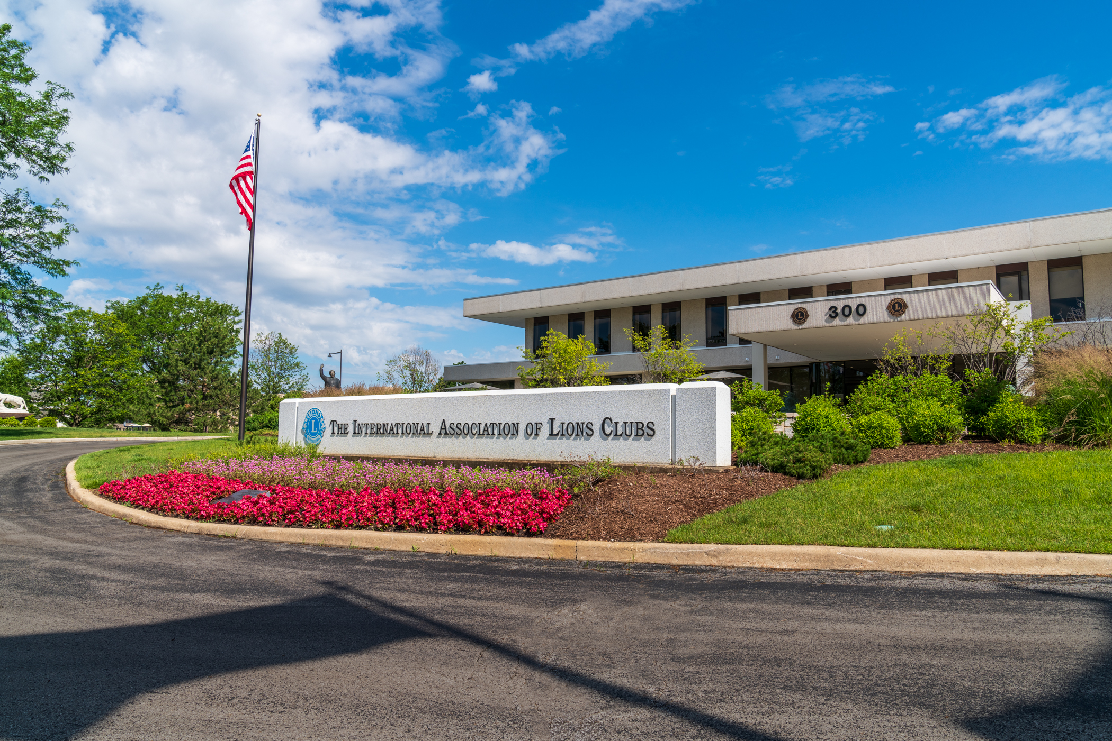
International Headquarters
Oak Brook, Illinois USA
300 W 22nd Street
Oak Brook, Illinois 60523 USA
4
Notes:
Lions International Headquarters is located in Oak Brook, Illinois, USA. There are 300 Lions International and LCIF associates here, providing support for Lions.

Slide 5
Leo Club Program resources
Leo page on the Lions website
Leo Marketing and Recruitment Materials
Leo Items from the Lions Shop
Leo eNews
Leo Facebook Page
Lions Learning Center and Leadership Institutes
Leo Leadership Grant Program
LCIF Leo Service Grant
Leo Constitutional Area Events, Lions Clubs International Convention
Awards and Recognition
5
Notes:
Here is the list of Leo Club Program Resources provided by Lions International Headquarters. The module will cover each of these in the following slides. For links to all the resources, visit www.lionsclubs.org/leos.

Slide 6
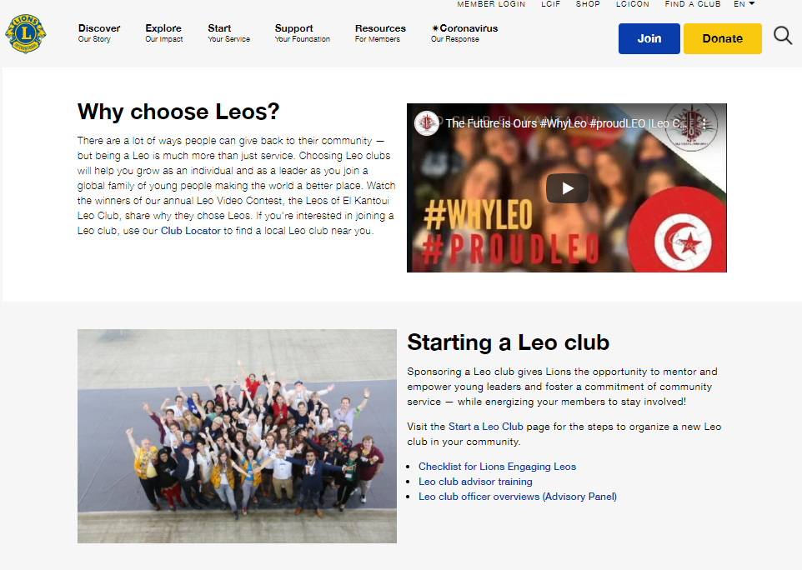
www.lionsclubs.org/leos
6
Notes:
The first place an advisor should visit is the Leo page at www.lionsclubs.org/leos. This page has links to all of the Leo club resources and other pages to explore related to Leo clubs on the Lions International website.

Slide 7
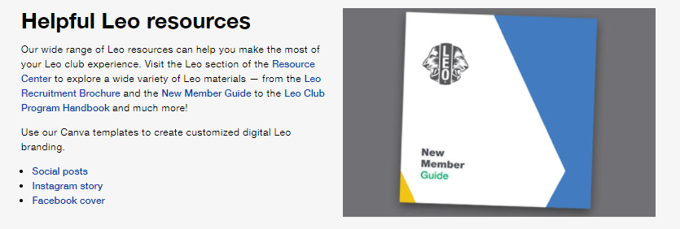
Online resources
7
Notes:
Lions International has created online resources to help market Leo clubs online and more. Leo advisors can find links to the Leo resources under the “Helpful Leo resources” section of the Leo webpage, or by visiting the Lions International website’s Resource Center and selecting the Leos audience.

Slide 8
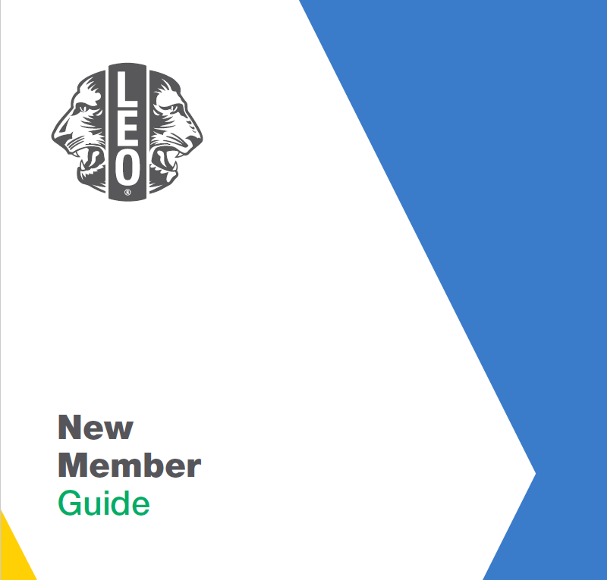
Leo club marketing and recruitment resources
8
Notes:
Lions International has several brochures, posters and guides on Leos which can be downloaded from the website. Lions can also place orders to receive printed materials.

Slide 9
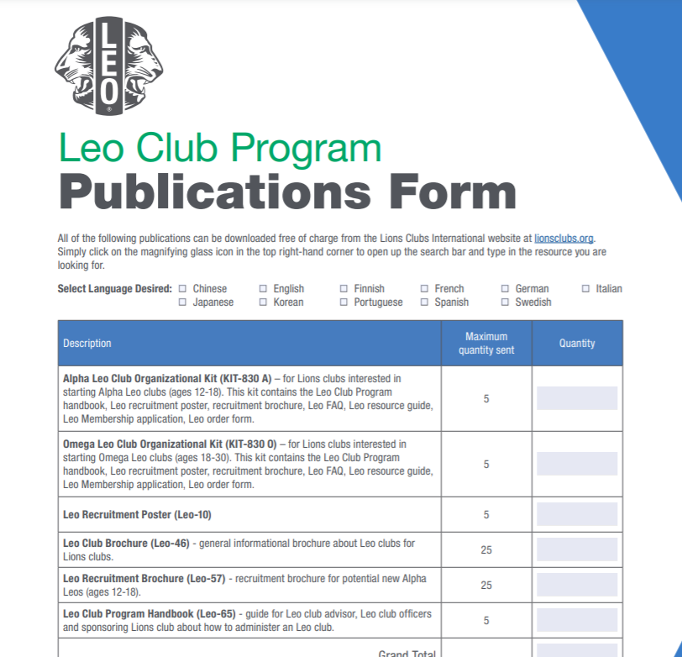
For printed Leo recruitment materials:
Search “Leo Club Program Publication Order Form” on lionsclubs.org for printed Leo recruiting materials.
Submit completed form to leo@lionsclubs.org.
9
Notes:
The Leo Club Publication Form has the full list of printed resources Lions International offers. Orders can be placed submitting a Leo club program order form to leo@lionsclubs.org. Resources are free of charge, but the Lions club, district or multiple district must pay shipping.

Slide 10
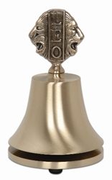
Leo club items from the Lions Shop
Available from the Lions Shop (https://lionsclubsinternational.myshopify.com/collections/leos):
Leo new member kits
Leo apparel
Leo club meeting accessories
Leo certificates and plaque
Leo club officer lapel pins
Leo membership pins
10
Notes:
The Lions Shop has a Leos section that features items for new Leo members and Leo club meetings, including Leo new member kits, Leo lapel pins, Leo bells and Leo apparel.

Slide 11
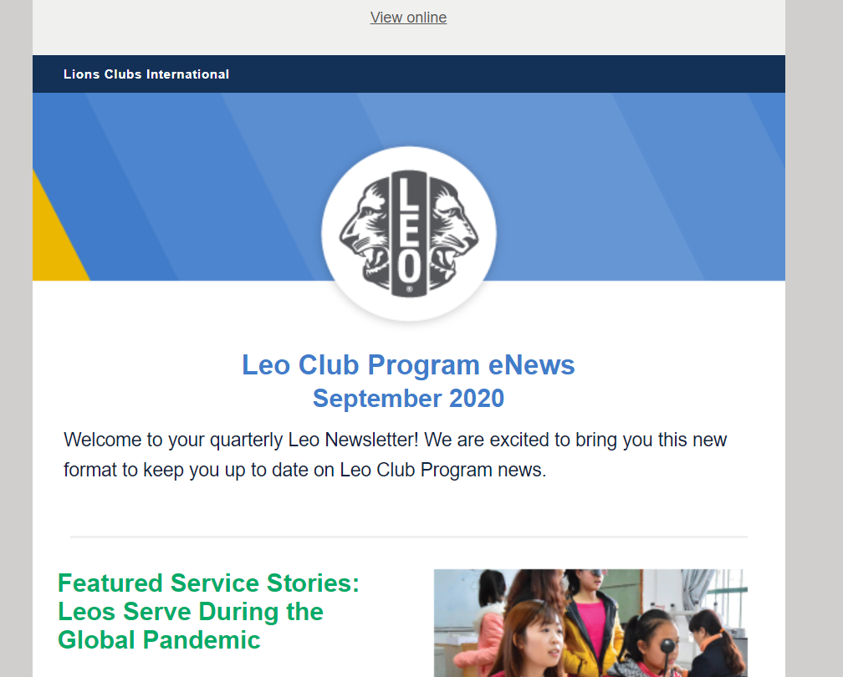
Leo eNews
Quarterly eNews sent by leo@lionsclubs.org with up-to-date information and announcements about the Leo Club Program.
eNews is sent to every Leo club and Leo club advisor that has an email address recorded in the Lions International online reporting system.
11
Notes:
All Leo club officers, Leo club members, Leo club advisors and district/multiple district Leo chairpersons who have been reported for the current fiscal year and provided a unique email address will automatically receive the Leo eNews from International Headquarters. The eNews is sent quarterly and provides important information about upcoming deadlines, events and resources for Leos and Lions involved in the Leo Club Program.
Advisors that have reported their contact details to International Headquarters and are not receiving the Leo eNews should contact the Leo Club Program Department to inquire.

Slide 12
Leo Facebook page
12
Notes:
The Leo Facebook page provides Lions and Leos with quick access to the latest news and developments within the Leo Club Program. The Facebook page also serves as a platform for Leos around the world to connect and share ideas on topics such as effective community service projects or being a good leader. Like the Leo eNews, it’s also a great way to stay informed of the latest news and events related to the Leo Club Program. Follow the page at www.facebook.com/leoclubs.

Slide 13
Leo Club Program Advisory Panel
The Leo Club Advisory Panel is a 32-member board, made of two Leos and two Lions from each constitutional area.
Applications are due August 15.
13
Notes:
The Leo Advisory Panel is an advisory board of 32 Leos and Lions from each constitutional area that meet monthly and work on committees, providing feedback to Lions International and creating resources to help the Leo Club Program. The panel works on three committees that focus on Leo recruitment, Leo membership experience and Leo-to-Lion transition. Each committee has created PowerPoints and guides that are available on the Lions website. Applications are due each year on August 15.

Slide 14
Leo or Leo-Lion Cabinet and Council Liaisons, Leo-Lion Board Liaisons
The district governor/ council chairperson can appoint a Leo or Leo-Lion to serve a one-year term at the Lions District/ Multiple District as a district liaison. This position represents the interests and perspectives of Leos and Leo-Lions and facilitate communication and connections.
The Leo-Lion Board Liaison is an international opportunity for two Leo-Lion members to serve as part of the Lions International Board of Directors. The liaisons are selected by the Lions International President to serve a one-year term as a non-voting appointee.
To learn more about each role, refer to Chapter III and VII of Lions Board Policy.
14
Notes:
A Leo or Leo-Lion can be appointed to serve at the Lions District or Lions Multiple District.
Leo-Lions also have the opportunity to serve as official liaisons to the Lions Club International Board of Directors. Two Leo-Lion are appointed annually to represent the interests and perspectives of young people.
To learn more about these positions, refer to Chapter III and Chapter VII of the Board Policy Manual. https://www.lionsclubs.org/en/resources-for-members/resource-center/board-policy-manual

Slide 15
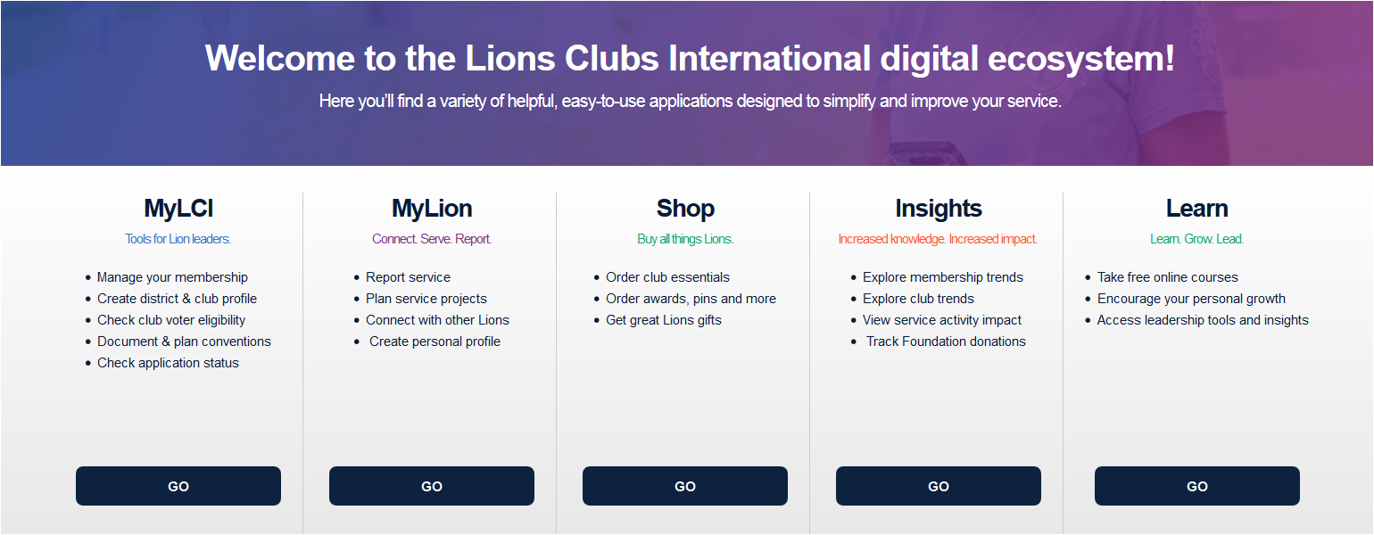
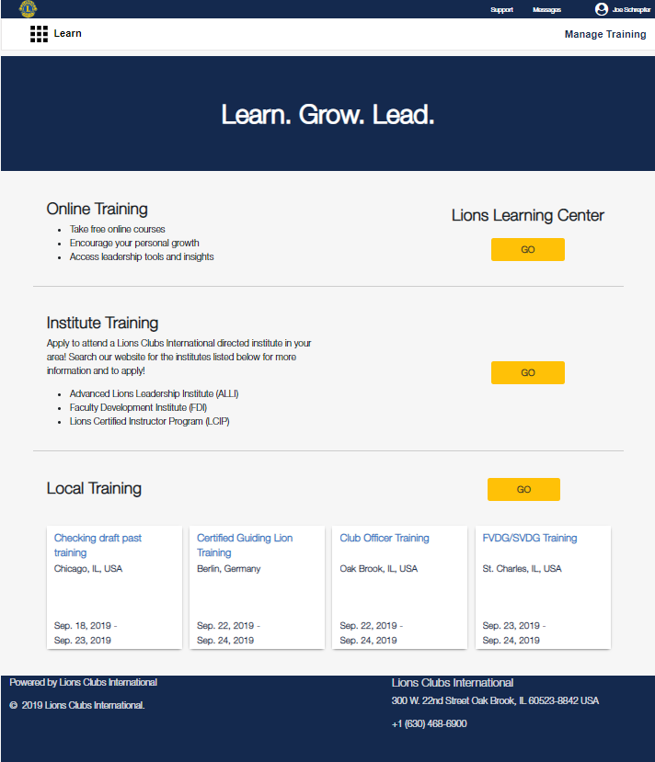
Lions Learning Center
Lion Account needed
Updated courses from Lions Learning Center
15
Notes:
The Lions Learning Center (LLC) provides Lions and Leos with the opportunity to develop leadership skills through online learning courses accessible through the Lions website. A Leo will need Lion Account credentials to log in and navigate to the Learn digital tool.

Slide 16
Leo Leadership Grants
Provides financial assistance to Lions multiple districts, sub-districts or single districts interested in organizing a Leo leadership event.
US$2,000 reimbursable grants
Up to three grants per constitutional area
Leos present or co-present sessions
Leos serve on conference planning committee
Lions and Leos collaborate
Accepted between July 1 and May 1.
First come first served.
16
Notes:
The Leo Leadership Grant offers Leos an opportunity to develop their leadership skills through a training or conference created with the specific needs of Leos in mind. Grants to help fund such conferences or trainings are available to Lions districts, multiple districts and constitutional areas. These trainings must address the development of Leos’ leadership skills, specifically in the areas of project management, teamwork, communication, innovation or planning community service projects. Recipients must use at least one of the sessions from the Leo Advancement Sessions within their event.
Lions International awards up to US$2,000 each fiscal year. To be considered for grant funding, grant applications must be submitted and approved prior to holding the event. Applications are reviewed in the order in which they are received beginning July 1 and are accepted on a rolling basis until May 1 of each fiscal year. Grants are awarded to eligible applicants based on the content and quality of the planned Leo leadership event. Applications are found on lionsclubs.org/leogrants

Slide 17
LCIF Leo Service Grants
Provides financial assistance to Leo service projects implemented by Leo clubs in a Lions multiple district or district.
US$1,500 to US$5,000 to a Lions district or multiple district
25% matching requirement collected locally
Should include:
Hands-on service
Collaboration between Leos and Lions
Accepted between July 1 and May 1.
First come first served.
17
Notes:
The LCIF Leo Service Grant was started in 2018 to help provide financial assistant to Leo service projects. A Lions district or multiple district can apply for up to US$5,000, regardless of the number of clubs involved or the type of club, with a 25% matching requirement mobilized by the local Leos and Lions. This grant is the first grant that LCIF has created just for Leos. Leo clubs looking to complete a project that has a strong service component, Leo/Lion collaboration or meets an unmet humanitarian need in the community should consider applying for this grant. If you have any questions, please email LCIFLeoGrants@lionsclubs.org.

Slide 18
Leo awards
Lions International offers various awards to recognize Leos and Lions active in the Leo Club Program. Below are just a few award types, but for criteria and more details, please visit the Lions website at https://www.lionsclubs.org/en/resources-for-members/resource-center/leo-awards-and-recognitions
Individual
Leo of the Year
Club
Club Excellence Award
Serving Together Award
District/ Multiple District
Leo District President Awards
18
Notes:
Lions International offers a variety of awards and recognition for Leos and Lions involved in the Leo Club Program. Some awards are meant for individual Leos and Lions, while others are designed to recognize Leo clubs, districts, or multiple districts. For more detailed information, including a full listing of awards and application forms, visit the Leo webpage at lionsclubs.org/leos.

Slide 19
Summary
Important points from the module
Lions International has both free printable online guides for Leo clubs and items in the Lions Shop available for purchase.
Lions International communicates to Leo clubs via the leo@lionsclubs.org email and Facebook Leo Club Program page.
There are many award programs to recognize outstanding Leos.
End of module activity
Reflect on the blueprint developed at the end of Module 2. What resources will you use to help achieve or augment your plans?
19
Notes:
Instructor Notes: For the optional end of module activity for Module 4, ask participants to reflect on the blueprint you developed at the end of Module 2. Ask what resources they will use to help achieve or augment the plans they made to have a successful club.
Example: Advisors who planned to host a recruitment night at the school can plan to order some brochures and posters from Lions Clubs International by filling out the Leo Club Program Publication Form.
Estimated Time: 10 minutes

