Slide 1

The value of service
March 2018 service presentation

Slide 2

What is the
Global Action Team?

Slide 3
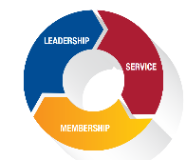
Global Action Team
Vision
Envisioning a day when every need in the world can be served by a Lion or Leo.
Passionate volunteers.
Dynamic leaders.
Innovative service.
Mission
The Global Action Team will champion the vision of LCI & LCIF and reignite the passion of our Lions and Leos through service.
Goal
To ensure that Lions Clubs International impacts 200 million lives through service with 1.7 million Lion and Leo members and provides learning opportunities to 500,000 members by the year 2020.

Slide 4
Global Action Team and LCIF Campaign Structures
Executive Officers
LCIF
LCIF Board of Trustees
Ambassadors
Past International Presidents
International Board of Directors
Immediate Past International Directors
Campaign Chairperson
Past International Presidents –
Campaign Ambassadors
Campaign Vice Chairperson
Special Committees
Global Action Team Chairperson & Vice Chairpersons
GLT
Constitutional Area Leaders
GMT
Constitutional Area Leaders
GST
Constitutional Area Leaders
GLT
Vice Constitutional Area Leaders
GMT
Vice Constitutional Area Leaders
GST
Vice Constitutional Area Leaders
LCIF
International Committee
Constitutional Area Leaders
GLT
Area Leaders
GMT
Area Leaders
GST
Area Leaders
Multiple District Global Action Team Chairperson (Council Chairperson)
LCIF
Area Leaders
GLT
Multiple District Coordinator
GMT
Multiple District Coordinator
GST
Multiple District Coordinator
LCIF
Multiple District Coordinator
District Global Action Team Chairperson (District Governor)
GLT
District Coordinator
GMT
District Coordinator
GST
District Coordinator
LCIF
District Coordinator
Club Global Action Team Chairperson (Club President)
GLT
First Vice President/Leadership Chairperson
GMT
Membership Chairperson
GST
Service Chairperson
LCIF
Club Coordinator

Slide 5
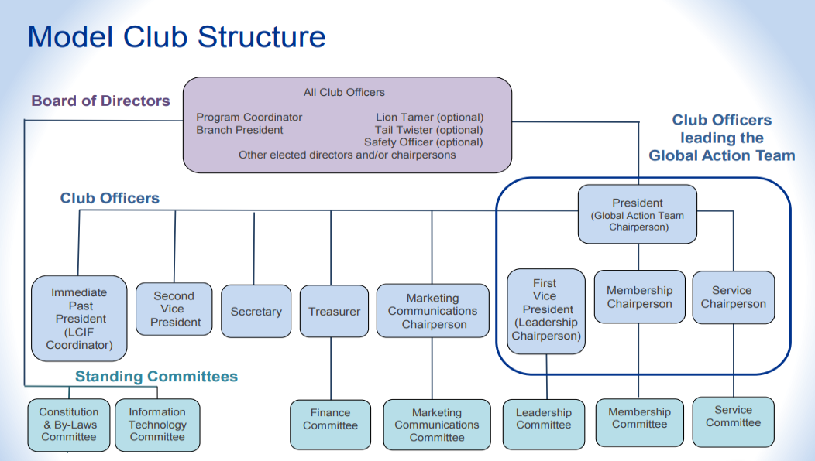
Chris Bunch – LION Managing Editor
Sanjeev Ahuja – Chief of Marketing & Membership
Dan Hervey – Brand & Creative Director
Stephanie Morales – Meetings Manager

Slide 6

Global Service Team
Club Service Chairperson

Slide 7
Putting service at the forefront
of Lions Clubs International
LCI Forward
Enhance service impact & focus
Service goal
Global Service Team
Global causes
Chris Bunch – LION Managing Editor
Sanjeev Ahuja – Chief of Marketing & Membership
Dan Hervey – Brand & Creative Director
Stephanie Morales – Meetings Manager

Slide 8





Our global causes
The footprint of our second century.
DIABETES
ENVIRONMENT
HUNGER
VISION
CHILDHOOD CANCER
Honoring our history and meeting emerging needs.
And giving young people new opportunities to serve with us.

Slide 9

Benefits of electing a CSC
Takes burden away from secretary
Allows for upward mobility in Lions Clubs International
Create new service opportunities
Opportunities to be more involved with your district
Opportunities to get Leos and youth involved in service
Directly receive new resources and ideas from LCI
Resources
  CSC e-book
  CSC webpage

Slide 10

Lions and Leos Service Toolkit
What is it?
A collection of tools that will help Lions and Leos plan, implement and report any service project. It will launch July 2018.
CSCs can help bring this and other service information to clubs using the newly created Service Initiatives Presentation.
What does it include?
Service Template
Club and Community Needs Assessment
Developing Local Partnerships
Guide to Fundraising

Slide 11
Electing a CSC
It is important to add your club’s CSC to MyLCI with a valid email address
  Ability to receive new resources
  Know other GST leaders (Multiple District and District Coordinators)
  Know GMT and GLT counterparts
The Club President and Club Secretary both have the ability to add a CSC in MyLCI

Slide 12
The value of reporting service
Sharing your impact

Slide 13
Sharing your impact
Why report service?
Captivate and connect
Increase global awareness
Pave the way to partnership
Uncover the next big idea
Enhance our support

Slide 14
Sharing your impact
Why report service?
Build a brighter future
Increase our membership
Leverage our foundation
Recognize and reward

Slide 15
Reporting service activities
Service activity
A one-off service project your club hosts that you should report as a regular service activity
Keep your eyes peeled for upcoming information on the Service Journey and our evolving digital platform for service reporting.
Signature activity
A signature activity is a service activity that clubs engage in on a repeated basis. If reporting a signature activity, the activity will auto-populate in MyLCI

Slide 16

Thank you.

