Slide 1
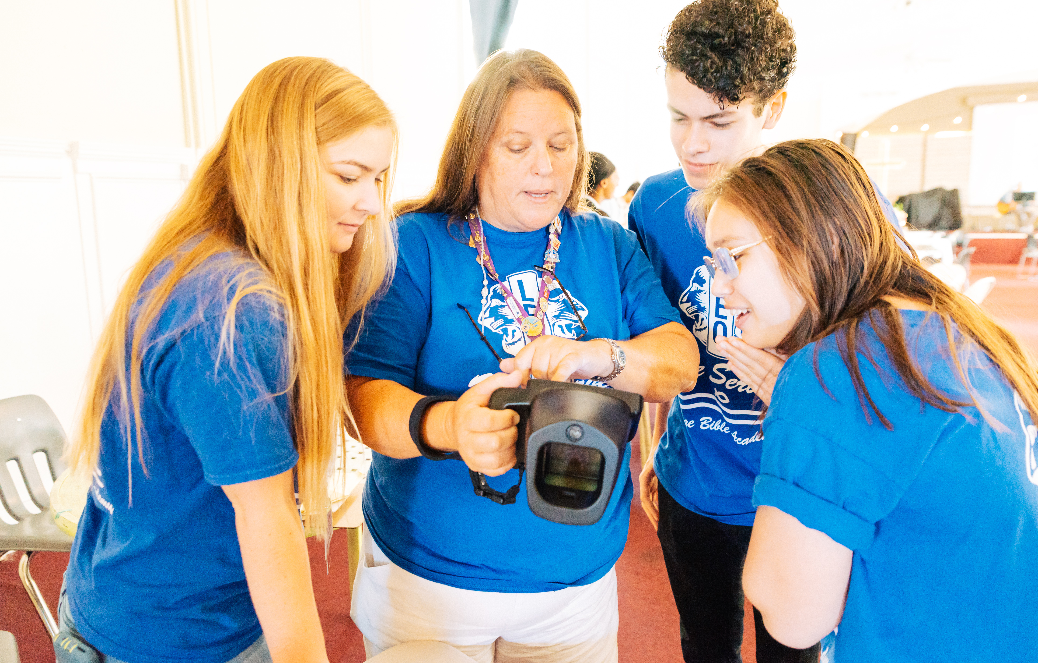
Leo Club Advisor
Training and Orientation
LIONS CLUBS INTERNATIONAL
1
Notes:
Instructor Note: Lions International designed this orientation and training program for Leo club advisors who are new to the role or have never received formal training about their role as a Leo Club Advisor. While the training will certainly not cover everything related to serving as a Leo club advisor, it provides the basic tools necessary to successfully carry out the duties of the position.
This training should be conducted under the guidance of a Lion trainer, such as a District or Multiple District Leo Chairperson, an experienced Leo Club Advisor who is familiar with resources and policies from LCI, or a Lion who has completed an LCI Faculty Development Institute or Lions Certified Instructor Program and is familiar with the Leo Club Program.

Slide 2
Module 1 // Leo Club Program Overview
Module 2 // The Role of the Leo Club Advisor
Modules
Module 3 // Leo Club Administration
Module 4 // Leo Club Program Resources
Module 5 // Working with Younger People
Module 6 // Continuing the Service Journey
2
Notes:
Instructor Note: This training is designed to present the modules all together or as stand-alone modules. The general recommendation is that instructors should review the material included in each section and determine the modules that are of greatest relevance to the Leo club advisors in the area. Training facilitators may choose to break the modules into various sessions or separate training programs.
Each module concludes with a suggested reflection or discussion activity. Reflection/discussion prompts can be used in many ways:
Individual reflection – encourage learners to make notes of their answers independently
Large group discussion – use a flipchart to capture responses
Small group discussion – allocate additional time for smaller groups to discuss first and then report back their ideas to the larger group

Slide 3
Module 3
Leo Club Administration
3
Notes:
It is important for Leo club advisors to have a clear understanding of the administrative responsibilities and obligations to ensure the Leo club is properly managed.
This module will cover key administrative aspects of Leo clubs including
Leo membership and reporting
Leo service activities and reporting
Leo club operations
Leo club fees and accounting
Privacy, insurance and branding
At the end of this module, the high-level administrative tasks of a Leo club advisor should be clear and understandable.

Slide 4
Application forms for Leo club membership
Leos interested in joining a club should submit a Leo club membership form (Leo 50A or Leo 50O) to the sponsoring
Lions club.
4
Notes:
Maintaining Leo club records is one of the first jobs of a Leo Club Advisor. All new Leo club members should fill out the Leo 50 membership form and submit it to the Leo club advisors or club officers. The information can then be used to put the members information in the Lions International online reporting system. The sponsoring Lions club keeps the forms in their record and do not send them to International Headquarters.

Slide 5
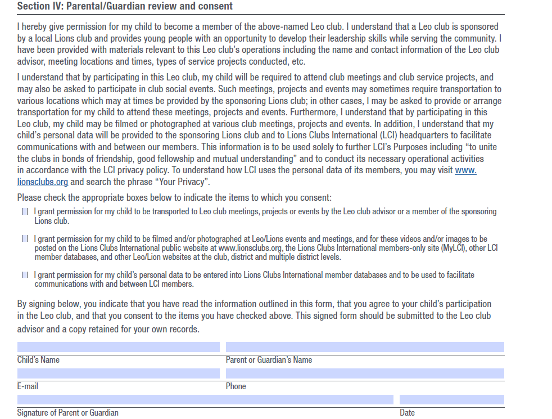
Parental consent for Alpha Leos
The Alpha Leo Membership form (Leo 50A) includes a parental consent section that must be completed
5
Notes:
The Alpha Leo Membership form (Leo 50A) is especially important for youth under legal age of majority in Alpha Leo clubs. The sponsoring Lions club must have an application form signed by one of their parents or guardians.

Slide 6
Importance of membership and officer reporting
6
Notes:
Each year, the sponsoring Lions club president or secretary must report a Leo club advisor, even if there are no changes. Leo club advisors can be reported online via the Lions International online reporting system or using the Leo-72 report form. After a Leo club advisor, Leo club president and Leo club secretary have been reported they can then log into the online reporting system to report Leo club members, access member resources and submit service activity reports.
Reporting is one of the key responsibilities of being a Leo club advisor. The advisor must ensure all Leo club officers and members are updated and that the Lions club officers have officially appointed them to the role of Leo club advisor, ensuring that they receive regular communications and program updates. When a new Leo member is added to the Lion Portal, the advisor can download a Leo membership card and Leo membership certificate for the new member.

Slide 7
Membership reporting access
Officer Title | Reported By | Access
Leo club president | Leo club advisor/ sponsoring Lions club president | Report members for their own Leo club
Leo club secretary | Leo club advisor/ sponsoring Lions club president | Report members for their own Leo club
Leo club advisor | Leo club advisor/ sponsoring Lions club president | Report members for their own Leo club
Sponsoring Lions club president | Lions International | Report members for Leo club that the Lions club sponsor
Sponsoring Lions club secretary | Lions International | Report members for Leo club that the Lions club sponsors
District Leo chairperson | District governor | Report Leo district officers
Multiple district Leo chairperson | Council chairperson | Report multiple district officers
7
Notes:
This is a list of officers that have the ability to report Leo members in in the Lions International online reporting system.

Slide 8
Importance of service reporting
In Lions International online reporting system, Leos and Lions can schedule upcoming service projects and report past service projects, providing the number of volunteers and the number of people served.
Reasons to report
Showcase impact of the Leo club.
Measure the global growth and impact of Leos around the world.
Service activity awards and recognitions.
8
Notes:
Service reporting is done for Leo clubs in the Lions International online reporting system.
All Leos have access to an account in the online reporting system with a member ID number. Any member can create a project for their club, but only the Leo club advisors, presidents, secretaries can complete it. Reasons to report include:
Demonstrating the impact of your Leo club.
Helping Lions Clubs International measure the global growth and impact of Leos around the world.
Opening the Leo members and clubs up for service reporting awards.

Slide 9
Service reporting access
Officer Title | Access
Leo club president | For their own Leo club
Leo club secretary | For their own Leo club
Leo club advisor | For the Leo club to which they are assigned as an officer
District Leo chairperson | On behalf of the Leo district
Leo district president | On behalf of the Leo district
Leo district secretary | On behalf of the Leo district
Multiple district Leo chairperson | On behalf of the Leo multiple district
Leo multiple district president | On behalf of the Leo multiple district
Leo multiple district secretary | On behalf of the Leo multiple district
9
Notes:
This is a list of officers that have the ability to complete service activities in the Lions International online reporting system.
When a Leo club advisor reports for a Leo club, they should make sure to select the Leo club name in the Sponsor dropdown menu, not their Lions club. A Leo club officer will only show the Leo club name in this section.

Slide 10
Leo club officer roles
Board of Directors
Leo Club President
Leo Club Vice President
Leo Club Secretary
Leo Club Treasurer
Leo Club Membership Chairperson (optional)
Leo Club Advisor
Three Leo club directors
Meetings
Regular meetings at time and place agreed on by club members.
Consider if in person, virtual and hybrid meetings work best for you.
10
Notes:
Similar to a Lions club, Leo clubs should designate a Leo Club Board of Directors which includes all Leo club officers and three Leo club members elected to serve as directors on the board. The Leo club advisor should work with the board of directors to oversee the club activities.
Responsibilities of the board of directors include control and supervision of the club’s activities such as project planning, membership growth, fundraising, and leadership development opportunities. The board of directors should present an annual report of these activities and operations to all Leo club members and the sponsoring Lions club each year. The board is also responsible for executing club policies, developing new policies, and submitting proposed policies for approval by Leo club members. Finally, the board of directors oversees committees and officers and also sets the direction of the Leo club. For more overview, visit the Leo Club Advisor page with links to Leo officer overviews. https://www.lionsclubs.org/en/resources-for-members/resource-center/leo-club-advisors
Leo clubs should meet regularly at a time and place agreed upon by club members and set forth in the club bylaws. Meetings should take place regularly at a convenient location. Clubs should also consider whether holding meetings in person, virtually or mixture of the two would work best for their members.
Leo club officers hold various responsibilities in managing club meetings. To start the meeting, the president calls the meeting to order. The secretary maintains attendance records and meeting minutes, while the treasurer provides an update on the club finances. The membership chairperson maintains the recruitment and support of new members. As the Leo club advisor, it is your responsibility to help guide the meetings and ensure that Leos understand their responsibilities and fulfill the demands of their positions. Ideally, the Leo club advisor, or a designated representative of the sponsoring Lions club, should be present at all Leo club meetings.

Slide 11
Leo club officer elections
Elections take place during the fourth quarter of each fiscal year and elected individuals take office on July 1.
Voting protocol:
Nominations of candidates should be made in writing prior to election or announced from the floor.
Voting is conducted by secret ballot.
Elected candidates must receive majority of votes by members present and in good standing.
11
Notes:
A Leo club advisor should be closely involved in the supervision of the Leo club officer elections and act as a reference for the Leos should there be any questions or discrepancies. Elections should take place during the fourth quarter of each fiscal year, with elected individuals taking office July 1. School-based clubs may opt to hold elections during a different time of the year, as fits with school policy and practices.
Voting protocol is shared here, however more detail can be found in Chapter XXII of Lions International Board policy. When in doubt, refer to Chapter XXII of the Lions International Board Policy Manual for specific details related to Leo club voting and protocol.

Slide 12
Officer installation and new member induction
Installing new members and officers is a pivotal part of starting Leos on their journey in a Leo club. Review the Leo Induction Ceremony guide for more details.
12
Notes:
Advisors should ensure that each member is properly inducted and that each year an officer installation occurs to hand over responsibilities from previous officers. The Leo Induction Ceremony guide provides a script for hosting those events.

Slide 13
Leo club fees
International fees
Organization fee of US$100 covers processing and charter kits (one time).
Annual Leo levy of US$100 cover yearly processing, billed in July.
*paid by the sponsoring Lions club
Club/district fees
Leo club membership dues: Determined by Leo club.
Leo district/multiple district membership dues: May be requested by Leo districts/multiple districts.
13
Notes:
In an effort to maintain pace with the ongoing growth and development of the Leo Club Program, certain fees are assessed both by the international headquarters office and the local Lions administration. These fees support the development of resources for Leos, such as the Leo Leadership Grant Program, e-Leoclubhouse, the Lions International online reporting system for Leos, the Leo Facebook page, a refreshed Leo brand and promotional materials, and many more.
The charter fee of US$100 is billed directly to the sponsoring Lions club at the time of a new Leo club’s organization. Because Leos are considered a service activity of a Lions club, sponsoring Lions clubs may remit payment for Leo club sponsorship using their administrative or activity account. The fee covers charter processing and the charter kits, which includes a certificate of organization (charter), Leo club officers' kit, Leo club sponsor kit and Leo lapel pins for each original Leo club member.
The annual Leo levy is a US$100 yearly fee for each active Leo club. The Lions clubs are billed an annual Leo club sponsor levy of US$100 each July to cover Leo Club Program materials, mailings, club record maintenance, communications, awards, program resources and insurance.
Club and district fees
While International Headquarters does not collect dues from Leos, individual Leo clubs may collect dues or admission fees to offset costs related to the annual Leo levy or other administrative expenses. The Leo club dues are determined by the individual club and should be specified in the club constitution and bylaws.
It is important to keep in mind that any dues or assessments on Leo club membership should be nominal and should only be for the purpose of covering the club’s administrative expenses. Generally speaking, funds for activities and projects undertaken by Leo clubs should not be collected through member dues or fees.
Any Leo club member who has failed to pay their member dues to the club at the time of a vote at any regular or special meeting will forfeit the privilege of voting and be considered as not in good standing until the dues are paid.
It’s also important to note that if a club falls within a Leo district or Leo multiple district, they may assess additional club or member dues.
If a Leo club is no longer active, the Leo Club Termination Form (Leo-86) must be received by the Leo Club Program Department by October 31 to receive a credit of US$100 for the current year’s Leo levy only.

Slide 14
Administrative funds versus activity funds
Administrative funds
Admission fees and annual dues from club members.
Used for administration and operating expenses.
Activity funds
Money raised from public fundraising projects.
Must be used for charitable purposes.
How funds are raised | Use for public projects? | Use for admin expenses?
Administrative – dues and admission fees | Yes | Yes
Public collection – any fundraising event open to the public, public contributions and bequests | Yes | No
Interest | Yes | No
14
Notes:
Some Leo clubs use the existing bank accounts of their sponsoring Lions club, while other Leo clubs may open their own bank accounts under the supervision of the sponsoring Lions club. If a Leo club chooses to open a bank account, two signors are required – the Leo club secretary or treasurer and a designee of the sponsoring Lions club. The Leo who is granted the authority to oversee this bank account should be able to open/co-sign a bank account and execute checks in accordance with local laws.
It is important that clubs have two distinct funds to separate the administrative activity from the public or fundraising account. The administrative funds should be used to support club activities and pay local dues, if applicable. The fundraising account should be used to support the club’s community service activities. With the consent of the board of directors, funds may be transferred from the administrative account to the activity account.
Leo clubs that have bank accounts should specifically state how the account will be handled and maintained in the club’s constitution and bylaws.

Slide 15
Lions International privacy policy and liability insurance
Personal Information Usage
Dues and other billings
Distribution of information/updates
Support of membership growth, extension and retention programs
Convention and meeting planning
Furtherance of public relations activities
Support of Lions clubs, the International Foundation (LCIF) and other adopted service programs
Special advertising and other purposes as determined by the International Board of Directors
Commercial general liability insurance
All Lions clubs, Leo clubs and districts are named insured under the Lions Clubs International General Liability Insurance Policy.
US$2,000,000 general aggregate coverage is provided by Lions International.
A Certificate of Insurance is available upon request through the Lions International website.
Additional liability insurance is available.
15
Notes:
Personal information that is collected by Lions International is used solely for operational activities, which include dues, distribution of updates, support of membership growth, convention and meeting planning, furtherance of public relations, supporting service programs and special advertising.
It is of course our hope that no harm or damage would ever occur as a result of Lions or Leo activities, but the truth is that accidents happen and clubs should be informed of their insurance and liability coverage. Leo clubs have the exact same coverage as Lions clubs and are automatically insured and covered under the general liability insurance policy of Lions Clubs International.
If you have any questions related to the specific coverage policy, please visit the Lions International website or contact the Legal Division at legal@lionsclubs.org.

Slide 16
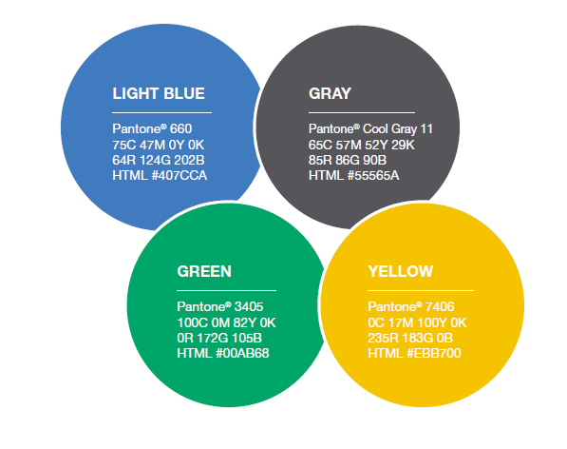
Leo and Lions emblems
16
Notes:
The official colors and logos of the Leo Club Program are light blue, gray, green and yellow. The Leo and Lions emblems are registered trademarks of Lions International. Downloads of the logos are available on the Lions International website at https://www.lionsclubs.org/en/resources-for-members/resource-center/logos-and-emblems.
There are rules on usage for these logos and emblems. Leo logos may be reproduced by the Leo club for usage on stationery, websites and other printed materials. Emblems cannot be used on any item sold to members or the general public for fundraising purposes. It’s important that clubs use the Leo logo properly and follow the Leo brand guidelines.

Slide 17
Important dates
October: Leo Membership Growth Month
December 5: International Leo Day
April: Leo Club Awareness Month
June/July: Lions International Convention
17
Notes:
Throughout the year, many special events take place to celebrate the Leo Club Program and recognize Leos for their contribution to the overall humanitarian work of Lions Clubs International.
In October, Leo clubs host membership drives and individual Leos will receive recognition for inviting youth into the club.
On December 5, the chartering of the very first Leo club in 1957 is commemorated. Known as International Leo Day, December 5 is a day of celebration and promotion of the Leo Club Program.
April is Leo Club Awareness Month, which calls on Leos and Lions to spread the word of Leo clubs and the great services that they provide to their communities and the leadership opportunities available to youth through this program.
And finally, at the end of the fiscal year Leos gather at the International Convention, where they participate in events, seminars, celebrations, and service activities.

Slide 18
Summary
Important points from the module
US$100 annual fee to sponsor a Leo club.
Reporting Leos shows the impact of the Leo club to Lions International; records must be updated yearly with each election.
Leos are covered under Lions’ insurance.
Leo logos are allowed to be used on promotional materials, communications and websites, but can’t be used on items sold for profit.
End of module activity
Discuss topics related to Leo club administration that advisors should be most concerned about. Get advice from current Leo club advisors on best tips for staying on top of administrative tasks.
18
Notes:
Instructor Notes: For the optional end of module activity for Module 3, ask participants to share what topics they’re most concerned about with the new Leo club advisor role. Invite current Leo club advisors to share best practices for working with their club.
Example: Lions who are wondering on how to run a successful officer election can ask current Leo club advisors for their voting operations and platforms.
Estimated Time: 10 minutes

