Slide 1


Certified Guiding
Lion Program
Empowerment is the
key to success!
1

Slide 2

Welcome!
Introduction of participants and special guests
Announcements
Breaks
Meals
Restrooms
For small groups, share expectations of training
2

Slide 3
aa
Certified Guiding Lion Course Objectives
Understand your role as a Guiding Lion
Develop a plan to guide the club to become self-sufficient and strong
Provide tools to help the club officers manage their club
Establish a system to track development over the course of your term
3

Slide 4
Six Elements of Club Success
The club members have conducted service projects that are meaningful to them.
The club has achieved a net growth in membership and involves new members in
activities quickly.
The club communicates effectively with the members and the public.
Club events are held regularly and are meaningful and positive.
Club Officers participate in zone and district leadership training.
The club is in good standing and reports regularly.
4

Slide 5
Course Organization
Section I: Skills of a Successful Guiding Lion
Section II: Getting Off to a Good Start –
Become an Information Expert
Section III: Develop a Club Officer Mentor Team
Section IV: Design Club Officer Training
Section V: Assessing Club Needs
Section VI: Guiding Lion Resources
The Certified Guiding Lion training may be completed through self study or in a classroom setting.
5

Slide 6
Course Materials for Today’s Workshop
  Club Officer Tools
  Standard Club Structure
  Standard Club Constitution & By-Laws
  Club President/First Vice President e-Book
  Club Secretary e-Book
  Club Treasurer e-Book
  Club Membership Chairperson e-Book
  Club Service Chairperson e-Book
  Club Marketing Chairperson Guide
  Club Officer Installation
  Club Quality Tools
  Best Practice for Financial Transparency
  Plan for Your Club’s Success
  Club Quality Initiative
  Your Club, Your Way!
  Club Membership and Project Planning
  New Member Orientation Guide
  Lions Community Needs Assessment
  Making it Happen: Guide to Club Project Development
  New Member Installation
  Participant Guiding Lion Tools
  Charter Night Planning Guide
  Certified Guiding Lion Course Workbook
  Certified Guiding Lion Rebuilding Assessment
  Guiding Lion Assignment Form
6

Slide 7

Certification Process
Complete course materials
Complete test and verification form (signed by DG, D/MD GLT Coordinator)
Send verification form to the District & Club Administration Division:
certifiedguidinglions@lionclubs.org
7

Slide 8
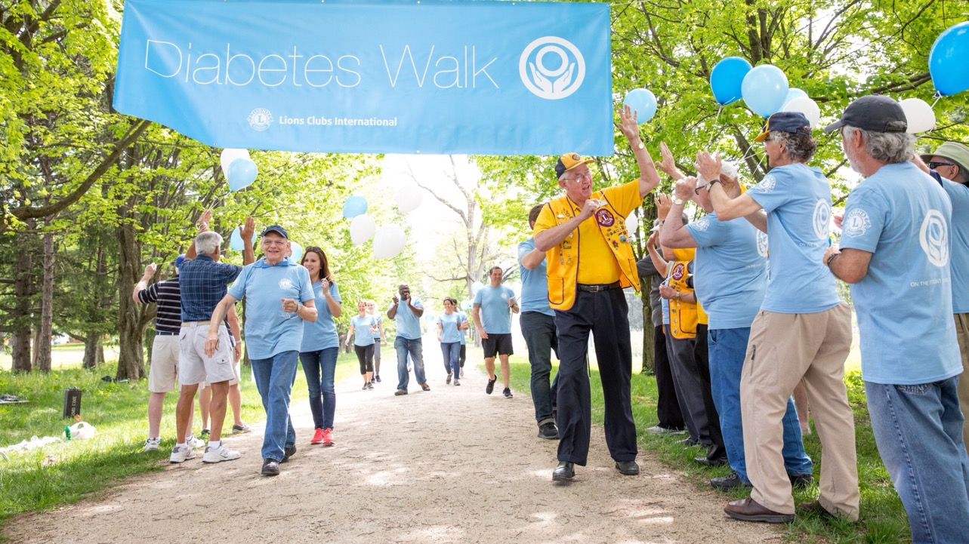
Section I
Skills of a Successful Guiding Lion
Empowerment is the key to success!

Slide 9
Section I: Skills of a Successful Guiding Lion
Administrator
Advisor
Liaison
Enthusiastic
Skilled Presenter
Listener
Technological
Motivator
Trainer
Communicator
Observer
Planner
Team Builder
Building your skills will help you personally and professionally
9

Slide 10
Section I: Skills of a Successful Guiding Lion
The most important skill of a Guiding Lion…
Commitment!!!
The Measure of Success. The ultimate goal for the guiding Lion is to make the club independent and self-reliant. The Guiding Lion is only successful when they are no longer needed by the club.
10

Slide 11

Exercise 1 – Page 7
Self Assessment of Guiding Lion Skills
Summarize the skills that you believe are important to the success of a Guiding Lion.
Which characteristics do you feel you already possess and which ones do you feel you would like to develop further?
How can you improve these skills?
11

Slide 12
Section II
Getting Off to a Good Start
Become an Information Expert!

Slide 13
Section II: Getting Off to a Good Start
Even seasoned
and knowledgeable Lions find it challenging to stay current with the latest policies, support materials and initiatives.
Lions Learning Center
Log into your Lions Portal
Disable pop-up blockers.
Review tutorial of how to set up an account.
Review frequently asked questions.
13

Slide 14
Section II: Getting Off to a Good Start
Look in the Course Catalog to find Club Officer Training
Club Officer Training
DETAILS
Start Course
Club President Responsibilities
DETAILS
Club Treasurer Responsibilities
DETAILS
Start Course
Club Secretary Responsibilities
DETAILS
Start Course
Start Course
14

Slide 15
Exercise 2 – Page 9
Identify Key Concepts of Club Officer Training
After reviewing the courses, determine at least three items or concepts that you believe would be the most valuable to the new club officers.
What is the most important information to share with the club president?
What is the most important information to share with the club secretary?
15

Slide 16
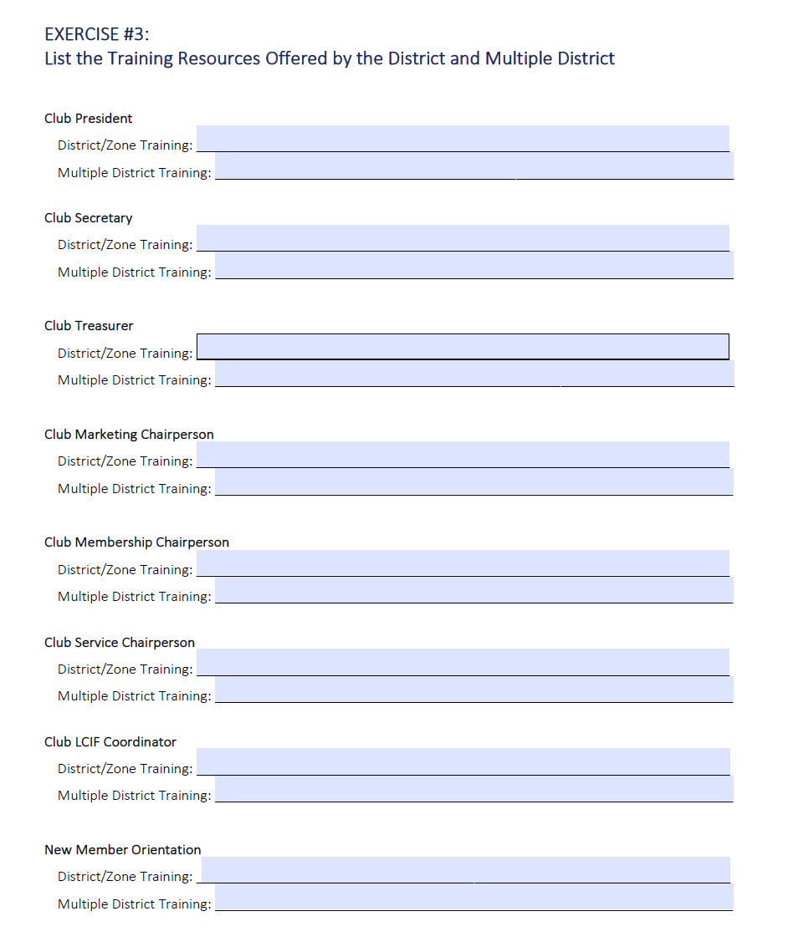
District and
Multiple District Training Resources
Exercise 3 – Page 10
List the training resources available at the district and multiple district level.
16

Slide 17
Section II
Getting Off to a Good Start
Resources for effective club operations
Be the resources that knows the resources

Slide 18

Standard Club Structure
    All Club Officers
    Program Coordinator Lion Tamer (optional)
Branch President Tail Twister (optional)
Safety Officer (optional)
Other elected directors and/or chairpersons
Board of Directors
Club Officers Leading the
Global Action Team
Club Officers
President
(Global Action Team
Chairperson)
Immediate
Past
President
(LCIF
Coordinator)
First
Vice
President
(Leadership
Chairperson)
Membership
Chairperson
Service
Chairperson
Second
Vice
President
Secretary
Treasurer
Marketing
Chairperson
Constitution
& By-Laws
Committee
Information
Technology
Committee
Finance
Committee
Marketing
Committee
Leadership
Committee
Membership
Committee
Service
Committee
18
DA-MCS.EN 4/2022

Slide 19



Standard Club Constitution & By-Laws
Revised Standard Club Constitution and By-Laws
Defines officers, directors and committee chairpersons positions
Committees’ roles
Defines model club structure
19
19

Slide 20
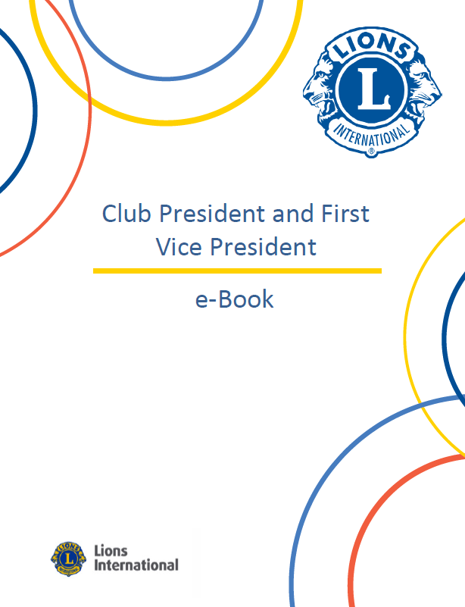
Club Officer e-Books
Club President/Vice President
Club Secretary
Club Treasurer
Club Membership Chairperson
Club Service Chairperson
Club Marketing Chairperson Guide
20

Slide 21

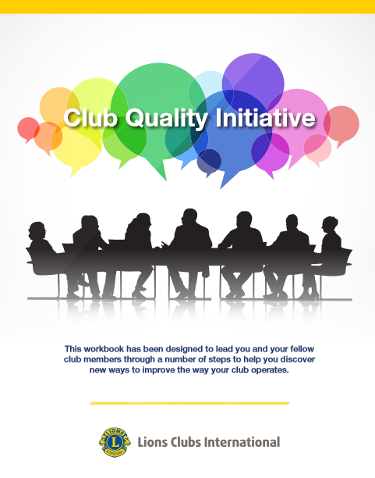
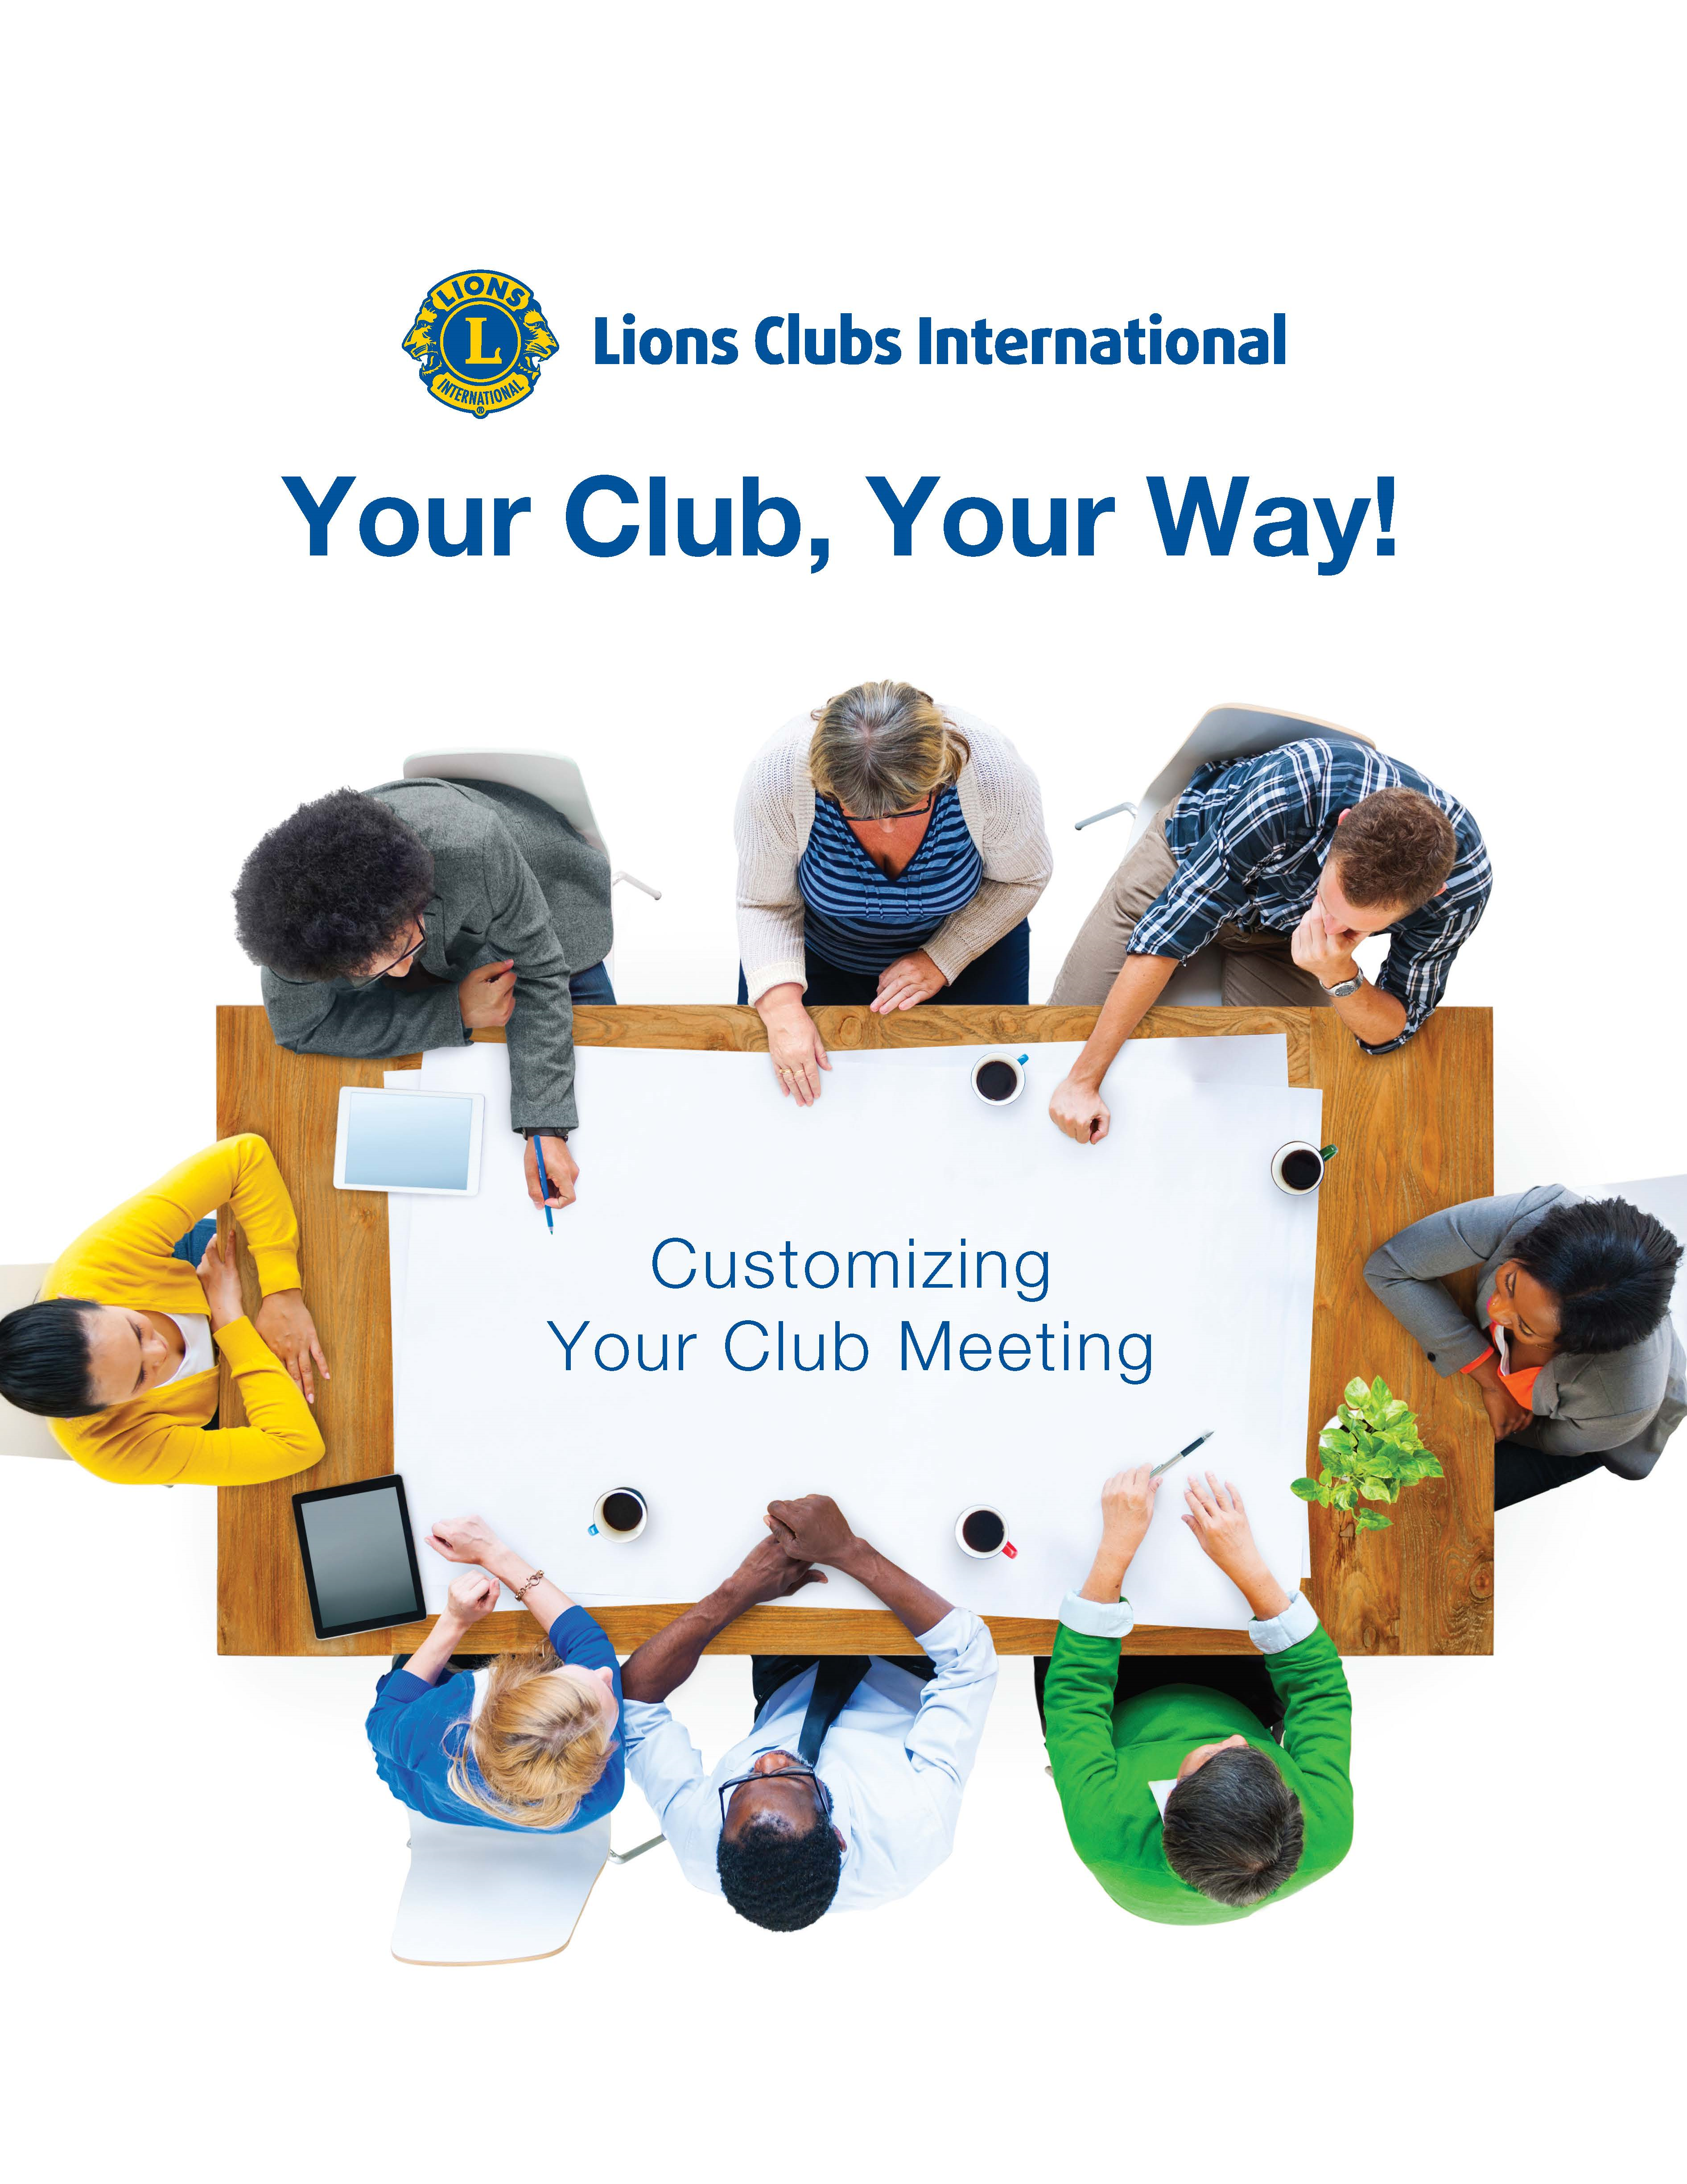
Improving Club Quality Programs
The Big Picture
The Annual Plan
Great Meetings!

Slide 22
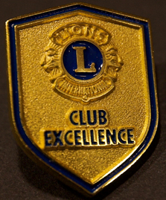
Club Excellence Award
Road Map to Success
Criteria has these areas of focus:
Membership
Service
Leadership & Organizational Excellence
Marketing
This award may be achieved every year – it is a great goal for every club to set!
22
Notes:
Donna

Slide 23
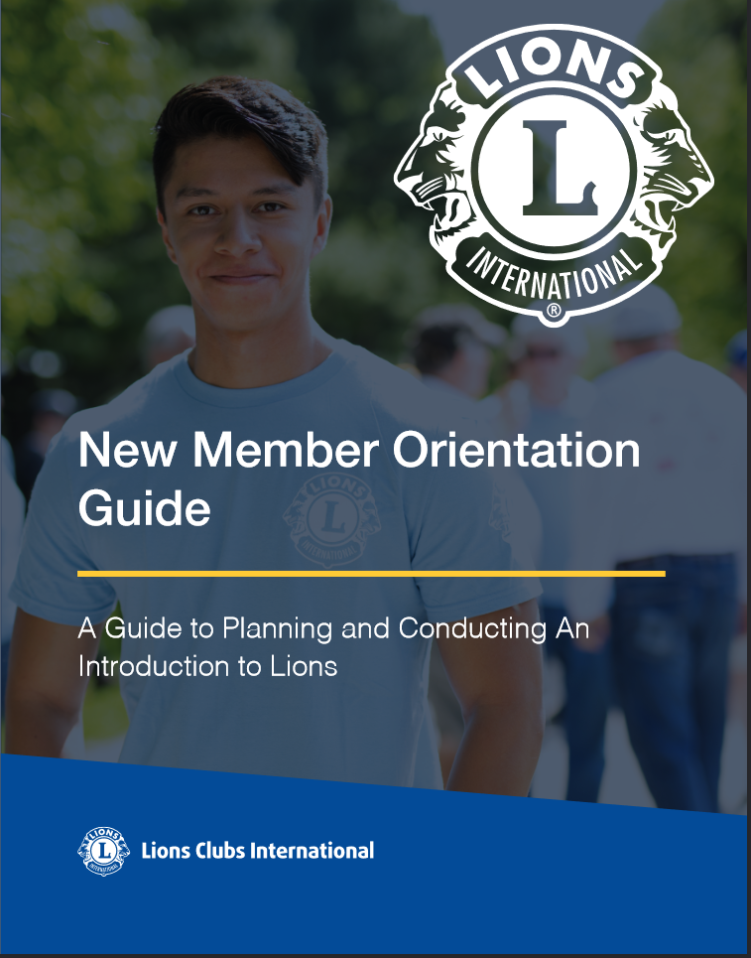
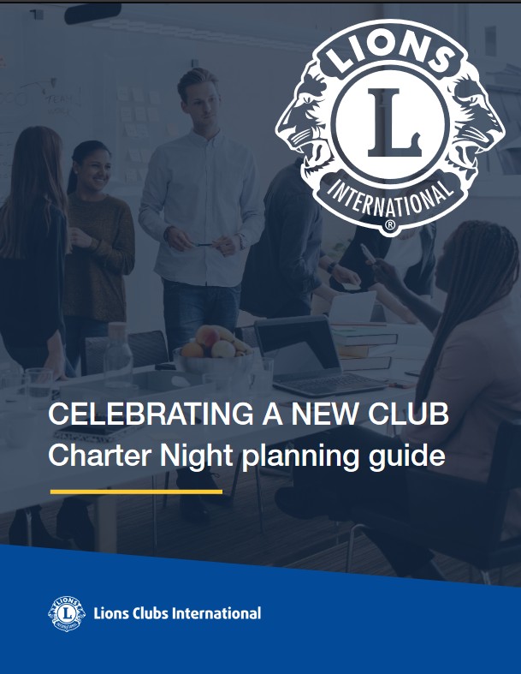
New Members and Charter Night

Slide 24
Exercise 4 – Page 11
Resources for
Club Operations
Determine the Value of the Club Management Resources webpage in the Resource Center
What were the top three items that you feel are useful to promote excellence in club management?
24

Slide 25
Lions Portal
Lions Portal is the place for club officers to manage their clubs efficiently
Manage club roster changes; additions, drops, transfers
Easily update member contact information
Create mailing lists for communicating and invoicing dues
Print club rosters
View and
pay club statements
Report
service activities thru The Lions Portal
25

Slide 26
Exercise 5 – Page 12
Lions Portal
Get Familiar with the Lions Portal
Review the Frequently Asked Questions
Registration
Managing your Club Officers
Managing your Club Roster
Managing your club’s Financial Statement
26

Slide 27
Section III
Develop a Club Officer Mentor Team

Slide 28

Section III: Develop a Club Officer Mentor Team
Expand the support for the club by establishing
a Club Officer Mentor Team
to ensure the club has the support and guidance needed to
be successful
28

Slide 29
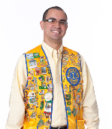
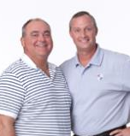



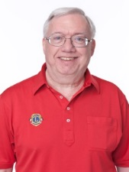
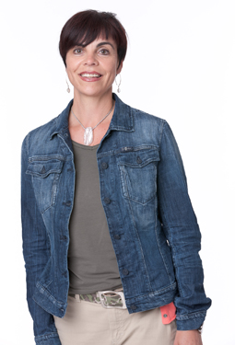



Section III: Develop a Club Officer Mentor Team
Zone Chairperson
Includes the club officers
in the training and
events hosted
by the zone.
Two Certified Guiding Lions
Providing two key leaders allows them to share the work load.
One Guiding Lion should
attend each meeting and
be available for questions.
Club
District Governor Team
Provides district-hosted
training at the earliest
opportunity available.
Club Officer Mentors
Matching the officers with
knowledgeable and experienced
club officers from another club will provide very practical support. Be aware of the latest tools and information.
29

Slide 30
Exercise 6 – Page 14-15
Develop a Club Officer Mentor Team
Identify the individuals who are qualified to serve in the following roles
District Support
(page 14)
Club Officer Mentors
(page 15)
30

Slide 31
Take a Break!
31

Slide 32
Section IV
Develop Club Officer Training

Slide 33
Section IV: Design Club
Officer Training Sessions
Training Session One: Getting Started!
Training Session Two: Club Operations
Training Session Three: Hosting Productive and Meaningful Club Events
Training Session Four: The Importance of Recruitment and Retention
Training Session Five: Planning for the Future and Achieving Excellence
Each training session should last approximately 60 minutes.
33

Slide 34
Training Session One
Getting Started!
Introduction to Lions Clubs International and
Lions Clubs International Foundation
Club Responsibilities
Charter Night Ceremony
Initial meeting with Club Officer Mentor Team
34

Slide 35
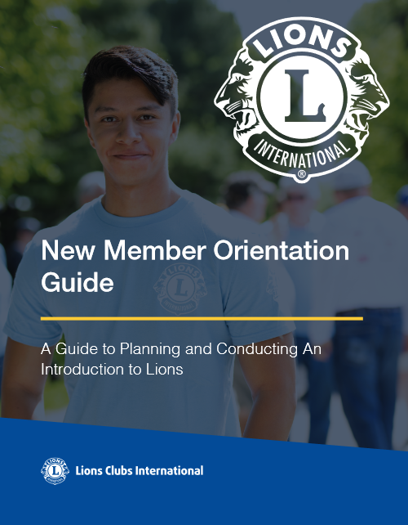
Introduction to
Lions Clubs International
Resource: New Member Orientation Guide
Who Lions Are
History of Your Club
Organizational Structure
- District and Multiple District
History of Lions Clubs International
Lions International Structure and Organization
35
35

Slide 36

Introduction to Lions Clubs International Foundation
The mission of LCIF: To empower Lions clubs, volunteers, and partners to improve health and well-being, strengthen communities, and support those in need through humanitarian services and grants that impact lives globally, and encourage peace and international understanding.
LCIF: Stories of Pride – Share stories of service
Grant Toolkit: Offers more information about the types of grants LCIF offers and resources to find which grant is right for a club, district, or multiple district for now or in the future.
36
Notes:
LCIF is your foundation. LCIF is here to empower service.
Manages Grants:
Humanitarian Initiatives
Global Health Initiatives
New & Emerging Initiatives
Invite your District LCIF Coordinator to a meeting to educate Lions about their foundation.

Slide 37
Understanding Club Responsibilities
Revised Standard Club Constitution and By-Laws
Contains the primary governing guidelines for the club and other helpful information such as:
Mission statement, slogan, motto, purpose
as well as objects and ethics
Type of Memberships
Fees and Dues
Managing Funds
Meetings and Quorums
Elections
37
37

Slide 38
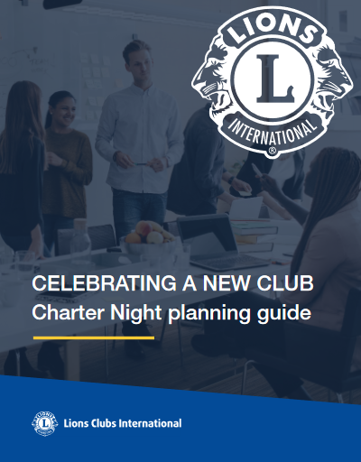
Charter Night
Resource: Charter Night Planning Guide
Plan the event with the Charter Night checklist
Introduction Etiquette
Travel Arrangements
The sponsoring club and district should offer assistance to help the new club organize the event.
38
38

Slide 39





Initial Meeting with the Club Officer Mentor Team
Introduce the Club Officers to their Club Officer Mentors.
Each officer should be assigned a Mentor who is currently fulfilling the same officer role.
The Mentor should be experienced, available and able to communicate/train the new officer effectively.
Provide each pair a copy of their respective checklist to review (See Pages 28 – 34).
39

Slide 40
Exercise 7 – Page 18
Key Objectives of Training Session One
Training Session One is an overview of Lions Clubs International
Why is that important?
What do you consider the three most important objectives of the first training session?
40

Slide 41
Training Session Two
Club Operations
Review the officer roles and initial meeting with Club Officer Mentor Team
Stress the concepts of planning, teamwork and communication to the new officers.
41

Slide 42
Club Officer Responsibilities
Resource: Club Officer e-Books
Highlights the important role of each club officer.
Note any local adaptations when appropriate.
Webpages designed for each specific officer.
Each Mentor should cover the details specific to their position on an on-going basis.
42
42

Slide 43
Best Practice for Financial Transparency
Resource: Best Practice for Financial Transparency Guide
Financial
Reporting
Guidelines for
Reimbursement
Bank Account
Management
Year-end
audits and
reviews
43

Slide 44
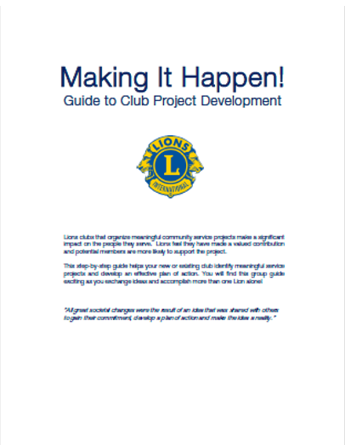
Planning Service
Activities
Resource: Making It Happen!
Step 1: Make a List of Possible Programs
Step 2: Appoint Task Forces
Step 3: Conduct Research
Step 4: Write a Plan
Step 5: Implement the Plan
Always remember that club projects are a club decision.
44
44

Slide 45
Exercise 8 – Page 20
Key Objectives of Training Session Two
Training Session Two is more focused on the roles and responsibilities of the club
What do you consider the three most important objectives of the second training session?
45

Slide 46
Training Session Three
Hosting Productive and Meaningful Meetings
Initial meeting with Club Officer Mentor Team
Stress the concepts of planning, teamwork and communication to the new officers
46

Slide 47
Hosting Productive and Meaningful Meetings
To encourage attendance, be sure these items meet the needs of your members:
The meeting date, time and location
Send invitations announcing activities
Make personal calls to invite current and potential members
By inviting interesting and relevant speakers
Involve members in projects right away.
47

Slide 48
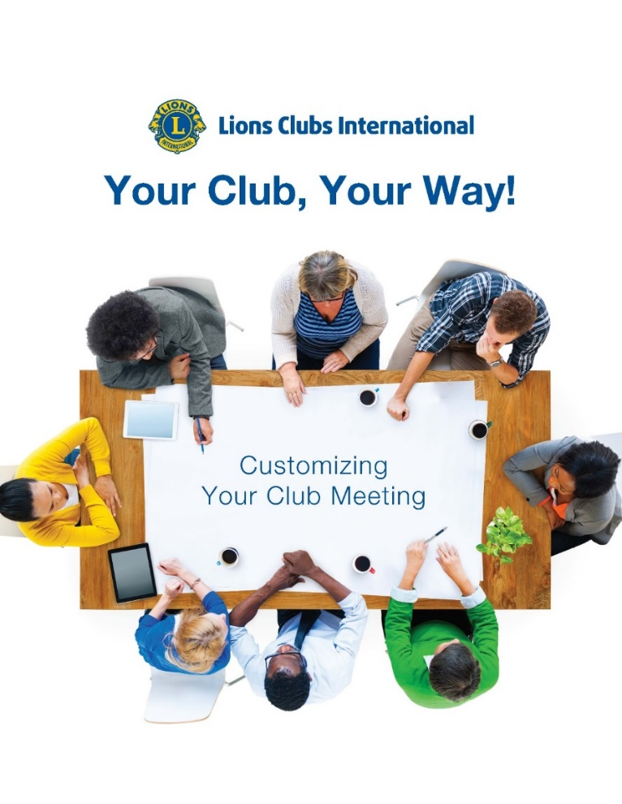
How to Improve Overall Meetings
Resource: Your Club, Your Way!
Customizing Your Meeting
Reinventing Your General Meeting
Phasing in Change
Key to Meeting Success
Ideas to Increase Involvement
Club Meeting Program Ideas
Promoting Your Meetings and Events to the Public
48
48

Slide 49
Exercise 9 – Page 22
Productive and Meaningful Meetings
Training Session Three is focused on Productive and Meaningful Meetings
What elements are key to a positive and productive meeting?
What can be done to increase attendance?
49

Slide 50
Training Session Four
The Importance of Recruitment and Retention
This section underscores the importance
of continued club growth and provides an opportunity to check the progress
made by the Club Officer Mentor Team.
50

Slide 51
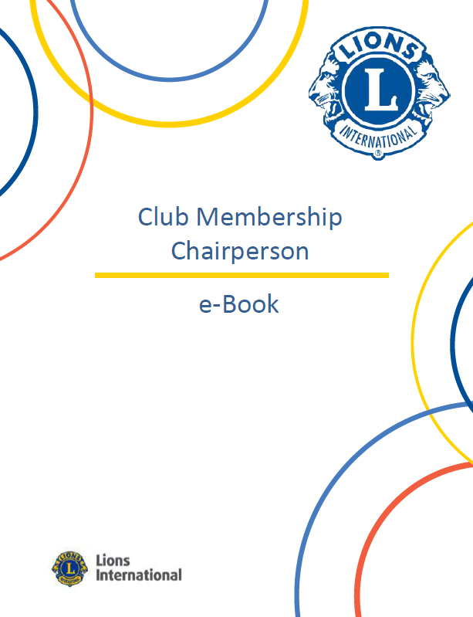
The Importance of Recruitment and Retention
Resource: Club Membership Chairperson e-Book
Recruiting New Members
Sponsor’s Responsibilities
Induction Ceremony
New Member Orientation
Membership Awards
Involvement
51
51

Slide 52
Exercise 10 – Page 24
Creating a
Membership Plan
Initiate an ongoing membership recruiting plan and confirm club officer development
Describe successful ideas for
recruiting new members
that could be shared
with new club officers.
52

Slide 53
Training Session Five
Planning for the Future
and Achieving Excellence
Review the need for ongoing planning and development.
This should take place after the club has operated
for a few months and before new club officers
take office for the next fiscal year.
Encourage planning and continued club development
53

Slide 54

Planning for the Future and Achieving Club Excellence
Resource: Plan for Your Club’s Success
(Global Membership Approach)
Discover your Club’s Strengths
SWOT Analysis
Smart Goals
Action Plans to Build a Team, Build a Vision, Build a Plan & Build Success
54
54

Slide 55
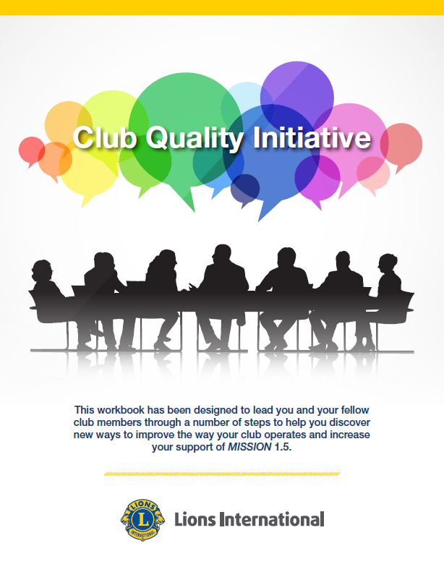
Planning for the Future and Achieving Club Excellence
Resource: Club Quality Initiative
This process takes approximately four hours
or can be conducted over a series of meetings.
  Step 1: Understanding the Process
  Step 2: Determine the need for change Using
  Critical Assessments
  Step 3: Determine the Need for Change
  Step 4: Develop Plans
  Step 5: Implement and Sustain Change
55
55

Slide 56
Planning for the Future and Achieving Club Excellence
Resource: Club Excellence Award
Based on outstanding achievements in:
  Membership
  Service
  Leadership & Organizational Excellence
  Marketing
56
56

Slide 57
Section V
Assessing Club Needs

Slide 58
Section V:
Assessing Club Needs
Understanding Club Responsibilities
Club Management
Service Activities
Marketing
Lions Clubs International Foundation
Meetings
Membership Growth
District Support
Further Leadership Development
Using the Club Assessment
(pages 35 – 39) determine the club’s needs and areas for development.
58

Slide 59
Section VI
Guiding Lion Resources

Slide 60

Assess your club’s health every month
Net membership
Resource: Club Health Assessment
Provides a quick look at:
Net membership Y-T-D
Service reporting
Officer rotation
Membership reporting history
Current club status
Service Reporting
Reporting History
Officer Rotation
Club Status
60

Slide 61
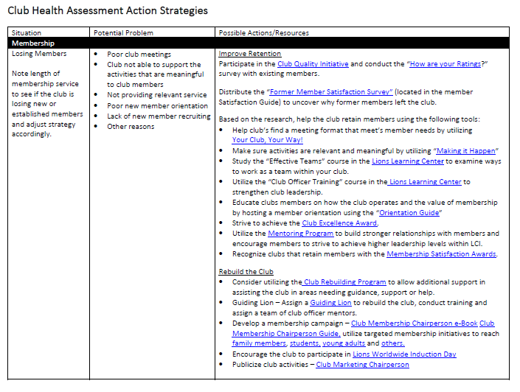
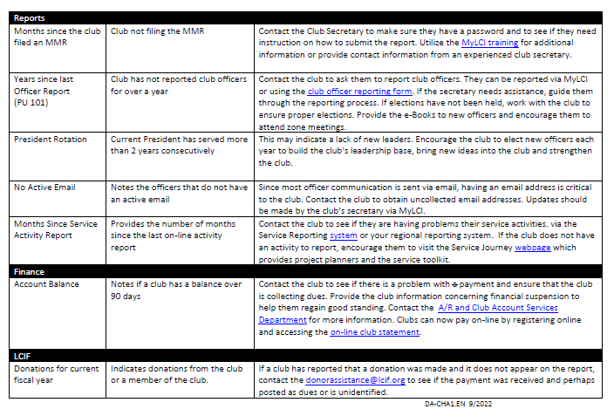
Club Health Assessment Strategies
61

Slide 62
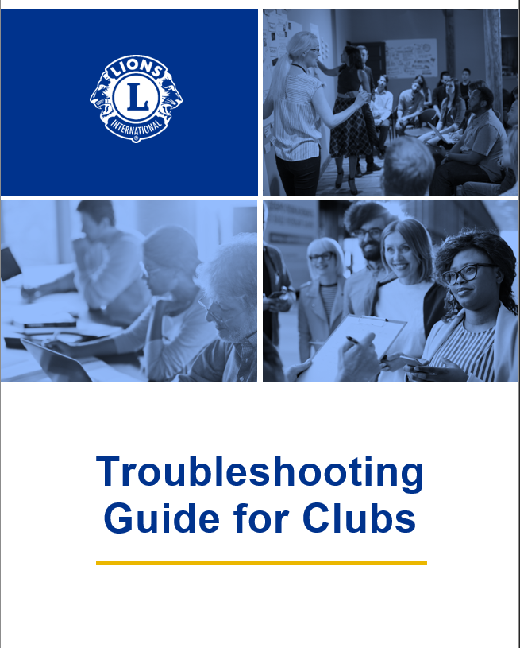
Troubleshooting Guide for Clubs
62

Slide 63
Section VI: Guiding Lion Resources
Quarterly Report
Final Report
Guiding Lion Support
Provides valuable information to ensure continued development.
At the close of a two-year assignment to a club, submit the Final Report
(page 46).
Lions International is available for assistance by phone:
(630) 468-6810
or email: certifiedguidinglions@lionsclubs.org
63

Slide 64
Review, Test and Questions

Slide 65
Review and Tests
Test for Certified Guiding Lion
To be completed upon the conclusion of the Lion taking the course (page 42-43).
Certified Guiding Lion
Completion Verification Form
Complete this form and the test. Meet with your district governor, district GLT coordinator or multiple district GLT coordinator to review your answers and discuss areas of further development. (page 44).
65

Slide 66

Presidential Certified Guiding Lion Award
Any Questions?
Thank You!
66

