Slide 1
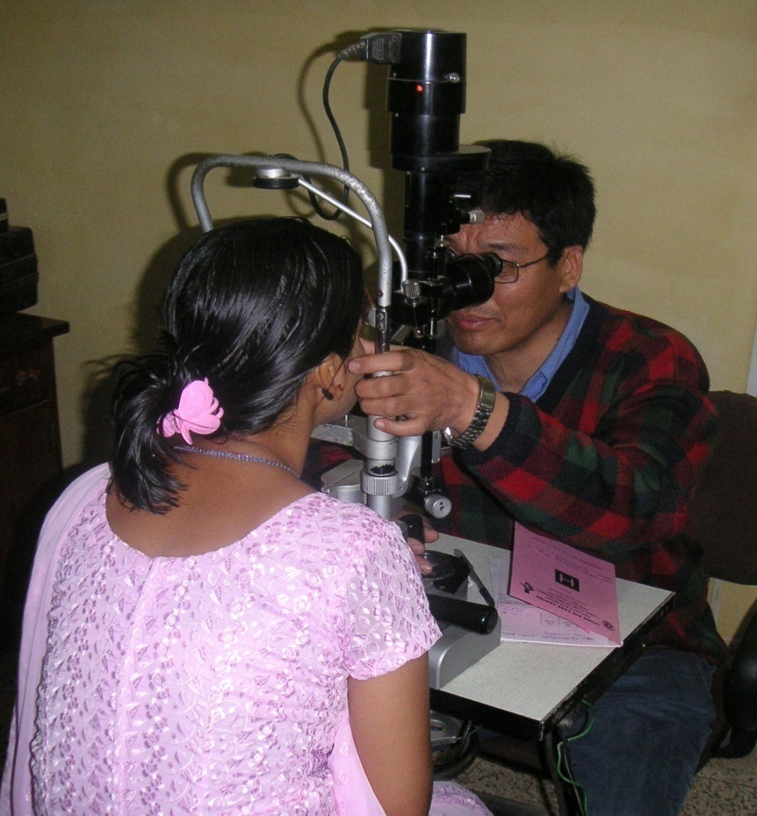


Slide 2
LCIF Mission
To support the efforts of Lions clubs worldwide in serving their local communities and the world community as they carry out essential humanitarian service projects.

Slide 3
LCIF’s 4 Areas of Focus
Preserving Sight
Supporting Youth
Providing Disaster Relief
Meeting Humanitarian Needs

Slide 4
Session Objectives
Promote awareness and support through collaboration by district leadership
Importance of setting district goals for LCIF fundraising

Slide 5
LCIF District Coordinator
  Oversee the implementation of district LCIF fundraising strategies
  Educate Lions about the mission and impact of LCIF
  Encourage the support of LCIF through all aspects of district fundraising

Slide 6
Promote Awareness and Support
Support education of Lions about LCIF
Encourage support through financial contributions

Slide 7

Identify Visitation Opportunities
Identify clubs that would benefit from a visit by the LCIF district coordinator

Slide 8
Impact of Contributions
Bronze Contributing Member (US$20)
  Treat 20 people for river blindness
Silver Contributing Member (US$50)
  Provide Lions Quest materials for a classroom of students

Slide 9
Impact of Contributions
Gold Contributing Member (US$100)
  Provide five families with basic immediate needs including water, food, clothing & medicine following a disaster
Melvin Jones Fellow (US$1000)
  Train two eye care professionals in developing countries to perform cataract surgery

Slide 10
Recognition
Recognize contributions at a district convention
  Top Donating Clubs
  Top Individual Donors
  MJF Recipients

Slide 11
LCIF Goal-Setting Meeting
Encourage individual members to donate
Increase the number of clubs that donate
Encourage clubs to continue donations

Slide 12
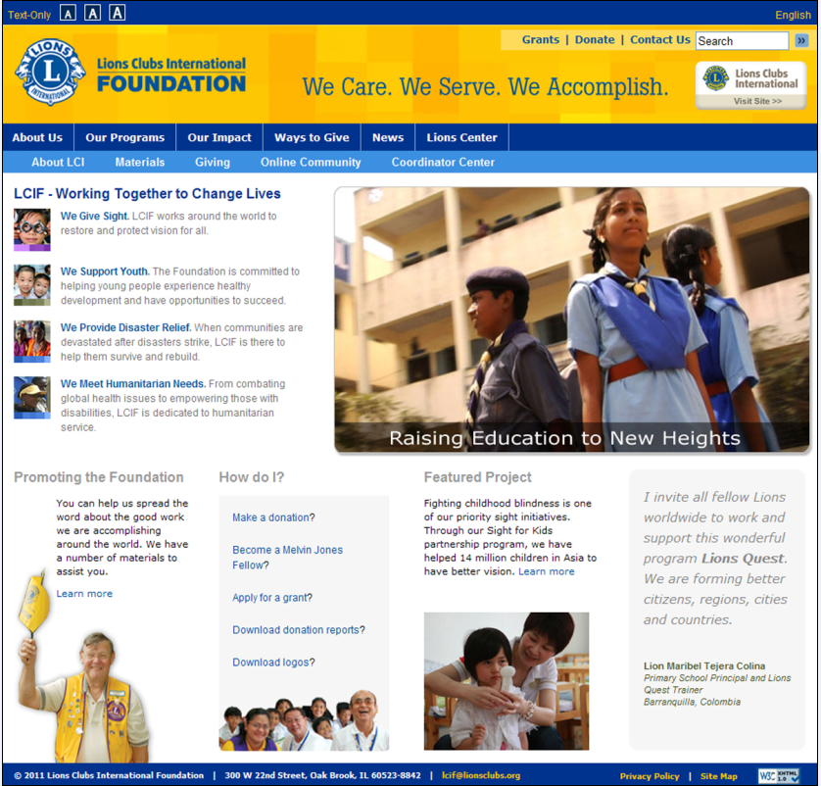
For more information go to: www.lcif.org

Slide 13
Objectives Met
Discussed techniques to promote awareness of LCIF throughout your District
Understand the role of the LCIF Coordinator and how to support them
The importance of setting fundraising goals for LCIF

Slide 14
As members we all belong to Lions Clubs International, but Lions Clubs International Foundation belongs to us.

