Slide 1

MISSION BRIEF
Notes:
Thank you for taking some time out to learn about our new global membership initiative.
This is a great opportunity to learn more about what we’re trying to achieve, why we’re trying to achieve it, and why you are so important to success.

Slide 2

OVERVIEW
Giving more to a world in need.
2
2
Notes:
Before we talk about the strategy for Mission 1.5, let’s talk about why we’re undertaking this initiative.
As Lions, we are serving a world in need.
We see it every day, everywhere we serve.
But we must continue to find ways to give even more to the communities we support and the world we share.

Slide 3

We live and
grow to serve.
3
3
Notes:
Our motto is We Serve, and nobody serves like a Lion.
We joined a Lions club and this incredible organization to put our kindness into action. And together, we are making a difference in our communities.
But to make an even greater impact, we have to grow.

Slide 4
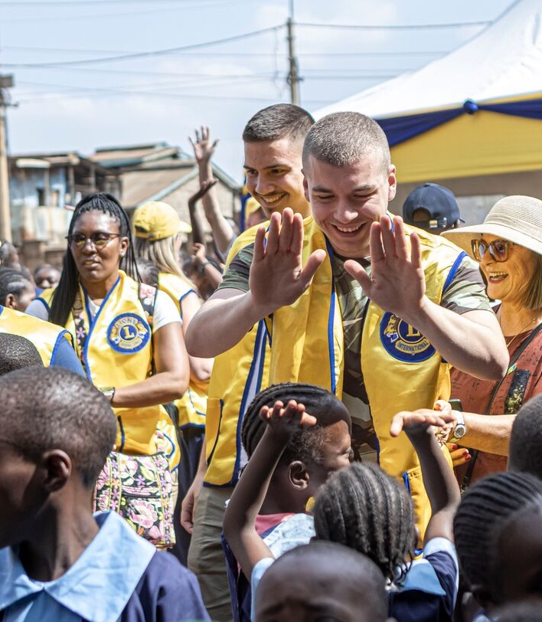
A Lion lives
inside us all
Each Lion matters to the people who depend on us. And every club is changing their community, making it a stronger, healthier and kinder place for all.
For more than a century, Lions have been there for our communities,
giving, supporting and serving.
To meet the growing needs in our communities, we need to invite new members to serve with us. To make sure we’re always there and ready to serve, we need to grow.
That’s why we’re launching MISSION 1.5.
4
Notes:
We matter to the communities we serve. And we matter to the world.
For more than a century, we have been there, giving, supporting and serving.
But the needs of our communities and the world are growing. So we need to grow too.
That’s why we’re launching MISSION 1.5.

Slide 5
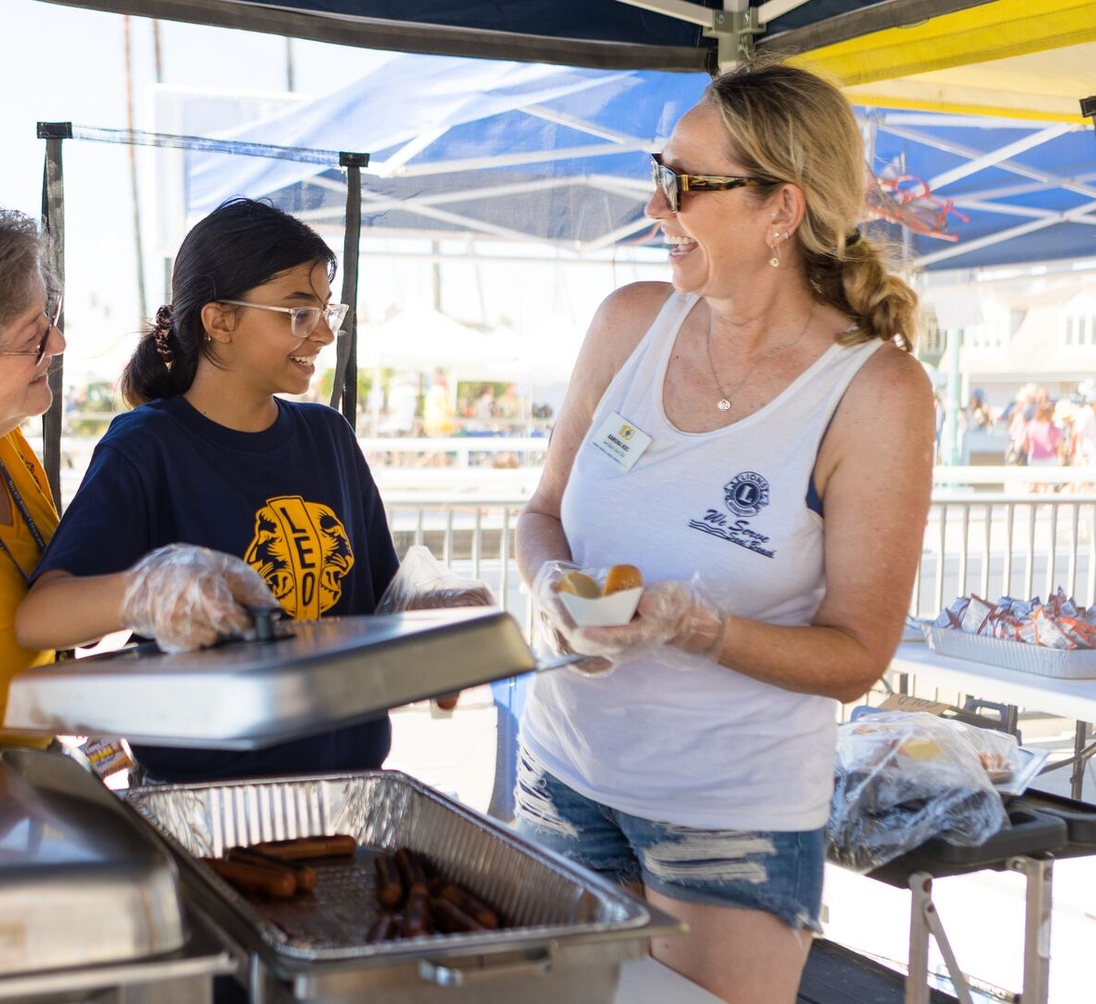
The biggest changes begin
with you.
MISSION 1.5 is the drive to reach 1.5 million members worldwide on July 1, 2027, so we can better meet the growing needs of our communities and serve more people than ever before.
The more we grow, the more we can give.
5
Notes:
MISSION 1.5 is our drive to reach 1.5 million members worldwide on July 1, 2027.
This will help us meet those growing needs and serve more people than ever before.
Because the more we grow, the more we can give.

Slide 6

The world needs
LIONS
like never before.
6
6
Notes:
It’s true. The world needs Lions like never before.
We only have to look around our communities and read the news to know that needs are growing, and that Lions are more important now than ever.
Let’s hear from some Lions on why it’s so important to grow.

Slide 7

7
7
Notes:
[play video]

Slide 8
So, why grow?
What are the opportunities for Lions?
8
8
Notes:
We’ve talked about the need to grow.
But it’s important that we also talk about the opportunities and benefits to Lions when we grow.

Slide 9
Key Benefits
We do not grow together by acting alone.
Increased capacity to serve
Inviting new members to your club will increase your capacity to serve your community and the people who depend on you.
Greater diversity and inclusion
Lions not only serve the world—we represent the world we serve. And as our communities continue to evolve and diversify, so must our membership.
Increased advocacy
for change
Every new Lion brings a fresh set of ideas and an extra pair of hands to our service. As you grow, you increase your local impact and expand your influence in the community, and our global impact grows.
Increased member benefits
Lions do more than serve together—we grow together. So club growth, on every level, all around the world, benefits us all.
Stronger at every level of Lions
Growing our membership makes Lions stronger. With more members, our associations, districts and clubs will have more resources to fulfill our mission of service, at home and around the world.
9
Notes:
When our clubs and districts grow, our Lions benefit. And our communities do too.
We increase the service we do and the impact we can make.
We create opportunities for a more diverse membership so we can better serve our communities—and better represent our communities.
We increase the voice and the influence we have in our local and global communities.
We learn from, and grow with, the new members in our clubs.
And we get stronger at every level of Lions.

Slide 10
We’re doing it.
Together.
10
10
Notes:
So how do we do it?
We do it together, like always.
Because we know that we are stronger, and better, when we work together.

Slide 11
MISSION BLUEPRINT
You are part of the plan.
11
11
Notes:
We’ve talked about why the mission is so important.
Now let’s spend some time talking about how we can successfully implement this global growth initiative here.

Slide 12
Operational Approach
Customizable by region
Establishes networked collaboration
Incentivizes top districts and clubs
Excites the entire Lions world
12
Notes:
To be successful, we know we have to:
Make sure the initiative is regionalized so it works for us and our Lions.
Collaborate and use the networks that we have built and that are in place around the world.
Incentivize top performers and all Lions to get involved and be part of our success.
Excite the Lions world—everyone needs to know what this is and how we will all benefit.

Slide 13
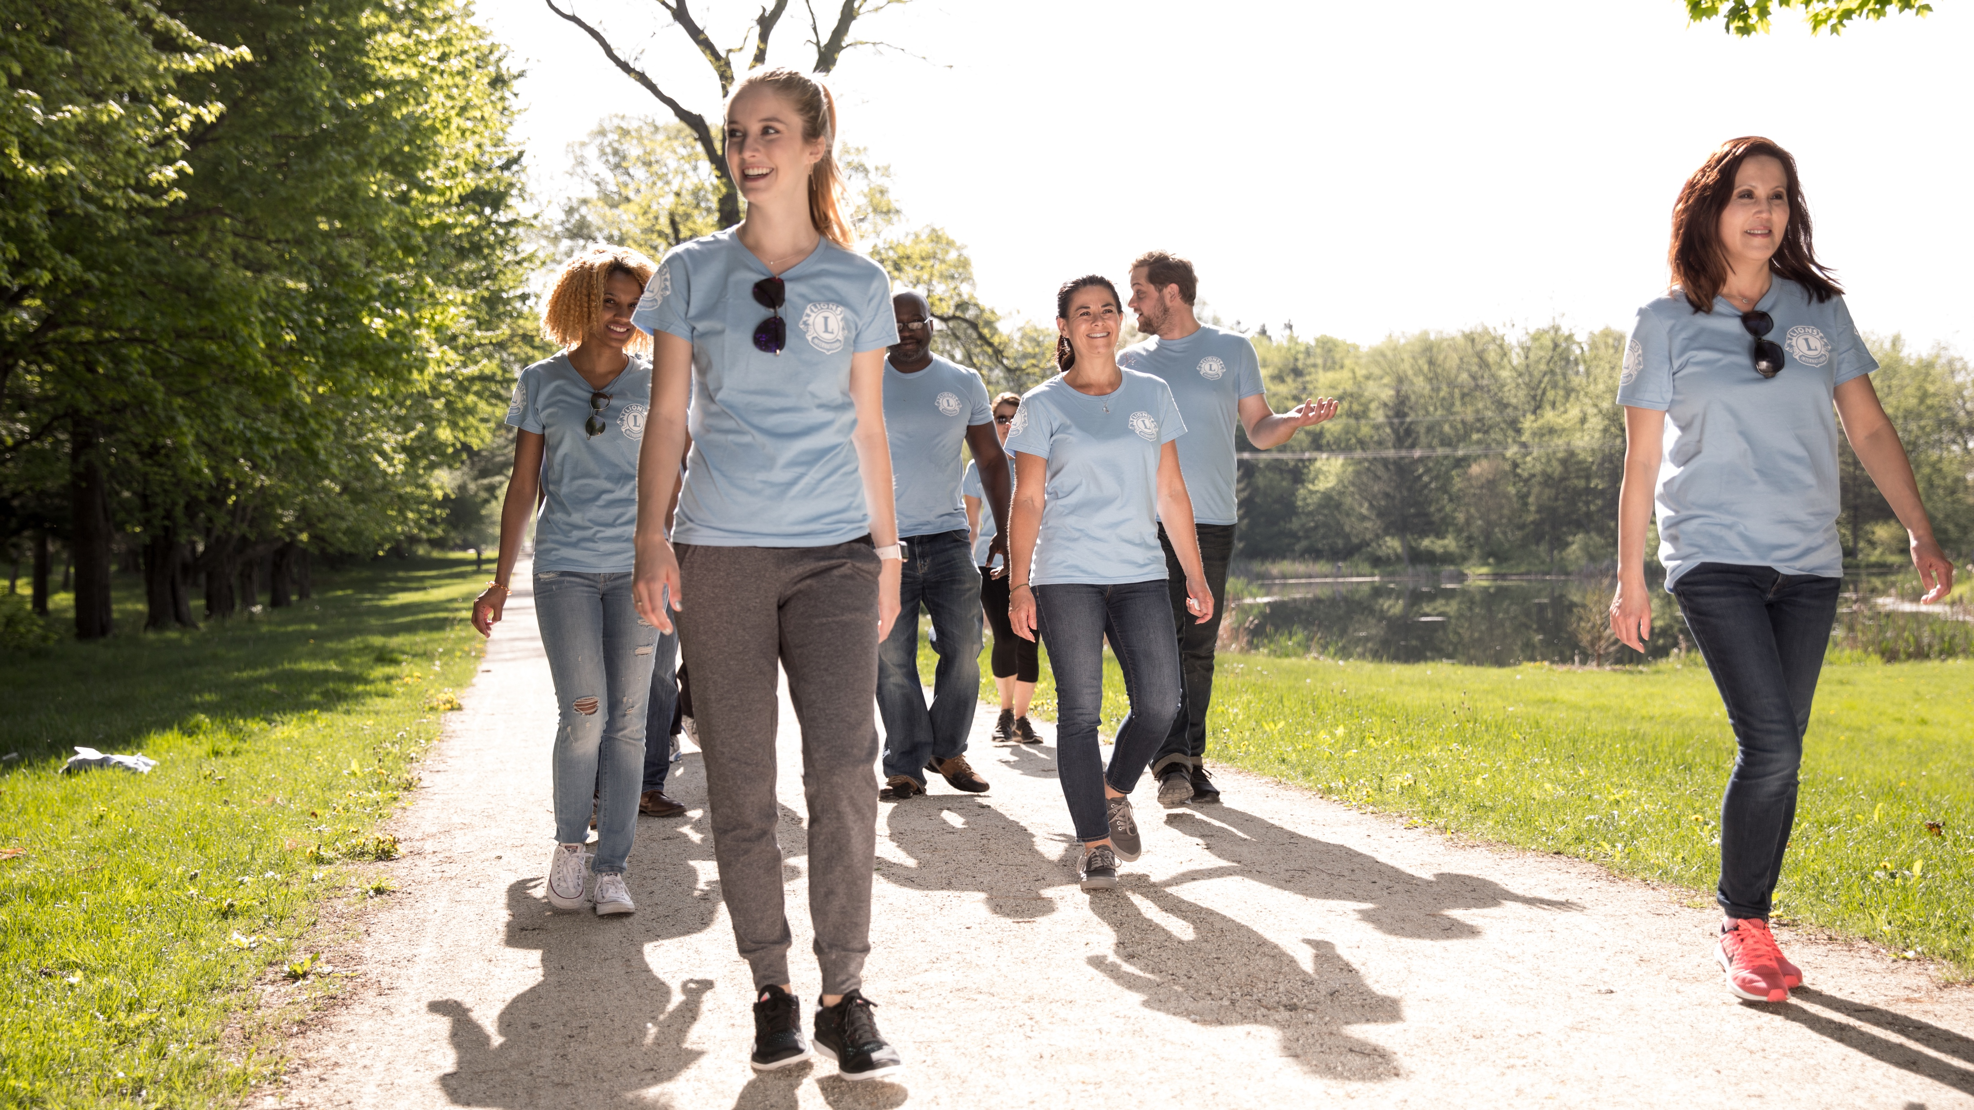
Roles and Responsibilities
A mission led at the highest levels of Lions
International leaders are committed and accountable for success.
ROLES |  | RESPONSIBILITIES
Steering Committee |  | Provide executive oversight for MISSION 1.5
Executive Officers |  | Serve on Steering Committee and provide strategic management of Global Action Team
International Directors |  | Drive global engagement and provide strategic support to CA, MD and district teams
GAT CA/Area Leaders |  | Provide strategic support to CA, MD and district teams
13
Notes:
It is important to point out that this initiative is being undertaken with the full support of our international leaders, including our executive officers.
Leaders at every level are invested and accountable for success.
Here is an overview of some key roles that our leaders will be taking on.

Slide 14
Roles and Responsibilities
A mission powered by the GAT
The Global Action Team is leading the charge at the club and district level.
Charter a club
Sponsor new members
Train/track success of districts
Provide resources and support
Accountable for achieving CA/Area targets
GAT CA
& Area
Leaders
District Leaders
FVDG/DGE training
and support
Participate in leadership engagements
Mentor and promote mission
Multiple District Leaders
Charter a club
Sponsor new members
Support district training
Provide resources and
track success
Accountable for MD targets
Inspire and promote membership growth
Facilitate and support the FVDG/DGE Training Program
Actively participate in leadership engagements
Be a MISSION 1.5 mentor and advocate for membership growth success
Group Leaders
14
Notes:
MISSION 1.5 will be powered by the Global Action Team.
The GAT will be driving engagement at the club and district level, which is critical to what we’re trying to achieve.
I want you to take a look at the roles and responsibilities and how key leaders will be leading and contributing to success.
As you can see, everyone has a part to play.

Slide 15
MISSION 1.5 Strategy
Understand MISSION 1.5
Make a personal commitment to MISSION 1.5
Understand MISSION 1.5 roles and responsibilities
Communicate and collaborate at all levels
Lead By Example
Sponsor at least 1 new member and charter
1 new club
Motivate, inspire and support Lions
Adjust plans when needed
Be Accountable
Own the success of MISSION 1.5
Provide reports and identify successes
and challenges
Achieve target goals
Take Action
Ensure MISSION 1.5 promotions, trainings and plans are implemented
Review reports and provide strategic guidance
Ensure support at all levels benefits new and existing clubs
15
Notes:
Let’s talk about some of the key strategies that will help us achieve our MISSION 1.5 goal.
You need to understand MISSION 1.5, promote it, and make a real commitment to success.
We all need to lead by example, and that means we have to take a personal role in starting clubs and growing our membership.
We all have to be accountable for our roles, our targets and our success.
And we need to take action to make sure Lions and leaders are trained, that plans are implemented and reports are monitored so we can provide the support that’s needed.

Slide 16
6 Steps To Success
To be adapted based on regional needs
Refine existing programs and resources to maximize membership growth.
Incorporate member feedback and knowledge to ensure ownership, buy-in, and optimize results.
Attract service-minded individuals to the Lions brand.
Ensure every Lion knows how to recruit a member and every leader knows how to charter a club.
Measure what matters and use recognition to drive action.
Improve leadership quality and effectiveness.
16
Notes:
So what are some of the keys to success?
Let’s use existing programs and tools that work, and refine them as needed.
Let’s use feedback to help adjust plans and approach.
Let’s all promote and recruit so we can bring more people into our service.
Let’s make sure every Lion is ready to recruit and that leaders know how to charter new clubs.
Use data to guide our approach, and let’s recognize the Lions who are helping us achieve success.
And finally, let’s continue to focus on developing great leaders who can help us accomplish our goals.

Slide 17

Working Together Works
Executive Leadership defines objectives and determines strategy.
Lions International provides resources and support.
Districts and clubs execute plans developed by leadership.
International Leadership develops targets and goals
MISSION 1.5
GOAL
ACHIEVED!
17
Notes:
We’ve talked about roles and strategies, but let’s take a look at how each level of Lions plays a role in achieving our MISSION 1.5 goal.
Executive leadership defines objectives and determines strategies.
International leadership develops targets and goals for each region of the world.
Lions International provides support and resources.
District and clubs execute the plans developed by leadership.

Slide 18
MISSION OBJECTIVE
1.5 million Lions on July 1, 2027.
18
18
Notes:
Our goal is to achieve 1.5 million members by 2027.
That will require the commitment of every leader and every Lion.
And it will also require that we grow at every level of Lions.

Slide 19

Membership
Goal and Objectives
Lions Clubs International will reach 1.5 million members worldwide on July 1, 2027.
All districts will add new clubs.
All clubs will induct new members.
All CAs will achieve positive net growth.
Districts should incorporate regional strategies to attract a diverse membership, including women and young Lions.
19
Notes:
Every district will need to add new clubs.
Every club will need to add new members.
And every constitutional area will need to achieve positive net growth.
To be successful, we will need to focus on attracting a more diverse membership, including women and younger Lions who can carry our mission of service into the future.
Like we talked about, MISSION 1.5 will make us stronger at every level of Lions.

Slide 20
2023–2024 Targets
Global Target
CA XX Target
xxx new members
xxx new clubs xxx net gain
xxx new members
xxx new clubs xxx net gain
Goals are based on July 1 – June 30.
20
20
Notes:
To reach our overall goal, we will need to meet yearly targets that will put us on track for reaching 1.5 million members in 2027.
These are our global targets for the year.
And these are our targets for our constitutional area.

Slide 21
THE MEANS TO SUCCESS
Lean on what works.
21
21
Notes:
We’ve talked a lot about success.
One of the keys to achieving it is to use what works for us and our Lions.

Slide 22
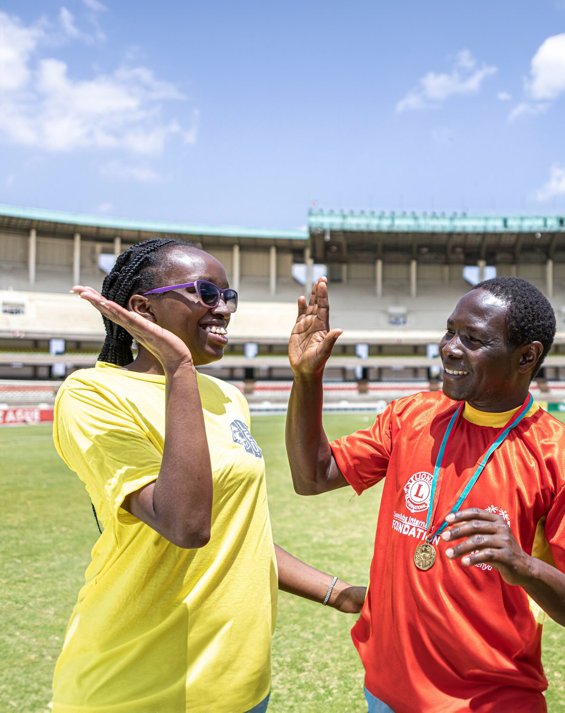
Training and Development
Training is an important part of growing our membership, particularly for Lions in key leadership roles.
Lions are encouraged to take advantage of
available training opportunities such as:
Updated GAT CA/A onboarding deck
Regional meetings
eLearning
In-person training by CAL/AL
Regionalized training by field specialists
22
Notes:
We know that preparing our leadership is critical to everything we do as Lions, including membership.
Let’s make sure that leaders are using all of the training opportunities and resources that are available.
Training will help ensure that we have the right skills to lead, and grow, our membership.

Slide 23
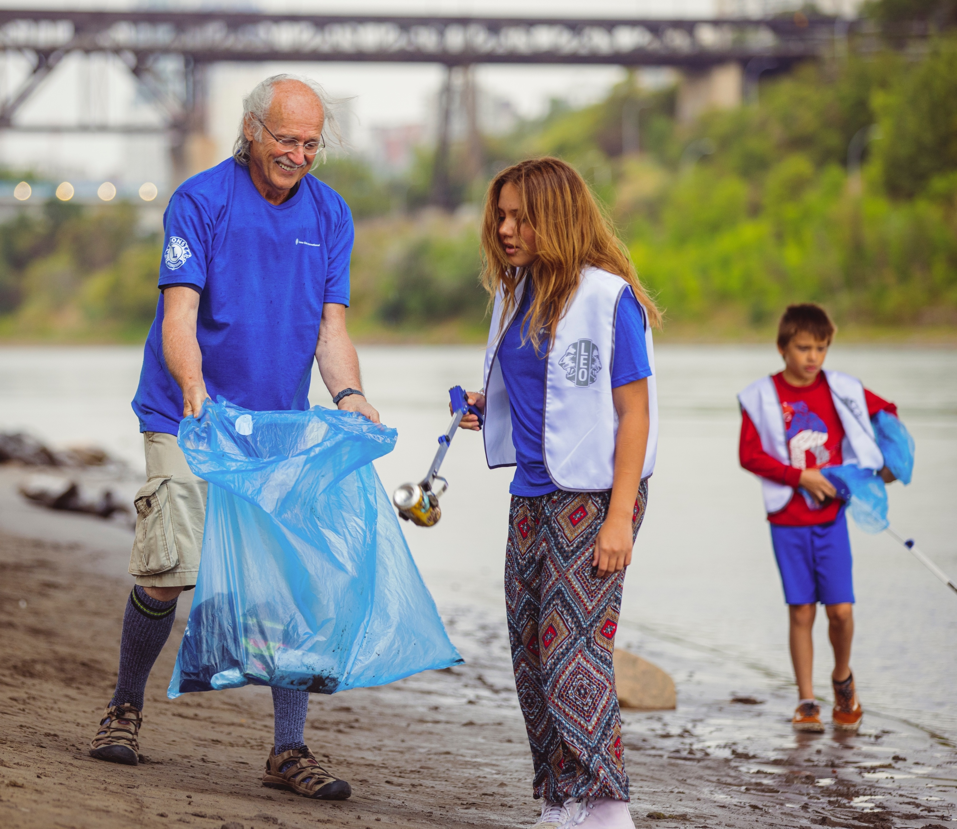


Available Resources
The Global Membership Approach provides a process and resources for all clubs and districts to achieve growth.
All the tools we need are already here!
lionsclubs.org/global
23
Notes:
We know it takes commitment to grow. But it also requires the right resources.
The Global Membership Approach provides a process and resources to help every district and club achieve growth.
The Global Membership Approach works.
It has been proven to be effective around the world, so let’s take advantage of the tools that are already available to us.

Slide 24
Developing a Detailed Plan
Growth won’t happen by accident. Luck isn’t part of the equation.
The success of MISSION 1.5 will depend on DEVELOPING and EXECUTING a detailed plan of action that works for our region.
Our plan for MISSION 1.5 will work because it is:
Teachable
Customizable
Sustainable
24
Notes:
To achieve our goals, we need a plan.
We need to develop a detailed plan that will work for us, and we need to implement it.
MISSION 1.5 is teachable, customizable and sustainable.
That word “sustainable” is important.
It means that the work we are doing for MISSION 1.5 will not only help us achieve our goal—it will help us continue to grow beyond 2027.

Slide 25
AWARDS AND RECOGNITION
Incentivizing success.
25
25
Notes:
Growing our membership provides so many benefits to our districts, our clubs and our communities.
But we also need to create recognition opportunities that will encourage Lions and leaders to help us grow.

Slide 26

Your dedication will be recognized.
MISSION 1.5 is your chance to make history as a Lion.
Become a mission leader.
Remember why you serve. Drive success and be rewarded for it.
26
26
Notes:
Hard work and dedication should be rewarded.
If we want to make history together, we need to recognize the Lions and leaders who are actively contributing to our growth and success.

Slide 27







Awards
Extension Excellence Pin and Patch
Heroes Are Welcome.
New clubs. New members.
Net growth. Retention.
All the above can earn unique MISSION 1.5 plaques, pins, Presidential medals and awards for high-performing clubs and Lions. See what you can earn!
SCAN ME
Learn more on our dedicated MISSION 1.5
awards ​page.
MISSION 1.5
Member and Sponsor Pins
27
Notes:
That’s why we developed a special MISSION 1.5 awards program.
Lions can earn MISSION 1.5 plaques and pins, plus special presidential medals and awards for helping us start new clubs, grow our clubs and keep our current members.
There is a dedicated MISSION 1.5 awards page, so I encourage you all to explore the many recognition opportunities. And make sure that Lions know that every Lion has the opportunity to earn recognition.

Slide 28
COMMUNICATION
Getting the word out about MISSION 1.5.
28
28
Notes:
Now, let’s talk about communication.
Communication is absolutely critical to our success.
As leaders, we have to stay in close communication so we can execute our plans in the most efficient and effective way possible.
Communication is also critical to engaging our Lions and clubs in MISSION 1.5.
We will all need to be active communicators to create awareness and excitement for this important initiative.

Slide 29
Turn up the volume.
Use all your channels to create awareness
and excitement for MISSION 1.5.
Social media
Use social media
to engage your Lions and invite your community
to join you.
Newsletters
Include MISSION 1.5 info, updates and ways to get involved.
Events
Highlight
MISSION 1.5 at
all your major
Lion events.
Club visits
Get Lions excited and engaged during club visits.
D/MD websites
Make sure
MISSION 1.5 is
front page news.
Lions International will use our communications and digital platforms
to amplify the message of MISSION 1.5.
29
Notes:
Let’s use all of our channels to promote MISSION 1.5 so we can create awareness, excitement and engagement in growing our membership.
Use social media to connect with Lions and our communities.
Add information in your club and district newsletter.
Talk about MISSION 1.5 at Lion events and club visits.
Make sure you have information on your district and MD websites.
Lions International is also leveraging its communication channels to amplify the message and the mission.

Slide 30
KEY BENEFIT | MESSAGING
Increased capacity to serve | The more we grow, the more we can give.
 | Kindness guides us.
 | Find yourself through being selfless.
Greater diversity and inclusion | A Lion lives inside us all.
 | Our clubs serve our communities in ways we never could alone.
 | You look like a Lion.
Increased advocacy for change | A little change goes a long way.
 | Local efforts, global change.
 | The biggest changes begin with you.
Increased member benefits | We do not grow together by acting alone.
 | Stronger together. Always.
 | Get more from giving.
Stronger at every level of Lions | Serving side by side means growing stronger together.
 | Lions stand together.
 | Always ready to serve.
MISSION 1.5 Messaging
We’ve developed a series of MISSION 1.5 specific messages that help speak directly to the initiative’s Key Benefits.
30
Notes:
As we consider how to best communicate with Lions, here is some messaging that can help reinforce the benefits of MISSION 1.5 in a brief but inspiring way.
We need to use messaging that will work for our Lions so we can best connect with them and motivate them to get involved.

Slide 31
Mission
Amplification
SCAN ME
Our MISSION 1.5 landing page helps Lions learn about this exciting initiative and get the tools to take action.
31
Notes:
Lions International has created a special MISSION 1.5 webpage to help Lions learn about the initiative and find resources that can help them take action.
This is a great destination for Lions who want to see what MISSION 1.5 is about.
Please share the page with Lions so they can learn more—and do more—to help us grow.

Slide 32
We will grow.
But how will we let the world know?
32
32
Notes:
I know that everyone here is committed to growing.
But how will we track our progress?
There are some important steps we need to take to make sure that we are making progress and are accountable for our goals.

Slide 33
Current MISSION 1.5 Membership Growth Leaders
Top 5 Growing Clubs
1 |  | CLUB NAME
2 |  | CLUB NAME
3 |  | CLUB NAME
4 |  | CLUB NAME
5 |  | CLUB NAME
33
Notes:
We need track our progress so we can highlight our success.
Let’s celebrate our achievements. And use them to inspire other Lions and clubs to achieve great outcomes of their own.
[Please note that this slide can be adapted for recognizing other types of individual, club and district growth.]

Slide 34
Regional Reporting
Schedule monthly meetings
GAT CAL to meet with AL
GAT AL to meet with MD/D GAT
(regionally adaptable)
  Group leaders invited
  (for 2024-2025)
District Governor or Coordinating Lion
(where applicable) to meet with FVDG,
District GAT and Zone/Region Chairpersons.
Depending on meeting schedules, zone/region chairperson should also
make time to meet with clubs.
Build a reporting agenda
Action plan review
Current FY progress on goals
Barriers/obstacles
Course corrections
Support needed
34
Notes:
Regional reporting is essential to understanding our progress.
It will also help us identify successes and challenges so we can fine tune our approach.
We will hold monthly meetings that will help bring key leaders together to review the data and get insights into what’s happening on the local level.
GAT CA leaders will meet with area leaders.
Area leaders will meet with the MD and district GAT.
DGs or coordinating Lions will meet with FVDG, District GAT and Zone/region chairs.
Zone/region chairs should also make time to meet with clubs.
To make sure meetings are productive, we will need to review items such as:
Action plans
Progress on goals
Obstacles and challenges
Course corrections or needed plan adjustments
And needed support
These meetings will be critical to achieving our goals and staying accountable to each other.

Slide 35
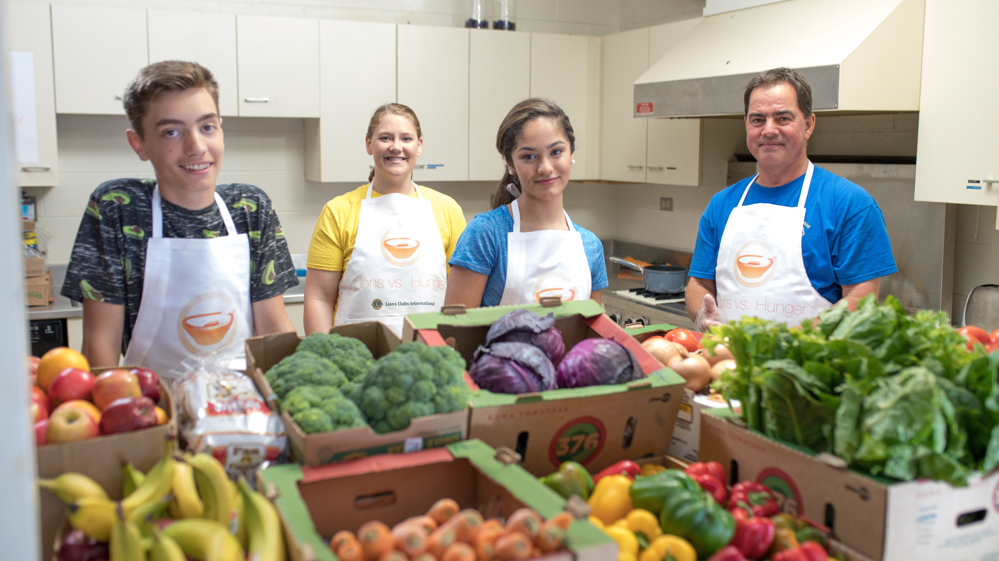
Worldwide
Report Days
Audience
Steering Committee
GAT CA Leaders (Reporting)
GAT Area Leaders (Observers)
LCI staff (Observers)
Group Leaders (Observers)
- For 2024–2025
Worldwide Report Days should be scheduled 3 times a year, one month prior to scheduled board of directors meetings.
They should last 60 minutes per CA, with the exception of OSEAL at 30 minutes per region.
Agenda
Current Lion Year Progress to Targets Established
Barriers/Obstacles
Support Needed
Next Lion Year Target Setting/Global Membership Approach
35
Notes:
We will also have Worldwide Report Days to help us stay focused on success regionally and globally.
These meetings will be scheduled three times a year to bring international leaders and Lions International staff together to make sure we’re on track to reach our goal of 1.5 million members.
Similar to regional reporting, Worldwide Report Days will focus on assessing progress, understanding challenges and identifying needed support, as well as membership goal setting for future years.

Slide 36
WRAP UP
We have an opportunity to redefine
the future of service.
36
36
Notes:
MISSION 1.5 will redefine the future of service.
This is an opportunity to build on the legacy of service we have built over the last 100 years.
This is an opportunity to make sure our clubs and our association are ready for the future.
This is an opportunity to help more people than ever before.
But to do it, we have to grow.

Slide 37
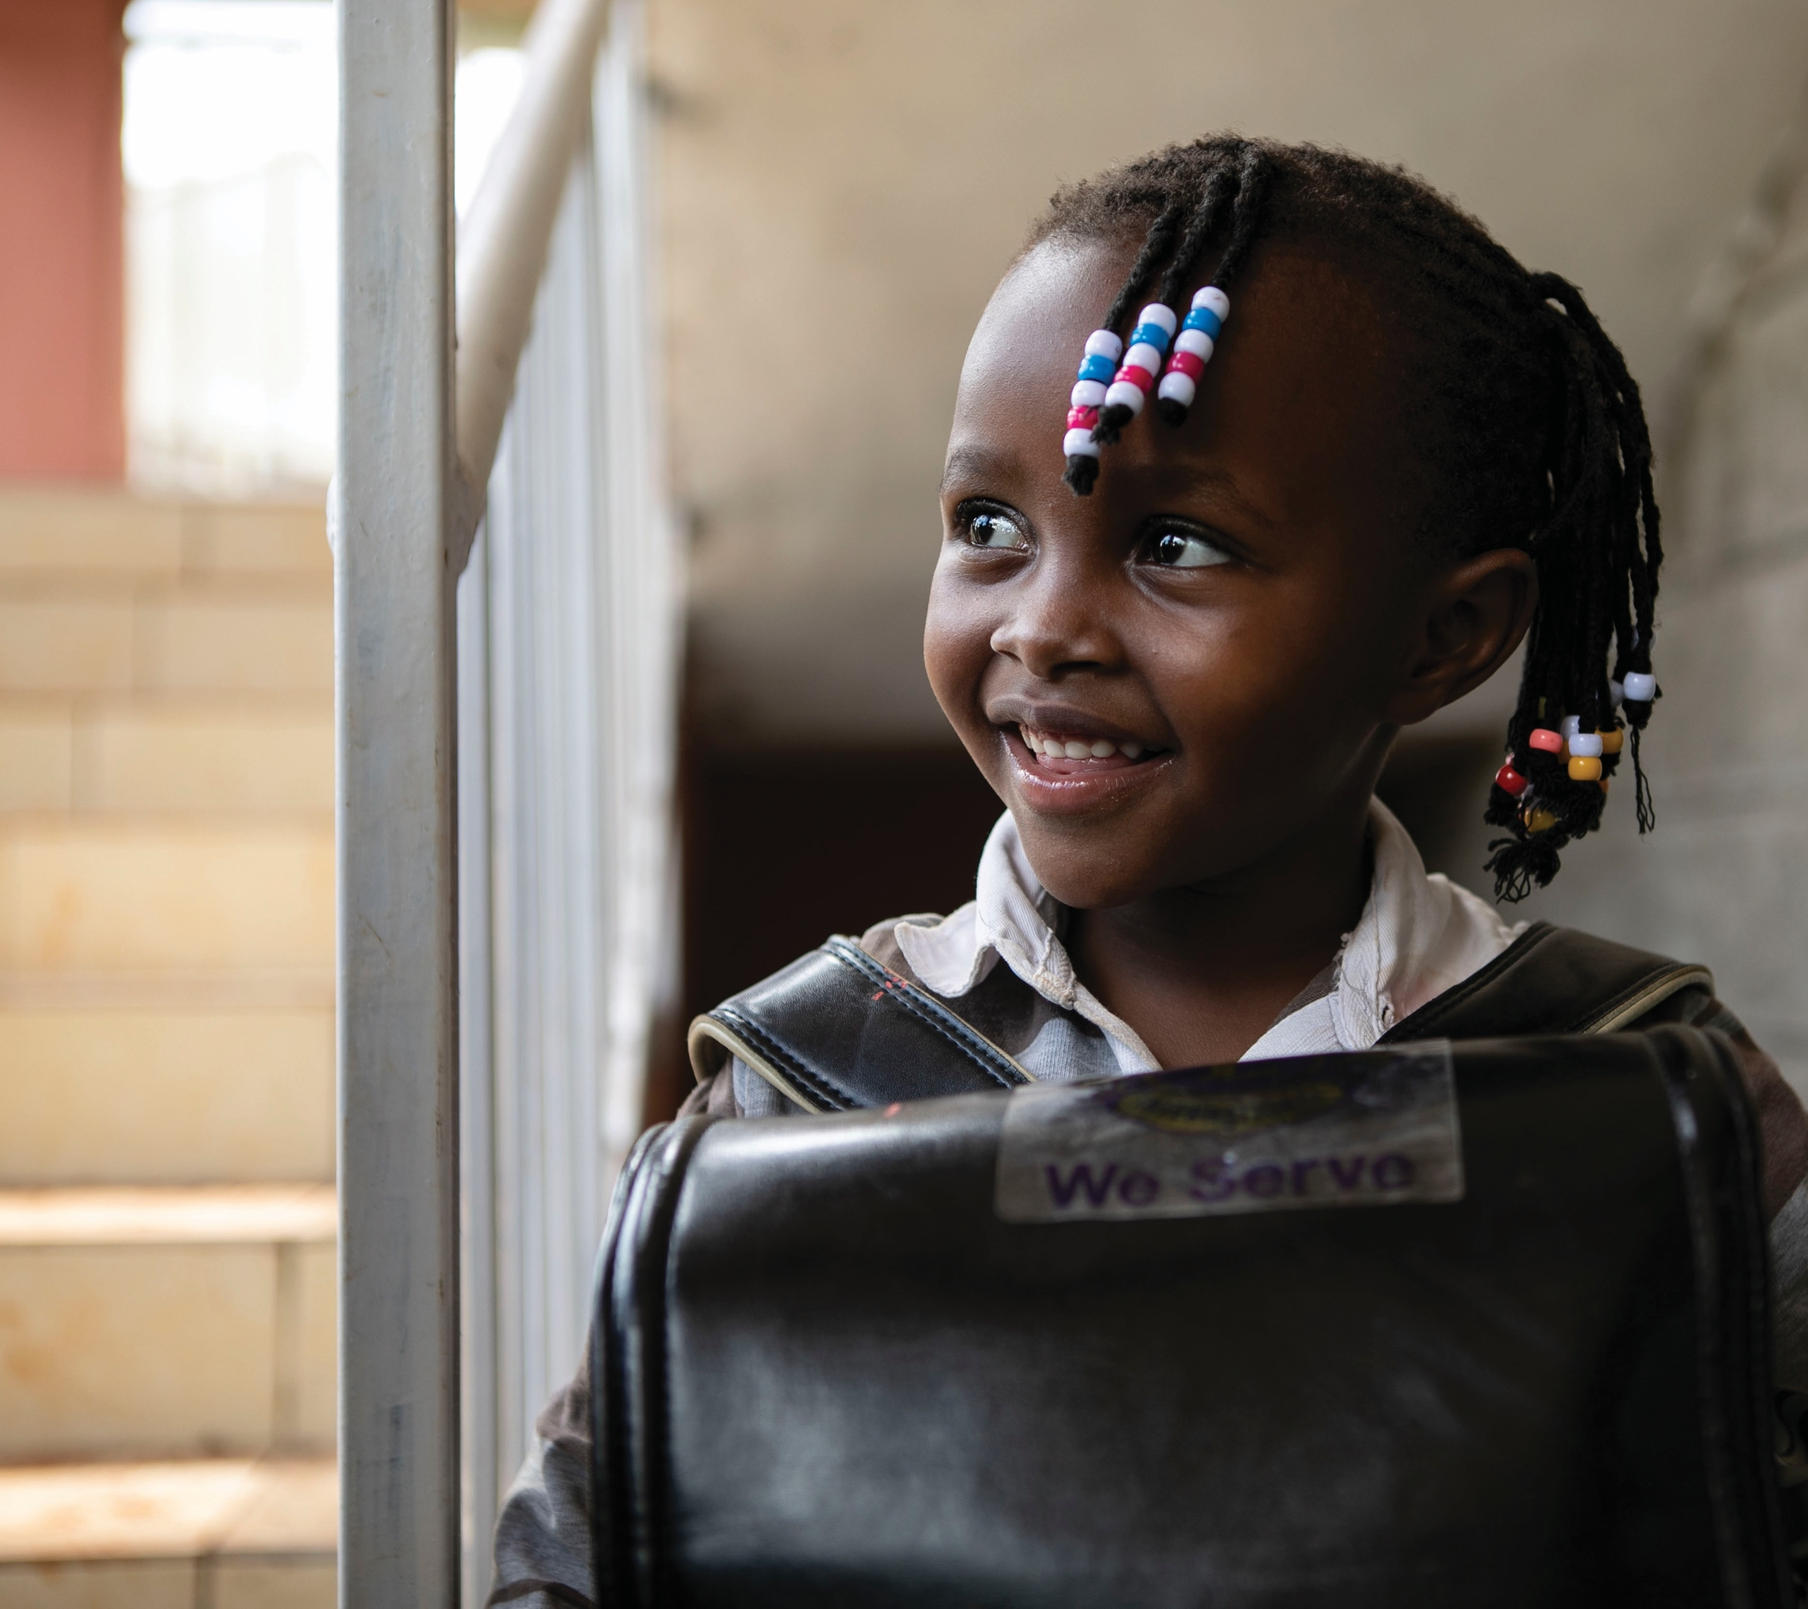
Things to remember
Growth is critical to our service and the future of Lions.
We are accountable to each other and the communities we serve.
Success depends on us and every other Lion.
37
Notes:
I want all of us to keep this in mind:
Growth is critical to our service and the future of Lions.
We are accountable to each other and the communities we serve.
Success depends on us, and every Lion.
We cannot forget why we’re doing this, and how important each of you are to success.

Slide 38
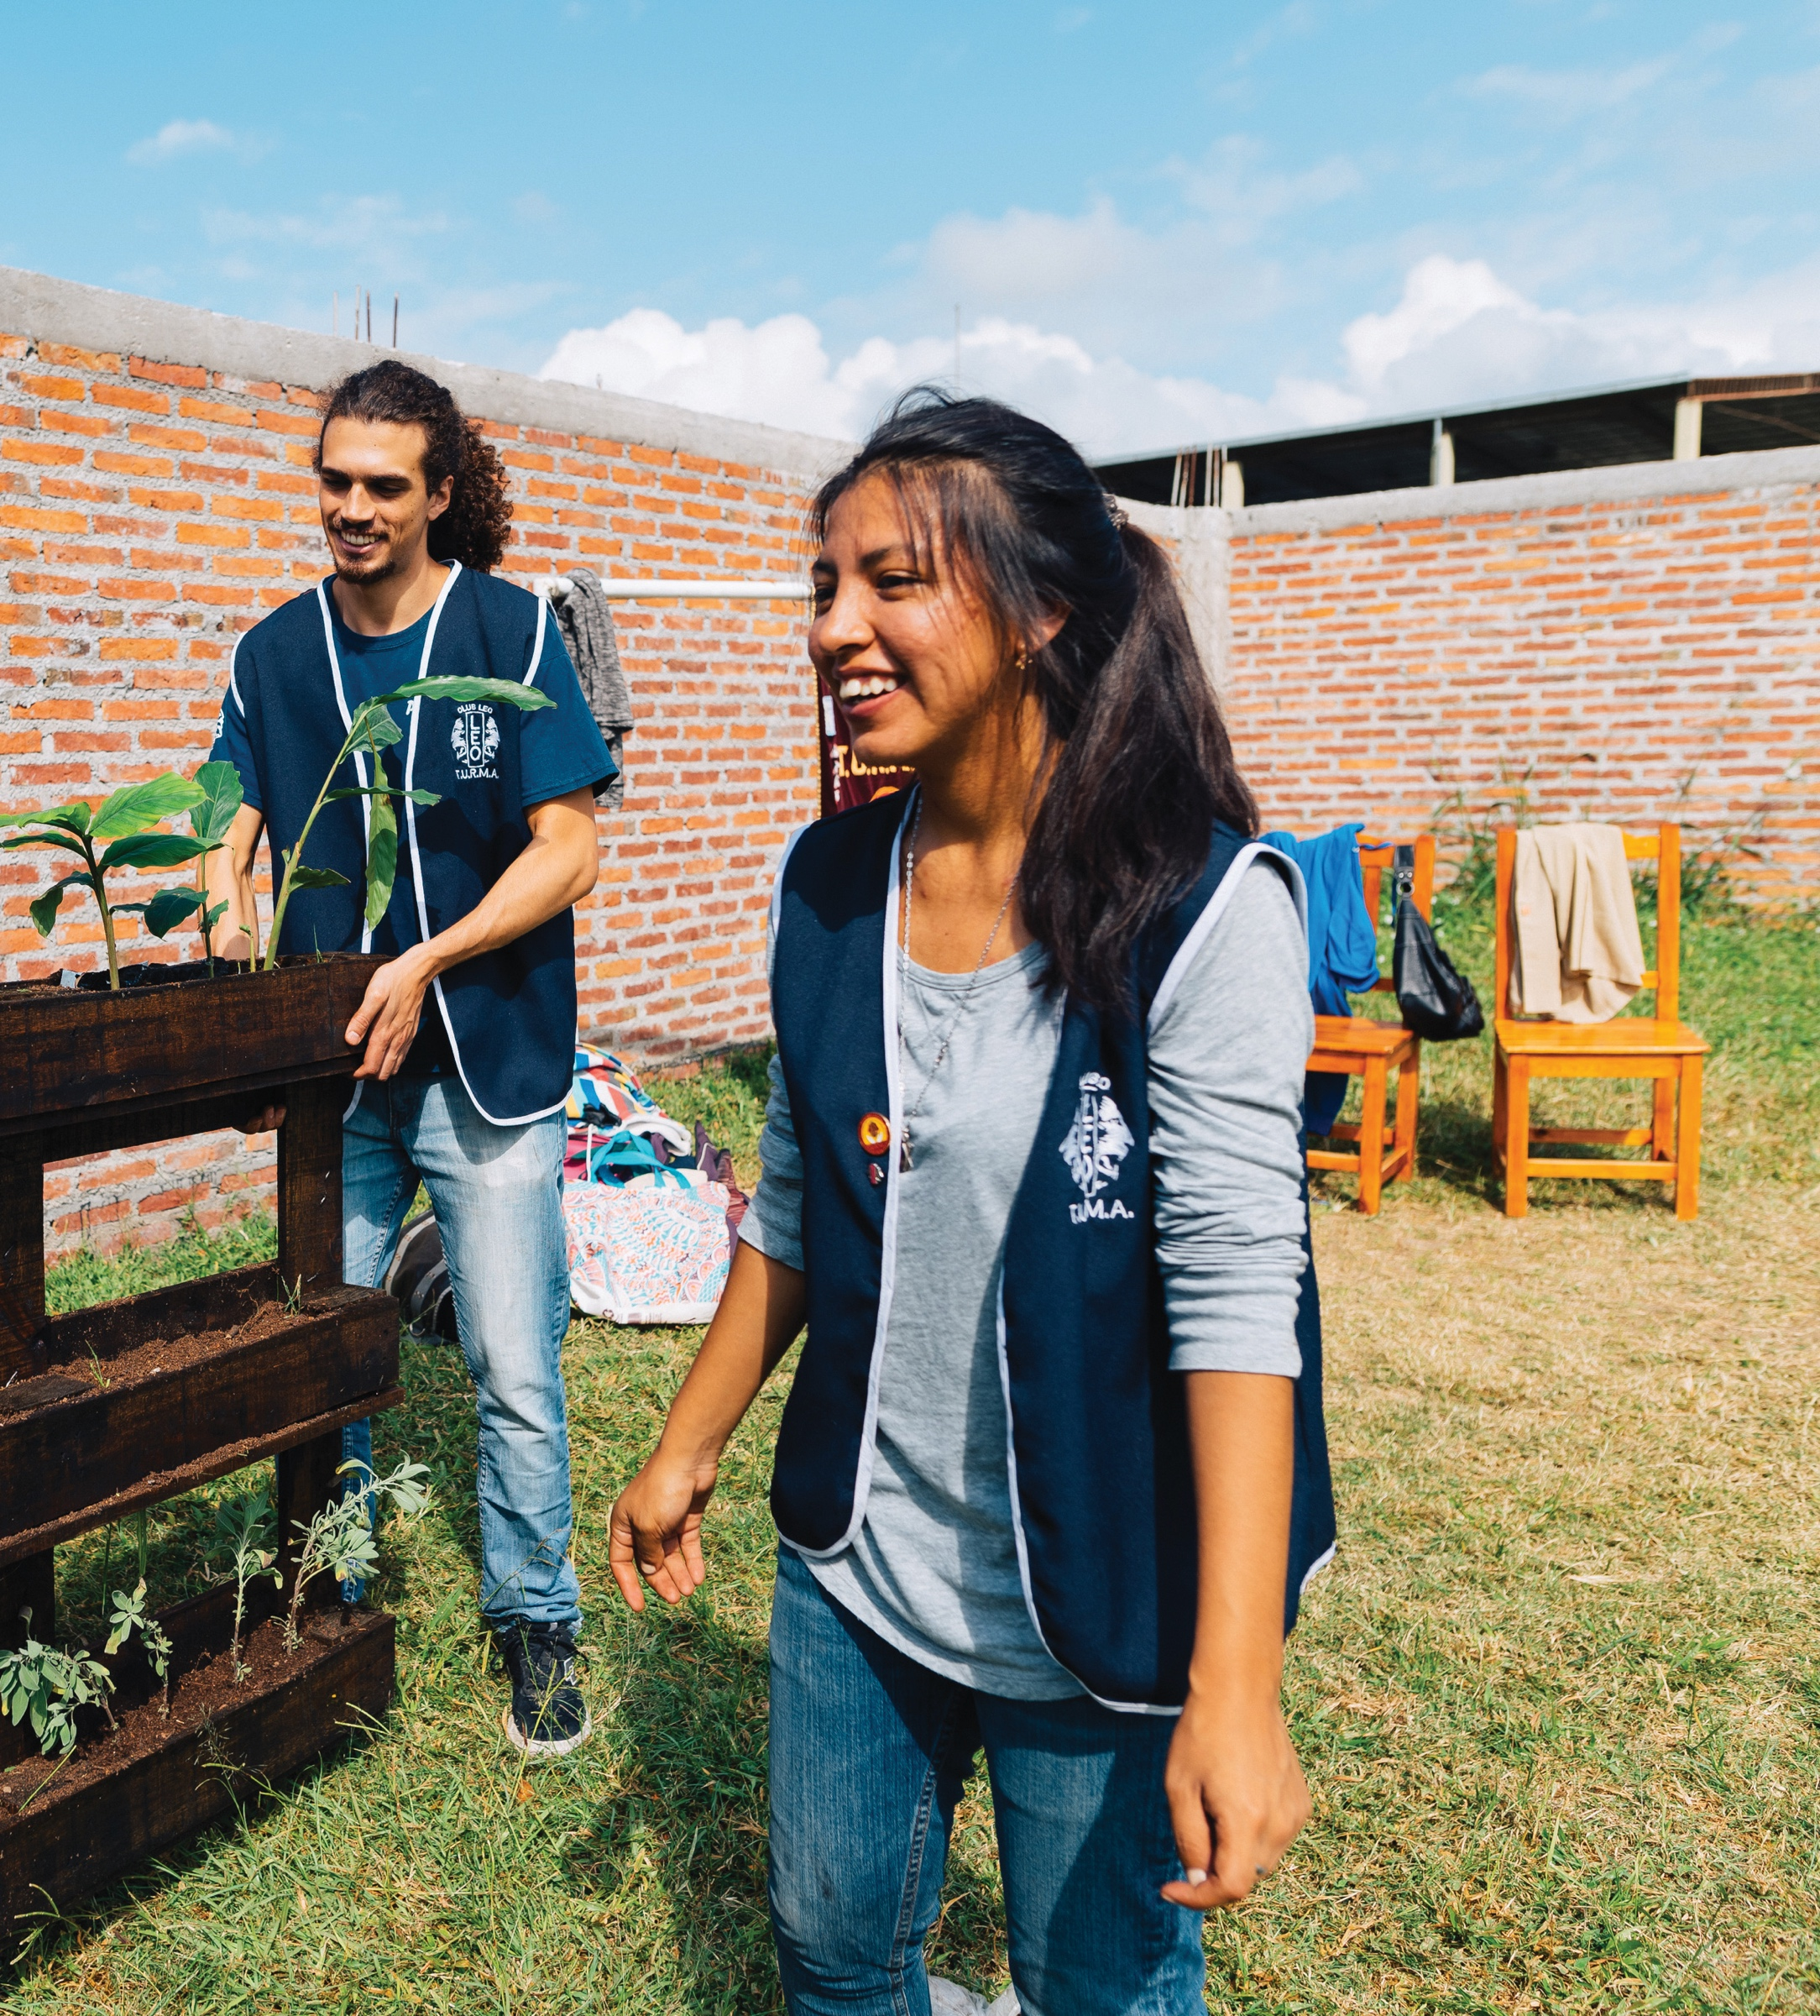
Stay focused on success
Make growth a priority.
Get clubs engaged and make sure Lions understand how MISSION 1.5 benefits them.
Execute plans and work together to achieve our goals.
Communicate, collaborate and adapt for the best outcomes.
Recognize success and the people making it happen.
38
Notes:
So let’s stay focused on success.
Let’s make growth a priority for all Lions.
Let’s get clubs engaged—we have to succeed.
Let’s execute our plans and work together to achieve our goals.
Let’s communicate and collaborate for the best outcomes.
And let’s recognize our achievements and acknowledge the people making it happen!

Slide 39
Stronger together. Always.
“Serving a World in Need” is more than a slogan.
It is our promise to the world.
The more we grow, the more we can give.
39
39
Notes:
Remember, we are stronger together.
Our service is a promise to the world.
It’s a commitment to make families, communities and our world better.
And we do it by serving. By giving.
And the more we grow, the more we can give.

Slide 40
ARE YOU IN?
There's never been a challenge too big for Lions.
Accept the challenge!
40
40
Notes:
MISSION 1.5 is a challenge to Lions. It’s a challenge to each of us.
It’s a challenge to you. And to me.
But there’s never been a challenge too big for Lions.
So, do you accept the challenge?
[wait for response]
One more time – do you accept the challenge?
[wait for response]
Then you are joining Lions around the world who are on a mission to grow.

Slide 41

41
41
Notes:
[play video]

Slide 42
Thank You
© 2023 Lions International
42
Notes:
I want to thank you all for joining me today. And for joining together with Lions around the world as we work together to reach 1.5 million members.
Each of you plays such an important role in success.
And with Lions and leaders like you working together, I know we will achieve our MISSION 1.5 goal together.
Thank you!

