Slide 1
Giving Every Lion and Leo a Voice
1

Slide 2
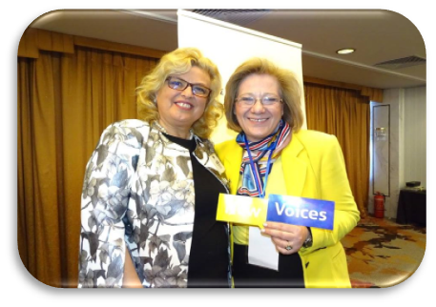
Being a Lion is Empowering
The New Voices Initiative promotes gender parity and diversity and seeks to increase the number of women, young adults and underrepresented populations within our association.
2

Slide 3
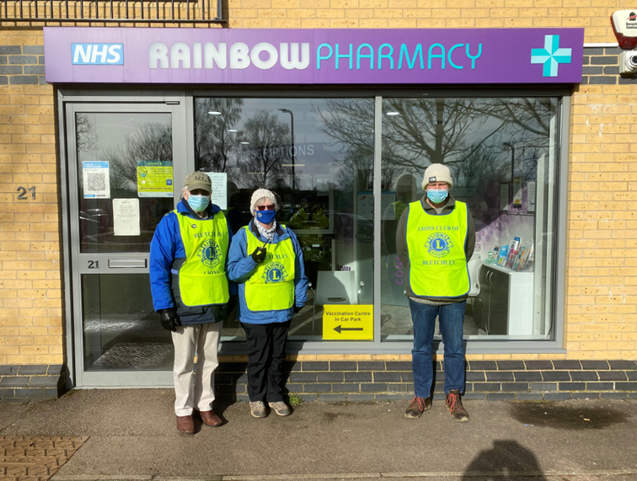
New Voices
Help Us Grow
New Voices is a grassroots initiative with the goal of sharing stories locally to inspire others and to promote the organization and its efforts to non-Lions in our communities.
Inspired Lions are likely to serve more, recruit more, become better leaders, and spread the message of Lions International.

Slide 4
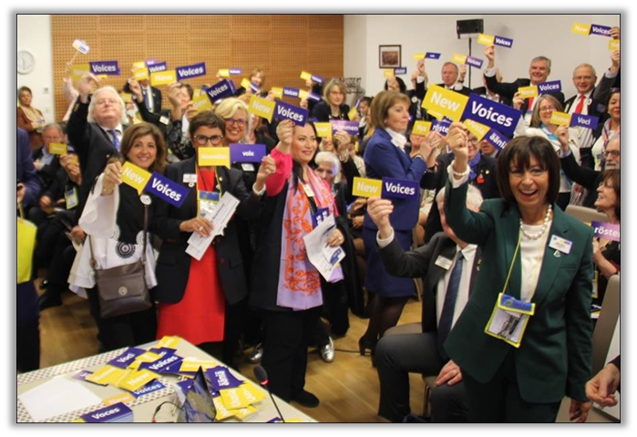
New Voices is a platform
For sharing new ideas and learning from each other. It seeks to encourage clubs to be dynamic and innovative by trying something new, and to give all the opportunity to grow personally and professionally.
For acknowledging the hard work of Lions and Leos excelling in the areas of marketing, membership, leadership and service
For inclusivity and hearing the voices of underrepresented populations
For barrier breaking and encouraging Lions and Leos to take leadership roles

Slide 5
New Voices are Lions and Leos who demonstrate exceptional influence, in one of four areas:
SERVICE
MEMBERSHIP
LEADERSHIP
MARKETING
WHO ARE
NEW VOICES?

Slide 6
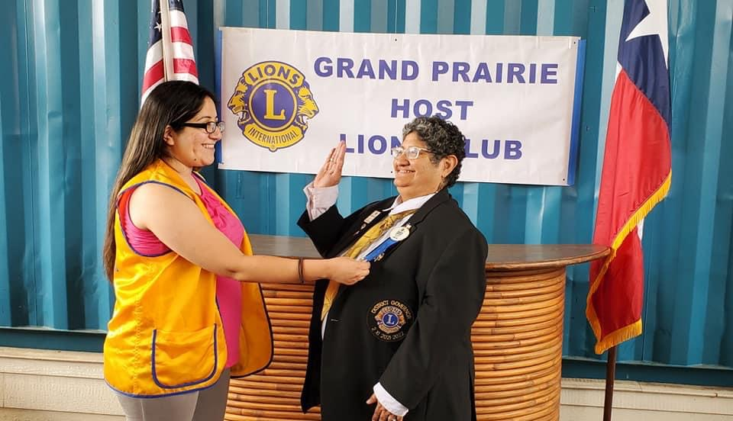
WHO IS ELIGIBLE TO BE A NEW VOICE?
Diverse and innovative Lions and Leos from districts all around the globe that feel empowered by Lions!
Who has an inspiring story or experience to share
Who has a new or innovative idea to share
Who has not had an opportunity to lead
Who believes in our mission and wants to get others involved

Slide 7
Structure and Support
7

Slide 8
Role of Districts
District Governor
Identify four New Voices locally – consider diversity and Lions/Leos that excel in each of the four areas
Presentation of New Voices certificates
Feature local New Voices at district events and in communications
Provide New Voices stories to LCI through New Voices Story collection form
Feature New Voices on local district websites and social media, or in club and district newsletters. Share their stories at zone, region, district and club meetings, service projects, and fundraising events
8

Slide 9
New Voices Process
Each District Governor is encouraged to nominate four Lions/Leos during their term in office.
District Governors present New Voices in their district with certificates
District promotes New Voices and provides opportunities for them to share their stories
New Voices speak out and encourage other Lions and Leos to take lead and be innovative
District Governors submit New Voice story collection forms to LCI for possible sharing at International level
9

Slide 10
Role of NEW VOICES
New Voices Nominees
Share their stories and find ways to spread their messages
Accept speaking engagements and serve as role models
Work with clubs and districts to promote stronger and more inclusive membership
Encourage and mentor others to take up leadership roles
10

Slide 11
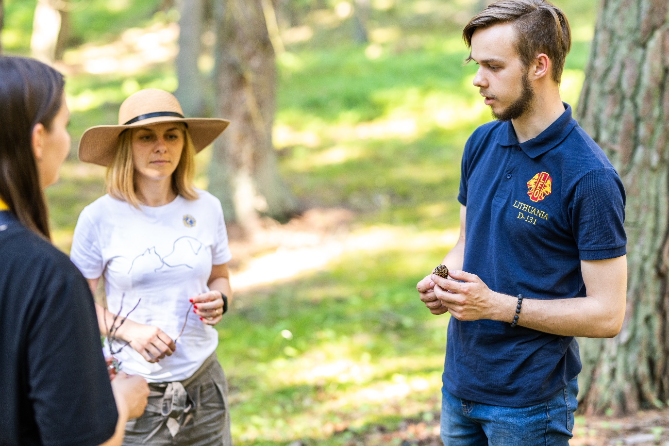
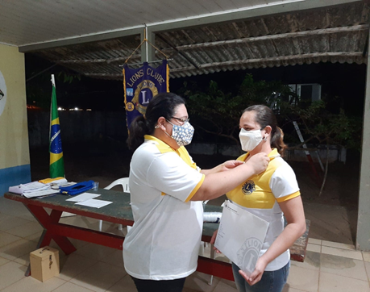
LCI call for New Voices stories
LCI requests that District Governors aim to submit their New Voices stories by November 1st, however, the collection process will remain open and ongoing throughout the year. There will be a quarterly reminders to submit stories.
11

Slide 12
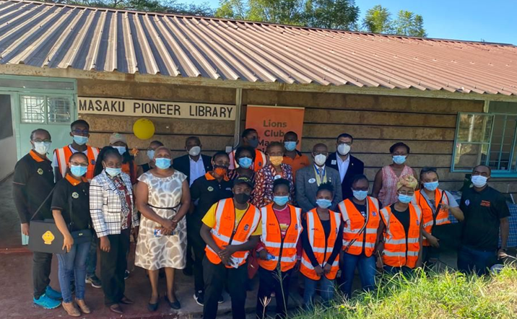
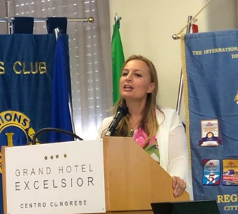
LCI PROGRAM SUPPORT
1
Social
Manage social media to be utilized to engage members at all levels, recognize select New Voices and share ideas.
2
Website
To serves as a destination for campaign promotion and resources.
3
Webinars
I‘m a voice of membership. I’m a voice of leadership. I’m a voice of service. I’m a voice of marketing. I’m a new voice, which voice are you?
“
Continue volunteer-led webinars that proved successful in sharing ideas and reaching Lions with leadership development concepts that were meaningful.
4
Resources
Provide marketing materials needed for local events showcasing New Voices

Slide 13
ADDITIONAL RESOURCES
New Voices Workshop Grant
New Voices Symposium Grant
• Explore factors surrounding the recruitment and retention of women, young Lions and Leos as well as diverse populations
• Devise strategies for increasing membership and diversity in Lions and in leadership positions
• Create action plans for implementation
• Identify new community projects that are of interest to women, young Lions and Leos as well as diverse populations
• Promote new clubs within the community
• Identify potential members
• Charter a new club/club branch to complete a new community project
US$8,000 is available per Constitutional Area, each fiscal year as designated funding to host a New Voices Symposium or Workshop
Up to US$2000 can be used towards each event.

Slide 14
Workshop and Symposium Programs
Focus has expanded from women to include youth and diversity.
Grants are awarded on first come first serve basis.
Multiple Districts or Districts may apply each fiscal year. If MD/D was awarded a grant the previous Lions year they may not apply till after November 1st.
Must submit grant application at least 30 days prior to event. Prior LCI approval is necessary for reimbursement.
Reimbursement requests and reports shall be submitted within 30 days of the event to receive grant.
14

Slide 15
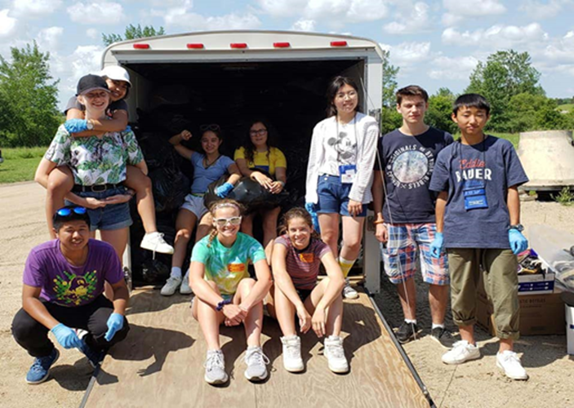
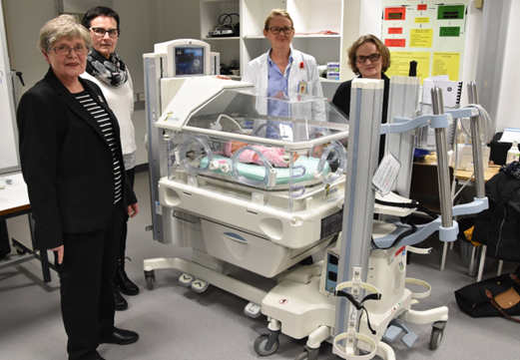
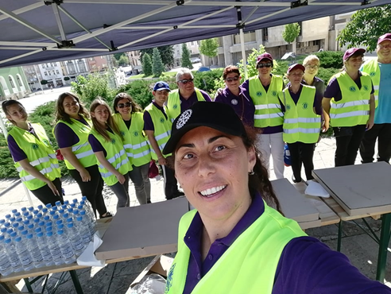
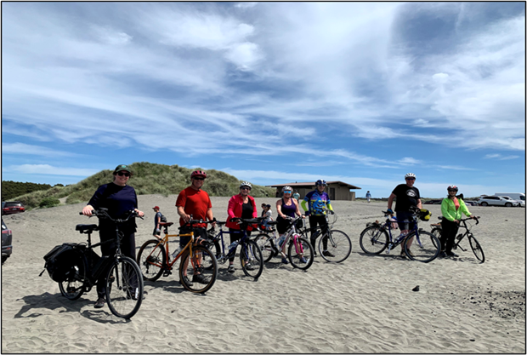
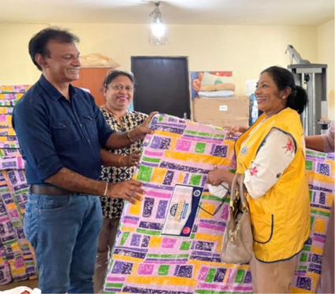
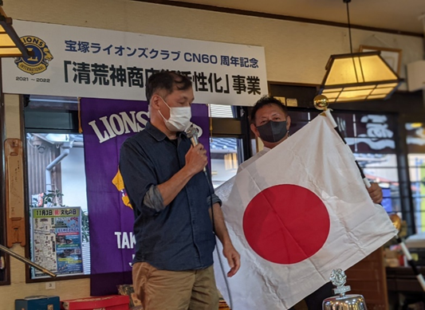
Innovation, inspiration, motivation and fun!
15

Slide 16
Discussion….
16

Slide 17
For more information contact:
District and Club Administration Staff at:
newvoices@lionsclubs.org
and visit
https://www.lionsclubs.org/newvoices
Facebook: Lions New Voices
Join the Conversation!
17

