Slide 1


Lions Clubs International
Conducting the Organizational Meeting
Post- Workshop Responsibilities
Notes:
The information on in this power point is designed to help the club organizers conduct a successful organizational meeting and post workshop follow up.

Slide 2

The Organizational Meeting
The organizational meeting takes place after the informational meeting. It is where the club members will elect officers, determine the club name, and plan the first service project.
2
Notes:
Speaker Script:
Thank you for joining us in helping to impact the community of _________________ by forming a Lions Clubs. The goal of the next few meetings will be to organize the club. These meetings are where we will vote for the officers, decide on our club name, and determine the types of service projects we want to do.

Slide 3

aa
The Meeting
Tips for Meeting
Review points from informational meeting
Identify service projects
Elect club officers
Choose a club name
Submit the club application
Discuss dues structure
3
Notes:
Speaker Notes:
This power point can be adjusted to meet the needs of the district. It was created as a training tool for the district team and as an outline for what should take place during the organizational meeting.

Slide 4

Choosing Service Projects
Service
Projects
Choosing service projects is an important focus for the new club. The following are tips for choosing service projects.
Choose projects that are relevant to community needs
Partner with local organizations to help meet the needs of the community
Choose one of the LCI global causes as one of your ongoing projects
Promote your service project in the community through local media sources
Be creative and think outside the box
Make your projects family friendly
Partner with other Leo or Lions clubs in the area
Notes:
Speakers Notes:
The information on this slide can be read directly from the slide. Service projects become a recruiting catalyst for potential new members and most importantly relevant to the community.

Slide 5
Choosing Club Officers
Leadership opportunities is one of the key benefits to joining Lions Club International. As a new club, a president, secretary, treasurer, and membership chairperson should be chosen prior to submitting a new club application .
5

Slide 6
aa
New Club Officers
Choosing New Club Officers
New Clubs should elect: President, Secretary, Treasurer, Membership Chairperson
Provide position descriptions for club officer to all members during the first organizational meeting.
Choose club officers by third organizational meeting
District Team, Guiding Lion, and Sponsoring Club officers should support new club through the club officer process
Guiding Lion will train new club officers once they have been elected
6
Notes:
Speakers Notes:
The discussion of club officers should begin during the informational meeting. Once the first organizational meeting takes place, a more guided conversation on new club officers should take place. The process of choosing officers can vary. It may be by recommendation or vote since the club is forming. Once the club has been formed it will follow Lions policy on selecting club officers. By the third organizational meeting the club officers should be chosen.

Slide 7
Charter Application Process
Now that officers have been chosen and the club has 20 members, it is now time to submit the new club application for chartering.
7
Notes:
Speaker notes.
Reading the message off the screen can set this section up well. Preparing the for the chartering application should not take place until officers have been decided.

Slide 8
aa
Application Submission
New Club Application Submission:
Choosing a name
The first step in the application process is to choosing a name. The following guidelines will help to support your name choice.
A proposed Lions Club or club branch must be known by the actual name of the “municipality” or it’s equivalent governmental subdivision in which it is located.
Campus clubs can use the college or university name as its “municipality.
“Distinguishing designation” for clubs located in the same municipality may be any name which clearly identifies the club from other clubs. Distinguishing designation will be added to the after the municipality. Ex. Oakbrook Sight Lions Clubs
“Host Club” shall be title for parent club in municipality
Lions Clubs cannot be named after living individuals
No Lions Club may add “International” as a distinguishing designation to its name
If including a company’s name, documentation must be provided by company prior to club approval
8
Notes:
Speaker Notes-
Choosing the right name is important for a club. LCI has set some naming standards for clubs and the name chosen must fall within the guidelines. The information listed in this slide is directly from board policy. It is recommended that you read from this slide.

Slide 9
aa
Application Submission
New Club Application Submission: District Level Process
The information below provides details on who can process the new club application on the district and club level.
Application Entry | Charter Member Entry | Guiding Lion Entry | Application Approval | Club Payment
District Governor | District Governor | District Governor | District Governor | District Governor
Coordinating Lion | Coordinating Lion | Coordinating Lion |  | New Club Treasurer
District GMT Coordinator | District GMT Coordinator
Sponsoring Club President | Sponsoring Club President
Sponsoring Club Secretary | Sponsoring Club Secretary
 | New Club President
 | New Club Secretary
9
Notes:
Speakers Note:
The organizational meetings is the time where the forming club begins the application submission process. But what is important is to understand that new club officers can’t submit the application and have limited access in MyLCI as to what they can do in the application. The above chart helps to explain who can do what during the process.

Slide 10
aa
Application Submission
New Club Application Submission: MyLCI
New Club Charter Applications are submitted online through MyLCI. The following steps should be taken for new club application submission.
Step 1: Log In to MyLCI. You can access MyLCI through the www.lionsclubs.org website and click on the MyLCI tab in the top panel
10
Notes:
Speaker Notes:
The new club application process is a 6 step process. The first steps begin at logging in through the LCI website.

Slide 11
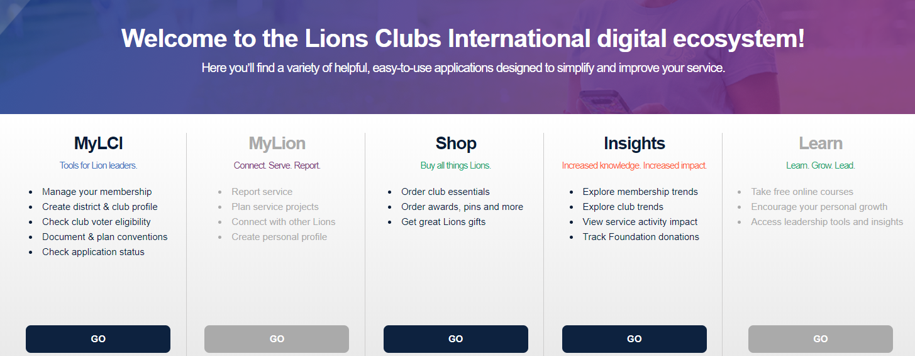

aa
Application Submission
New Club Application Submission: MyLCI
Step 2 : Universal Log In Page:
You will be directed to the Lions Club International Universal Log in page. Choose the GO Button under “MyLCI Tools for Lion Leaders”.
Notes:
Speaker Notes:
Only the DG, GMT Coordinator, Sponsoring Club President or Secretary has access to submit the application. Once club has been submitted and moved to the “completion phase” will the new club officers have access in MyLCI. “Completion” doesn’t mean that it is completed it means that the club organizers need to enter additional information. They will get an email with instructions on how set their log in for MyLCI.

Slide 12
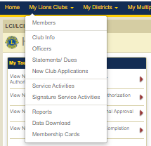


aa
Application Submission
New Club Application Submission: MyLCI
Step 3: Click on the “My Lions Clubs” Tab and click on the new club applications dropdown. Click on the add club button.
Notes:
Speaker Notes
You can read directly from this slide. If the person completing the application does not see the “add club” button, then they should check to make sure there title at the top of the page has been changed to the title that allows for application submission.

Slide 13
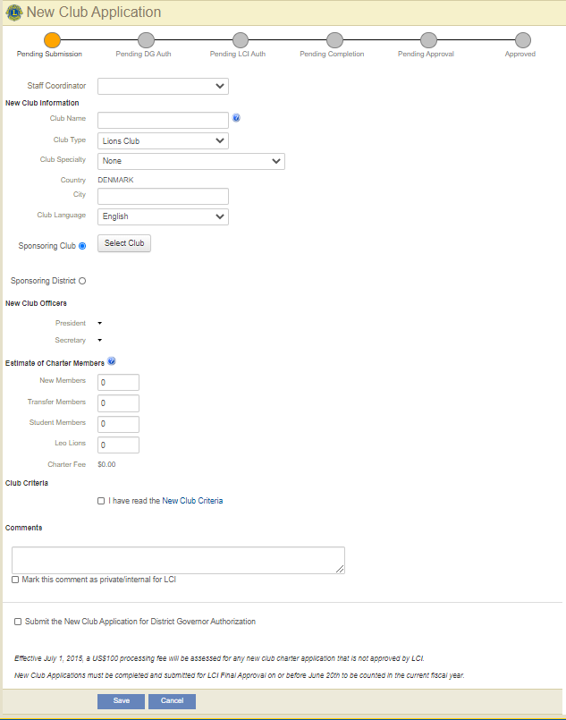
aa
Application Submission
New Club Application Submission: MyLCI
Step 4: Enter all of the listed information. You will add members as you move through the phases of the application.
The application is made up of 6 simple sections:
New Club Information
Sponsoring Club
New Club Officers
Estimate of Charter Members
Club Criteria
Comments
Notes:
Speaker Notes-
This is the application page. The information they gather from the “New Club Charter Application Worksheet” will help them complete this first stage of the application. Once the information has been entered, reading and click the “club criteria”, clicking the DG Authorization button, and the save button all move the application to the next phase in the process. It will be an error message if there are missing items in the sections

Slide 14
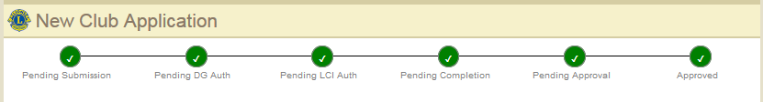
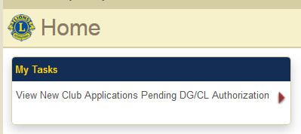
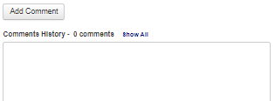
aa
Application Submission
New Club Application Submission: MyLCI
New Club Application Approval Steps. There are six steps.
Application Tips
The application is not final until submitted for
Pending Approval
Communication and visibility throughout the process
  Notification emails
  Tasks in Home page task panel
  Comments
Notes:
Speaker Notes-
There are 6 stages to the application process. There is a LCI staff person that will work with the application during the entire chartering process. Once the initial information has been entered, the application will be moved through the stages. At each stage of the process the club officers and DG will get a message regarding what’s needed to move the application through the process. The LCI Staff Coordinator will also communicate via the comments section in the application.

Slide 15
aa
Application Submission
New Club Application Submission: MyLCI
Club Charter Approval
Club chartering can take up to 45 days
Clubs will be able to obtain a bank account and 501C3 status once the club has been chartered
To expedite the application process, view comments in MyLCI and follow processing instructions
Once club has been approved all chartering materials will be sent to the District Governor
Charter materials include: Charter Member Pins, Charter Member Certificates, Charter Certificate, Sponsor Patch, and Letter from International President
For full instructions on submitting the charter application, go the resource page at www.lionsclubs.org and type in “MyLCI Charter Application Instructions”.
Notes:
Speaker Notes-
This can be read from the slide.

Slide 16
Continued Club Development
Now that the club has been established, continued club development will be critical to the success of the new club.
16
Notes:
Speaker Notes-
Club development is a continual process for the life of the club. Healthy clubs are always looking for ways to add new members, build leadership opportunities within the club, and developing new projects that will make an impact in the community.

Slide 17
aa
Next steps
Post-Organizational Meeting Follow-Up
Guiding Lion will setup club officers training
Continue to promote club and encourage members to invite others to join
Follow up with leads from recruiting events to invite to club
Continue to provide ideas for service areas in community
Plan to meet frequently until the club is chartered
17
Notes:
Speaker Notes
Post- Organizational meeting helps to prepare the club for the work that will take place in the club. (Read from the slide to give organizers information)

Slide 18
aa
Club Development
Continued Club Development
Sponsoring Club Assistance
Sponsoring club should continue to support club as needed.
Sponsoring club officers should attend meetings , provide assistance with activities and meet with officers
Guiding Lion Support
Only need one Guiding Lion
Stay with a club for 2 years
Conducts club officer trainer
Transition of Power
Goal is to build a strong and healthy club
Support new officers to take control over club
Club sponsor is a support, not the dictator of what club should be
Notes:
Speaker Notes-
The information on this slide provides information on the supports that will be available to the new club officers and members. The new club will need a strong support system to ensure they are retained. Historically by year 3, if clubs are not healthy ( strong membership, strong presence in the community, etc.), they we close. By starting off well with strong supports the retention of the club is increased.

Slide 19
Thank you
For more questions contact membership@lionsclubs .org.
© 2019 Lions Clubs International
Updated 10/2021 EN
19
Notes:
Speaker Notes-
At the end of the presentation you can remind club members that the club will meet frequently (the club should determine before the meeting ends) until the club has been chartered. The club should decide during the organizational meetings the day of the week, time and location should be decided. If there are questions, please feel free to contact the LCI Program staff at membership@lionsclubs.org.

