Slide 1

MyLCI Club Branch
Process Manual

Slide 2


Club Branch
Clubs are now able to process branches in MyLCI. This guide will provide instructions on how to compete the process. The sponsor club officers (president and secretary) have access to start a new branch.
2

Slide 3
Getting Started
The following information will be needed prior to completion of the branch application.
Proposed club branch name
List of club branch officers
At least 5 members not including the branch liaison
All new members must be added to parent club prior to starting the branch process on MyLCI
Drop any transfer members from old club and add to parent club
Use the Club Branch Application worksheet and Report of Branch Members worksheet to gather all information needed for online submission. These forms do NOT need to be submitted directly to LCI Headquarters.
3

Slide 4
Club Branch Process
Follow these simple steps to learn how to add a branch in MyLCI.
Step 1
Step 2
Step 3
Step 4
Step 5
Step 6
Log into MyLCI
Club Information
Enter Club Branch Information
Enter Club Branch Member Information
Review and Submit
Update Club Information
4

Slide 5
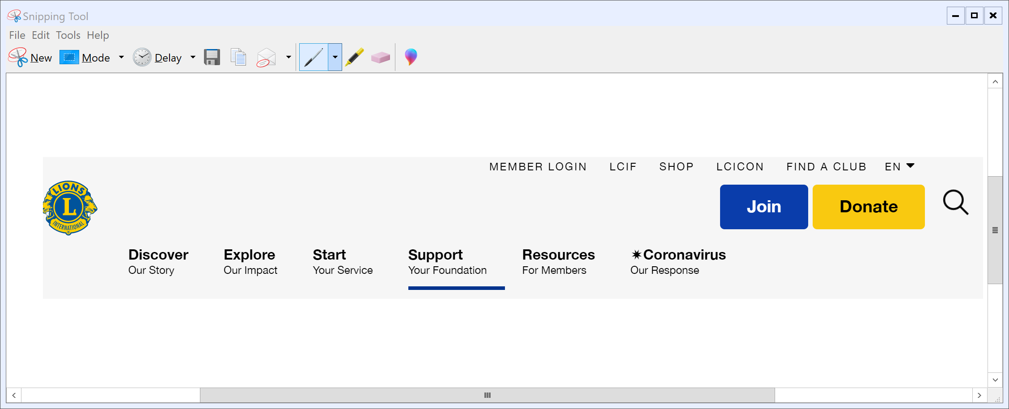

Step 1: Logging in to MyLCI
Go to www.lionsclubs.org and click on the “Membership Login” tab at the top of the screen.
5

Slide 6
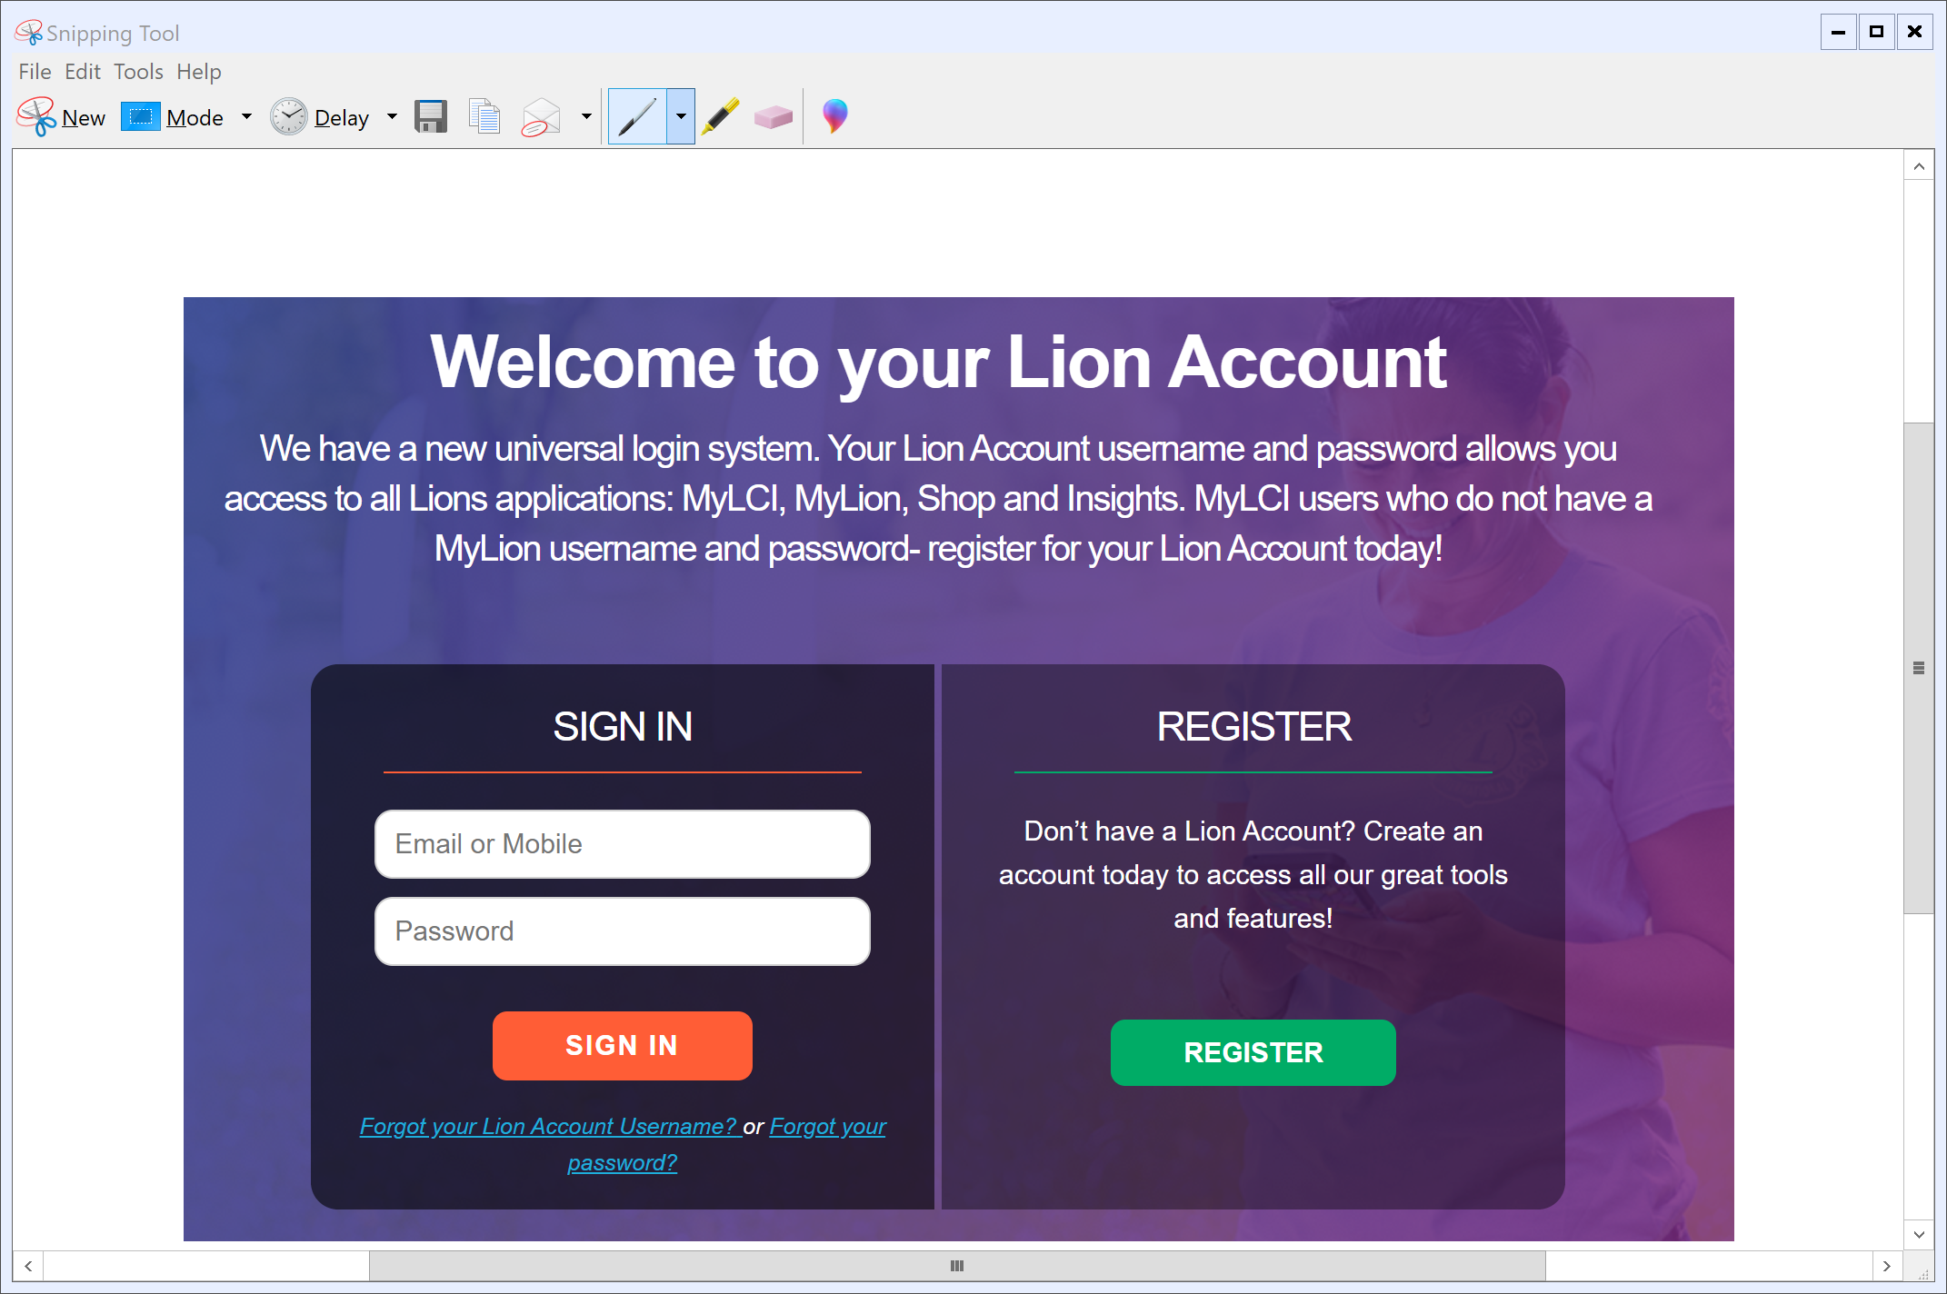
Step 1: Logging in to MyLCI continued
Log in to MyLCI using your designated login and password. If you forgot your login and password or have difficulty logging in, contact the MyLCI support team at MyLCI@lionsclubs.org or at 630-468-6900.
6

Slide 7

Step 2: Club Information Page
Once you have logged in, click on the “MyLCI Tools for Lion Leaders” tab to get to the Club Information page.
7

Slide 8
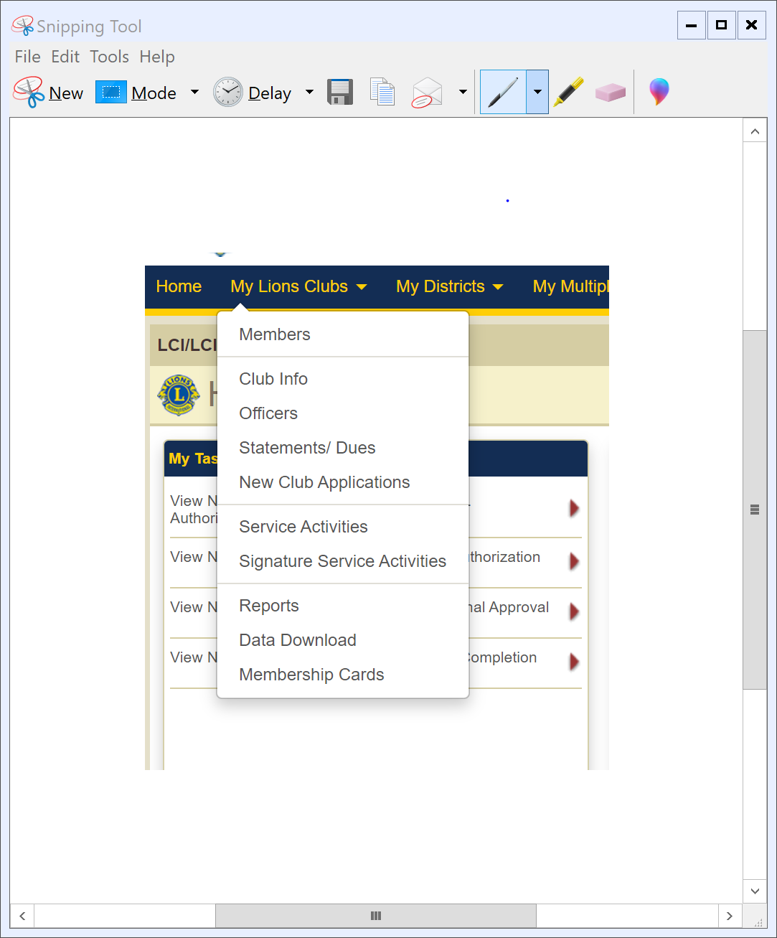
Step 2: Club Information Page continued
Click on the “My Lions Club” tab to get to the Club Information page. Click the dropdown tab that says, “Club Info”
8

Slide 9
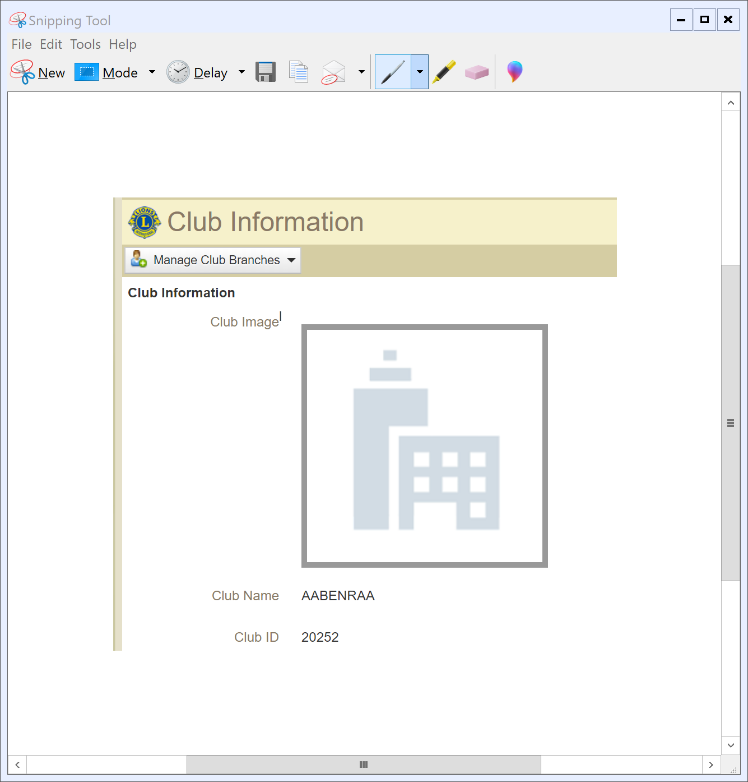
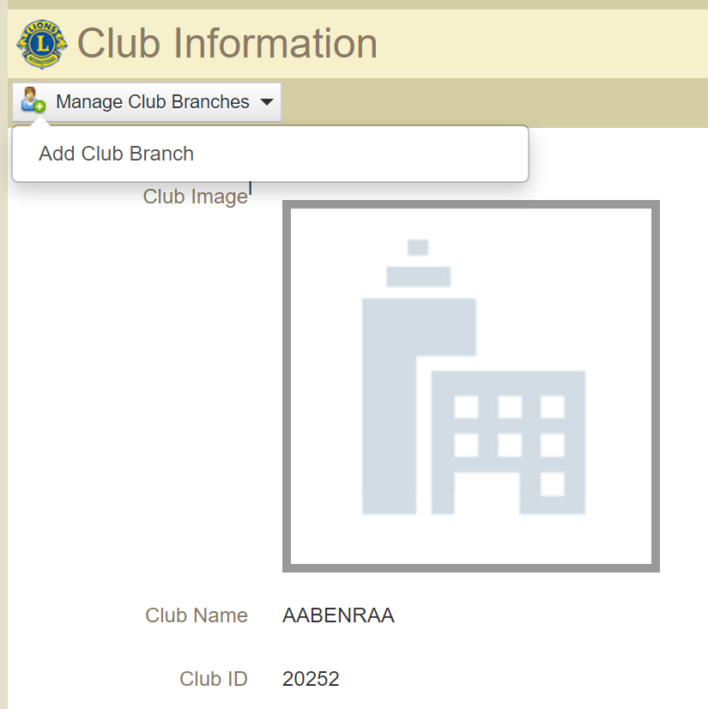
Step 2: Club Information Page continued
Click the dropdown tab that says, “Manage Club Branches”. For all new club branch submissions click the “Add Club Branch” button.
9

Slide 10
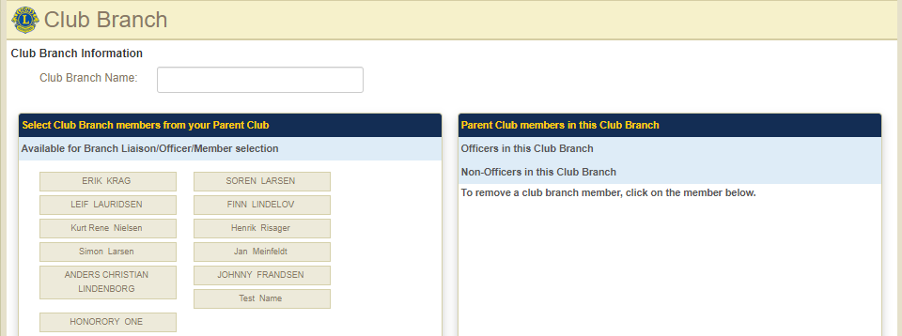
Step 3: Enter Club Branch Information
On this page all branch information will be entered, including branch name, assigning officers and entering branch members. **Special Note: All branch members must be entered in the parent club in order to add them to the branch in MyLCI.
Enter proposed name
Choose branch member left panel
On the right, click on the area to add member
10

Slide 11
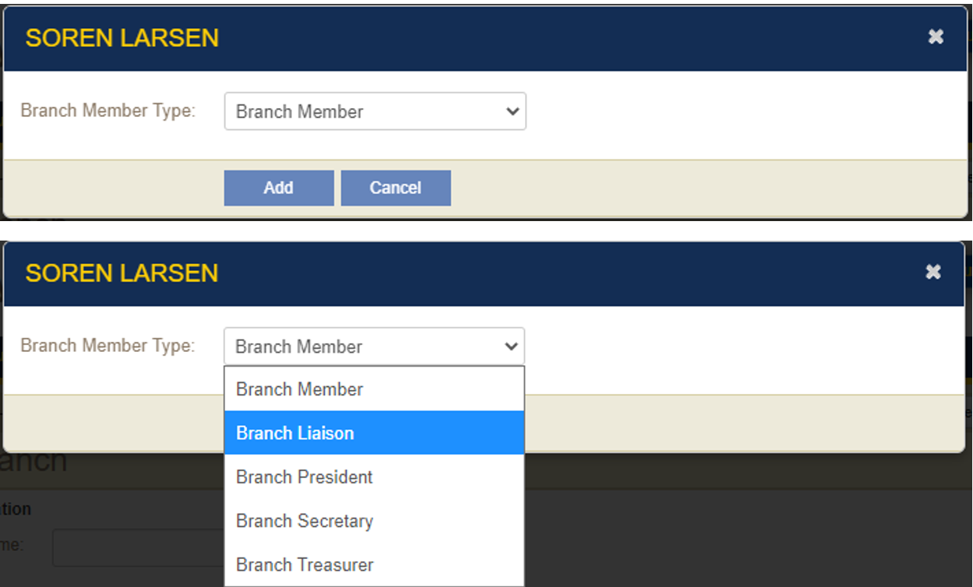
Step 4: Club Branch Member Information
When clicking on name, the prompts below will appear. Click on the drop down and add the branch member type.
11

Slide 12
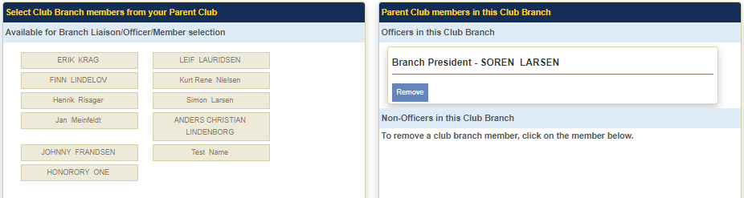
Step 4: Club Branch Member Information cont.
Once the membership type has been chosen, it will automatically add the member to the designated membership type in the panel on the right side. Review member information for accuracy. Click the “remove” button if a member should not be added to the club.
12

Slide 13
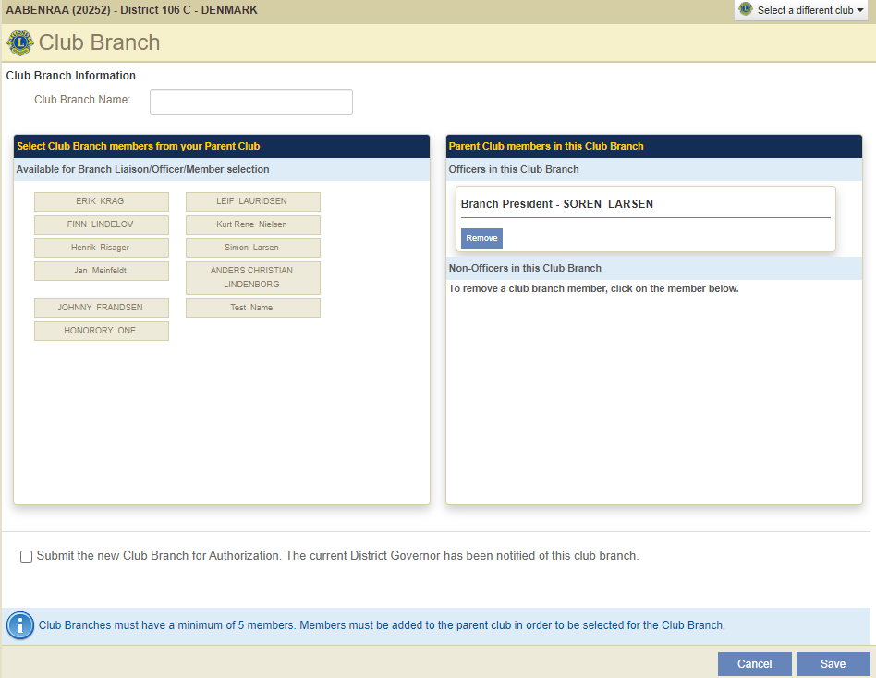
Step 5: Review and Submit
Review all club branch information prior to submission.
Confirm club name, officers and members are correct.
Once all information has been confirmed, click the submission button
Click “save”.
13

Slide 14
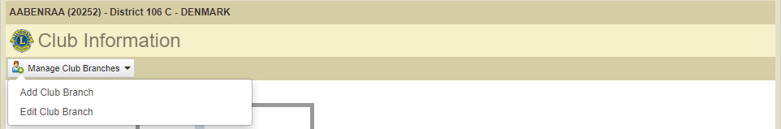
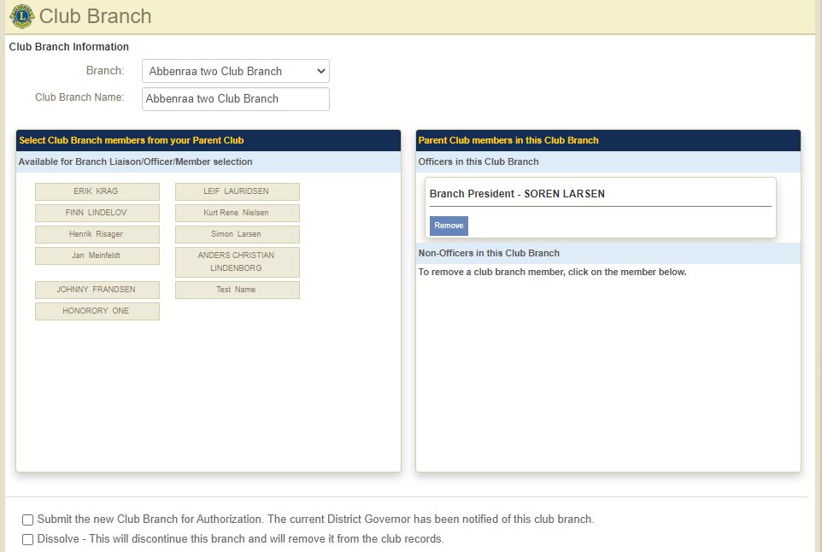
Step 6: Update Club Information Page
Once branch has been saved, sponsoring clubs can update branch information by clicking the “Manage Club Branches” dropdown.
Clubs can:
Add a club branch
Edit a club branch
Add members to the branch
Dissolve a branch.
14

Slide 15
Thank You
© 2019 Lions Clubs International
Updated 10/2021 EN

