Slide 1
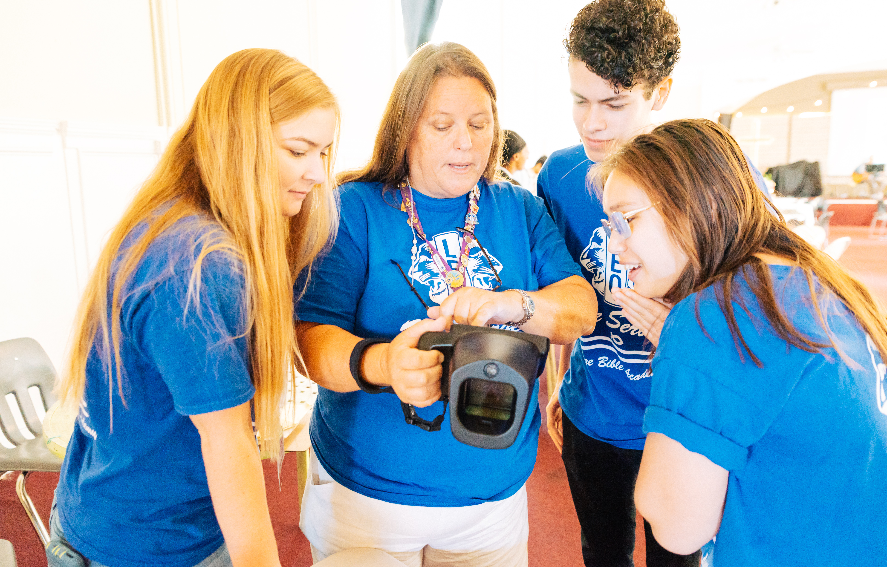



Leo Club Advisor
Training and Orientation
LIONS CLUBS INTERNATIONAL
1
Notes:
Instructor Note: LCI Headquarters designed this orientation and training program for Leo club advisors who are new to the role or have never received formal training about their role as a Leo Club Advisor. While the training will certainly not cover everything related to serving as a Leo club advisor, it provides the basic tools necessary to successfully carry out the duties of the position.
This training should be conducted under the guidance of a Lion trainer, such as a District or Multiple District Leo Chairperson, an experienced Leo Club Advisor who is familiar with resources and policies from LCI, or a Lion who has completed an LCI Faculty Development Institute or Lions Certified Instructor Program and is familiar with the Leo Club Program.

Slide 2


Module 1 // Leo Club Program Overview
Module 2 // The Role of the Leo Club Advisor
Modules
Module 3 // Leo Club Administration
Module 4 // Leo Club Program Resources
Module 5 // Continuing the Service Journey
2
Notes:
Instructor Note: This training is designed to present the modules all together or as stand-alone modules. The general recommendation is that instructors should review the material included in each section and determine the modules that are of greatest relevance to the Leo club advisors in the area. Training facilitators may choose to break the modules into various sessions or separate training programs.
Each module concludes with a suggested reflection or discussion activity. Reflection/discussion prompts can be used in many ways:
Individual reflection – encourage learners to make notes of their answers independently
Large group discussion – use a flipchart to capture responses
Small group discussion – allocate additional time for smaller groups to discuss first and then report back their ideas to the larger group
Please use the following time estimates as a guide when planning to deliver the training (activity times are estimates based on individual reflection or large group discussion):
Module 1 – 15 minutes + 15 minutes activity, Slides 3-15
Module 2 - 15 minutes + 15 minutes activity, Slides 16-24
Module 3 - 20 minutes + 10 minutes activity, Slides 25-41
Module 4 - 15 minutes + 10 minutes activity, Slides 42-58
Module 5 - 15 minutes + 10 minutes activity, Slides 59-84

Slide 3

Module 1
Leo Club Program Overview
3
Notes:
This module will cover:
History of Leo Club Program
Structure of Leo Club Program
Leo Club Objectives
Current Data of the Leo Club Program
At the end of this module, the participants should have basic knowledge to explain the Leo Club Program.

Slide 4
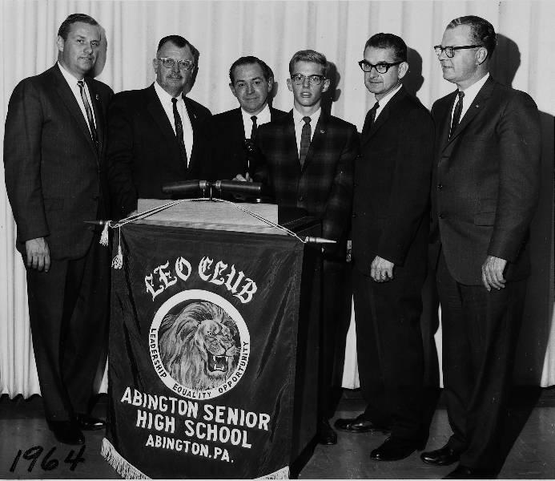
A brief history of Leo clubs
-1957-
First Leo club founded in Abington, Pennsylvania, USA
-1964-
Leo clubs became an official district project
in Pennsylvania
-1967-
The Leo club program became an official program of Lions Clubs International
4
Notes:
The Leo Club Program has been around for over 60 years.
1957 – The first Leo club was founded in Abington, Pennsylvania, United States by the Glenside Lions Club. Local high school baseball coach and active Lion Jim Graver chartered the first club on December 5 with 35 male high school students. The club created the acronym, “Leadership, Equality and Opportunity,” and then chose the school colors of maroon and gold to serve as the Leo club colors. “Equality” was later changed to “Experience.”
1964 – The Leo Club Program became an official district project in Pennsylvania and began rapidly expanding.
1967 – In October 1967, the Leo Club Program became an official Lions Clubs International program when the Board of Directors adopted it as an official program of the association.

Slide 5


Recent history of Leo clubs
-2008-
Two distinct Leo tracks created, Alpha and Omega
-2009-
Leo club advisory panel created
Age limits created for Alpha and Omega clubs
-2018-
Leo-Lion board liaisons appointed as the first youth representations on the Lions International Board
-2019-
Leo Club Program reaches 150 countries
5
Notes:
More recent history Leo history
2008 – Two distinct Leo tracks were created, .
2009 – The Leo Club Advisory Panel was created as an international board of advisors, with 32 Leos and Lions representatives from each of the Constitutional areas and separating Alpha Leos to ages 12 – 18 and Omega Leos to ages 18 – 30
2018 – Two Leo-Lion Board Liaisons were appointed to the Lions Board of Directors, serving as the first youth-appointed representatives.
2019 – Leo Club Program reached 150 countries.

Slide 6


The Leo club purpose
Leadership
Experience
Opportunity
6
Notes:
The purpose of the Leo club is to promote the service activities that develop the individual qualities of Leadership, Experience and Opportunity among young people in the community. The Leo program embodies those words by:
Leadership – Developing Leos’ skills as a project organizer, time manager and team leader.
Experience –Encouraging Leos to discover how teamwork and cooperation can bring positive changes in the community.
Opportunity – Creating lifelong connections to Leos as they see their impact through community service.

Slide 7
Leo Club Program objectives
To make available to Lions clubs an activity allowing them to serve the needs of youth in their respective areas.
To provide the youth of the world with an opportunity for development and contribution, individually and collectively, as responsible members of the local, national, and international communities.
To promote service activities among young people and offer them an opportunity to develop the individual qualities of Leadership, Experience and Opportunity.
As stated in Board Policy Manual, Chapter XXII
7
Notes:
The Leo Club Program is a youth development program. It adheres to the following objectives to grow the community of young people. As stated in Lions International Board Policy, Chapter XXII, the objectives are as follows.

Slide 8
Role of the sponsoring Lions club
Cover the Leo club charter and annual organization fees.
Ensure coverage to Leos under the General Liability Insurance Program provided by LCI and any additional local insurance needed.
Counsel Leo clubs in administrative and service issues.
Set up bank accounts, accounting, community partnerships for the Leo club.
Assign an energetic Leo club advisor, attend Leo club planned events.
8
Notes:
The sponsoring Lions club is responsible for guiding and counseling the Leo club.
Per Board Policy, Leo clubs are a service activity of a Lions club, not a membership category. Leos do not pay dues to Lions International headquarters. Instead, their sponsoring Lions club is billed for the maintenance and organization of the club.
The sponsoring Lions club must counsel Leo clubs in administrative and service issues, including setting up bank accounts, tracking accounting and establishing community partnerships. The sponsoring club also provides support through assigning an energetic Leo club advisor and attending Leo club events.

Slide 9

Why are Leo clubs important?
9
Notes:
Why are Leo clubs important? Through service, youth develop personally and professionally and have opportunities to improve their communities. Lions can gain valuable skills in mentorship while reaching a new audience in the community. Together, Lions and Leos form one family, partnered in service.

Slide 10
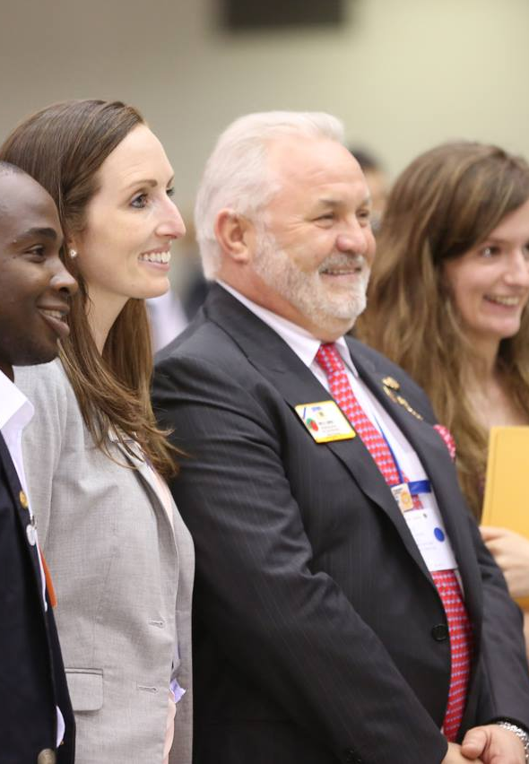
Benefits for a Lions clubs sponsoring a Leo club
Inspire and energize Lion’s members.
Inform Lions about new trends and community needs.
Increase Lions club exposure in the community.
Gain potential new members in the Lions club, with both graduating Leos and their parents/family members.
10
Notes:
There are great benefits to sponsoring a Leo club. A Leo club can help inspire Lion’s members to be more bold and innovative in their service projects and inform them on the newer community needs and technology. Sponsoring a Leo club can also increase the Lion’s club exposure in the community. And perhaps one of the largest benefits is that Leos and their families are potential members for a Lions club. Speaking to parents, siblings or family members of current Leos as well as attracting graduating Leos can be a great source of new members for the club. Club advisors should speak to Leos about their life-time journey of service, including taking the step to join the Lions club throughout a Leo’s career.

Slide 11
Sponsoring Lions club
Leo club advisor
Leo club board of directors
Leo club members
President
Vice president
Secretary
Treasurer
3 board members
Leo club organization structure
11
Notes:
A Leo club is structured very similarly to a Lions club, with the exception that all Leo clubs must be sponsored by a local Lions club and provided with a Leo club advisor.
Each fiscal year, Leo clubs elect four main club officers: the Leo club president, vice president, secretary and treasurer. Clubs can choose to create a board of directors and board committees to organized and oversee the business of the club with support and guidance from the Leo club advisor. Only a Leo club president, vice president, secretary and treasurer can be reported in MyLCI for a Leo club.

Slide 12

Alpha Leos: 12 – 18 years old.
Focused on service to the community and creating a strong foundation in leadership and responsibility.
Omega Leos: 18 – 30 years old
Focused on furthering personal and professional skills and creating a direct, positive impact on the community.
12
Notes:
Leo clubs are divided into two tracks: Alpha and Omega. All Leo clubs must be designated either as Alpha or Omega.
Alpha Leos are 12 – 18 years old. This track is designated for teens and focuses on individual and social development by creating strong foundation in leadership and responsibility.
Omega Leos are 18 – 30 years old. This track is designated for young adults and centers on personal and professional development as they focus on building community, furthering their skills and creating a direct, positive impact on society.
While youth and young adults have many things in common, these two groups are in very different life stages, and therefore require developmentally appropriate activities to accommodate their needs. For example, young people in their mid to late teens are likely concerned with graduating from high school/secondary school, while young adults in their mid-to-late 20s are likely preparing to graduate from university and/or begin their professional careers. With this background in mind, the Lions International board of directors determined that it was appropriate for Alpha-aged Leos and Omega-aged Leos to serve separately.

Slide 13
150,000+
reported
members
7,400+ clubs
150+ countries
Leos at a glance
13
Notes:
Lions International is the world’s largest service club organization, with approximately 1.6 million members. Regardless of the language Lions speak, religion they practice or politics they support, they all share a common dedication to helping people in need.
Leos are an integral part of the Lions International network, with approximately 7,400 clubs in more than 150 countries and geographic areas. The international scope of Lions International provides Leo and Lions club members a unique global identity.

Slide 14
Leos are around the world
Number of clubs by constitutional area
Top 10 Countries
Bangladesh
Brazil
Germany
India
Italy
Japan
Malaysia
Nepal
Sri Lanka
United States
80+
1100+
1700+
700+
1900+
500+
1100+
200+
14
Notes:
There are Leos in all of the Lions Constitutional Areas. The map shows the approximate number of Leo clubs per the different Constitutional Areas. The top countries with Leos are Malaysia, Germany, Italy, India, Sri Lanka, United States, Brazil, Bangladesh, Japan and Nepal.

Slide 15
Summary
Important points from the module
Leo stands for “Leadership, Experience and Opportunity.”
Starting a Leo Club Program can be beneficial to a Lions club as Leos offer new ideas, new energy and new potential members.
Leo clubs exist all around the world, and feature members 12 – 18 years old and 18 – 30 years old.
End of module activity
Brainstorm what activities a Lions club can do with a Leo club to welcome them to the Lions family. If the Leo club already exists, what are some ways to re-introduce Leos to Lions members?
15
Notes:
Instructor Note: For the optional end of module activity for Module 1, ask participants to spend 5 minutes brainstorming activities a Lions club can do with a Leo club to welcome the members into the Lions family. Encourage them to share their ideas with the group.
Examples: New clubs can host a social with food, collaborate on a fun service project, or appoint a Leo representative on the Lions club board. Existing clubs can invite Leos to the Lions club meetings, create joint fiscal year goals, or plan a joint service project.
Estimated Time: 15 minutes

Slide 16
Module 2
Role of Leo Club Advisor
16
Notes:
The Leo club advisor is critical to the club’s success, as they are there provide guidance for club’s leaders.
This module will cover:
Responsibilities of a club advisor, which is divided into five major responsibilities.
Differences between the types of Leo clubs
At the end of this module, participants will understand the role that a Leo club advisor plays in a Leo club.

Slide 17
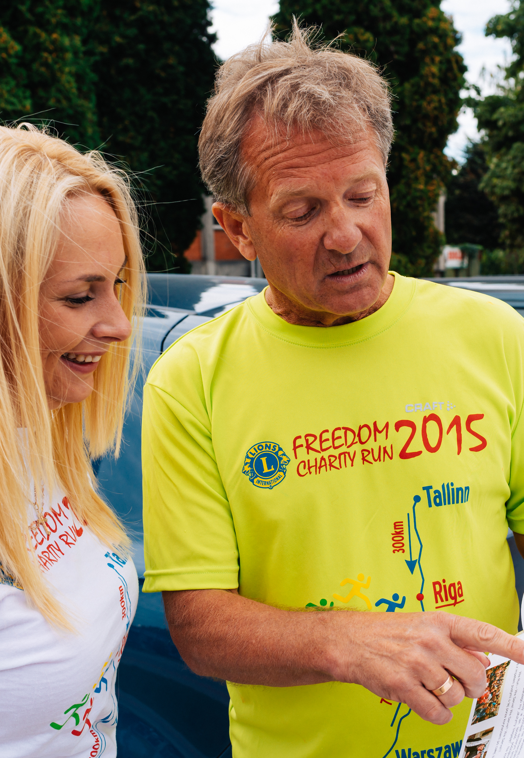
Role of Leo club advisor
Mentor
Motivator
Counselor
Liaison
Service Role Model
17
Notes:
When working with Leos, advisors fill the role of mentor, motivator, counselor and service role model. Advisors guide Leo club members in managing their club and developing effective community service projects to help increase confidence and leadership abilities.

Slide 18

Role of Leo club advisor
Mentor
Advisors teach and support the Leo club officers and help members reach their potential as leaders. They also teach Leos the importance of planning and organizing.
Motivator
Advisors should motivate youth, promoting peer acceptance, recognition of accomplishments and a sense of personal achievement.
18
Notes:
As a mentor, advisors teach and support Leo club officers and help members reach their potential as leaders. Advisors also teach Leos the importance of planning and organizing.
As a motivator, advisors understand the nuances of motivating youth and the factors that can empower them, such as peer acceptance, recognition of accomplishments and a sense of personal achievement. Although advisors should inspire Leos to participate in service activities, they should not impose their personal views on Leos.

Slide 19

Role of Leo club advisor
Counselor
Advisors must understand when to counsel the club and when to let Leos take charge and make their own decisions. Also be familiar with Lions Board Policy, Chapter XXII.
Liaison
Advisors act as the bridge between the sponsoring Lions clubs and Leo clubs in the district, multiple district, country and internationally.
19
Notes:
As counselors, advisors listen to Leos and understand their needs. They must know when to counsel the group and when to let Leos take charge and make their own decisions. Advisors must be familiar with the Standard Leo Club Constitution and Bylaws, which is available on the Lions International website in the official Board Policy Manual.
As liaisons, advisors act as the bridge between the sponsoring Lions clubs and the Leo clubs in the district, multiple district and around the world. They inform the Lions club of Leo activities and foster a healthy relationship between the two. It is crucial that advisors also create a roadmap to help transition Leos into Lions club members.

Slide 20
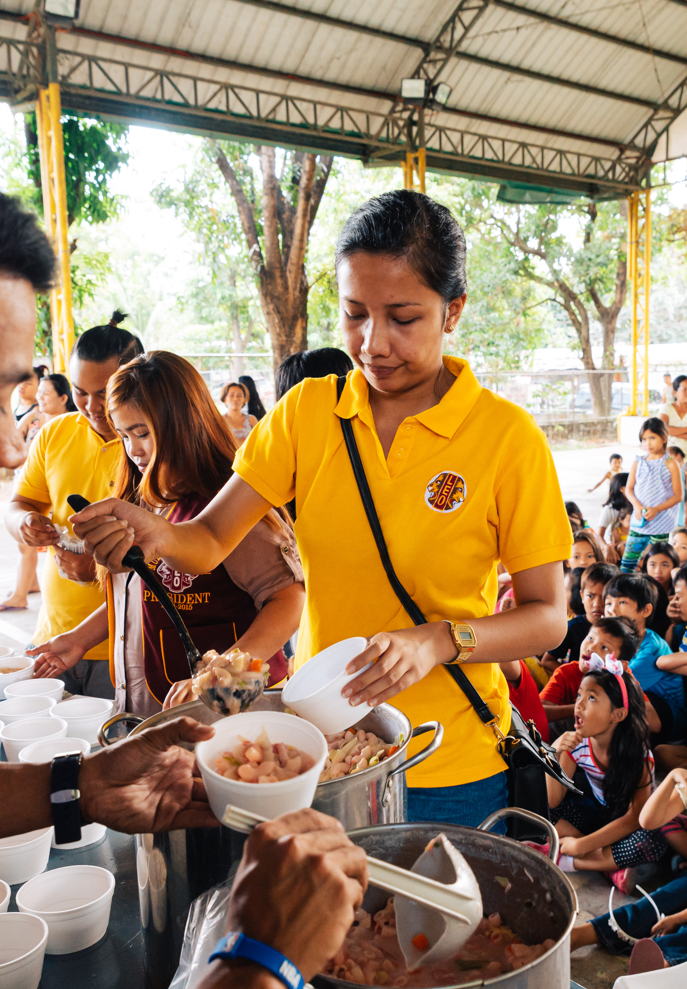
Role of Leo club advisor
Service role model
Advisors lead by example and demonstrate compassion for their communities and others.
20
Notes:
As service role models, advisors lead by example and demonstrate compassion for their communities and others, helping Leo club members understand the altruistic and compassionate aspects of community service. It is crucial that the Leo club advisor acts as a role model by not only showing the importance of service, but how they act at service projects and present themselves as representatives of Lions International.

Slide 21
Specific Leo advisor responsibilities
Oversee initiation and ongoing development of the Leo club.
Report Leo club officers and members in MyLCI and the Leo club’s service activities in MyLion.
Train Leo club officers to use MyLCI and MyLion for reporting.
Promote collaboration between Leos and sponsoring Lions club by regularly updating Lions on Leo club activities.
Attend Leo club and board of directors’ meetings.
Ensure new Leos receive new member materials and orientation.
Recognize Leos for their achievements.
Encourage eligible Leos to become Lions.
21
Notes:
In addition to serving as a liaison, mentor, motivator, counselor, liaison and service role model, Leo club advisors also fulfill a variety of other roles, including those shown here.

Slide 22
Difference between Alpha and Omega clubs
Alpha Leo club advisors
Takes an active role in guiding Leos through projects and meetings.
Corresponds between parents, schools and Lions club.
Omega Leo club advisors
Acts as a liaison between the Leo club and sponsoring Lions club.
Less directly involved in day-to-day administration as Leos take on more responsibilities.
Supports the personal and professional development of Leos.
22
Notes:
The approach to take with the Leo club will depend on the Leo club track.
An Alpha advisor should take a more active role in the Leo club, guiding the Leo members, as well as interacting with any parents, guardians and teachers involved. Younger Alphas typically need more direction than older Alphas.
Omega Leos work more independently. An advisor will fill the role of liaison between the Leo club and sponsoring Lions club, but once the club is up and running, the role will likely be more hands-off. The advisor is supporting the personal and professional development of Leos between the ages of 18 and 30, so should be cognizant of issues that are regular for college students, young professionals and young families.

Slide 23
Difference between school and community based clubs
Community-based Leo club advisors
Open to any eligible young person in a local area.
Meets at a central location in the community like a community center, religious space or school.
School-based Leo club advisors
Draws members from students of a local school.
Works with a faculty advisor, who may or may not be a member of the sponsoring Lions club.
Meets at school or determined space near the school
23
Notes:
An advisor’s approach may also depend on where the Leo club is located.
Community-based Leo clubs offer membership to any eligible young person within the local area of the Lions club. These clubs meet at a suitable location in the community like a community center, religious space or school. They can also meet virtually or have a hybrid meeting schedule
School-based Leo club advisors work as a liaison to the schools. Most school-based clubs require a faculty advisor who may or may not be members of the sponsoring Lions club. Some schools may charge a fee to the Lions club to have a club in their school. Faculty advisors are typically involved in the day-to-day affairs but should update the Leo club co-advisor frequently. Before the Leo club is organized the Lions club and school should agree with procedures for organizing club activities on and off school property, which adhere to school policies and Lion’s policies.

Slide 24
Summary
Important points from the module
Leo club advisors act as a mentor, motivator, counselor, liaison and service role model.
The way the Leo club advisor works with the club will depend on the type of club, the location and the Leos themselves.
End of module activity
Create a blueprint for success as a Leo club advisor by developing a strategy based on your type of club, location and each of the five characteristics into action.
24
Notes:
Instructor Note: For the optional end of module activity for Module 2, ask participants to spend 5 minutes individually developing their personal approach to serving as an effective Leo club advisor. This strategy or blueprint should include the how the advisor personally defines each of the following and plans to put these characteristics into action with his/her Leo club: mentor, motivator, counselor, liaison and service role model.
Example:
As an Alpha Leo Club advisor at a middle school, I will plan to meet with the faculty advisor once a month to touch base on the operations of the club.
Mentor: I will do quarterly check ins with the Leo club officers.
Motivator: I will encourage Leos to host at least one service project a month.
Counselor: I will encourage open communication between officers and myself when there’s an issue and not take sides when there’s a conflict.
Liaison: I will bring at least 3 Lions to every Leo project
Service Role Model: I will wear my Leo shirt at every service project
Estimated Time: 15 minutes

Slide 25
Module 3
Leo Club Administration
25
Notes:
It is important for Leo club advisors to have a clear understanding of the administrative responsibilities and obligations to ensure the Leo club is properly managed.
This module will cover key administrative aspects of Leo clubs including
Leo membership and reporting
Leo service activities and reporting
Leo club operations
Leo club fees and accounting
Privacy, insurance and branding
At the end of this module, the high-level administrative tasks of a Leo club advisor should be clear and understandable.

Slide 26
Application forms for Leo club membership
Leos interested in joining a club should submit a Leo club membership form (Leo 50A or Leo 50O) to the sponsoring
Lions club.
26
Notes:
Maintaining Leo club records is one of the first jobs of a Leo Club Advisor. All new Leo club members should fill out the Leo 50 membership form and submit it to the Leo club advisors or club officers. The information can then be used to put the members information in MyLCI. The sponsoring Lions club keeps the forms in their record and do not send them to International Headquarters.

Slide 27
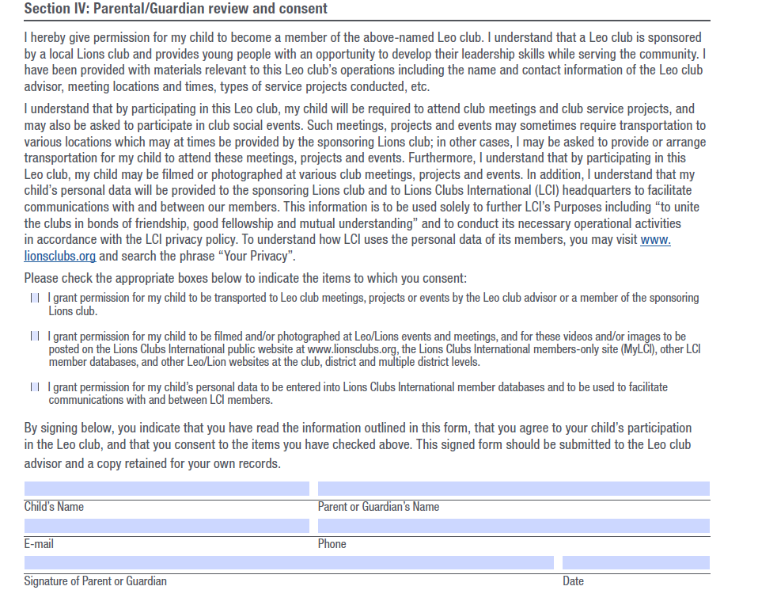
Parental consent for Alpha Leos
The Alpha Leo Membership form (Leo 50A) includes a parental consent section that must be completed
27
Notes:
The Alpha Leo Membership form (Leo 50A) is especially important for youth under legal age of majority in Alpha Leo clubs. The sponsoring Lions club must have an application form signed by one of their parents or guardians.

Slide 28
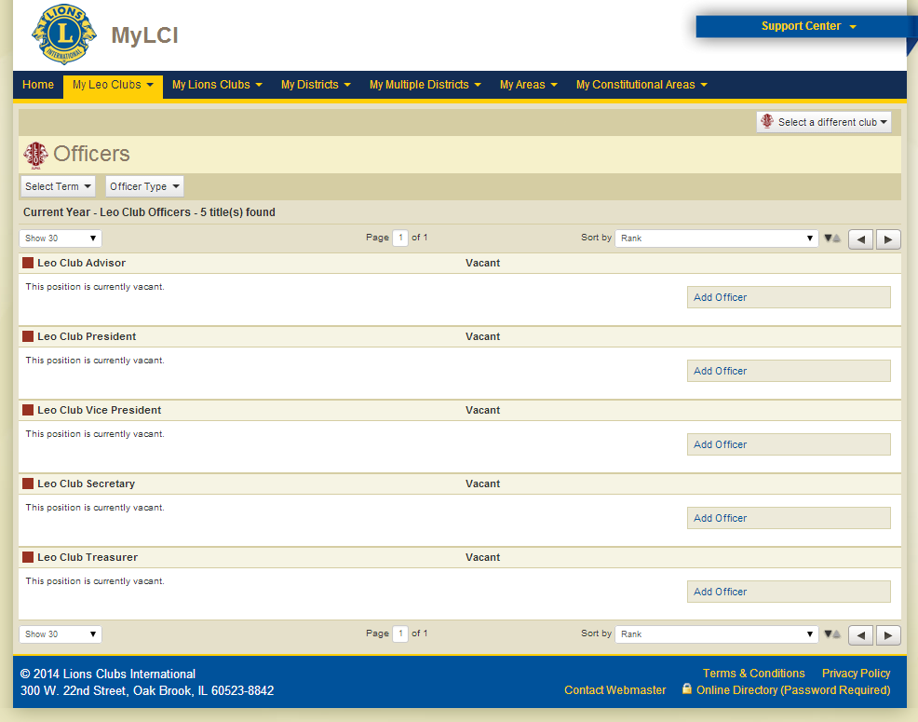
Importance of membership and officer reporting
28
Notes:
Each year, the sponsoring Lions club president or secretary must report a Leo club advisor, even if there are no changes. Leo club advisors can be reported online via MyLCI, or using the Leo-72 report form. After a Leo club advisor, Leo club president and Leo club secretary have been reported as the Leo club advisor, they can then log into their Lion account and view MyLCI and MyLion to report Leo club members, access member resources and submit service activity reports.
Reporting is one of the key responsibilities of being a Leo club advisor. The advisor must ensure all Leo club officers and members are updated and that the Lions club officers have officially appointed them to the role of Leo club advisor, ensuring that they receive regular communications and program updates. When a new Leo member is added to MyLCI, the advisor can download a Leo membership card and Leo membership certificate for the new member.

Slide 29
MyLCI membership reporting access
Officer Title | Reported By | Access
Leo club president | Leo club advisor/ sponsoring Lions club president | Report members for their own Leo club
Leo club secretary | Leo club advisor/ sponsoring Lions club president | Report members for their own Leo club
Leo club advisor | Leo club advisor/ sponsoring Lions club president | Report members for their own Leo club
Sponsoring Lions club president | Lions International | Report members for Leo club that the Lions club sponsor
Sponsoring Lions club secretary | Lions International | Report members for Leo club that the Lions club sponsors
District Leo chairperson | District governor | Report Leo district officers
Multiple district Leo chairperson | Council chairperson | Report multiple district officers
29
Notes:
This is a list of officers that have the ability to report Leo members in in MyLCI.

Slide 30
Importance of service reporting
In MyLion, Leos and Lions can schedule upcoming service projects and report past service projects, providing the number of volunteers and the number of people served.
Reasons to report
  Showcase impact of the Leo club.
  Measure the global growth and impact of Leos around the world.
  Service activity awards and recognitions.
30
Notes:
Service reporting is done for Leo clubs in MyLion. Unlike MyLCI, all Leos have access to a MyLion account with a member ID number. Any member can create a project for their club, but only the Leo club advisors, presidents, secretaries can approve it. Reasons to report include:
Demonstrating the impact of your Leo club.
Helping Lions Clubs International measure the global growth and impact of Leos around the world.
Opening the Leo members and clubs up for service reporting awards.

Slide 31
MyLion service reporting access
Officer Title | Access
Leo club president | For their own Leo club
Leo club secretary | For their own Leo club
Leo club advisor | For the Leo club to which they are assigned as an officer
District Leo chairperson | On behalf of the Leo district
Leo district president | On behalf of the Leo district
Leo district secretary | On behalf of the Leo district
Multiple district Leo chairperson | On behalf of the Leo multiple district
Leo multiple district president | On behalf of the Leo multiple district
Leo multiple district secretary | On behalf of the Leo multiple district
31
Notes:
This is a list of officers that have the ability to report service activities in MyLion.

Slide 32
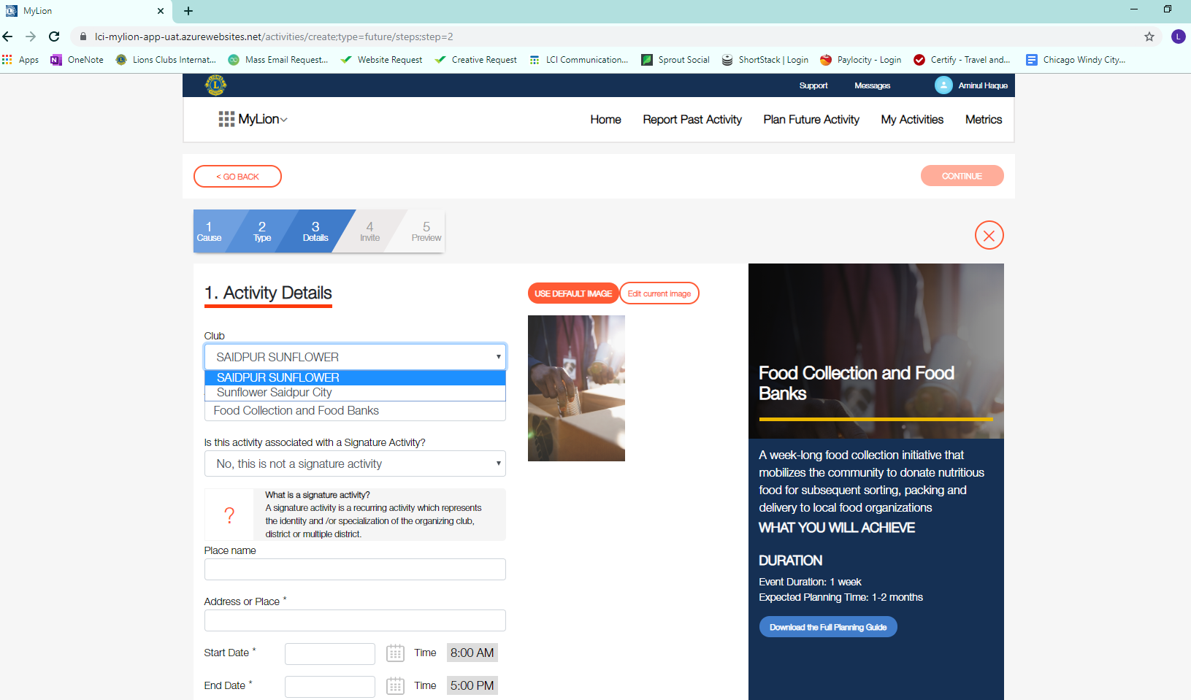
MyLion service reporting access
In the drop down menu under Club, select the Leo club name
32
Notes:
When a Leo club advisor reports for a Leo club, they should make sure to select the Leo club name in the drop down menu for club under “Activity Details”, not their Lions club name. This screen shot shows what the Leo club options are under “Plan Future Activity.” A Leo club officer will only show the Leo club name in this section.

Slide 33
Leo club officer roles
Board of Directors
Leo Club President
Leo Club Vice President
Leo Club Secretary
Leo Club Treasurer
Leo Club Advisor
Three Leo club directors
Meetings
Regular meetings at time and place agreed on by club members.
Consider if in person, virtual and hybrid meetings work best for you.
33
Notes:
Similar to a Lions club, Leo clubs should designate a Leo Club Board of Directors which includes all Leo club officers and three Leo club members elected to serve as directors on the board. The Leo club advisor should work with the board of directors to oversee the club activities.
Responsibilities of the board of directors include control and supervision of the club’s activities such as project planning, membership growth, fundraising, and leadership development opportunities. The board of directors should present an annual report of these activities and operations to all Leo club members and the sponsoring Lions club each year. The board is also responsible for executing club policies, developing new policies, and submitting proposed policies for approval by Leo club members. Finally, the board of directors oversees committees and officers and also sets the direction of the Leo club. For more overview, visit the Leo Club Advisor page with links to Leo officer overviews. https://www.lionsclubs.org/en/resources-for-members/resource-center/leo-club-advisors
Leo clubs should meet regularly at a time and place agreed upon by club members and set forth in the club bylaws. Meetings should take place regularly at a convenient location. Clubs should also consider whether holding meetings in person, virtually or mixture of the two would work best for their members.
Leo club officers hold various responsibilities in managing club meetings. To start the meeting, the president calls the meeting to order. The secretary maintains attendance records and meeting minutes, while the treasurer provides an update on the club finances. As the Leo club advisor, it is your responsibility to help guide the meetings and ensure that Leos understand their responsibilities and fulfill the demands of their positions. Ideally, the Leo club advisor, or a designated representative of the sponsoring Lions club, should be present at all Leo club meetings.

Slide 34

Leo club officer elections
Elections take place during the
fourth quarter of each fiscal year
and elected individuals take office on July 1.
Voting protocol:
  Nominations of candidates should be made in writing prior to election or announced from the floor.
  Voting is conducted by secret ballot.
  Elected candidates must receive majority of votes by members present and in good standing.
34
Notes:
A Leo club advisor should be closely involved in the supervision of the Leo club officer elections and act as a reference for the Leos should there be any questions or discrepancies. Elections should take place during the fourth quarter of each fiscal year, with elected individuals taking office July 1. School-based clubs may opt to hold elections during a different time of the year, as fits with school policy and practices.
Voting protocol is shared here, however more detail can be found in Chapter XXII of Lions International Board policy. When in doubt, refer to Chapter XXII of the Lions International Board Policy Manual for specific details related to Leo club voting and protocol.

Slide 35
Officer installation and new member induction
Installing new members and officers is a pivotal part of starting Leos on their journey in a Leo club. Review the Leo Induction Ceremony guide for more details.
35
Notes:
Advisors should ensure that each member is properly inducted and that each year an officer installation occurs to hand over responsibilities from previous officers. The Leo Induction Ceremony guide provides a script for hosting those events.

Slide 36
Leo club fees
International fees
Organization fee of US$100 covers processing and charter kits (one time).
Annual Leo levy of US$100 cover yearly processing, billed in July.
*paid by the sponsoring Lions club
Club/district fees
Leo club membership dues: Determined by Leo club.
Leo district/multiple district membership dues: May be requested by Leo districts/multiple districts.
36
Notes:
In an effort to maintain pace with the ongoing growth and development of the Leo Club Program, certain fees are assessed both by the international headquarters office and the local Lions administration. These fees support the development of resources for Leos, such as the Leo Leadership Grant Program, e-Leoclubhouse, MyLCI for Leos, the Leo Facebook page, a refreshed Leo brand and promotional materials, and many more.
The charter fee of US$100 is billed directly to the sponsoring Lions club at the time of a new Leo club’s organization. Because Leos are considered a service activity of a Lions club, sponsoring Lions clubs may remit payment for Leo club sponsorship using their administrative or activity account. The fee covers charter processing and the charter kits, which includes a certificate of organization (charter), Leo club officers' kit, Leo club sponsor kit and Leo lapel pins for each original Leo club member.
The annual Leo levy is a US$100 yearly fee for each active Leo club. The Lions clubs are billed an annual Leo club sponsor levy of US$100 each July to cover Leo Club Program materials, mailings, club record maintenance, communications, awards, program resources and insurance.
Club and district fees
While International Headquarters does not collect dues from Leos, individual Leo clubs may collect dues or admission fees to offset costs related to the annual Leo levy or other administrative expenses. The Leo club dues are determined by the individual club and should be specified in the club constitution and bylaws.
It is important to keep in mind that any dues or assessments on Leo club membership should be nominal and should only be for the purpose of covering the club’s administrative expenses. Generally speaking, funds for activities and projects undertaken by Leo clubs should not be collected through member dues or fees.
Any Leo club member who has failed to pay their member dues to the club at the time of a vote at any regular or special meeting will forfeit the privilege of voting and be considered as not in good standing until the dues are paid.
It’s also important to note that if a club falls within a Leo district or Leo multiple district, they may assess additional club or member dues.
If a Leo club is no longer active, the Leo Club Termination Form (Leo-86) must be received by the Leo Club Program Department by October 31 to receive a credit of US$100 for the current year’s Leo levy only.

Slide 37
Administrative funds versus activity funds
Administrative funds
Admission fees and annual dues from club members.
Used for administration and operating expenses.
Activity funds
Money raised from public fundraising projects.
Must be used for charitable purposes.
How funds are raised | Use for public projects? | Use for admin expenses?
Administrative – dues and admission fees | Yes | Yes
Public collection – any fundraising event open to the public, public contributions and bequests | Yes | No
Interest | Yes | No
37
Notes:
Some Leo clubs use the existing bank accounts of their sponsoring Lions club, while other Leo clubs may open their own bank accounts under the supervision of the sponsoring Lions club. If a Leo club chooses to open a bank account, two signors are required – the Leo club secretary or treasurer and a designee of the sponsoring Lions club. The Leo who is granted the authority to oversee this bank account should be able to open/co-sign a bank account and execute checks in accordance with local laws.
It is important that club have two distinct funds to separate the administrative activity from the public or fundraising account. The administrative funds should be used to support club activities and pay local dues, if applicable. The fundraising account should be used to support the club’s community service activities. With the consent of the board of directors, funds may be transferred from the administrative account to the activity account.
Leo clubs that have bank accounts should specifically state how the account will be handled and maintained in the club’s constitution and bylaws.

Slide 38
Lions International privacy policy
and liability insurance
Personal Information Usage
  Dues and other billings
  Distribution of information/updates
  Support of membership growth, extension and retention programs
  Convention and meeting planning
  Furtherance of public relations activities
  Support of Lions clubs, the International
  Foundation (LCIF) and other adopted service programs
  Special advertising and other purposes as determined by the International Board of Directors
Commercial general liability insurance
All Lions clubs, Leo clubs and districts are named insured under the Lions Clubs International General Liability Insurance Policy.
US$2,000,000 general aggregate coverage is provided by Lions International.
A Certificate of Insurance is available upon request through the Lions International website.
Additional liability insurance is available.
38
Notes:
Personal information that is collected by Lions International is used solely for operational activities, which include dues, distribution of updates, support of membership growth, convention and meeting planning, furtherance of public relations, supporting service programs and special advertising.
It is of course our hope that no harm or damage would ever occur as a result of Lions or Leo activities, but the truth is that accidents happen and clubs should be informed of their insurance and liability coverage. Leo clubs have the exact same coverage as Lions clubs and are automatically insured and covered under the general liability insurance policy of Lions Clubs International.
If you have any questions related to the specific coverage policy, please visit the LCI website or contact the Legal Division at legal@lionsclubs.org.

Slide 39
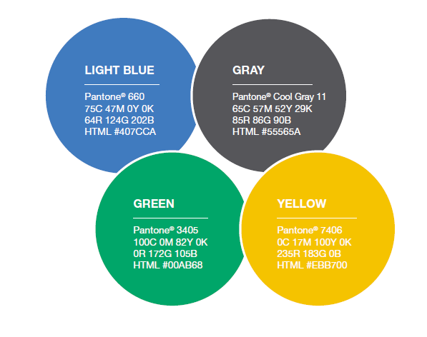
Leo and Lions emblems
39
Notes:
The official colors and logos of the Leo Club Program are light blue, gray, green and yellow. The Leo and Lions emblems are registered trademarks of Lions International. Downloads of the logos are available on the Lions International website at https://www.lionsclubs.org/en/resources-for-members/resource-center/logos-and-emblems.
There are rules on usage for these logos and emblems. Leo logos may be reproduced by the Leo club for usage on stationery, websites and other printed materials. Emblems cannot be used on any item sold to members or the general public for fundraising purposes. It’s important that clubs use the Leo logo properly and follow the Leo brand guidelines.

Slide 40

Important dates
October: Leo Membership Growth Month
December 5: International Leo Day
April: Leo Club Awareness Month
Last week of June:
Lions Clubs International Convention
40
Notes:
Throughout the year, many special events take place to celebrate the Leo Club Program and recognize Leos for their contribution to the overall humanitarian work of Lions Clubs International.
In October, Leo clubs host membership drives and individual Leos will receive recognition for inviting youth into the club.
On December 5, the chartering of the very first Leo club in 1957 is commemorated. Known as International Leo Day, December 5 is a day of celebration and promotion of the Leo Club Program.
April is Leo Club Awareness Month, which calls on Leos and Lions to spread the word of Leo clubs and the great services that they provide to their communities and the leadership opportunities available to youth through this program.
And finally, at the end of the fiscal year Leos gather at the International Convention, where they participate in events, seminars, celebrations, and service activities

Slide 41
Summary
Important points from the module
US$100 annual fee to sponsor a Leo club.
Reporting Leos shows the impact of the Leo club to Lions International; records must be updated yearly with each election.
Leos are covered under Lions’ insurance.
Leo logos are allowed to be used on promotional materials, communications and websites, but can’t be used on items sold for profit.
End of module activity
Discuss topics related to Leo club administration that advisors should be most concerned about. Get advice from current Leo club advisors on best tips for staying on top of administrative tasks.
41
Notes:
Instructor Notes: For the optional end of module activity for Module 3, ask participants to share what topics they’re most concerned about with the new Leo club advisor role. Invite current Leo club advisors to share best practices for working with their club.
Example: Lions who are wondering on how to run a successful officer election can ask current Leo club advisors for their voting operations and platforms.
Estimated Time: 10 minutes

Slide 42
Module 4
Leo Club Program Resources
42
Notes:
The Leo club resource module includes an overview of support provided by Lions International along with many resources for Leo club advisors. The module will cover:
Leo club resources
Leo club communications
Leo grants
At the end of this module, advisors should know all the resources that Lions International offers to support Leo clubs.

Slide 43
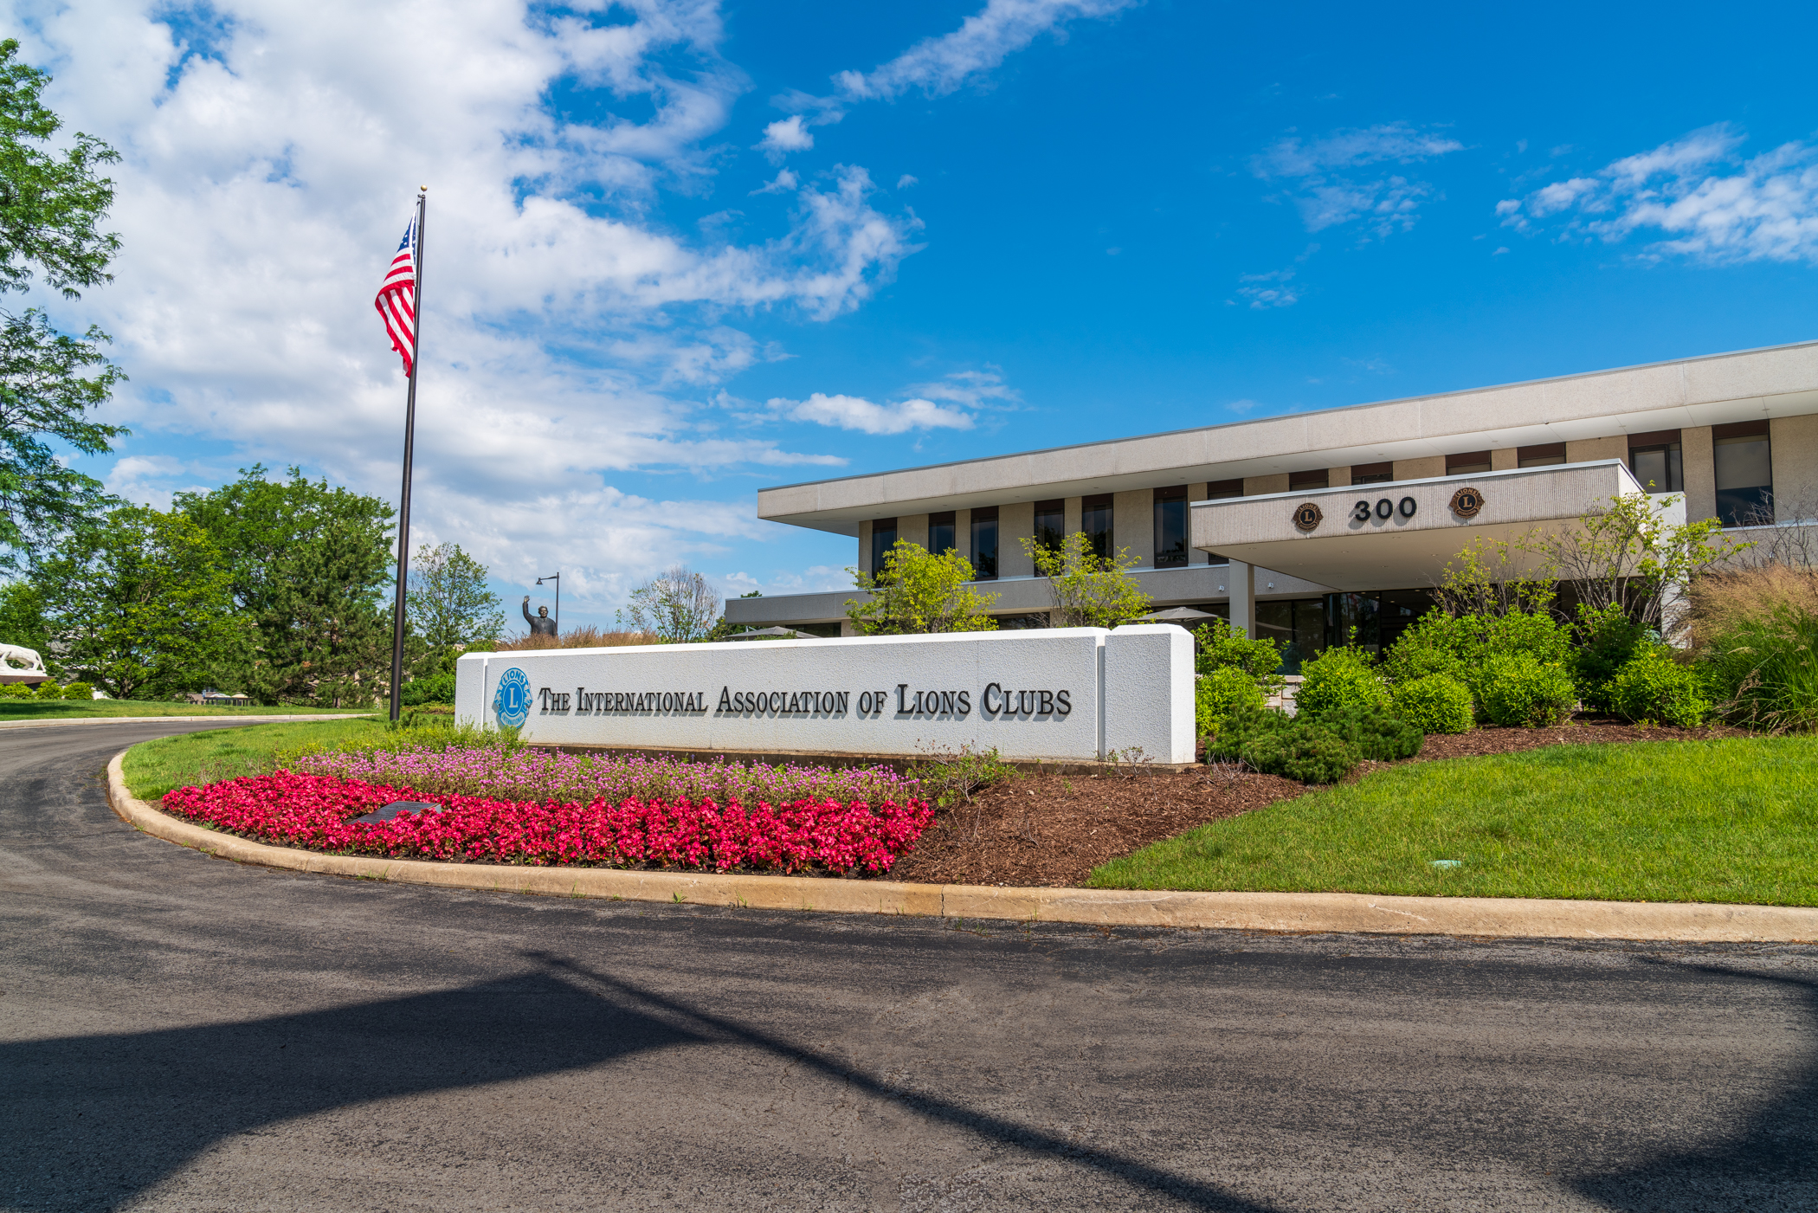
International Headquarters
Oak Brook, Illinois USA
300 W 22nd Street
Oak Brook, Illinois 60523 USA
43
Notes:
Lions Clubs International Headquarters is located in Oak Brook, Illinois, USA. There are 300 Lions International and LCIF associates here, providing support for Lions.

Slide 44
Leo Club Program resources
Leo page on the Lions website
Leo Marketing and Recruitment Materials
Leo Items from the Lions Shop
Leo eNews
Leo Facebook Page
Lions Learning Center and Leadership Institutes
Leo Leadership Grant Program
LCIF Leo Service Grant
Leo Constitutional Area Events, Lions Clubs International Convention
Awards and Recognition
44
Notes:
Here is the list of Leo Club Program Resources provided by Lions International Headquarters. The module will cover each of these in the following slides. For links to all the resources, visit www.lionsclubs.org/leos.

Slide 45
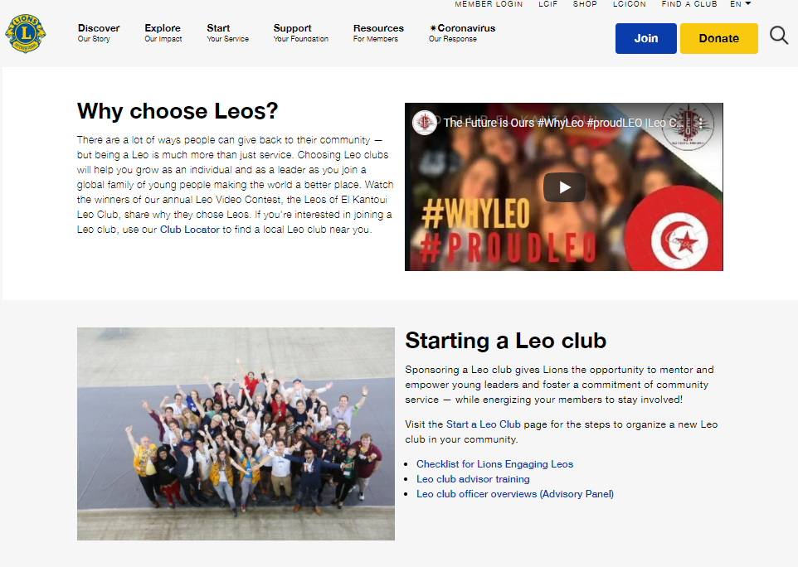
www.lionsclubs.org/leos
45
Notes:
The first place an advisor should visit is the Leo page at www.lionsclubs.org/leos. This page has links to all of the Leo club resources and other pages to explore related to Leo clubs on the Lions International website.

Slide 46



Online resources
46
Notes:
Lions International has created online resources to help market Leo clubs online and more. Leo advisors can find links to the Leo resources under the “Helpful Leo resources” section of the Leo webpage, or by visiting the Lions International website’s Resource Center and selecting the Leos audience.

Slide 47

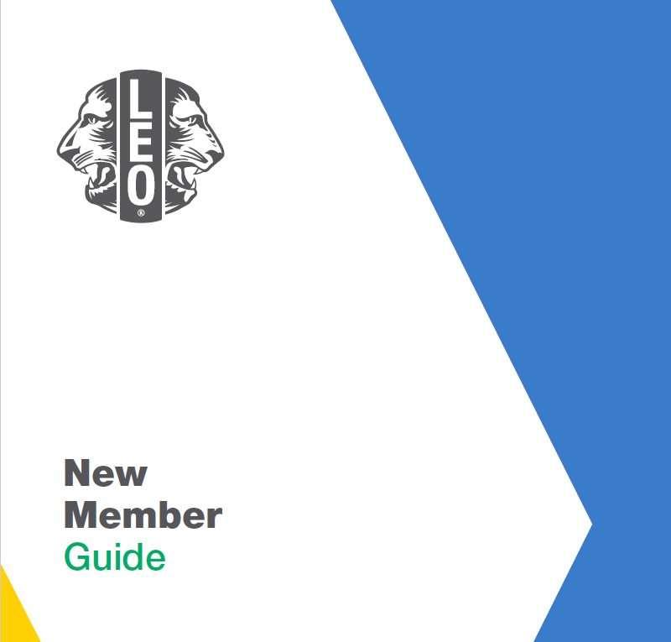


Leo club marketing and recruitment resources
47
Notes:
Lions International has several brochures, posters and guides on Leos which can be downloaded from the website. Lions can also place orders to receive printed materials.

Slide 48
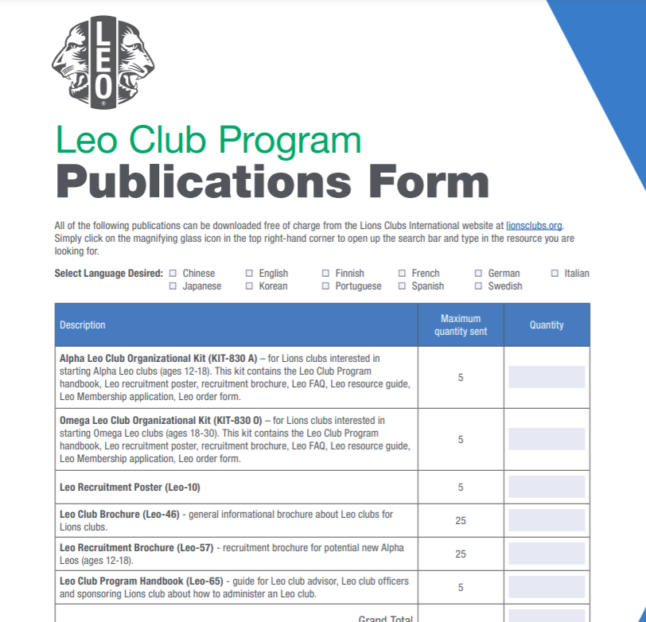
For printed Leo recruitment materials:
Search “Leo Club Program Publication Order Form” on lionsclubs.org for printed Leo recruiting materials.
Submit completed form to leo@lionsclubs.org.
48
Notes:
The Leo Club Publication Form has the full list of printed resources Lions International offers. Orders can be placed submitting a Leo club program order form to leo@lionsclubs.org. Resources are free of charge, but the Lions club, district or multiple district must pay shipping.

Slide 49


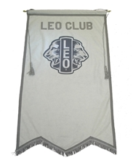
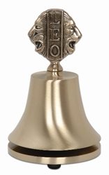
Leo club items from the Lions Shop
Available from the Lions Shop (https://lionsclubsinternational.myshopify.com/collections/leos):
  Leo new member kits
  Leo apparel
  Leo club meeting accessories
  Leo certificates and plaque
  Leo club officer lapel pins
  Leo membership pins
49
Notes:
The Lions Shop has a Leos section that features items for new Leo members and Leo club meetings, including Leo new member kits, Leo lapel pins, Leo bells and Leo apparel.

Slide 50
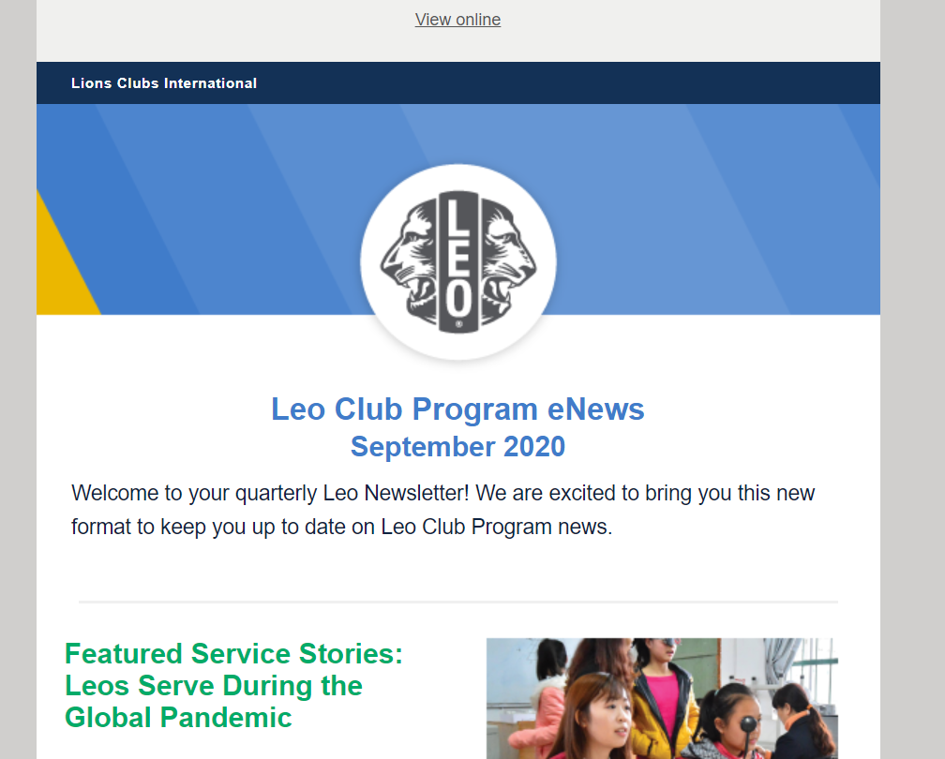
Leo eNews
Quarterly eNews sent by leo@lionsclubs.org with up-to-date information and announcements about the Leo Club Program.
eNews is sent to every Leo club and Leo club advisor that has an email address recorded in MyLCI.
50
Notes:
All Leo club officers, Leo club members, Leo club advisors and district/multiple district Leo chairpersons who have been reported for the current fiscal year and provided a unique email address will automatically receive the Leo eNews from International Headquarters. The eNews is sent quarterly and provides important information about upcoming deadlines, events and resources for Leos and Lions involved in the Leo Club Program.
Advisors that have reported their contact details to International Headquarters and are not receiving the Leo eNews should contact the Leo Club Program Department to inquire.

Slide 51
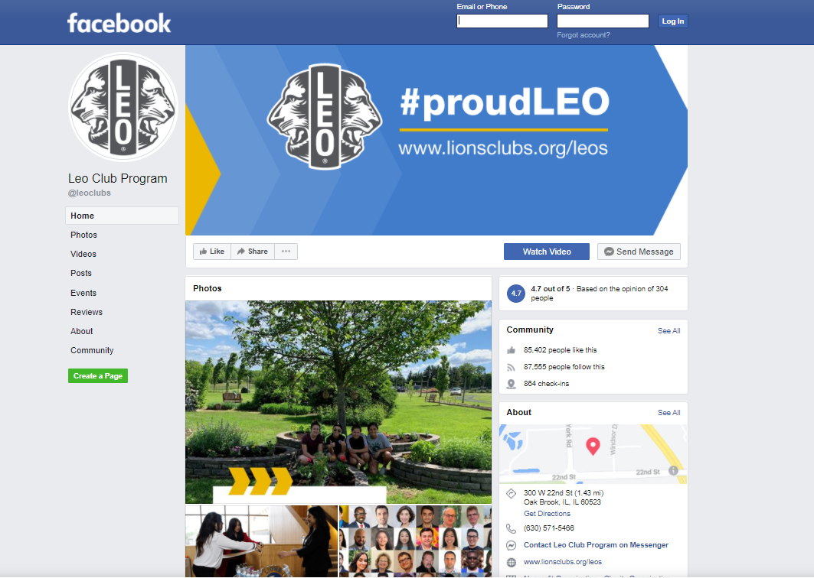
Leo Facebook page
51
Notes:
The Leo Facebook page provides Lions and Leos with quick access to the latest news and developments within the Leo Club Program. The Facebook page also serves as a platform for Leos around the world to connect and share ideas on topics such as effective community service projects or being a good leader. Like the Leo eNews, it’s also a great way to stay informed of the latest news and events related to the Leo Club Program. Follow the page at www.facebook.com/leoclubs.

Slide 52

Leo Club Advisory Panelist
The Leo Club Advisory Panel is a 32-member board, made of two Leos and two Lions from each constitutional area.
Applications are due August 15.
52
Notes:
The Leo Advisory Panel is an advisory board of 32 Leos and Lions from each constitutional area that meet monthly and work on committees, providing feedback to Lions International and creating resources to help the Leo Club Program. The panel works on three committees that focus on Leo recruitment, Leo membership experience and Leo-to-Lion transition. Each committee has created PowerPoints and guides that are available on the Lions website. Applications are due each year on August 15.

Slide 53
Leo or Leo-Lion Cabinet and Council Liaisons, Leo-Lion Board Liaisons
The district governor/ council chairperson can appoint a Leo or Leo-Lion to serve a one year term at the Lions District/ Multiple District as a district liaison. This position represents the interests and perspectives of Leos and Leo-Lions and facilitate communication and connections.
The Leo-Lion Board Liaison is an international opportunity for two Leo-Lion members to serve as part of the Lions International Board of Directors. The liaisons are selected by the Lions International President to serve a one-year term as a non-voting appointee.
To learn more about each role, refer to Chapter III and VII of Lions Board Policy.
53
Notes:
A Leo or Leo-Lion can be appointed to serve at the Lions District or Lions Multiple District.
Leo-Lions also have the opportunity to serve as official liaisons to the Lions Club International Board of Directors. Two Leo-Lion are appointed annually to represent the interests and perspectives of young people.
To learn more about these positions, refer to Chapter III and Chapter VII of the Board Policy Manual. https://www.lionsclubs.org/en/resources-for-members/resource-center/board-policy-manual

Slide 54
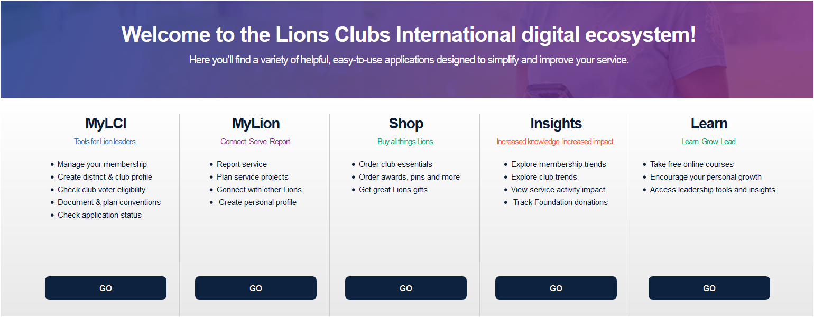
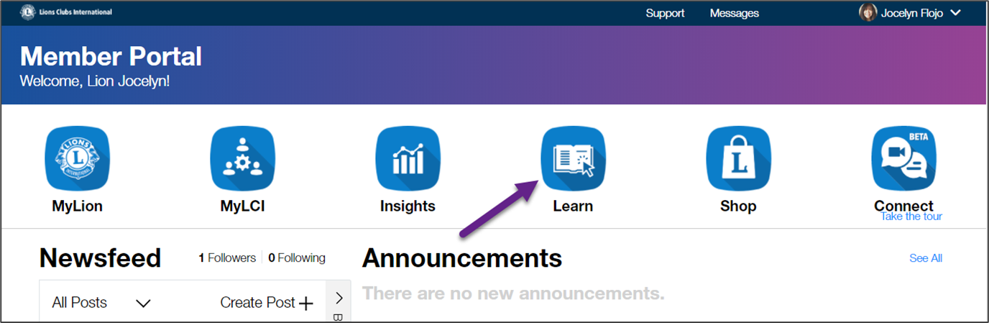
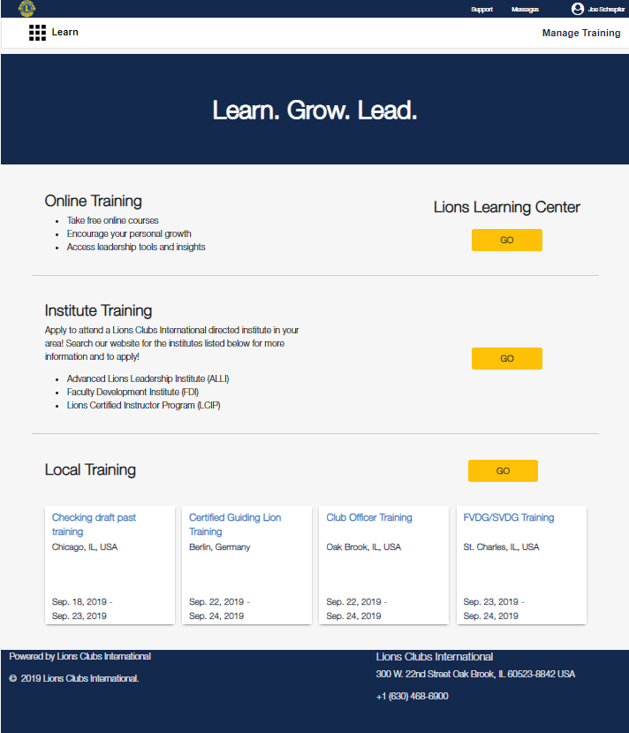
Lions Learning Center
Lion Account needed
Updated courses from Lions Learning Center
54
Notes:
The Lions Learning Center (LLC) provides Lions and Leos with the opportunity to develop leadership skills through online learning courses accessible through the Lions website. A Leo will need Lion Account credentials to log in and navigate to the Learn digital tool.

Slide 55
Leo Leadership Grants
Provides financial assistance to Lions multiple districts, sub-districts or single districts interested in organizing a Leo leadership event.
US$2,000 reimbursable grants
Up to three grants per constitutional area
Leos present or co-present sessions
Leos serve on conference planning committee
Standalone event
Lions and Leos collaborate
Accepted between
July 1 and May 1.
First come first served.
55
Notes:
The Leo Leadership Grant offers Leos an opportunity to develop their leadership skills through a training or conference created with the specific needs of Leos in mind. Grants to help fund such conferences or trainings are available to Lions districts, multiple districts and constitutional areas. These trainings must address the development of Leos’ leadership skills, specifically in the areas of project management, teamwork, communication, innovation or planning community service projects.
Lions International awards up to US$2,000 each fiscal year. To be considered for grant funding, grant applications must be submitted and approved prior to holding the event. Applications are reviewed in the order in which they are received beginning July 1 and are accepted on a rolling basis until May 1 of each fiscal year. Grants are awarded to eligible applicants based on the content and quality of the planned Leo leadership event. Applications are found on lionsclubs.org/leogrants

Slide 56
LCIF Leo Service Grants
Provides financial assistance to Leo service projects implemented by Leo clubs in a Lions multiple district or district.
US$1,500 to US$5,000 to a Lions district or multiple district
25% matching requirement collected locally
Should include:
  Hands-on service
  Collaboration between Leos and Lions
Accepted between
July 1 and May 1.
First come first served.
56
Notes:
The LCIF Leo Service Grant was started in 2018 to help provide financial assistant to Leo service projects. A Lions district or multiple district can apply for up to US$5,000, regardless of the number of clubs involved or the type of club, with a 25% matching requirement mobilized by the local Leos and Lions. This grant is the first grant that LCIF has created just for Leos. Leo clubs looking to complete a project that has a strong service component, Leo/Lion collaboration or meets an unmet humanitarian need in the community should consider applying for this grant. If you have any questions, please email LCIFLeoGrants@lionsclubs.org.

Slide 57
Leo awards
Lions International offers various awards to recognize Leos and Lions active in the Leo Club Program. Below are just a few award types, but for criteria and more details, please visit the Lions website at https://www.lionsclubs.org/en/resources-for-members/resource-center/leo-awards-and-recognitions
Individual
Leo of the Year
Club
Club Excellence Award
Serving Together Award
District/ Multiple District
Leo District President Awards
57
Notes:
Lions International offers a variety of awards and recognition for Leos and Lions involved in the Leo Club Program. Some awards are meant for individual Leos and Lions, while others are designed to recognize Leo clubs, districts, or multiple districts. For more detailed information, including a full listing of awards and application forms, visit the Leo webpage at lionsclubs.org/leos.

Slide 58
Summary
Important points from the module
Lions International has both free printable online guides for Leo clubs and items in the Lions Shop available for purchase.
Lions International communicates to Leo clubs via the leo@lionsclubs.org email and Facebook Leo Club Program page.
There are 20 award programs to recognize outstanding Leos.
End of module activity
Reflect on the blueprint developed at the end of Module 2. What resources will you use to help achieve or augment your plans?
58
Notes:
Instructor Notes: For the optional end of module activity for Module 4, ask participants to reflect on the blueprint you developed at the end of Module 2. Ask what resources they will use to help achieve or augment the plans they made to have a successful club.
Example: Advisors who planned to host a recruitment night at the school can plan to order some brochures and posters from Lions Clubs International by filling out the Leo Club Program Publication Form.
Estimated Time: 10 minutes

Slide 59
Module 5
Continuing the Service Journey
59
Notes:
The “continuing the Leo service journey” module discusses how a Leo club advisor can help Leos continue their journey to becoming a Lion and the different pathways to membership for a Leo.
This module will cover:
How Leo club advisors support the Leo to Lion journey.
Different types of Lions clubs Leos can join.
At the end of this module, advisors should know all the options Leos have to join a Lions club.

Slide 60


Continuing the Service Journey
How to support the Leo to Lion pathway
Training for Leo Club Advisors and Leo Chairpersons

Slide 61


Objectives
Notes:
This training is an overview of the different service pathways available to Leos, with a deep dive into the Leo-Lion membership program, Lion club types and awards for advisors and chairpersons.
These slides are intended for Leo Club Advisors and Leo Chairpersons to help educate them on the Leo to Lion transition.
A quick fact: in a 2019 survey, the majority of Leos indicated that continuing their service journey as Lions was important to them. However, the transition rate from Leo to Lion is under 10%.

Slide 62
Why your support matters
Notes:
The Leo Club Advisor is usually the first and most prominent connection a Leo has to the broader Lions Club family.
Their role:
Encourage the relationship between Leos and their Lions club members
Help Leos plan a roadmap to their continuing service with Lions Clubs International
A Leos relationship with their Lions club doesn't start at when you ask them to become a Lion, it's throughout a Leo's experience.
Some pointers on helping Leos
Hold joint Leo and Lion service projects.
Make Leos feel welcome at Lions meetings and events — while they are still active Leos — before thinking about inviting them as new Lions members.
Positive role models and experiences matter! Feeling respected and vital to the group and their cause makes for a very positive experience.
A diminished input or feeling of failure can demotivate Leos.

Slide 63
Report your Leos TODAY
Notes:
Reporting service in MyLCI is huge for a Leo’s service journey. Here’s why:
They only get communications about continuing their journey if they are reported in the system.
They can see the years of impact they’ve had on their record in MyLCI.
Their service will help them reach the eligibility requirements — Leos must serve at least one year and a day to be eligible for the Leo-Lion program.

Slide 64
Planning the road map
Notes:
As an advisor, your role is to provide a road map that presents multiple options for Leos to continue their service journey in Lions.
Talk to them about their future plans. Find out what they’re looking for.
Understand the different choices, opportunities and challenges that Leos face today compared to your experiences.
Encourage them to keep serving and to develop their leadership skills.
Offer them different pathways to Lions membership — show them how Lions membership is flexible.
It’s easy to think: “Leos don’t want to become Lions. They’ll be too busy with school and will come back later.” Here are some things to remind you and your Leos:
Schools around the world are filled with students who have joined service clubs and organizations.
In fact, some schools require service to maintain good standing.
Volunteer hours are now part of scholarship requirements and part of a well-rounded professional resume.

Slide 65

Important points
Leos benefit from a positive relationship with Lions early in their Leo journey
Reporting your Leos to Lions Clubs International ensures communication, credit for years of service and eligibility as a Leo-Lion
Help your Leos plan their continued service with Lions Clubs International
Notes:
Let's review the important takeaways from this section.
The next section of slides will review the Leo-Lion membership type and Lions club options attractive to Leos.

Slide 66
Leo-Lion Program

Slide 67




A membership program for Leos who are ready to become Lions
Eligibility
Former Leo
Served as a Leo for over a year
Legal age of majority through age 35
Notes:
The Leo-Lion program is a membership program exclusively for Leos who are ready to become Lions.
This is a Lions membership type, and not part of the Leo program.
It’s important to understand the eligibility. A current or former Leo seeking membership must also meet the criteria of:
Having served as a Leo for at least one year plus one day
Is between the age of legal majority through age 35.
A current Leo can transition directly from the Leo program to this Lions membership type. Or a former Leo who left Lions can return to the organization and join as a Leo-Lion member if they still meet the requirements of the program.
Access the Leo-Lion Info Card by clicking on the “Learn more” link in the slide

Slide 68

Benefits
50% discount on international dues
Entrance or charter fee waiver
Credit to your Lions record for Leo years of service
Exclusive Leo-Lion Membership Pin
Recognition with the “Leo-Lion” membership name
LinkedIn Professional Networking Group
Scholarship opportunities
Eligible to serve as a Leo-Lion Board Liaison
Learn more
A program created to meet the interests of Leos
Notes:
In July of 2018, then International President Gudrun Yngvadottir, appointed the first Leo-Lion Board Liaisons as an added a program benefit.
Each year, two Leo-Lion board liaisons are appointed by the IP to promote the Leo-Lion Program, represent young Lions members and Leos around the world.
Many districts and multiple districts have followed this model of inviting young leaders to non-voting positions on their cabinets and councils to gain insight to issues important to young members.
In 2019, Leos shared their feedback in a survey, and identified membership benefits that are important in their decision to become Lion members. In January of 2020, the enhanced Leo-Lion program was launched.
Read more about each of these benefits by following the “Learn more” link in the slide

Slide 69
Leo-Lion Membership Pin
Exclusive for Leo-Lion members
To be worn only by current active Leo-Lions
Not designed for trading
Notes:
Each month Lions Clubs International ships complimentary Leo-Lion membership pins to new Leo-Lion members who were entered in MyLCI the month prior.
Leo-Lions may purchase additional pins from the Lions clubs Shop.
Pins are to be worn only by Leo-Lions, and are not to be traded or gifted to non-Leo-Lion members.

Slide 70

Scholarship opportunities
Leo-Lion Cultural Exchange Ambassador Scholarship
One Leo-Lion scholarship recipient from each Constitutional Area
Financial support to attend a Forum outside of recipient’s Constitutional Area
International service opportunity
Learn more
Advanced Lions Leadership (ALLI) Leo-Lion Scholarship
One Leo-Lion scholarship recipient from each CA
Financial support to attend an ALLI
Learn more
Notes:
The Leo-Lion Cultural Exchange Ambassador Scholarship:
Provides an opportunity for a Leo-Lion from each constitutional area to attend a forum outside of their own
Supports a Leo-Lion participating in at least one forum sponsored service project.
Financial support for eligible travel, meal, and lodging expenses with approved limited reimbursements.
LCI’s Advanced Lion Leadership Institute (ALLI):
One Leo-Lion scholarship per Constitutional Area
Financial support for things that are not covered under the ALLI program with approved reimbursements.
Both scholarship Information sheets are available on the Leo-Lion Program webpage.

Slide 71



Professional networking
Private LinkedIn Group
Global network of Leo-Lions
Build your professional contact list
Share service ideas
Discuss leadership resources and essential skills
Notes:
The Leo-Lion private LinkedIn group is a professional networking group for Leo-Lions to:
Ask questions
Post resources
Share skills and insights from school, work and service.
Want to contribute? Reach out to the membership division Young Lions Specialist or the Global Action Team staff specialists for upcoming leadership and professional development events in their area to be posted on this Leo-Lion LinkedIn group.

Slide 72

Dual Leo and Lion memberships
Learn more
Notes:
Dual Memberships are an attractive opportunity for Leo-Lions. Here’s the qualifications:
If a Leo-Lion has a strong relationship with their Leo club, they can continue serving with their Leo club while serving in their Lions club.
They must be between the age of 18 as an Alpha Leo and through the age of 30 as an Omega Leo.
Dual membership ends at age 30.
Read more about Dual Memberships by following the “Learn more” link in the slide

Slide 73
Lions club types
attractive to young Lions

Slide 74

Leo-Lion clubs
At least 10 former Leos must be part of the 20 minimum charter member requirement
Serve with other former Leos and friends
Build Leo-Lion and young Lion communities
Learn more
Notes:
Leo-Lions clubs offer an opportunity for Leos and Lions to build young Lion service communities and specialize in service initiates that are meaningful to them.
Lions of all ages may join a Leo-Lion club
Non Leo-Lions under the age of 31 are also eligible for the same international dues discount and fee waiver as their Leo-Lions friends under the “Young Adult” membership type.
Members over the age of 30 may join Leo-Lion clubs, but do not qualify for the Leo-Lion discounts.
“Learn more” on the LCI website.

Slide 75
Campus Lions Clubs
and Student Membership
A great club option for Leo-Lions
At least 5 Student Members must be part of the minimum 20 charter member requirement.
Student Membership Discount Program
Learn more
Notes:
University/Campus Lions Clubs offer an opportunity to transition from Leo to Lion.
Leos can join under the Leo-Lion membership program with other young Lions who join as Student Members.
Student Members through age 30
Half international dues
Charter/entrance fee waiver
Student Members over age 30 (In a Campus Lions club)
Discounted charter/entrance fee of US $10.00
“Learn more” on the Campus Lions club webpage.

Slide 76
Club options
Club branches
Form a club branch with five or more members
Leo-Lions and other Young Lions meet and serve independently
Learn more
Specialty clubs
Unite common interests, professions, culture, hobbies or life experiences
Choose a specialty category to uniquely describe club members or service focus
Learn more
Notes:
Club branches:
Only need 5 members to form a club branch of a sponsoring Lions club.
With support from the parent club, members can meet and choose service projects that they are passionate about.
Specialty clubs
Connects members by a similar service cause, culture, life stage, partnership, sport or hobby, or any number of unique qualities a club or its members want to highlight.
All clubs and club branches may be specialty clubs. For example:
Campus Lions club members who are studying healthcare or other human services may want to specialize to provide related service in their communities like supporting children battling cancer or partnering with drug prevent programs.
Members of Leo-Lion clubs and Leo-Lion club branches may chose a specialty category that best represents their members or the service they provide.
“Learn more” at the the Lions club branch and Specialty club webpages.

Slide 77
Leo to Leo-Lion
Easy transition steps

Slide 78

Easy steps to become a Leo-Lion
Verify Leo-Lion membership eligibility
Decide which club type works best for each member
IMPORTANT: Make sure to remind your Lions club president or secretary to indicate membership type as a “Leo-Lion” in MyLCI or local reporting systems.
Notes:
Leos, Lions clubs secretaries and presidents may use the Leo to Lion Certification (LL2) as a worksheet to keep for club records. The LL2 form is not required to be submitted to LCI.
Complete the Transfer of Leos to Lions Membership using MyLCI.

Slide 79
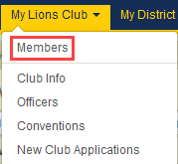
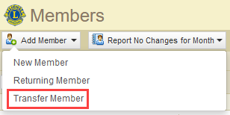
Transferring Leos to Lions Membership
using MyLCI
1)
From the My Lions Club menu, select the “Members” tab
2)
While on the Members page, click the “Add Member” drop-down and select “Transfer Member.”
Learn more
Notes:
A Lions club president, secretary or administrator can initiate the transfer of a Leo member to a Lions club using MyLCI.
Leos will retain their Leo member numbers as their new Lions membership numbers.
Leo years of service will automatically be credited to new Lions’ member records.
Follow the "Learn more" link for complete instructions.
Contact memberservicecenter@lionsclubs.org for any questions or assistance in adding or editing Leo-Lion member records.

Slide 80
Leo-Lion Program Awards

Slide 81
Leo to Leo-Lion Awards
Award | Recipient | Criteria
Leo-Lion Membership Award Certificate (club) | Leo club advisor | 5 new Leo-Lions from any of their sponsored Leo clubs
Leo-Lion Membership Award Certificate (district) | District Leo chairpersons | 15 new Leo-Lions from any Leo clubs within their district
Leo-Lion Membership Award Certificate (multiple district) | Multiple district Leo chairperson | 30 new Leo-Lions from any districts within their multiple district
Leo-Lion Club Charter Award Certificate | Sponsoring Lions club, district governor, district Leo chairperson, multiple district Leo chairperson | Sponsor at least one new Leo-Lion club in your district/ multiple district
Learn more
Notes:
The Leo to Leo-Lion Membership Award recognizes Leo club advisors, district Leo chairpersons and multiple district Leo chairpersons who have supported our Leos to transition to membership.
Special certificates will also be awarded at the club, district, and multiple district level by Lions Clubs International for completed Leo-Lion club charters approved for each current fiscal year.
Follow the “Learn more” link for full details about the Leo-Lion Program awards.

Slide 82
Additional Resources

Slide 83

Young Lions
Young Lions are dynamic members of our organization, approximately ages 40 and younger, who bring fresh perspectives and leadership skills to our clubs and communities.
Resources
Connecting to Young Lions
Young Lions Membership Guide
Learn more
Notes:
Lions Clubs International defines Young Lions as members who are approximately ages 40 and younger, which include Leo-Lions.
Follow the “Learn more” link on the slide to find out more about Young Lions and access two helpful resources:
Connecting to Young Lions – to learn how to make your Lions club attractive to Young Lions.
Young Lions Membership Guide – A comprehensive guide to membership and club types for all Young Lions.

Slide 84


Visit lionsclub.org/leo-lion to read more about the benefits and resources of the Leo-Lion Program and frequently asked questions
End of module activity: Discuss which Lions membership pathways would work best for Leos in your club. Share how you plan to approach eligible Leos with the membership opportunity
Notes:
Visit lionsclubs.org/leo-lions for additional links and more information.
End of module activity: Discuss which Lions membership pathways would work best for Leos in your club. Share how you plan to approach eligible Leos with membership opportunities.
Example: For an Omega Leo club that is based in a community, if there is not enough members to create a whole new Lions club, consider opening a club branch of a sponsoring Lions club for Leo-Lions. A club branch only needs 5 members to start and has the opportunity to become its own Lions club of former Leos in the future.
Estimated Time: 10 minutes

Slide 85
Leo Club Advisor Training and Orientation
© 2021 Lions Clubs International
Leo Advisor Training EN
85
Notes:
The Leo club advisor training is now complete! Please email leo@lionsclubs.org with any questions.

