Slide 1
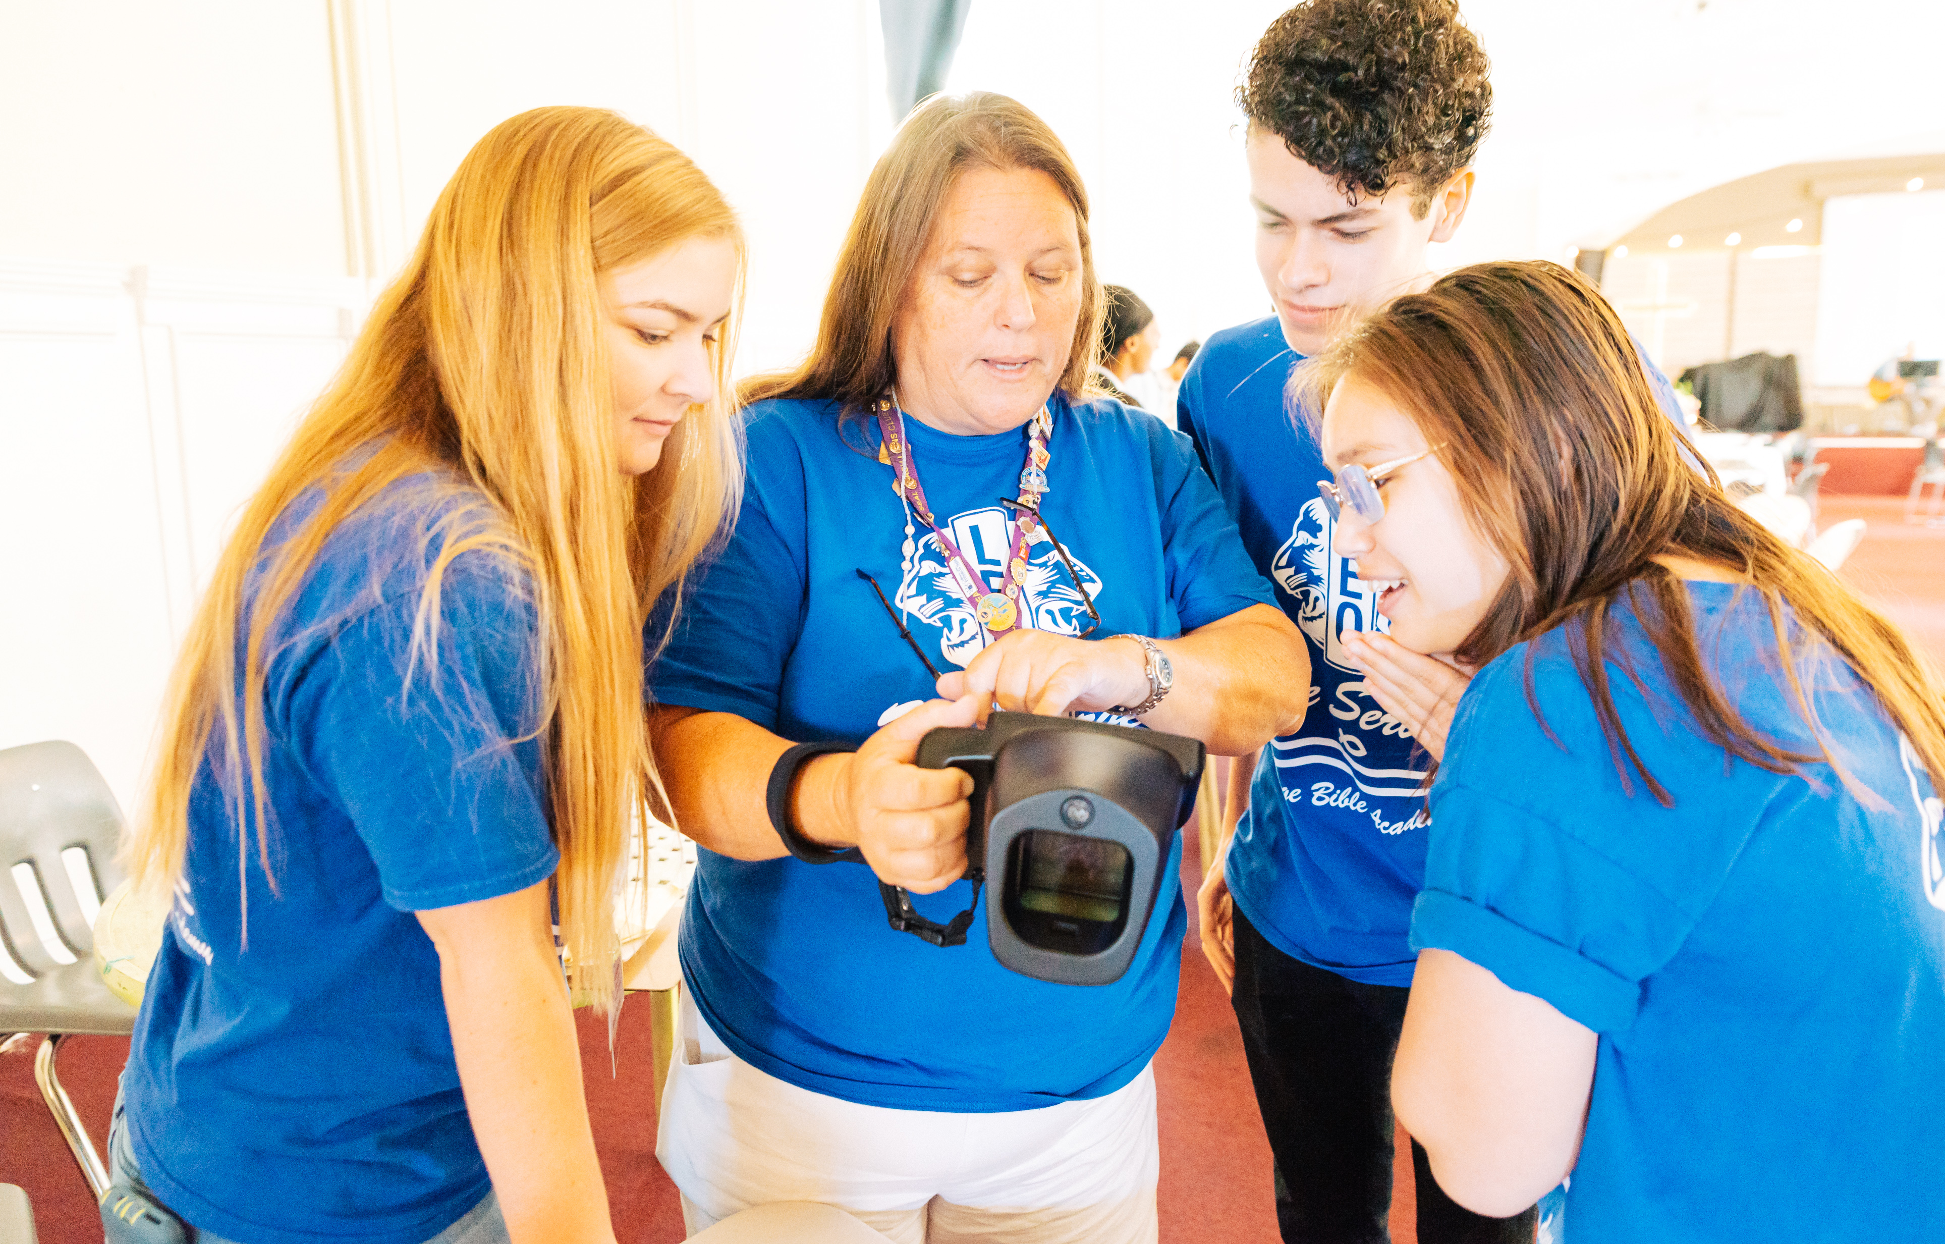
Conselheiro de Leo clubes
Treinamento e Orientação
LIONS INTERNATIONAL
1
Notes:
Instructor Note: Lions International designed this orientation and training program for Leo club advisors who are new to the role or have never received formal training about their role as a Leo Club Advisor. While the training will certainly not cover everything related to serving as a Leo club advisor, it provides the basic tools necessary to successfully carry out the duties of the position.
This training should be conducted under the guidance of a Lion trainer, such as a District or Multiple District Leo Chairperson, an experienced Leo Club Advisor who is familiar with resources and policies from Lions International, or a Lion who has completed a Lions International Faculty Development Institute or Lions Certified Instructor Program and is familiar with the Leo Club Program.

Slide 2
Módulo 1 // Visão Geral do Programa de Leo Clubes
Módulo 2 // O Papel do Conselheiro de Leo Clubes
Módulos
Módulo 3 // Administração de Leo Clubs
Módulo 4 // Recursos do Programa de Leo Clubs
Módulo 5 /// Como Trabalhar com os Jovens
Módulo 6 // Continuação da Jornada de Serviços
2
Notes:
Instructor Note: This training is designed to present the modules all together or as stand-alone modules. The general recommendation is that instructors should review the material included in each section and determine the modules that are of greatest relevance to the Leo club advisors in the area. Training facilitators may choose to break the modules into various sessions or separate training programs.
Each module concludes with a suggested reflection or discussion activity. Reflection/discussion prompts can be used in many ways:
Individual reflection – encourage learners to make notes of their answers independently
Large group discussion – use a flipchart to capture responses
Small group discussion – allocate additional time for smaller groups to discuss first and then report back their ideas to the larger group

Slide 3
Módulo 5
Trabalhando com pessoas mais jovens
3
Notes:
This module will cover:
Tips for working with Alphas v. Omegas
How to start the Leo year
Importance of relationships and team-building
Empowering Leos to lead
Tips for creating a positive climate, working in groups, active listening, and leadership/service
At the end of this module, the participants should have basic ideas of how to work with younger people.

Slide 4
Trabalhando com Leões vs. Leos
Leos e Leões são iguais - todos nós queremos servir nossas comunidades!
mas
Como o trabalho com pessoas mais jovens pode ser diferente do trabalho com seus companheiros Leões?
Notes:
As a Lion, you have a lot of experience working with your peers. How might working with younger people be different than working with your fellow Lions? What might you need to consider? How will you adapt?

Slide 5
Os Leo Omega são jovens entre 18 e 30 anos de idade.
Assuma mais responsabilidades e deseje mais liberdade
•Ajuda tanto no desenvolvimento pessoal como profissional
Os conselheiros servem como uma ponte entre o Lions clube patrocinador e o Leo club.
Os Leo Alfa são jovens entre 12 e 18 anos de idade.
Necessidade de mais orientação e treinamento para projetos e reuniões
Pode precisar do conselheiro Leo para delegar tarefas
O conselheiro é o elo entre os pais, as escolas e o Lions Clube
5
Notes:
While youth and young adults have many things in common, these two groups are in very different life stages, and therefore require developmentally appropriate activities to accommodate their needs. For example, young people in their mid to late teens are likely concerned with graduating from high school/secondary school, while young adults in their mid-to-late 20s are likely preparing to graduate from university and/or begin their professional careers.
Refer to Leo Advisor Training Module 2 for more on specific Leo advisor responsibilities.

Slide 6
Clubes fortes têm conexões fortes
Os clubes prósperos têm associados que não apenas estão dispostos a servir juntos, mas que QUEREM servir juntos.
Chaves para o Sucesso
Utilizar competências sociais e emocionais
Desenvolver a auto-estima e a autoconfiança
Manter uma comunidade saudável e centrada em relacionamentos
Capacitar os Leos a liderar
Notes:
As an advisor you are instrumental in building and maintaining a thriving Leo club. Here are a few key components of successful Leo clubs. The next few slides will help explain more about these concepts and how to implement them.

Slide 7
Aprendizado social e emocional,
A aprendizagem social e emocional (SEL) é o processo pelo qual todos os jovens e adultos adquirem e aplicam o conhecimento, as habilidades e as atitudes para desenvolver vidas saudáveis, controlar emoções e atingir metas pessoais e coletivas, sentir e demonstrar empatia pelos demais, estabelecer e manter relacionamentos confiáveis e tomar decisões responsáveis e conscientes.
7
Notes:
Leo clubs that incorporate this type of learning and encourage its members to build these skills maintain positive environments and build strong teams as a result of relationship-centered communities.
All SEL instruction is based upon the teaching of five core competencies. In its Safe and Sound guide (2003), the Collaborative for Academic, Social and Emotional Learning (CASEL) defines these five core competencies as:
Self-Awareness: Recognizing feelings as they occur; having a realistic assessment of one’s own abilities and a well-grounded sense of self-confidence.
Social Awareness: Sensing what others are feeling; being able to take their perspective; appreciating and interacting positively with diverse groups.
Self-Management: Handling emotions so they facilitate rather than interfere with the task at hand; delaying gratification to pursue goals; persevering in the face of setbacks.
Relationship Skills: Handling emotions in relationships effectively; establishing and maintaining healthy and rewarding relationships based on cooperation; negotiating solutions to conflict; seeking help when needed.
Responsible Decision Making: Accurately assessing risks; making decisions based on a consideration of all relevant factors and the likely consequences

Slide 8
Estabelecimento de uma comunidade centrada no relacionamento
O que é uma comunidade centrada no relacionamento?
É uma comunidade desenvolvida que ajuda a criar um ambiente seguro, acolhedor, participativo e bem administrado.
Um lugar onde todos se sintam reconhecidos, ouvidos, conhecidos, valorizados e profundamente cuidados.
Adaptado de:
8
Notes:
Research confirms that a relationship-centered community builds resilience and maximizes young people’s ability to learn academically as well as thrive socially and emotionally. When members of your club feel part of this type of community, they are more likely to remain members, are excited to serve together and want to invite others to participate.

Slide 9
Como criar uma comunidade centrada em relacionamentos
9
Notes:
The following slides share examples of how you can establish a relationship-centered community, including team-building and techniques to empower Leos to lead.

Slide 10
Criar uma comunidade centrada no relacionamento
Cumprimente e faça um breve contato com cada jovem sempre que se reunirem.
Estabeleça acordos compartilhados para serem usados durante as reuniões e sempre que os Leos se reunirem.
Sempre que os Leos estiverem trabalhando em algum projeto, ou planejando suas experiências de serviço, certifique-se de que cada jovem desempenhe um papel com base em seus próprios gostos, habilidades, interesses e talentos.
Adaptado de:
10
Notes:
Research confirms that a relationship-centered community builds resilience and maximizes young people's ability to learn academically as well as thrive socially and emotionally.
Greet and do a brief check-in with each young person every time you gather. Something as simple as a thumbs up or thumbs down check-in helps Leos feel seen.
Establish shared agreements to be used during meetings and whenever Leos gather: Let the Leos generate their own agreements based on what they need to feel respected, valued, included and a part of the group.
Whenever Leos are working on something or planning their service experiences, make sure each young person plays a role based on their own likes and abilities.

Slide 11
Formação de equipe
Crie oportunidades para que os Leos se conectem e se conheçam.
Conduza energizadores e faça atividades que promovam a formação de equipes para estabelecer conexões e um senso de pertencimento.
11
Notes:
The Leo Advancement Sessions found on lionsclubs.org have several examples of fun team-building activities for Leos to get to know each other.
Create opportunities for Leos to connect with and get to know each other: use energizers and get-to-know-you activities that help them make connections, discover what they have in common, make new friends, and discover new things about others that help them expand their “friend pool”

Slide 12
Iniciando o ano Leonístico
Ajude os Leos a conhecerem uns aos outros e a você
Estabeleça um acordo comunitário compartilhado e em grupo
Compartilhe a história do Programa Leo Clube e o lema LEO
Eleição/nomeação de dirigentes e treinamento
Discuta o que eles gostariam de fazer e realizar este ano
12
Notes:
Here are suggestions for how to start the Leo year in a way that’s inclusive for everyone:
Help the Leos get to know one another – and you! – through team-building games and activities
Establish rules and a shared community agreement together as a group. Let Leos share what rules they’d like to follow this year, while also consulting the Leo Constitution and Bylaws
Share the history of the Leo Club Program and the motto of Leos (found in Module 1 of Advisor Training)
If officers weren’t already elected, elect/appoint officers and provide training
Discuss what they’d like to do this year – start to form committees/working groups for service and fund-raising activities

Slide 13
Capacitando os Leos a liderar
Determine as expectativas
Identifique talentos e incentive seu uso
Assegure que todos tenham um trabalho ou propósito
Planeje seu calendário para o ano
Dê a todos a chance de participar
Ouça à novas ideias
Permita que eles falhem e os responsabilize
Forneça feedback imediato
Decida como comunicar uns com os outros
13
Notes:
Leos are leading and advisors are helping them do this. The Positive Collaboration with Lions and Leos webpage on lionsclubs.org explains why Lions and Leos should work together, as well as examples of how they can collaborate.
Ensure everyone has a job or purpose – identify their talents and encourage they use them
Plan a wish list for the year & encourage Leos to decide their own focus
Give everyone the chance to interact, including Lions – help them to collaborate
Listen to new ideas
Allow them to fail and hold them accountable
Provide immediate feedback
Set expectations
Decide how to communicate – is cell or email better? How often should committees/groups meet and can some work be done online? How do they want to receive reminders?

Slide 14
Dicas dos consultores da Leo
14
Notes:
Several Leo advisors were surveyed, and the following few slides are their advice for creating a positive climate, working in groups, listening actively and leading with service.

Slide 15
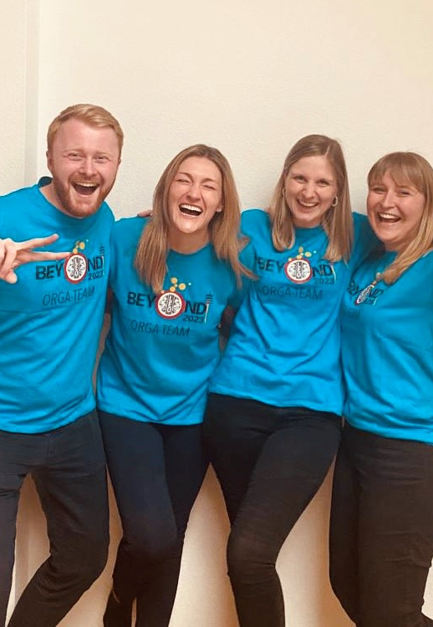
Criação de um clima positivo
É a reunião dos Leos
Ambiente neutro
Discussão aberta
Divirta-se!
Comida e jogos
Festa de final de ano
15
Notes:
It is the Leos’ meeting so allow them to run the meetings as they’d like, as they agreed upon at the beginning of the year, and according to the Leo Constitution and Bylaws
Create a neutral environment so that everyone feels welcome
Allow for open discussions – try not to take over too much
Have fun! That can mean having food, starting meetings with ice breakers and playing games.
Host an end of year party celebrating all of their accomplishments. Throughout the year, Leos could receive tickets for helpful behavior for prizes at the party.

Slide 16
Trabalho em grupos
Formar comitês para atividades de serviço e arrecadação de fundos
Permitir que os Leos escolham o que mais lhes interessa
Para discussões durante a reunião, encontre uma maneira criativa de formar grupos e eliminar cliques
Compartilhar normas de trabalho em conjunto
Incentivar todos a participar e contribuir
Apoiar novas ideias
16
Notes:
Groups can be formed for service and fund-raising activities, as well as in-meeting discussions
Pick a way to create groups
Grab a deck of cards: similar suits go together
Count off: 1s go to together, 2s go together, etc.
Hand out colored pieces of paper: reds go together, blues together, etc.
Try to form random groups so Leos can get to know each other
Share and discuss norms of working together - what are the norms/expectations of working together
Encourage everyone to participate and contribute
Support new ideas

Slide 17
Não usar telefones nas reuniões
Fazer contato visual
Fazer perguntas.
Seguir a agenda definida para a reunião
Ouvir atentamente
17
Notes:
Active listening
Encourage Leos to turn off their phones at meetings
Make eye contact with the Leos and encourage them to do the same with others
Ask questions throughout your meetings to ensure Leos are engaged and ask Leos to reflect on their experiences after hosting events
Set an agenda in advance for meetings and share that with Leos – be sure to follow it as allowed

Slide 18
Liderar através do Serviço
Dê a cada Leo a oportunidade de liderar
Faça elogios ativamente
Planeje com bastante antecedência
Crie uma avaliação da comunidade e planos de ação
Ensine os Leos a criar relacionamentos com a comunidade
18
Notes:
How can you encourage Leos to lead with service?
Give each Leo the opportunity to lead – try to allow for different people to serve in leadership roles
Give active praise
Plan in advance - project planning guide on lionsinternational.org
Assess your community needs and create an action plan
Younger Leos may need to be taught how to contact people – provide them scripts
Stress the importance of building relationships with the community, including knowing local officials and school principals

Slide 19
Cinco etapas do aprendizado de serviço
Etapa 1: Investigação
Etapa 2: Preparação e Planejamento
Etapa 3: Ação
Etapa 4: Reflexão
Etapa 5: Demonstração e comemoração
Adaptado de:
19
Notes:
Service learning is an educational methodology that engages young people in learning and applying academic, social and personal skills to real-life issues that improve the community. This is particularly helpful for Alpha Leos as they are learning the importance of giving back to their communities.
Five steps to planning a service project:
Step 1: Encourage Leos to investigate what their community needs. They can determine their own skills and interests in relation to the community needs.
Step 2: Leos start to prepare and plan for their service project once they’ve chosen what they want to do.
Step 3: Take action through their service project!
Step 4: Leos should reflect on how the project went and gather feedback from participants.
Step 5: Share with the community – through local marketing and social media – the effects of the service project. Be sure to celebrate!

Slide 20
Resumo
Pontos importantes do módulo
Estabelecer uma comunidade centrada no relacionamento, incluindo iniciar o ano com atividades de formação de equipe e planejar o ano juntos
Os Leos lideram e os conselheiros os ajudam a fazê-lo
Criar um clima positivo, trabalhar em grupos, ouvir atentamente e liderar por meio do serviço e do exemplo
Atividade de final do módulo
Pense em maneiras de criar uma comunidade positiva e centrada em relacionamentos em seu Leo clube. Inclua ideias que você poderia levar para a próxima reunião de Leo clube - ou para as duas primeiras reuniões, caso ainda não tenha começado o ano.
20
Notes:
Instructor Note: For the optional end of module activity for Module 5, ask participants to spend 5 minutes brainstorming ways they can create a relationship-centered community within their club. Encourage them to share their ideas with the group.
Examples: Team-building activities, work in groups, provide training, etc.
Estimated Time: 15 minutes

