Slide 1
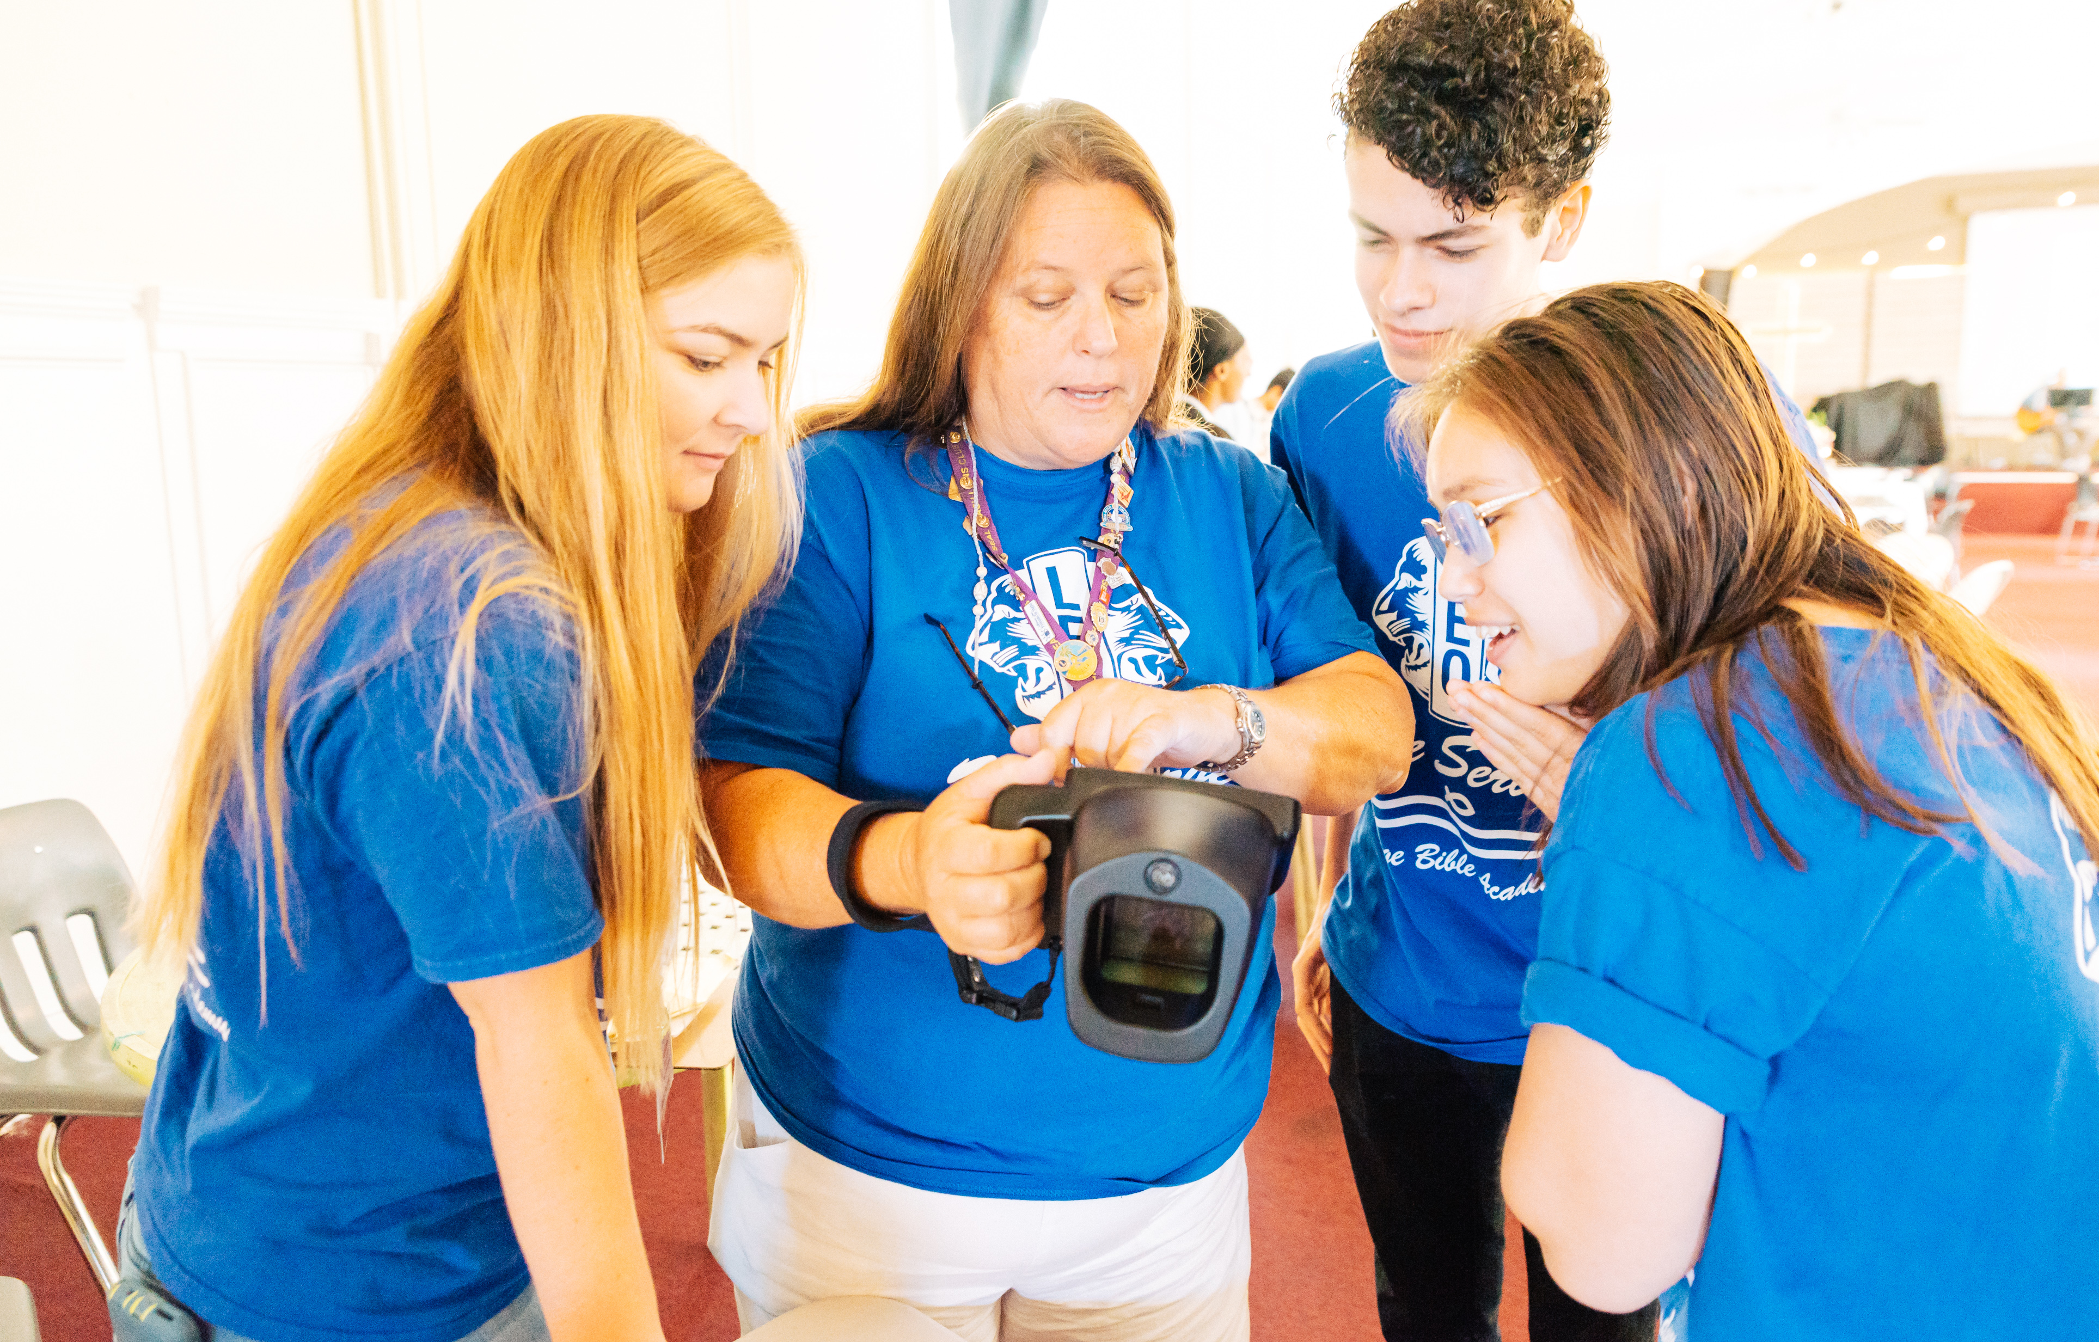
Leo Club Advisor
Training and Orientation
LIONS INTERNATIONAL
1
Notes:
Instructor Note: Lions International designed this orientation and training program for Leo club advisors who are new to the role or have never received formal training about their role as a Leo Club Advisor. While the training will certainly not cover everything related to serving as a Leo club advisor, it provides the basic tools necessary to successfully carry out the duties of the position.
This training should be conducted under the guidance of a Lion trainer, such as a District or Multiple District Leo Chairperson, an experienced Leo Club Advisor who is familiar with resources and policies from Lions International, or a Lion who has completed a Lions International Faculty Development Institute or Lions Certified Instructor Program and is familiar with the Leo Club Program.

Slide 2
Module 1 // Leo Club Program Overview
Module 2 // The Role of the Leo Club Advisor
Modules
Module 3 // Leo Club Administration
Module 4 // Leo Club Program Resources
Module 5 // Working with Younger People
Module 6 // Continuing the Service Journey
2
Notes:
Instructor Note: This training is designed to present the modules all together or as stand-alone modules. The general recommendation is that instructors should review the material included in each section and determine the modules that are of greatest relevance to the Leo club advisors in the area. Training facilitators may choose to break the modules into various sessions or separate training programs.
Each module concludes with a suggested reflection or discussion activity. Reflection/discussion prompts can be used in many ways:
Individual reflection – encourage learners to make notes of their answers independently
Large group discussion – use a flipchart to capture responses
Small group discussion – allocate additional time for smaller groups to discuss first and then report back their ideas to the larger group

Slide 3
Module 5
Working with Younger People
3
Notes:
This module will cover:
Tips for working with Alphas v. Omegas
How to start the Leo year
Importance of relationships and team-building
Empowering Leos to lead
Tips for creating a positive climate, working in groups, active listening, and leadership/service
At the end of this module, the participants should have basic ideas of how to work with younger people.

Slide 4
Working with Lions vs. Leos
Leos and Lions are the same – we all want to serve our communities!
but
How might working with younger people be different than working with your fellow Lions?
Notes:
As a Lion, you have a lot of experience working with your peers. How might working with younger people be different than working with your fellow Lions? What might you need to consider? How will you adapt?

Slide 5
Alpha Leos (12-18 years old)
Need more guidance and coaching for projects and meetings
May need Leo advisor to delegate tasks
Advisor is the link between parents, schools and Lions club
Omega Leos (18-30 years old)
Take on more responsibilities and need more freedom
Are looking for personal and professional development
Advisor acts as liaison between sponsoring Lions club and Leo club
5
Notes:
While youth and young adults have many things in common, these two groups are in very different life stages, and therefore require developmentally appropriate activities to accommodate their needs. For example, young people in their mid to late teens are likely concerned with graduating from high school/secondary school, while young adults in their mid-to-late 20s are likely preparing to graduate from university and/or begin their professional careers.
Refer to Leo Advisor Training Module 2 for more on specific Leo advisor responsibilities.

Slide 6
Strong clubs have strong connections
Thriving clubs have members who are not only willing to serve together, they WANT to serve together.
Keys to success:
Utilize social and emotional competencies
Build self-esteem and self-confidence
Maintain a healthy, relationship-centered community
Empower Leos to lead
Notes:
As an advisor you are instrumental in building and maintaining a thriving Leo club. Here are a few key components of successful Leo clubs. The next few slides will help explain more about these concepts and how to implement them.

Slide 7
Social and emotional learning
Social and emotional learning (SEL) is the process through which all young people and adults acquire and apply the knowledge, skills and attitudes to develop healthy identities, manage emotions and achieve personal and collective goals, feel and show empathy for others, establish and maintain supportive relationships and make responsible and caring decisions.
7
Notes:
Leo clubs that incorporate this type of learning and encourage its members to build these skills maintain positive environments and build strong teams as a result of relationship-centered communities.
All SEL instruction is based upon the teaching of five core competencies. In its Safe and Sound guide (2003), the Collaborative for Academic, Social and Emotional Learning (CASEL) defines these five core competencies as:
Self-Awareness: Recognizing feelings as they occur; having a realistic assessment of one’s own abilities and a well-grounded sense of self-confidence.
Social Awareness: Sensing what others are feeling; being able to take their perspective; appreciating and interacting positively with diverse groups.
Self-Management: Handling emotions so they facilitate rather than interfere with the task at hand; delaying gratification to pursue goals; persevering in the face of setbacks.
Relationship Skills: Handling emotions in relationships effectively; establishing and maintaining healthy and rewarding relationships based on cooperation; negotiating solutions to conflict; seeking help when needed.
Responsible Decision Making: Accurately assessing risks; making decisions based on a consideration of all relevant factors and the likely consequences

Slide 8
Establishing a relationship-centered community
What is a relationship-centered community?
Building community by helping create a safe, caring, participatory and well-managed environment.
A place where everyone feels seen, heard, known, valued and deeply cared for.
Adapted from
8
Notes:
Research confirms that a relationship-centered community builds resilience and maximizes young people’s ability to learn academically as well as thrive socially and emotionally. When members of your club feel part of this type of community, they are more likely to remain members, are excited to serve together and want to invite others to participate.

Slide 9
How to create a relationship-centered community
9
Notes:
The following slides share examples of how you can establish a relationship-centered community, including team-building and techniques to empower Leos to lead.

Slide 10
Creating a relationship-centered community
Greet and do a brief check-in with each young person every time you gather.
Establish shared agreements to be used during meetings and whenever Leos gather.
Whenever Leos are working on something or planning their service experiences, make sure each young person plays a role based on their own likes, abilities, interests and talents.
Adapted from
10
Notes:
Research confirms that a relationship-centered community builds resilience and maximizes young people's ability to learn academically as well as thrive socially and emotionally.
Greet and do a brief check-in with each young person every time you gather. Something as simple as a thumbs up or thumbs down check-in helps Leos feel seen.
Establish shared agreements to be used during meetings and whenever Leos gather: Let the Leos generate their own agreements based on what they need to feel respected, valued, included and a part of the group.
Whenever Leos are working on something or planning their service experiences, make sure each young person plays a role based on their own likes and abilities.

Slide 11
Team building
Create opportunities for Leos to connect with and get to know each other.
Conduct energizers and do activities that foster team building to establish connections and a sense of belonging.
11
Notes:
The Leo Advancement Sessions found on lionsclubs.org have several examples of fun team-building activities for Leos to get to know each other.
Create opportunities for Leos to connect with and get to know each other: use energizers and get-to-know-you activities that help them make connections, discover what they have in common, make new friends, and discover new things about others that help them expand their “friend pool”

Slide 12
Starting the Leo year
Help the Leos get to know one another and you
Establish a shared community agreement together as a group
Share the history of the Leo Club Program and the LEO motto
Elect/appoint officers and training
Discuss what they’d like to do and accomplish this year
12
Notes:
Here are suggestions for how to start the Leo year in a way that’s inclusive for everyone:
Help the Leos get to know one another – and you! – through team-building games and activities
Establish rules and a shared community agreement together as a group. Let Leos share what rules they’d like to follow this year, while also consulting the Leo Constitution and Bylaws
Share the history of the Leo Club Program and the motto of Leos (found in Module 1 of Advisor Training)
If officers weren’t already elected, elect/appoint officers and provide training
Discuss what they’d like to do this year – start to form committees/working groups for service and fund-raising activities

Slide 13
Empowering Leos to lead
Set expectations
Identify talents and encourage their use
Ensure everyone has a job or purpose
Plan a wish list for the year
Give everyone the chance to interact
Listen to new ideas
Allow them to fail and hold them accountable
Provide immediate feedback
Decide how to communicate with each other
13
Notes:
Leos are leading and advisors are helping them do this. The Positive Collaboration with Lions and Leos webpage on lionsclubs.org explains why Lions and Leos should work together, as well as examples of how they can collaborate.
Ensure everyone has a job or purpose – identify their talents and encourage they use them
Plan a wish list for the year & encourage Leos to decide their own focus
Give everyone the chance to interact, including Lions – help them to collaborate
Listen to new ideas
Allow them to fail and hold them accountable
Provide immediate feedback
Set expectations
Decide how to communicate – is cell or email better? How often should committees/groups meet and can some work be done online? How do they want to receive reminders?

Slide 14
Tips from Leo advisors
14
Notes:
Several Leo advisors were surveyed, and the following few slides are their advice for creating a positive climate, working in groups, listening actively and leading with service.

Slide 15
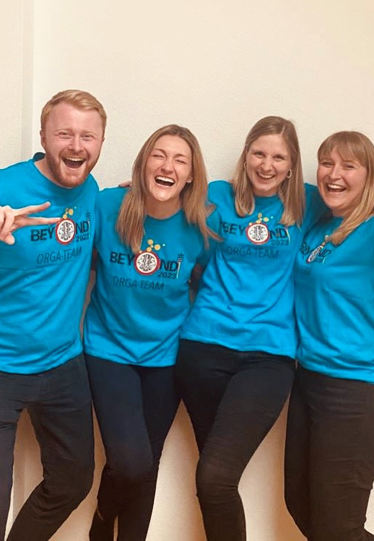
Creating a positive climate
It is the Leos’ meeting
Neutral environment
Open discussions
Have fun!
Food and games
End of year party
15
Notes:
It is the Leos’ meeting so allow them to run the meetings as they’d like, as they agreed upon at the beginning of the year, and according to the Leo Constitution and Bylaws
Create a neutral environment so that everyone feels welcome
Allow for open discussions – try not to take over too much
Have fun! That can mean having food, starting meetings with ice breakers and playing games.
Host an end of year party celebrating all of their accomplishments. Throughout the year, Leos could receive tickets for helpful behavior for prizes at the party.

Slide 16
Working in groups
Form committees for service and fund-raising activities
Allow Leos to choose what interests them most
For in-meeting discussions, find a creative way to form groups and break up cliques
Share norms of working together
Encourage everyone to participate and contribute
Support new ideas
16
Notes:
Groups can be formed for service and fund-raising activities, as well as in-meeting discussions
Pick a way to create groups
Grab a deck of cards: similar suits go together
Count off: 1s go to together, 2s go together, etc.
Hand out colored pieces of paper: reds go together, blues together, etc.
Try to form random groups so Leos can get to know each other
Share and discuss norms of working together - what are the norms/expectations of working together
Encourage everyone to participate and contribute
Support new ideas

Slide 17
No phones at meetings
Make eye contact
Ask questions
Follow agenda set for meeting
Active listening
17
Notes:
Active listening
Encourage Leos to turn off their phones at meetings
Make eye contact with the Leos and encourage them to do the same with others
Ask questions throughout your meetings to ensure Leos are engaged and ask Leos to reflect on their experiences after hosting events
Set an agenda in advance for meetings and share that with Leos – be sure to follow it as allowed

Slide 18
Leading with service
Give each Leo the opportunity to lead
Provide active praise
Plan well in advance
Create a community assessment and action plans
Teach Leos how to build relationships with the community
18
Notes:
How can you encourage Leos to lead with service?
Give each Leo the opportunity to lead – try to allow for different people to serve in leadership roles
Give active praise
Plan in advance - project planning guide on lionsinternational.org
Assess your community needs and create an action plan
Younger Leos may need to be taught how to contact people – provide them scripts
Stress the importance of building relationships with the community, including knowing local officials and school principals

Slide 19
Five Steps of service-learning
Step 1: Investigation
Step 2: Preparation and planning
Step 3: Action
Step 4: Reflection
Step 5: Demonstration and celebration
Adapted from
19
Notes:
Service learning is an educational methodology that engages young people in learning and applying academic, social and personal skills to real-life issues that improve the community. This is particularly helpful for Alpha Leos as they are learning the importance of giving back to their communities.
Five steps to planning a service project:
Step 1: Encourage Leos to investigate what their community needs. They can determine their own skills and interests in relation to the community needs.
Step 2: Leos start to prepare and plan for their service project once they’ve chosen what they want to do.
Step 3: Take action through their service project!
Step 4: Leos should reflect on how the project went and gather feedback from participants.
Step 5: Share with the community – through local marketing and social media – the effects of the service project. Be sure to celebrate!

Slide 20
Summary
Important points from the module
Establish a relationship-centered community, including starting the year with team-building activities and planning the year together
Leos lead and advisors help them to do this
Create a positive climate, work in groups, listen actively and lead through service and by example
End of module activity
Brainstorm ways you can create a positive, relationship-centered community within your Leo club. Include ideas that you could bring into your next Leo club meeting – or the first couple of meetings if you haven’t already started the year.
20
Notes:
Instructor Note: For the optional end of module activity for Module 5, ask participants to spend 5 minutes brainstorming ways they can create a relationship-centered community within their club. Encourage them to share their ideas with the group.
Examples: Team-building activities, work in groups, provide training, etc.
Estimated Time: 15 minutes

