Slide 1

Public Speaking
Part 1

Slide 2

75%
of adults are estimated to be affected by fear of public speaking.
90%
of anxiety we feel before giving a presentation comes from lack of preparation.
Statistics: Journal of Education and Educational Development

Slide 3

91%
of people claim they feel confident with a well-prepared and well-designed presentation.
Statistics: Presentation Panda

Slide 4
Session objectives
1
Describe effective delivery skills for public speaking
Identify key steps for writing a speech outline
Develop a speech outline for a 3 – 4-minute speech
Deliver an organized, 3 – 4-minute speech using effective delivery skills
Recognize differences between presenting in-person and virtually
2
3
4
5

Slide 5
Public Speaking Factors
Visual
Vocal
Verbal

Slide 6
Effective Public Speaking
Statistics: Business Insider

Slide 7


Slide 8

Delivery Skills
Eye Contact
Voice
Body Language
Word Choice
Appearance

Slide 9

The Steps to writing a speech outline
Big Picture, Objective, Message, Relevance, Structure

Slide 10


Steps 1 & 2
“At the end of the speech, the audience will ____________.”
The Big Picture
Speaker – Subject
Audience – Subject
Speaker – Audience
Objective

Slide 11


Steps 3 & 4
A speech is never about the speaker, it is always about the audience
Reasons why your audience should care about your message
Message
Something that holds the speech together
Written as a single sentence, not a series of points
Relevance

Slide 12

ACTIVITY: Getting started – Steps 1-4
Choose a topic from page 13 of your participant manual
Complete Steps 1-4 on pages 14-15
Big Picture
Message
Relevance
Objective

Slide 13

Step 5 – Structure
Opening
Body
Conclusion

Slide 14
Opening
Hook
Signpost

Slide 15
Body
1. Gather content
2. Chose important points
3. Order points
4. Add supporting details
5. Transitions

Slide 16
Conclusion
Link to opening
Repeat and summarize message
Call to action

Slide 17
ACTIVITY: Speech structure – Step 5
First complete Steps 1-4 on pages 14-15 in your participant manual.
Begin developing the structure of your speech on page 16.
Body
Opening
Conclusion

Slide 18

Power Pose
Power Posing before a speech can help increase confidence and reduce stress while giving a speech
Statistics: The Career Cafe

Slide 19

What’s Your Power Pose?
Stand up
Choose your power pose
Hold for 2 minutes

Slide 20
Session objectives
1
Describe effective delivery skills for public speaking
Identify key steps for writing a speech outline
Develop a speech outline for a 3 – 4-minute speech
Deliver an organized, 3 – 4-minute speech using effective delivery skills
Recognize differences between presenting in-person and virtually
2
3
4
5

Slide 21

Public Speaking
Part 2

Slide 22
Session objectives
1
Describe effective delivery skills for public speaking
Identify key steps for writing a speech outline
Develop a speech outline for a 3 – 4-minute speech
Deliver an organized, 3 – 4-minute speech using effective delivery skills
Recognize differences between presenting in-person and virtually
2
3
4
5

Slide 24
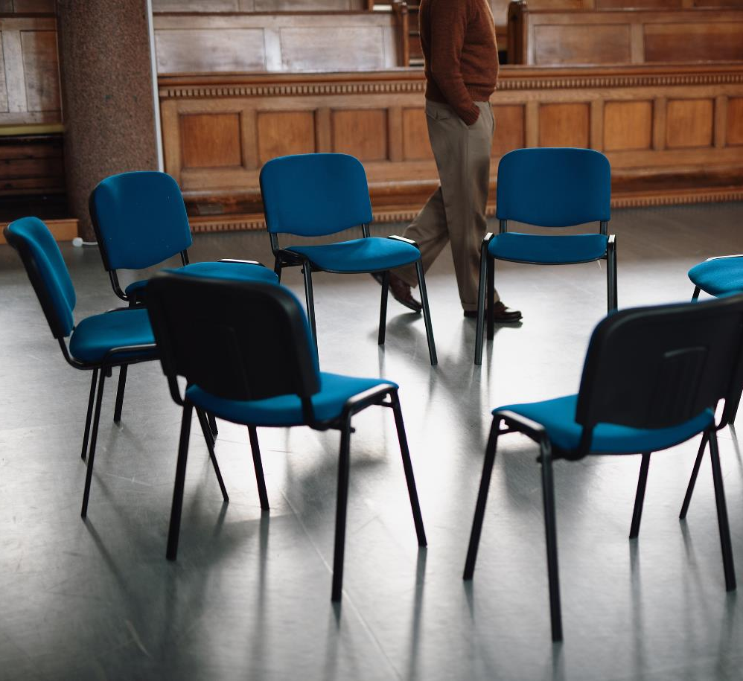
SPEECH INSTRUCTIONS
Form groups of 6-7 people
Nominate a timekeeper
Take turns giving speeches and receiving feedback
Each person is allotted no more than 4 minutes for their speech and 1-2 minutes of feedback from peers
Speech evaluation checklist starting on page 26

Slide 25

Discussion Questions
As you are waiting for other groups to finish up, discuss the following questions as a group.
What did you learn from listening to each other’s speeches?
What did you learn individually by going through this speech development process?

Slide 26

Congratulations!

Slide 27

VIRTUAL VERSUS IN-PERSON PRESENTING
Brainstorm ways virtual presenting differs from in-person presenting
What considerations do you have to make when presenting virtually?
After 8 minutes ½ your group switches with another group and shares

Slide 28
Session objectives
1
Describe effective delivery skills for public speaking
Identify key steps for writing a speech outline
Develop a speech outline for a 3 – 4-minute speech
Deliver an organized, 3 – 4-minute speech using effective delivery skills
Recognize differences between presenting in-person and virtually
2
3
4
5

