Slide 1
Member Motivation

Slide 2
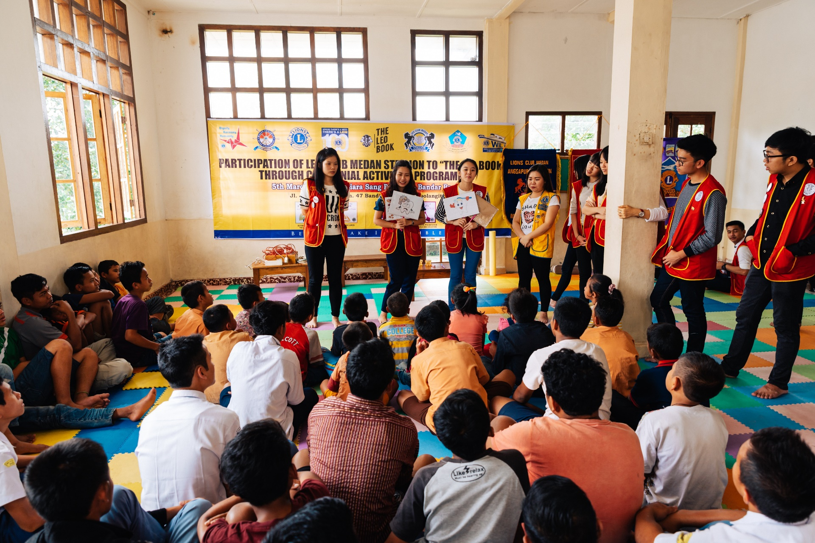
Session Objectives
Recognize the differences between extrinsic and intrinsic motivation
Identify three components of intrinsic motivation
Promote ways to develop intrinsic motivation among team members

Slide 3
Daniel Pink
American author
Field of behavior, management, business
Author of
Drive: The Surprising Truth About What Motivates Us

Slide 4
Extrinsic/External Motivation
Motivation to act as a result of an external, tangible reward or consequence.

Slide 5
Intrinsic/ Internal Motivation
Motivation to act as the result of internal desire or the self-satisfaction one believes will be gained from the action.

Slide 6
External vs. Internal
External is more effective when:
Path to achievement is defined
Internal is more effective when:
Path to achievement requires critical thinking/problem-solving
Notes:
Flipped text

Slide 7
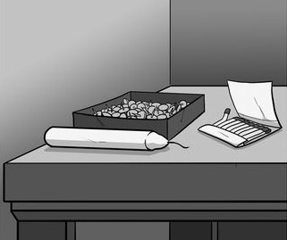
Duncker’s Candle Problem

Slide 8
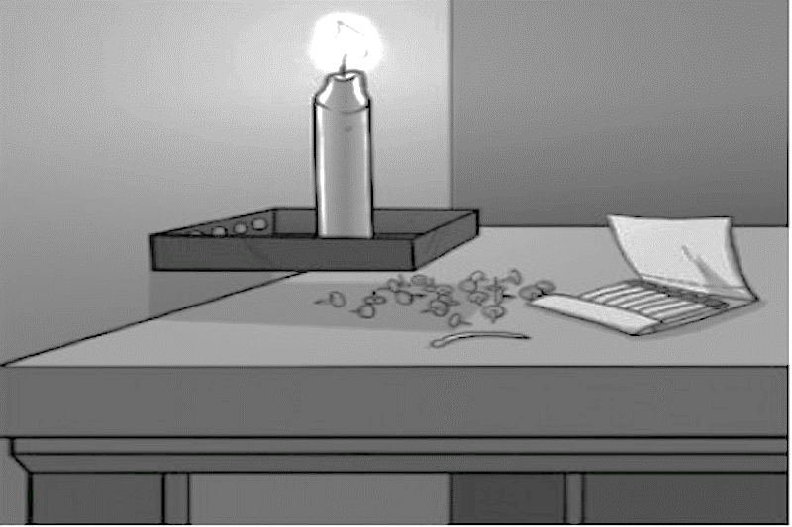
Solution

Slide 9
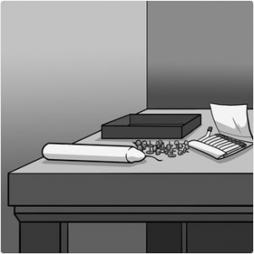
Duncker’s Candle Problem: Part 2

Slide 10
Components of Internal Motivation
Autonomy
Mastery
Purpose
Internal Motivation

Slide 11
Autonomy:
The desire to be self-directed in one’s actions and behaviors.

Slide 12
Mastery:
The desire to continually improve one’s skills or performance.

Slide 13
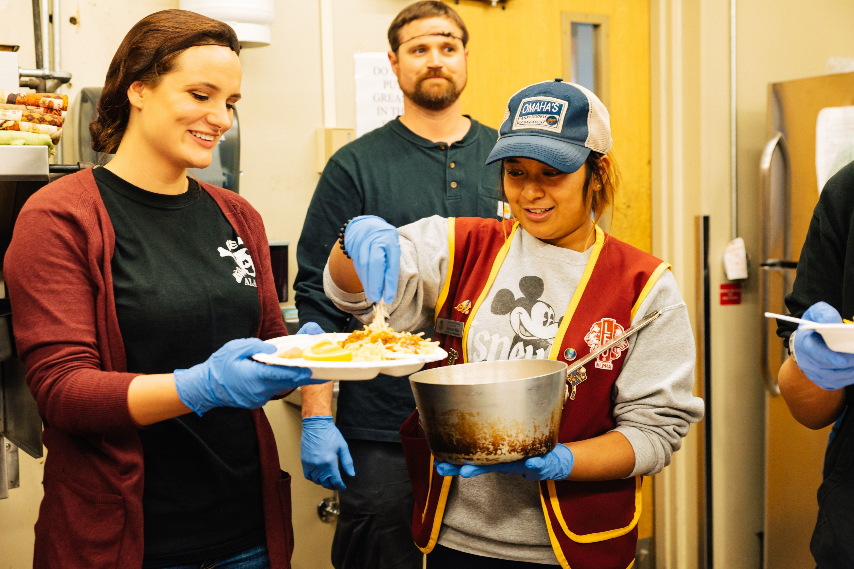
Purpose:
The desire to make a contribution and be part of a cause greater than oneself.

Slide 14
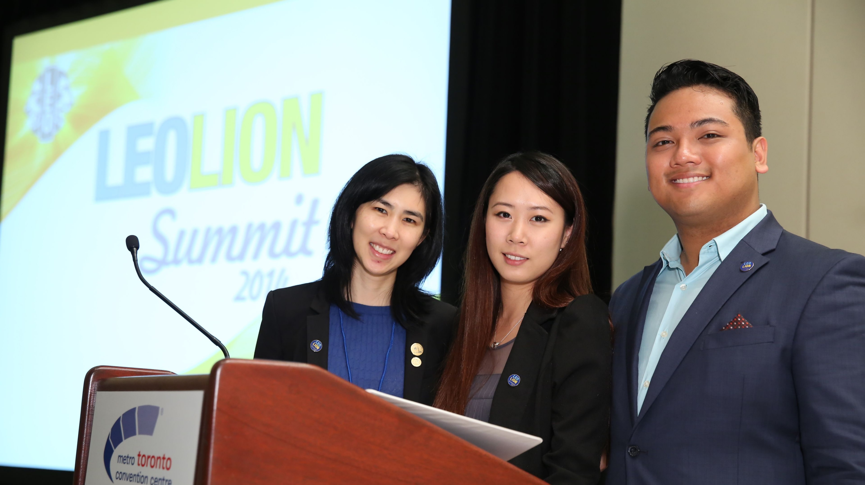
Personal Purpose Statement
Defines who you are and the mark you want to leave on this world.

Slide 15
Session Objectives
Recognize the differences between extrinsic and intrinsic motivation
Identify three components of intrinsic motivation
Promote ways to develop intrinsic motivation among team members

