Slide 1
Evolving the
Lion Digital Experience
Finding technology solutions to meet the needs of our members
Notes:
Hello, today we would like to provide an update about our digital products for Lions & Leo’s.
This presentation was prepared by LCI/LCIF staff. Questions can be sent to Salesforcefeedback@lionsclubs.org
This is a journey for all of us, your questions are encouraged!

Slide 2


What does the Lion digital experience look like today?
Notes:
Let’s start by examining our current experience
[If live presentation ask for thoughts from 4-5 members of audience]

Slide 3
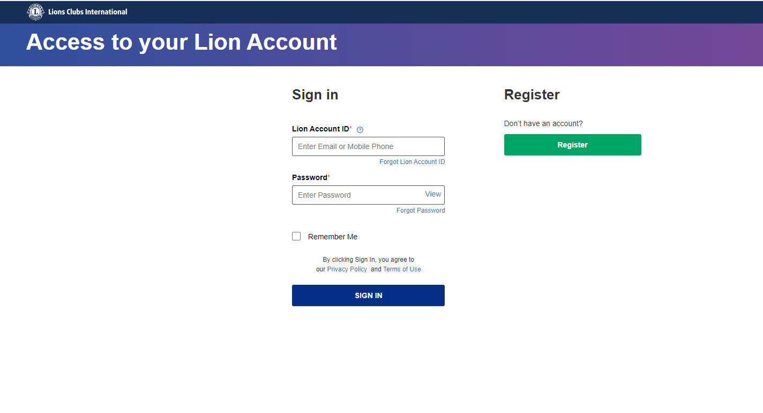
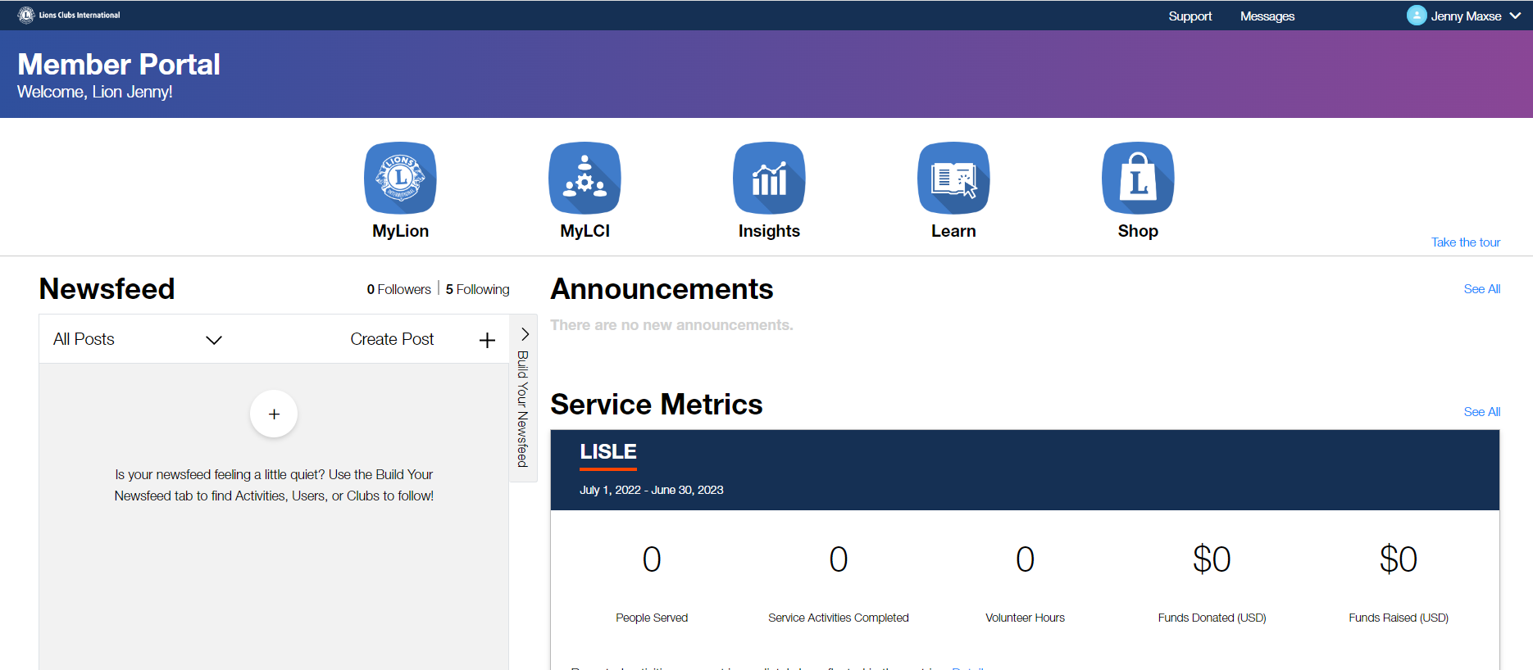
One account. One portal.
Notes:
Today we think of our Lion Account… It is one account to access all the resources you need to lead and serve.
But is it really?

Slide 4

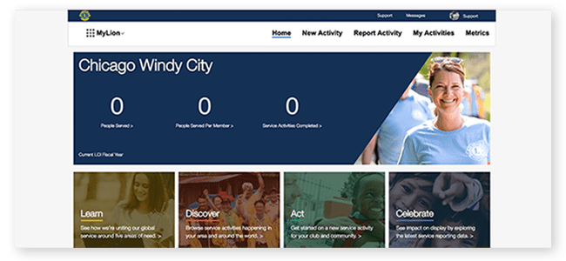
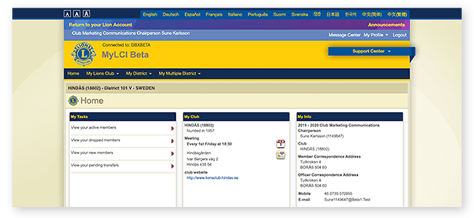
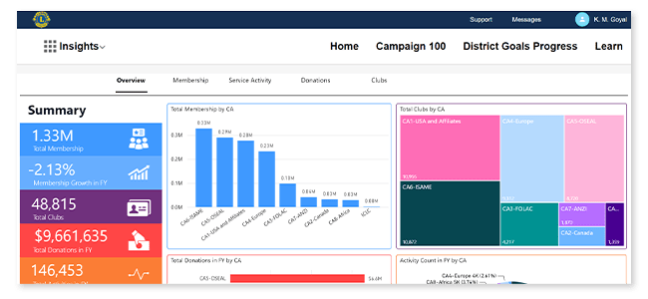
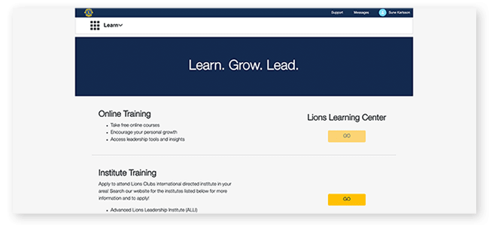
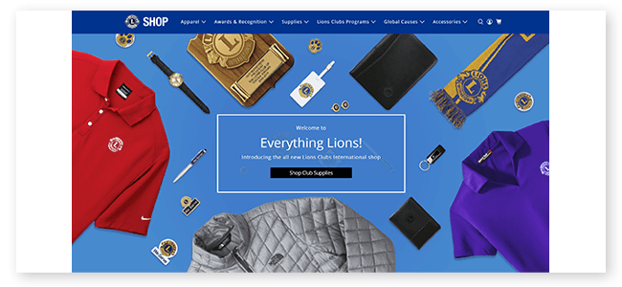
Five products. Five user experiences.
Five places to store data.
Notes:
Behind the scenes, it is five different application products. Each of these applications has their own look and feel, navigation and user experience.
Which means multiple things to learn, multiple places to try to find how to do what you need to accomplish.
Further, this relies on multiple independent data bases that often do not have the same data.
The multiple data stores add significant complexity in securing and managing you have the proper and compliant access to the data you need.

Slide 5




Even with the current portal, many other interactions are completely disconnected
Inquiries to the Member Service Center
Viewing detailed donation history
Individual and Club Recognitions & Awards
Grants Applied & Awarded
Notes:
Even with our current digital tools, many of your other interactions are completely disconnected from your “Lion account”. When you need assistance from the Member Service Center, they are working from an independent application without integrated data.
There is very limited donation information available today, which often means a call or inquiry to the Foundation to get the question answered about the status of an award or recognition.
Speaking of recognitions, it can also be very confusing to find the report that may have the data you are seeking and when no report exists you may have to call someone for help. Taking a long time to get an answer to a simple question.
Finally, today there are still highly manual functions like applying for and reporting on a grant supporting the critical work you are doing. This makes the process take longer with much more effort.

Slide 6











Creating an inconsistent and frustrating experience
Supplies & Shop
Payments & History
Convention & Delegates
New Member
New Club
Club Recognitions
Reporting
Individual Recognitions
Service Planning
Learning & History
Club Management
Grants Applied & Awarded
Donations Made
Member
Services
Individual Member
Notes:
It takes a great deal of work to manage a club, support the growth and development of an area/district, and deliver services to those in need. Our current digital tools with multiple applications and data sources have made this an inconsistent and frustrating experience at all levels.
The last major investment in digital tools was over five years ago, and technology has continued to advance, even faster during the pandemic. And we need to advance our technology to better help you serve.

Slide 7
Where are we headed?
Notes:
This leads to the question of “Where are we headed”.

Slide 8

In 2024, we are moving to one streamlined digital experience.
Bringing Together Lions Applications & Data
Notes:
In our past fiscal year, your international board approved investment in moving forward with modernizing our digital tools to simplify our solutions by unifying Lions applications and data into one cohesive and consistent experience.
Behind the scenes work has been in progress over the past months and will continue into early 2023 toward a launch of an improved experience in mid 2023.
This is an evolution, guided by lessons learned, feedback from Lions and leveraging new, more secure commercially available cloud-based software.

Slide 9

We are taking the functionality of our current digital tools and evolving the overall experience.
One Lion account.
One member portal.
One streamlined user experience across all your devices; phone, tablet, and computer.
One technology platform powering it all.
Notes:
This evolution takes our existing capabilities and implements them into one unified experience. Allowing access from one Lion account, to a consistent user interface, providing a unified experience with all capabilities available across your computer, tablet or mobile device. To put it simply, we’re taking the functionality you have today with MyLion, MyLCI, Insights and some other tools and combining them into one cohesive and consistent experience — all built on a single platform: Salesforce.
Salesforce is the industry leader in cloud solutions used by more than 150,000 organizations, including over 40,000 nonprofit entities. We are in good company, with significant support of this proven technology.

Slide 10
How do we get there?
Together.
Notes:
So how do we make this transition? How will we jointly get there? By working through this change together.
Your involvement is key. So how can you get involved to let your voice be heard?

Slide 11
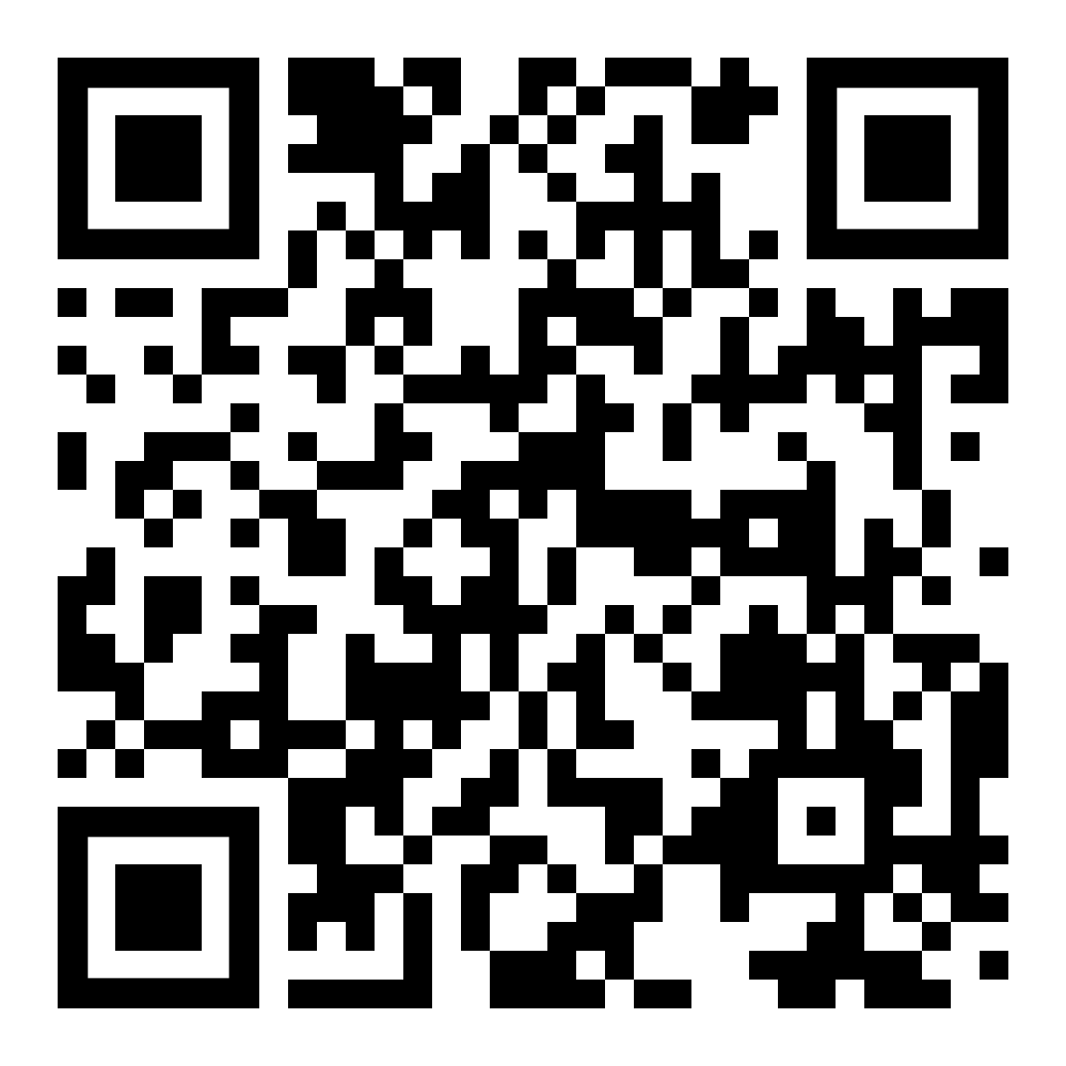
How can you get involved?
Sharing your input helps us keep a pulse on how technology can help you do what you do best — lead and serve.
Use the QR code to take the technology
usage survey
We want to know what’s important to you.
Club websites
Mobile experiences
Service reporting
Service activity discovery
Networking and communicating
with members
Social media integrations
Document search
Fundraising tools
Managing data and preferences
Accessibility tools and support
Digital tools education and support
Other …
Sign-up to stay informed
Participate in focus groups
Notes:
Sharing your input and staying involved is key!
Use the QR code to take the technology use survey. This asks about how you use all types of technology at every level of participation; member to leader, to do the work you do in support of our shared mission.
At the conclusion of the survey, you can sign-up for informational updates or to participate in focus groups and testing teams.
We need your participation to develop solutions that work for you.

Slide 12
Thank You!
© 2022 Lions Clubs International

