Slide 1
m
Global Membership Approach
2021-2022 FVDG/DGE Kick-Off
1

Slide 2
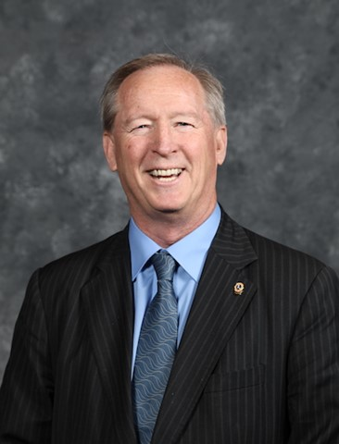
Welcome
VP Brian Sheehan
2

Slide 3
Welcome & Introductions
Vision and Objectives
District Goals
Global Membership Approach
FVDG/DGE Training Program Overview
Supporting Actions for District Success
Questions
Agenda
3

Slide 4
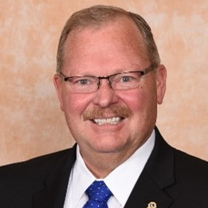
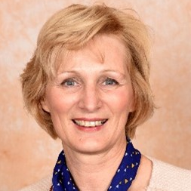
FVDG/DGE Seminar Chairpersons
PID Bruce Beck
Seminar Chairperson
PID Elisabeth Haderer
Seminar Vice Chairperson

Slide 5
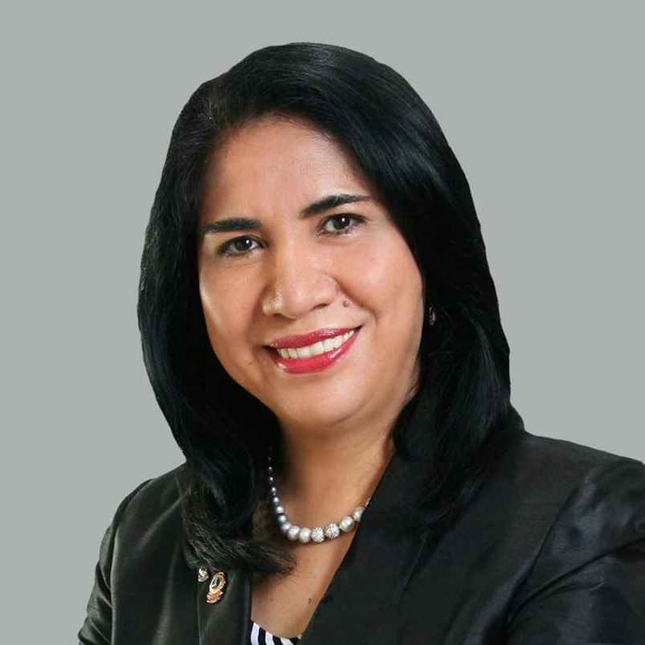
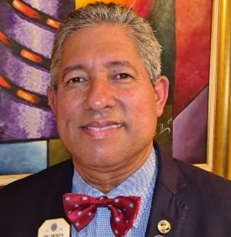
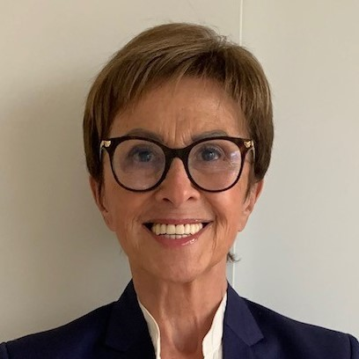
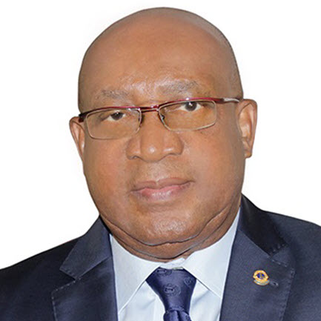
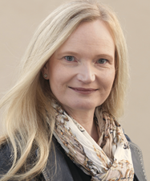
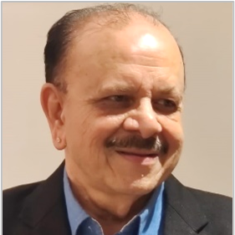
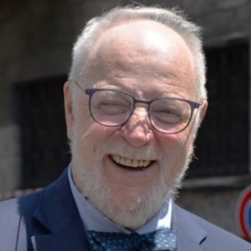
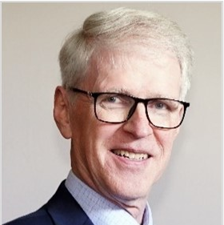
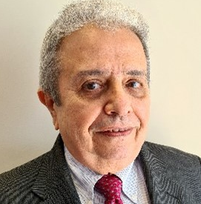
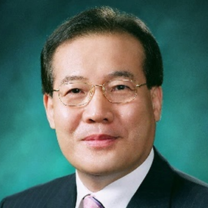
FVDG/DGE Seminar Group Leaders
PCC Miryam Luna Loaiza
(Grp 1)
PCC Luis Castillo Gamboa
(Grp 2)
PCC Corinne Bloemendal-Kramarz (Grp 3)
PCC André Gbadoe
(Grp 4)
PDG Constanze Leißling
(Grp 5)
PDG Pankaj Mehta
(Grp 6)
PDG Claudio Pasini
(Grp 7)
PCC Halldór Kristjánsson
(Grp 8)
PDG José Carlos Stipp
(Grp 9)
PDG Choong-Lai Lim
(Grp 10)

Slide 6
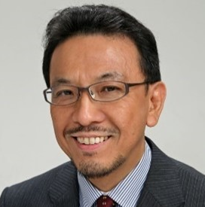
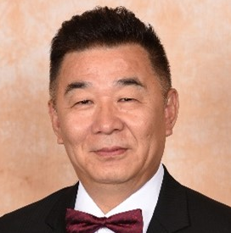
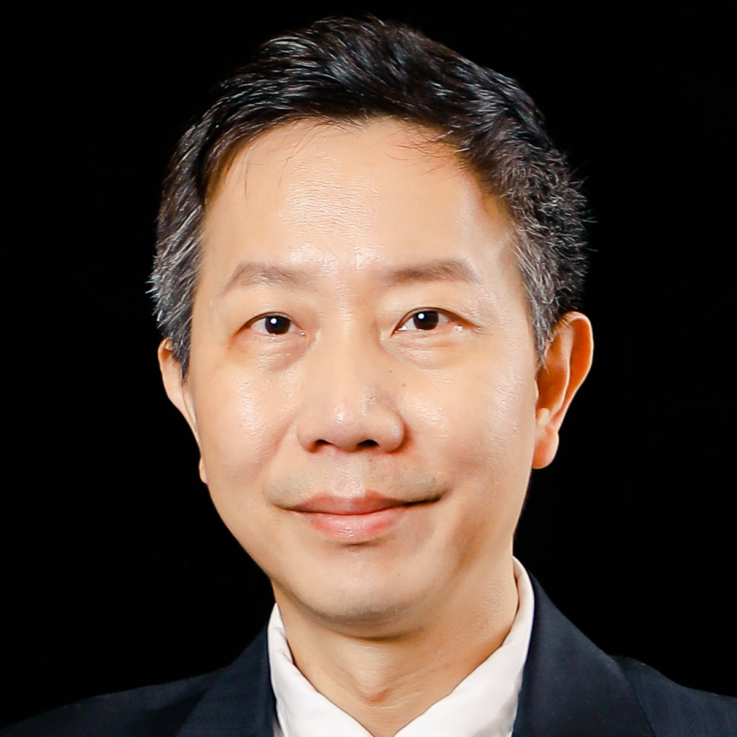
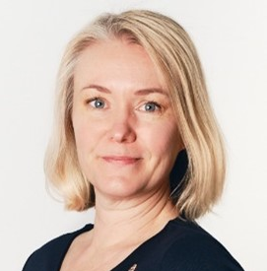
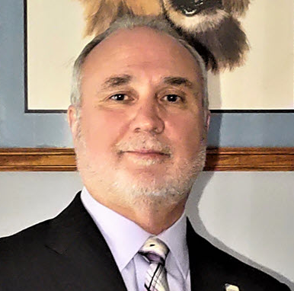
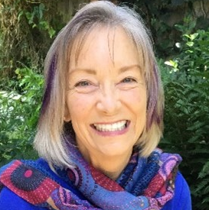
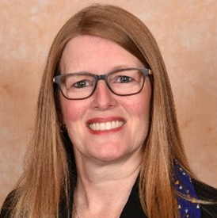
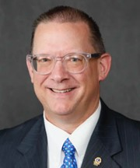
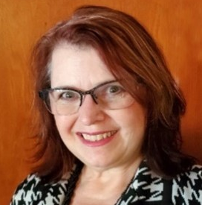
FVDG/DGE Seminar Group Leaders
PDG Masashi Hamano
(Grp 11)
PID Magnet Lin
(Grp 12)
PDG Jain-Wei (Raymond) Lei
(Grp 13)
PDG Sanna Mustonen
(Grp 14)
PID Gary Anderson
(Grp 15)
PDG Chris Carlone
(Grp 16)
PCC Liz Crooke
(Grp 17)
PID Jennifer Ware
(Grp 18)
PID Mark Lyon
(Grp 19)
PCC Jodi Burmester
(Grp 20)

Slide 7
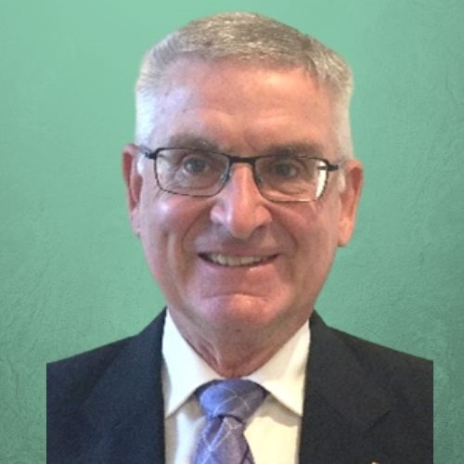
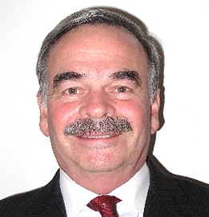
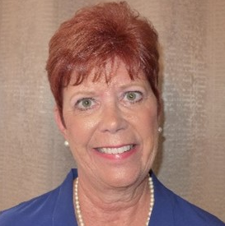
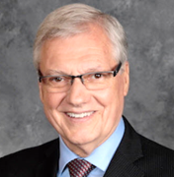
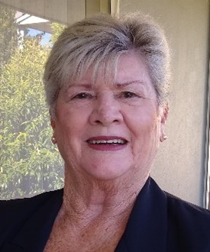
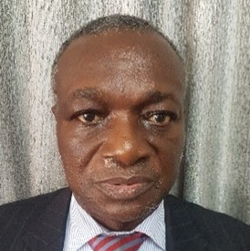
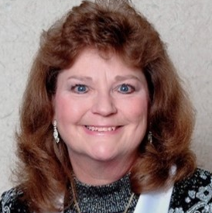
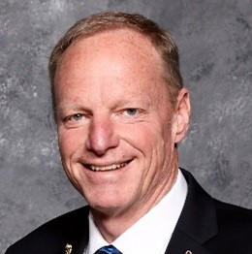
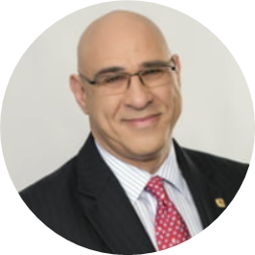
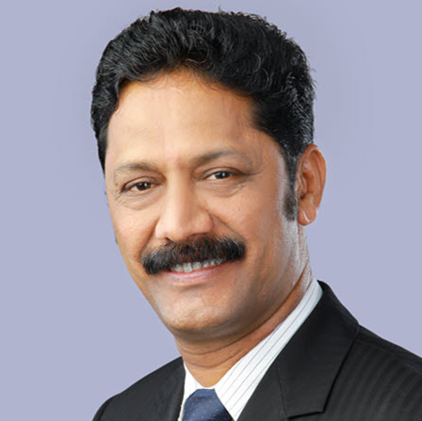
FVDG/DGE Seminar Group Leaders
PDG Steve Somerset
(Grp 21)
PDG Dennis W. Kelly III
(Grp 22)
PDG Jacqueline Tripp-Spencer
(Grp 23)
PID Thomas Gordon
(Grp 24)
PDG Lesley Lyons
(Grp 25)
PDG Chief Bassey Edem
(Grp 26)
PID Ardie Klemish
(Grp 27)
PDG Mark Mansell
(Grp 28)
PDG Niels Schnecker
(Grp 29)
PCC A.V. Vamanakumar
(Grp 30)

Slide 8
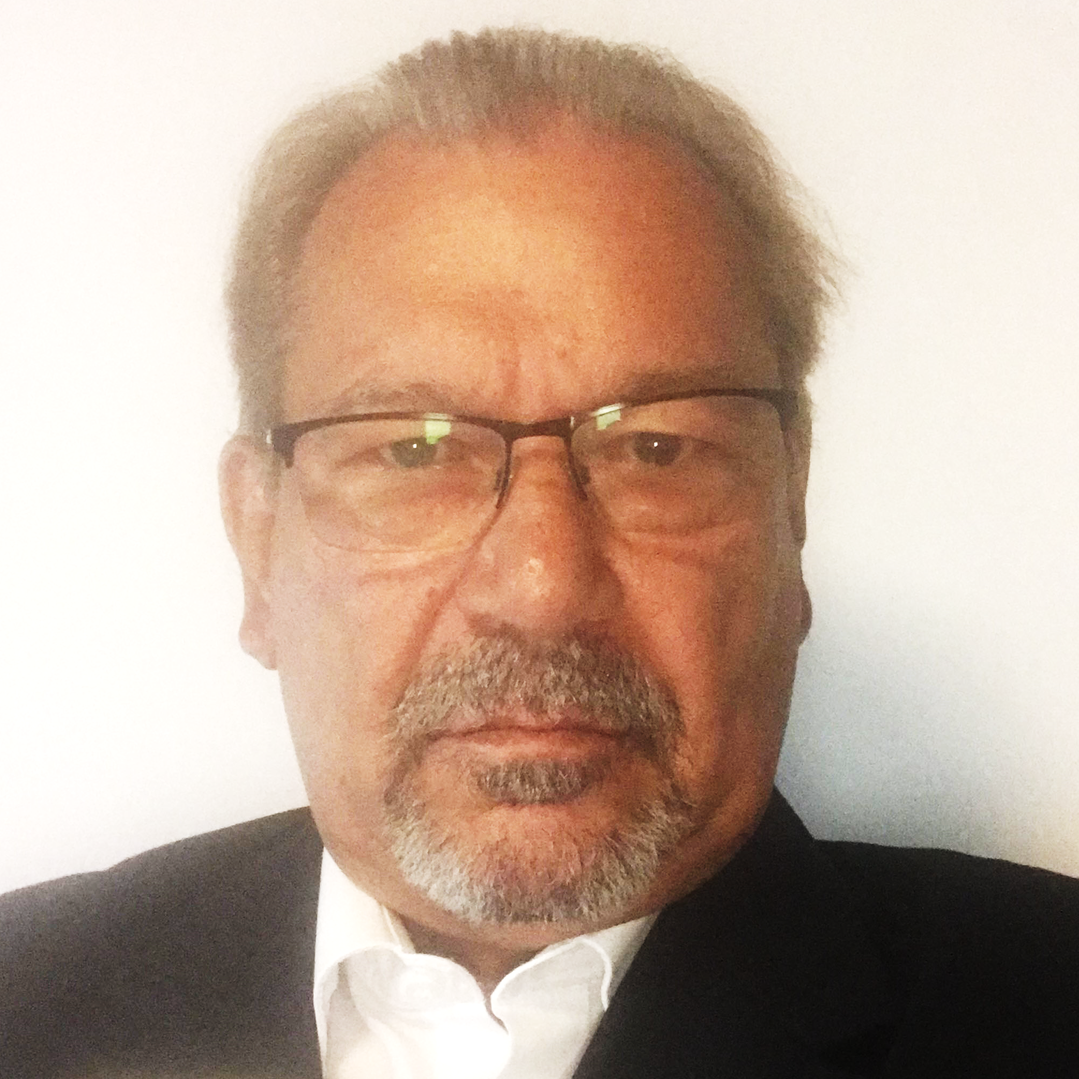
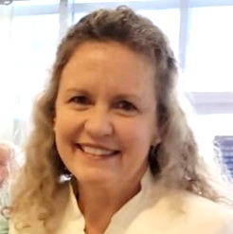
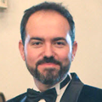
FVDG/DGE Seminar Associates
PID Miklós Horváth
PDG Mónica Segura
PDG Andreja Stojkovski

Slide 9
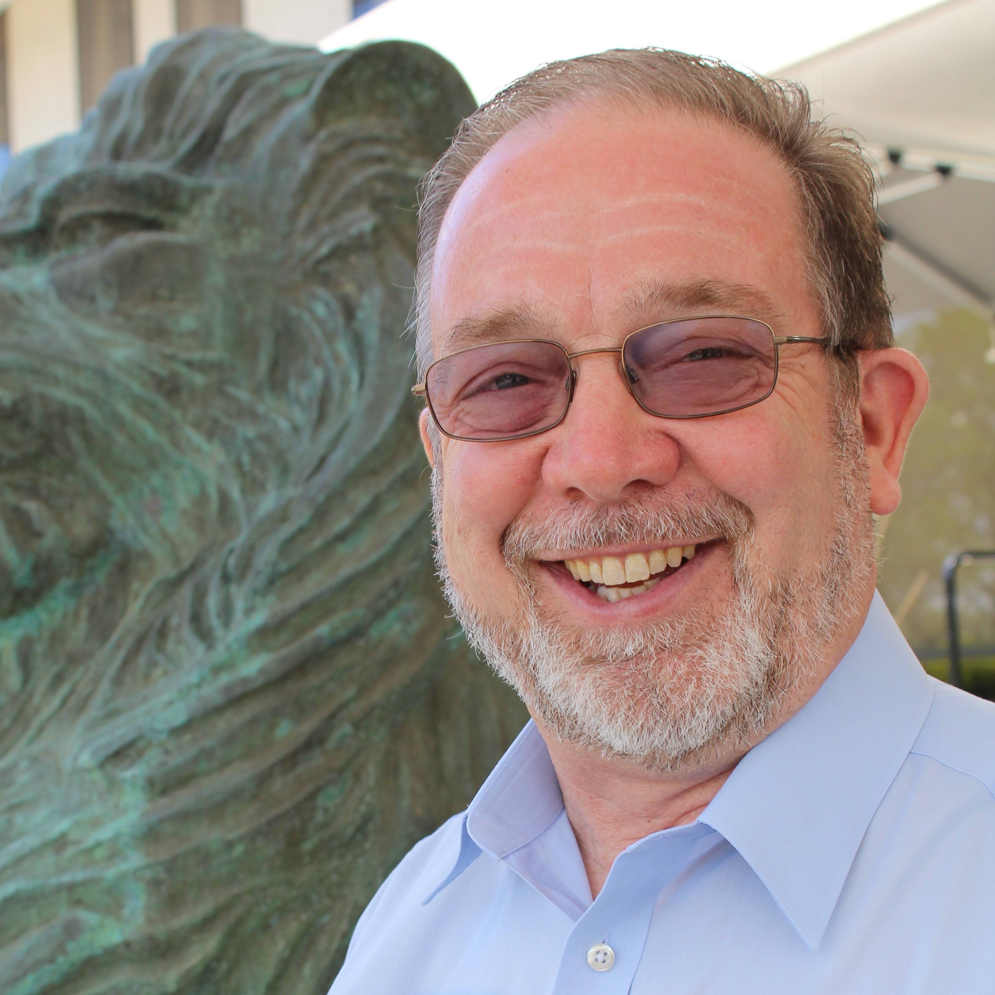
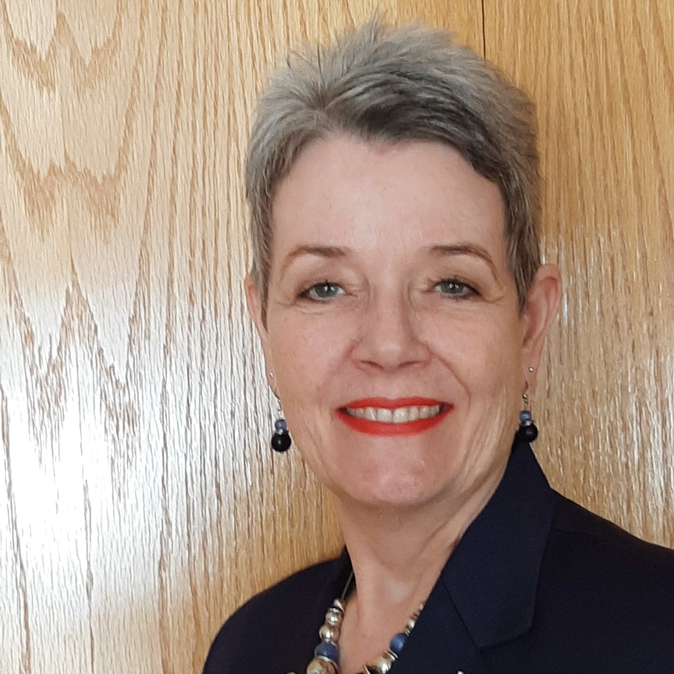
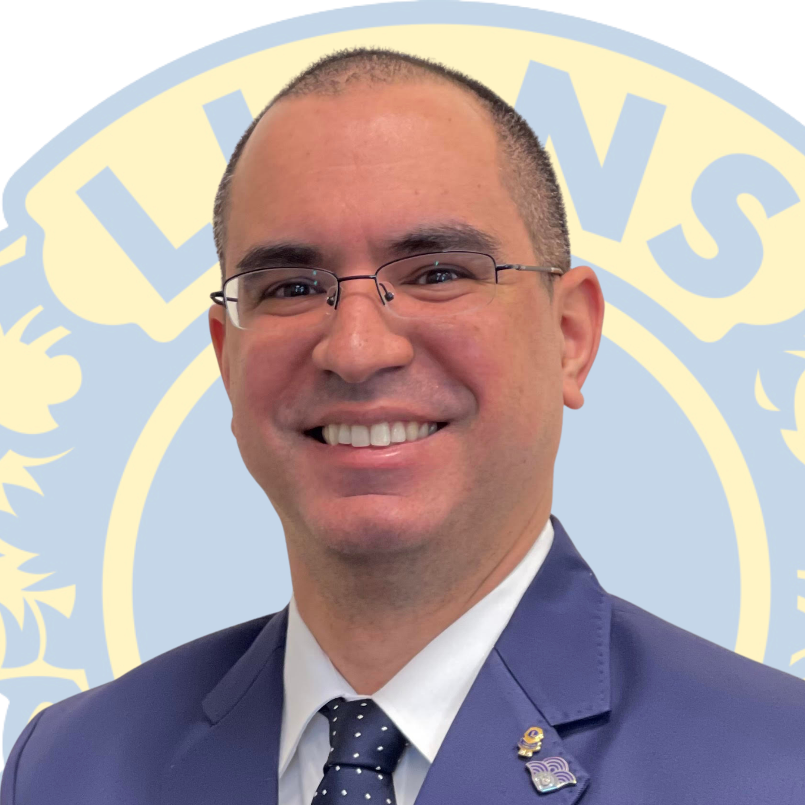
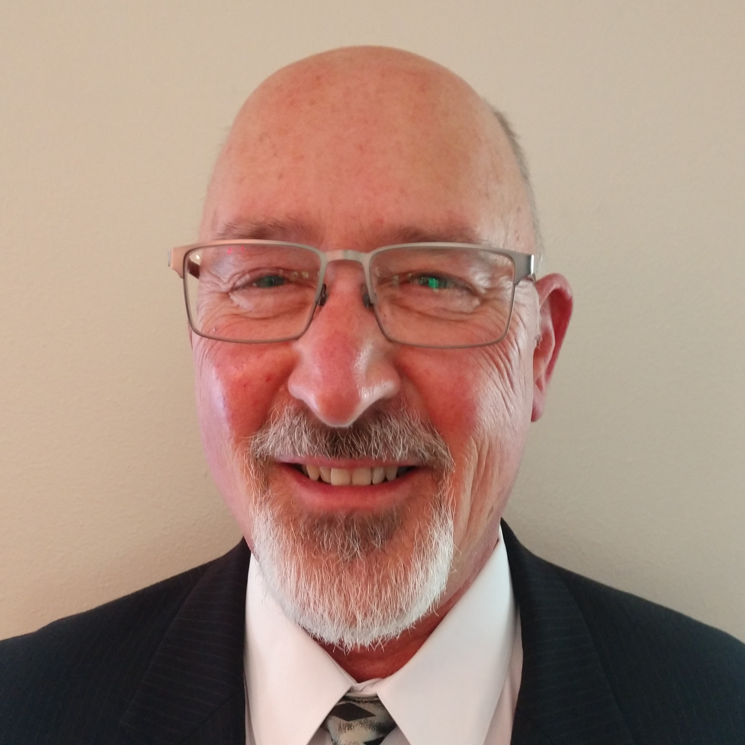
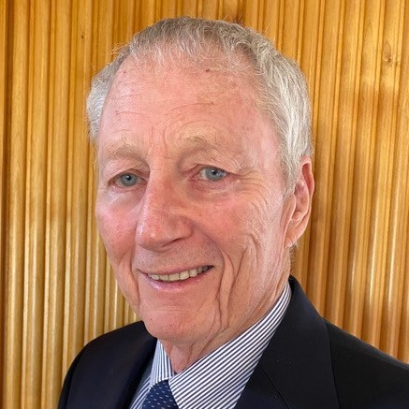
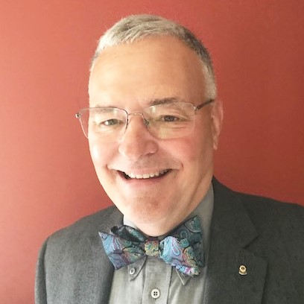
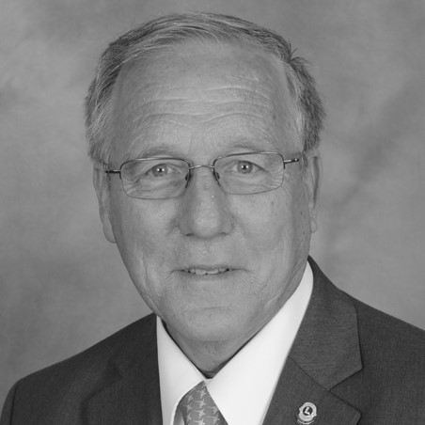
Global Action Team Area Leaders: CA 1
PCC John Landrum
PID Cindy Gregg
PID Connie Le Cleir-Meyer
PCC Winster Ceballos
PCC Randy Ritterbush
Lion Richard Stevenson
PDG Dave Wineman
PID William “Bill” Phillipi

Slide 10
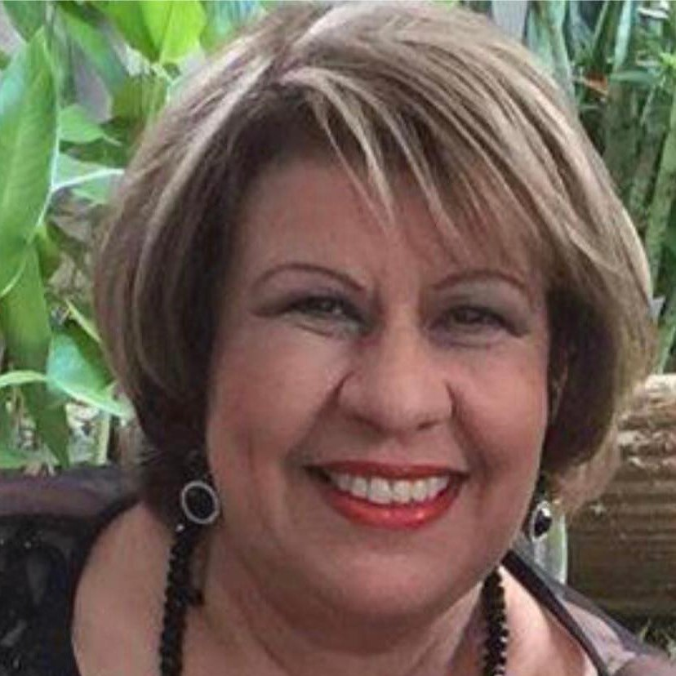
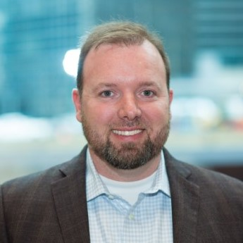
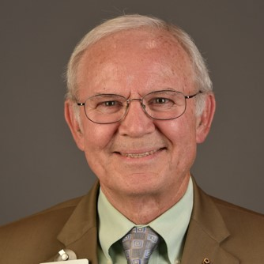
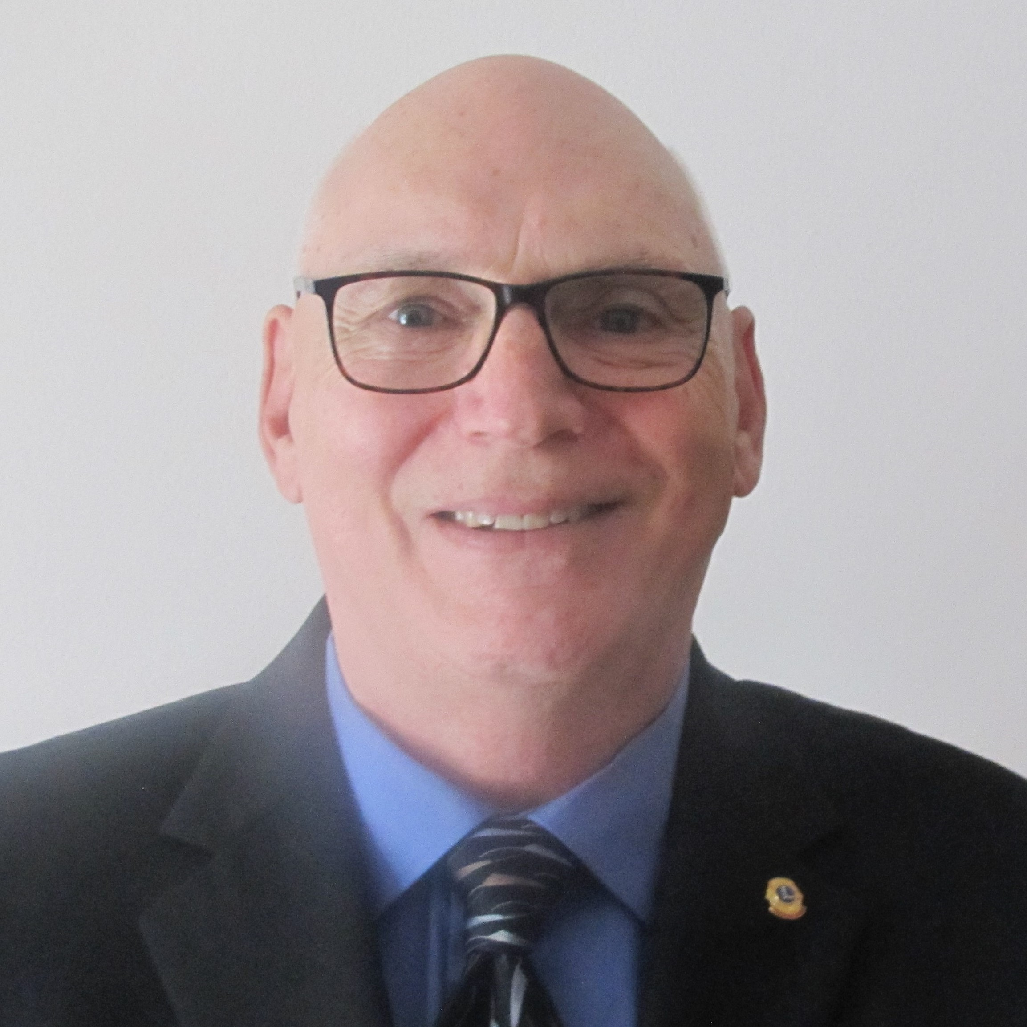
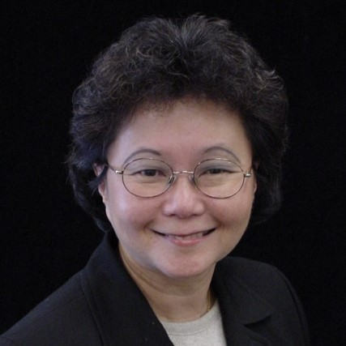
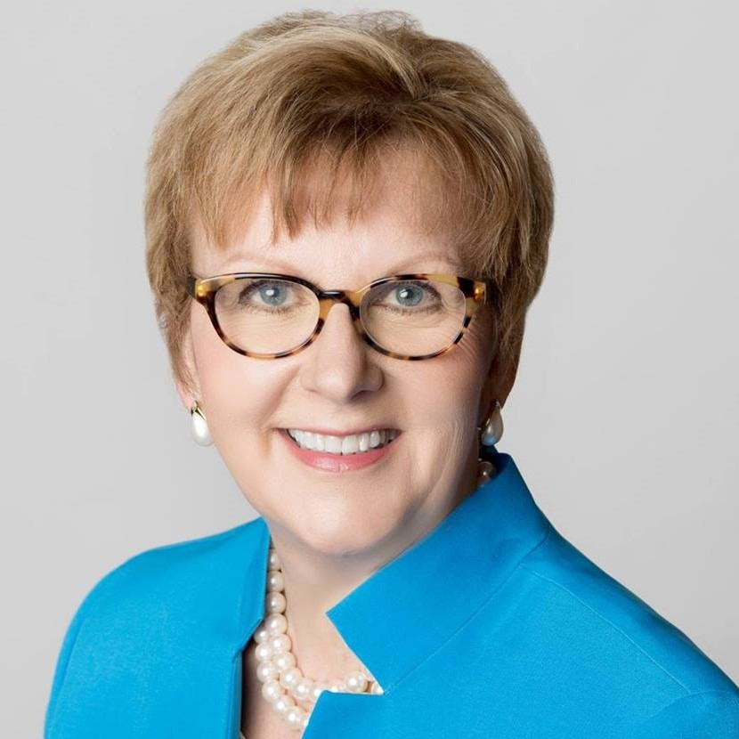
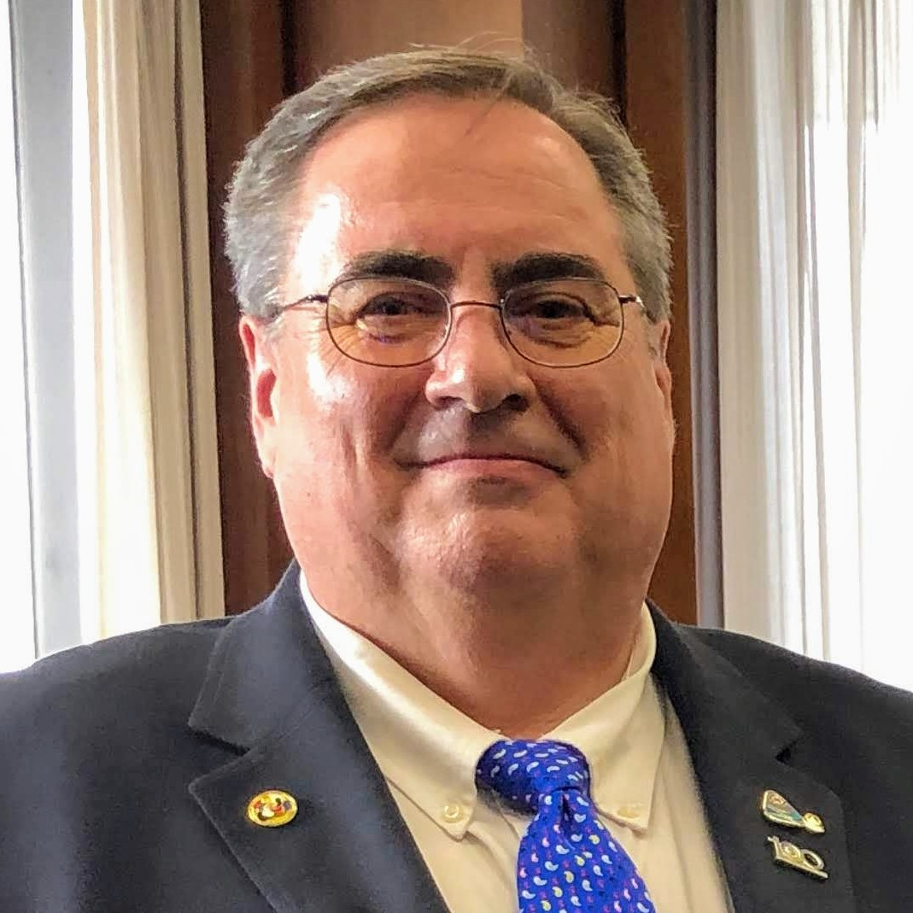
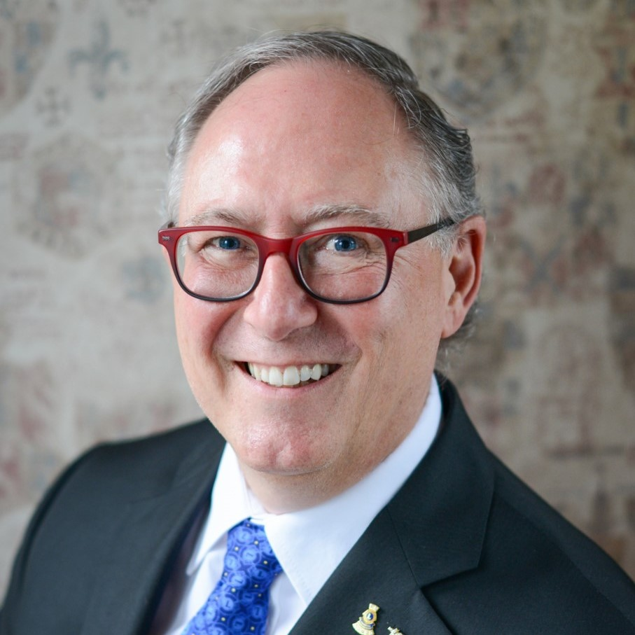
Global Action Team Area Leaders: CA I & II
PID Mark Lyon
PCC Miriam Vázquez
PCC Garner Andrews
PID Thomas Matney
PDG Orest “OJ” Wilura
PCC Polly Voon
PID Patricia “Pat” Vannett
PDG Mark Piva
PID Yves Léveillé

Slide 11
Global Action Team Area Leaders: CA III
PDG Luis Esparza
PID Carlos Valencia
PCC Luis Jesús Castillo Gamboa
PCC Miryam Luna Loaiza
PCC Estela Acosta de Riquelme
PCC Edward Lago de Macedo
PDG Ricardo Komatsu
PCC Orley Ademar Ikert
PDG Christian Colombo
PDG Eraldo da Silva Pereira

Slide 12
Global Action Team Area Leaders: CA IV
PDG Jenni Luomala
PCC Hilde Straumsheim
PCC Udo Genetsch
PDG Werner Gschwandtner
PID Regina Risken
PID Miklos Horvath
PDG Niels Schnecker
PDG Heiko Dallmann

Slide 13
Global Action Team Area Leaders: CA IV
PDG Surinder "Max" Mongia
PDG Zeynep Kocasinan
PCC Corinne Bloemendal-Kramarz
PCC Pol Navarre
PID Claudette Cornet
PID Dr. José-Maria Gorgulho
PID Domenico Messina
PID Gabriele Sabatosanti Scarpelli

Slide 14
Global Action Team Area Leaders: CA V
(China, China Taiwan, Japan)
PDG Manxiong Liao
PDG Ziqin Gao
Lion Zhe Zhang
PDG De Gang Zheng
PDG Jeff Huang
PDG Eagle Chao
PDG Chizuko Nagasawa
PDG Chikao Suzuki
PCC Katsuki Shirosaka
PCC Yasunobu Shikina

Slide 15
Global Action Team Area Leaders: CA V
(Korea, English-Speaking Areas)
PID Byeong-Deok Kim
PDG Hee-Chae Park
PCC Je-Kwan Ha
Leo-Lion Potter Ka Kai Fong
PCC George Ong Tan
PDG Prayat Sirinaphaphan
PID Dr. Datuk Nagaratnam (Naga)

Slide 16
Global Action Team Area Leaders: CA VI
PID Malik Khuda Baksh
PCC Wijitha Manamperi
PDG Nazmul Haque
PCC Khagendra Sitaula
PDG Nabil Rousse
PID Vijay Kumar Raju Vegesna
PID Krishna Reddy V V
PID Murugan R.

Slide 17
Global Action Team Area Leaders: CA VI
PDG Bheemaiah Jagini
PID Jagdish Gulati
PID Bishnu Bajoria
PDG Bhavna Shah
PDG Subhash Dasani
PDG Tilok Chand Bardia
PCC Jayesh Thakkar
PDG Pandiarajan Thalamuthu

Slide 18
Global Action Team Area Leaders: CA VII & VIII
CC Delwyn Seebeck
PDG Wendy Miller
PDG Satyo Fatwan
Lion Dr. Cathy Sebat
PCC André Gbadoe
PCC Samuel Ekpuk
PCC Herman Smit
PDG Nejib Chaabouni
PCC Rajinder "Pape" Sembi
PDG Patrick Herve

Slide 19
Work directly with GAT CA/RA/Area leaders
Communicate vision
Gain approval/buy-in from GAT
Maintain consistent communication
Ensure worldwide expansion of the Global Membership Approach for 2022-2023 District Governors
Begin earlier adoption with International President Alexander’s approval
2022-2023
Objectives
Utilize GAT leaders to regionalize the Global Membership Approach
19

Slide 20
2022-2023 District Governors
2022-2023
Vision
Highest priority
Guarantee they are prepared and focused
Hand-selected Group Leaders
High-energy
Importance of fun/excitement
Accountability and results
20

Slide 21
Group
Composition
Determining Group Allocation
Mixed Groups
Provide international learning opportunities
GAT Area Groups
Develop membership growth and teamwork
Determined to have the best of both!
21

Slide 22
Roles and Responsibilities Overview
Group Leaders
GAT Area Leaders
Mentor, guide and motivate FVDGs/DGEs
Facilitate leadership development training
Understand the relationship between district goals and the Global Membership Approach and attend GAT-led webinars
Host webinars with FVDGs and invite GAT area leaders to attend
Oversee, coordinate and support Global Membership Approach training and invite Group Leaders to attend
Encourage, support and monitor the development and submission of 2022-2023 S.M.A.R.T goals and action plans
Ensure communication is maintained and the global rollout is implemented successfully
22

Slide 23
2022-2023
District Goals
PIP Kajit Habanananda
23

Slide 24
2022-2023 District Goals
Service Activities
Our district will increase the percentage of clubs reporting service (meet or exceed last year’s service reporting numbers).
Membership Development
Our district will achieve a positive membership growth (meet or exceed last year’s membership numbers).
Leadership Development
Our district will hold training for club officers and zone chairpersons.
The district GLT coordinator will report each training using the manage training reporting tool in Learn.
LCIF
Our district will support Lions Clubs International Foundation (LCIF) in its endeavor to achieve its fundraising goal.

Slide 25
Integrating Global Membership Approach
into District Goals
Membership Development
Membership development goal focuses on new members, new club development and member retention.
First vice district governors/ district governors-elect will complete their district membership development goal using the Global Membership Approach:
Build a Team
Build a Vision
Build a Plan
Build Success
District leaders along with regions/zones will conduct a district strategic analysis, set realistic membership targets and build a plan to ensure a successful year ahead.
Global Membership Approach developed goals and action plans will be submitted through the district goals submission platform once available.

Slide 26
Global Action Team
Constitutional/ Regional Area Leaders
PID Jerome Thompson
PDG Rob Hill
PID Jaime García Cepeda
PID Elisabeth Haderer
PDG Jeff Huang
PID Magnet Lin
PID Yasuhisa Nakamura
PID Doo-Hoon Ahn
PID Dr. Datuk Nagaratnam (Naga)
PID Narendra Bhandari
PID Sheryl Jensen
PID Manoj Shah

Slide 27
Global Membership Approach
VP Brian Sheehan
27

Slide 28
Evolution of Global Membership Approach
North American Membership Initiative
Global Membership Approach
October 2018, Pilot Program “North America Membership Initiative" launched to help rejuvenate membership growth in CA1 and CA2
June 2020, North American pilot program resulted in a new approach to membership development, to be rolled out worldwide in a phased manner as the “Global Membership Approach”
The Global Membership Approach will be delivered and supported by the
Global Action Team, while the essential leadership skills that will help make the Global Membership Approach successful will be trained by Group Leaders.
28

Slide 29
Rejuvenate
districts with
new clubs
Global Membership Approach Objectives
1
Revitalize clubs with new members
Grow membership across all CAs
2
Re-motivate
members with
fellowship and
exciting service
3
29

Slide 30
Pilot Overview
30

Slide 31
The Road to Success
September
January
June
Meet and greet
Q Center Preparation
Review steps for success
Day 4 Preparation
Potential survey: needs and expectations
Pre-Q Center Party
Potential games
Group Leaders:
August- September
November
February- March
Process Overview
Build a Vision
GAT Vacancy Filling
Build a Team
District Goals Process Begins
Build a Plan
May
Build Success
Potential fun ‘Jeopardy’ session
GAT Area Leaders:
Remember to keep things fun and exciting!
31

Slide 32
Global Membership Approach Kick-Off
August
August – September FVDG Onboarding
June - July District Implementation
November FVDG Onboarding
February - March FVDG Onboarding
April District Implementation
May FVDG Onboarding
October District Implementation
December - January District Implementation
Build a Team
Build Success
Build a Vision
Build a Plan
Onboarding and Support
Timeline
* Global Membership Approach will be emphasized during days 1-3 of the FVDG/DGE Seminar
32

Slide 33
Strategic Communication Channels
1st VP Communications
Group Leader/ GAT
Support
Facebook/ WhatsApp Group
Global Membership Approach Website
Direct communication channel to FVDGs and Group Leaders
Direct communication channel between Group Leaders and GAT
Group Leader online assignment support
GAT Staff/Field onboarding and support
Alignment with global rollout timeline
Centralized location for tools and resources
33

Slide 34
2021-2022 FVDG/DGE Training Program
Seminar Chairperson Bruce Beck
34

Slide 35
FVDG/DGE Training Program Components
Multiple District Training
Online Learning and Assignments
Seminar Days 1-3
Seminar Day 4
35

Slide 36
Organized by multiple district GLT coordinators
GAT area leaders and LCIF multiple district coordinators support
Topics:
District Governor Orientation
LCIF
Public Speaking
Effective Listening
Promoting Service Journey Resources
Local topics, as needed
Multiple District Training
36

Slide 37
Group leaders and district team provide support.
Assignments:
Various elearning courses
District goals assignment
Pre-assignments booklet
Online Learning and Assignments
37

Slide 38
FVDGs/DGEs attend
Interactive classroom sessions facilitated by group leaders
Seminar focus:
develop leadership skills
action planning workshop
promote LCI and LCIF priorities
General session topics:
2022-2023 global priorities
Global Membership Approach
Other session and convention topics
FVDG/DGE Seminar Days 1-3
38

Slide 39
Day 4:
DGEs and spouses/companions attend
Presentations by Lions, LCI/LCIF staff and guests
Seminar focuses on the latest news and updates from LCI and LCIF
Concludes with a celebration banquet
FVDG/DGE Seminar Day 4
39

Slide 40
Supporting the Global Membership Approach
Build a Team
Selecting Your Team
Communication Skills for District Governors
Becoming a Whole Leader
Managing Your Team
Conflict Management
Supporting Membership
Leading Change
Build a Vision
Introduction to SWOT Analysis
District Goals Assignment
Supporting Membership
Build a Plan
Introduction to SWOT Analysis
Goal Setting
Action Planning to Achieve District Goals
District Goals Assignment
Managing Your Team
Conflict Management
Action Planning workshop
Supporting Membership
Leading Change
Build Success
Succession Planning
Becoming a Whole Leader
Managing Your Team
Conflict Management
Supporting Membership
Leading Change
40

Slide 41
41

Slide 42
Questions
42

Slide 43
Closing Comments
43

Slide 44
Thank You
44

