Slide 1
North America Membership Initiative
Build a Vision
Notes:
Welcome to this district meeting of the North America Membership Initiative. My name is ___ and I am excited to see all of you here today.
In this meeting we will analyze our district’s current situation and set our goals for our future.
_______________________
{PRESENTER NOTES:
This is a guide. Please edit as you determine necessary to insert district data (see slide 9) or add questions relevant to your district.
Several of the exercises start with small group discussions. Have flip charts, white boards or paper available for each table/group.
When you are asking for input, call on Lions and Club Officers first to help this initiative resonate at the club level. Past International Officers and DG Team members should wait for all other Lions to have input first.
Your group may provide ideas in this meeting that would be good for your district’s NAMI plan or other initiatives. Set aside flip chart, whiteboard or paper space to note those ideas. This is often referred to as a “Parking Lot” and can help your group stay focused.
You should use a clean sheet for each of the questions. This will assist in recording the “raw data”, which will be used in developing the IDEA Plan, which is the next NAMI step.
}

Slide 2
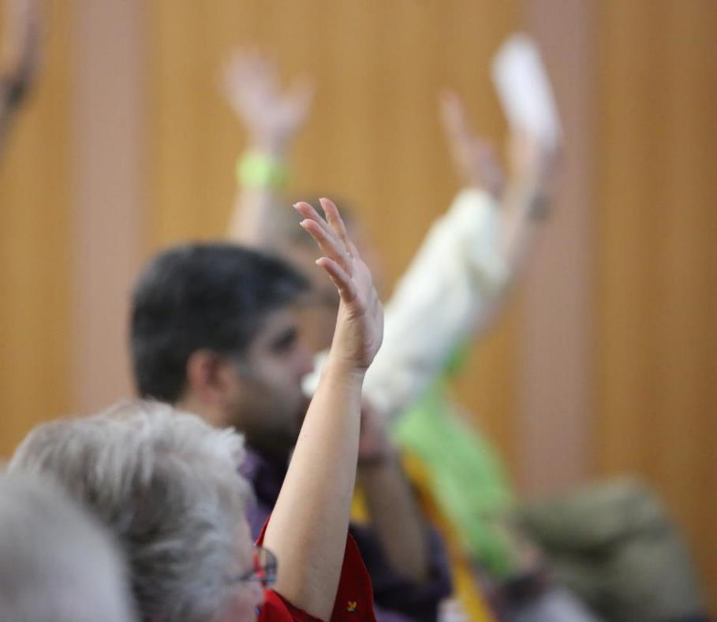
Agenda
1
NAMI Overview
District Vision
District Goals
Next Steps
2
3
4
Notes:
In today’s meeting we will:
Review what NAMI is about
Create a vision for the future of our district by examining our district’s achievements and areas for development
Set goals for our district
Plan the next steps in this program
But the most important part of today’s meeting is you. Only with the participation of all of us, can we succeed.
So let’s start with introductions. If you could tell us your name, your club, years as a Lion, and, if you could be world-class in any sport, what sport would it be?

Slide 3
NAMI Overview
Notes:
The image of NAMI is the dawn rising over North America.
We will all play our part in making that happen, so let’s answer the most common questions about NAMI.

Slide 4
Membership Trends
* Forecast
Notes:
The first question is Why? Why NAMI?
These two charts are the story of North America membership over the last 40 years. What’s important in this story is the trend line, which is basically the same on both charts.
It is the NAMI mission to reverse that trend.
It’s not going to be easy. If it was, it would have already been done.
But it is vitally important. Why?

Slide 5
District Discovery Objectives
2
Grow membership within the district
Revitalize clubs with new members
Rejuvenate districts with new clubs
Re-motivate members with new fellowships and exciting service
1
3
Notes:
The second question is “What?” What are we going to do? We will grow membership in the US and Canada by:
{click} Rejuvenating districts with new clubs
{click} Revitalizing clubs with new members
{click} Re-motivating members with new fellowships and exciting service
Today, each Lion here will have a part in Building a Vision for a better district in each of these key areas.

Slide 6
Why Lions Clubs?
Vision
To be the global leader in community and humanitarian service.
Mission
To empower volunteers to serve their communities, meet humanitarian needs, encourage peace and promote international understanding through Lions clubs.
Notes:
But before we start building, let’s ask a foundational question: Why are we Lions?
Here are our vision and mission statements.
What are the key words in those statements? What means the most to you?
I ask you to consider this meeting a “Safe Place” where all ideas are heard, respected and valued. I encourage each of you to think outside the box and share your ideas openly.

Slide 7
NAMI Process
1
All districts that would like to participate, opt-in to NAMI
We begin building a team of NAMI leaders
We develop a vision, analyze, and set goals for our district
We create a plan to achieve our goals
We build success by executing the plan and being accountable
2
3
4
5
Notes:
NAMI districts have a 5 step process:
We opt-in to success, build a team, build a vision, build a plan and build success.
Your DG Team is to be congratulated for leading us to the third step.
And we anticipate that this process will be repeated each year.

Slide 8
Expectations
What do Lions and club officers expect from their District Governor team?
What do Lions and club officers expect from their Zone chairperson?
What do we expect of Lions clubs?
Notes:
Let’s start by talking about our own expectations as Lions and Lion leaders.
{click} What do Lions and club officers expect from their District Governor team? We’ll take 5 minutes to have each table discuss their thoughts and then a spokesperson from each table will share the ideas. {discuss}
{click} What do Lions and club officers expect from their Zone chairperson? Again, we’ll take 5 minutes to have each table discuss their thoughts and then a spokesperson from each table will share the ideas. {discuss}
{click} What do we expect of Lions clubs? Again, we’ll take 5 minutes to have each table discuss their thoughts and then a spokesperson from each table will share the ideas. {discuss}
Let’s keep our expectations in mind as we move to the next step…

Slide 9
IYADWYHADYWAGWYHAG
If You Always Do What You Have Always Done You Will Always Get What You Have Always Gotten.
District members this year: __ People served this year: __
District members last year: __ People served last year: __
3 year retention of new members: __% Clubs reporting service: __%
Are we happy with where we are?
Can we do better?
What changes are needed to help us be the best we can be?
Notes:
{PRESENTER NOTES
The Insights reports, available at https://insights.lionsclubs.org, provide data to assist with district analysis. Login with your Lion Account and use these reports to fill in the blanks above prior to the presentation.
In the Membership chart area, click the Detailed View button. Click the + to the left of your Constitutional Area and then the + to the left of your Multiple District to view your district’s data. (Single districts not part of a Multiple District would click the + to the left of Undistricted.) Then click on your district number to highlight your row. Note your district’s membership for this year and last year, then scroll to the right and note the 3 year new member retention rate. Return to the main page by using the Go Back button at the top of the page.
In the Service Activity chart area, use the same steps as above to see your district’s service numbers. Note the number of people served this year and last year, then scroll to the right and note the percent of clubs reporting service.
The 5 Year Trend report, available at http://www8.lionsclubs.org/reports/5YearTrendReport, shows key metrics over the past 5 years, including new and dropped members and clubs. It is suggested to print copies of this report for the attendees, so they can refer to the numbers for district analysis and goal setting. }
__________________________________
…the performance of our district.
Here are our membership numbers and people served for this year and last year, as well as the 3 year retention rate for new members and the percent of our clubs reporting service activities.
You also have a handout with the numbers of clubs and members added and lost over the last 5 years, as well as the percent of women and men in our district.
What stands out to you? Any surprises? {discuss}
{click} Who knows what this means?
{click} If you always do what you have always done, you will always get what you have always gotten
{click} Are you happy with these numbers?
{click} Can all of us, working together, do better?
{click} If we’re not happy with these trends, its time to change!

Slide 10
The Path To District Improvement…
Leverage our Strengths
Manage our Weaknesses
Take advantage of Opportunities
Minimize impact of Threats
Strengths
Weaknesses
Opportunities
Threats
1
1
1
2
3
2
3
2
3
1
2
3
Notes:
During our time together today, we will collaborate on each of these points.
Ultimately, we will Build a Plan which Leverages our Strengths and Minimizes our Weaknesses.

Slide 11
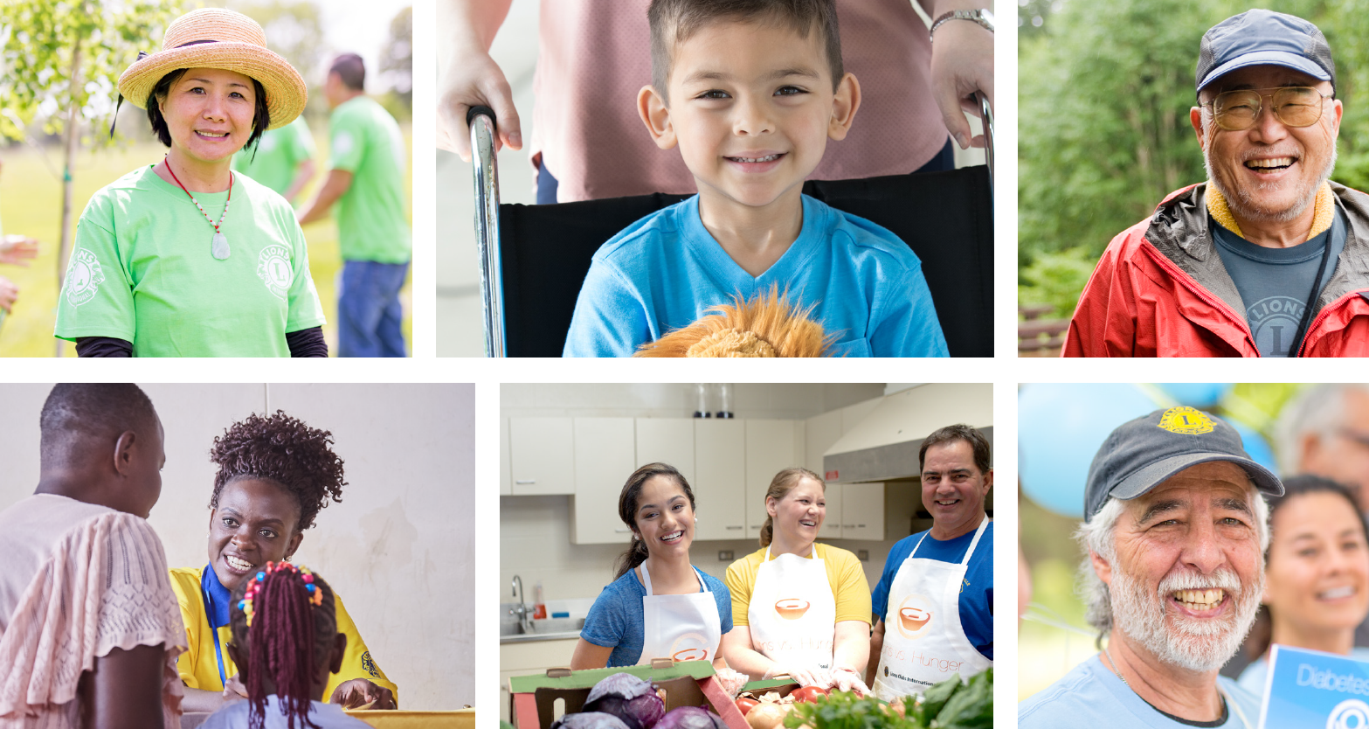
Accomplishments
What have the Lions
in your club and district
achieved?
Notes:
But we don’t want to change everything. There are some things we are great at. These are our strengths.
What are some of those things? We’ll take 5 minutes to have each table discuss their thoughts and then a spokesperson from each table will share the ideas. {discuss}
As Lions, we have an awful lot to be proud of.

Slide 12
Vision of the Future
Five years from now, if a former member called to inquire about your club, what would you like to tell them about changes for the better that have been made?
Notes:
An important part of Building a Vision is thinking about the future. What would you like your future club to be, to do, that’s different than today?
{Presenter Notes: Spend the time to let each Lion share the improvements they would like to see. These ideas, when incorporated into the plan, provide investment and commitment from all Lions in attendance. Listen, record and utilize these ideas to foster greater success.}

Slide 13
Recognizing the truth about ourselves is the starting point of all change.
Akiroq Brosst
Notes:
{pause}
Let’s get started.

Slide 14
Strengths
What exists or is currently being done well?
New Clubs
New Members
Member Satisfaction
Leader Support
Notes:
How about our strengths?
Looking over these four areas of focus: chartering new clubs, inducting new members, ensuring member satisfaction and providing leader support, what would you say we do well? We’ll take 5 minutes to have each table discuss their thoughts and then a spokesperson from each table will share the ideas. {discuss}
How can we build on those strengths, so our district can grow stronger? {discuss}

Slide 15
Weaknesses
What exists or is currently being done that can be improved?
New Clubs
New Members
Member Satisfaction
Leader Support
Notes:
Now we’ll talk about weaknesses.
Looking over those same four areas of focus, what would you say we don’t do very well? We’ll take 5 minutes to have each table discuss their thoughts and then a spokesperson from each table will share the ideas. {discuss}
How can we overcome our weaknesses? {discuss}

Slide 16
Opportunities
Where do we have opportunities to expand our service impact by engaging volunteers?
New Clubs
New Members
Member Satisfaction
Leader Support
Notes:
Opportunities and Threats are a little different, because they are a reaction to what’s going on outside our clubs:
Are businesses starting up or closing?
Are more people retiring, are there new families moving in or are people staying single longer?
Are there other charitable organizations nearby?
Are people becoming more or less connected with their communities?
Who can share an example of an external change in their area? We’ll take 5 minutes to have each table discuss their thoughts and then a spokesperson from each table will share the ideas. {discuss}
How can we take advantage of those changes? {discuss, considering some changes may be Threats, if no advantage can be found}

Slide 17
Threats
What’s happening outside Lions clubs, which may impact our success?
New Clubs
New Members
Member Satisfaction
Leader Support
Notes:
Not every change is good, but we can think of ways to reduce the harm to our clubs.
Like Opportunities, Threats can be business changes, demographic shifts, competing organizations, or cultural changes.
Who can share an example of what’s happening in their area that’s really not good? We’ll take 5 minutes to have each table discuss their thoughts and then a spokesperson from each table will share the ideas. {discuss}
How can we reduce the harm of those changes? {discuss, considering some can be converted to Opportunities if an advantage can be identified}

Slide 18
I can’t change the direction of the wind, but I can adjust my sails to always reach my destination.
Jimmy Dean
Notes:
So, here’s what we have for our SWOT results. {summarize}
Does anyone have anything they would like to add to our analysis before we move on?

Slide 19
District Goals
New Clubs
New Members
Member Satisfaction
Leader Support
For each Focus area
SMART
Accountability
Notes:
In this section of our meeting, we’ll draft a goal for each NAMI area of focus.
Who knows what SMART goals are? {Specific Measurable Attainable Relevant and Timely} Why is that a good idea for goals? {discuss}
We’ll also start talking about how we will take part in achieving our goals.

Slide 20
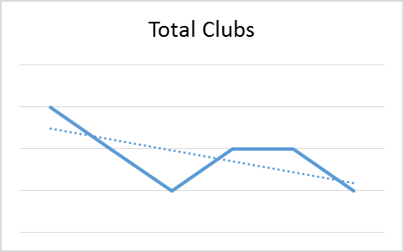
Focus Area 1 Rejuvenate districts with new clubs
Discussion Questions
Why are new clubs valuable?
Where can we start new clubs?
What Specialty Clubs would be most successful?
What training / resources are needed?
Goal 1
District ## will charter __ Lions clubs by June 2021
Notes:
Let’s start thinking about new clubs. Why are new clubs valuable? {discuss a couple of ideas}
Spend 5 minutes at your table on the discussion questions. Then a speaker from group will share your thoughts.
Once we’ve heard all the ideas, we’ll agree on a goal for our district.
Is everyone ready? Your 5 minutes starts now. {discuss}
Let’s talk about a goal. From all we’ve learned, how many clubs can we realistically charter by June 2021? {discuss}

Slide 21
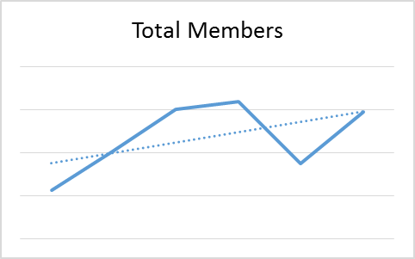
Focus Area 2 Revitalize clubs with new members
Discussion Questions
Why invite people to join your club?
What’s the best way for a club to add new members?
Does your club host Membership Growth Events? How? How often?
What training or assistance is needed?
Goal 2
District ## will induct ___ new Lions into our existing clubs by June 2021
Notes:
Now we’ll think about new members. Why should people join a Lions club? {discuss a few ideas}
Spend 5 minutes at your table on the discussion questions. Then a speaker from group will share your thoughts.
Once we’ve heard all the ideas, we’ll agree on a goal for our district.
Is everyone ready? Your 5 minutes starts now. {discuss}
Let’s talk about a goal. From all we’ve learned, how many members can we realistically induct into our existing clubs by June 2021? {discuss}

Slide 22
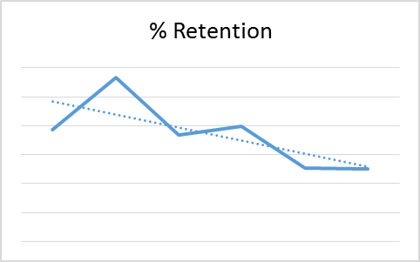
Focus Area 3 Re-motivate members with fellowship and exciting service
Discussion Questions
How do you know a Lion is engaged?
Why is new member orientation important?
How do hands-on service projects help retain members?
How can we re-engage members who stop participating in club activities?
Goal 3
District ## will lose no more than ___ Lions by June 2021
Notes:
Now we’ll think about engaging our existing members. How do we know members are engaged? {discuss a few ideas}
Spend 5 minutes at your table on the discussion questions. Then a speaker from group will share your thoughts.
Once we’ve heard all the ideas, we’ll agree on a goal for our district.
Is everyone ready? Your 5 minutes starts now. {discuss}
Let’s talk about a goal. From all we’ve learned, what is the maximum number of members we will lose in our district by the end of June 2021? {discuss}

Slide 23
Focus Area 4 Support District and Club leaders
Discussion Questions
What programs, seminars or training should be offered to club officers?
What is the best format to deliver training?
If the District hosted a Lions Leadership Institute, who should attend?
What other types of support can we provide to our leaders?
Notes:
Now we’ll think about our Lion leaders. What types of programs or seminars would be most helpful to support our three goals? {discuss a few ideas}
Spend 5 minutes at your table on the discussion questions. Then a speaker from group will share your thoughts.
Is everyone ready? Your 5 minutes starts now. {discuss}
What can we realistically plan to provide for district and club leaders by June 2021? {discuss}

Slide 24
The greater danger for most of us lies not in setting our aim too high and falling short; but in setting our aim too low and achieving our mark.
Michelangelo
Notes:
Let’s review the goals we set. {list goals}
Any additional thoughts on those goals? {discuss, and adjust if needed}

Slide 25
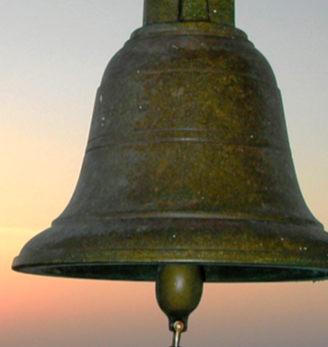
All hands on deck!
Clubs
PIDs
IDs
PIPs
PDGs
GAT
MDs
Zones
Districts
Notes:
If we want to achieve those goals, it’s all hands on deck, especially in our clubs.
We need clubs committed to testing new ways of operating and being open in reporting their successes and where they are struggling, so we can learn how all clubs can improve.
I’m ringing the bell for all hands on deck in our district. Who can I depend on? {raise hand}
{choose a raised hand} Tell me how you will contribute? {discuss ideas}

Slide 26
Next Steps
Review by Council Chairperson and GAT-MD
Write an Individual District Enhancement Action Plan (IDEA Plan)
IDEA Plan review
Mobilize for plan implementation and goal achievement
Notes:
Congratulations! We have completed our district analysis and created district goals. What happens next?
First, our Council Chairperson and GAT-MD will review our progress.
Then, we will meet again to create our own NAMI Plan, also known as an Individual District Enhancement Action Plan, or IDEA Plan.
Then we’ll get our entire district involved to execute our plan and achieve our goals.
Does anyone have any questions?

Slide 27
Comments, Concerns, Questions?
Notes:
Thank you. Thank you for participating in this District Discovery meeting. Thank you for being a leader in our great organization.
With all of us working together, along with the other NAMI districts, I am confident we will turn membership around in North America.
With leaders like you, the future is bright for Lions clubs. Thank you.

