Slide 1
The Global Action Team
in Action

Slide 2

One Team Approach
Notes:
The Global Action Team believes in a one-team approach, working together to increase leadership development, enhance membership opportunities and promote innovative, impactful service projects in communities all over the world.
Through teamwork, a small idea in a rural community can grow into the next big idea that impacts millions across a country. That’s the power of action.

Slide 3
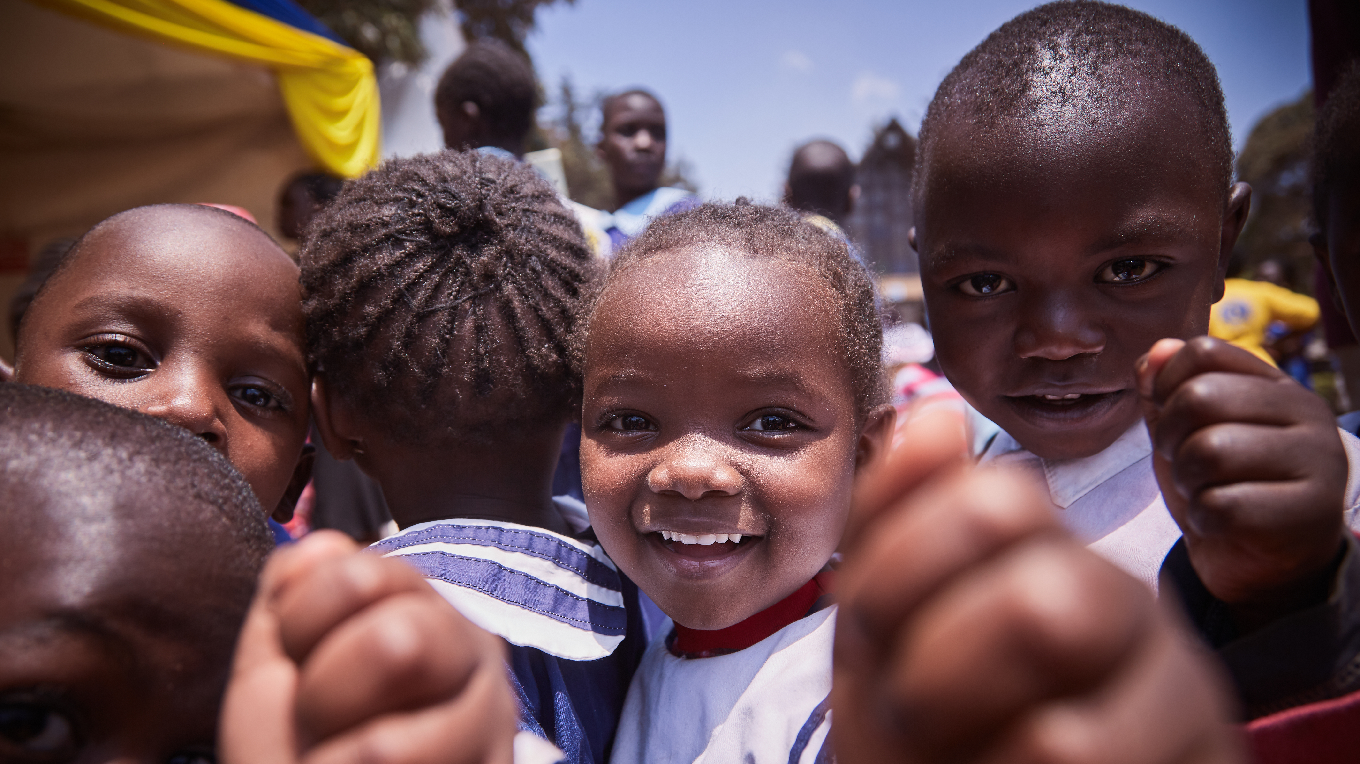
Lions in Kenya
Advocating and Educating on Diabetes
Lions of Kenya began working in diabetes 10 years ago, but have expanded their efforts considerably in the past few years.
3
Notes:
I’d like to share an example of how this one-team approach creates lasting impact through service.
The Lions of Kenya are bringing awareness to the public about diabetes prevention and control. They began working in diabetes 10 years ago but seeing the need expanding to surrounding communities, they have expanded their efforts considerably in the past few years.

Slide 4

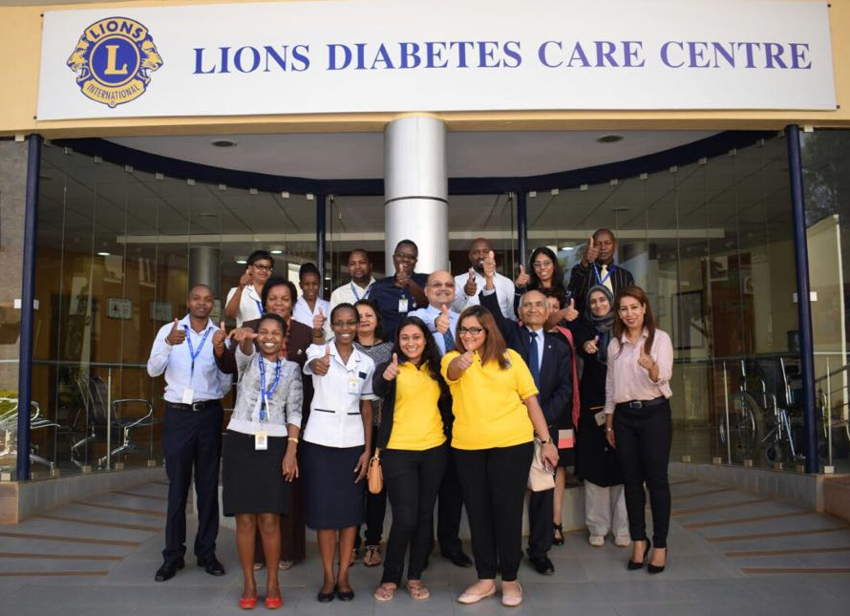
Lion Leaders Mobilize For Diabetes
Chris Bunch – LION Managing Editor
Sanjeev Ahuja – Chief of Marketing & Membership
Dan Hervey – Brand & Creative Director
Stephanie Morales – Meetings Manager
With non-communicable diseases as a growing public health threat in Kenya and a focus area of Kenya’s Ministry of Health, Lion leaders decided to expand upon the care they were providing by building Lions Diabetes Care Centers.
In April 2017, Lions of Kenya opened their first center.
Notes:
Global Action Team leaders saw the opportunity to expand the care they were providing. Through their existing partnerships with The Lions Sight First Eye Hospital and M.P. Shah Hospital in Nairobi GAT leaders conceived the idea for Lions Diabetes Care Centers, and opened the first center in April 2017.

Slide 5
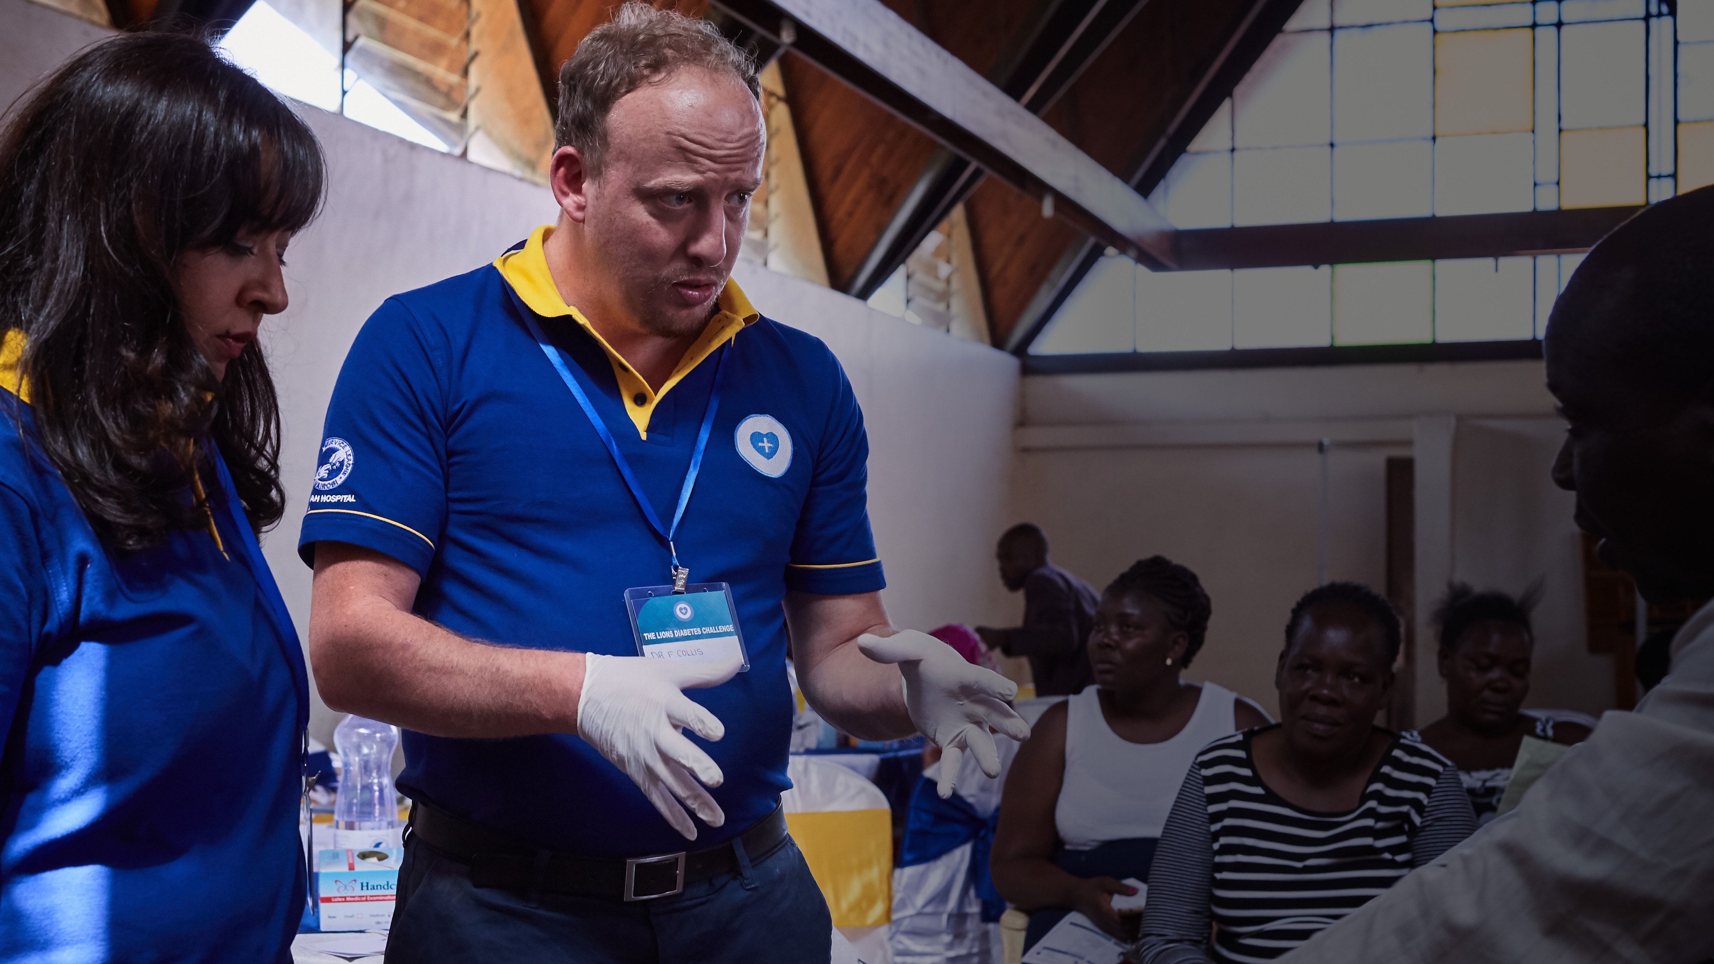
Conquering all forms of diabetes by providing care, educating the public, and investing in research for a diabetes cure.
The diabetes centers focus on a holistic, multidisciplinary care that involves not only patients, but also family. They offer:
• Nutrition education
• Counseling
• Specialized foot care
• Specialty clinics for vascular issues,
nephrology, and ophthalmology.
5
Notes:
Lions leveraged professional expertise, partnerships with healthcare providers and Lions hospitals and diabetes centers. They now provide comprehensive screenings, ensure follow-up care and create outstanding educational materials and resources.

Slide 6
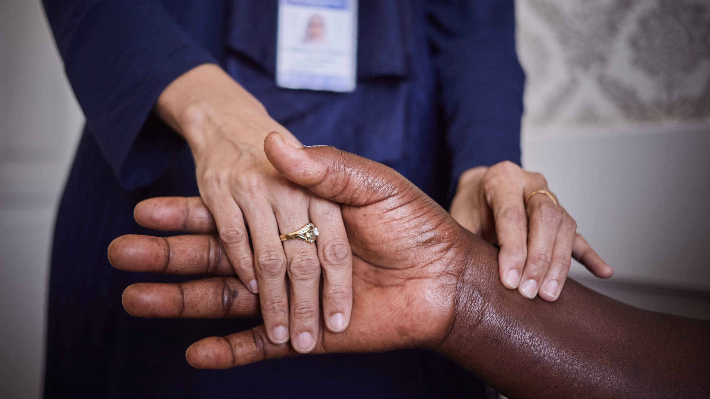
Each Pillar Plays Its Part
Leadership, Membership, & Service in Action
6
Notes:
Each pillar of the Global Action Team- leadership, membership and service- played an important role in expanding diabetes education, screenings and continuing care to those most in need.
Here’s how the GAT brought together service, leadership development and membership to multiply their impact in Nairobi

Slide 7
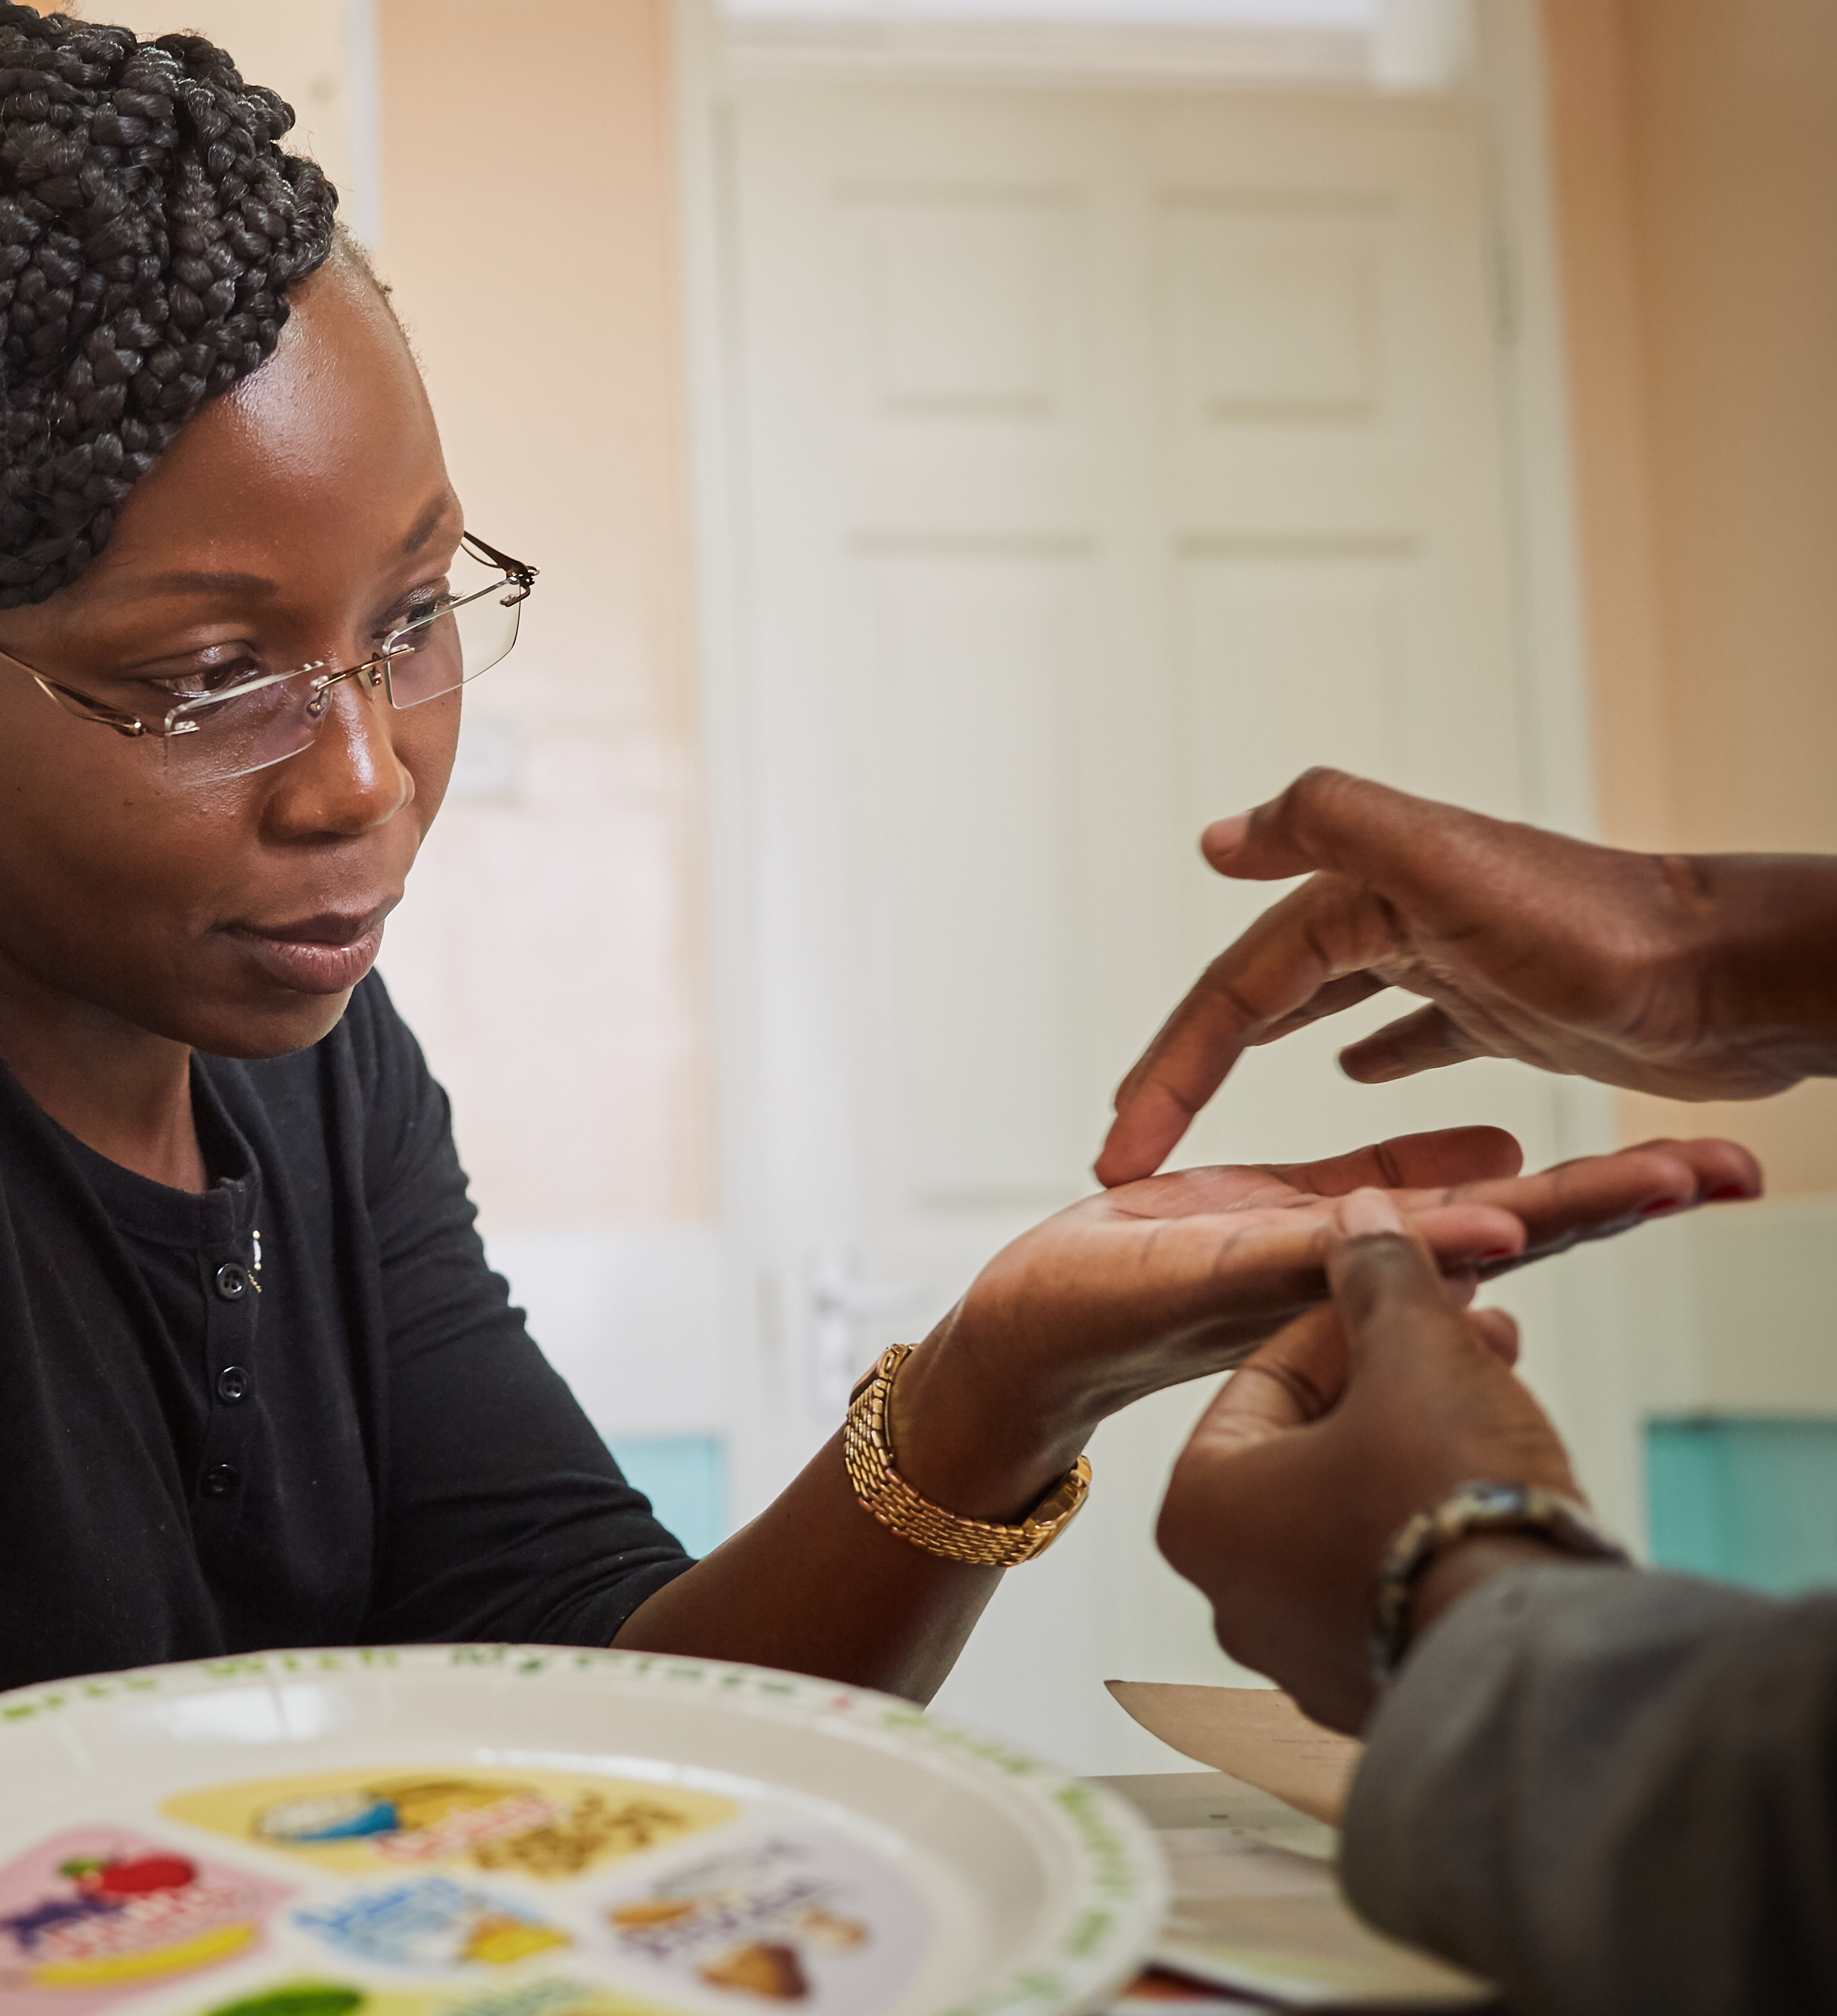
SERVICE
Lions of Kenya host diabetes screenings for Kenyans from all walks of life.
7
Notes:
Service - Lions hosted diabetes screenings at hospitals, schools, business, rural and poor areas for all Kenyans. Educational materials were distributed, and those who were diagnosed or at risk of diabetes were connected to health support services, which including follow-up and on-going care.

Slide 8
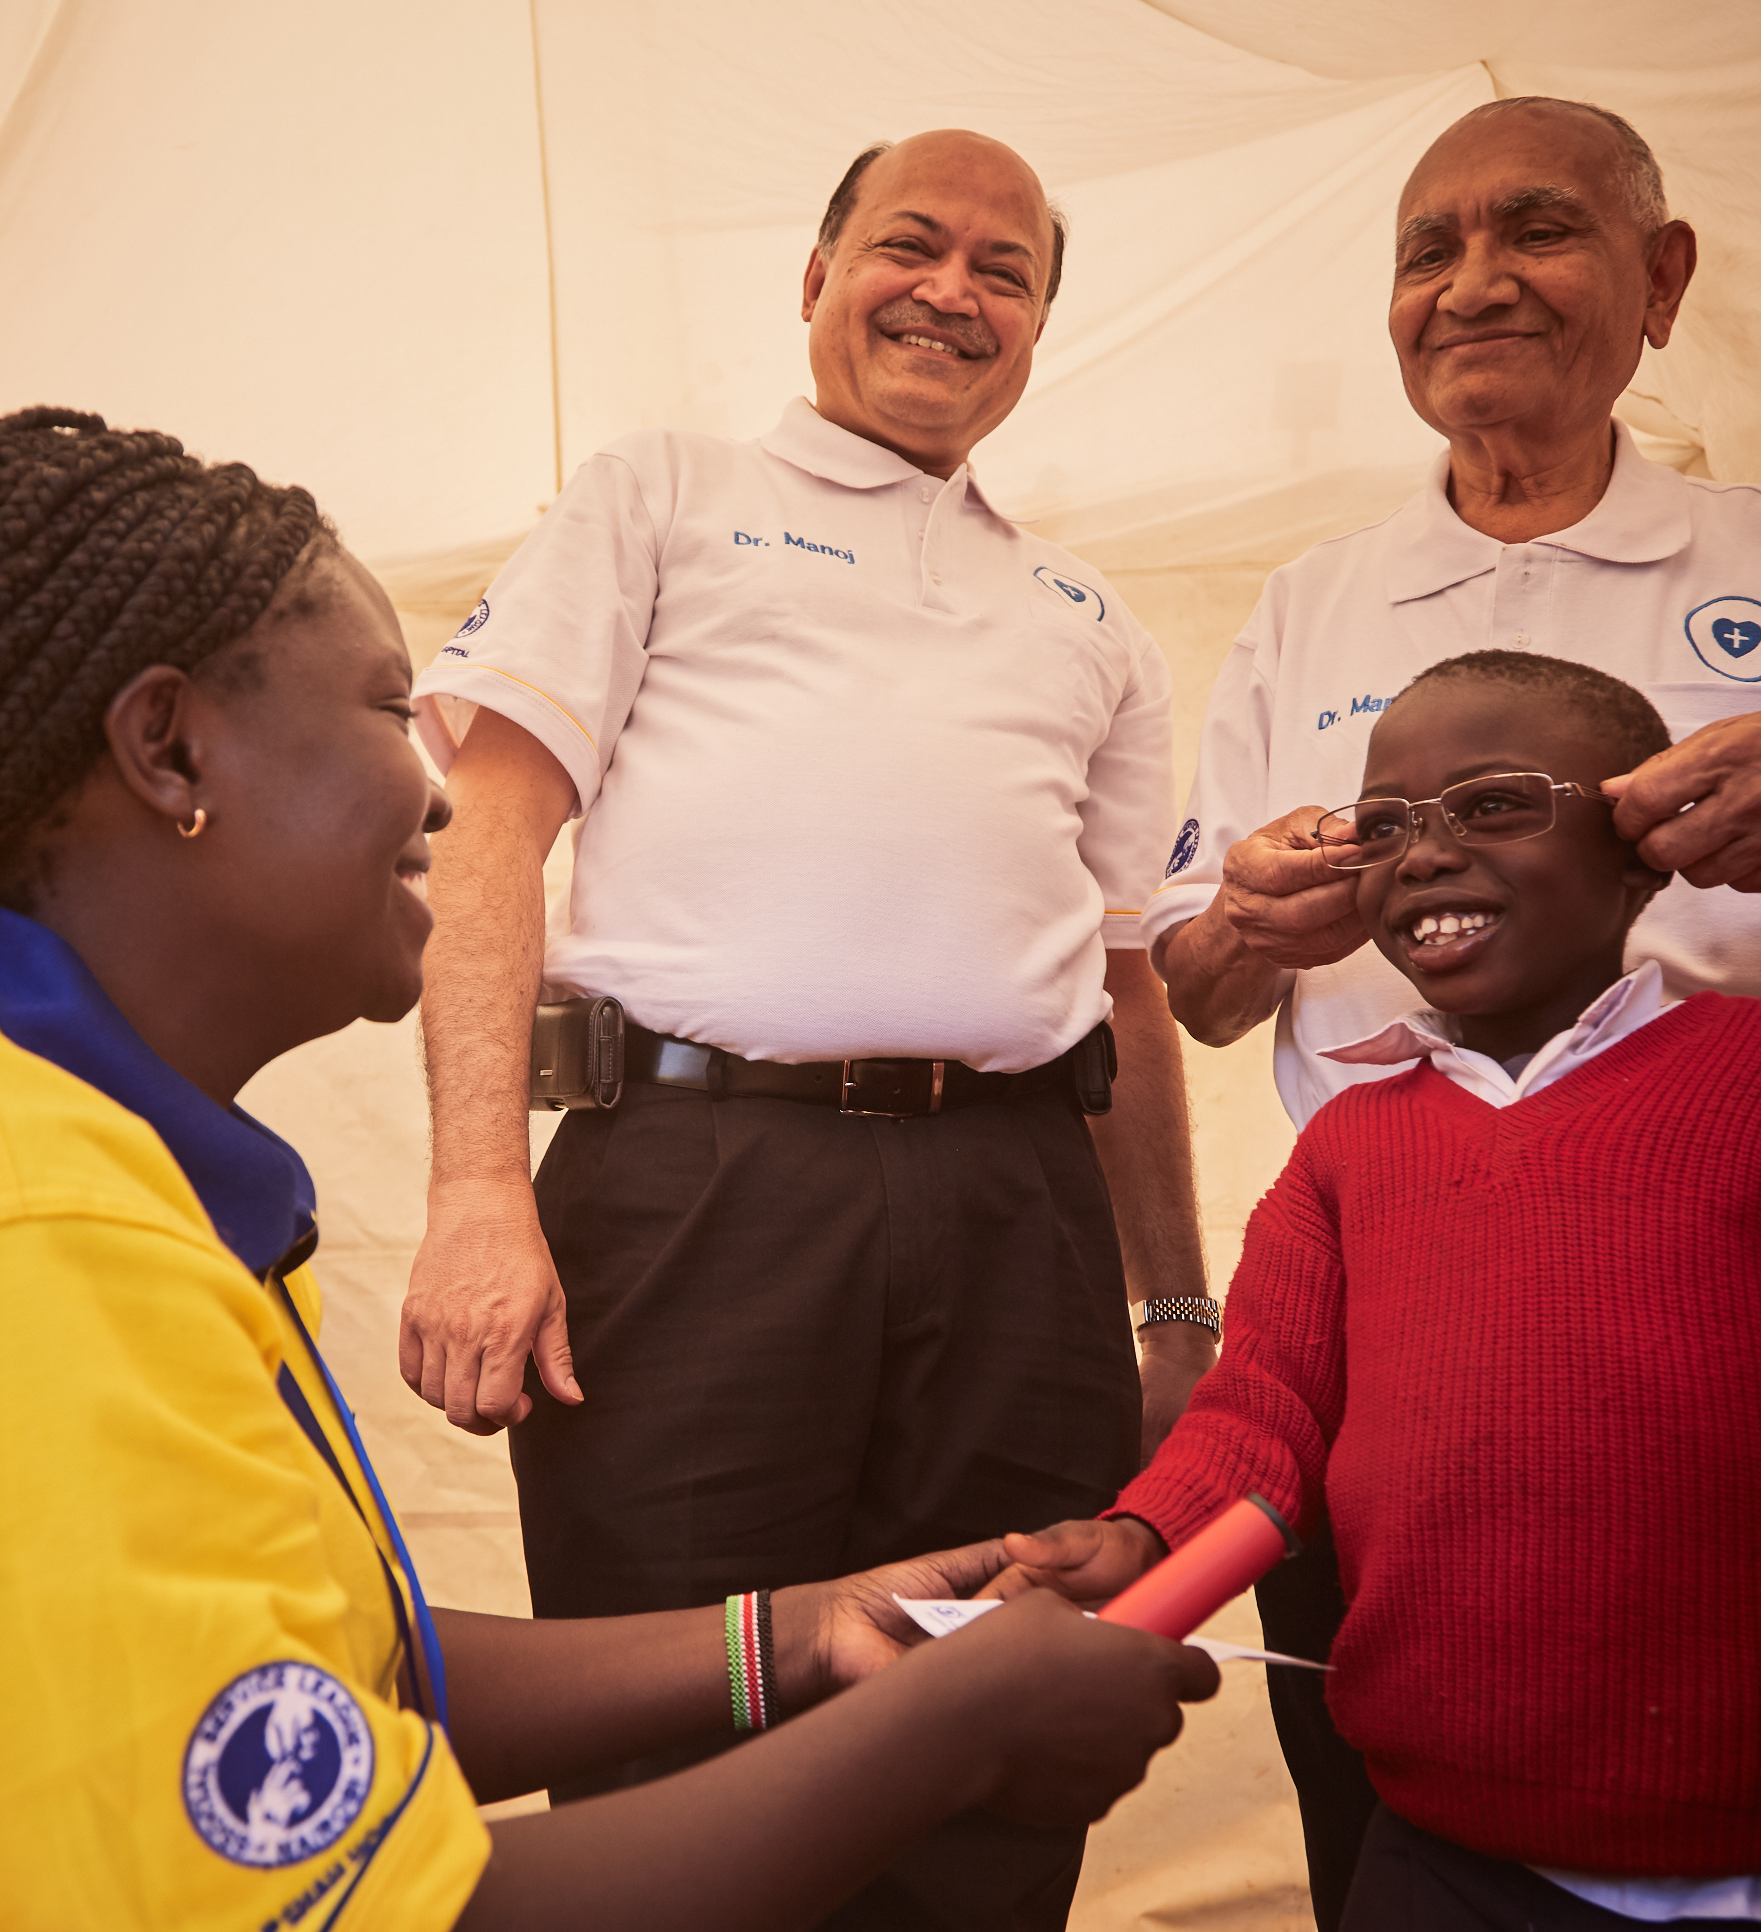
LEADERSHIP
The Global Action Team leaders ensured that staff and students were prepared to support their community.
The two Diabetes Care Centers (MP Shah Hospital and Lions Sight first Eye Hospital) provide several internal and external training opportunities for staff and students.
8
Notes:
Leadership is identifying and providing opportunities to lead. Global Action Team leaders in Kenya recognized that the diabetes care centers teams are leaders and provided internal and external training opportunities for staff and medical students. These trainings ensured the teams were prepared to support the community.
Trainings include:
1. Certified Diabetes Educator Trainings
2. Peer Leader Training for
Diabetes Support Groups (DSG)
3. Outreach and education trainings

Slide 9
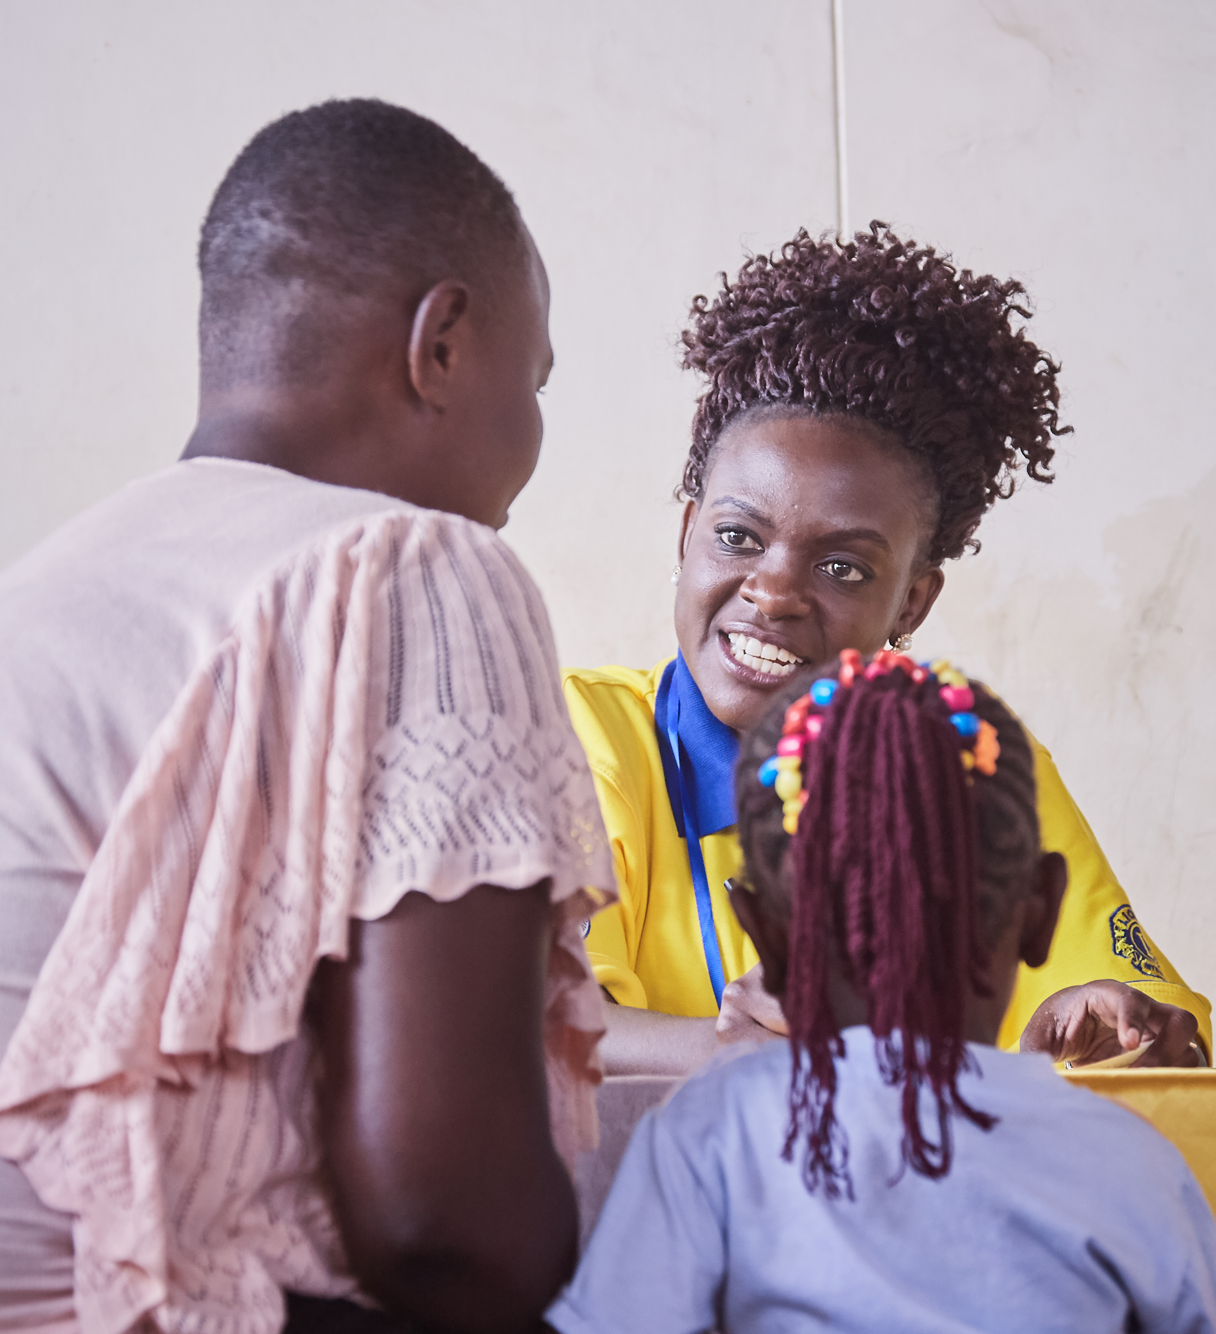
MEMBERSHIP
Lions of Kenya mobilized heavily during World Diabetes Day in November of 2017
Innovative and impactful service environment, engaged community members
New specialty club chartered as a result
9
Notes:
Lions of Kenya mobilized their existing membership with outside partners and members of the community during World Diabetes Day in November 2017. They served together, raising awareness during the lead-up to service on World Diabetes Day. From that shared experience a new specialty club was chartered with a vision to educate and create more diabetes awareness in the community.

Slide 10
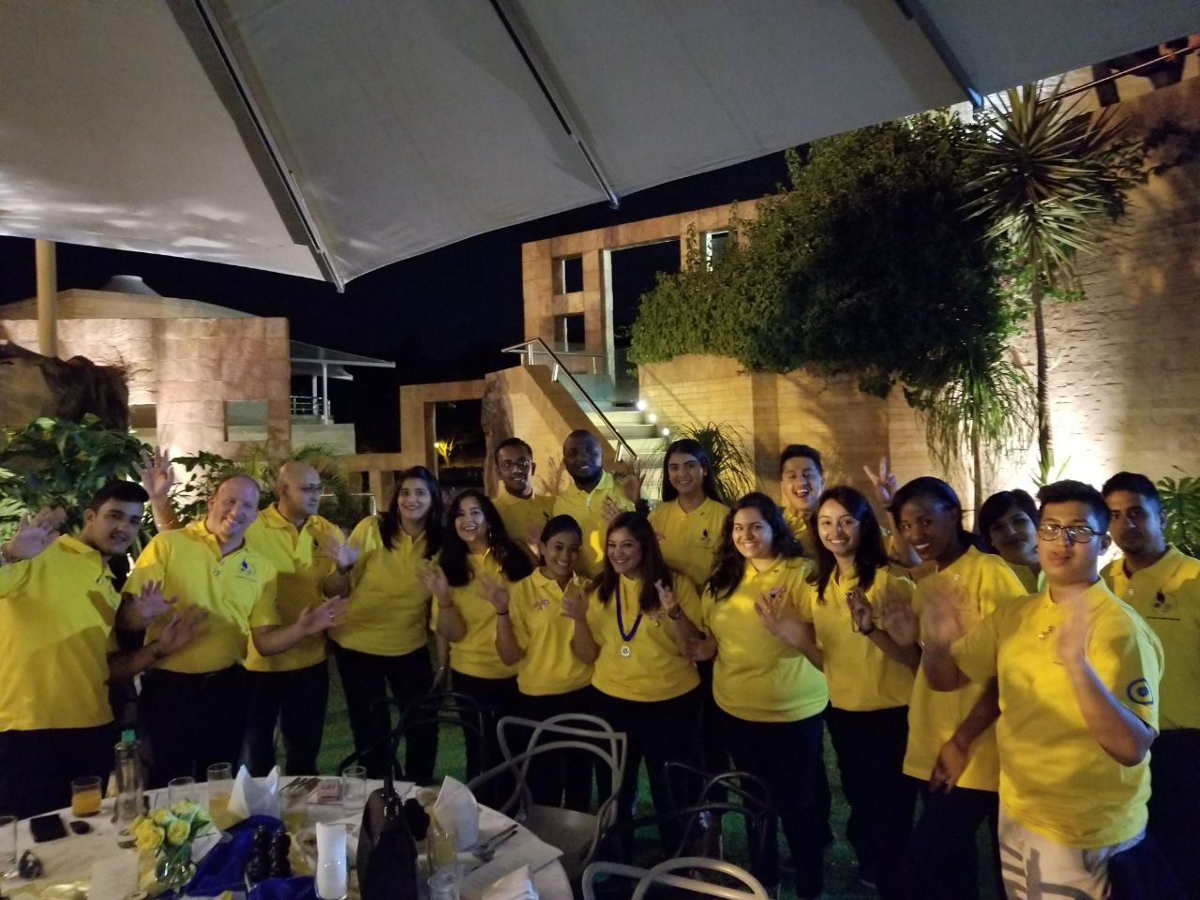
Lions Club of Nairobi Phoenix
"I care about diabetes because my whole family is affected by it. I see my family members injecting themselves with insulin every day. Just like them, there are so many people around Africa and other parts of the world who do not even know they are suffering from this deadly disease.”
Soyum Shah
Lions Club Nairobi Phoenix
10
Notes:
Nairobi Phoenix Lions Club is proud to be a Specialty Lions Club focusing on diabetes. Through outreach camps, they have screened over 15,000 people, supported over 320 newly diagnosed community members and provided counseling and training to people living with diabetes.
Here is a quote for Soyum Shah, charter member of the Nairobi Phoenix Lions Club:
"I care about diabetes because my whole family is affected by it. I see my family members injecting themselves with insulin every day. Just like them, there are so many people around Africa and other parts of the world who do not even know they are suffering from this deadly disease.”

Slide 11
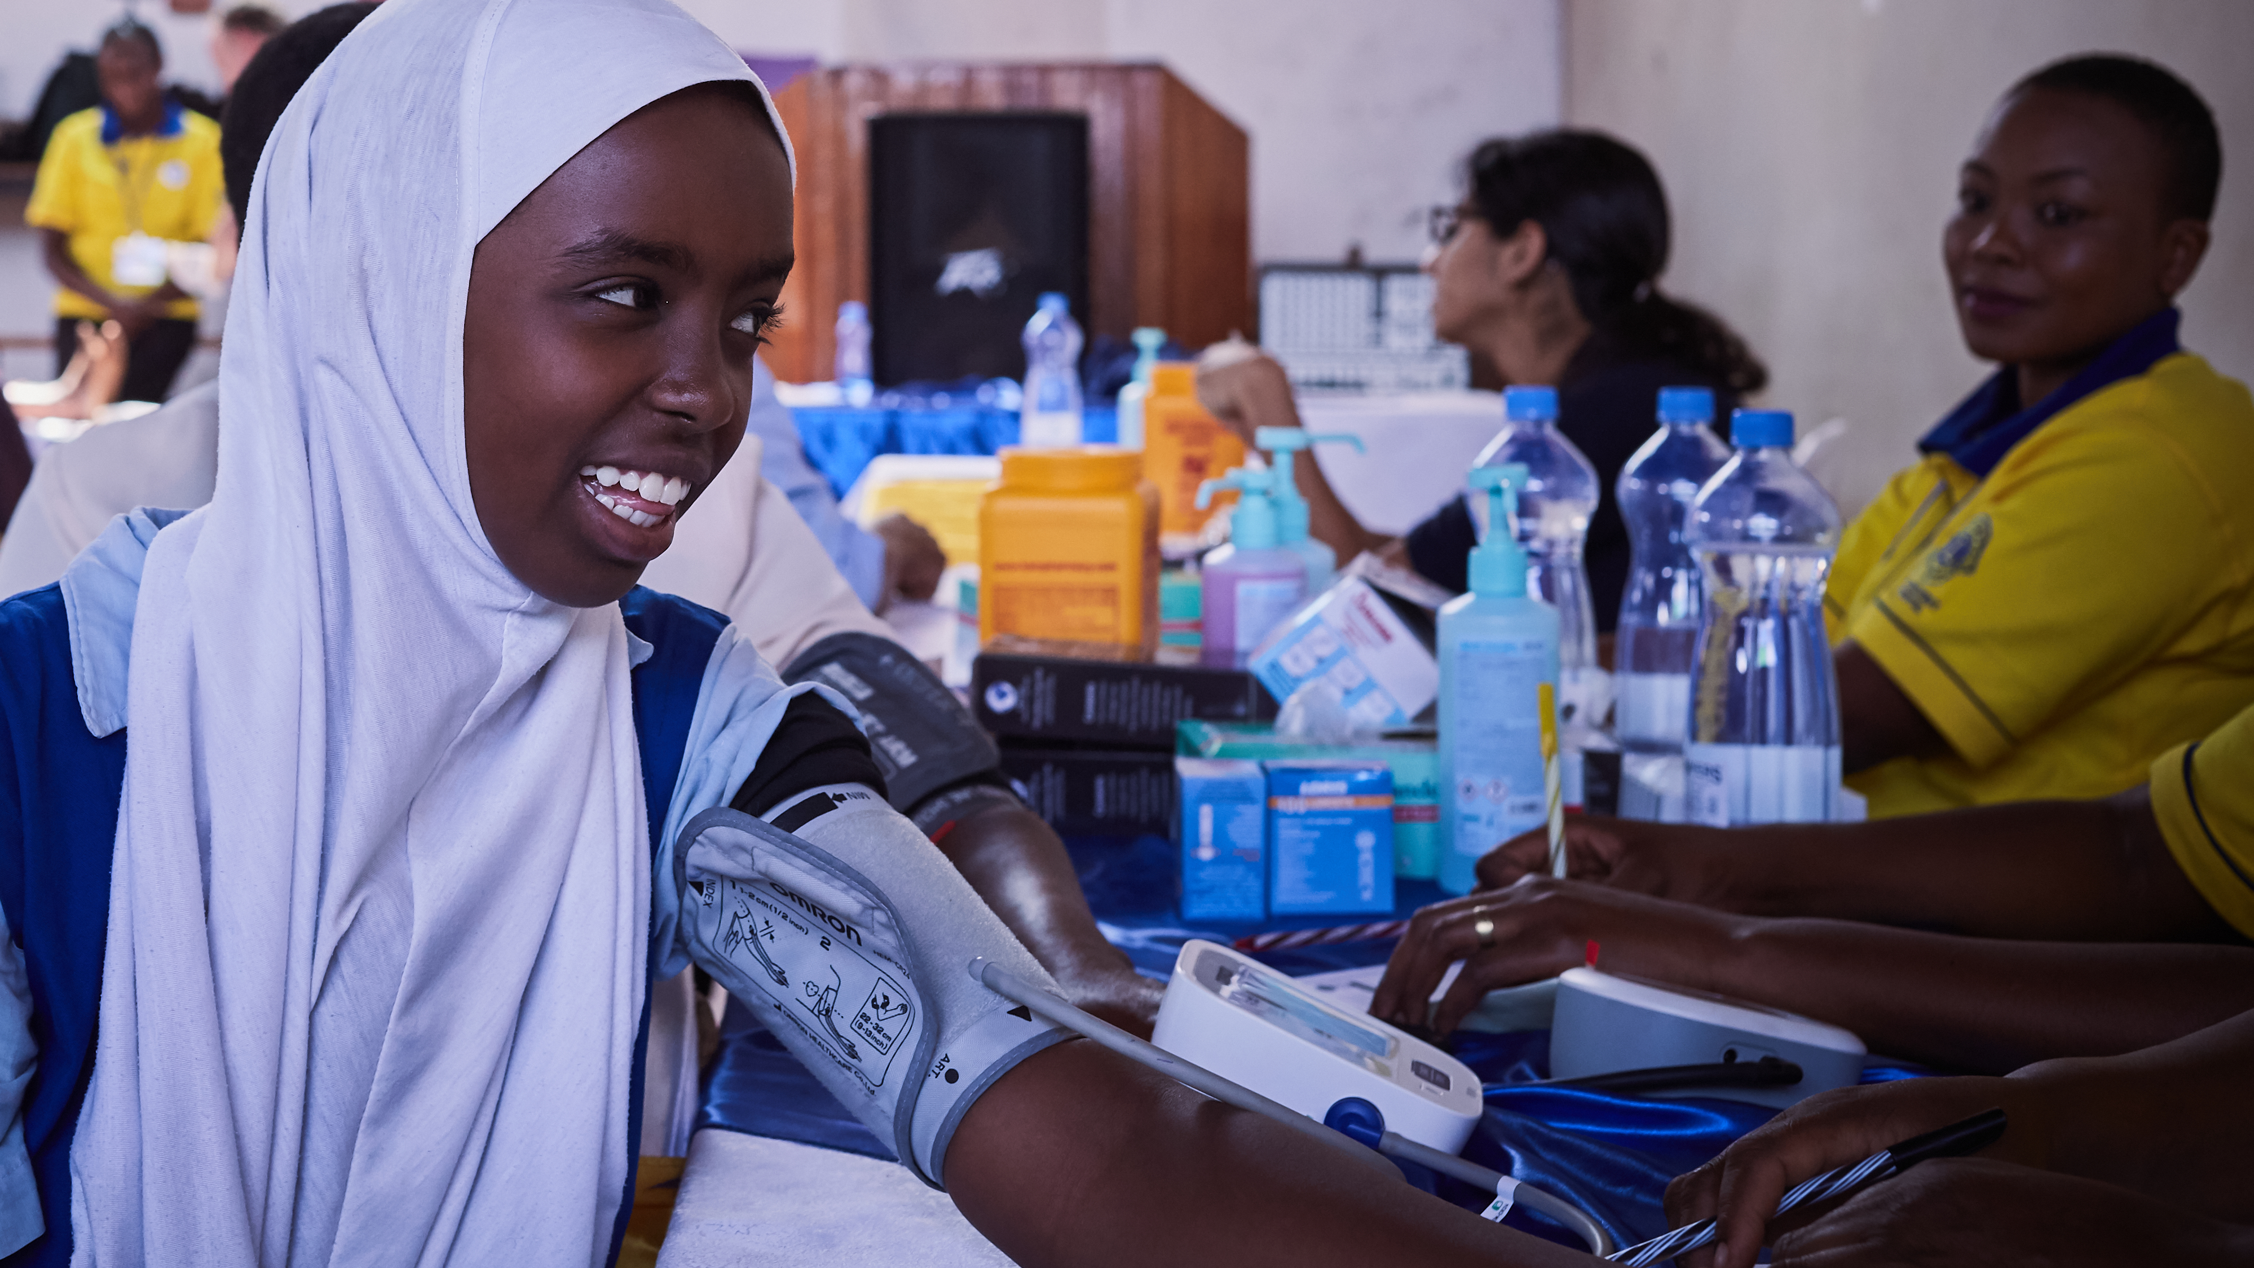
Impact by the Numbers
2017 - 2018
Number of diabetes activities
Number of people served in diabetes
Number of new members
158
442,882
770
11
Notes:
What started as Lion leaders seizing an opportunity to meet community needs by providing diabetes education and care, has grown into a movement, serving almost half a million people.
As a result of this service, almost 800 community members and local partners have decided to become Lions.
And among those new members are the next generation of Lion leaders.
They not only saw the impact of service. They felt it.

Slide 12
Power of Action
Inspire Lions and partners by sharing stories of success
Assess the needs of your community
Utilize the Global Action Team
Seize your moment
Notes:
The impact of service is overwhelming. Service drives membership. And with more Lion members involved in our movement, there is more opportunity for leadership development.
I hope that you are inspired by the work being done by the Lions of Kenya. Lions are doing amazing work like this all over the world.
I encourage you share this success story with Lions in your own district. Through the power of Leadership, Membership and Service, you too can to rally the leaders in your community to make a lasting and sustainable difference.

Slide 13
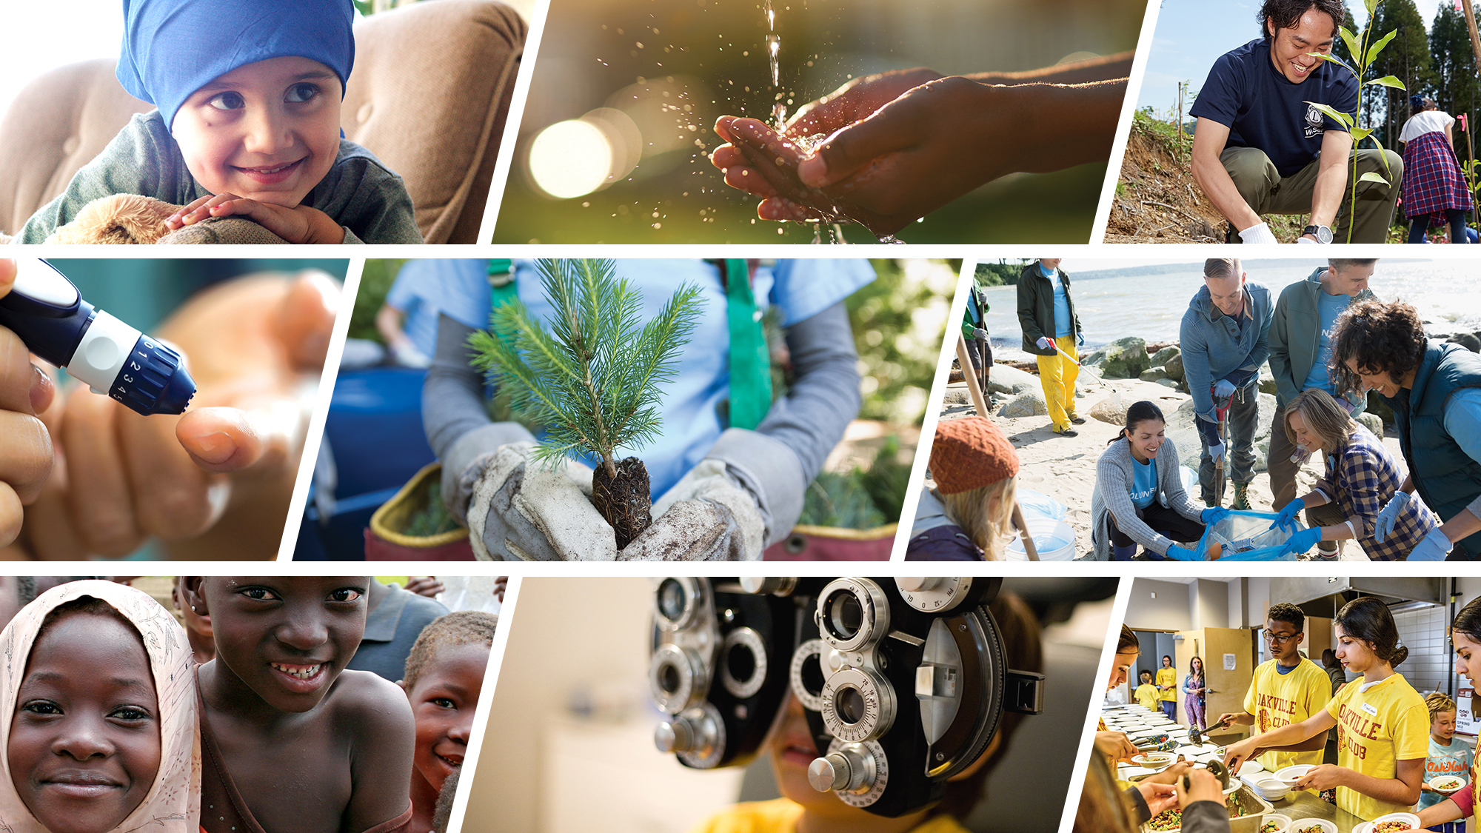
Thank You
© 2018 Lions Clubs International
9/18 EN

