Slide 1
The Global Action Team

Slide 2
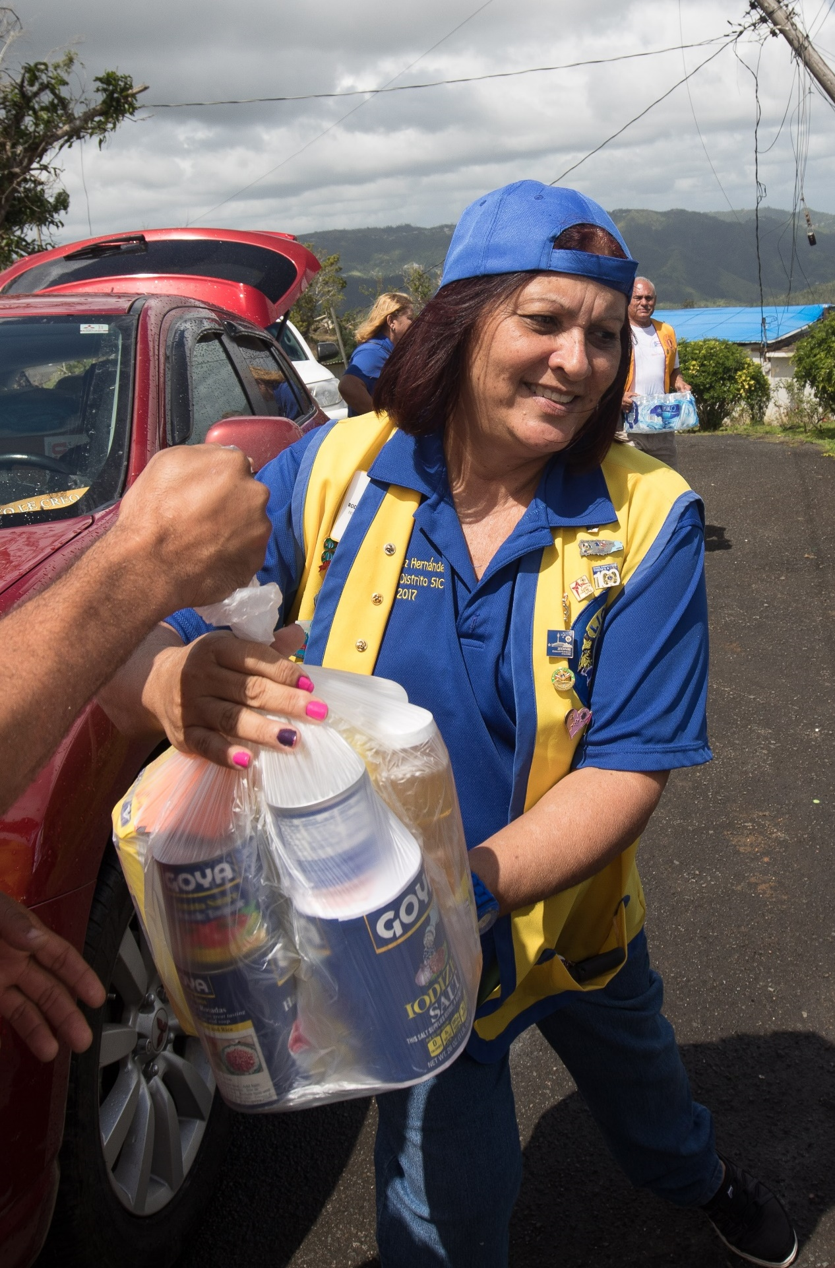
Our Vision
To champion the visions of LCI and LCIF:
To be the global leader in community and humanitarian service and to reignite the passion for service in our Lions and Leos.
2
Notes:
We all want Lions and LCIF to be the global leader in community and humanitarian service
We want to be recognized by the public, and for the community to know about Lions and what we do.
We want our Lions to be excited and proud to be a part of our great organization.
Excitement is contagious. When Lions are excited and passionate about the service they provide, they attract family, friends, colleagues, neighbors, and other community leaders. They make people want to belong to a great organization that does so much for the community.

Slide 3
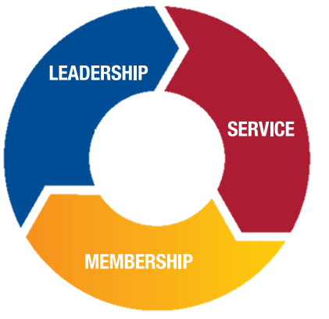
aa
Why is the Global Action Team Needed?
A Unified Approach
The Global Action Team (GAT) helps districts and clubs achieve their goals by creating a unified approach to all key areas of Lions.
With goals at the forefront, the GAT is uniquely positioned from constitutional area to club level, to
help foster positive membership growth in clubs,and increase Lion’s visibility in the
community
3
Notes:
Have you ever wanted to do more in your community/district but were unable to because you didn’t have enough Lions to support it?
Has your district or club ever struggled trying to get Lions to take on leadership roles?
Has your club ever lost members due to club conflicts or lack of engagement and meaningful service?
As leaders of Lions, we take on the responsibility to leave our district or club better at the end of the year than it was when we started. To make improvements, strategic changes, and to be responsible for ensuring we are improving in all areas, including leadership, membership, service, club operations, and marketing.

Slide 4
Who is the GAT?
The GAT is uniquely positioned at all levels of our organization
4
Notes:
GAT touches every club, district, zone and region. To help you understand who is involved in the Global Action Team, lets go through the members level by level.

Slide 5
aa
Who is the GAT?
At the Club Level
Club Global Action Team Chairperson (Club President)
GLT
First Vice President/Leadership Chairperson
GMT
Membership Chairperson
GST
Service Chairperson
5
Notes:
Let’s start at the club level since this is really where all the “Action” happens.
The club president is the chairperson of the Global Action Team
The club’s first vice president is the GLT Chairperson who organizes training for leaders and helps members find and participate in district and multiple district level trainings.
Then there is the GMT Club Membership Chairperson whose primary focus is to not only bring new members into the club, but also keep existing members active and engaged.
The GST club service chairperson is responsible for organizing and creating engaging service activities for the club.

Slide 6
aa
Who is the GAT?
At the District Level
District Global Action Team Chairperson (District Governor)
GLT
District Coordinator
GMT
District Coordinator
GET
District Coordinator
GST
District Coordinator
Region and Zone Chairpersons
6
Notes:
The district level is absolutely critical.
The district governor is the chairperson of the Global Action Team. He/she works with their team to develop the goals they wish to achieve during their fiscal year. The team then works closely in support of those goals.
The GLT coordinator organizes trainings for the district's clubs and individual members. They are also responsible for reporting local trainings in LEARN behind single sign on.
The GMT coordinator’s primary focus is to implement membership growth and retention strategies to achieve the district’s goals.
The GET coordinator’s is directly focused on chartering new clubs. Launched in July 2022, this role is considered an optional position.
The GST coordinator is the one who organizes district-wide service events and informs clubs about service programs resources that might be helpful to them. They also report district level service activities in MyLion.
Region and Zone Chairpersons help the coordinators communicate with clubs and provide feedback to districts from clubs and members.

Slide 7
aa
Who is the GAT?
At the Multiple District Level
Multiple District Global Action Team Chairperson (Council Chairperson)
GLT
Multiple District Coordinator
GMT
Multiple District Coordinator
GST
Multiple District Coordinator
7
Notes:
The Multiple district level ………
The Council Chairperson is the chairperson of the Global Action Team. He/She works with their team to support their districts in achieving their goals and sets the multiple district goals they would like to see achieved.
The GAT Coordinators serve the same functions as their counterparts at the district level, but work with each district within the multiple district, similarly to how the district coordinators work with each club within the district.

Slide 8
aa
Who is the GAT?
At the International Level
GAT Ambassadors
Past International Presidents
International Board of Directors
LCIF Board of Trustees
Past International Directors
Past District Governors
Global Action Team Chairperson
GAT Constitutional Area and Regional Area Leadership
GAT Area Leadership
8
Notes:
The International Level supports and guides all the rest while developing regionalized strategies around Leadership, Membership, Service and LCIF.
Ambassadors spread the message and excitement from the Global Action Team to other Lions.
The GAT Chairperson works closely with Constitutional and Regional Area leaders and with Lions International to ensure that leaders have solid strategies and the staff support that they need to implement them.
Constitutional and Regional Area Leaders work with area leaders to support the goals of Lions International and deliver feedback to headquarters to be incorporated into programs and resources
Area Leaders work with multiple district and district coordinators to support them in achieving their goals.

Slide 9
aa
What does the GAT Do?
One Team Approach to Achieve Goals
Leadership Development
Membership Growth
Service Innovation
Foundation Support
Share and Utilize Resources
Provide Input and Feedback
Report
9
Notes:
One-team approach to achieve goals. The Global Action Team puts the entire Lions network to work for districts and clubs. It brings the GLT, GMT, and GST together to support districts and clubs in reaching their goals. When we work as a team, we can make the most impact.
Leadership development. It provides leadership development opportunities that can empower Lions to lead and serve their communities and districts. Strong leaders can help drive membership, champion new service projects and ensure that districts and clubs position themselves for continued success.
Membership Growth. The GAT can also help districts and clubs develop effective membership programs to start new clubs and attract new members, and they can help clubs create a great membership experience that will keep new and seasoned members coming back. More members allow clubs to bring more service to their communities.
Service Innovation. They also assist districts and clubs in identifying resources and best practices to improve their service projects and, by extension, their impact. Quality service projects increase member satisfaction and help to attract new members who are looking to serve.
Foundation Support. The GAT supports and promotes Lions donations to LCIF and Campaign 100. By supporting our foundation, we are supporting Lions all over the world who are in need of various grants and other financial support.
Share and Utilize Resources. Lions International, provides GAT members access to numerous resources for leadership, membership, service, operations, and marketing that can be used to support districts and clubs.
Provide Input and Feedback. Members of the GAT have opportunities to share their input on resources that are in development and/or feedback on how it is utilized and regionalized for their area.
Report. Clubs should be submitting their monthly membership report and reporting on any service projects that have been conducted. MD and districts submit reports on trainings that were conducted.

Slide 10
Constant Communication
Collaboration & Teamwork
Development of goals and action plans
Monitoring progress throughout the year
How does GAT get it all done?
10
Notes:
By involving the entire team in both the goal setting and goal attaining process, GAT is able to have a consistent approach in all aspects of Lionism that strengthens clubs and districts.

Slide 11
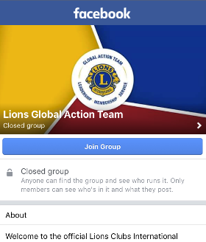
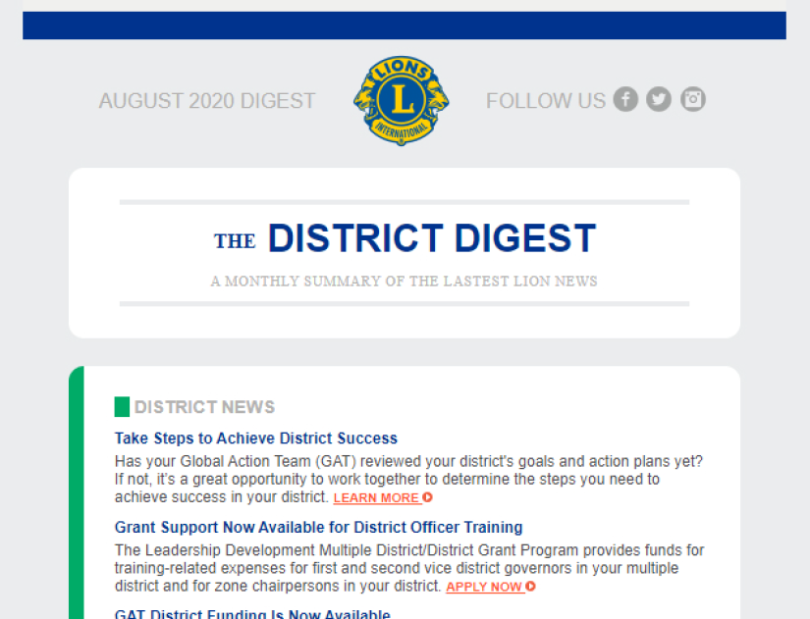
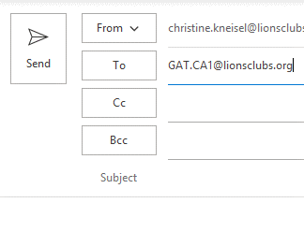
GAT Communications
Lion’s Monthly Digest
GAT Facebook Group
GAT Regional Specialists
11
Notes:
GAT staff at Lions International communicate with Lions in the field in a variety of ways.
Important messages and updates are included in LCI’s monthly digest to club and district officers and posted on the GAT Facebook Group. Regional specialists also work closely with GAT members in their constitutional area to provide support when necessary. You can contact your specialist by emailing GAT.CA_@lionsclubs.org.
If you haven’t already, be sure to join the GAT Facebook group to connect with fellow Lions around the world.

Slide 12
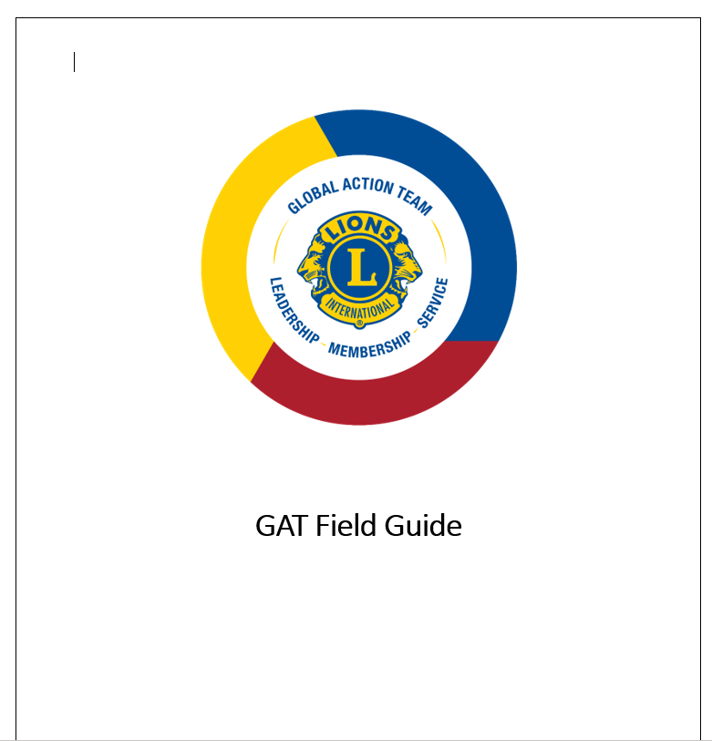
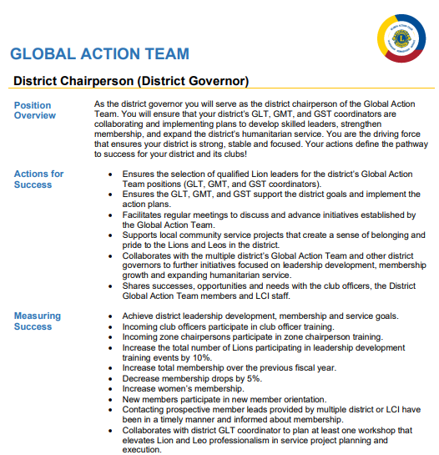
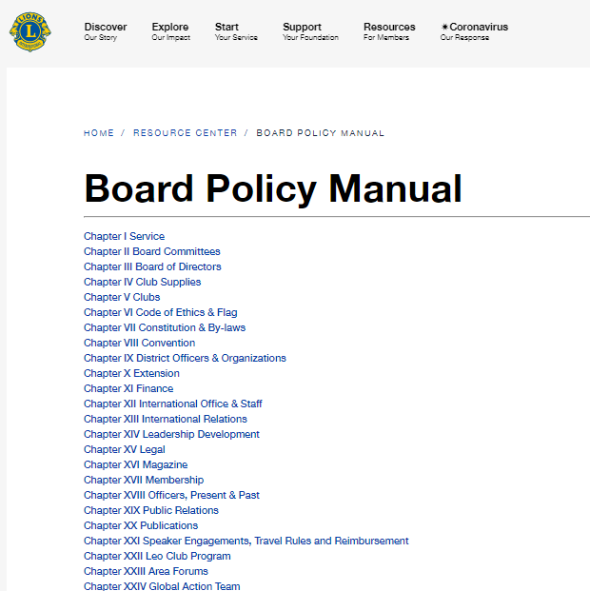
GAT Resources
Roles and Responsibilities
GAT Field Guide
Board Policy Manual Chapter XXIV
12
Notes:
There are many resources available for the GAT to utilize covering countless topics around Lions. The GAT Roles and Responsibilities, GAT Field Guide, and Board Policy Manual are a great place to start learning more about those resources and what the Global Action Team does.

Slide 13
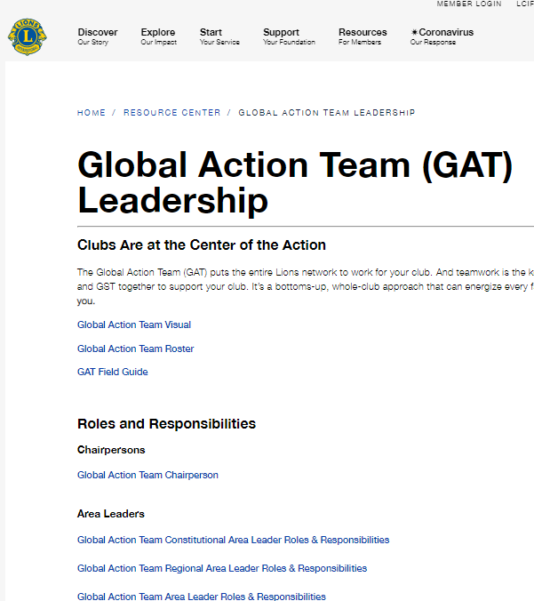
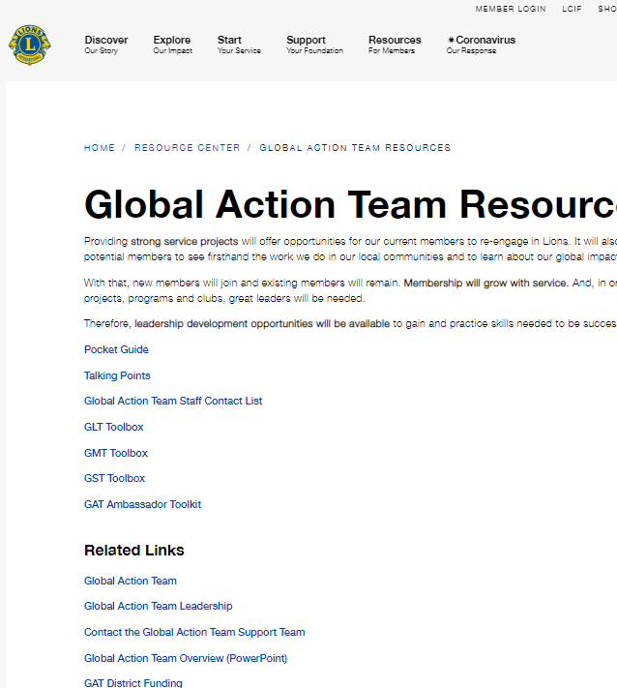
GAT Webpages
GAT Landing Page
GAT Leadership Page
GAT Resources Page
13
Notes:
GAT has 3 main webpages as well as several supplemental pages also containing valuable resources.
The Landing Page houses General Information & Success Stories from GAT.
The GAT Leadership Page contains Roles & Responsibilities for each position within the GAT.
The GAT Resources Page has other useful tools and resources for the GAT as well as links to the GLT, GMT, and GST Toolboxes containing even more resources.
District Goals, District Funding and GAT Ambassadors also each have their own webpage with resources that can be found by using the search function on lionsclubs.org

Slide 14
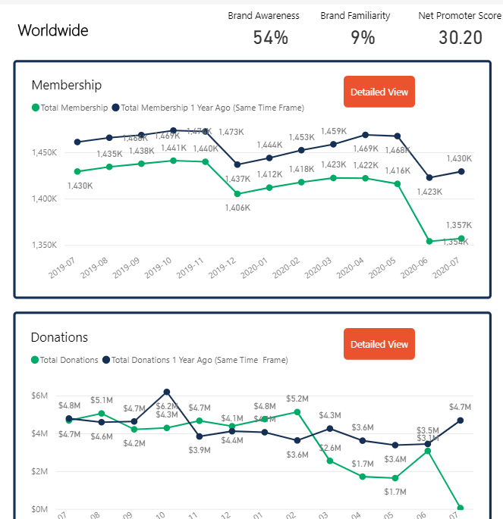
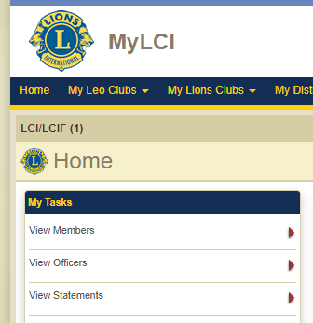
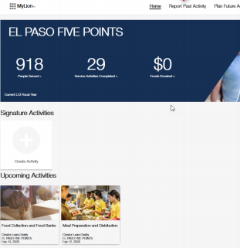
GAT Reports
Insights
My LCI
MyLion
14
Notes:
GAT Members can use Insights, MyLCI and MyLion in their Lion Account to view metrics for their multiple district/district/club. Metrics are a critical part of setting goals and monitoring progress towards those goals.

Slide 15
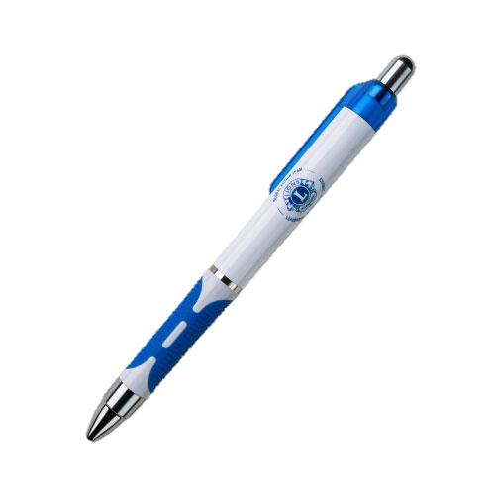
GAT in the Lions Shop
15
Notes:
Represent the Global Action Team with GAT merchandise from the Lions Shop or request a GAT logo when you purchase customized Lions apparel.

Slide 16
aa
Global Membership Approach
Step 1
BUILD A TEAM
Step 2
BUILD A VISION
Step 3
BUILD A PLAN
Step 4
BUILD SUCCESS
Build a team to support the Global Membership Approach.
Conduct and analysis of your district and develop goals to best serve its needs.
Build a plan as a team to achieve the established vision.
Execute your plan, maintain accountability and adjust as necessary
16
Notes:
The Global Membership Approach combines a strategic approach and a set of resources for district teams to utilize to develop membership by:
• Rejuvenating districts with new clubs
• Revitalizing clubs with new members
• Re-motivating existing members with fellowship and exciting service.
The approach has universal applicability, with the ability to customize based on regional needs and circumstances.
All CAs have piloted this approach, with regional variances in 2021-2022. The Global Action Team (GAT) drove the piloting process, and provided support and accountability in each CA. The best ideas were integrated in the worldwide process in 2022-2023.
More information and resources are available at lionsclubs.org/global

Slide 17
Lions Clubs International Foundation
LCIF grant funding MAGNIFIES Lions’ service
GAT Leaders are one of LCIF’s strongest resources
LCIF empowers Lions to always answer the call to serve
SM
17
Notes:
As the only foundation to empower the service of Lions worldwide, LCIF grant funding magnifies Lions’ service to help more people in need around the world.
As GAT Leaders, you are one of LCIF's strongest resources, not only because of your personal donations, but also as ambassadors for the foundation, encouraging others to support LCIF.
The calls to serve a world in need continue to grow. Through continued support, LCIF empowers Lions to always answer.

Slide 18
aa
Contact GAT
Email: GAT@lionsclubs.org Phone: 1-630-468-3815
18
Notes:
You can contact your regional specialists directly by emailing
GAT.CA1@lionsclubs.org
GAT.CA2@lionsclubs.org
GAT.CA3@lionsclubs.org
GAT.CA4@lionsclubs.org
GAT.CA5@lionsclubs.org
GAT.CA6@lionsclubs.org
GAT.CA7@lionsclubs.org
GAT.CA8@lionsclubs.org

Slide 19
Thank You

