Slide 1
Campaign 100
A Campaign to Empower the Service of Lions

Slide 2
Agenda
Background
Introducing Campaign 100: Empowering Service
Our Global Causes
Recognition
How You Can Get Involved
Notes:
Welcome, and thank you for your time today! I am excited to share with you an overview of Lions Clubs International Foundation’s capital fundraising campaign. As Lions, we have dedicated our lives to service, and this campaign will empower us to take our service to new levels.
First, I’ll take you through a very brief history of what we’ve accomplished, and how the capital campaign is a logical next step in the evolution of our foundation, and our service. Then, we’ll spend some time talking through the campaign objectives, the theme, the case for support, and the operational plan. I’ll provide an overview of our global causes, and LCIF’s vision for improving our communities, and the world. I’ll share some important information about the campaign marketing and recognition as well. Then, we’ll close with some suggestions for how you can all get involved, something I’m sure you’ll be interested to learn!
So, let’s get started!

Slide 3
Background

Slide 4
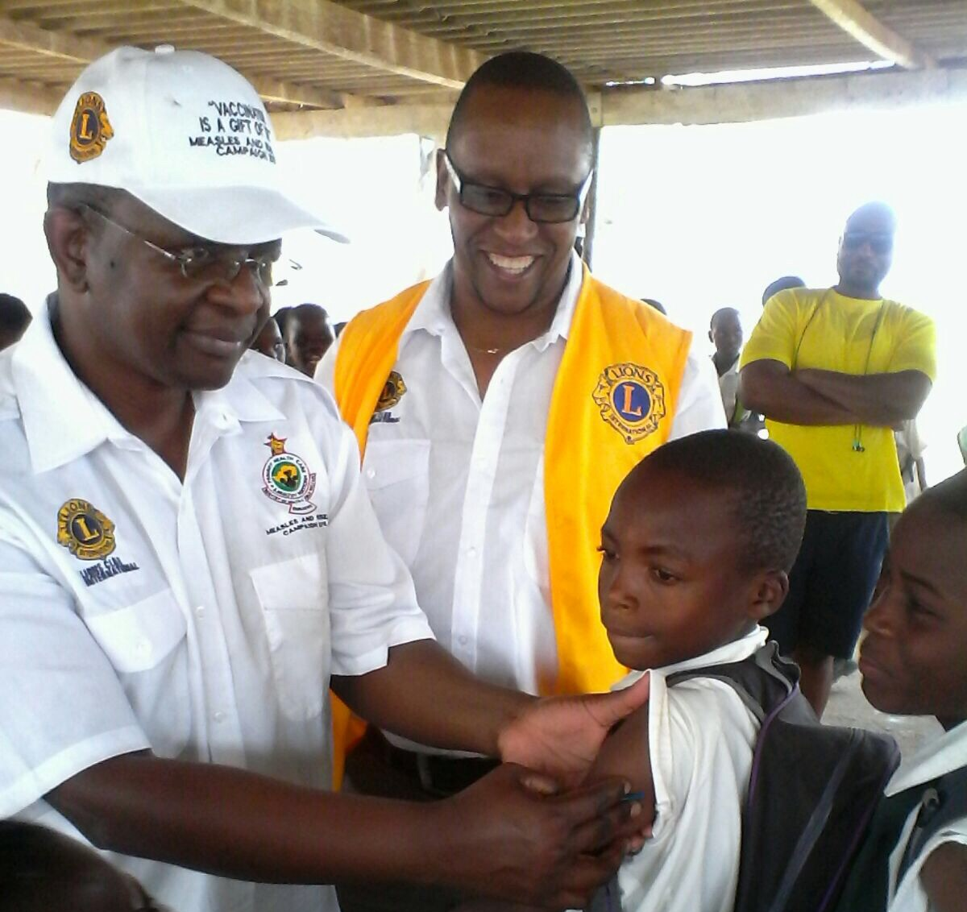
50 Years of Impact
1 Billion
9.1 Million
US DOLLARS IN GRANTS AWARDED
CATARACT SURGERIES
In June 2018, LCIF celebrates its 50th anniversary
Millions of children vaccinated against the measles
118 Million
16 Million
CHILDREN SERVED BY THE LIONS QUEST PROGRAM
US DOLLARS IN DISASTER RELIEF
Notes:
In June of 2018, LCIF celebrates it’s 50th anniversary. LCIF is our foundation. And in these past 50 years, our foundation has made an enormous impact on so many local and global projects and initiatives. Through the awarding of over US $1 billion in grants, we have saved the sight of 9.1 million people through cataract surgeries. We’ve improved the lives of over 16 million children with the positive life skills taught in the Lions Quest program. We’ve been there for our neighbors, and communities around the world, when disaster has struck, awarding over US$118 million in disaster relief. We’ve supported the vaccination of millions of children from measles, saving countless lives.
What are some of the most powerful impacts that LCIF has made in your community?

Slide 5
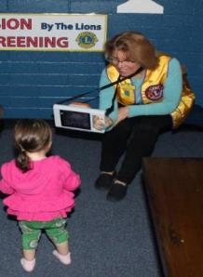
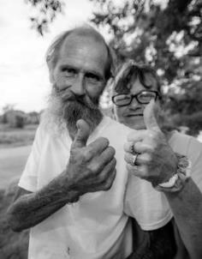
Thank You, LCIF
“Thank you for giving my daughter a better quality of life.”
“They gave him hope that there are still people who care.”
Notes:
A mother whose young child received an eye screening from Lions recently reached out to LCIF saying, “Thank you for giving my daughter a better quality of life because of your foundation’s kindness and concern for the wellbeing of our children!”
Another Lion recounted a story of her club coming together to help a lonely, elderly man in their neighborhood whose home was severely damaged in a flood. The Lions did more than repair his home; they gave him hope that there are still people who care.
And there are so many other examples. As we hear these heartwarming stories, we are reminded why we choose to serve, and why it’s important to expand our focus and our impact with this new campaign.

Slide 6
Thank you for your support of LCIF!
This slide is a placeholder for grant / donation information relevant to the club, district, multiple district or constitutional area receiving this presentation. Please reach out to your LCIF development specialist, or lcifdevelopment@lionsclubs.org, for this information.
Notes:
Here you can see how our (club / district / multiple district / constitutional area) has both contributed to and benefitted from LCIF. Thank you for everything you have done! Your contributions, both in service and donations, are making an impact in our community, and around the world.
Include specific insights as relevant.

Slide 7

The Journey to a Campaign
2015 Global Service Assessment + LCI Forward strategic planning process
= Expanded Global Causes:
75%
Positive / very positive view of Global Causes
80%
would be willing to serve as leaders
86%
would be willing to ask Lions for gifts / pledges
83%
agree that a campaign should move forward
72%
would consider making a gift
Priority of focus areas varies by constitutional area
2017
Campaign feasibility and planning study:
Notes:
Many of you may remember the Global Service Assessment that LCI conducted in 2015, in conjunction with the LCI Forward strategic planning process. That process resulted in Our Global Causes (formerly referred to as “the new Global Service Framework”). The causes refer to five priority focus areas: Diabetes, Environment, Hunger, Vision, and Childhood Cancer – as well as the engagement and benefit of youth across those areas.
LCIF’s mission is to empower Lions service. With the expansion of the Global Causes, LCIF recognized the need to do something extraordinary to make this possible.
To test the level of interest and commitment to support these causes through a fundraising campaign, LCIF embarked upon a campaign feasibility and planning study between June and August of 2017, to test a goal of US$300 million and understand the priority of different focus areas. As you can see here, there was significant positive reaction to the possibility of a campaign, particularly one that supports the Global Causes.
The Board of Trustees therefore approved a campaign to move forward in August 2017.

Slide 8
Introducing
Campaign 100:
Empowering Service

Slide 9

Introducing Campaign 100
Notes:
I’m excited to share that our capital fundraising campaign now has a name, Campaign 100, and a tagline, LCIF: Empowering Service. You may be asking, what does Campaign 100 mean?
100 years ago, it began with Melvin Jones. He had a vision, and Lions are still working toward that vision today. Restoring sight and preventing blindness. Mobilizing disaster relief. Creating positive learning environments for kids. Serving the disabled, the elderly, and the most vulnerable among us. These are not things that any one Lion, club or district can do alone. But together, we can.
As Lions reflect with pride on these accomplishments, we also look to the future, toward the next 100 years. We see that the needs of the world have never been greater. We see new challenges ahead.
What if 100% of Lions contributed to this global effort? What could we accomplish if every Lion gave $100, every year?
There’s nothing more important to Lions than service. It’s what we do. Of course, we don’t do it alone. Lions are empowered by LCIF. Because of LCIF, Lions have the resources we need to take on the issues we care about. Because we understand that service is both giving and doing, our impact will last for the next 100 years, and beyond.

Slide 10
Campaign Objective and Timing
Fundraising Objective: US$300 million
Increase Service Impact
across current focus areas: Vision, Youth, Disaster, Humanitarian
Fight Diabetes
Reduce prevalence and improve quality of life for those diagnosed
Expand Global Causes
Identify and develop new ways to impact our world and its most vulnerable inhabitants in new focus areas:
Environment, Childhood Cancer, Hunger
Campaign Timing
Donations received during LCIF’s 50th Anniversary year count toward the fundraising goal
Campaign officially launches Lions Clubs International Convention in Las Vegas, July 2018, runs for the following three fiscal years
Notes:
The capital fundraising campaign officially launches at International Convention in Las Vegas, and will run for three fiscal years after that launch. The fundraising goal is to raise US $300 million to support the service of Lions. This will be inclusive of all donations made to the foundation during the campaign’s duration. Donations made to LCIF during our 50th anniversary year, this year, will also count toward the capital campaign.
Let me emphasize two very important points that I just made. First, the campaign is inclusive of all donations made to the foundation. And second, all donations made to LCIF in this current fiscal year, count.
A successful campaign will allow us to increase our service impact across LCIF’s current focus areas: vision, youth, disaster relief and humanitarian causes. The capital campaign will also fund our fight against diabetes, a modern global health crisis and LCI’s signature cause. The campaign will also fund LCIF’s expanding focus areas, including the environment, childhood cancer and hunger.
We’ll get into more details about LCIF’s vision and programmatic goals a bit later in the presentation.

Slide 11
Guiding Principals
A Comprehensive Campaign
Include all five Global Causes and our Ongoing Mission
Access new opportunities for expanded corporate, foundation, government agency and non-Lion individual support
Increase and sustain individual Lion giving to LCIF
Increase ease of giving to LCIF
Robust Lead and Major Gift effort
Notes:
There are six guiding principles that drive our campaign strategy, which we’d like to share with you today:
This will be a comprehensive campaign. Again, all dollars raised for LCIF will count towards the campaign fundraising goal of US$300 million. This will promote awareness of the foundation and long-term giving habits moving forward.
All five Global Causes are included in the case for support. This recognizes the different priorities of different constitutional areas, while uniting Lions around the Global Causes as a whole.
During this campaign, we will seek new opportunities to engage with non-Lion organizations and individuals.
The campaign should promote, encourage, and increase individual Lion giving to LCIF, for the long-term sustainability of the foundation.
The campaign should implement and promote methods of giving that make it easier and quicker to donate to LCIF. This includes electronic and recurring or monthly giving options.
In order to be successful, the campaign will implement a robust Lead and Major Gift plan. These significant gifts will build momentum and inspire confidence in the goals of the campaign.
These principles will help guide us to success.

Slide 12
Operational Plan
Compelling Case for Support
Model Clubs
Special Recognition
Participation of All Lions and Clubs
Lead, Major, Corporate, Foundation, Government, & non-Lion individual gifts
Goal-Setting
Notes:
The operational plan for the campaign consists of the tactics that will be used to execute campaign strategy and drive fundraising activity. The operational plan will consist of the following major components:
A compelling case for support – why are we raising $300 million and how will it be used.
Model Clubs – a special group of clubs that will establish challenging fundraising goals and lead the way in the campaign
Special Recognition – for donors, for leaders and for clubs
Encouraging individual Lion and Club participation
Lead and Major individual gifts and Corporate, Foundation, and Government support
All of these things lead us to be able to set challenging yet achievable goals through a collaborative and specific goal-setting process.

Slide 13
A Strong Case for Support
Increase Service Impact
Youth, Vision, Disaster, Humanitarian
A World in Need
Our Story
Lions Respond
Fight Diabetes
Call to Action
Expand Global Causes
Hunger, Environment, Childhood Cancer
Notes:
Here you’ll see an outline of our case for support.
We begin, as Lions do, with the needs of the world, which we know have never been greater.
We then transition to our story, outlining LCIF’s many accomplishments over our 50-year history, including the US$1 billion in grants we have awarded in support of the service of Lions.
The case then outlines the key objective of Campaign 100, to raise US$300 million in order to serve more than 200 million people per year by 2021, and the specific programmatic goals of the campaign.
Through Campaign 100, LCIF will increase the service impact of Lions across all of LCIF’s current focus areas. LCIF will address the modern health crisis of diabetes, reducing its prevalence and improving the quality of life for those diagnosed. LCIF will expand our focus to include all the causes of hunger, the environment and childhood cancer.
Finally, we close with a call to action. We volunteer to make an impact in our community. We give to make an impact on our world. We empower service when we do both.

Slide 14

LCIF’s Journey
Singular focus
A case for sight
Fundraising for non-sight causes on separate track
Post-campaign fundraising falls to lower levels
Expanded focus
A unifying case
Fundraising inclusive of all LCIF causes
Post-campaign fundraising remains at increased levels – a tipping point for LCIF
A culture-revolutionizing perspective
Notes:
While LCIF has undertaken two successful capital campaigns in the past, Campaign SightFirst and Campaign SightFirst II, we’ve never had a capital campaign quite like Campaign 100.
Whereas SightFirst had a singular focus, Campaign 100 has an expanded focus on all of our existing focus areas, as well as our new global causes. We envision Campaign 100 as a tipping point moment in LCIF philanthropy, changing our perspective and our culture of giving.

Slide 15
Our Global Causes
Notes:
Now I’d like to spend some time talking about each of our current focus areas and expanding global causes. As you’ll see, LCIF has a clear vision statement for how the foundation will make a global impact in each cause area, as well as specific programmatic goals that, together, will make that vision a reality.

Slide 16
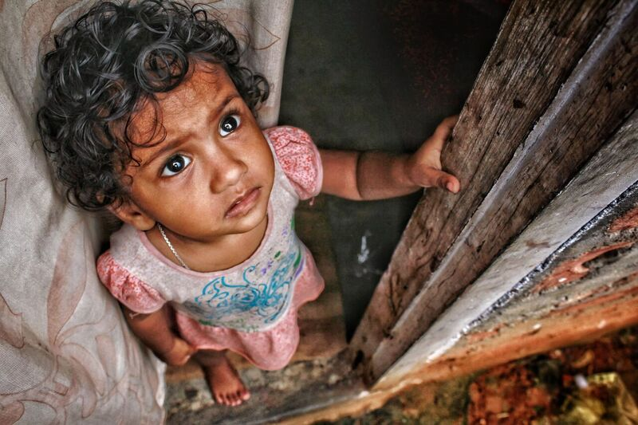
A World in Need
253 million blind or visually impaired
245 people lost every day to measles
15% annual increase in natural disasters
2/3 of children impacted by bullying
400 million people with diabetes
800 million people go to bed hungry
A child diagnosed with cancer every 2 minutes
½ of the population water stressed by 2025
Notes:
The numbers can overwhelm you.
253 million individuals are blind or visually impaired, and global trends, including an aging population, suggest this number may triple by 2050. Each year, our planet experiences a 15% increase in natural disasters; and these earthquakes, hurricanes, tsunamis, floods, droughts and fires rob innocent people of their homes, jobs and lives. 245 people die every day from measles, a disease that can be prevented by a safe, effective and inexpensive vaccine. Two thirds of our children report that they have been the victim of bullying.
400 million people are living with diabetes and its complications, and this number may reach nearly 650 million by 2040. Each night, more than 800 million people go to bed hungry. Every two minutes, a child is diagnosed with cancer. By 2025, half of the world’s population will be living in water-stressed areas.
We see the effects of this devastation every day, on our television screens, on social media, in our own communities and sometimes in our own homes. We see that this devastation has a particular impact on the world’s children, who we are called to protect. Many say the needs of the world are too great. Many say there’s nothing we can do.
Lions say, “We Serve.”
Empowered by Lions Clubs International Foundation (LCIF), Lions are taking on these global challenges. In fact, we’ve been doing so for one hundred years.

Slide 17
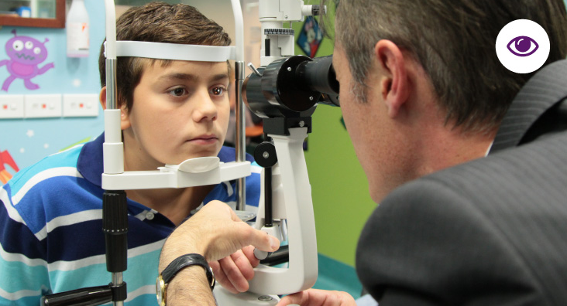

Vision
Ridding the world of infectious blindness
Reducing avoidable blindness and visual impairment
Improving overall quality of life through services to the blind or visually impaired
Notes:
Since the launch of SightFirst in 1990, Lions have improved eye health and eye care for hundreds of millions of people around the world. Nearly 75 percent of vision impairments are preventable or curable, often for mere dollars. As we reinforce our quarter century commitment to eliminating avoidable blindness worldwide, we will:
Lead the world in establishing and strengthening comprehensive eye care institutions and systems through capital expansions, equipment and human resource training;
Reaffirm Lions’ global leadership in child eye care service provision in partnership with the World Health Organization;
Support national efforts to eliminate blinding diseases like onchocerciasis (aka “river blindness”) and trachoma, the world’s leading causes of infectious blindness and visual impairment, through volunteer training and supervision, advocacy, surgical services and distribution of appropriate medications;
Lead the global response to the uncorrected refractive error challenge by supporting projects that will provide high-quality, sustainable and high-impact refractive error services;
Fulfill Helen Keller’s call for Lions to become “Knights of the Blind” by investing in projects that support services for the blind or visually impaired, including improvements to educational systems, assistive device loaner programs and low vision program capacity building;
Establish SightFirst challenge grants that inspire Lions and their partners to develop innovative, ground-breaking approaches to service in underserved areas; and,
Enhance and expand Lions-led comprehensive vision screening programs for adults and children.

Slide 18
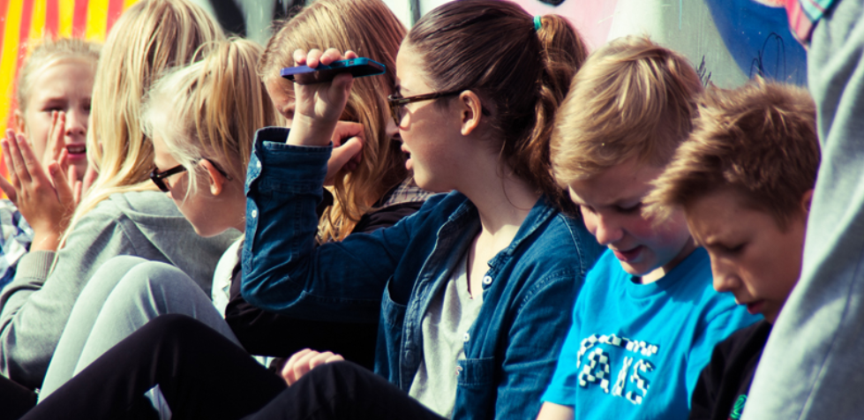

Youth
Improve access to quality education, vital health services, inclusive social and recreational opportunities, and positive youth development.
Continue to be a world leader in Social Emotional Learning via LCIF’s Lions Quest program, ensuring that every child has a safe and welcoming place to learn.
Notes:
Youth is a driving force of our organization, and serving the youth of our world is one of the most rewarding aspects of being a Lion.
LCIF’s signature youth program, Lions Quest, is based on the concept of social emotional learning (SEL), and promotes positive learning environments in schools worldwide. For more than 30 years, we have transformed the lives of millions of children in countries around the globe by developing and distributing the Lions Quest program, and by providing financial, technical and volunteer support to help Lions implement the program in their own communities.
Today, we are a world leader in SEL, with the program implemented in more than 100 countries, aiding more than 600,000 educators and impacting the lives of 16 million students. Our impact—measured in significantly improved test scores, changing attitudes and beliefs around substance abuse and violence, lowering rates of disciplinary problems, and the decreased use of alcohol, tobacco and other drugs—is profound. We commit, through Campaign 100, to ensuring that every child has a safe and welcoming place to learn. As we work toward this goal, and build the largest, most widely-used SEL program in the world, we will:
Revise and update, on an ongoing basis, the Lions Quest curricula, to ensure the program addresses the issues most relevant to students, teachers and communities;
Develop new multimedia tools, including dynamic videos and game-based learning, to engage learners with the most current effective educational technology;
Translate all program materials into non-English languages, so that Lions Quest remains true to its goal of being the worldwide leader in SEL programming;
Conduct, on an ongong basis, rigorous independent evaluations of Lions Quest programs in markets around the world to ensure the ongoing effectiveness and accreditation of our programs; and,
Provide training opportunities to Lions so that they can assist with the implementation and expansion of the program in their own communities.
Lions are uniquely positioned in the community to collaborate with local schools, youth organizations, government agencies, social services and other key stakeholders invested in providing opportunities to youth to enhance their abilities, skills, well-being, safety and overall development. In addition to the Lions Quest program, LCIF will continue to serve youth in a variety of important ways:
Addressing the needs of vulnerable youth populations, such as those that are disabled, homeless, orphaned, critically ill, or refugees;
Funding Lions-led projects for youth including vision screening services, disabled accessible playgrounds, school expansions, centers for at-risk youth and camps for diabetic children;
Supporting projects that focus on meeting the unique needs of girls and promoting gender equality;
Engaging youth as volunteers and developing projects that accommodate this inclusion.

Slide 19
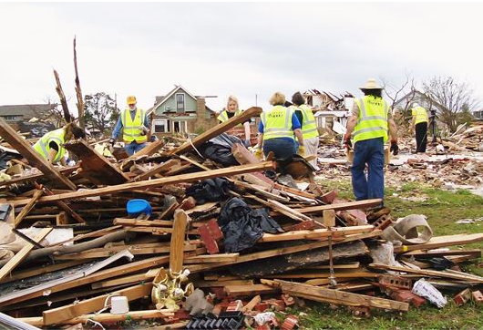
Disaster Relief
Preparing for and responding to natural disasters, providing for short-term relief and long-term recovery of our communities around the world
Notes:
Natural disasters can be profoundly destructive, leaving in their wake a trail of injury, death and economic loss. Today, approximately 90,000 people die each year, and another 160 million are negatively impacted, as a result of natural disasters. The United Nations Office for Disaster Risk Reduction anticipates that these numbers will only escalate, with 15 percent more disaster events occurring each year.
From 1970 to 2017, we have invested US$112 million in disaster-related grants, and we will continue to help communities recover by:
Supporting current and expanded disaster relief activities with key partners and organizations who are experts in the disaster relief sector;
Supporting Lions’ participation in different phases of emergency management, including disaster preparedness, immediate aid, community restoration and long-term reconstruction; and,
Utilizing major catastrophe and discretionary grant making to enable Lions to respond strategically to disasters, including through the establishment of humanitarian aid depots in pilot regions.

Slide 20
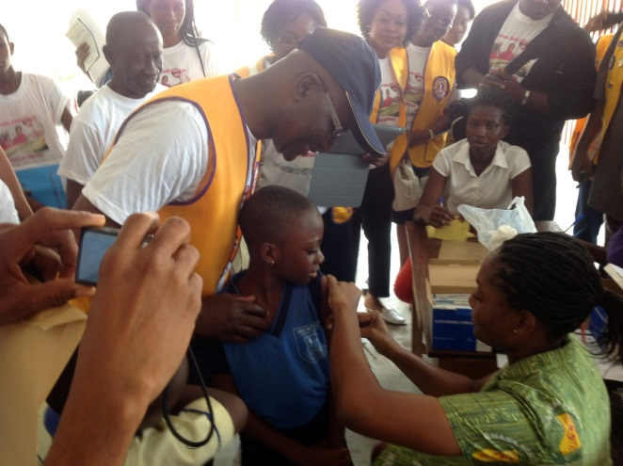
Humanitarian Causes
Addressing the distinct needs of at-risk and vulnerable populations, such as the elderly, the disabled, girls and women, orphans and others who are disproportionately impacted by social and economic factors and require special services
Notes:
Humanitarian service remains at the heart of our work. We identify the most crucial needs of communities around the world, and empower Lions to drive humanitarian efforts that transform the lives of millions at home and abroad. Campaign 100 will allow us to continue to undertake an extensive range of humanitarian projects, including in the areas of:
Measles and Rubella. We commit to joining in the global effort to eliminate measles from every community on Earth by 2020. Measles is a leading cause of death among children, and rubella is the leading vaccine-preventable cause of birth defects. Children born with congenital rubella syndrome can have multiple, life-altering defects including heart disorders, blindness, deafness or brain damage. We will continue to support Lions in the critical fight to eliminate measles and rubella, as they mobilize and advocate during vaccination campaigns worldwide.
Empowering Those with Disabilities. For decades, we have been working to help people with disabilities lead more independent, productive and fulfilling lives. Lions have built more than 1,000 handicapped-accessible homes in partnership with Habitat for Humanity, and partnered with Special Olympics to help support acceptance of people with intellectual disabilities within their communities. We will continue to support people with disabilities by facilitating the training and services they need to improve their education and job prospects, ultimately enhancing their day-to-day lives and emotional well-being.
Supporting At-Risk and Vulnerable Populations. We will continue to identify the world’s most vulnerable and at-risk populations and develop and execute innovative programs to meet their needs.

Slide 21


Diabetes
Reducing the prevalence of diabetes and improving the quality of life for those diagnosed
Notes:
Diabetes is a global epidemic, and one of the fastest-growing in the world. It is a leading cause of death globally and a leading cause of blindness and visual impairment. In particular, it is the sixth leading cause of death among women. This causes massive negative repercussions with regard to personal and familial well-being, community development, and economic growth and prosperity.
Through Campaign 100, we have an opportunity to be a major part of the response to this global epidemic. We will help prevent diabetes through multi-faceted, comprehensive health initiatives that are targeted to the communities where we live and serve. In 2016 and 2017, we funded more than US$650,000 to support 27 pilot diabetes projects around the world. This platform enables us to make efficient and effective investments in:
Efforts to sustain and establish world-class diabetes management and control services through diabetes camps, comprehensive diabetes screening events, healthcare infrastructure and human resource capacity building;
Establishing an operational research program that will investigate gaps between the accessibility and affordability of comprehensive diabetes care, and communities in need of services; and,
Efforts to increase comprehensive diabetes screening and health education activities linked to primary and secondary healthcare services.

Slide 22
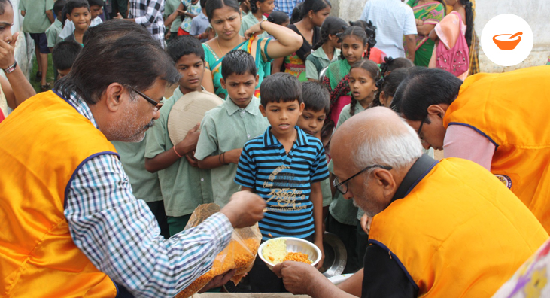

Hunger
Working toward our a world in which no child goes hungry, expanding the resources and infrastructure needed to address food shortage gaps around the world
Notes:
Due to rising food and energy prices, economic recessions, climate change and political instability, hunger remains one of the world’s most critical and urgent challenges, particularly for children. In 2015, the United Nations reported that 777 million people were chronically hungry, and in 2016 this number rose to 815 million. This means that 11 percent of the world’s population is chronically hungry, despite sufficient global production to feed the entire population. We are committed to improving food access for all through the following initiatives:
Investment in infrastructure and improved transportation systems that increase the local capacity of existing food banks, feeding centers and food distribution facilities—and create new, sustainable food banking systems where they do not currently exist;
Securing vehicles to transport, collect and deliver food or meals;
Supplying commercial refrigeration and freezer units to store perishable food items where they are needed; and,
Equipping selected feeding centers with kitchen equipment, such as stoves and ovens, for preparing meals for serving or distribution.

Slide 23


Childhood Cancer
Creating a coalition of medical and social services to increase global life expectancy and enhance quality of life for children living with cancer and their families
Notes:
Every two minutes, a child is diagnosed with cancer. The average age for diagnosis is six. While the survival rate in high-income countries is 80 percent, children in low- and middle-income countries, which represent roughly 60 percent of children with cancer worldwide, may have survival chances as low as 10 to 20 percent. Over 90 percent of deaths due to childhood cancer occur in low-resource settings. We will focus on areas where there is a stark need for healthcare infrastructure development and human resource capacity building. We will also expand successful projects such as genome mapping to increase diagnosis, treatment and the overall survival rate of those afflicted with childhood cancer. Specifically, we will invest in:
Improving or establishing child oncology services in developing countries through long-term infrastructure development;
Major medical and laboratory equipment for pediatric cancer screenings, treatment and research;
Mobile cancer screening units;
The construction and expansion of pediatric cancer centers;
Transport vehicles for Lions to provide transportation services to families for medical appointments; and,
Construction services and equipment for patient guest house facilities or other communal lodging for families during treatment and camp facilities serving pediatric cancer patients and their families.

Slide 24
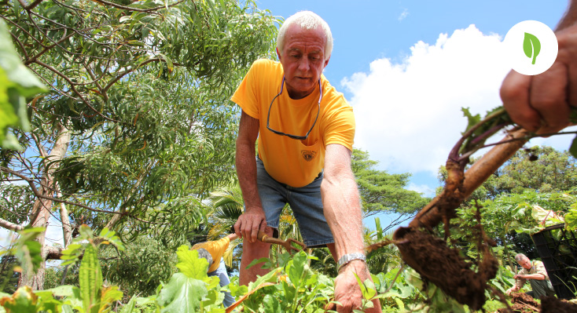

Environment
Protecting the environmental health of our global communities, generating a long-term, positive ecological and humanitarian impact
Notes:
Some of the most profound, interconnected environmental challenges of the 21st century are deforestation, climate change and water scarcity. While the global rate of deforestation has drastically slowed over the past 25 years, 129 million hectares of forest have been lost since 1990. Meanwhile, at least 1.8 billion people globally still use a drinking water source contaminated by fecal matter and 40 percent of the global population is affected by water scarcity. LCIF will focus efforts on the following critical initiatives:
The construction and installation of water tanks, wells and pumps where our communities need them;
Providing equipment for water storage and irrigation;
Securing water purification equipment for public facilities such as schools and medical clinics;
The installation of toilets and sanitation services in regions where they do not currently exist; and,
Other projects that improve the overall health of our environment, benefiting humanity today and for generations to come.

Slide 25
Recognition

Slide 26
Individual Recognition
Total Gift Level
Recognition May Include…
Pins, certificates, plaques, public presentations, other opportunities
For one-time donations, monthly donations or pledges
Automated Giving
Recognition May Include…
Pins, portfolios, stationary, tote bags, notebooks, mugs, other gifts
For automatic recurring gifts
Recognition Levels and Memberships
to be announced for gifts of US $25 to US $25,000
Notes:
The campaign is employing a variety of recognition strategies to encourage both individual and club giving. For recognition of gifts from individuals, the new campaign-related opportunities will coincide with current LCIF recognition already in place. This means that successful and well-received ongoing programs, such as Melvin Jones Fellowships and Progressive Melvin Jones Fellowships, will continue throughout the campaign – and all gifts will count toward MJF credits in addition to receiving their appropriate campaign recognition. The new recognition framework seeks to encourage regular and recurrent giving, celebrate the foundation’s 50th anniversary, and incentivize increased giving levels.
For gifts or pledges by total amount, the campaign will offer several levels of pins and other recognition. The names of the levels will incorporate messages from the campaign’s case for support.
To recognize automated giving, the campaign will likely form memberships, with accompanying recognition.
More detail on specific recognition levels and opportunities will be approved and announced soon.

Slide 27
Club Recognition & Leadership Awards
Non-Model Club Recognition for per-member average and overall totals
Leadership Awards:
Non-competitive – Awards to clubs and select areas, multiple districts, and districts, who achieve certain participation levels.
Competitive – Five possible awards at the Area, Multiple District, and District levels:
Highest per-member giving
Highest per-member recurring giving
Highest percentage participation
Highest percentage recurring participation
Elite: achieving all four other awards in a single year
Notes:
In addition to the Model Club program, which we will discuss in a few minutes, the campaign will be recognizing clubs for achieving other per-member-averages and overall donation totals. Those recognition levels will be announced soon.
The campaign will also offer a series of non-competitive awards to leaders of any and all clubs, along with select areas, multiple districts, and districts, who achieve certain participation levels.
In addition, the campaign will offer five possible competitive awards to leaders at the Area, Multiple District, and District levels. These are:
Highest per-member giving
Highest per-member recurring giving
Highest percentage participation
Highest percentage recurring participation
Achieving all of the aforementioned awards in a single year, which will be considered an elite level of recognition

Slide 28
How can YOU get involved?

Slide 29
How can you help make Campaign 100 a success?
Be part of the campaign’s launch by helping us achieve this year’s $50 million benchmark goal
Make a personal financial contribution
Learn more about what it means to be a Model Club.
Talk to other Lions about Campaign 100
Introduce your family, friends and colleagues to Campaign 100
Consider planning a fundraiser, either online or in your community
Consider becoming a Club LCIF Coordinator
Notes:
I hope as this presentation comes to a close you are starting to think about ways you might support Campaign 100. I am happy to share a few suggestions with you.
As stated earlier, all funds raised in this fiscal year count toward our Campaign 100. We have a $50 million benchmark goal in celebration of our LCIF’s 50th anniversary. Achieving this benchmark goal will ensure not only a successful launch, but also put us on a clear path to our overall success. If you can, get involved early.
We are asking all Lions to make a personal contribution to LCIF. In celebration of the 50th and to get started, perhaps you are called to give $50 in honor of our foundation’s 50th anniversary, or perhaps you’d like to give $100 this year in support of Campaign 100. Go to our website and consider making it a recurring gift so that the impact will last long into the future. Your gift will help in our mission to empower the service of Lions. Every gift counts.
Of course, you need not stop with making a personal gift. Once you’ve done so, you are prepared to inspire and lead by example as you take the Campaign 100 message to others! Talk to your club about becoming a model club. You will want to learn more about Model Clubs so be in touch with your regional development specialist. Talk to other Lions, as well as your family, friends and colleagues. Given the wide variety of causes that the foundation serves, there is certain to be something motivating and inspiring to everyone in our campaign message.
Consider planning a fundraiser, because whether they are done online or in your community, they are a fun and effective way to get others involved. Finally, considering becoming a Club LCIF Coordinator. There is no more important position to the success of our campaign than our volunteers who are the voice of the foundation to our club members around the world.

Slide 30
Model Club Program
Strategies:
Gifts from members, local businesses, club treasury
Events & activities
Qualifications – Clubs that:
Embrace fundraising
Want to lead the way
Are resourceful and strategic-focused
Are ready to conduct campaign over the next 2-4 months
Aim high, setting the highest possible club goal
Have ability to set a PMA goal of + US $750 over 3 years
Are excited to serve and promote the campaign’s causes
Notes:
Model Clubs lead the way and set an example for all Clubs, by setting a challenging goal well above and beyond the minimum per-member average and by raising funds through a variety of strategies:
Gifts from members (including recurring gifts, pledges, and one-time gifts)
Fundraising events and activities
Gifts and pledges from local businesses
A gift from the club treasury
A club can become a Model Club if they commit to raising a goal based on a minimum per-member average of US$750 or higher. Although we call this a per-member average, the goal will be achieved from Lion, Club, and non-Lion gifts.
We ask Area Leaders to help identify potential Model Clubs. Strong Model Club candidates will meet the following criteria:
They are willing and excited to raise funds for LCIF
They want to be leaders
They are willing to attempt a variety of fundraising strategies – not just individual gifts, not just events, and not just a gift from the Club treasury.
We’re looking for clubs who could feasibly complete their Model Club campaign before Convention first – but Model Clubs will continue throughout the entire campaign.
We want Clubs willing to set goals at the highest possible level, even above and beyond the minimum Model Club PMA.
They are excited to serve – they embrace the values of Lionism and the mission of LCIF, and they will promote the Global Causes and the Foundation’s support of them.

Slide 31
Campaign Marketing Resources
Videos
Slide Presentations
Speaking notes or speeches
Brochures
Pocket guides
Pledge cards
Buttons and pins
Posters
Emails
Notes:
All levels of volunteer leadership will have access to a variety of marketing materials and tools to use in their outreach. They will continue to evolve and develop over the course of the campaign. As always, they can be customized to meet the needs of different Constitutional Areas and regions.
These materials may include videos, power point presentations, speaking notes, brochures, pocket guides, pledge cards, buttons and pins, posters and emails.
Please contact your Club Coordinator or Regional Specials for more information on available resources.

Slide 32
Contact Information
Visit www.lcif.org/donate to make an online donation, or to learn about other ways to donate.
To mail in your donation, simply send a check to:
  Lions Clubs International Foundation
  Department 4547
  Carol Stream, Illinois 60122-4547
  USA
Reach out to campaign100@lionsclubs.org with any questions
Contact your LCIF regional development specialist for more information at lcifdevelopment@lionsclubs.org
Notes:
Here you’ll see some helpful information on how you can make a donation to LCIF online or by mailing in a check. The website also provides additional information on various ways to donate.
If you have questions or would like additional information, such as how your club can become a Model Club, your LCIF development staff is ready to help.

Slide 33
Notes:
I thank you for your time today!

