Slide 1
The Story of Lions Clubs International
Notes:
As part of our Centennial celebration, I would like to share the story of Lions Clubs International.

Slide 2
Lions Clubs Founding
“You can't get very far until you start doing something for somebody else"
Melvin Jones, Founder
Notes:
In 1917, Melvin Jones was a successful insurance agency owner and a member of the Business Circle of Chicago.
He encouraged his fellow members to expand beyond their business interests and seek the betterment of the community, saying “You can’t get very far until you start doing something for somebody else.”
He also contacted similar groups, inviting them to meet and discuss forming a new organization.

Slide 3
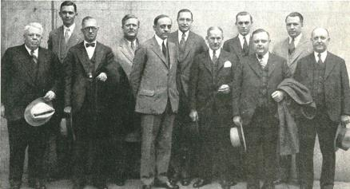
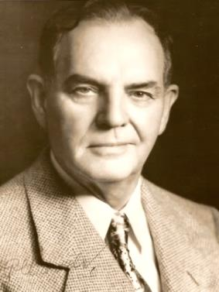
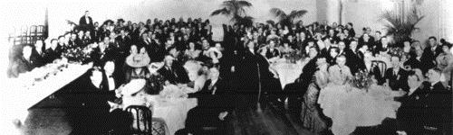
Lions Clubs Firsts
First Meeting: June 7, 1917
Chicago, Illinois USA
First President: Dr. William Woods
First Convention: October 8-10, 1917
Dallas, Texas USA
Notes:
That organizational meeting was held on June 7, 1917 in Chicago, Illinois USA.
Based on the success of that meeting, the first Lions Clubs convention was held in Dallas, Texas in October of that year, where Dr. William Woods of Evansville, Indiana was elected as the first President.
Melvin Jones was named Secretary Treasurer and authorized to establish a headquarters in Chicago.

Slide 4
International Expansion
1920: Canada
1927: Mexico
1947: Australia
1948: Sweden
1949: Philippines
1953: Morocco
1957: Antarctica
Notes:
Our new association expanded rapidly, becoming international in 1920, with the addition of a club in Windsor, Canada.
In 1927, the Nuevo Laredo club was formed in Mexico and a number of other clubs in Latin America quickly followed.
With the addition of Lions Clubs in Lismore, Australia; Stockholm, Sweden; and Manila, Philippines in the 1940s, Lions were well on their way to a global presence.
By 1950, there were more than 400,000 Lions in 31 countries and we would soon include every continent with the establishment of a club in Casablanca, Morocco in 1953 and one by Antarctica research scientists in 1957.

Slide 5
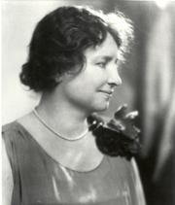
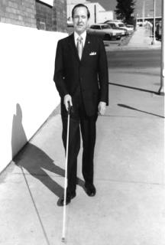
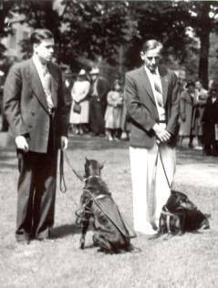
Lions become “Knights of the Blind”
1925: Helen Keller challenged Lions to be “knights of the blind”
1930: Lion George Bonham painted a cane white with a red band
1939: The Detroit Uptown Lions Club started a guide dog school
Notes:
In 1925, Helen Keller spoke at the Lions convention and challenged Lions to become “knights of the blind.” Lions enthusiastically accepted her challenge, expanding their service to people who were visually impaired.
To allow people who were blind to navigate streets more safely, Lion George Bonham painted a cane white with a red band in 1930, an innovation that is still in use today.
And in 1939, members of the Detroit Uptown Lions Club converted a farmhouse into a guide dog school, helping to popularize the idea of service dogs.
Many clubs continue to provide guide dog and other sight-related services, such as eyeglass recycling, vision screening, and eye bank support. Through these efforts, Lions have gained worldwide recognition for improving the lives of those who are blind and visually impaired.

Slide 6
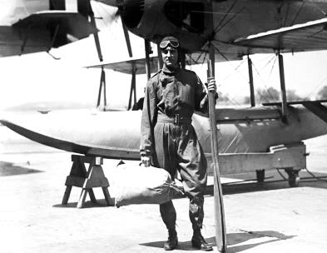
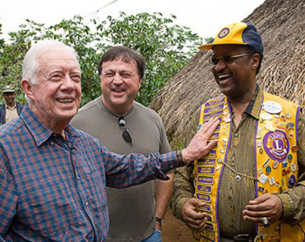
More Notable Contributions
1926: Admiral Richard E. Byrd, Lion, explorer, publicist
1977: Lion Jimmy Carter (left) becomes U.S. President
1999: Lions partner with The Carter Center to defeat preventable blindness
Notes:
More notable Lions contributors include:
Admiral Richard E. Byrd, a Lion and an explorer, who publicized Lions on his trips to the north and south pole, writing “We carried the Lions Club flag with us to the top of the world and felt it was the greatest possible honor to do so.”
In 1977, Lion Jimmy Carter became president of the United States. His association with Lions continues, and in 1999, Lions Clubs and The Carter Center formed a partnership to defeat preventable blindness in Africa and Latin America.

Slide 7
Development Landmarks
Motto “We Serve” chosen
First Leo Club chartered
LCI Foundation established
Membership opened to women
Notes:
Other landmarks in Lions Clubs’ development include:
{click} In 1954, the motto “We Serve” was chosen.
{click} In 1957, the first Leo Club was chartered, giving young people the opportunity to serve. Today there are more than 6700 Leo clubs in more than 140 countries.
{click} In 1968, the Lions Clubs International Foundation was established. The foundation, which provides funding for disaster relief, youth, sight and other humanitarian projects, now awards millions of dollars in grants each year, largely through the generosity of Lions.
{click} In 1987, membership was opened to women. Today, women make up nearly 30% of our membership and are the fastest growing segment of members.

Slide 8
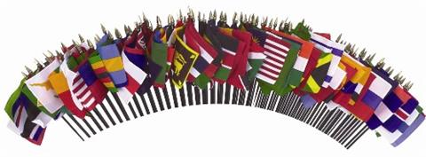
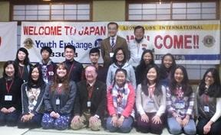
A Spirit of Understanding
Club Twinning & Youth Exchange Programs
UN Partnership
Peace Poster & Essay Contests
Notes:
One of the purposes of Lions Clubs is “To Create and foster a spirit of understanding among the peoples of the world.”
In addition to the global reach of our service mission, Lions Clubs also:
- Fosters Twinning between clubs to formalize friendships with clubs in other countries, learn about different cultures and exchange experiences and ideas about what it means to be a Lion.
- Runs Youth Camp and Exchange Programs to develop thousands of young global citizens by encouraging peace and promoting international understanding.
- Have supported the United Nations since its founding and continues partnering with UN agencies today. Each year, Lions Day with the UN gives Lions the opportunity to demonstrate how the UN and Lions can continue to help those in need on a global scale.
We also established the Peace Poster and Peace Essay Contests, providing a platform for millions of young people worldwide to express their visions of peace.

Slide 9
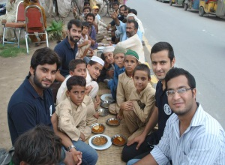
Lions Clubs Today
1.4 million Lions
46,000 clubs
200 countries and geographic areas
United by 1 idea
Notes:
Today,
{click} there are 1.4 million Lions
{click} in more than 46,000 clubs
{click} in more than 200 countries and geographic areas
{click} And all united by a single idea: We Serve

Slide 10
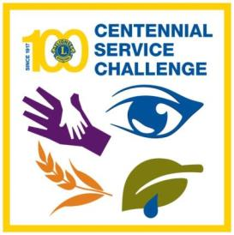
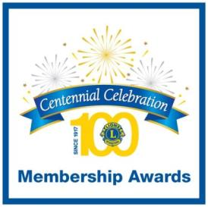
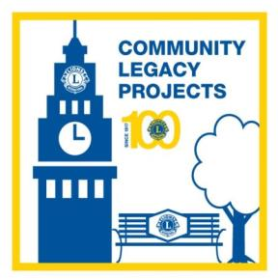
Celebrate the Centennial
Lead through Service
Invite for Impact
Connect with Community
Notes:
As Lions Clubs approaches our 100th anniversary, all Lions are called to celebrate our Centennial by:
Leading through Service: Help benefit over 100 million people by completing Centennial Service Challenge projects involving youth, vision, hunger and the environment.
Inviting for Impact: One Lion serves an average of 50 people every year. Adding new members and clubs means more people can be served than ever before.
Connecting with Community: Your club can leave a lasting impact on your community through activities like donating a park bench, establishing a community garden or building a clinic as a Community Legacy Project.

Slide 11
The Story of Lions Clubs International
Notes:
Melvin Jones once described the Lions logo by saying it “Represents a lion facing the past with pride and the future with confidence, looking in all directions to render service.”
The legacy of Lions Clubs is the many millions of people who have benefitted from the service Lions have provided across the globe.
{click}
I hope you have enjoyed the story of Lions Clubs International and look forward with me to expanding our service in the next 100 years of Lions!

