Slide 1
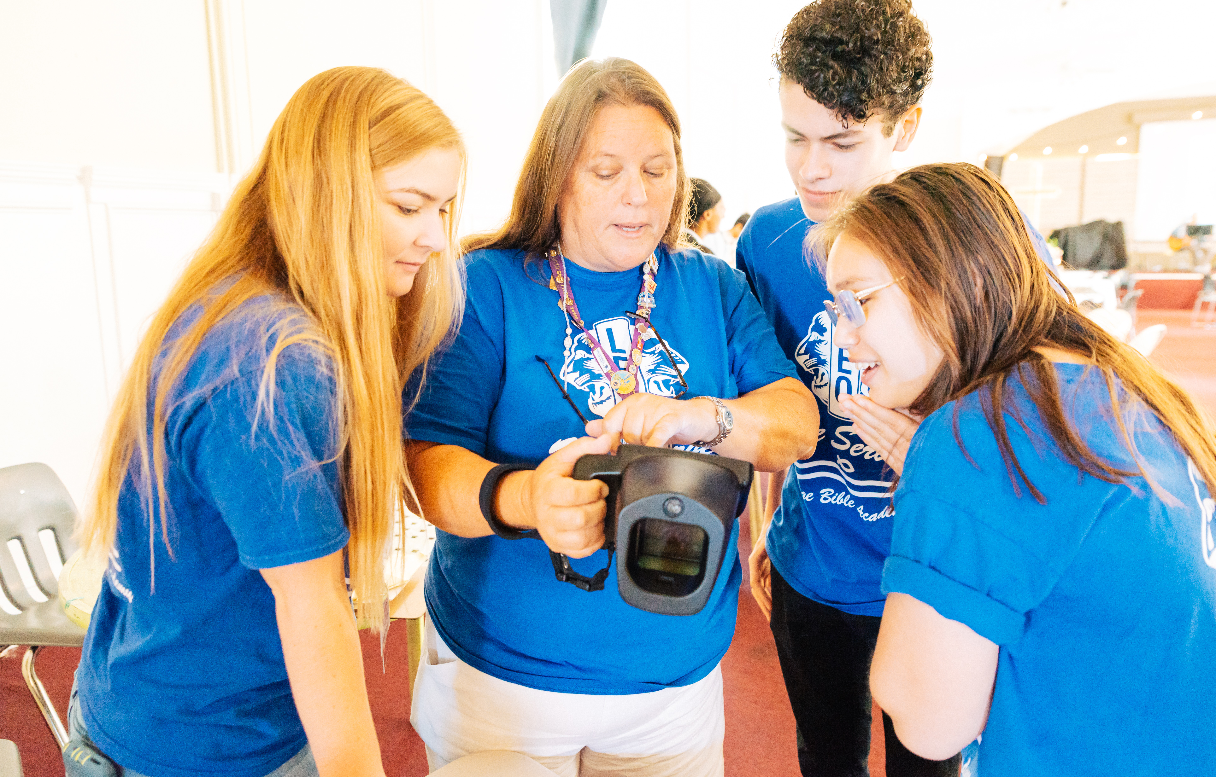
Leo Club Advisor
Training and Orientation
LIONS CLUBS INTERNATIONAL
1
Notes:
Instructor Note: Lions International designed this orientation and training program for Leo club advisors who are new to the role or have never received formal training about their role as a Leo Club Advisor. While the training will certainly not cover everything related to serving as a Leo club advisor, it provides the basic tools necessary to successfully carry out the duties of the position.
This training should be conducted under the guidance of a Lion trainer, such as a District or Multiple District Leo Chairperson, an experienced Leo Club Advisor who is familiar with resources and policies from LCI, or a Lion who has completed an LCI Faculty Development Institute or Lions Certified Instructor Program and is familiar with the Leo Club Program.

Slide 2
Module 1 // Leo Club Program Overview
Module 2 // The Role of the Leo Club Advisor
Modules
Module 3 // Leo Club Administration
Module 4 // Leo Club Program Resources
Module 5 // Working with Younger People
Module 6 // Continuing the Service Journey
2
Notes:
Instructor Note: This training is designed to present the modules all together or as stand-alone modules. The general recommendation is that instructors should review the material included in each section and determine the modules that are of greatest relevance to the Leo club advisors in the area. Training facilitators may choose to break the modules into various sessions or separate training programs.
Each module concludes with a suggested reflection or discussion activity. Reflection/discussion prompts can be used in many ways:
Individual reflection – encourage learners to make notes of their answers independently
Large group discussion – use a flipchart to capture responses
Small group discussion – allocate additional time for smaller groups to discuss first and then report back their ideas to the larger group

Slide 3
Module 2
Role of Leo Club Advisor
3
Notes:
The Leo club advisor is critical to the club’s success, as they are there provide guidance for club’s leaders.
This module will cover:
Responsibilities of a club advisor, which is divided into five major responsibilities.
Differences between the types of Leo clubs
At the end of this module, participants will understand the role that a Leo club advisor plays in a Leo club.

Slide 4
Role of Leo club advisor
Mentor
Motivator
Counselor
Liaison
Service Role Model
4
Notes:
When working with Leos, advisors fill the role of mentor, motivator, counselor and service role model. Advisors guide Leo club members in managing their club and developing effective community service projects to help increase confidence and leadership abilities.

Slide 5
Role of Leo club advisor
Mentor
Advisors teach and support the Leo club officers and help members reach their potential as leaders. They also teach Leos the importance of planning and organizing.
Motivator
Advisors should motivate youth, promoting peer acceptance, recognition of accomplishments and a sense of personal achievement.
5
Notes:
As a mentor, advisors teach and support Leo club officers and help members reach their potential as leaders. Advisors also teach Leos the importance of planning and organizing.
As a motivator, advisors understand the nuances of motivating youth and the factors that can empower them, such as peer acceptance, recognition of accomplishments and a sense of personal achievement. Although advisors should inspire Leos to participate in service activities, they should not impose their personal views on Leos.

Slide 6
Role of Leo club advisor
Counselor
Advisors must understand when to counsel the club and when to let Leos take charge and make their own decisions. Also be familiar with Lions Board Policy, Chapter XXII.
Liaison
Advisors act as the bridge between the sponsoring Lions clubs and Leo clubs in the district, multiple district, country and internationally.
6
Notes:
As counselors, advisors listen to Leos and understand their needs. They must know when to counsel the group and when to let Leos take charge and make their own decisions. Advisors must be familiar with the Standard Leo Club Constitution and Bylaws, which is available on the Lions International website in the official Board Policy Manual.
As liaisons, advisors act as the bridge between the sponsoring Lions clubs and the Leo clubs in the district, multiple district and around the world. They inform the Lions club of Leo activities and foster a healthy relationship between the two. It is crucial that advisors also create a roadmap to help transition Leos into Lions club members.

Slide 7
Role of Leo club advisor
Service role model
Advisors lead by example and demonstrate compassion for their communities and others.
7
Notes:
As service role models, advisors lead by example and demonstrate compassion for their communities and others, helping Leo club members understand the altruistic and compassionate aspects of community service. It is crucial that the Leo club advisor acts as a role model by not only showing the importance of service, but how they act at service projects and present themselves as representatives of Lions International.

Slide 8
Specific Leo advisor responsibilities
Oversee initiation and ongoing development of the Leo club.
Report Leo club officers and members in the Lions International online reporting system and the Leo club’s service activities in the online reporting system.
Train Leo club officers to use the Lions International online reporting system for reporting.
Promote collaboration between Leos and sponsoring Lions club by regularly updating Lions on Leo club activities.
Attend Leo club and board of directors’ meetings.
Ensure new Leos receive new member materials and orientation.
Recognize Leos for their achievements.
Encourage eligible Leos to become Lions.
8
Notes:
In addition to serving as a liaison, mentor, motivator, counselor, liaison and service role model, Leo club advisors also fulfill a variety of other roles, including those shown here.

Slide 9
Difference between Alpha and Omega clubs
Alpha Leo club advisors
Takes an active role in guiding Leos through projects and meetings.
Corresponds between parents, schools and Lions club.
Omega Leo club advisors
Acts as a liaison between the Leo club and sponsoring Lions club.
Less directly involved in day-to-day administration as Leos take on more responsibilities.
Supports the personal and professional development of Leos.
Review Module 5 for more information on how to work with youth.
9
Notes:
The approach to take with the Leo club will depend on the Leo club track.
An Alpha advisor should take a more active role in the Leo club, guiding the Leo members, as well as interacting with any parents, guardians and teachers involved. Younger Alphas typically need more direction than older Alphas.
Omega Leos work more independently. An advisor will fill the role of liaison between the Leo club and sponsoring Lions club, but once the club is up and running, the role will likely be more hands-off. The advisor is supporting the personal and professional development of Leos between the ages of 18 and 30, so should be cognizant of issues that are regular for college students, young professionals and young families.

Slide 10
Difference between school and community-based clubs
Community-based Leo club
Open to any eligible young person in a local area.
Meets at a central location in the community like a community center, religious space or school.
School-based Leo club
Draws members from students of a local school.
Works with a faculty advisor, who may or may not be a member of the sponsoring Lions club.
Meets at school or determined space near the school.
10
Notes:
An advisor’s approach may also depend on where the Leo club is located.
Community-based Leo clubs offer membership to any eligible young person within the local area of the Lions club. These clubs meet at a suitable location in the community like a community center, religious space or school. They can also meet virtually or have a hybrid meeting schedule.
School-based Leo club advisors work as a liaison to the schools. Most school-based clubs require a faculty advisor who may or may not be members of the sponsoring Lions club. Some schools may charge a fee to the Lions club to have a club in their school. Faculty advisors are typically involved in the day-to-day affairs but should update the Leo club co-advisor frequently. Before the Leo club is organized the Lions club and school should agree with procedures for organizing club activities on and off school property, which adhere to school policies and Lion’s policies.

Slide 11
Summary
Important points from the module
Leo club advisors act as a mentor, motivator, counselor, liaison and service role model.
The way the Leo club advisor works with the club will depend on the type of club, the location and the Leos themselves.
End of module activity
Create a blueprint for success as a Leo club advisor by developing a strategy based on your type of club, location and each of the five roles of a Leo club advisor into action.
11
Notes:
Instructor Note: For the optional end of module activity for Module 2, ask participants to spend 5 minutes individually developing their personal approach to serving as an effective Leo club advisor. This strategy or blueprint should include the how the advisor personally defines each of the following and plans to put these characteristics into action with his/her Leo club: mentor, motivator, counselor, liaison and service role model.
Example:
As an Alpha Leo Club advisor at a middle school, I will plan to meet with the faculty advisor once a month to touch base on the operations of the club.
Mentor: I will do quarterly check ins with the Leo club officers.
Motivator: I will encourage Leos to host at least one service project a month.
Counselor: I will encourage open communication between officers and myself when there’s an issue and not take sides when there’s a conflict.
Liaison: I will bring at least 3 Lions to every Leo project
Service Role Model: I will wear my Leo shirt at every service project
Estimated Time: 15 minutes

