Slide 1


Club Quality Initiative
1
Notes:
The Club Quality Initiative is the foremost tool used by a club to assess itself in terms of its ability to meet the needs of its members and its community.
In today’s busy world, a club needs to be able to manage and implement a positive assessment and goal setting process so simple that it can become a part of standard operating procedures as needed to remain focused on the foremost most critical factors of a successful club: service, quality members and growing leaders.

Slide 2
Five Steps
  Step One: Understand the Process
  Step Two: Determine the Need for Change Using Critical Assessments
  Step Three: Determine the Need for Change
  Step Four: Develop Plans
  Step Five: Implement and Sustain Change
2

Slide 3

Step One
Understanding the Process
The process of change is the process for doing things better!
Notes:
Change is critical for each club. By understanding our current operation, identifying areas that may be improved and taking measured steps to accomplish our goals, every club can be even better!
The four areas are:
Rejuvenate your club with new members
Revitalize your club with new service opportunities
Excel in leadership development and club operations
Share your club’s achievements with your community

Slide 4
Step Two
Determine the Need for Change
Complete four assessments
Notes:
Each assessment was designed to help identify areas that can be improved.
The assessments:
Helps to focus thought
Guides discussion
Encourages exploration of resources
Process may be completed individually or as a group
At this time, we will form small groups to complete or review the assessments. What will you discover?

Slide 5

Assessment One
Rejuvenate your club with new members
Complete Assessment on page 2
Our club recruits community leaders who can help advance our projects
Our club actively seeks prospective members and successfully recruits them
Recruiting efforts are recognized and supported
New members receive an orientation that is engaging and informative
5

Slide 6
Assessment One
Rejuvenate your club with new members
Complete the Club Member Evaluation on page 3
What actions can the club take to recruit members?
How can the club keep members interested and engaged in our activities?
Thinking about the members who have left, what could have been done differently to keep them as active and engaged?
6

Slide 7


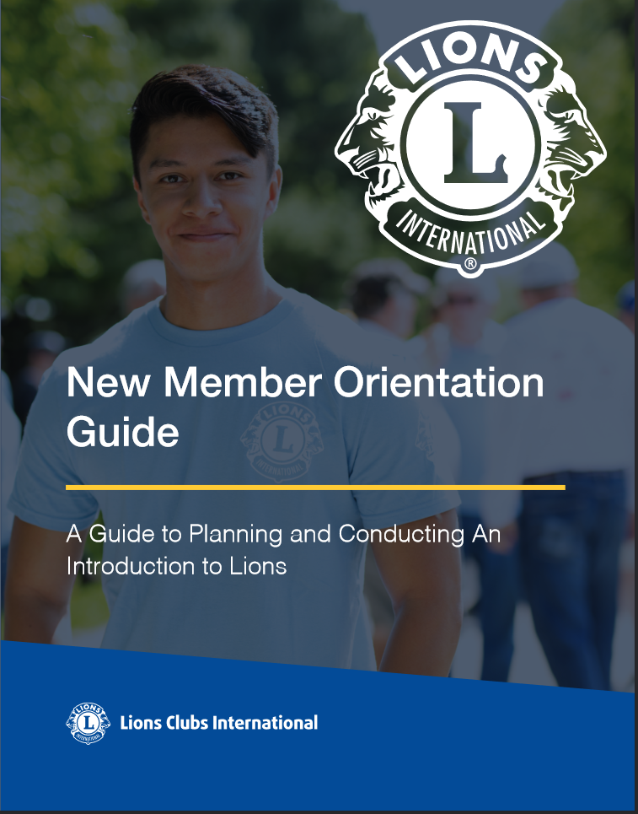
Resources: Rejuvenate your club with new members

Slide 8
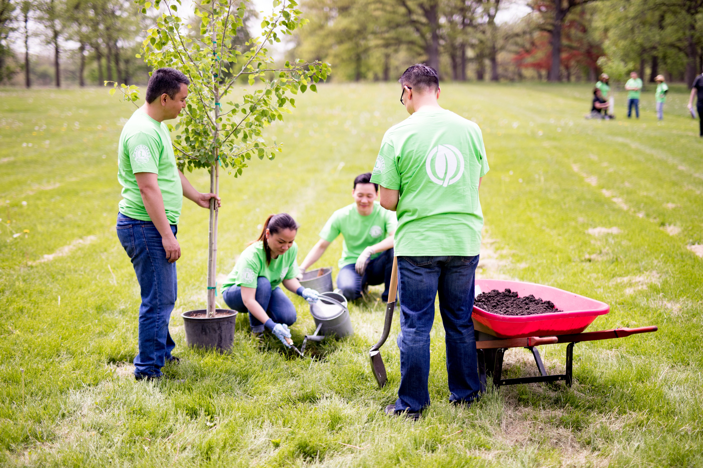
Assessment Two
Revitalize your club with
new service opportunities
Complete Assessment on page 4
Our club partners with community organizations and/or businesses to identify areas of need
Our activities attract new members to our club
Our club invites Leos and other youth to serve alongside us
Members see the impact of their projects
8

Slide 9
Assessment Two
Revitalize your club with
new service opportunities
Complete the club Member Evaluation on page 5
Do you have any suggestions regarding the questions in the evaluation or ideas on how we can improve our service?
What is your favorite project or activity?
What is your least favorite project or activity?
What new protentional projects should be considered?
Are there current projects that should be reconsidered or redesigned?
9

Slide 10








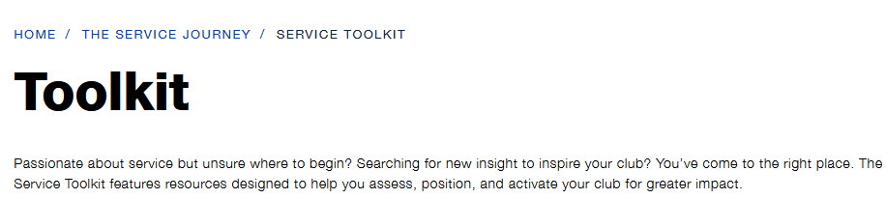
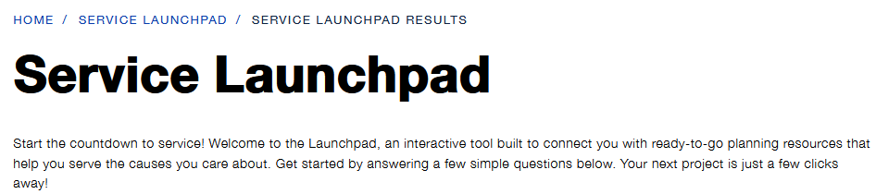
Resources: revitalize your club with new service opportunities
The Service Journey
CHILDHOOD
CANCER
DIABETES
DISASTER
RELIEF
ENVIRONMENT
HUMANITARIAN
HUNGER
VISION
YOUTH

Slide 11

Assessment Three
Excel in leadership development and club operations
Complete Assessment on page 6
Club encourages all members to seek leadership positions
Club officers keep the members informed of club decisions
Members feel engaged and their involvement is a good use of their time
Members are satisfied with how the club is managed
11

Slide 12
Assessment Three
Excel in leadership development and club operations
Complete the club Member Evaluation on pages 6 & 7
Do you have questions regarding the operations of our club?
What improvements to our club meetings could be made?
What changes could make your participation more meaningful?
Is there conflict within the club?
Does the club need more communication between members?
If you could change one thing, what would it be?
12

Slide 13



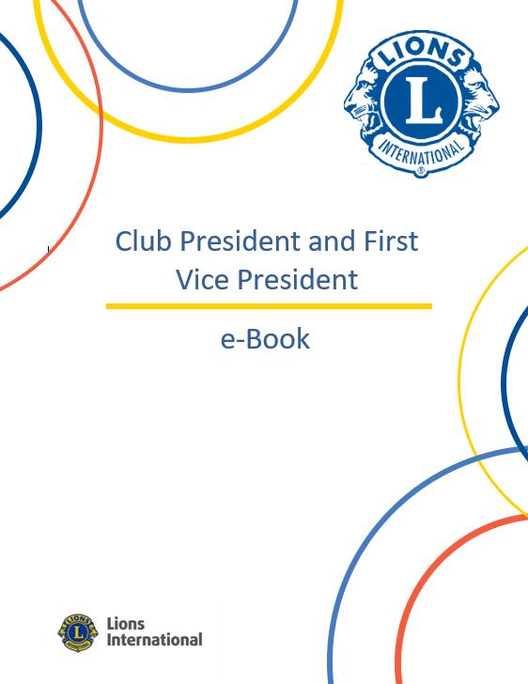

Resources: Club Operations and Quality Tools Available
Your Club, Your Way!
Tools for Planning and Goal Setting
Standard
Constitution
and By-Laws
e-Books for
each club officer
Notes:
Constitution and By-Laws: New officers, director and committee chairperson positions. Committees repurposed. Defines new standard club structure
Your Club, Your Way!: Guide to customizing your meeting types. Reinvent your general meetings. Ideas to increase involvement. Club meeting program ideas. Promote your meetings and events to the public.
e-Books: Club President/Vice President, Secretary, Treasurer, Membership Chairperson, Service Chairperson
Plan for Your Club’s Success!: Guide and PowerPoint available to assist the club in discovering your club’s strengths, ways to improve and new opportunities that will help your club grow and thrive! Planning forms help develop a vision, assess your club’s needs and organize your plan for successful implementation.

Slide 14
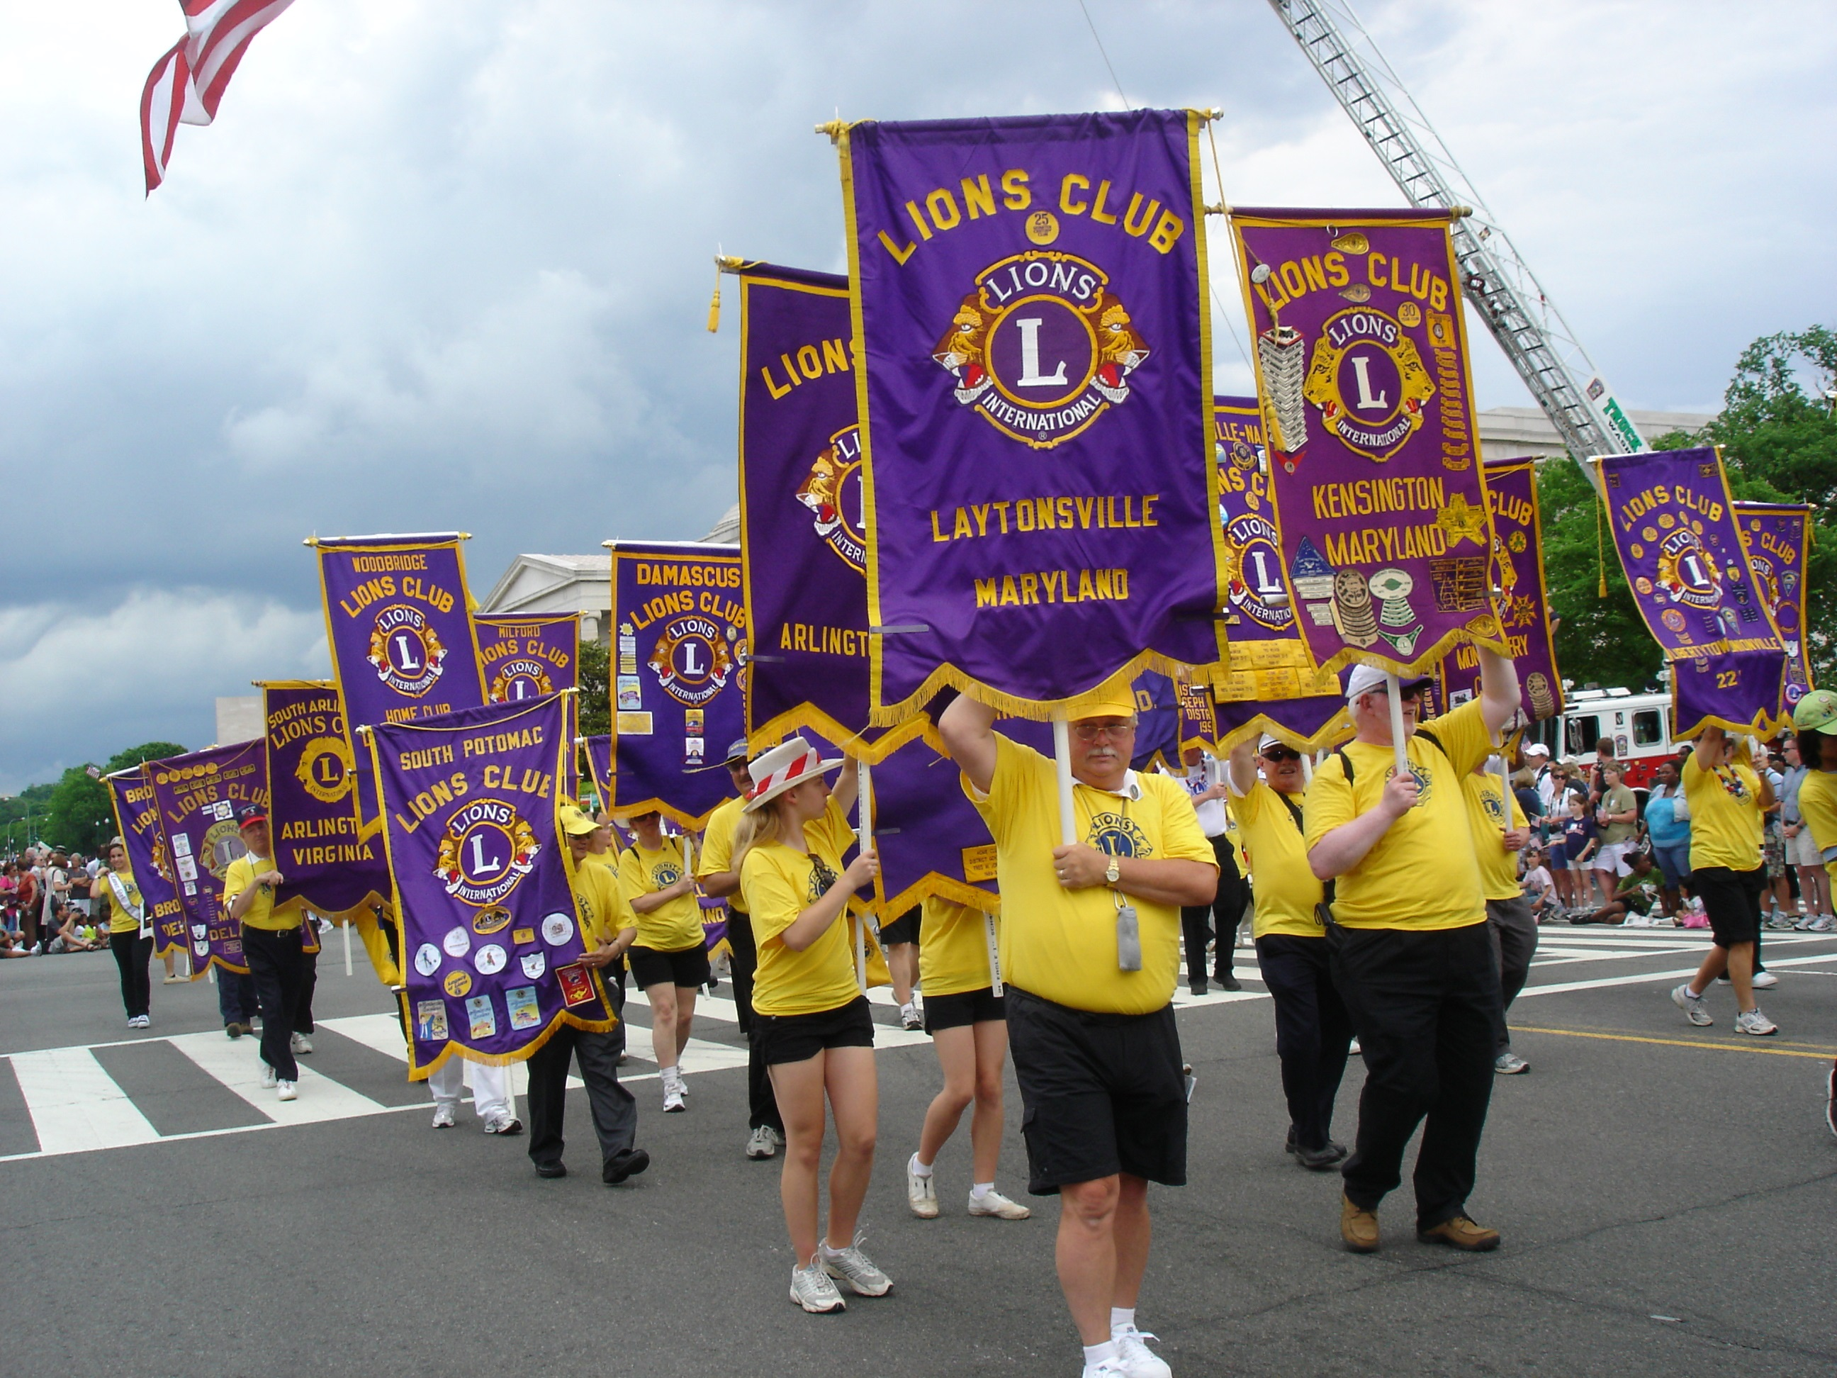
Assessment Four
Share your club’s achievements with your community
Complete Assessment on pages 8 & 9
How the community views your club, positively and negatively
Visibility to community leaders
Connections with local media and social media
Effectiveness of internal communications
14

Slide 15
Assessment Four
Share your club’s achievements with your community
Complete the club Member Evaluation on page 8 & 9
How do people in the community perceive our club?
What can our club do to reshape public opinion about Lions and increase our visibility?
15

Slide 16






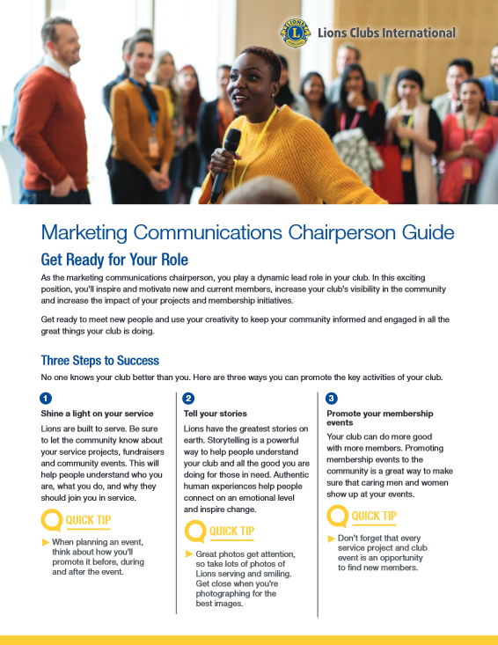


Resources: Public Relations & Media Tools Available

Slide 17
Break!
17

Slide 18
Step Three
Set Goals

Slide 19
Set Goals
S
M
A
R
T
S
M
A
R
T
pecific
easurable
ctionable
ealistic
ime Bound
Ensure that the objective is clear.
Benchmarks and progress must be measurable.
Each goal must be achievable.
Timeframe that outlines a schedule of progress.
Challenging but not unrealistic.
19
Notes:
Develop three SMART Goals for each assessment.
Lets take time to discuss the goals and develop three SMART Goals for each assessment. Check occasionally to make sure each assessment is discussed effectively.

Slide 20
Group Discussion
20
Notes:
Lets report your goals. We will share 3 goals from each group.

Slide 21
Step Four
Develop Plans
      Determine long and short-term priorities
      Assign goals to committees
      Encourage all club members to
      be involved in solutions

Slide 22
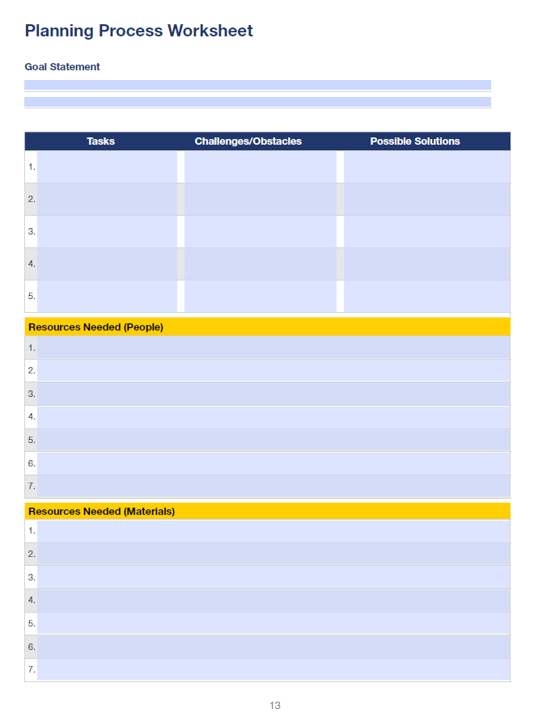
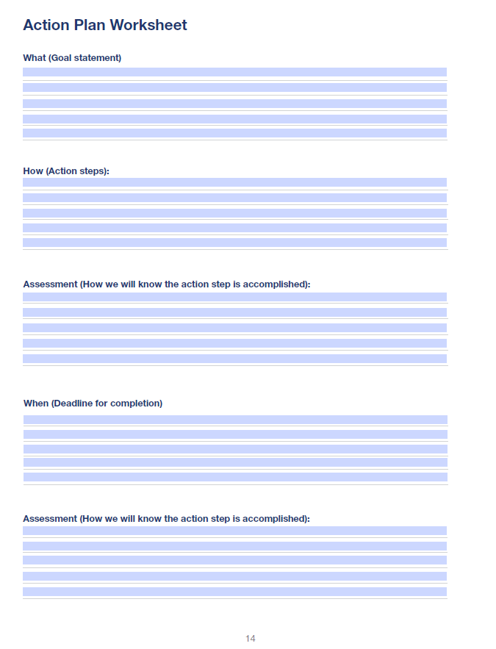
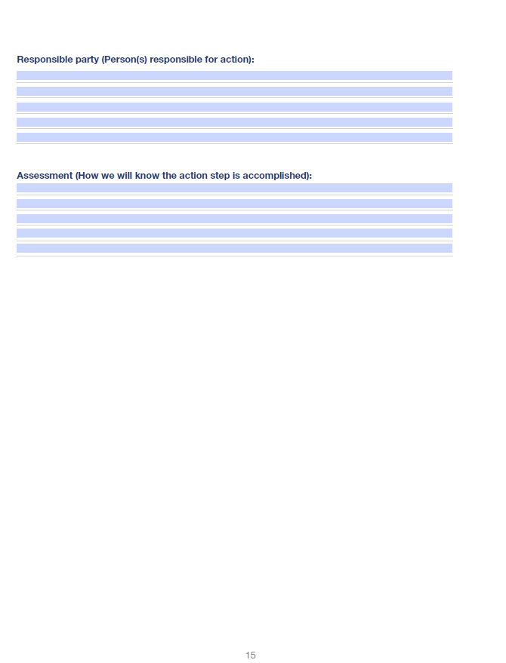
Use these tools to prepare and plan for change!

Slide 23
Group Discussion
23
Notes:
Lets report your goals. We will share 3 goals from each group.

Slide 24
Step Five
Implement and sustain change

Slide 25
Use these tools to prepare and plan for change!
Implementing Change
Track achievements
Have an agreed upon deadline for each benchmark
Report to your club until benchmark is completed
Sustaining Change
Change results in more change
Look for new opportunities
25

Slide 26
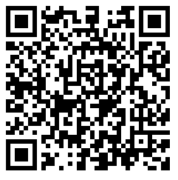
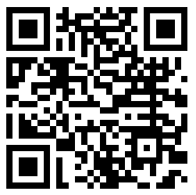
Tools and Resources
Website:
https://www.lionsclubs.org/en/resources-for-members/resource-center/improving-club-quality
Facebook Group:
https://www.facebook.com/groups/317754885360703/
Website QR Code
Facebook Group QR Code
Notes:
Lions International offers many tools and resources to the club. Visit the Improving Club Quality Webpage and join the Improving Club Quality Facebook Group.

Slide 27
Closing
Group Discussion
Notes:
Ask volunteers to state the most important thing they discovered during the workshop.
After discussion, pull together their statements and recap.

Slide 28

Club Excellence Award
Road Map to Success
Criteria has these areas of focus:
Membership
Service
Leadership & Organizational Excellence
Marketing
Contact us: clubexcellenceaward@lionsclubs.org
Website: lionsclubs.org/ClubExcellenceAward
28
Notes:
Clubs that excel in Membership growth community service, organization excellence and communications may qualify for the prestigious Excellence Awards. Use the qualifications outlined in the club excellence award application as your road map to excellence.

Slide 29
Thank You
© 2022 Lions International
29
Notes:
Thank the group for coming

