Slide 1
FOLAC Santo Domingo, Republica Dominicana
20 de enero del 2018
Notes:
[no speaking]

Slide 2
PIP Jim Ervin Pasado Presidente de LCIF
Introducción y Visión de LCIF
Notes:
Hello and welcome! It’s nice to be here with all of you fellow Lions, friends and LCIF Trustees.
I know many of you in this room have worked with our Foundation over the years. Thank you very much.
As a past chairperson for our foundation, I am eager to share with you some important information about LCIF. Today, we will discuss the following:
Our foundation
Our focus areas of this year
Our programs
Our coordinator structure
And, most importantly, your role with LCIF
(transition to 50th)

Slide 3
Celebrando 50 Años de Impacto
Notes:
This year marks the Foundation’s 50th anniversary. And in that time, we have awarded more than 13,000 grants totaling over 1 billion dollars to support the works of Lions around the world.
For 50 years, LCIF has stood alongside Lions, helping them to serve more people in bigger ways than they could do alone. 50 years of support and teamwork. This is an incredible milestone, and one of which we can all be proud.
You’re going to hear a lot about our anniversary this year, because there will be many ways for Lions to get involved and celebrate. There will be birthday parties at area forums, including the one here at the FOLAC forum yesterday. You’ll hear more about how LCIF is celebrating this milestone by communicating powerful, inspiring stories of individual Lions accomplishing great things with the support of the foundation. We have launched a new website, LCIF50.org. We hope you’ll visit, as it’s a great way to learn even more about the foundation. While you’re there, you can take part in a simple, fun contest and be entered to win a 50th anniversary medal, available only to contest winners.
(Transition to what comes to mind…?)

Slide 4
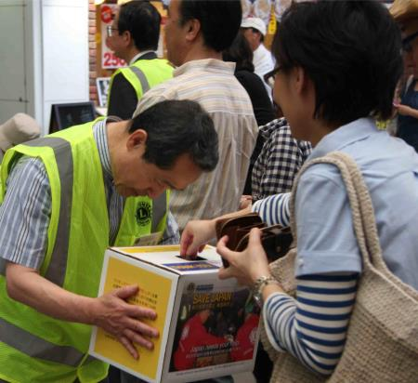
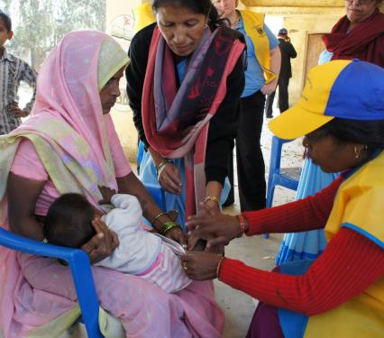
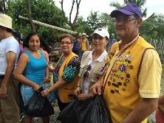
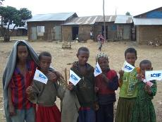
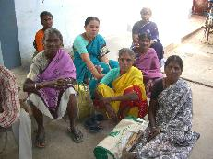
¿Qué viene a la mente al pensar en LCIF?
Notes:
When you think of LCIF , what comes to your mind?
Yes…
Some people say disaster relief
Others say sight program
Also, some say the Lions Quest program
The needs of people and communities are very different around the world. And that is why our foundation is so great– it offers so many solutions to diverse problems. LCIF has programs to help Lions work for very different needs.
Today, we will review these programs and grants to help you become more familiar with LCIF, and to understand why you must encourage everyone to support LCIF.
But, first, let’s share some basic information about LCIF.
(Transition to LCIF at a Glance slide)

Slide 5
LCIF de un Vistazo
LCIF fue fundada en 1968 – es la Fundación oficial de la Asociación Internacional de los Clubes de Leones. Da apoyo a los Clubes.
Provee subvenciones para proyectos de gran escala
Depende de donaciones
Más de mil millones en subvenciones otorgadas hasta la fecha
Notes:
LCIF seems very simple – we receive money as donations, and we give money as grants; give support to clubs doing service in communities and around the world. The results are life-changing for so many people. LCIF provides grants for large-scale projects that clubs can’t do alone.
As a nonprofit organization, we rely 100% on donations from Lions and others. They donate to us because they share our mission.
So, it is very important to promote LCIF’s mission and values. Since 1968, LCIF has given out more than US$1 billion in grants! Please think about the millions of lives that Lions have changed through these grants.
Our Foundation changes lives around the world.
And it is through four areas of service…
(Transition to next slide)

Slide 6
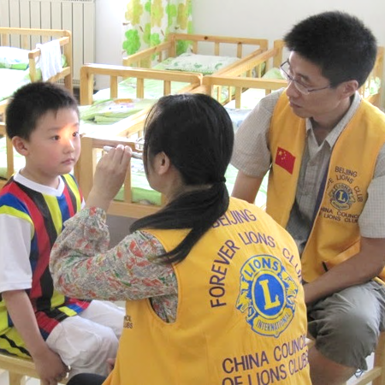
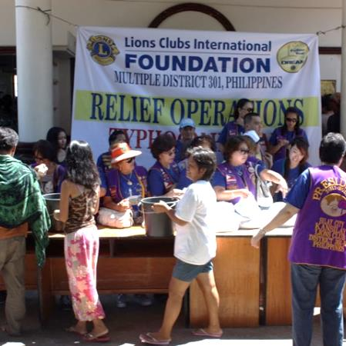
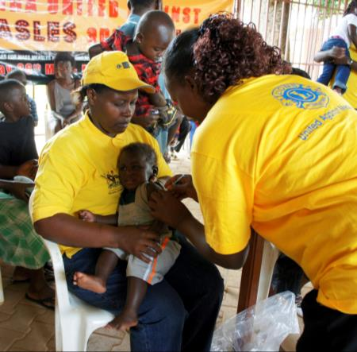
Vista
Desastre
Juventud
Humanitario
Notes:
The first area of service is, PROVIDING DISASTER RELIEF. LCIF provides support around the world, and we constantly receive more and more requests.
The next area of service is SAVING SIGHT. Campaign SightFirst II was a huge success for LCIF. Thanks to that campaign, we are doing great service in this area, following our tradition.
LCIF also helps Lions SUPPORT YOUTH in many ways. Our most important youth program is the Lions Quest program.
Finally, LCIF helps Lions MEET HUMANITARIAN NEEDS in communities around the world. This includes global health issues, such as measles, diabetes prevention and education. We also support people with disabilities, and many other people in need.
(Transition to measles slide)

Slide 7
Una vacuna, Una vida: Iniciativa Leonística Contra el Sarampión
400 personas mueren cada día a causa del Sarampión
Los Leones apoyan por medio de movilización social
Leones, junto con Gavi (Alianza de la Vacuna), recaudaron US$30 millones para vacunas contra el Sarampión para el año 2017
Notes:
Today, I want to highlight our measles program, “One shot, one life.” And most importantly – what YOU can do to support this program.
I am sure you have heard about this terrible number: 400 people die every day from measles. Most of them are children.
And even if they survive, they often have serious complications, including blindness. But we can prevent this, with just $1 for each child!
That is why we partnered with Gavi, the Vaccine Alliance. We made a commitment to raise $30 million by our centennial. By doing so, we are helping families around the world to live healthy and productive lives.
$30 million is a big amount of money. But, what if every Lions club donated 100 dollars per member to LCIF this year? We could raise US$143 million!
Do you think donating $100 is too difficult for our Lions? For some members, yes, but for many of them, not at all!
And, Lions can do more than giving money. Lions can also provide physical support for measles vaccination campaigns – we are in the communities in need – we can provide support around the world for vaccinations, through both donations and service.
Now, I am going to ask a capable colleague to give you more details. Please welcome Kimberly Anderson, Regional Specialist for the Lions Quest Department.
(transition to Kim)

Slide 8
Kimberly Anderson Especialista Regional Departamento Lions Quest
Metas Financieras y Recaudación de fondos

Slide 9
Metas Financieras de LCIF
Metas quinquenales de LCIF
US$50 million en 2017-2018 para el cincuentenario de LCIF
Meta en Millones
Año
Notes:
There are many ways to provide support. But for us to continue our support, we need a fund. To secure our solid funding, we have certain financial goals each year.
And in 2009, LCIF established its new Coordinator structure.
In just a few years, LCIF Coordinators increased average donations to LCIF from 20 million to 30 million per year. This structure has worked so well, so the LCIF Board of Trustees approved a new goal: raising $50 million per year, by this, our 50th anniversary year, 2017 – 2018.
Now, you may be asking yourself: why do we need to increase our donations?
(Transition to case for support)

Slide 10
Necesidad de apoyo
Notes:
The answer is simple. Because there is more demands for grants.
As you can see in this graph, it’s not uncommon for LCIF to approve more grants than our grant budget. We can do so because we are managing donations well, and expenses are low. But we need more donations to keep up with the grant requests to support the great work of Lions.
We have so much potential, but to realize the potential, we need your help.
(transition to FY donations)

Slide 11
Donaciones en el ejercicio 2017-2018*
US$14,5 millones
29% de la meta
Meta: US$50 millón
US$8.1 millones Sin restricciones
US$5,1 millones restringidos
US$1,3 millones sarampión
*desde el 6 de noviembre del 2017; no auditado, cifras en Dólares Estadounidenses
Notes:
We have a very ambitious fundraising goal this year: US$50 million for our 50th anniversary year. As of November 6, we are at more than US$14.5 million, about 29 percent of our goal. Last year, we reached 86% of our $45.3 million goal.
Thank you for your support. Now I ask you, please continue to encourage Lions to support our foundation. LCIF awarded more 500 grants worth over $43 million last year. We are only able to award grants to Lions because of the generous support of our donors.
(Transition to donations by CA)

Slide 12
Donaciones por área estatutaria 2016-2017
Área Estatutaria | Donaciones totales | Porcentaje de clubes que donaron | Porcentaje de individuos que donaron | Porcentaje de la meta
I | US$5,098,409 | 46% | 2% | 64%
II | US$461,928 | 33% | 1% | 61%
III | US$736,225 | 12% | 2% | 51%
IV | US$5,110,326 | 36% | 0.5% | 90%
V | US$22,786,936 | 21% | 21% | 90%
VI | US$2,971,498 | 6% | 1% | 85%
VII | US$773,189 | 36% | 3% | 99%
No asignados | US$1,138,218 | -- | --
Notes:
Last year, less than 30% of clubs give to LCIF.
Only 6% of individual members give to LCIF.
Excluding OSEAL, only 1% members gave to LCIF last year.
The average personal donation is $325. ($18 if averaged using ALL members instead of donating members)
The average club donation is $685. ($186 if averaged using ALL clubs instead of donating clubs)
(Transition to current donations by CA slide)

Slide 13
Donaciones por área estatutaria 2017 (hasta el 6 de noviembre)
Área Estatutaria | Donaciones totales | Porcentaje de clubes que donaron | Porcentaje de individuos que donaron | Porcentaje de la meta
I | US$2,523,477 | 8% | 0.4% | 9%
II | US$119,683 | 4% | 0.2% | 3%
III | US$135,991 | 2% | 0.2% | 6%
IV | US$757,766 | 4% | 0.04% | 5%
V | US$9,779,870 | 5% | 8% | 35%
VI | US$688,707 | 1% | 0.2% | 8%
VII | US$335,835 | 4% | 0.2% | 15%
No asignados | US$178,310
Notes:
So far this year:
1% of individuals give to LCIF
If OSEAL is excluded, only 0.2% of individuals give to LCIF
1,911 clubs have donated out of 47,752 to LCIF. This means only 4% of clubs have donated to LCIF. There is definitely room for opportunity.
The average personal donation is $478. ($5 if averaged using ALL members instead of donating members)
The average club donation is $508. ($20 if averaged using ALL clubs instead of donating clubs)
(Transition to top 5 Latin American countries slide)

Slide 14
Los 5 países Latinoamericanos con mayores donaciones
País | Cantidad (USD) | Categoría Mundial
Brazil | US$109,528 | #12
Mexico | US$22,472 | #26
Argentina | US$6,585 | #38
Venezuela | US$5,001 | #43
Colombia | US$3,566 | #50
Notes:
These are the top 5 Latin American countries by donation amount with world ranks.
(transition to Club LCIF Coordinators)

Slide 15
Coordinadores de LCIF de Clubes
Notes:
How many Club LCIF Coordinators are here today? Stand up, please.
Thank you for volunteering for this new and very important position. [applause]
Club LCIF Coordinators serve as ambassador for our Foundation. They enable LCIF to advance its humanitarian work both locally and globally. I urge all of you to find out who your club’s Club LCIF Coordinator is. Connect with that person and see what they have to say about LCIF. And, if your club hasn’t appointed someone, won’t you please consider volunteering? LCIF needs your help to continue to make the world a better place.
(transition to how you can help)

Slide 16
¿Como vas a ayudar a nuestra fundación?
Contar la historia de LCIF.
Fomentar donaciones individuales.
Aumentar donaciones de clubes.
Notes:
LCIF is our foundation. The foundation should be supported by all clubs and all members. So we must work to increase the participation percentage.
As an officer, international director or appointee, what can you do? I ask you, please tell the LCIF Story. Tell how grants are making possible essential activities for clubs, and changing people’s lives. Please tell members that every dollar counts. Tell members how $20 can make a difference.
Please help all Lions to understand that LCIF is our foundation – LCIF supports Lions to grow, and Lions are in charge of making LCIF grow. As a top leader in your area, you are in charge of LCIF as well. So when you have speaking opportunities, please also talk about LCIF. Please do not forget. This is our Foundation. And if we all do what we can, we will have a great year.
Up next is Erika Klotz, Regional Specialist of the humanitarian programs department, to talk to you about LCIF grants.
(Transition to quiz)

Slide 17
Erika Klotz Programas Humanitarias LCIF
Incitativas y Subvenciones

Slide 18
Encuesta Rápida
¿A cuál clase de subvención creen que LCIF otorgó la mayor cantidad de fondos el pasado año fiscal?
Subvenciones Regulares
Subvenciones 4 Puntos Básicos
Subvenciones de Asistencia Internacional
Subvenciones SightFirst
Subvenciones Designadas
Otras subvenciones
Notes:
Last year, what type of grant do you think awarded the most funds?
A?
B?
C?
D?
E?
F?
Answer: TBD, info will be on next slide.
(transition to LCIF Grants pie chart slide)

Slide 19
Subvenciones LCIF 2016-2017
Durante el año 2016-2017, LCIF otorgó más de 500 subvenciones por un total de más de US$43 millones
Notes:
It was E), designated grants (31%). LCIF awarded more than US$43 million in grants this past year and more than one billion dollars in grants throughout our history. But, it is really about the individual lives that are being changed because of what you are doing with support from our foundation.
Designated: 31%
SF: 30%
Standard- 19%
Core 4: 18%
IA: 1%
Other: 1%
(Transition to types of grants)

Slide 20
Clases de subvenciones: Nueva estructura
Humanitaria
Fondos correspondidos
(anteriormente regulares)
Lions Quest (anteriormente Core 4 LQ)
Diabetes (anteriormente Core 4 Diabetes)
Desastre
Emergencia
Preparación Comunitaria
Recuperación Comunitaria
Catástrofe
Mayor (MCAT)
SightFirst
Leo
Designadas
Compartidas entre Distritos/Clubes
Dirigida por la Junta de Síndicos
Otros
(Premio Humanitario, Alianzas)
Notes:
How many of you have been involved with a LCIF grant? Raise your hands. (Lions raise hands)
Well, then some of you know already the great things we accomplish through the Foundation. Now, some changes have been made.
In order to best support the new service framework, we are making some exciting changes to the LCIF grant structure.
As you can see, the foundation’s grants are grouped into six categories.
One very exciting new addition is the opportunity for Leo clubs to apply for Leo service grants. We believe this will empower Leos to make an even bigger impact in their communities. Another addition is the District/Club Sharing Program which I’ll speak on in a little while.
Note to Erika: explain that IAGs and Core 4 grants are being rebranded under the humanitarian category
(Transition to humanitarian grants)

Slide 21
Subvención Humanitaria – Fondos Correspondidos (Anteriormente Subvenciones Regulares)
Fondos disponibles entre US$10,000 y US$100,000
Apoyan proyectos Leonísticos de gran escala (equipo o construcción- no costos operativos)
Leones identifican y desarrollan proyectos
Tienen un impacto local y visibilidad en la comunidad
Notes:
This is our most popular grant category, with funds available from US$10,000 up to US$100,000.
Let me give you a few examples of what past standard grants have provided:
Dental and Ophthalmological equipment for Lions clinics in Paraguay and Ecuador.
New dialysis machines for four kidney dialysis centers in Brazil
Improve school facilities in Bolivia and Mexico
House and improve Lions Guide Dog program in Argentina
And countless other humanitarian efforts that give hope to people in need.
(Transition to Diabetes Grants)

Slide 22
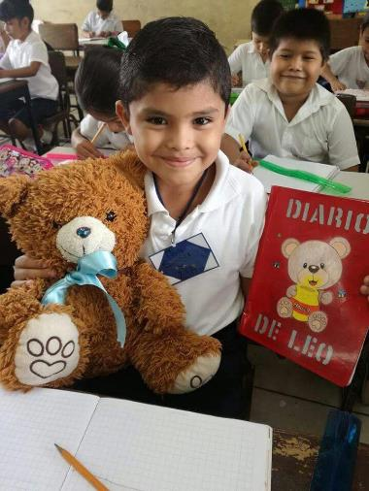
Subvención Humanitaria – Lions Quest
Más de 16 millones de jóvenes han aprendido habilidades de vida positivas a través de Lions Quest
Subvenciones de implementación y de expansión
Hasta US$50,000 para distritos
Hasta US$150,000 para distritos múltiples
Se requiere una participación de 3 a 1 (los Leones deben proporcionar 25% del costo total del proyecto en fondos locales)
Notes:
Lions Quest is a school program that promotes positive life skills through Social an Emotional Learning (SEL).
Lions Quest improves achievement test scores, changes attitudes and beliefs regarding substance abuse and violence, lowers rates of disciplinary problems, lowers risk of dropping out of school and decreases use of alcohol, tobacco and other drugs.
Implementation and expansion grants- 3 to 1 match required.
(transition to SightFirst Grants)

Slide 23
Subvención Humanitaria - Diabetes
Subvenciones de escala grande para prevenir y reducir el impacto de la diabetes como un problema de salud pública
Subvenciones hasta US$100,000 para distritos o hasta US$200,000 para distritos múltiples
Proyectos típicos:
Programas de conciencia
Actividades de detección para poblaciones de alto riesgo
Programas de educación para autogestión
Grupos de apoyo
Capacitación y
equipamiento
Notes:
Multi-year grants allow large-scale Lion efforts that expand and enhance diabetes education, prevention, and treatment.
Diabetes is steadily rising; there were 108 million people with diabetes in 1980. As of 2014, there were 422 million.
(transition to Lions Quest Grants)

Slide 24
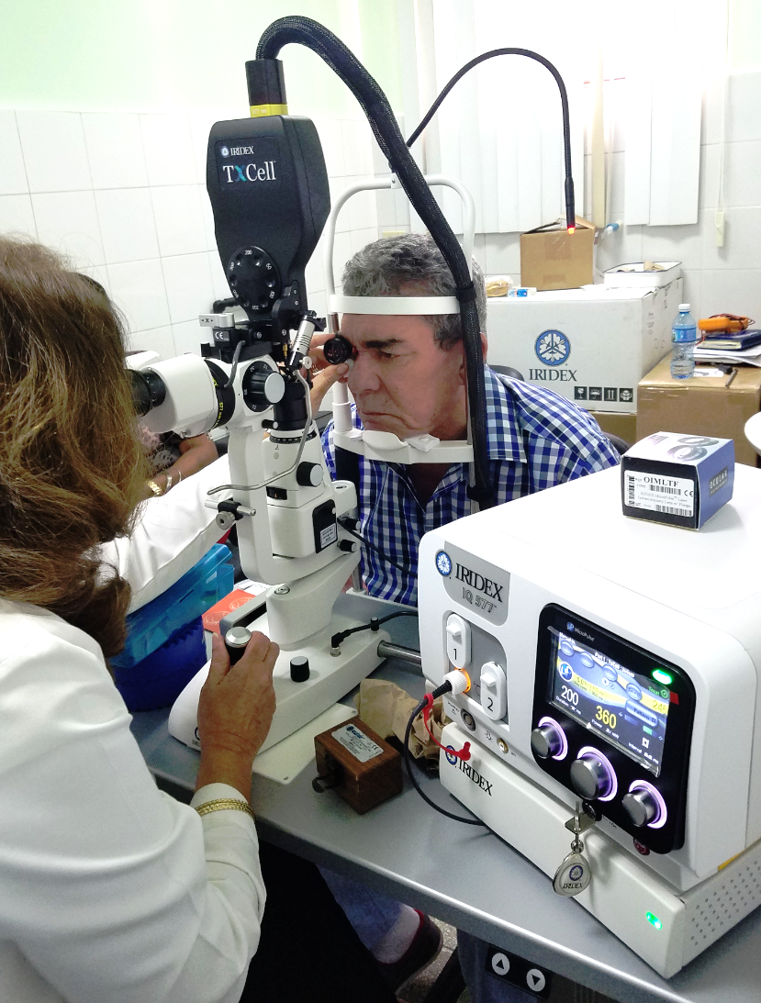
Subvenciones SightFirst
Enfocadas en las causas principales de la ceguera
Alcanzan poblaciones desatendidas
Financian proyectos sostenibles que:
Ofrecen servicios del cuidado de la vista
Desarrollan infraestructura
Capacitan personal o proveen rehabilitación
Sin límite máximo de subvención; no se requiere fondos locales
Notes:
Here is a bit more detail about SightFirst grants and the criteria for these applications. We continue to target underserved populations to deliver comprehensive eye care services.
I would also point out that there are regional technical advisors and SightFirst district chairpersons that are trained to assist your districts in developing SightFirst applications.
(Transition to Quick Quiz)

Slide 25
Encuesta Rápida
¿Cuál fue el primer tipo de subvención otorgada por LCIF?
SightFirst
B. Lions Quest
C. Desastre
D. Humanitario
Notes:
With another show of hands, does any know what type of grant the first ever LCIF grant awarded was?
A?
B?
C?
D?
Answer: C. Disaster. The first grant ever awarded was a disaster grant in 1972; given to the community of Rapid City, South Dakota, USA. Floods took the lives of more than 200 people and left more than 5,000 people homeless. Lions were among the first on the scene to provide help and LCIF donated US$5,000 to help the community rebuild.
(transition to Disaster Grants)

Slide 26
Subvenciones para Desastres Naturales
Subvenciones de Emergencia: Para distritos impactados por un desastre natural; US$10,000 máximo
Subvenciones de Catástrofe Mayor (MCAT): Otorgadas para esfuerzos inmediatos y de largo plazo después de desastres naturales catastróficos; No hay forma de solicitarlo.
Subvenciones de Preparación: Apoyan esfuerzos de preparación antes de un desastre natural; US$10,000 máximo
Subvenciones de Recuperación Comunitaria:
Reparaciones menores de hogares e instituciones; US$20,000 máximo
Notes:
Many of you probably already know our emergency grant program for natural disasters. Emergency grant funds can be used to purchase and distribute immediate relief supplies. Major Catastrophe grants are awarded for long-term rebuilding efforts after catastrophic disasters. Disaster Preparedness grants support natural disaster preparedness. Community Recovery Grants support minor repair of homes & institutions for disaster victims.
Perhaps the most relevant of these is the Emergency grant. Some key points to remember about emergency grants are:
Lions must be involved in the relief efforts; grants are not given so that the funds can be given to another organization
Request should be made as soon as possible by the district governor and within 30 days of the disaster. Sometimes, given the scope, LCIF will even contact you.
-One grant per disaster, per district.
Please submit a final report on how the funds were used.
(Transition to Designated Grants)

Slide 27
Subvenciones Designadas
Fondos restringidos para una causa particular
Ejemplos de fondos designados incluyen:
Asistencia a refugiados en Turquía - 2016
Iniciativa contra el sarampión de los Leones: Una vacuna, Una Vida - en curso
Notes:
Designated Grant money is spent as directed. The grant is only given upon approval from the Board of Trustees and cannot be applied for by Lions.
This photo of a Lion giving a boy water is from our efforts after the earthquake in Haiti.
(transition to Leo Grants)

Slide 28
Subvenciones para Leos
Leos pueden evaluar, planificar e implementar sus propios proyectos de servicio
Las subvenciones para Leos no requieren fondos locales.
Las subvenciones están disponibles para distritos y distritos múltiples
Subvenciones entre US$2,500 para distritos y US$5,000 para distritos múltiples
Notes:
LCIF looks to support Leos by providing grant funding opportunities for global humanitarian efforts by providing funding for service projects in their local communities. By supporting local projects through direct funding, LCI and LCIF look to motivate a global network of young, service-minded volunteers to act as catalysts of positive and sustainable change.
Grants will encourage Leos to participate in more impactful service projects, addressing unmet humanitarian needs in their community.
This grant opportunity exposes Leos to valuable and transferable leadership and life skills.
The criteria have just been finalized, so look for the application and more information on our website soon.
(transition to district sharing)

Slide 29
Programa de Subvenciones Compartidas entre Distritos/Clubes
Sólo para donaciones sin restricciones
Clubes tienen que donar un mínimo de US$5,000 anualmente y Distritos un mínimo de US$10,000 anualmente para participar
El porcentaje de los fondos donados en un año Leonístico será disponible el próximo año Leonístico
Los clubes y distritos deben enviar una solicitud para recibir fondos de intercambio distrital
Criterio aún se está desarrollando
A través de un modelo de intercambio distrital, un porcentaje de las contribuciones a la Fundación Internacional Lions Club (LCIF) puede ser utilizado para subvenciones que financian proyectos locales (a nivel de distrito y/o club) en alineación con las áreas de enfoque de la Fundación.
Notes:
This new district/club sharing program has potential to increase donations from non-supporters.
It will give Lions ownership of grants, create decision-making at a local level, and encourage Lions to plan projects with corresponding fundraising.
(transition to Tips for Grant Applicants)

Slide 30
Consejos para solicitar subvenciones de LCIF
Aliente a los Leones a ponerse en contacto con el personal de LCIF y los coordinadores de LCIF antes de presentar una solicitud
No se puede solicitar fondos para proyectos terminados
Contribuciones de fondos locales de los Leones es un requisito para ciertas subvenciones
El proyecto debe ser de gran escala con objetivos claros
Se requiere un presupuesto de ingresos y gastos
Presentar la solicitud en su totalidad antes de la fecha límite
Notes:
.
.
.
.
.
(transition to Latin American grants)

Slide 31
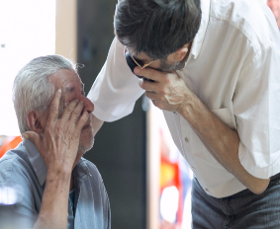
Subvenciones otorgadas a América Latina (CA III)
Año Leonístico 2016-2017
Subvenciones Regulares: 30 para US$1,849,797
Subvenciones de Emergencia: 32 para US$340,000
Subvenciones de Asistencia Internacional: 2 para US$40,000
Subvenciones Core 4 : 4 para US$249,013
Subvenciones SightFirst: 1 para US$314,128
Notes:
-
-
-
-
(transition to ongoing grants)
(In case anyone asks, the total for FY2016-2017 grants awarded to CAIII is: US$2,792,938

Slide 32
Subvenciones MCAT en curso para CAIII
Colombia (Deslave abril del 2017)
Ecuador (Terremoto abril del 2016)
Haiti (Terremoto enero del 2010)
Notes:
We now have a short video to share with you that highlights the great work of LCIF and also encourages District Governors to work with LCIF coordinators to increase awareness of the foundation. After the video, PIP Jim Ervin will speak.
(transition to video)

Slide 33
LCIF: Serving Lions, Serving the World
Notes:
(LCIF DGE video from 2016)
After video is finished, (transition to PIP Jim Ervin)

Slide 34
PIP Jim Ervin LCIF Past Chairperson
Concluding Remarks
Notes:
I know we have covered a lot of information today. I have just a few closing remarks.
(Transition to club LCIF coordinators)

Slide 35
Próximamente: Campaña Capital
Objetivo de US$300 millones
Financiará las competencias básicas y todas las áreas del nuevo marco de servicios
Lanzamiento en Las Vegas
Jóvenes incorporados en cada área de la campaña
Notes:
Kimberly spoke earlier about how grants awarded are exceeding donations received by our Foundation. Then you heard about some new grant opportunities that will be available to Lions and Leos. By now, you might be wondering how we’ll fund new opportunities and continue to support existing ones. The answer is simple: we will embark on a capital campaign, beginning at the 2018 International Convention in Las Vegas.
We recently completed a feasibility study to see if Lions around the world would be interested in such a campaign, and Lions are on board! It is our hope that you’ll spend this next year learning all you can about our Foundation, sharing our stories with fellow Lions, and really feeling connected to LCIF. We are here for you and because of you; we want to work with you to expand the impact of your service.
(transition to Enriching Lives)

Slide 36
Enriqueciendo Vidas
Somos compasivos y atentos - ¡enriquecemos vidas en comunidades de todo el mundo!
Notes:
Thank you very much for your time today, and thank you for your support.
(transition to Q&A slide)

Slide 37
Sesión de Preguntas y Respuestas
Notes:
Q & A
After Q & A, (transition to Thank You slide)

Slide 38
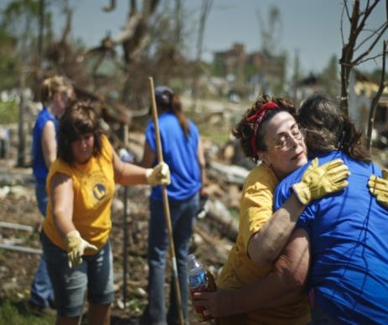
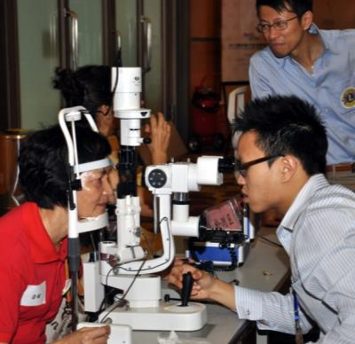
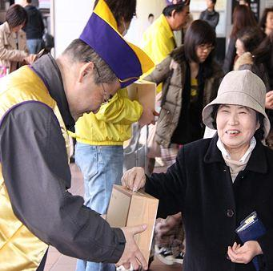
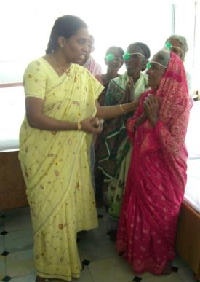
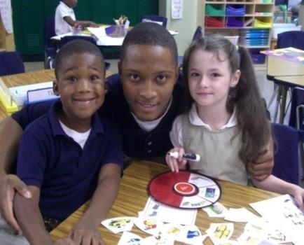
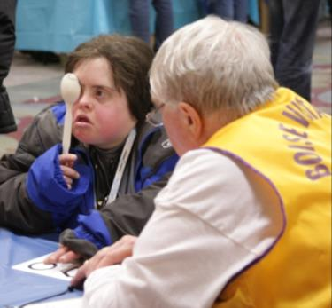
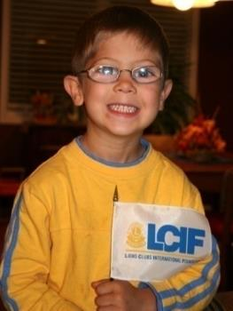
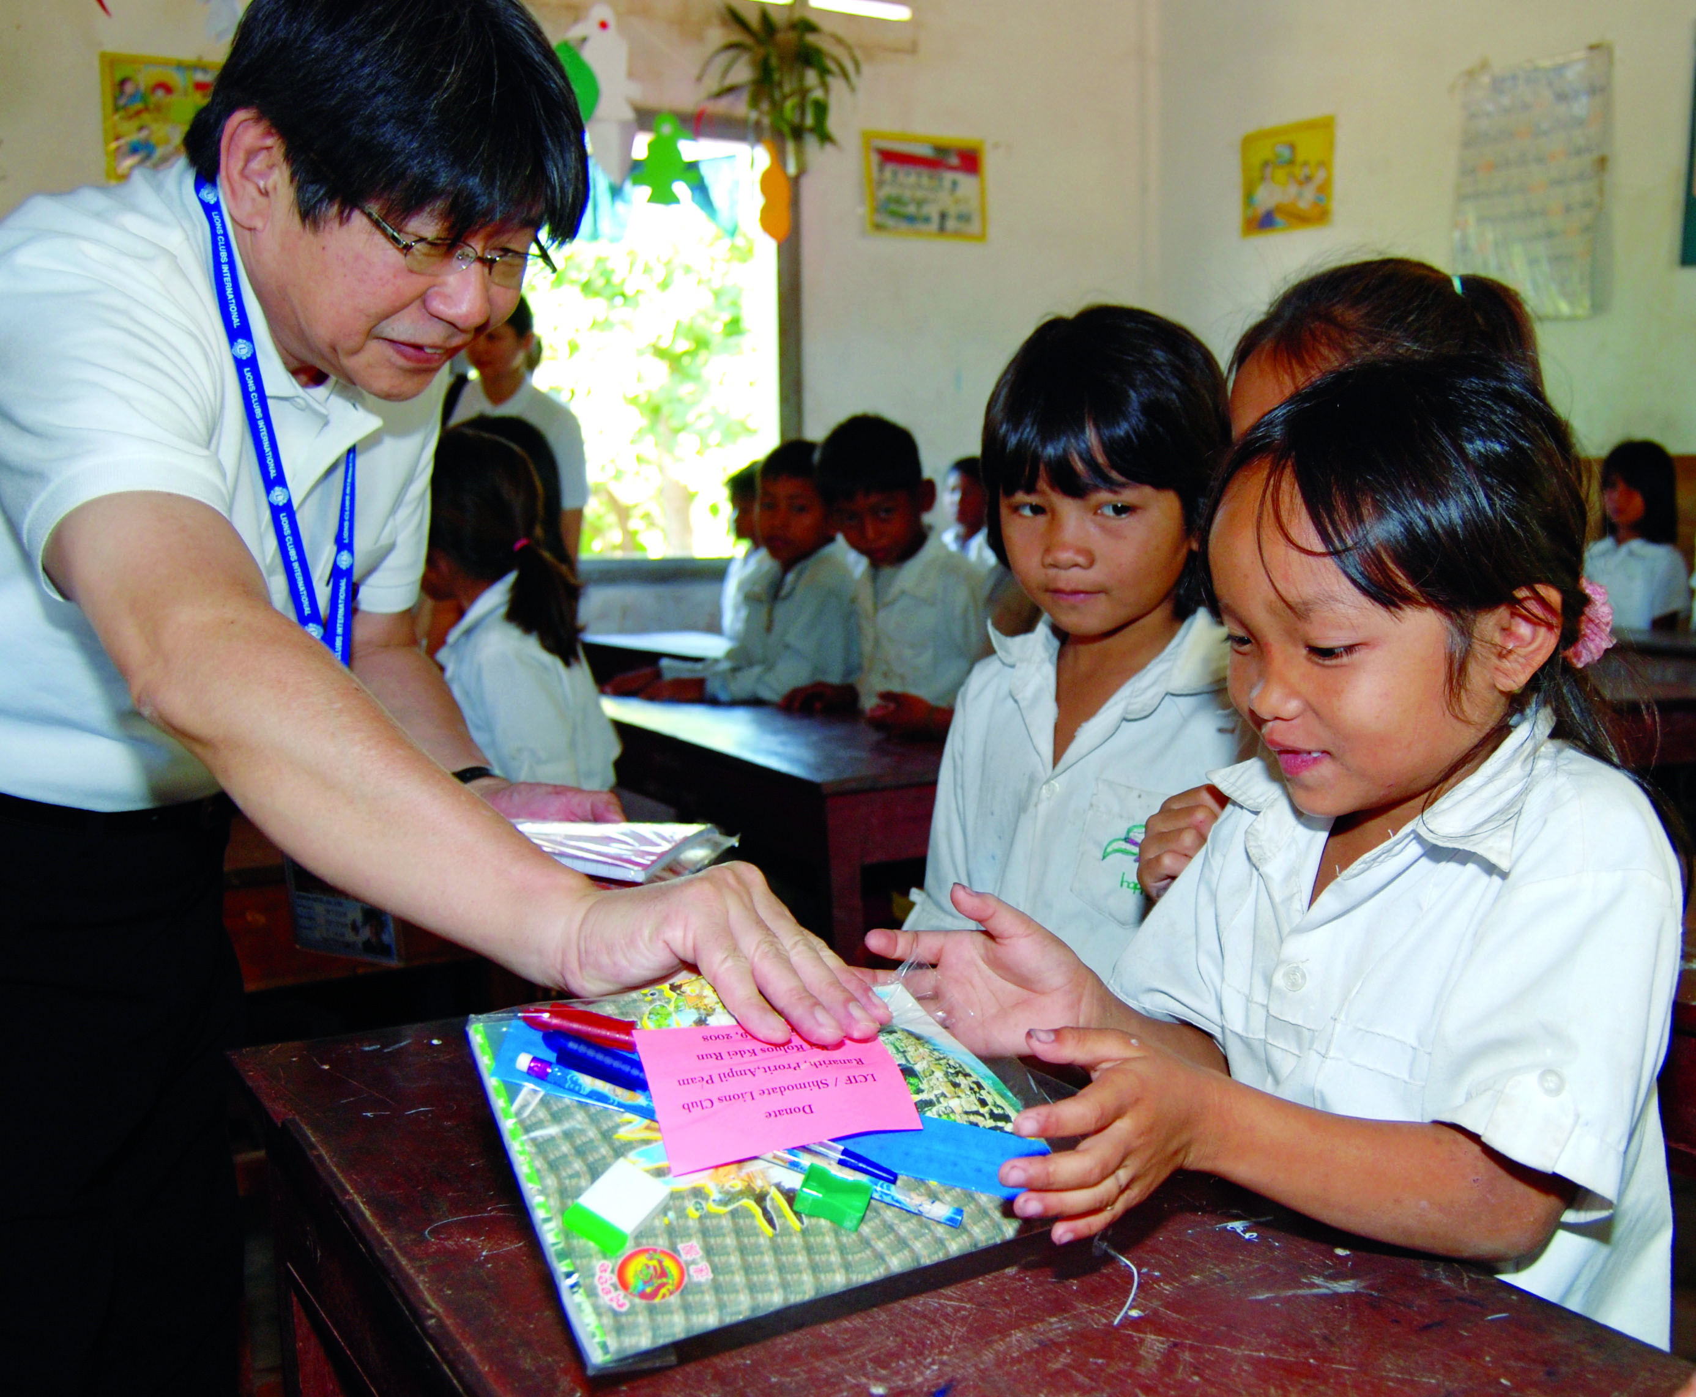
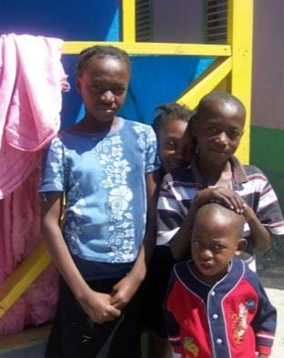
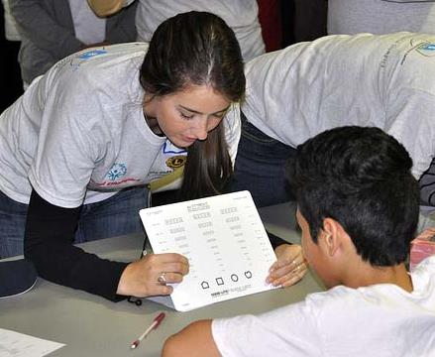
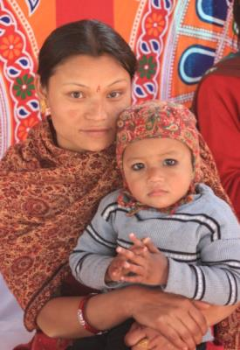
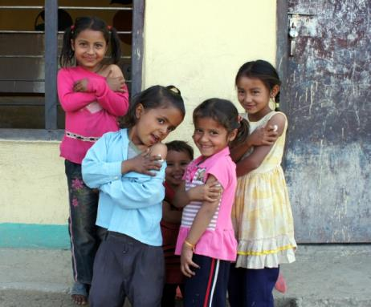
¡GRACIAS POR SU APOYO!
Notes:
Thank you!

