Slide 1
Starting a Leo Club
1

Slide 2
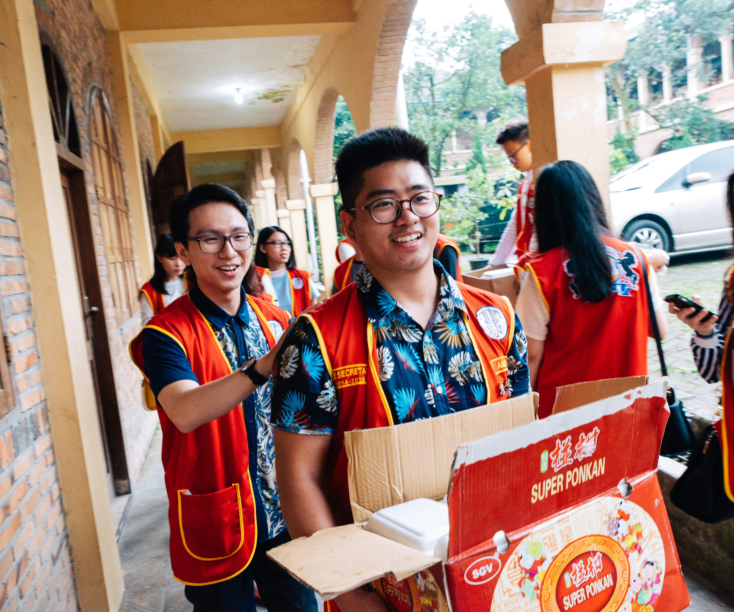
Leo Club Program Objective
To provide the youth of the world an opportunity for development and contribution, individually and collectively, as responsible members of their local, national and international community.
Notes:
Established in the year 1957, the Leo Club Program provides young people with opportunities for personal development, leadership training and community service. The program aims to encourage young individuals between the ages of 12 and 30 to become actively involved in community service projects and make a positive impact in their local communities.

Slide 3
Who are Leos?
3
Notes:
Leo clubs are home to Lions Clubs International’s youngest members whose insights and actions are invaluable to further the mission of Lions International.

Slide 4
Who are Leos?
Leo stands for
Leadership
Experience
Opportunity
Lions and Leos
Leo clubs are sponsored by local Lions clubs through Lions International. The sponsoring Lions club can help with the organization, supervision and guidance of the Leo club. Leos help Lions clubs with creative ideas and act as a partner in service.
Notes:
Leos are youth between the ages of 12 and 30. Leo clubs are sponsored by local Lions clubs through Lions Clubs International — the world’s largest community service organization with 1.4 million members across the globe. The Leo Club Program has been going strong for over 65 years and there are now more than 7,800 Leo clubs around the world.

Slide 5
Who are Leos?
Alpha Leo clubs
Ages 12-18
Focus on the individual and social development of teens
Omega Leo clubs
Ages 18-30
Focus on the personal and professional development of young adults
Club Types
School Based
Community Based
Notes:
Leos are young people who want to give back to their communities and serve others.

Slide 6
History of the Leo Club Program
Youth Ad Hoc Committee on Youth Engagement is started to determine strategies for engaging young members
Lions Clubs International adopts the Leo Club Program as an official program
Leo or
Leo-Lion Rep to the UN is started
1957
2008
2022
On December 5, 1957 the first Leo club is formed in Pennsylvania, USA
1967
Alpha and Omega Leo tracks are decided and Leo logo is updated. Leo Club Advisory Panel is approved. First panelists start during the 2009-2010 Lion year.
Leo or Leo-Lion Cabinet and Council Liaison positions are started
2014
2016
2023

Slide 7
What does it mean to be a Leo?
7
Notes:
Why would a youth between the ages of 12 and 30 want to join the Leo club program?

Slide 8
There are a lot of ways people can give back to their community – Why Leos?
Serve the community locally and globally
Grow as an individual and a leader
Develop crucial life skills & leadership skills
Build lifelong connections with like-minded individuals
Network opportunities
8
Notes:
There are a lot of ways people can give back to their community — but being a Leo is much more than just service
Choosing to start a Leo club will help you grow as an individual and as a leader
Find your purpose
Starting a Leo club can bring Leos (and you!) a world of opportunity — from developing crucial life skills and making change in your community, to building lifelong connections with like-minded individuals.
Leadership skills – leadership trainings, officer positions, planning events/projects
Quote: During my time as a Leo we’ve taken our ideas and turned them into reality. People respect that.
Leos were surprised at how enjoyable the act of service could be. One Leo member stated, “This was service? I would have helped even it wasn’t this fun.” - Cutler Orosi Leo Club
Networking and Team-building
Service

Slide 9
Why start a Leo club?
9
Notes:
Why should your Lions club start a Leo club? What do Lions get out of starting a Leo club?

Slide 10
Why should your Lions club start a Leo club?
Grow the Lions global family
Mentor and empower young leaders
Foster a commitment to service
Attract younger members and their families
Energize and inspire Lions members
Gain partners in service
Develop future Lions
10
Notes:
When a Leo club is started, Leos and Leo Advisors join a global family of young people making the world a better place
Sponsoring a Leo club gives Lions the opportunity to mentor and empower young leaders and foster a commitment of community service — while energizing your members to stay involved!
Today’s leaders build tomorrow’s world
Organizing Leo clubs offers Lions a chance to engage with young people in their community. Leos share your passion and are invested in Lions clubs’ work. Recognizing Leos as prospective members is an effective way to ensure the future of Lions in your community.
Leo Club of KIU [Drops of Hope]: Valuable guidance of the Lions paved the way to identify what Leos can do to the society and how to improve leadership practices.
Networking
Leadership skills – leading young people
Investing in young people
Learning from young people
Attract younger members – their family members
Reach further into your community

Slide 11
How do I start a Leo club?
11

Slide 12
Ready to start a Leo club? Take these steps!
Agree to sponsor a Leo club
Determine Leo Advisor
Decide type of club and potential members
Invite prospective members to an informational meeting or service activity
Host a formation meeting
Complete required paperwork
Pay organization fee of $100US to Lions International
Plan an installation ceremony
12
Notes:
Leo clubs are sponsored by a Lions club, so the Lions club first needs to decide they want to start a Leo club.
Determine Leo Advisor – someone who wants to work with young people and help them to grow as leaders; need to attend all meetings and support the group
Establish a framework – Alpha or Omega, school or community-based
Identify potential Leos - Obtain the names of potential Leos from schools, universities, colleges, houses of worship, youth groups, friends and relatives.
Invite prospective members to an informational meeting
Host a formation meeting - Organize a Leo club formation meeting to elect Leo club officers, discuss potential projects, accept The Leo Club Constitution and Bylaws and determine the place and time for club meetings.
Complete required paperwork- Organizational kits can be ordered from LCI to support the formation of a new club. You can also find membership applications, and organizational forms on the website.
Plan an installation ceremony
Financial obligation

Slide 13
Ready to start a Leo club?
Use these resources!
Start a Leo Club webpage
Leo Advisor webpage
Leo Club Installation and New Member Initiation Guide
Leo Club officer webpage
Leo Recruitment brochure & posters
Leo Learning Path on the Lions Learning Center
13

Slide 14
14
Notes:
This video is from real Leos from around the world sharing about their experiences as a Leo

Slide 15
Questions
© 2020 Lions Clubs International
15

