Slide 1
Achieving Club Excellence
Chris Bunch – LION Managing Editor
Sanjeev Ahuja – Chief of Marketing & Membership
Dan Hervey – Brand & Creative Director
Stephanie Morales – Meetings Manager
Notes:
Winster
Welcome to the Achieving Club Excellence Seminar. We are excited to have you join us today!
This webinar is being recorded and will be available on the LCI Website and also on Social Media. We will have time at the end of the session for questions. You may also drop your inquiries into the questions box and staff from the District & Club Administration Division will be monitoring.

Slide 2
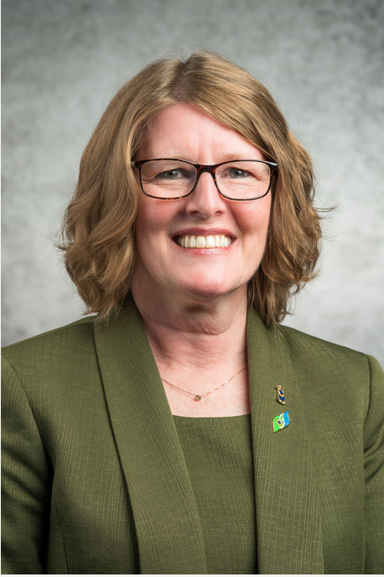
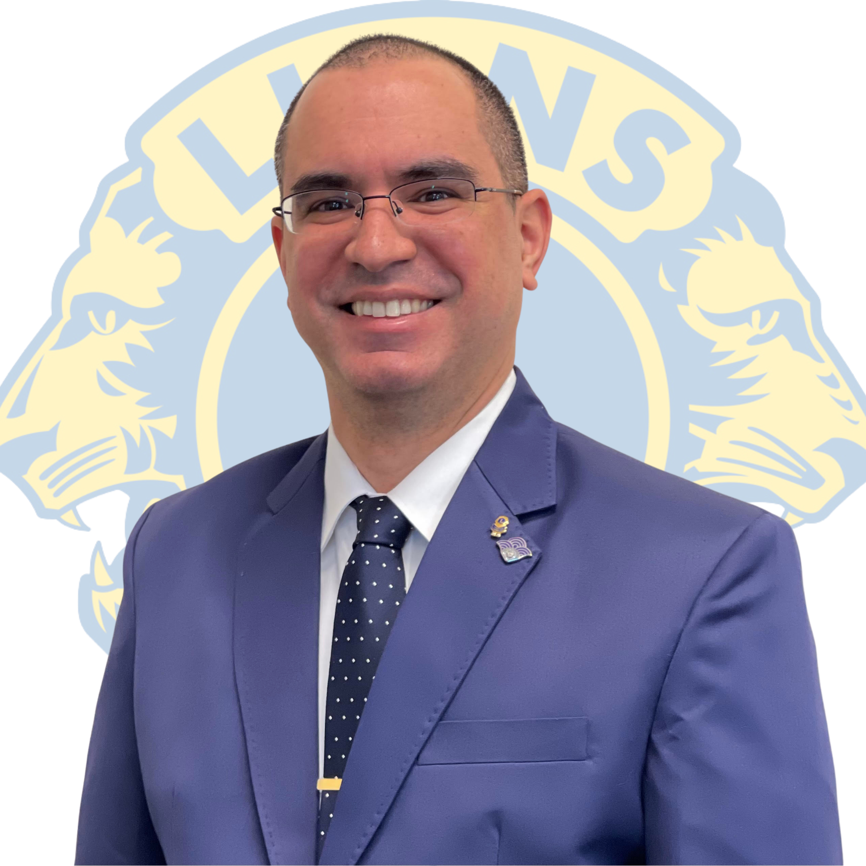
Our Presenters
Chris Bunch – LION Managing Editor
Sanjeev Ahuja – Chief of Marketing & Membership
Dan Hervey – Brand & Creative Director
Stephanie Morales – Meetings Manager
Winster Ceballos, PCC and GAT Area Leader
New Jersey, USA
Jennifer Ware, PID
Michigan, USA
Notes:
I am PCC Winster Ceballos of New Jersey, USA and with me today is Past International Director Jennifer Ware of SD 10 Michigan

Slide 3

Coming together is a beginning. Keeping together is progress. Working together is success.
- Henry Ford
3
Notes:
Slide 5 to turn over to PID Ware

Slide 4
Global Membership Approach for Clubs
1
Build a Team of Club Leaders
2
Build a Vision, Assess Needs and Set Goals
3
Build a Plan to Achieve our Goals
4
Build Success
4
Notes:
PID Ware –
The Global Membership Approach for Clubs is a 4 step process:
Build a Team of Club Leaders
Build a Vision, Assess Needs and Set Goals
Build a Plan to Achieve our Goals
Build Success

Slide 5
Build a Team of Club Leaders
Current Leaders: Identify who can carry out and lead the development of the strategy.
Future Leaders: Include Lions who can serve as future leaders. Lions who have held leadership positions, who can provide insight, support and are interested in the future of the club.
Poll the Members: To gain a full perspective of your club’s needs. Look for a cross section of members who represent the club or in smaller clubs involve as many members as possible (established members, new members, young Lions, professionals) to both understand their needs and engage their talent.
5

Slide 6
Build a Vision, Assess Needs and Set Goals
Grow membership within the club
Revitalize your club with new service opportunities
Rejuvenate your club with new members
Excel in leadership development and club operations
Share your club’s achievements with your community
2
3
1
4
6
Notes:
Build a Vision, Assess Needs and Set Goals in the arears of
Rejuvenate Your Club with new members
Revitalize your club with new service opportunities
Excel in leadership development and club operations
Share your club’s achievements with your community

Slide 7

Focus Area 1
Rejuvenate Club with New Members
Discussion Questions
What opportunities exist to expand membership?
What do we need to do to better recruit members?
Why are members not joining our club?
Why do people join our club?
7

Slide 8
Focus Area 2
Revitalize Clubs with New Service Opportunities
Discussion Questions
Are the club’s service projects relevant to current community needs?
Are members enthusiastic and actively involved in service projects?
Is club leadership receptive to members’ ideas for new service ideas?
Do our service projects attract new members?
8

Slide 9
Focus Area 3
Excel in Leadership Development and Club Operations
Discussion Questions
Do club officers participate in training for their positions?
Are members encouraged to take leadership positions?
Do members regularly attend and participate in club functions?
Do you need to reconsider the format of club meetings?
9

Slide 10
Focus Area 4
Share your Club’s Achievements with your Community
Discussion Questions
Is the club active on social media (Facebook, Instagram, Twitter)?
Does your club have an e-Clubhouse or website?
How are you keeping the public informed of your events?
Do we include welcoming messaging that encourages people to join?
10

Slide 11
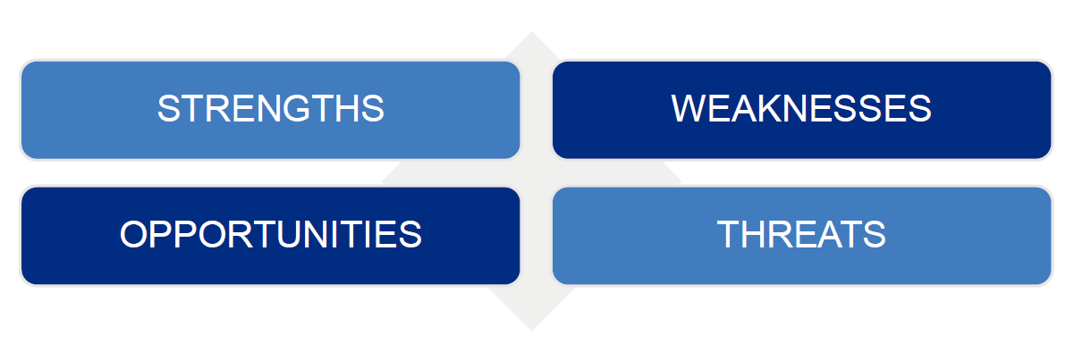
SWOT Analysis
Leverage our Strengths
Manage our Weaknesses
Take advantage of Opportunities
Minimize impact of Threats
11
Notes:
Use the SWOT Analysis to identify needs and strategize goals.
Leverage our Strengths
Manage our Weaknesses
Take advantage of Opportunities
Minimize impact of Threats
TURN OVER TO PCC WINSTER

Slide 12

RESOURCES TO SUPPORT FOCUS AREAS
12
Notes:
PID WINSTER

Slide 13

Plan for Your Club’s Success Webpage
Notes:
Coming Soon a new webpage dedicated to Plan for Your Club’s Success offering resources, tools and more to help your club move in a dynamic new direction using the Global Membership Approach.
An announcement will be made when it is available. Be on the look out!

Slide 14




Resources
14
Notes:
Club & Community Needs Assessment – Intended to provide recommendations and help your club reflect on their service and discover new ways to impact your community.
Your Club Your Way – This guide provides the steps for a walk-through process to help your club customize and hold club meetings that are well planned, implemented and fun; increasing fellowship and membership satisfaction.
Club Quality Initiative – This resource assists a club to explore how it can continually improve and is simple enough to use as an annual planning tool. It encourages participation from all members.
Club Membership Chairperson Guide – Designed to help you support members both current and new and ensure that they have a meaningful, impactful and rewarding experience as part of the club.

Slide 15
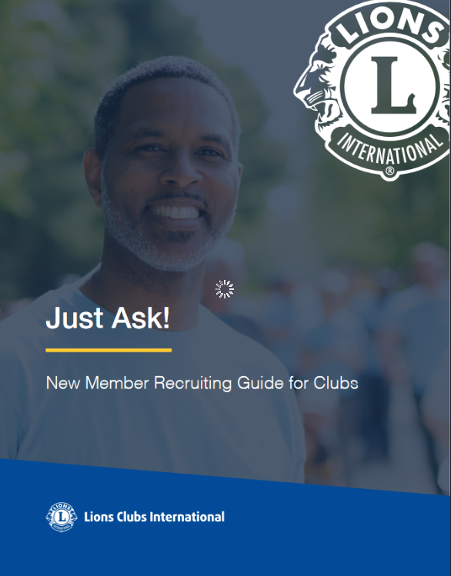
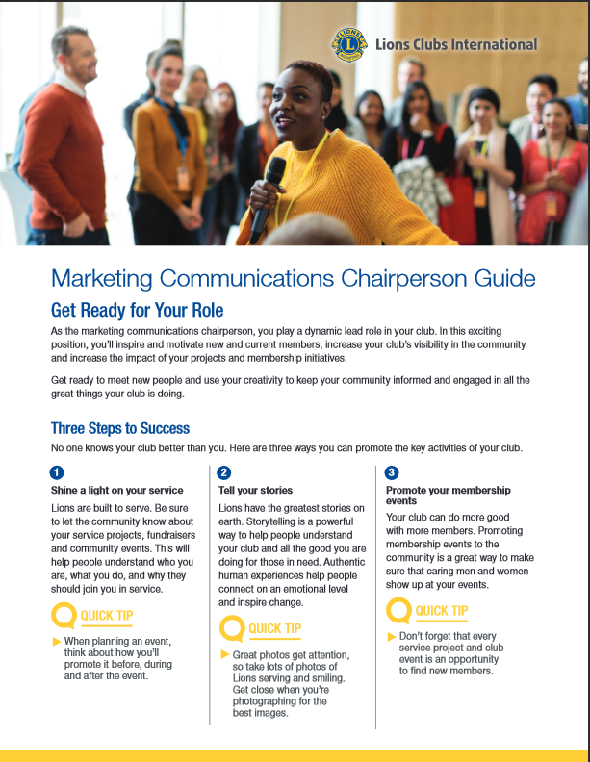

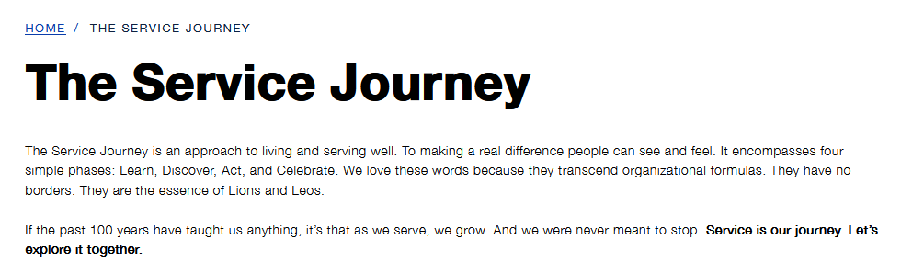
Resources
15
Notes:
Membership Satisfaction Guide - Outlines a three-step process to help improve satisfaction among your club members and provides some tips for common barriers to member satisfaction.
Just Ask! New Member Recruiting Guide: Designed to guide your club through the process of recruiting new members and effectively manage club growth.
The Service Journey: It encompasses four simple phrases: Learn,
Marketing Chairperson Guide: Includes tips for working with various media channels, ideas of how to make your message newsworthy and access to resources offered by Lions International that can be used by local clubs. Club Health Assessment: helps track membership growth,
The Service Journey: It encompasses four simple phrases: Learn, Discover, Act and Celebrate.

Slide 16

Resources
16
Notes:
New Resource - The Troubleshooting Guide for clubs identifies common club issues and provides resources with potential solutions.
TURN OVER TO PID WARE

Slide 17
ESTABLISH GOALS
17
Notes:
PID WARE
Lets talk about how to establish goals

Slide 18
S
M
A
R
T
S
M
A
R
T
pecific
easurable
ctionable
ealistic
ime Bound
Ensure that the objective is clear.
Benchmarks and progress must be measurable.
Each goal must be achievable.
Timeframe that outlines a schedule of progress.
Challenging but not unrealistic.

Slide 19
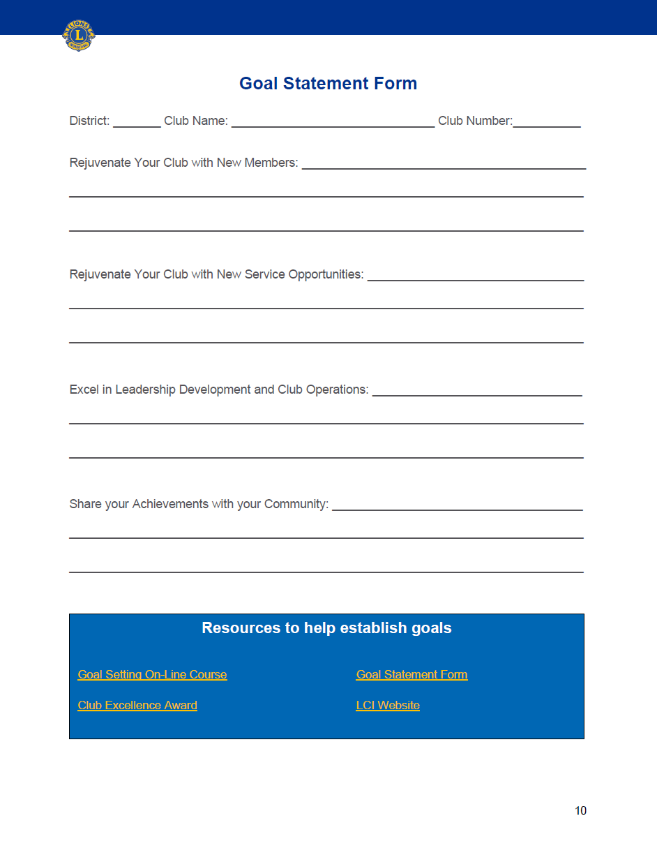

aa
Goal
Statement Form
19
Notes:
Encourage your club to use this form and help set goals for the club

Slide 20
BUILD A PLAN TO ACHIEVE OUR GOALS
20

Slide 21
Build A Plan to Achieve Our Goals
For Each Area
What? (Goal Statement)
How? (Action Steps)
When? (Deadline for Completion)
Who? (Person (s) Responsible for Action)
How Will You Know? (How Will You Know It’s Accomplished)
DEVELOP YOUR ACTION PLAN by outlining the steps you will take to achieve your goals.
This step outlines how the goal will be achieved (action steps), when each step will be completed, who will be responsible for the step, and how you can determine each step has been completed. The Action Plan Worksheet is a tool you can use as you develop a plan to achieve each goal. Together, the plans for each goal comprise your Vision.
21

Slide 22
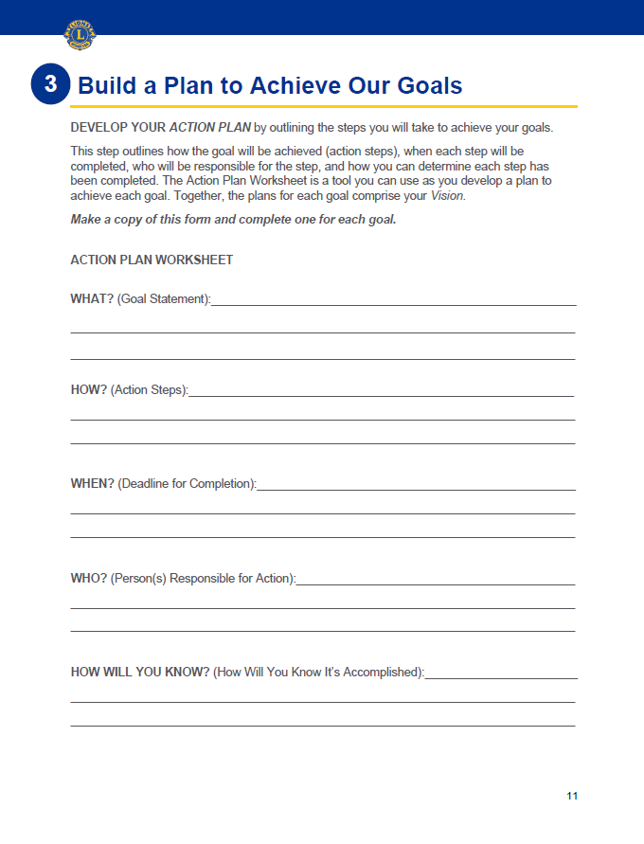
aa
Action Plan Worksheet
Make a copy of this form and complete one for each goal
22

Slide 23
BUILD SUCCESS
23

Slide 24
Build Success
To be Successful:
SHARE
SUPPORT
RECOGNIZE
EVALUATE
CHANGE
Share
Support
Recognize
Evaluate
Change
24
Notes:
Share: your club’s Vision with all club members so that they are aware of what the club wants to achieve, along with their role in achieving club goals. It is very important to the health and vibrancy of any club that its members feel connected to the club’s success.
Support: the members committed to the plan by ensuring they have the resources they need to succeed. Leaders should check in with members to make sure they feel supported and receive the guidance they need.
Recognize: milestones so members feel valued and know they are moving in the right direction. Every journey was started with a single step. Reassure members frequently to keep them motivated and engaged. Don’t keep your success a secret! Share the success with your community to get like-minded (and prospective members) involved!
Evaluate: the plan. It is also critical to evaluate your plan on a regular basis. As circumstances change, your plan may require revision. The creation of the initial Vision is just the beginning. Keep it alive and relevant by measuring progress and gathering feedback from club members on a routine basis. This is how you will realize your desired results.
Change: the Plan. Don’t be afraid to change the plan as opportunities change to keep the plan relevant. Regularly revisit the plan, assess needs and refine action steps. Keep plan members involved in decisions so they stay involved and committed.
TURN OVER TO PCC WINSTER

Slide 25

REMEMBER TO
CELEBRATE
25
Notes:
PCC WINSTER

Slide 26
Remember to Celebrate
The LCI Store is an easy way to order certificates, plaques and more to celebrate. If you have further questions regarding club supplies, please email orderdetails@lionsclubs.org.
How will you celebrate?
26

Slide 27
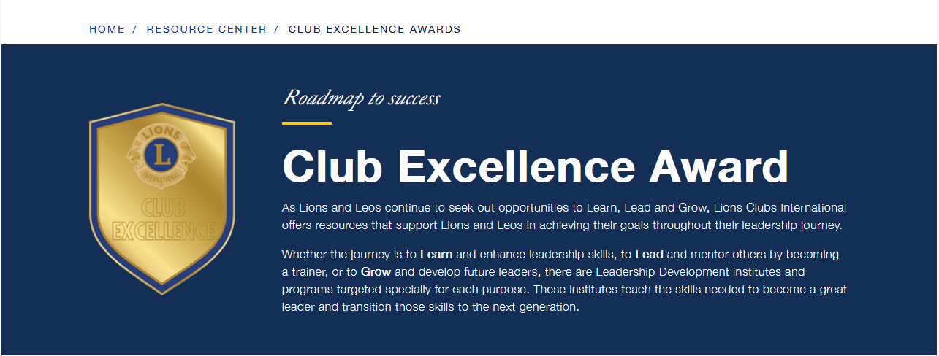
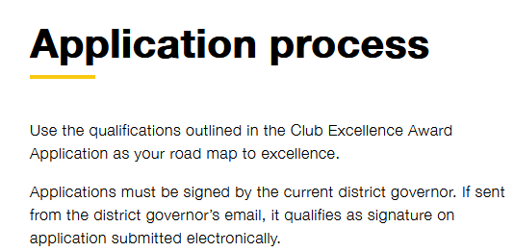
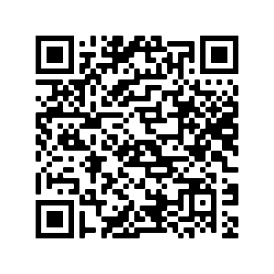

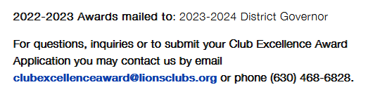

Club Excellence Award
27
Notes:
This is your landing page for the club Excellence Award. The application and helpful resources are available to you here. The webpage is broken into sections that align with the award application.

Slide 28
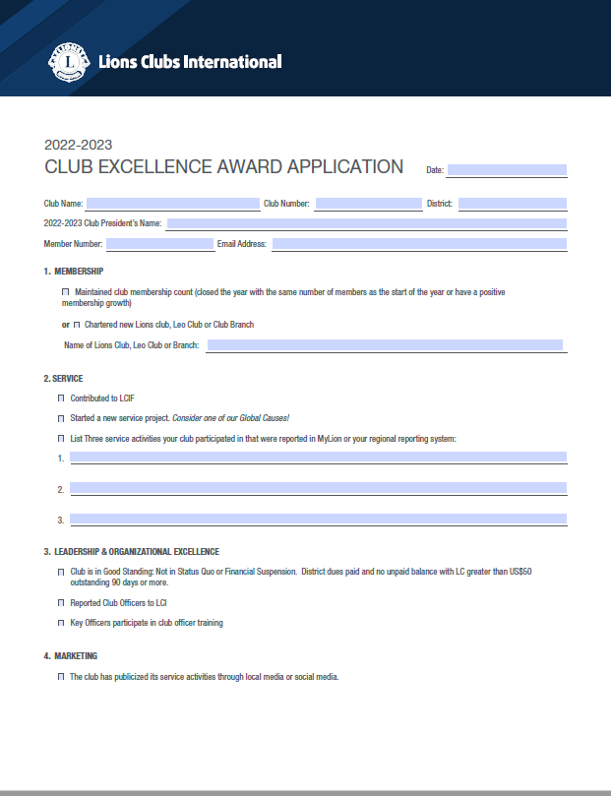
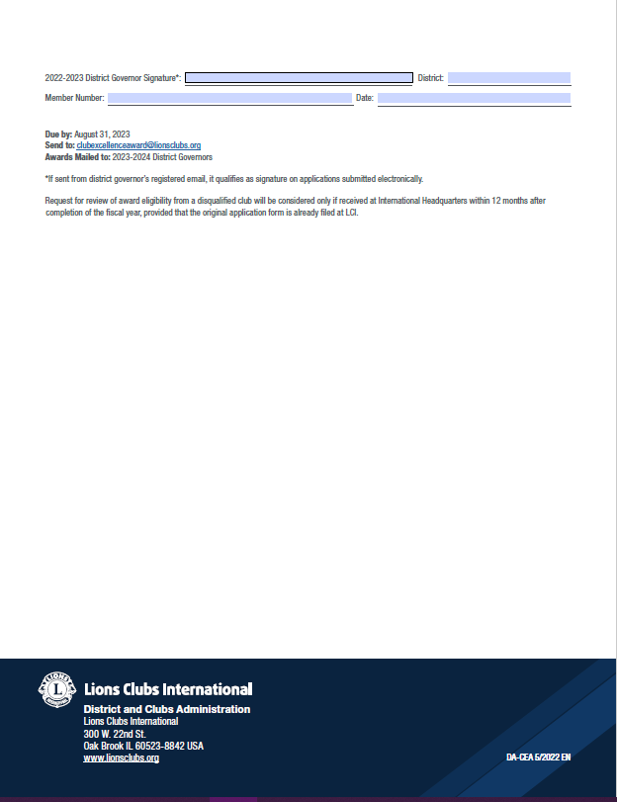

Club Excellence Award
28
Notes:
The Roadmap to Reaching Club Excellence. This application should be reviewed at the start of each Fiscal Year. The criteria focuses on 4 areas.:
Clubs should review the application at the beginning of the year and use it as their Roadmap to Reaching Club Excellence.
Membership: maintained club membership count (closed the year with the same number of members as the start of the year OR have a positive membership growth
2. Service: Contributed to LCIF, Started a New Service Project and List three service activities your club participated in that were reported in MyLION or your regional reporting system
Leadership & Organizational Excellence: Clubs to be in good standing, Reported club officers to LCI, Key officers participated in club officer training
4. Marketing: Publicized its service activities through local media/social media
Clubs that are chartered prior to January 1, qualify.

Slide 29
LCI Contact Information
Phone: (630) 468-7084
Email: clubofficers@lionsclubs.org
Websites:
Plan for Your Club’s Success
COMING SOON
Improving Club Quality
https://www.lionsclubs.org/en/resources-for-members/resource-center/improving-club-quality
Facebook Group: Improving Lions Club Quality https://www.facebook.com/groups/317754885360703/
29
Notes:
Staff in the District and Club Administration Division is here to support you. On this slide is their contact information.

Slide 30
Questions ???
30
Notes:
At this time, we’d like to open it up for any questions you might have.
PID WARE & PCC WINSTER COME BACK TO ANSWER QUESTIONS

Slide 31
THANK YOU!
31
Notes:
PID WARE & PCC WINSTER
Provide closing remarks

