Slide 1

Family membership
Helping to promote multi-generational Lions clubs to serve their communities, meet humanitarian needs, encourage peace and promote international understanding.
1

Slide 2
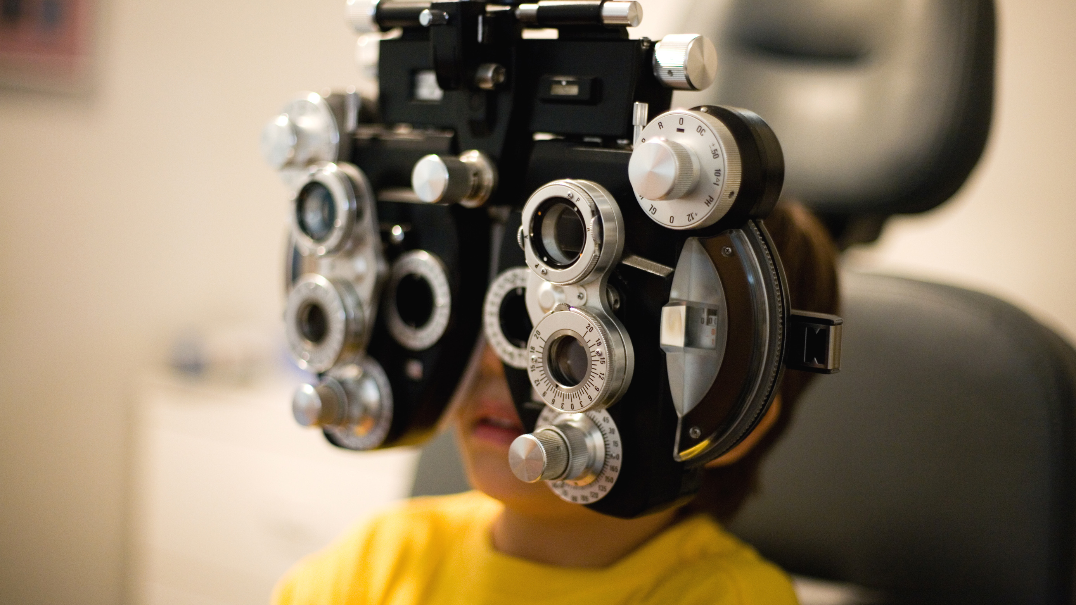


Basics of family membership
2

Slide 3

aa
Basics of family membership
Why involve family members in service?
Increase quality family time
Be a role model
Help your community
3

Slide 4

Who qualifies for the Family Membership Program?
The Family Membership Program applies to family members who are:
Eligible for Lions membership
Currently in or joining the same Lions club
Living in the same household and related by birth, marriage or other legal relationship
4
Notes:
Do we need to say joining the same club or a sponsoring club? For example, what happens if the Father is in the Lions club and the daughter wants to join the Leo Club, that is sponsored by the same club?

Slide 5

Family membership is a program that gives the opportunity for Lions to make it easier for other family members serve their community.
The program makes it easier by giving family members a dues discount.
The dues discount is determined by the district.
What is family membership?
5
Notes:
Kyle question- do we want to give an example of the dues or leave in open ended?

Slide 6

Getting started
6

Slide 7
Where to begin?
Even with its many benefits, the family concept is not right for every club. In order to successfully implement the family-friendly club concept, you need the acceptance and enthusiasm of your entire membership. Before proceeding, make sure you thoroughly understand and are prepared to make the changes necessary to include families within your Lions club.
Introduce the idea to your club. Explain the family concept and how it would impact your club.
If your club membership is in favor of exploring the idea further, form a committee to understand all the important issues that will impact your club. Set a deadline for the committee to present its findings.
If the club membership is in favor of proceeding, list goals and create an action plan to implement the necessary changes within your club.
After the changes have been made and your club has comfortably adjusted to its new schedule, plan and implement activities to promote the family friendly club.
7

Slide 8
aa
Getting started
Ideas for club meetings
Club meetings: Club meetings would need to be altered so that they offer a hospitable environment for families while still being productive.
  Club meetings will need to take place at a time that is convenient for families to be involved. The club may also adopt a virtual platform, so that members can log into the meeting from home.
  The meeting location will need to be appropriate for children. Consider including activities for children led by Leos in your club.
  Traditional sit-down dinner meetings would not necessarily be conducive to meetings with younger children. Consider something more casual, such as a buffet or pot-luck type of meal.
  Meetings should be shorter to accommodate families’ busy schedules.
8

Slide 9
aa
Getting started
Service projects for families
Service activities: Club service activities would need to be family-friendly. The following elements are generally NOT conducive to family-centered service activities:
  Those that require involvement of the entire family all the time.
  Mixing families with young children with community agencies with small children (supervision becomes an issue).
  Fixed, recurrent assignments.
  Single-function tasks that cannot be broken down.
  Projects that take place over several hours may not be appropriate for families with young children.
  Projects that have a great deal of physical movement may not be suitable for older Lions or family members.
9

Slide 10
aa
Getting started
Possible ideas for service projects
Lions Clubs International youth programs
Other community children’s activities – scouting, sports, schools, etc.
Helping senior citizens
Working with the homeless
Literacy projects
Environmental projects
School sporting events
Teen babysitting clinics
10

Slide 11
Where can you recruit families?
Speak with teachers and students
Reach out to coaches and sports teammates
Talk with religious and community leaders
Direct family members
Speak with your neighbors
Partner with other community organizations and clubs
11

Slide 12
Current Lions programs to help with engaging families
12

Slide 13
Current Lions programs to help with engaging families
Cub program
Leo clubs
A sponsored activity of a Lions club, Leo clubs invite young adults ages 12–18 and 18–30 to create their own Leo clubs and develop life skills through service and Lions values.
Campus clubs
Campus Lions clubs can make an impact on both the local campus community and communities around the world while connecting students, faculty members and business leaders.
.
A special program for children, ages 12 and younger, and relatives of Lions members to serve along side the Lions club
Specialty clubs
The Specialty Club program was designed to create clubs in which members share a common interest or passion, allowing them to connect with one another on a deeper level.
Virtual clubs
Many families in today's world are very busy and are not able to attend meetings in person. Consider adopting a hybrid model for your club, allowing members to join meetings online.
13
Notes:
The Cub Program is the way for Lions clubs to engage youth in the community in service in the community. More on this program in the upcoming slides.
“Leadership, Experience, Opportunity.” That’s what makes a Leo. As the youngest members of Lions Clubs International, Leos embody the best qualities of our incredible organization. More information to come on Leo’s in future slides.
Campus Clubs are a great way to engage families that a part of the campus. By engaging a local campus, it will also open your club to the students and staff in your community.
Your Club specialty can be around family or children engagement.
Virtual Clubs give the option for people to log into meetings that may be to busy to attend traditional meetings.

Slide 14
Helps encourage families to volunteer together by incorporating Cub members into your Lions club's meetings, activities and service projects
Designed for children ages 12 and under
Members may order Cub patches for each of the three levels from Lions Clubs International
Cub
program
14

Slide 15
Lions clubs can sponsor a Leo club to mentor and empower young leaders and foster a commitment to service
Alpha Leos: 12–18 years old
Omega Leos: 18–30 years old
LEO stands for:
  Leadership
  Experience
  Opportunity
Leo
clubs
15

Slide 16
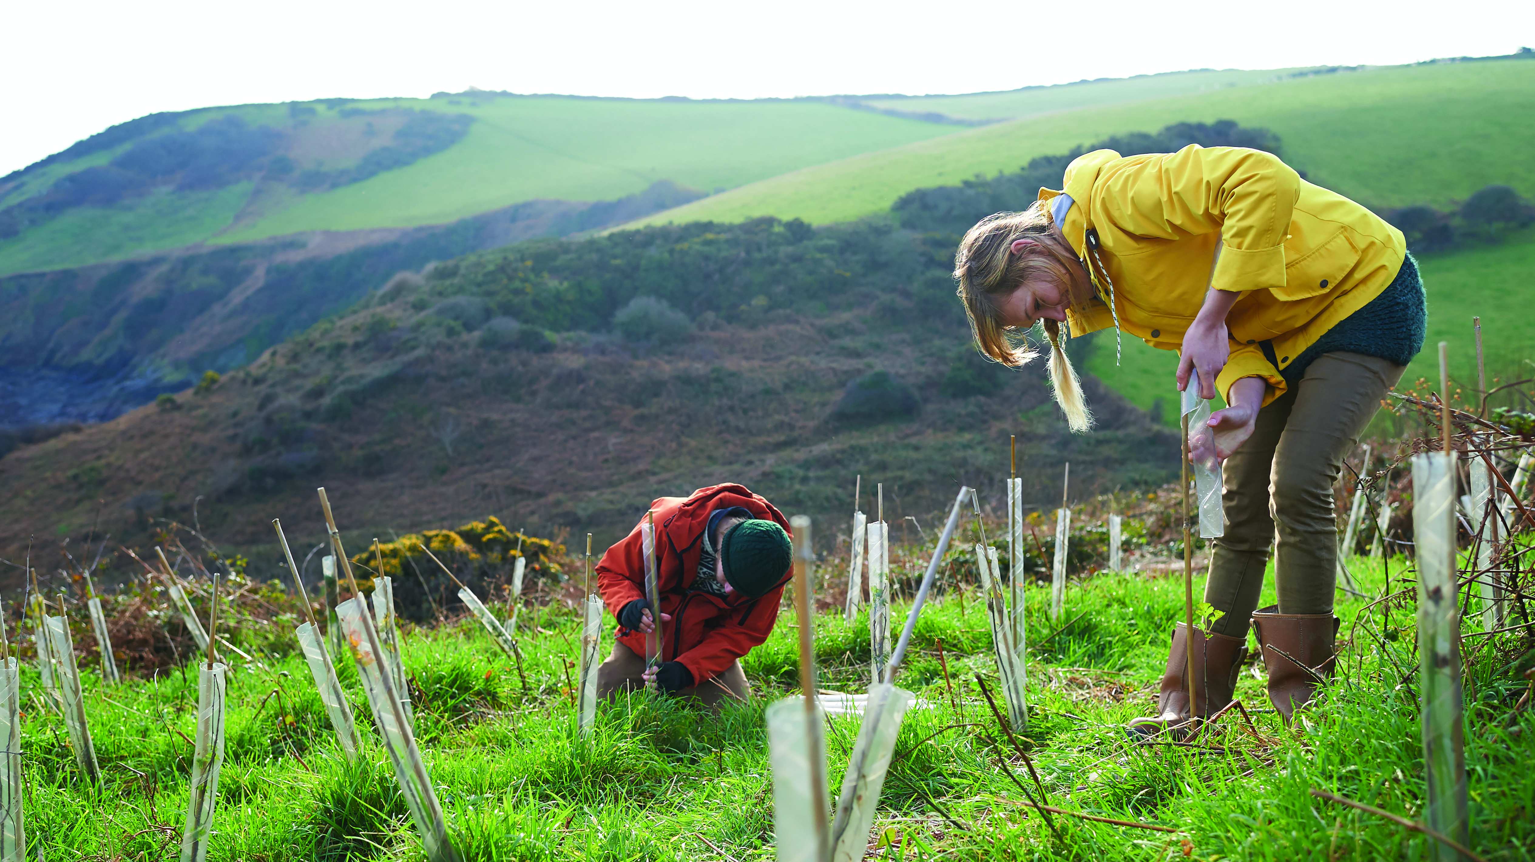
Reporting family membership
16

Slide 17

Reporting family membership
Reporting family membership
To be part of the Family Membership program, your club secretary must complete the Family Unit Certification form or file online.
17

Slide 18
Thank you
© 2019 Lions Clubs International
XXXX 00/00 EN
18

