Slide 1


Virtual Engagement Web Series
Ohio County Virtual Lions Club
Serving Locally, Thinking Globally
Episode 1 - “The Decision (To Change)”
Notes:
Richard: (Intro how you see fit – explaining what cyber clubs are briefly, etc)….every Cyber Lions club has a rather recent origin story, and we are going to find out more about a club that is getting ready to celebrate their first anniversary, the Ohio County Virtual Lions Club. I’m joined by their 1st VP, Lion Matt Rafa, to talk about “The Decision” to start a cyber club.
Matt, take me through the events leading up to “The Decision” to start a Cyber club.
Thank you, Richard, for that introduction, and thank you Lions for giving your time today to have a conversation about Change and Virtual Engagement in our Clubs. Tonight’s episode will focus on the mindset behind change and prepare us for the later episodes that actually dive into how we embraced change in our club and received wonderful results!

Slide 2

Note
Our goal is to show how to incorporate virtual components to attain connection with more people for recruiting and service in the community you serve.
We serve with traditional clubs, not in competition.
2

Slide 3
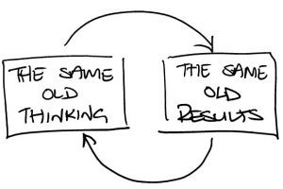
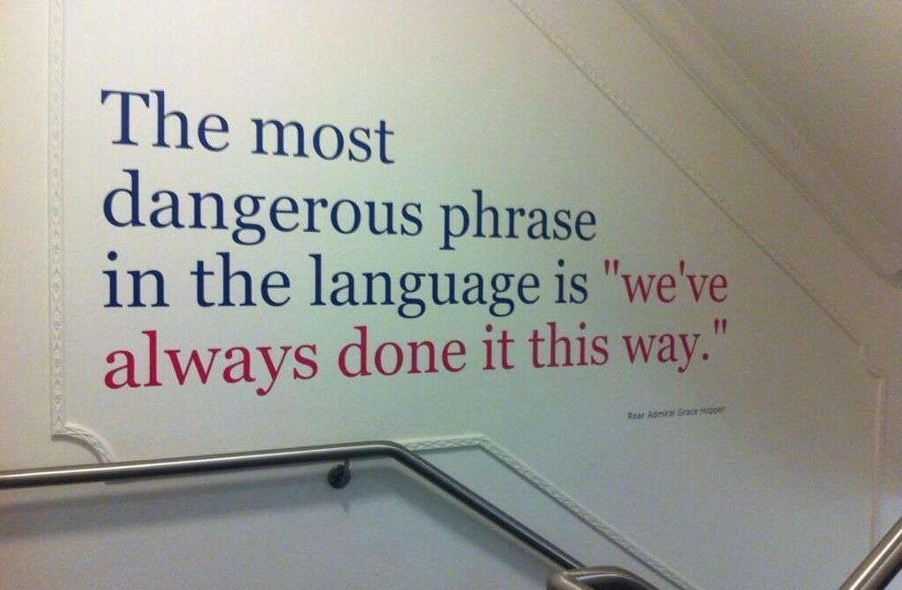
The most dangerous phrase in the language is “We’ve always done it this way”- Admiral Grace Hooper
3
Notes:
Today we are going to be talking about a SIX letter word that scares many, CHANGE. Hopefully, by the end of this segment, you’ll embrace it as an opportunity.
I like to start off with this slide because I think it helps us to realize a need to examine our clubs’ willingness to change. If we want different results, we have to take different approaches.
According to LCI, membership has continued to drop over the last three decades, and yet, we still have clubs that are unable or unwilling to try new approaches to improve membership. If you look at membership as a function of how we can best benefit the communities we serve, it’s easy to see how change is needed to correct us from continued results.
Simply blaming young people because “they don’t volunteer anymore and are lazy” doesn’t change the situation many of our clubs are in…and as we know from our Leo clubs, is just not correct. We have to package it and sell it in a way that young people find attractive. For many young people, their time is more valuable than their money, so finding ways to work efficiently may yield better results. With all the needs in our world, we can’t waste time.

Slide 4
Tradition
A time ordered practice
The passing down of elements of a culture from generation to generation
An inherited, established, or customary pattern of thought, action, or behavior.
4
Notes:
Some think change and tradition are opposing forces, and I hope to show you how to make both viable components of your club.
To start, let’s define what a tradition is. These are a few definitions I found, and I’d like to focus on the term “passing down”. If you don’t pass down the importance of the tradition, it’s at risk for no longer being a tradition.

Slide 5


Questions on tradition
What happens when the tradition no longer resonates with its members?
Lack of identity
“Inefficient”
“Slow-Moving”
Corny
5
Notes:
Traditions are great when they continue to show value to the organization. Part of that is on us to educate incoming generations of Lions about the traditions that we wish to continue. However, some traditions no longer resonate with the members or worse yet distract people from wanting to participate/join. What traditions do we no longer do that if we pulled out of the box today would be very unacceptable in today’s world?
When the tradition is not passed down properly, through education, it lacks identity with the membership. It can be a practice that is viewed as slowing down meetings or the club. And, in some cases, can be viewed as corny.
When your tradition prevents you from getting work done efficiently, like this old computer, maybe it’s time to consider an upgrade.

Slide 6


Tradition Vs Change
6
Notes:
Clubs must have a delicate balance between tradition and change. When the roots of a tradition die, and the meaning or symbolism may be lost, it’s time to consider change.
The transformation of a caterpillar to a butterfly doesn’t happen without change. Do we as Lions want to stay catapillars or emerge as butterflies?
On the other hand, having a regular meeting time or place may allow members to have enough consistency to plan around other work/home schedules to make regular meetings. Too much change may make it hard to plan or lead to confusion.

Slide 7

aa
World Changes
As the world changes, shouldn’t our clubs also change in order to maintain identity with those we serve?
If our projects don’t reflect similar change to our ever-changing world, are we really doing the best we can to serve?
7

Slide 8
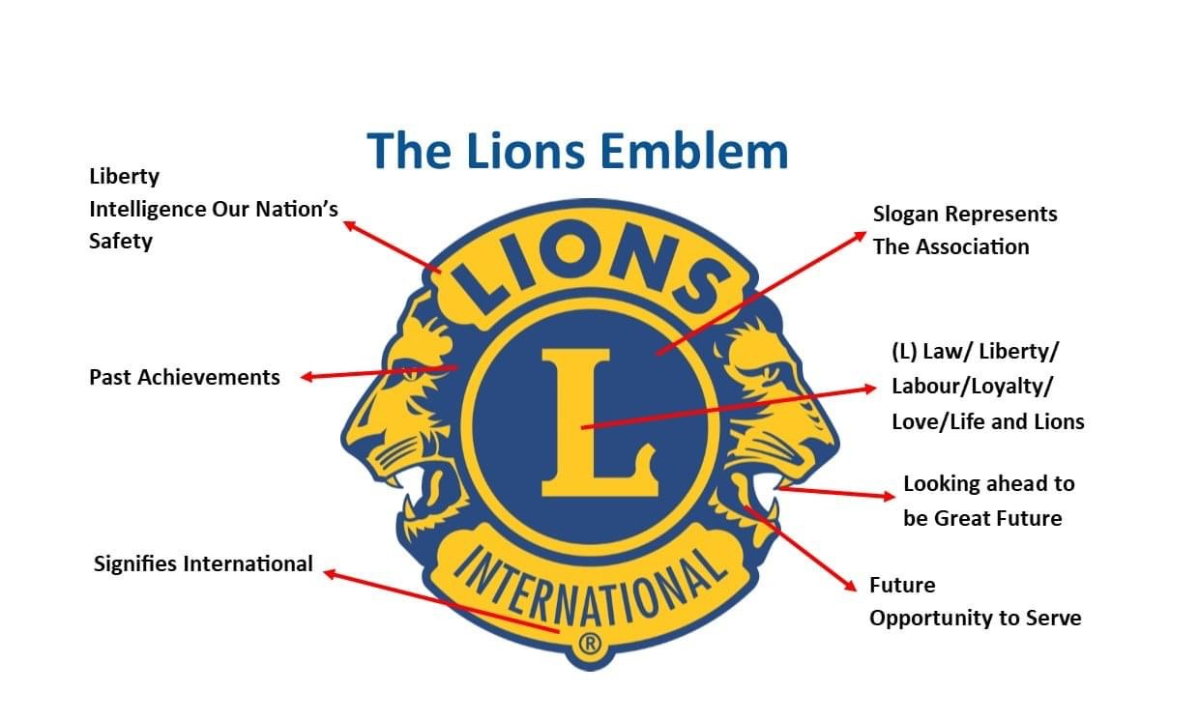
8
Notes:
Another way of looking at it – our emblem has a rich tradition dating back to 1921, but even then, our forefathers knew the importance of looking to the future. If we are rigid to accepting change and stay rooted in the past, we are only honoring half of the logo that represents us.
In the words of Former U.S. President John F Kennedy, “Those who look only to the past or the present are certain to miss the future.”

Slide 9
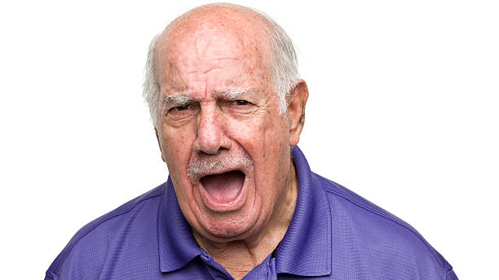
“If don’t come to dinner, you do not need to come at all”
Excepteur sint occaecat cupidatat non proident, sunt in culpa qui officia mollit anim id est laborum proident, sunt in deserunt mollit anim id est laborum.
Excepteur sint occaecat cupidatat non proident, sunt in culpa qui aute irure dolor in reprehenderit officia deserunt mollit anim id est laborum.
“ No new projects!”
9
Notes:
Hopefully there aren’t too many of you that are making this expression right now! I wanted to share two small examples of how we need to be accepting of change.
For many Lions, meetings involve dinner before or after to socialize and build fellowship. And there’s nothing wrong with that. However, for some newer, working Lions, they would choose to eat with their family before or after the meeting or maybe their dietary restrictions prevent them from partaking in the catered option. As dinner reservations started to decline, the tradition was in jeopardy as the club was having trouble meeting their minimum, and one of our eldest Lions yelled “If you don’t come to dinner, you don’t need to come at all!” Is that really the most important part of being a Lion? Is the tradition encouraging or preventing them from joining and participating?
In another example, a younger Lion attended her first district convention and came back with new ideas for a fundraiser/service project that many clubs do every year to generate income and recognition for their club and community. She presented it at the next club meeting, and again, a veteran Lion stood up and yelled “no new projects!”. How do you think it made that Lion feel who took the time to attend the convention, got excited about a project, and was yelled at after presenting an idea that is accepted by most Lions clubs!
If you find yourself getting ready to look like this person, maybe grab a Snickers before you potentially say or do something that may harm your club’s ability to grow and serve in defense of a tradition.

Slide 10
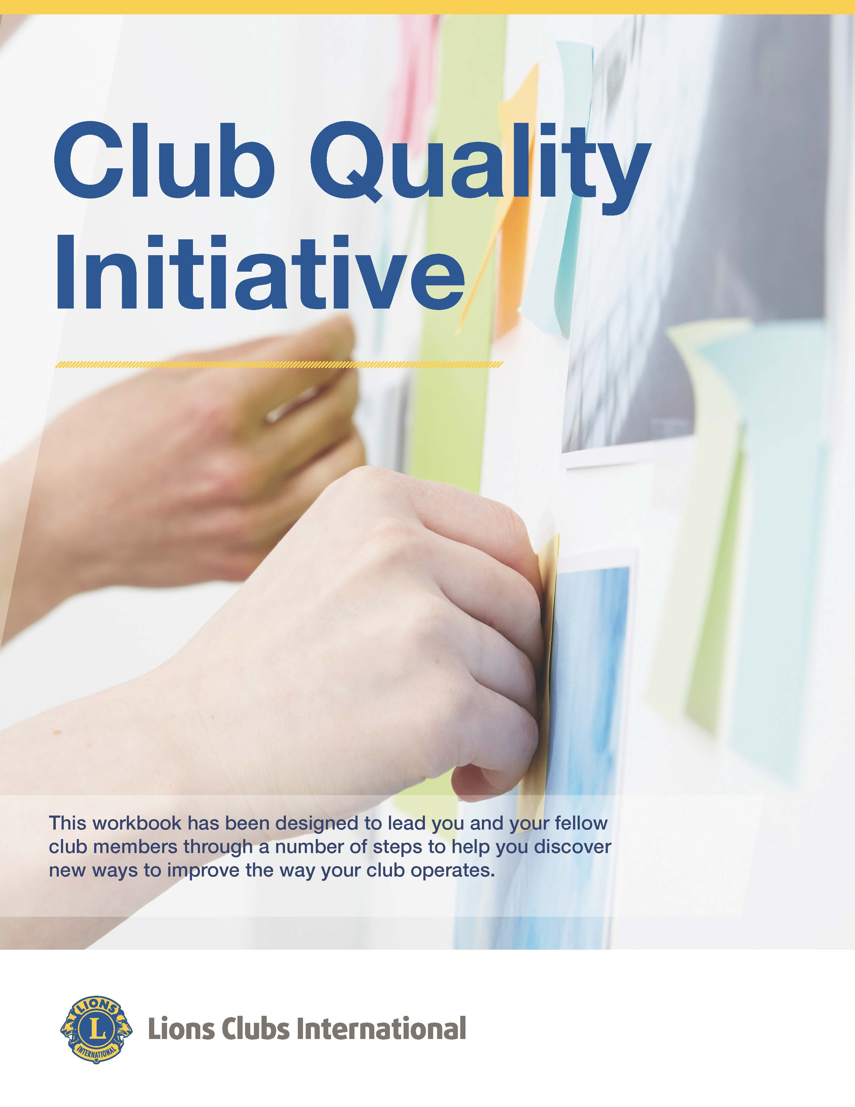
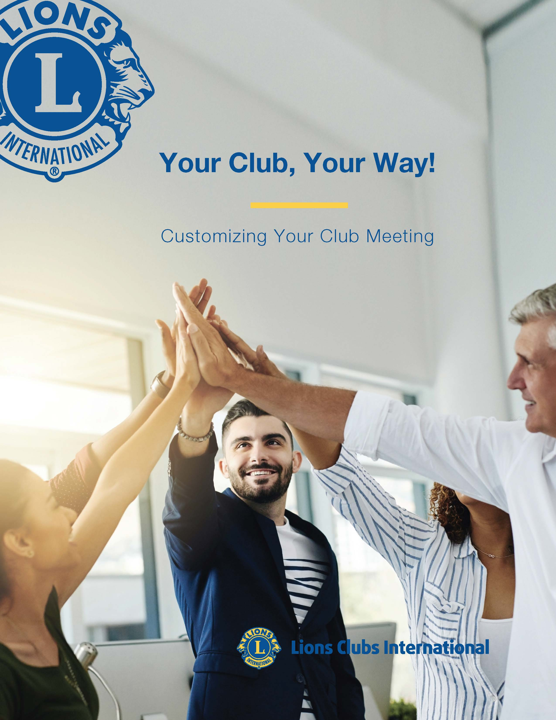
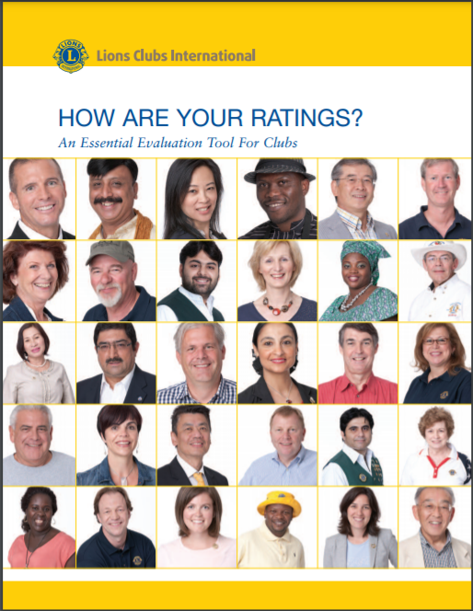

aa
Time for Change
https://www.lionsclubs.org/en/resources-for-members/resource-center/club-quality-initiative
https://www.lionsclubs.org/en/resources-for-members/resource-center/improving-club-quality
https://www.lionsclubs.org/en/v2/resource/download/79863807%20 (How Are Your Ratings?)
10
Notes:
After having numerous experiences like the stories I shared, a core group read a LCI publication, “Your Club, Your Way!”. We were surprised to learn that a lot of the things we were told were REQUIRED by LCI were not, and that LCI gives us the autonomy to make the club fit our members and our communities.
So if you believe now is the time for change in your club, consult the resources already available to help you make that transition. These three documents provide a lot of tools to assess the needs of your club and your community. Strong clubs grow and are able to take care of the needs of the communities they serve to their full potential. There are all kinds of tools at www.lionsclubs.org

Slide 11
“You have a choice…Your club has the freedom to structure club meetings in a way that best meets your members’ needs. While many clubs value the traditions that have been passed down from generation to generation, it is good to know that most traditions are optional, and members can choose to change the elements, frequency, and structure of their meetings to make the meeting more inviting and/or use new forms of technology to keep members connected and manage club business.
QUESTION TRADITIONS
CONSIDER FAMILY MEMBERS
EXAMINE PROTOCOL
How is your current club structure aiding or prohibiting the working individual from participation?
11
Notes:
This paragraph is directly from Your Club your Way – *READ QUOTE*
These are areas all clubs should address.
QUESTION TRADITIONS… Many clubs open with a song or a pledge, but your club does not have to! Determine the traditions that your members would like to keep and drop the others. Ask your younger members if they enjoy the club’s traditions and adjust the activities to appeal to young potential members too!
CONSIDER FAMILY MEMBERS… Does your club have (or would like to recruit) young parents or families with children? If so, discuss how the meeting format, location and time might be changed to accommodate family members.
EXAMINE PROTOCOL… Similar to traditions, the way the meeting room is set and the way club leaders are addressed can be determined by the club. The club has the authority to continue or eliminate items such as a head table for club leaders and visitors or acknowledging members in the order of importance. Some clubs prefer an atmosphere where everyone is equal.”
Why do we care about the working individual so much? Over 60% of the world is a working individual, including an all-time high number of people over 65. People have less time to spend on extracurriculars, so we have to make Lions fit their schedule if we want to continue to grow. It’s no longer a 9-5 working world, so we need to consider things like meeting time, structure, length, etc and make sure we aren’t prohibiting people from being members.

Slide 12
aa
Start New
Traditions
Encourage Membership
Meet the Needs of Your Community
Make a New Image/ Marketability
12
Notes:
So today is the time to examine those current traditions, eliminate traditions that have lost value or relevancy, and start NEW traditions
to encourage membership,
meet the current needs of your community, and
give your club a new image for the community to support.

Slide 13
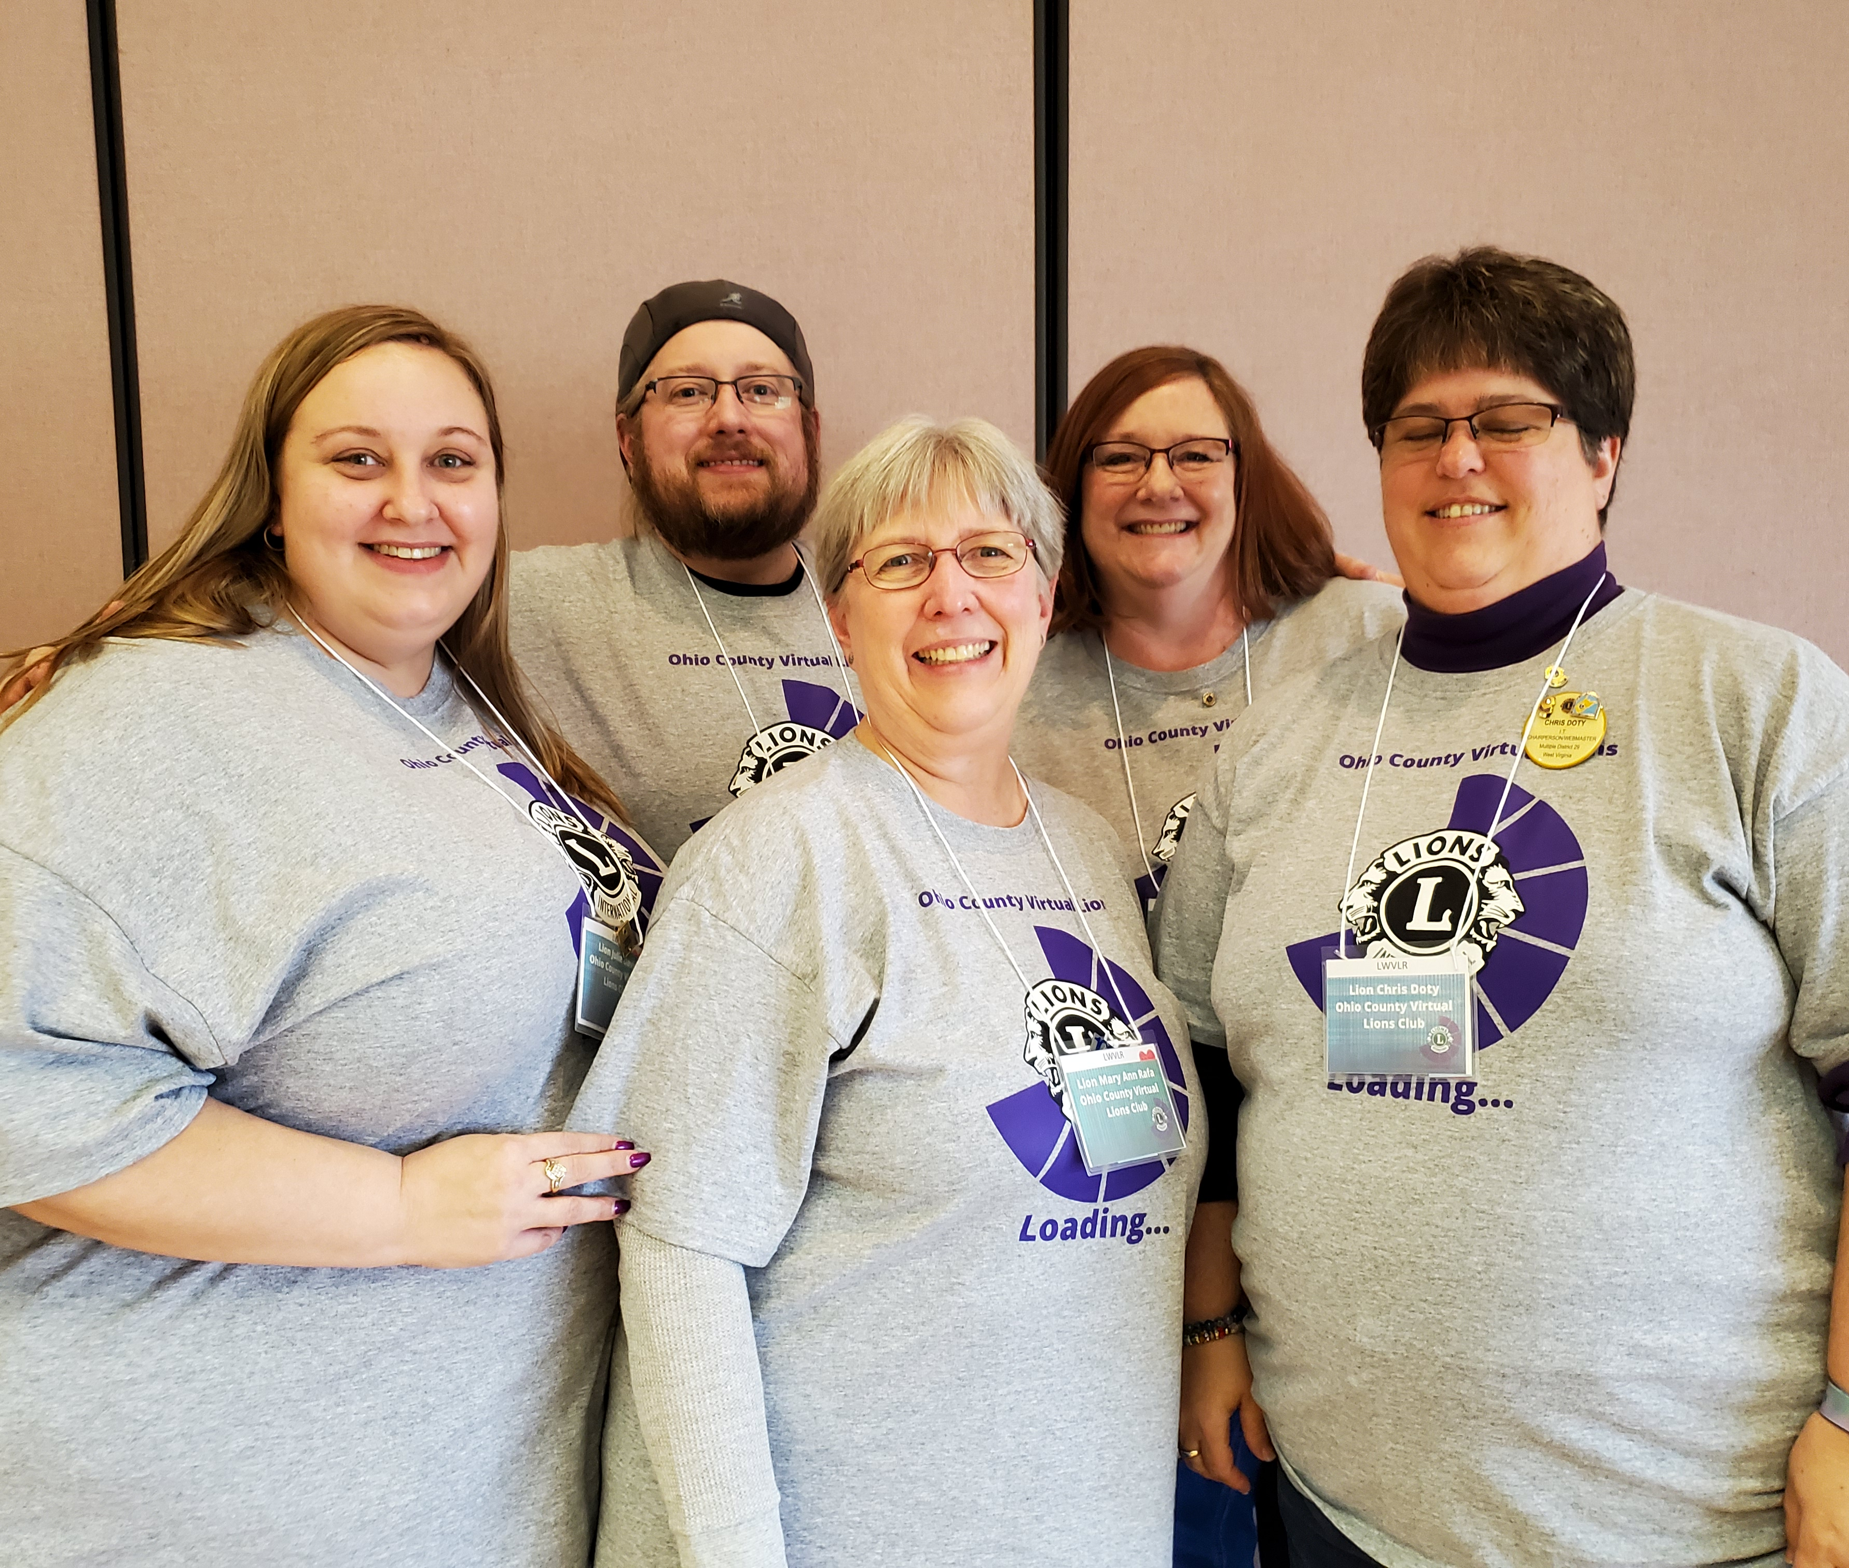

Next steps:
Officer trainings
Leadership Retreat
USA/Canada Lions University
Training helped us to understand what was REQUIRED, what was OPTIONAL.
Open to new ideas, no “it’s always been done that way”
People’s input valued, so members feel valued and invested in the club operations.
13
Notes:
Why are we spending so much time talking about traditions and change in a discussion of virtual engagement? Because it’s a huge change that also has huge benefits!
Ultimately, we decided to start our own club, and we had NO traditions that were preventing us from operating efficiently or recruiting. This group of core leaders attended as many officer training retreats and read officer documents to get a better understanding of what is REQUIRED by LCI, and we found that there’s far less required than what one might think.
Being open to new ideas AND valuing people’s input allowed us create our club operations that would become our own traditions that have relevant, healthy roots.

Slide 14
Recruiting
Every person has value and can do something to help us
We are a service organization first and an elite club second.
We work with the community to meet their needs
We work with our members’ limitations
We capitalize on our members’ strengths and talents
We are a specialty club, serving children in our county
Cafeteria-style volunteerism: help when/where you can
More hands make light work
We are a club for family, generations working together
14
Notes:
Where many clubs still recruit by invitation only, we decided our club wanted EVERYONE in our community to join, so these are some of our tenants of recruiting.

Slide 15
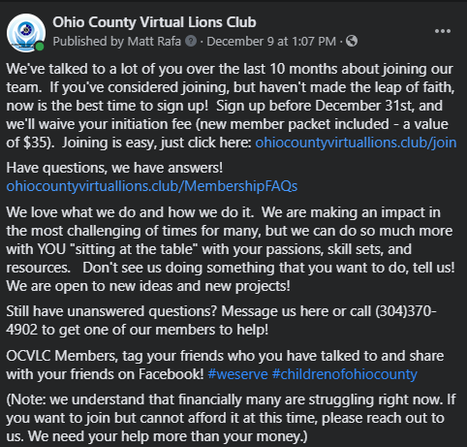

15
Notes:
We posted a Facebook ad to let the community know that we want them to join and what we plan to do for the community. We felt it important to show how low cost it was to join and the types of service we do. How many in your community could rattle off these 5 global causes of the Lions? How many of our MEMBERS could do it? YOU NEED TO ADVERTISE all that you do because there may be one thing that resonates enough with someone to join!

Slide 16

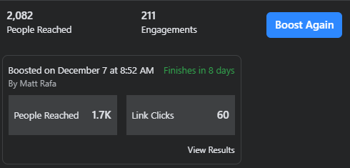
aa
1% of 2082 = 20 people!
16
Notes:
Here’s a similar ad. Eye catching, tells them to the pont “We want you” and “This is what we do”. If we even get 1% of the number of people that see this ad on Facebook, that would be a successful YEAR for most any Lions Club recruitment plan.

Slide 17

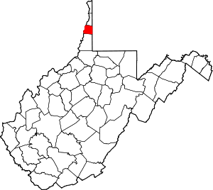
aa
As of February 28th, 2020
The first virtual club in West Virginia
The 16th virtual club in the United States
One of less than 200 specialty clubs in United States
Serving the children of Ohio County
17
Notes:
We are proud to be the first virtual club in WV serving the children of Ohio County as a specialty.
We chartered with 34, and in less than one year, in the middle of a global pandemic, we have doubled. Our community hears us. They see us working.
We developed a winning product– people want to play for a champion club. For our US sports fans, the NY Yankees, not the Pittsburgh Pirates. People want to play for the NE Patriots, not the Cleveland Browns. They aren’t winning teams; they are winning franchises! Turn your franchise around by examining changes that need to be made in your organization.

Slide 18
aa
Where was your club when the world stopped turning?
For many, the world halted on or around March 13th, 2020. Although everything shut down, there was still more need for Lions’ work than ever before. We needed to figure out how to serve our communities with almost no treasury and limited ability to meet in person.
Charter Night
Feb 27, 2020
Pandemic
March 13, 2020
Now What?
Stay Tuned!
18
Notes:
We were chartered on February 27, 2020, and less than a month later, we were scrambling to figure out how to serve our communities without money.
To say that it was easy would be a lie.but we had already planned to be a cyber club – we just had to rely on our cyber-ness a little more. The pandemic tested most of us in operating in worst case scenarios, so the remaining episodes will showcase our efforts in fundraising, service project, and recruiting. The last episode will showcase the online tools we used to connect us with our community when we couldn’t connect in person.

Slide 19

Register for next Thursday’s web episode: Serving in a Pandemic
Need a balance of tradition and change
Need to examine traditions to see if they are preventing you from recruiting or retaining members.
Not all clubs are one size fits all (Your Club, Your Way).
Everyone is a recruit in our club.
The cyber and specialty tags are advertising points, but it’s also how we function
We do more to plan/coordinate outside of meetings using technology than inside meetings, which makes our meetings few and brief.
We are very respectful of our members’ time and busy schedules.
Components can be incorporated into traditional clubs. It’s not all or none.
Takeaways
Questions?
www.Ohiocountyvirtuallions.club
Register for next Thursday’s web episode: Fundraising in a Pandemic
19
Notes:
(If you take nothing else away, I want you to take away how important it is for the future of your club and Lions International to examine the direction your club is going in and be willing to make some potentially difficult decisions to correct that direction. Have those discussions of what traditions are valued and what changes need made now to improve recruiting, to retain current membership, and to stay relevant to your communities.
Once the pandemic is over we look to use the lessons learned from the current virtual club stage to bring in more members and continue outstanding service projects. We look forward to being able to have more in-person meetings and projects, but this isn’t an either or situation! We are going to come out of the pandemic with 70 members because of how we incorporated virtual components, and built new philosophies and traditions
Our next episodes will discuss HOW we used virtual engagement now that we’ve opened the conversation of WHY we should be open to change overall and specifically regarding virtual engagement.

Slide 20
Thank You
For any further questions, e-mail membership@lionsclubs.org
© 2021 Lions Clubs International
3/25/2021
Notes:
Thank you for listening to the first of five webinars on virtual engagement to impact your communities. I hope you found it informative, and we hope to see you back here next week for part 2: virtual engagement and fundraising in a pandemic. You can sign up for each part in the virtual events center on the LCI website. If you are viewing this presentation after the live broadcast, you may send questions to membership@lionsclubs.org.
Richard, I turn the floor back over to you! Any comments or questions you’d like to share with us?

