Slide 1
Host a Virtually Great Convention!
Tips for Success

Slide 2
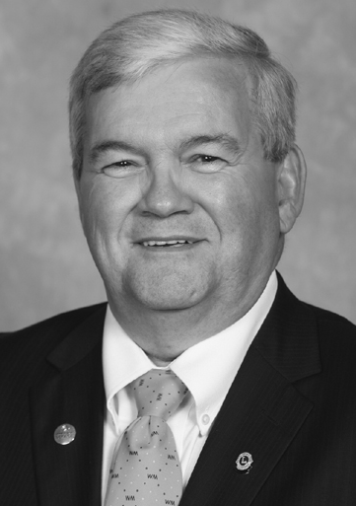
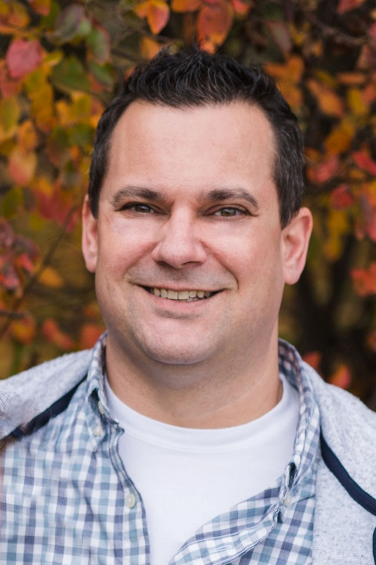
Welcome!
Tom Gordon
Past International Director
Canada
Stephen M. Glass
Past International Director
West Virginia, USA
And
Wendy Cain
Past District Governor
David Kingsbury
General Counsel
LCI

Slide 3

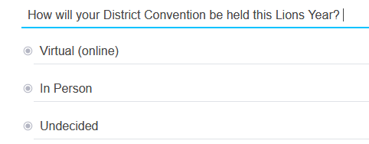
Opening Poll

Slide 4
What makes for a
Great Convention?
What makes for a
Virtually Great Convention?
Have Fun and Share in Fellowship
Get Inspired for meaningful service
Share in Learning
Celebrate Being a Lion
Recognition
Well-run business session
Smooth Logistics for all participants
Have Fun and Share in Fellowship
Get Inspired for meaningful service
Share in Learning
Celebrate Being a Lion
Recognition
Well-run business session
Smooth Logistics for all participants
4
Notes:
PID Steve

Slide 5
Preparing for the Convention
Notes:
PID Steve

Slide 6

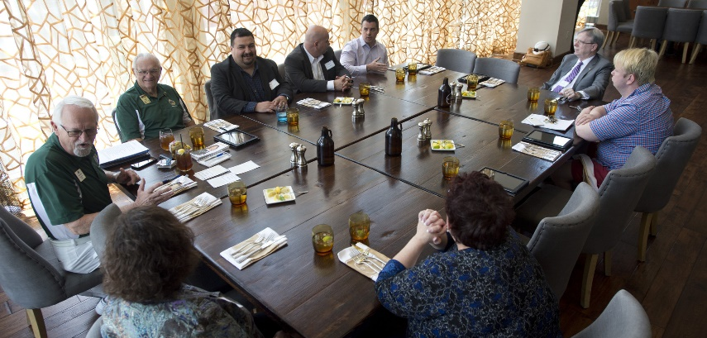
Use a wide variety of outlets to promote!
Social media (i.e. Facebook, Twitter, Instagram)
District web pages
Club web pages
Newsletters
Emails
Zone meetings
Cabinet meetings
Club visits
Promote the Event!
Chris Bunch – LION Managing Editor
Sanjeev Ahuja – Chief of Marketing & Membership
Dan Hervey – Brand & Creative Director
Stephanie Morales – Meetings Manager
Notes:
PID Steve

Slide 7

Consideration for pricing the event.
Consider the cost for the online platforms when determining the price for registration.
Request a live demonstration of the platform’s capacities if you are considering several vendors/products.
Ensure that the platform can handle as many active participants as needed for the event.
Chris Bunch – LION Managing Editor
Sanjeev Ahuja – Chief of Marketing & Membership
Dan Hervey – Brand & Creative Director
Stephanie Morales – Meetings Manager
Notes:
PID Tom

Slide 8

The Call to Convention
IMPORTANT - Report convention date in MyLCI or your local reporting system
Sufficient Notice for Call to Convention – 60 days as per policy.
Include the Rules of the Convention.
Include any resolutions that will be entertained.
Provide the current status of accepted good standing in regard to the certified list of clubs.
Chris Bunch – LION Managing Editor
Sanjeev Ahuja – Chief of Marketing & Membership
Dan Hervey – Brand & Creative Director
Stephanie Morales – Meetings Manager
Notes:
The official call must include the time, date and location of the convention, which may include a website if the convention is held in a virtual format. Delegates and attendees should be provided with all information necessary to participate in the convention and delegates should be informed of the voting process.
David

Slide 9

Introduce the Virtual Platform information with the call and registration
documents
With Registration/payment instructions:
Include information regarding the online “platform.”
Inform of prerequisites to install platform application if required.
Include the website link and/or password upon receipt of registration payment.
Chris Bunch – LION Managing Editor
Sanjeev Ahuja – Chief of Marketing & Membership
Dan Hervey – Brand & Creative Director
Stephanie Morales – Meetings Manager
Notes:
PID Tom

Slide 10

Think Long Term when choosing digital equipment for the district’s use.
Secure appropriate computer equipment, such as a personal computer or tablet, before the seminar begins.
Plan to continue using this equipment to your advantage in performing your duties as district governor.
Main speakers should use proper microphone and headset, too.
Chris Bunch – LION Managing Editor
Sanjeev Ahuja – Chief of Marketing & Membership
Dan Hervey – Brand & Creative Director
Stephanie Morales – Meetings Manager
Notes:
PID Tom

Slide 11

Use equipment and training platform features, such as audio and video, to participate fully in all aspects of the training.
Review the virtual platform user guides and participant manual and its functions, like “Chat, Questions and Polls,” before the live virtual sessions begin and keep them within easy reach.
Plan to continue using this equipment to your advantage in performing your duties as district governor.
Assist attendees properly prepare for online platforms and equipment
Chris Bunch – LION Managing Editor
Sanjeev Ahuja – Chief of Marketing & Membership
Dan Hervey – Brand & Creative Director
Stephanie Morales – Meetings Manager
Notes:
PID Tom

Slide 12
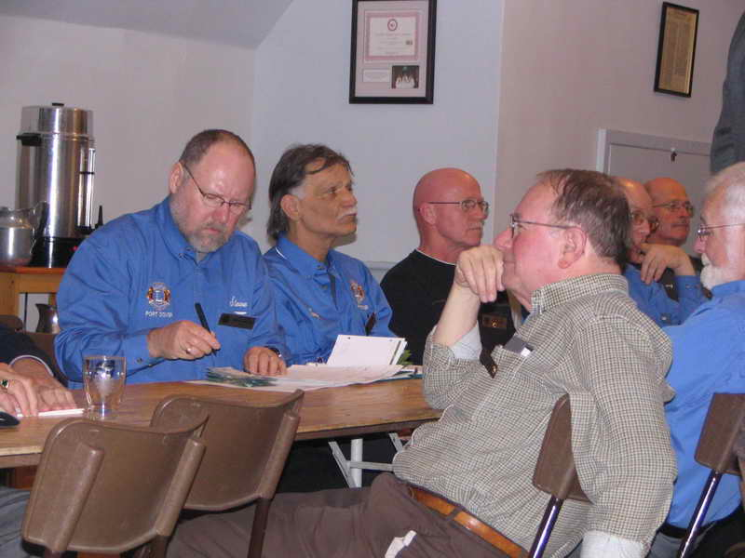
Tips for a Smooth Certification Process
Report the convention date in MyLCI or your district’s reporting system as early as possible.
This triggers the creation of the certified list of clubs and delegate count.
Compile a list of all clubs in good standing for use by the credentials committee
Chris Bunch – LION Managing Editor
Sanjeev Ahuja – Chief of Marketing & Membership
Dan Hervey – Brand & Creative Director
Stephanie Morales – Meetings Manager
Notes:
David - Once a district or multiple district has updated its convention date in MyLCI, the certified delegate list will be accessible to the district cabinet and must be shared with the credentials committee. Additionally, each Lions club will be notified how many delegates it is entitled to for the convention, and whether outstanding dues remain to be paid in order to be eligible to vote.
This year, because the International Board of Directors has offered flexible payment of International dues, and Lions clubs in good standing on December 31, 2020 are not being placed in status quo or financial suspension if international dues are outstanding through June 30, 2021. Therefore, in determining “good standing” of a Lions club at a district or multiple district convention for purposes of establishing delegate entitlement, those clubs which are not in financial suspension or status quo and have paid all district and multiple district dues should be considered to be in good standing and eligible for delegates.
David

Slide 13
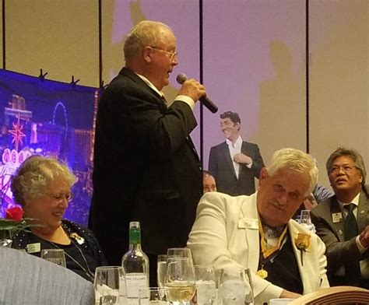
Use Platform features for the nominations business
Please complete post-election
Post photographs of the candidates or turn on their cameras during the business session.
Complete nomination speeches as usual.
See the document LG23 – “District Election Guidance” for election guidance.
Chris Bunch – LION Managing Editor
Sanjeev Ahuja – Chief of Marketing & Membership
Dan Hervey – Brand & Creative Director
Stephanie Morales – Meetings Manager
Notes:
PID Steve

Slide 14
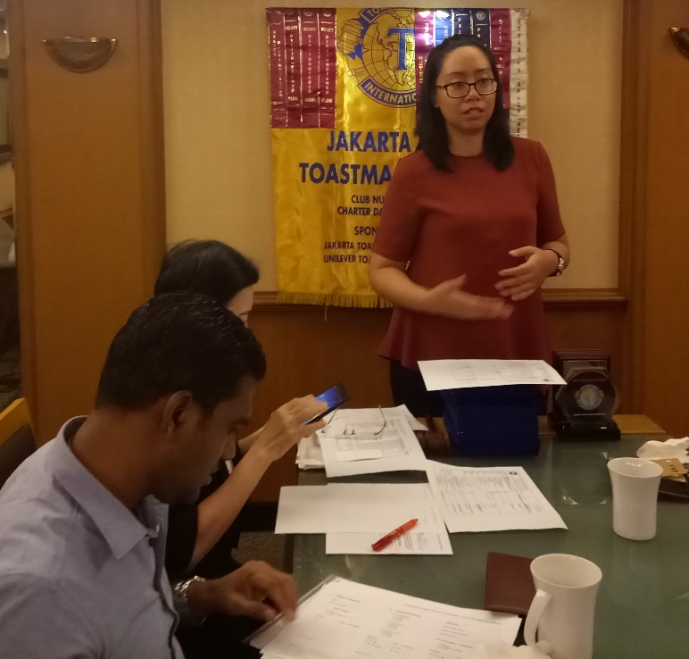
Remember these important items.
Conducting Elections
Voting should be confidential and autonomous whether completed by electronic or written balloting.
Check off those who have voted but keep votes confidential.
Be sure to introduce the new officers after elections are complete.
Report the election results. Use for DA-20 – District Convention Report.
Chris Bunch – LION Managing Editor
Sanjeev Ahuja – Chief of Marketing & Membership
Dan Hervey – Brand & Creative Director
Stephanie Morales – Meetings Manager
Notes:
PID Steve

Slide 15

How to Make “Online” Seminars Fun and Interesting
Notes:
PID Glass – transition to poll

Slide 16
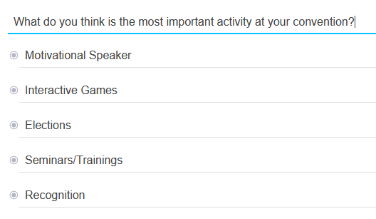
Poll #2
Notes:
Natalie, Transition to PID Gordon

Slide 17

Help attendees get comfortable using the platform!
Best Practices for Success
Teach/Show the Lions how to use the Convention Platform Technology!
Use Live Demonstrations if possible.
Make sure you have some “techie’s” behind the scenes as an ongoing “help desk” for the convention participants.
Chris Bunch – LION Managing Editor
Sanjeev Ahuja – Chief of Marketing & Membership
Dan Hervey – Brand & Creative Director
Stephanie Morales – Meetings Manager
Notes:
PID Tom on this topic

Slide 18

Choose topics of interest for your attendees!
Offer a wide range of seminars and webinar Topics
Using technology – offer a review of common platforms being used for meetings.
Lions orientation and/or re-orientation. Not just for new members!
Certified Guiding Lion – consider holding a training
Club Quality Initiative - for all of the club officers.
Chris Bunch – LION Managing Editor
Sanjeev Ahuja – Chief of Marketing & Membership
Dan Hervey – Brand & Creative Director
Stephanie Morales – Meetings Manager
Notes:
PID Tom

Slide 19
Choose topics of interest for your attendees!
Offer a wide range of seminars and webinar Topics
Service Projects - story-telling.
LCIF – Grants education and Campaign 100 updates.
MyLCI/MyLION – demonstrate the Lion Account.
Chris Bunch – LION Managing Editor
Sanjeev Ahuja – Chief of Marketing & Membership
Dan Hervey – Brand & Creative Director
Stephanie Morales – Meetings Manager
Notes:
PID Tom

Slide 20

Choose topics of interest for your attendees!
Interactive Engagement
Explore integrating interactive components to presentations.
  Polls and reactions.
  Chats.
  Share Screens.
Add some energizers and refreshment breaks.
Open question and answer sessions – use raise hand features for participants.
Chris Bunch – LION Managing Editor
Sanjeev Ahuja – Chief of Marketing & Membership
Dan Hervey – Brand & Creative Director
Stephanie Morales – Meetings Manager
Notes:
PID Tom

Slide 21

Choose topics of interest for your attendees!
Within PowerPoint, there is a time clock and other add-ins to explore – time clock and other fun features (add ins).
Maximize features of software and the online platform to engage attendees.
Use “break-out rooms” like you would for in person meetings.
Interactive Engagement
in Virtual
Training and Presentation
Sessions
Chris Bunch – LION Managing Editor
Sanjeev Ahuja – Chief of Marketing & Membership
Dan Hervey – Brand & Creative Director
Stephanie Morales – Meetings Manager
Notes:
PID Tom

Slide 22
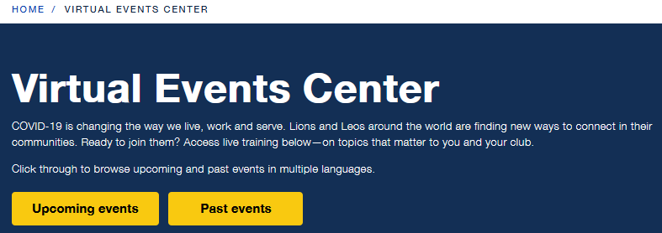
Check these out for Videos!
Make use of existing
pre-recorded videos.
Chris Bunch – LION Managing Editor
Sanjeev Ahuja – Chief of Marketing & Membership
Dan Hervey – Brand & Creative Director
Stephanie Morales – Meetings Manager
Additional pre-recorded Videos are at YouTube.com/Lionsclubs
Test pre-recorded videos on your chosen platform – make sure both audio and visual function properly.
Recordings may also be used at later date for showing at other functions
Notes:
PID Steve

Slide 23

Check this out!
Lions Virtual Community invites Lions from all over the world https://lionsvirtual.teamapp.com/
Learning. Training and sharing ideas through webinars
Entertaining. Trivia Games and Virtual happy hours.
Connecting. Meet Lions from all over the world.
Lions Virtual Facebook Page https://www.facebook.com/LionsVirtual
Chris Bunch – LION Managing Editor
Sanjeev Ahuja – Chief of Marketing & Membership
Dan Hervey – Brand & Creative Director
Stephanie Morales – Meetings Manager
Notes:
PID Steve

Slide 24
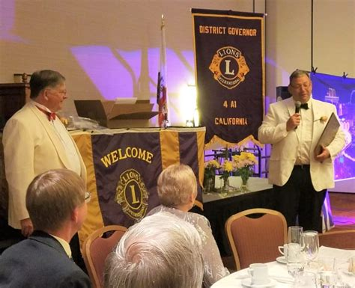
If Awards and Certifications are able to be distributed to recipients prior to the convention:
Awards and Recognition
Be sure that all award recipients are registered present to receive the award or recognition.
Turn on cameras of presenters and recipients for the presentation.
Presenter should share the significance of the award.
Could also do slideshows of multiple recipients for one award type. (Extension, Key, Club Excellence Awards, etc.)
Chris Bunch – LION Managing Editor
Sanjeev Ahuja – Chief of Marketing & Membership
Dan Hervey – Brand & Creative Director
Stephanie Morales – Meetings Manager
Notes:
PID Steve

Slide 25

Give Recognition to attendees unable to be present at the convention
Awards and Recognition
Turn on the Presenter’s camera so they may share the significance of the award and display it for the attendees.
Could also do slideshows displaying photographs of Lions who are all receiving the same kind of award. (Extension, Key, Club Excellence Awards, etc.).
Make sure to let recipients know that the award will be mailed as quickly as possible.
Chris Bunch – LION Managing Editor
Sanjeev Ahuja – Chief of Marketing & Membership
Dan Hervey – Brand & Creative Director
Stephanie Morales – Meetings Manager
Notes:
PID Steve

Slide 26
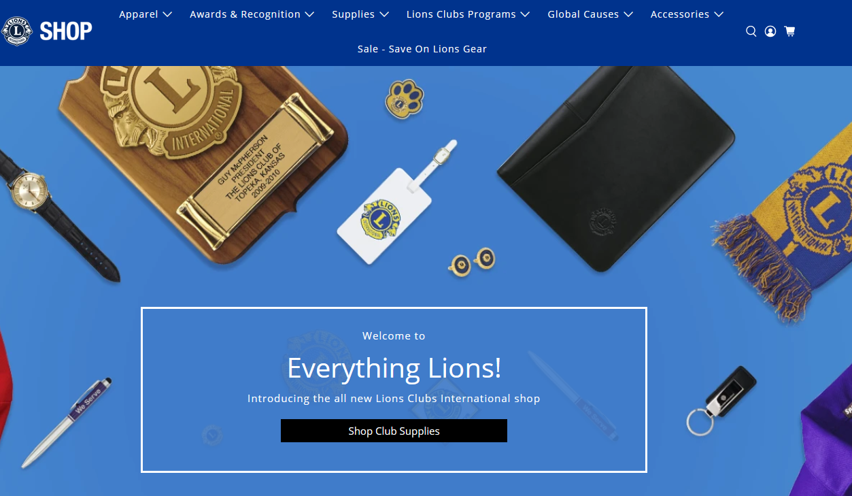
LCI Shop has great recognition and appreciation items.
Notes:
PID Tom

Slide 27

Offer Some Small Team games of competition or trivia!
Chris Bunch – LION Managing Editor
Sanjeev Ahuja – Chief of Marketing & Membership
Dan Hervey – Brand & Creative Director
Stephanie Morales – Meetings Manager
Use virtual Breakout Rooms in online platform to serve club hosted receptions.
Wendy Cain – Share Lions Jeopardy!
Notes:
PID Steve and PID Tom

Slide 28
Organization
History
Events
Projects
LCI Forward
Club
1917
WVLLR
LCIF
Goal
District
1925
MD-29 Conv.
Youth
Service Impact & Focus
Multiple District
1920-1921
LCI Conv.
Diabetes
Improve Visibility
MD Leaders
1987
Dan Dague Memorial Car Show
Leader Dogs
Pursue Excellence
Inter-national
1990
USA/Can. Lions Lead. Forum
Pilot Dogs
Improve Member Value

Slide 29

1920
Lionism becomes international!
Windsor, Ontario, Canada Lions Club chartered.
Next

Slide 30

1921
Lionism comes to West Virginia!
Charleston Lions Club chartered on September 30, 1921.
Return to Main Board

Slide 31
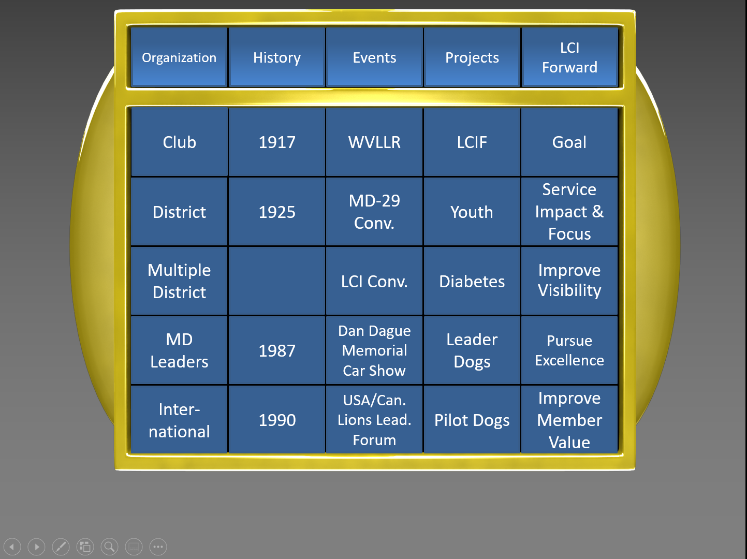

Slide 32
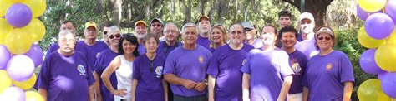
Combine some Trivia games with a virtual cocktail hour, entertainment for fun to get them together.
Software packages like “Hopin” which organize your content for a virtual presentation. $$$$
Bring your own picnic!
Don’t forget to set aside some time just for Having Fun!
Chris Bunch – LION Managing Editor
Sanjeev Ahuja – Chief of Marketing & Membership
Dan Hervey – Brand & Creative Director
Stephanie Morales – Meetings Manager
Notes:
PID Steve and PID Tom

Slide 33
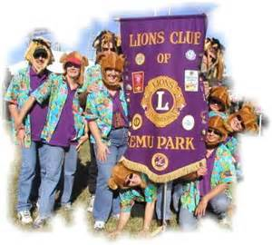
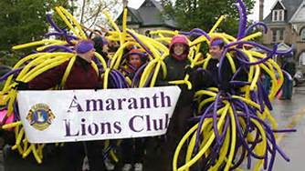
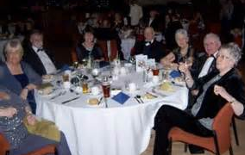
Make everyone feel like they’re in the front row!
Notes:
PID Steve and PID Tom

Slide 34

Questions and Sharing Best Practices
Notes:
PID Steve and PID Tom

Slide 35
Thank you

