Slide 1
aa
PowerPoint Best Practices
Keep slide content to 3-4 bullets per slide at 28pt. font
Keep content on the screen brief, and use the narrative and speaker notes to draw out the details
Add cues to your speaker notes to help the webinar operator know when to switch slides
1

Slide 2
Global Action Team Stories from the Field
[TITLE]
2

Slide 3
aa
Moderator
[MODERATOR NAME]
[MODERATOR TITLE]
Global Action Team Staff Support
[NAME] – CA [X], CA [X]
[NAME] – CA [X], CA [X]
[NAME] – CA [X], CA [X]
3

Slide 4
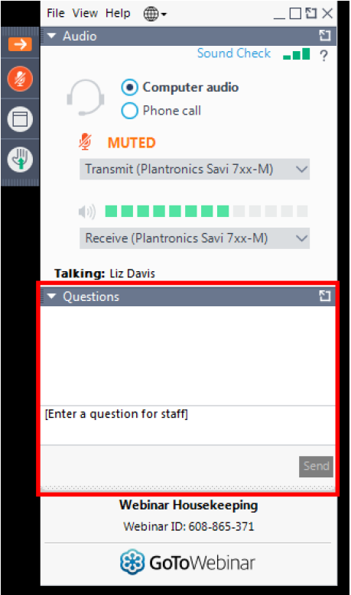
aa
Important information about this webinar
This webinar is being recorded. The recording and presentation will be available later this week on the Lions International Virtual webpage: lionsclubs.org/virtual
Your microphone has been muted and will remain so for the duration of this webinar
Have a question? Submit it using the “Question” tab located in the sidebar
4

Slide 5
Meet Today’s Presenters
[NAME] [TITLE]
[NAME] [TITLE]
[NAME] [TITLE]
[NAME] [TITLE]
[NAME] [TITLE]
[NAME] [TITLE]
5

Slide 6
[STORY TITLE]
MD [X]
[PRESENTER NAME]
[TITLE] CA [X]: [CA NAME]
Notes:
There are map slides for each individual CAs and RA at the end of this template

Slide 7
[STORY TITLE]
MD [X]
MD [X]
[PRESENTER NAME]
[TITLE] CA [X]: [CA NAME]
Notes:
Animated Line Instructions:
Insert Shape>Curve
Click the starting point of the line, as well as any points along the way where you would like the line to curve
Once you click the end point of the line, hit “Escape” on your keyboard
Open the Format Menu for the shape and make the following selections:
Solid Line
Color: Custom (175R 30G 45B)
Width: 2.75pt
Dash Type: Long Dash
Shape Effects: Shadow (Offset Bottom)
Navigate to the Animations Tab, Select the line, then click on the “Wipe” animation
Open the Animations Pane, and input the following setting for the animation:
Timing:
Start: With Previous
Delay: 0 Seconds
Duration: 3 Seconds (Slow)
Effect:
Direction: Set as applicable to your start and end point locations
Select the MD Label at the end point of the line (the yellow teardrop/text)
In the Animations Tab, select “Fade”
Input the following settings in the Animations Pane:
Timing:
Start: After Previous
Delay: 0 Seconds
Duration: 1 Second (Fast)

Slide 8
[STORY TITLE]
MD [X]
MD [X]
MD [X]
[PRESENTER NAME]
[TITLE] CA [X]: [CA NAME]
Notes:
Animated Line Instructions:
Insert Shape>Curve
Click the starting point of the line, as well as any points along the way where you would like the line to curve
Once you click the end point of the line, hit “Escape” on your keyboard
Open the Format Menu for the shape and make the following selections:
Solid Line
Color: Custom (175R 30G 45B)
Width: 2.75pt
Dash Type: Long Dash
Shape Effects: Shadow (Offset Bottom)
Navigate to the Animations Tab, Select the line, then click on the “Wipe” animation
Open the Animations Pane, and input the following setting for the animation:
Timing:
Start: With Previous
Delay: 0 Seconds
Duration: 3 Seconds (Slow)
Effect:
Direction: Set as applicable to your start and end point locations
Select the MD Label at the end point of the line (the yellow teardrop/text)
In the Animations Tab, select “Fade”
Input the following settings in the Animations Pane:
Timing:
Start: After Previous
Delay: 0 Seconds
Duration: 1 Second (Fast)

Slide 9
aa
[SLIDE TITLE]
9

Slide 10
m
[SLIDE TITLE]
Chris Bunch – LION Managing Editor
Sanjeev Ahuja – Chief of Marketing & Membership
Dan Hervey – Brand & Creative Director
Stephanie Morales – Meetings Manager
[SLIDE SUB-TITLE]
10

Slide 11
aa
[SLIDE TITLE]
11

Slide 12
[SLIDE TITLE]
[COPY]
[COPY]
[COPY]
[COPY]
[COPY]
[COPY]
12

Slide 13
[SLIDE TITLE]
[COPY]
[COPY]
[COPY]
[COPY]
[COPY]
[COPY]
13

Slide 14
aa
[SLIDE TITLE]
[COPY]
[COPY]
[COPY]
[COPY]
[CAPTION]
14

Slide 15
[SLIDE TITLE]
[COPY]
[COPY]
[COPY]
[COPY]
[CAPTION]
15

Slide 16
[SLIDE TITLE]
[COPY]
[COPY]
[COPY]
16

Slide 17
aa
[SLIDE TITLE]
[COPY]
[COPY]
[COPY]
17

Slide 18
aa
[SLIDE TITLE]
[COPY]
[COPY]
[COPY]
18

Slide 19
aa
[SLIDE TITLE]
[COPY]
[COPY]
[COPY]
19

Slide 20
[COPY]
[COPY]
[COPY]
[COPY]
[COPY]
[SLIDE TITLE]
20

Slide 21
[COPY]
[COPY]
[COPY]
[COPY]
[COPY]
[SLIDE TITLE]
21

Slide 22
aa
Poll Break
[POLL TITLE]
[POLL QUESTION]
22

Slide 23
Questions or Comments?
23

Slide 24
Join Group
Join the Conversation
Connect with Lions around the world
Get real-time updates from Lions International Headquarters
Learn about new and updated resources, upcoming webinars and Lions’ success stories
24
Notes:
Not only do Lions GAT Group members get the opportunity to participate in discussions with Lions across the world, but they also get additional benefits such as:
Real-time updates from Lions International Headquarters
Notifications of upcoming Lions’ webinars
Links to new and updated Lions’ resources and webpages
Access to inspiring success stories from around the world
Reminders of upcoming deadlines and events

Slide 25
aa
Next steps
[NEXT STEP]
[NEXT STEP]
[NEXT STEP]
25

Slide 26
Thank You
© 2020 Lions Clubs International
26

Slide 27
[STORY TITLE]
MD [X]
[PRESENTER NAME]
[TITLE] CA [X]: [CA NAME]

Slide 28
[STORY TITLE]
MD [X]
MD [X]
[PRESENTER NAME]
[TITLE] CA [X]: [CA NAME]
Notes:
Animated Line Instructions:
Insert Shape>Curve
Click the starting point of the line, as well as any points along the way where you would like the line to curve
Once you click the end point of the line, hit “Escape” on your keyboard
Open the Format Menu for the shape and make the following selections:
Solid Line
Color: Custom (175R 30G 45B)
Width: 2.75pt
Dash Type: Long Dash
Shape Effects: Shadow (Offset Bottom)
Navigate to the Animations Tab, Select the line, then click on the “Wipe” animation
Open the Animations Pane, and input the following setting for the animation:
Timing:
Start: With Previous
Delay: 0 Seconds
Duration: 3 Seconds (Slow)
Effect:
Direction: Set as applicable to your start and end point locations
Select the MD Label at the end point of the line (the yellow teardrop/text)
In the Animations Tab, select “Fade”
Input the following settings in the Animations Pane:
Timing:
Start: After Previous
Delay: 0 Seconds
Duration: 1 Second (Fast)

Slide 29
[STORY TITLE]
MD [X]
MD [X]
MD [X]
[PRESENTER NAME]
[TITLE] CA [X]: [CA NAME]
Notes:
Animated Line Instructions:
Insert Shape>Curve
Click the starting point of the line, as well as any points along the way where you would like the line to curve
Once you click the end point of the line, hit “Escape” on your keyboard
Open the Format Menu for the shape and make the following selections:
Solid Line
Color: Custom (175R 30G 45B)
Width: 2.75pt
Dash Type: Long Dash
Shape Effects: Shadow (Offset Bottom)
Navigate to the Animations Tab, Select the line, then click on the “Wipe” animation
Open the Animations Pane, and input the following setting for the animation:
Timing:
Start: With Previous
Delay: 0 Seconds
Duration: 3 Seconds (Slow)
Effect:
Direction: Set as applicable to your start and end point locations
Select the MD Label at the end point of the line (the yellow teardrop/text)
In the Animations Tab, select “Fade”
Input the following settings in the Animations Pane:
Timing:
Start: After Previous
Delay: 0 Seconds
Duration: 1 Second (Fast)

Slide 30
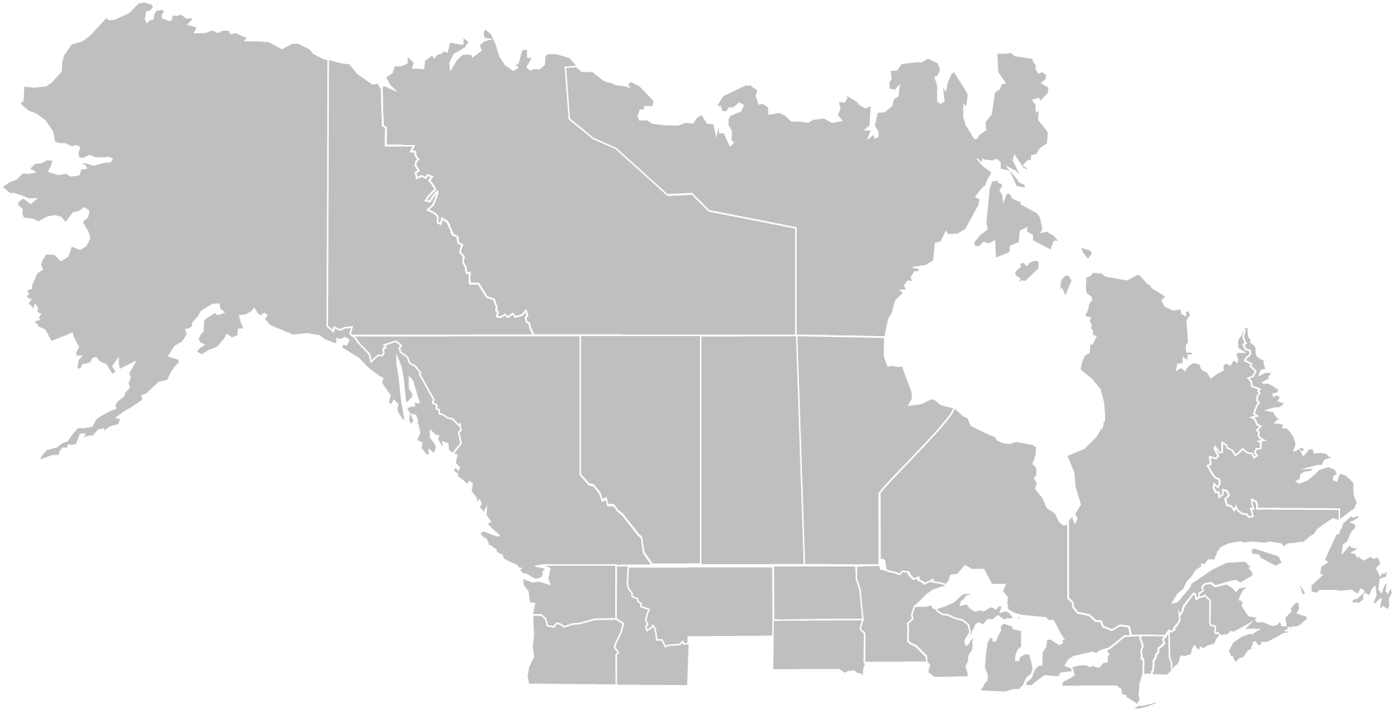
[STORY TITLE]
MD [X]
[PRESENTER NAME]
[TITLE] CA [X]: [CA NAME]

Slide 31
[STORY TITLE]
MD [X]
MD [X]
[PRESENTER NAME]
[TITLE] CA [X]: [CA NAME]
Notes:
Animated Line Instructions:
Insert Shape>Curve
Click the starting point of the line, as well as any points along the way where you would like the line to curve
Once you click the end point of the line, hit “Escape” on your keyboard
Open the Format Menu for the shape and make the following selections:
Solid Line
Color: Custom (175R 30G 45B)
Width: 2.75pt
Dash Type: Long Dash
Shape Effects: Shadow (Offset Bottom)
Navigate to the Animations Tab, Select the line, then click on the “Wipe” animation
Open the Animations Pane, and input the following setting for the animation:
Timing:
Start: With Previous
Delay: 0 Seconds
Duration: 3 Seconds (Slow)
Effect:
Direction: Set as applicable to your start and end point locations
Select the MD Label at the end point of the line (the yellow teardrop/text)
In the Animations Tab, select “Fade”
Input the following settings in the Animations Pane:
Timing:
Start: After Previous
Delay: 0 Seconds
Duration: 1 Second (Fast)

Slide 32
[STORY TITLE]
MD [X]
MD [X]
MD [X]
[PRESENTER NAME]
[TITLE] CA [X]: [CA NAME]
Notes:
Animated Line Instructions:
Insert Shape>Curve
Click the starting point of the line, as well as any points along the way where you would like the line to curve
Once you click the end point of the line, hit “Escape” on your keyboard
Open the Format Menu for the shape and make the following selections:
Solid Line
Color: Custom (175R 30G 45B)
Width: 2.75pt
Dash Type: Long Dash
Shape Effects: Shadow (Offset Bottom)
Navigate to the Animations Tab, Select the line, then click on the “Wipe” animation
Open the Animations Pane, and input the following setting for the animation:
Timing:
Start: With Previous
Delay: 0 Seconds
Duration: 3 Seconds (Slow)
Effect:
Direction: Set as applicable to your start and end point locations
Select the MD Label at the end point of the line (the yellow teardrop/text)
In the Animations Tab, select “Fade”
Input the following settings in the Animations Pane:
Timing:
Start: After Previous
Delay: 0 Seconds
Duration: 1 Second (Fast)

Slide 33
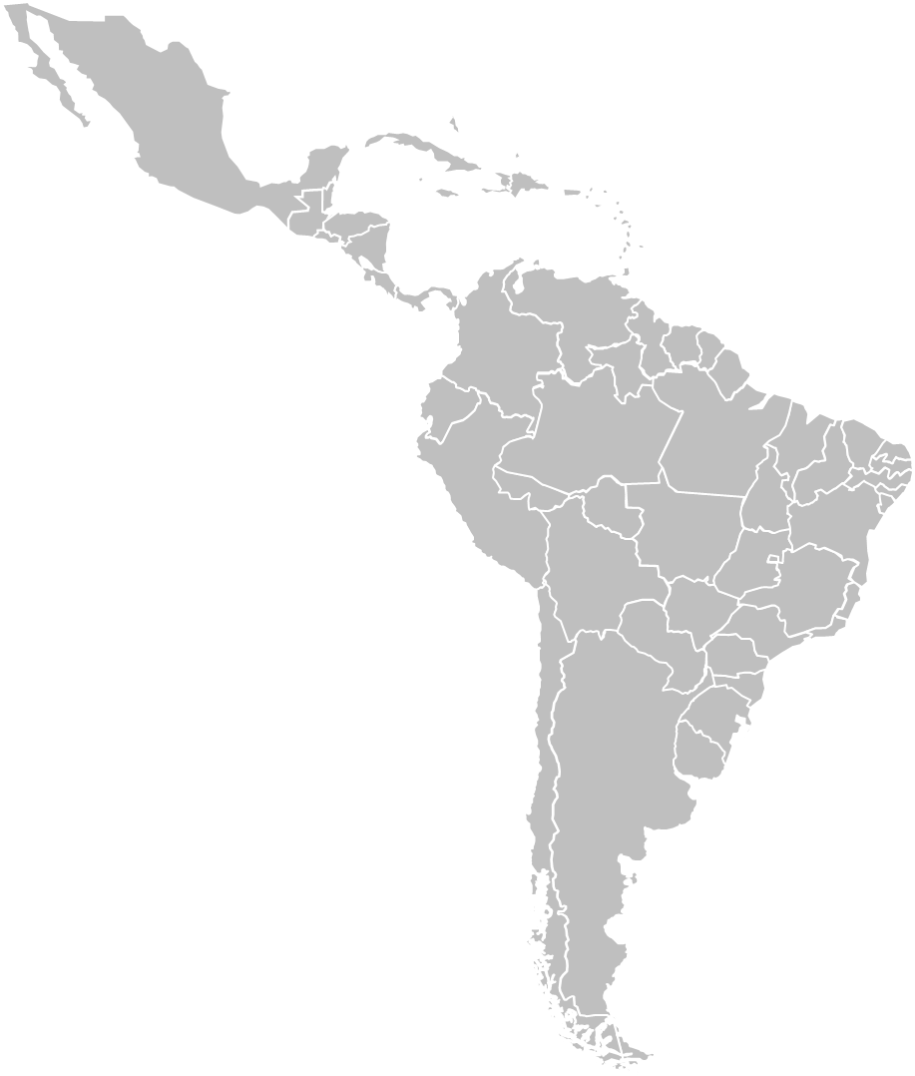
[STORY TITLE]
MD [X]
[PRESENTER NAME]
[TITLE] CA [X]: [CA NAME]

Slide 34
[STORY TITLE]
MD [X]
MD [X]
[PRESENTER NAME]
[TITLE] CA [X]: [CA NAME]
Notes:
Animated Line Instructions:
Insert Shape>Curve
Click the starting point of the line, as well as any points along the way where you would like the line to curve
Once you click the end point of the line, hit “Escape” on your keyboard
Open the Format Menu for the shape and make the following selections:
Solid Line
Color: Custom (175R 30G 45B)
Width: 2.75pt
Dash Type: Long Dash
Shape Effects: Shadow (Offset Bottom)
Navigate to the Animations Tab, Select the line, then click on the “Wipe” animation
Open the Animations Pane, and input the following setting for the animation:
Timing:
Start: With Previous
Delay: 0 Seconds
Duration: 3 Seconds (Slow)
Effect:
Direction: Set as applicable to your start and end point locations
Select the MD Label at the end point of the line (the yellow teardrop/text)
In the Animations Tab, select “Fade”
Input the following settings in the Animations Pane:
Timing:
Start: After Previous
Delay: 0 Seconds
Duration: 1 Second (Fast)

Slide 35
[STORY TITLE]
MD [X]
MD [X]
MD [X]
[PRESENTER NAME]
[TITLE] CA [X]: [CA NAME]
Notes:
Animated Line Instructions:
Insert Shape>Curve
Click the starting point of the line, as well as any points along the way where you would like the line to curve
Once you click the end point of the line, hit “Escape” on your keyboard
Open the Format Menu for the shape and make the following selections:
Solid Line
Color: Custom (175R 30G 45B)
Width: 2.75pt
Dash Type: Long Dash
Shape Effects: Shadow (Offset Bottom)
Navigate to the Animations Tab, Select the line, then click on the “Wipe” animation
Open the Animations Pane, and input the following setting for the animation:
Timing:
Start: With Previous
Delay: 0 Seconds
Duration: 3 Seconds (Slow)
Effect:
Direction: Set as applicable to your start and end point locations
Select the MD Label at the end point of the line (the yellow teardrop/text)
In the Animations Tab, select “Fade”
Input the following settings in the Animations Pane:
Timing:
Start: After Previous
Delay: 0 Seconds
Duration: 1 Second (Fast)

Slide 36
[STORY TITLE]
MD [X]
[PRESENTER NAME]
[TITLE] CA [X]: [CA NAME]

Slide 37
[STORY TITLE]
MD [X]
MD [X]
[PRESENTER NAME]
[TITLE] CA [X]: [CA NAME]
Notes:
Animated Line Instructions:
Insert Shape>Curve
Click the starting point of the line, as well as any points along the way where you would like the line to curve
Once you click the end point of the line, hit “Escape” on your keyboard
Open the Format Menu for the shape and make the following selections:
Solid Line
Color: Custom (175R 30G 45B)
Width: 2.75pt
Dash Type: Long Dash
Shape Effects: Shadow (Offset Bottom)
Navigate to the Animations Tab, Select the line, then click on the “Wipe” animation
Open the Animations Pane, and input the following setting for the animation:
Timing:
Start: With Previous
Delay: 0 Seconds
Duration: 3 Seconds (Slow)
Effect:
Direction: Set as applicable to your start and end point locations
Select the MD Label at the end point of the line (the yellow teardrop/text)
In the Animations Tab, select “Fade”
Input the following settings in the Animations Pane:
Timing:
Start: After Previous
Delay: 0 Seconds
Duration: 1 Second (Fast)

Slide 38
[STORY TITLE]
MD [X]
MD [X]
MD [X]
[PRESENTER NAME]
[TITLE] CA [X]: [CA NAME]
Notes:
Animated Line Instructions:
Insert Shape>Curve
Click the starting point of the line, as well as any points along the way where you would like the line to curve
Once you click the end point of the line, hit “Escape” on your keyboard
Open the Format Menu for the shape and make the following selections:
Solid Line
Color: Custom (175R 30G 45B)
Width: 2.75pt
Dash Type: Long Dash
Shape Effects: Shadow (Offset Bottom)
Navigate to the Animations Tab, Select the line, then click on the “Wipe” animation
Open the Animations Pane, and input the following setting for the animation:
Timing:
Start: With Previous
Delay: 0 Seconds
Duration: 3 Seconds (Slow)
Effect:
Direction: Set as applicable to your start and end point locations
Select the MD Label at the end point of the line (the yellow teardrop/text)
In the Animations Tab, select “Fade”
Input the following settings in the Animations Pane:
Timing:
Start: After Previous
Delay: 0 Seconds
Duration: 1 Second (Fast)

Slide 39
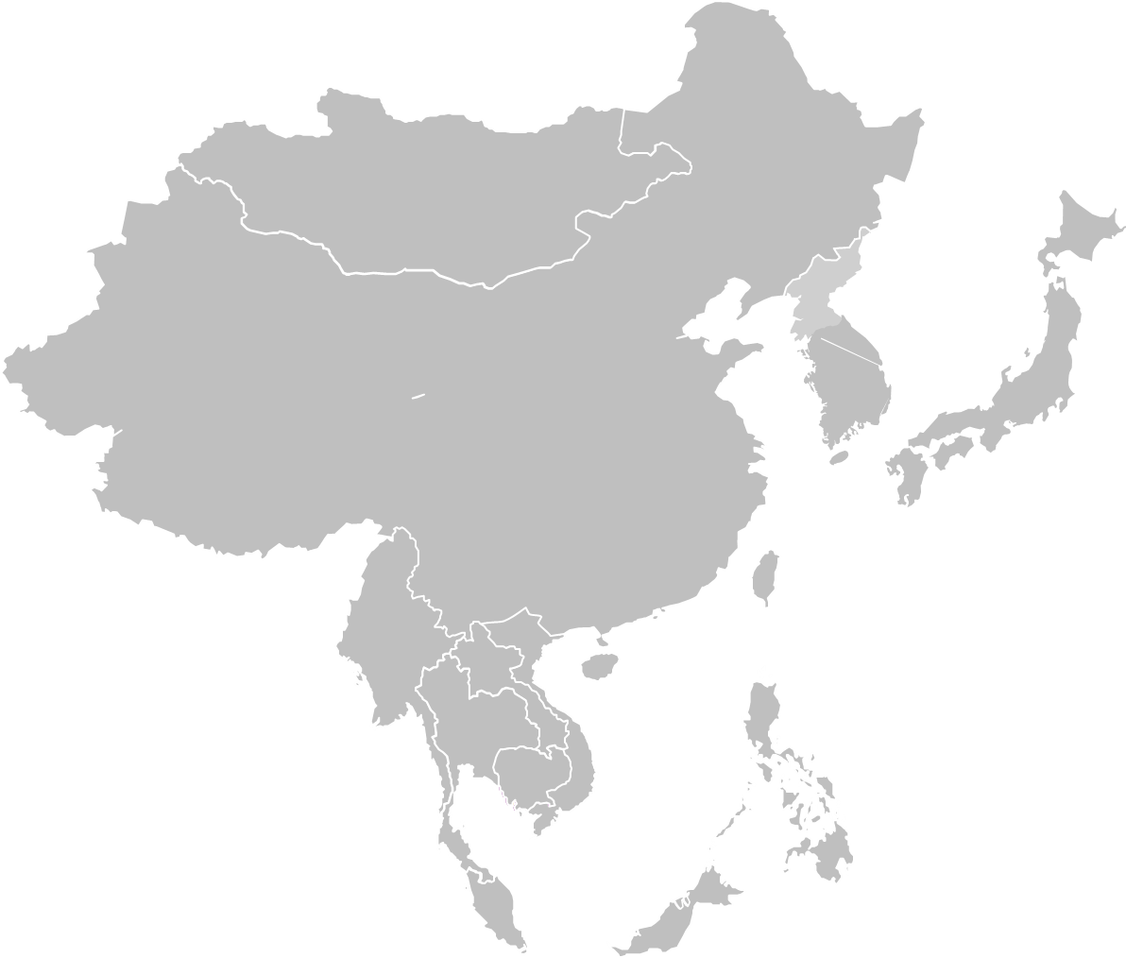
[STORY TITLE]
MD [X]
[PRESENTER NAME]
[TITLE] CA [X]: [CA NAME]

Slide 40
[STORY TITLE]
MD [X]
MD [X]
[PRESENTER NAME]
[TITLE] CA [X]: [CA NAME]
Notes:
Animated Line Instructions:
Insert Shape>Curve
Click the starting point of the line, as well as any points along the way where you would like the line to curve
Once you click the end point of the line, hit “Escape” on your keyboard
Open the Format Menu for the shape and make the following selections:
Solid Line
Color: Custom (175R 30G 45B)
Width: 2.75pt
Dash Type: Long Dash
Shape Effects: Shadow (Offset Bottom)
Navigate to the Animations Tab, Select the line, then click on the “Wipe” animation
Open the Animations Pane, and input the following setting for the animation:
Timing:
Start: With Previous
Delay: 0 Seconds
Duration: 3 Seconds (Slow)
Effect:
Direction: Set as applicable to your start and end point locations
Select the MD Label at the end point of the line (the yellow teardrop/text)
In the Animations Tab, select “Fade”
Input the following settings in the Animations Pane:
Timing:
Start: After Previous
Delay: 0 Seconds
Duration: 1 Second (Fast)

Slide 41
[STORY TITLE]
MD [X]
MD [X]
MD [X]
[PRESENTER NAME]
[TITLE] CA [X]: [CA NAME]
Notes:
Animated Line Instructions:
Insert Shape>Curve
Click the starting point of the line, as well as any points along the way where you would like the line to curve
Once you click the end point of the line, hit “Escape” on your keyboard
Open the Format Menu for the shape and make the following selections:
Solid Line
Color: Custom (175R 30G 45B)
Width: 2.75pt
Dash Type: Long Dash
Shape Effects: Shadow (Offset Bottom)
Navigate to the Animations Tab, Select the line, then click on the “Wipe” animation
Open the Animations Pane, and input the following setting for the animation:
Timing:
Start: With Previous
Delay: 0 Seconds
Duration: 3 Seconds (Slow)
Effect:
Direction: Set as applicable to your start and end point locations
Select the MD Label at the end point of the line (the yellow teardrop/text)
In the Animations Tab, select “Fade”
Input the following settings in the Animations Pane:
Timing:
Start: After Previous
Delay: 0 Seconds
Duration: 1 Second (Fast)

Slide 42
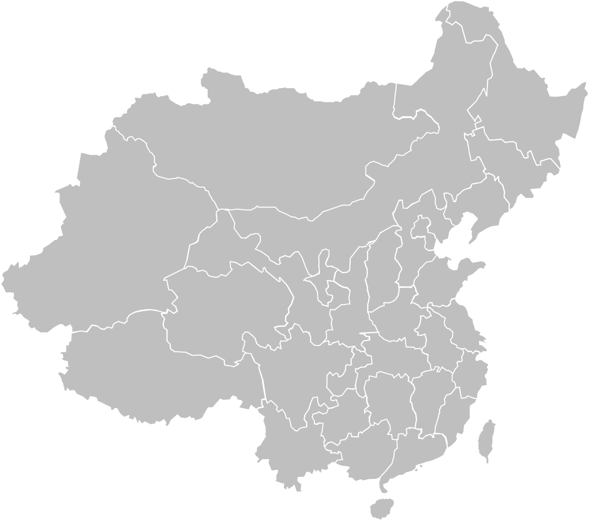
[STORY TITLE]
MD [X]
[PRESENTER NAME]
[TITLE] CA [X]: [CA NAME]

Slide 43
[STORY TITLE]
MD [X]
MD [X]
[PRESENTER NAME]
[TITLE] CA [X]: [CA NAME]
Notes:
Animated Line Instructions:
Insert Shape>Curve
Click the starting point of the line, as well as any points along the way where you would like the line to curve
Once you click the end point of the line, hit “Escape” on your keyboard
Open the Format Menu for the shape and make the following selections:
Solid Line
Color: Custom (175R 30G 45B)
Width: 2.75pt
Dash Type: Long Dash
Shape Effects: Shadow (Offset Bottom)
Navigate to the Animations Tab, Select the line, then click on the “Wipe” animation
Open the Animations Pane, and input the following setting for the animation:
Timing:
Start: With Previous
Delay: 0 Seconds
Duration: 3 Seconds (Slow)
Effect:
Direction: Set as applicable to your start and end point locations
Select the MD Label at the end point of the line (the yellow teardrop/text)
In the Animations Tab, select “Fade”
Input the following settings in the Animations Pane:
Timing:
Start: After Previous
Delay: 0 Seconds
Duration: 1 Second (Fast)

Slide 44
[STORY TITLE]
MD [X]
MD [X]
MD [X]
[PRESENTER NAME]
[TITLE] CA [X]: [CA NAME]
Notes:
Animated Line Instructions:
Insert Shape>Curve
Click the starting point of the line, as well as any points along the way where you would like the line to curve
Once you click the end point of the line, hit “Escape” on your keyboard
Open the Format Menu for the shape and make the following selections:
Solid Line
Color: Custom (175R 30G 45B)
Width: 2.75pt
Dash Type: Long Dash
Shape Effects: Shadow (Offset Bottom)
Navigate to the Animations Tab, Select the line, then click on the “Wipe” animation
Open the Animations Pane, and input the following setting for the animation:
Timing:
Start: With Previous
Delay: 0 Seconds
Duration: 3 Seconds (Slow)
Effect:
Direction: Set as applicable to your start and end point locations
Select the MD Label at the end point of the line (the yellow teardrop/text)
In the Animations Tab, select “Fade”
Input the following settings in the Animations Pane:
Timing:
Start: After Previous
Delay: 0 Seconds
Duration: 1 Second (Fast)

Slide 45
[STORY TITLE]
MD [X]
[PRESENTER NAME]
[TITLE] CA [X]: [CA NAME]

Slide 46
[STORY TITLE]
MD [X]
MD [X]
[PRESENTER NAME]
[TITLE] CA [X]: [CA NAME]
Notes:
Animated Line Instructions:
Insert Shape>Curve
Click the starting point of the line, as well as any points along the way where you would like the line to curve
Once you click the end point of the line, hit “Escape” on your keyboard
Open the Format Menu for the shape and make the following selections:
Solid Line
Color: Custom (175R 30G 45B)
Width: 2.75pt
Dash Type: Long Dash
Shape Effects: Shadow (Offset Bottom)
Navigate to the Animations Tab, Select the line, then click on the “Wipe” animation
Open the Animations Pane, and input the following setting for the animation:
Timing:
Start: With Previous
Delay: 0 Seconds
Duration: 3 Seconds (Slow)
Effect:
Direction: Set as applicable to your start and end point locations
Select the MD Label at the end point of the line (the yellow teardrop/text)
In the Animations Tab, select “Fade”
Input the following settings in the Animations Pane:
Timing:
Start: After Previous
Delay: 0 Seconds
Duration: 1 Second (Fast)

Slide 47
[STORY TITLE]
MD [X]
MD [X]
MD [X]
[PRESENTER NAME]
[TITLE] CA [X]: [CA NAME]
Notes:
Animated Line Instructions:
Insert Shape>Curve
Click the starting point of the line, as well as any points along the way where you would like the line to curve
Once you click the end point of the line, hit “Escape” on your keyboard
Open the Format Menu for the shape and make the following selections:
Solid Line
Color: Custom (175R 30G 45B)
Width: 2.75pt
Dash Type: Long Dash
Shape Effects: Shadow (Offset Bottom)
Navigate to the Animations Tab, Select the line, then click on the “Wipe” animation
Open the Animations Pane, and input the following setting for the animation:
Timing:
Start: With Previous
Delay: 0 Seconds
Duration: 3 Seconds (Slow)
Effect:
Direction: Set as applicable to your start and end point locations
Select the MD Label at the end point of the line (the yellow teardrop/text)
In the Animations Tab, select “Fade”
Input the following settings in the Animations Pane:
Timing:
Start: After Previous
Delay: 0 Seconds
Duration: 1 Second (Fast)

Slide 48
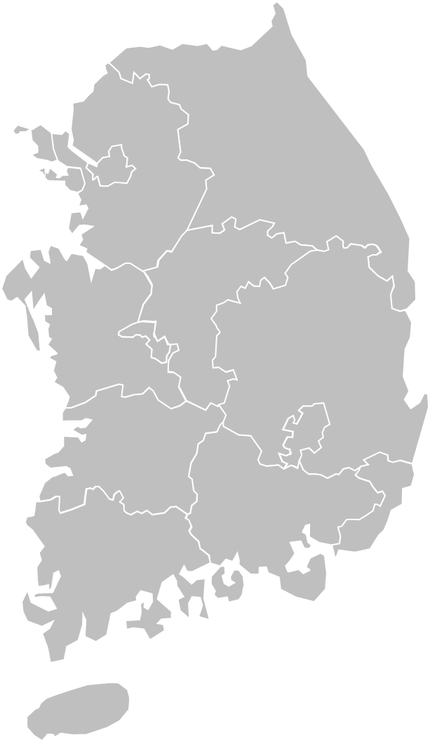
[STORY TITLE]
MD [X]
[PRESENTER NAME]
[TITLE] CA [X]: [CA NAME]

Slide 49
[STORY TITLE]
MD [X]
MD [X]
[PRESENTER NAME]
[TITLE] CA [X]: [CA NAME]
Notes:
Animated Line Instructions:
Insert Shape>Curve
Click the starting point of the line, as well as any points along the way where you would like the line to curve
Once you click the end point of the line, hit “Escape” on your keyboard
Open the Format Menu for the shape and make the following selections:
Solid Line
Color: Custom (175R 30G 45B)
Width: 2.75pt
Dash Type: Long Dash
Shape Effects: Shadow (Offset Bottom)
Navigate to the Animations Tab, Select the line, then click on the “Wipe” animation
Open the Animations Pane, and input the following setting for the animation:
Timing:
Start: With Previous
Delay: 0 Seconds
Duration: 3 Seconds (Slow)
Effect:
Direction: Set as applicable to your start and end point locations
Select the MD Label at the end point of the line (the yellow teardrop/text)
In the Animations Tab, select “Fade”
Input the following settings in the Animations Pane:
Timing:
Start: After Previous
Delay: 0 Seconds
Duration: 1 Second (Fast)

Slide 50
[STORY TITLE]
MD [X]
MD [X]
MD [X]
[PRESENTER NAME]
[TITLE] CA [X]: [CA NAME]
Notes:
Animated Line Instructions:
Insert Shape>Curve
Click the starting point of the line, as well as any points along the way where you would like the line to curve
Once you click the end point of the line, hit “Escape” on your keyboard
Open the Format Menu for the shape and make the following selections:
Solid Line
Color: Custom (175R 30G 45B)
Width: 2.75pt
Dash Type: Long Dash
Shape Effects: Shadow (Offset Bottom)
Navigate to the Animations Tab, Select the line, then click on the “Wipe” animation
Open the Animations Pane, and input the following setting for the animation:
Timing:
Start: With Previous
Delay: 0 Seconds
Duration: 3 Seconds (Slow)
Effect:
Direction: Set as applicable to your start and end point locations
Select the MD Label at the end point of the line (the yellow teardrop/text)
In the Animations Tab, select “Fade”
Input the following settings in the Animations Pane:
Timing:
Start: After Previous
Delay: 0 Seconds
Duration: 1 Second (Fast)

Slide 51
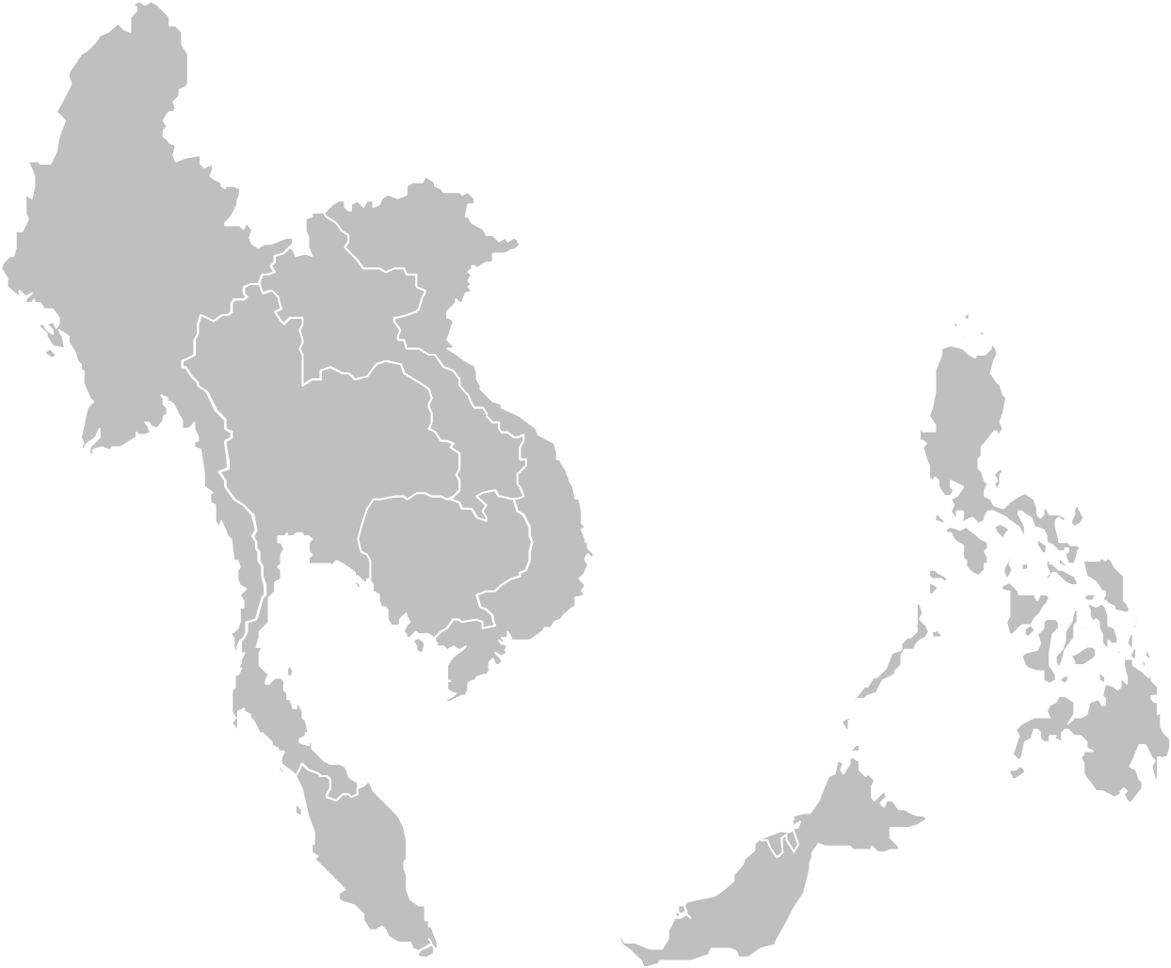
[STORY TITLE]
MD [X]
[PRESENTER NAME]
[TITLE] CA [X]: [CA NAME]

Slide 52
[STORY TITLE]
MD [X]
MD [X]
[PRESENTER NAME]
[TITLE] CA [X]: [CA NAME]
Notes:
Animated Line Instructions:
Insert Shape>Curve
Click the starting point of the line, as well as any points along the way where you would like the line to curve
Once you click the end point of the line, hit “Escape” on your keyboard
Open the Format Menu for the shape and make the following selections:
Solid Line
Color: Custom (175R 30G 45B)
Width: 2.75pt
Dash Type: Long Dash
Shape Effects: Shadow (Offset Bottom)
Navigate to the Animations Tab, Select the line, then click on the “Wipe” animation
Open the Animations Pane, and input the following setting for the animation:
Timing:
Start: With Previous
Delay: 0 Seconds
Duration: 3 Seconds (Slow)
Effect:
Direction: Set as applicable to your start and end point locations
Select the MD Label at the end point of the line (the yellow teardrop/text)
In the Animations Tab, select “Fade”
Input the following settings in the Animations Pane:
Timing:
Start: After Previous
Delay: 0 Seconds
Duration: 1 Second (Fast)

Slide 53
[STORY TITLE]
MD [X]
MD [X]
MD [X]
[PRESENTER NAME]
[TITLE] CA [X]: [CA NAME]
Notes:
Animated Line Instructions:
Insert Shape>Curve
Click the starting point of the line, as well as any points along the way where you would like the line to curve
Once you click the end point of the line, hit “Escape” on your keyboard
Open the Format Menu for the shape and make the following selections:
Solid Line
Color: Custom (175R 30G 45B)
Width: 2.75pt
Dash Type: Long Dash
Shape Effects: Shadow (Offset Bottom)
Navigate to the Animations Tab, Select the line, then click on the “Wipe” animation
Open the Animations Pane, and input the following setting for the animation:
Timing:
Start: With Previous
Delay: 0 Seconds
Duration: 3 Seconds (Slow)
Effect:
Direction: Set as applicable to your start and end point locations
Select the MD Label at the end point of the line (the yellow teardrop/text)
In the Animations Tab, select “Fade”
Input the following settings in the Animations Pane:
Timing:
Start: After Previous
Delay: 0 Seconds
Duration: 1 Second (Fast)

Slide 54
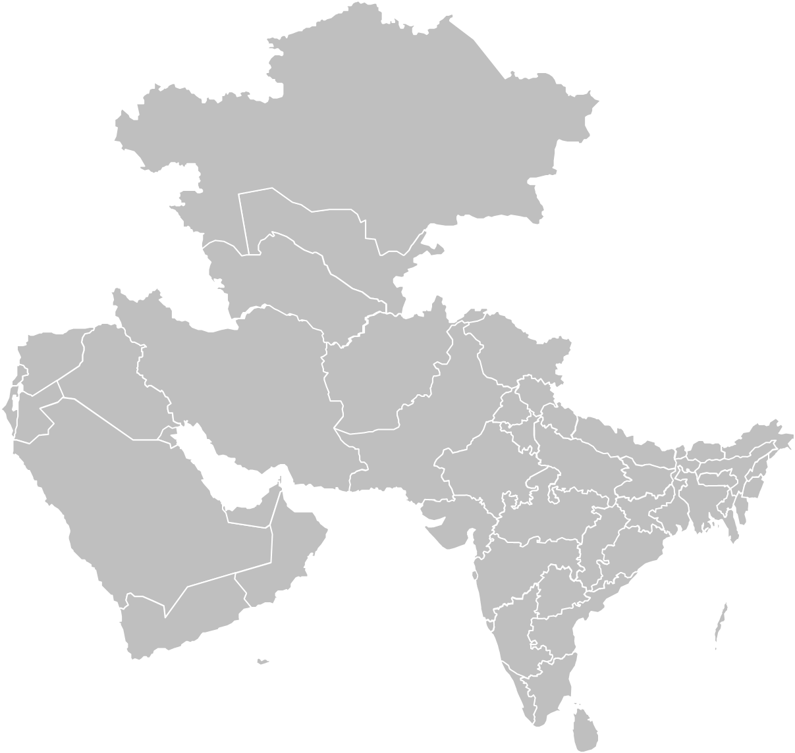
[STORY TITLE]
MD [X]
[PRESENTER NAME]
[TITLE] CA [X]: [CA NAME]

Slide 55
[STORY TITLE]
MD [X]
MD [X]
[PRESENTER NAME]
[TITLE] CA [X]: [CA NAME]
Notes:
Animated Line Instructions:
Insert Shape>Curve
Click the starting point of the line, as well as any points along the way where you would like the line to curve
Once you click the end point of the line, hit “Escape” on your keyboard
Open the Format Menu for the shape and make the following selections:
Solid Line
Color: Custom (175R 30G 45B)
Width: 2.75pt
Dash Type: Long Dash
Shape Effects: Shadow (Offset Bottom)
Navigate to the Animations Tab, Select the line, then click on the “Wipe” animation
Open the Animations Pane, and input the following setting for the animation:
Timing:
Start: With Previous
Delay: 0 Seconds
Duration: 3 Seconds (Slow)
Effect:
Direction: Set as applicable to your start and end point locations
Select the MD Label at the end point of the line (the yellow teardrop/text)
In the Animations Tab, select “Fade”
Input the following settings in the Animations Pane:
Timing:
Start: After Previous
Delay: 0 Seconds
Duration: 1 Second (Fast)

Slide 56
[STORY TITLE]
MD [X]
MD [X]
MD [X]
[PRESENTER NAME]
[TITLE] CA [X]: [CA NAME]
Notes:
Animated Line Instructions:
Insert Shape>Curve
Click the starting point of the line, as well as any points along the way where you would like the line to curve
Once you click the end point of the line, hit “Escape” on your keyboard
Open the Format Menu for the shape and make the following selections:
Solid Line
Color: Custom (175R 30G 45B)
Width: 2.75pt
Dash Type: Long Dash
Shape Effects: Shadow (Offset Bottom)
Navigate to the Animations Tab, Select the line, then click on the “Wipe” animation
Open the Animations Pane, and input the following setting for the animation:
Timing:
Start: With Previous
Delay: 0 Seconds
Duration: 3 Seconds (Slow)
Effect:
Direction: Set as applicable to your start and end point locations
Select the MD Label at the end point of the line (the yellow teardrop/text)
In the Animations Tab, select “Fade”
Input the following settings in the Animations Pane:
Timing:
Start: After Previous
Delay: 0 Seconds
Duration: 1 Second (Fast)

Slide 57
[STORY TITLE]
MD [X]
[PRESENTER NAME]
[TITLE] CA [X]: [CA NAME]

Slide 58
[STORY TITLE]
MD [X]
MD [X]
[PRESENTER NAME]
[TITLE] CA [X]: [CA NAME]
Notes:
Animated Line Instructions:
Insert Shape>Curve
Click the starting point of the line, as well as any points along the way where you would like the line to curve
Once you click the end point of the line, hit “Escape” on your keyboard
Open the Format Menu for the shape and make the following selections:
Solid Line
Color: Custom (175R 30G 45B)
Width: 2.75pt
Dash Type: Long Dash
Shape Effects: Shadow (Offset Bottom)
Navigate to the Animations Tab, Select the line, then click on the “Wipe” animation
Open the Animations Pane, and input the following setting for the animation:
Timing:
Start: With Previous
Delay: 0 Seconds
Duration: 3 Seconds (Slow)
Effect:
Direction: Set as applicable to your start and end point locations
Select the MD Label at the end point of the line (the yellow teardrop/text)
In the Animations Tab, select “Fade”
Input the following settings in the Animations Pane:
Timing:
Start: After Previous
Delay: 0 Seconds
Duration: 1 Second (Fast)

Slide 59
[STORY TITLE]
MD [X]
MD [X]
MD [X]
[PRESENTER NAME]
[TITLE] CA [X]: [CA NAME]
Notes:
Animated Line Instructions:
Insert Shape>Curve
Click the starting point of the line, as well as any points along the way where you would like the line to curve
Once you click the end point of the line, hit “Escape” on your keyboard
Open the Format Menu for the shape and make the following selections:
Solid Line
Color: Custom (175R 30G 45B)
Width: 2.75pt
Dash Type: Long Dash
Shape Effects: Shadow (Offset Bottom)
Navigate to the Animations Tab, Select the line, then click on the “Wipe” animation
Open the Animations Pane, and input the following setting for the animation:
Timing:
Start: With Previous
Delay: 0 Seconds
Duration: 3 Seconds (Slow)
Effect:
Direction: Set as applicable to your start and end point locations
Select the MD Label at the end point of the line (the yellow teardrop/text)
In the Animations Tab, select “Fade”
Input the following settings in the Animations Pane:
Timing:
Start: After Previous
Delay: 0 Seconds
Duration: 1 Second (Fast)

Slide 60
[STORY TITLE]
MD [X]
[PRESENTER NAME]
[TITLE] CA [X]: [CA NAME]

Slide 61
[STORY TITLE]
MD [X]
MD [X]
[PRESENTER NAME]
[TITLE] CA [X]: [CA NAME]
Notes:
Animated Line Instructions:
Insert Shape>Curve
Click the starting point of the line, as well as any points along the way where you would like the line to curve
Once you click the end point of the line, hit “Escape” on your keyboard
Open the Format Menu for the shape and make the following selections:
Solid Line
Color: Custom (175R 30G 45B)
Width: 2.75pt
Dash Type: Long Dash
Shape Effects: Shadow (Offset Bottom)
Navigate to the Animations Tab, Select the line, then click on the “Wipe” animation
Open the Animations Pane, and input the following setting for the animation:
Timing:
Start: With Previous
Delay: 0 Seconds
Duration: 3 Seconds (Slow)
Effect:
Direction: Set as applicable to your start and end point locations
Select the MD Label at the end point of the line (the yellow teardrop/text)
In the Animations Tab, select “Fade”
Input the following settings in the Animations Pane:
Timing:
Start: After Previous
Delay: 0 Seconds
Duration: 1 Second (Fast)

Slide 62
[STORY TITLE]
MD [X]
MD [X]
MD [X]
[PRESENTER NAME]
[TITLE] CA [X]: [CA NAME]
Notes:
Animated Line Instructions:
Insert Shape>Curve
Click the starting point of the line, as well as any points along the way where you would like the line to curve
Once you click the end point of the line, hit “Escape” on your keyboard
Open the Format Menu for the shape and make the following selections:
Solid Line
Color: Custom (175R 30G 45B)
Width: 2.75pt
Dash Type: Long Dash
Shape Effects: Shadow (Offset Bottom)
Navigate to the Animations Tab, Select the line, then click on the “Wipe” animation
Open the Animations Pane, and input the following setting for the animation:
Timing:
Start: With Previous
Delay: 0 Seconds
Duration: 3 Seconds (Slow)
Effect:
Direction: Set as applicable to your start and end point locations
Select the MD Label at the end point of the line (the yellow teardrop/text)
In the Animations Tab, select “Fade”
Input the following settings in the Animations Pane:
Timing:
Start: After Previous
Delay: 0 Seconds
Duration: 1 Second (Fast)

