Slide 1
The Global Action Team
Action = Impact

Slide 2

One Team Approach
Notes:
The Global Action Team believes in a one-team approach, working together to increase leadership development, enhance membership opportunities and promote innovative, impactful service projects in communities all over the world.
Through teamwork, a small idea in a community can grow into the next big idea that impacts millions across a world, and people across the world can come together to support one cause. That’s the power of action.

Slide 3
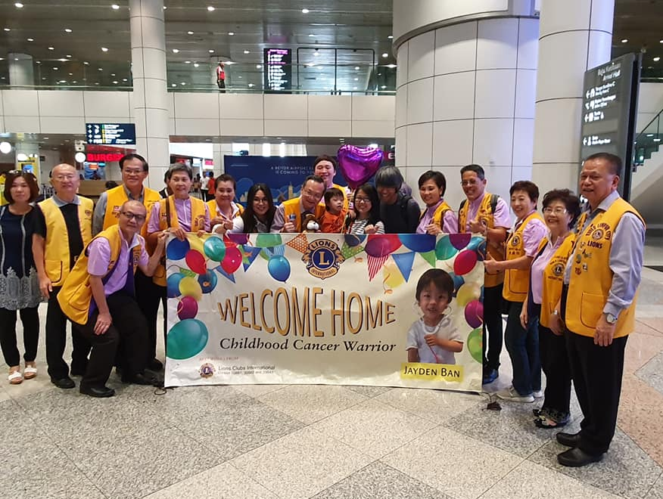

International GAT Leaders Join Together
Through collaboration and kindness,
the Global Action Team transcended boundaries to help one little boy in need.
3
Notes:
I’d like to share an example of how this one-team approach creates lasting impact.
By utilizing its international leadership, the Global Action Team was able to provide various types of support for one family in Malaysia.

Slide 4
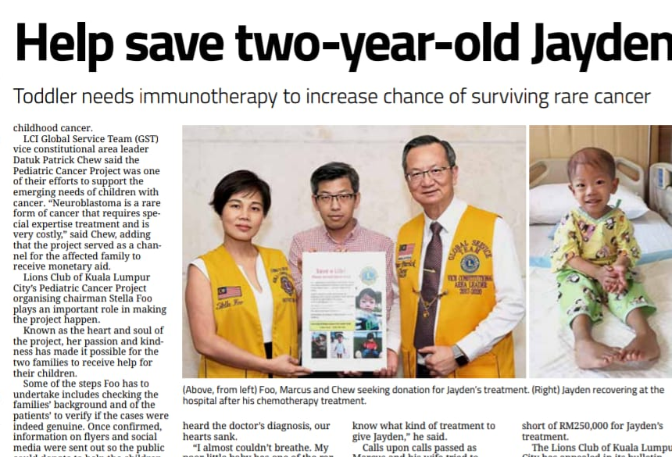
Lion Leaders Mobilize For Childhood Cancer
Chris Bunch – LION Managing Editor
Sanjeev Ahuja – Chief of Marketing & Membership
Dan Hervey – Brand & Creative Director
Stephanie Morales – Meetings Manager
When Marcus Ban found out his 2-year-old son was diagnosed with neuroblastoma, he asked for help from the Lions Clubs in Malaysia. This started tidal wave of support that grew into the collaboration of Lions in Malaysia, Singapore, Spain and the United States.
Notes:
After Jayden was diagnosed with neuroblastoma, a rare type of cancer, his father contacted Lions from the Kuala Lumpur City Lions Club to ask for help with his son's treatment. After Jayden received unsuccessful chemotherapy in Singapore, the GAT Lions mobilized throughout other parts of the world to find a facility that could provide Jayden with the treatment that he needed.

Slide 5
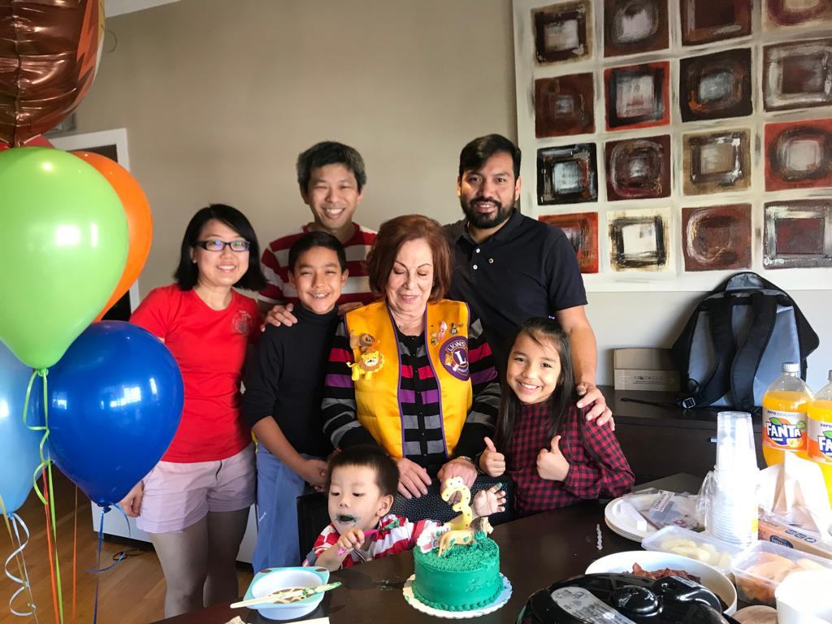
Finding a facility to treat Jayden's condition was
not the only obstacle
that Lions had to
overcome.
Easing the burden that this disease placed on Jayden's family was also a priority for Lions
5
Notes:
After many attempts to find treatment, Jayden's family landed in Barcelona. The Lions there were eager to help the family in any way they could. They welcomed them with emotional support, provided Metro Cards for them to get around the city, and even threw Jayden his 3rd birthday party.

Slide 6
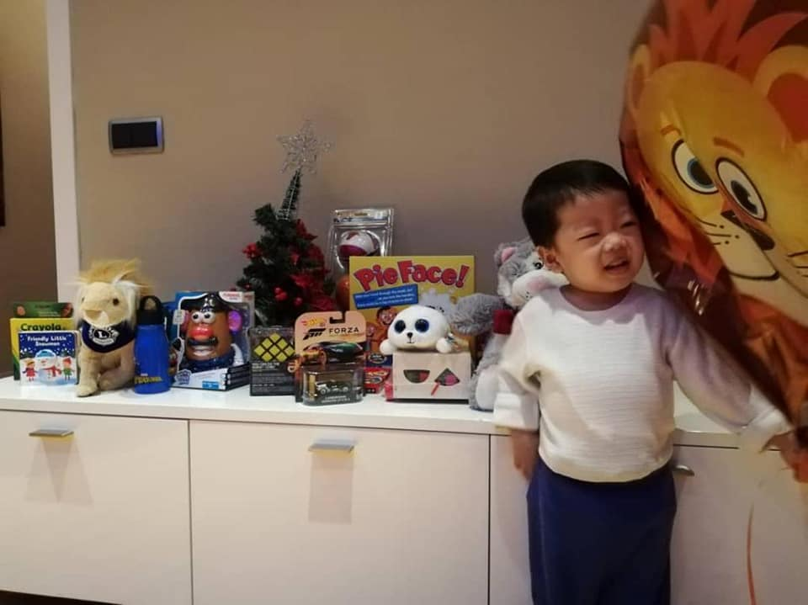
Each Pillar Plays Its Part
Leadership, Membership, & Service in Action
6
Notes:
Each pillar of the Global Action Team- leadership, membership and service- played an important role in getting Jayden the treatments needed to save his life.
Here’s how the GAT brought together leadership, service and membership to expand their impact.

Slide 7
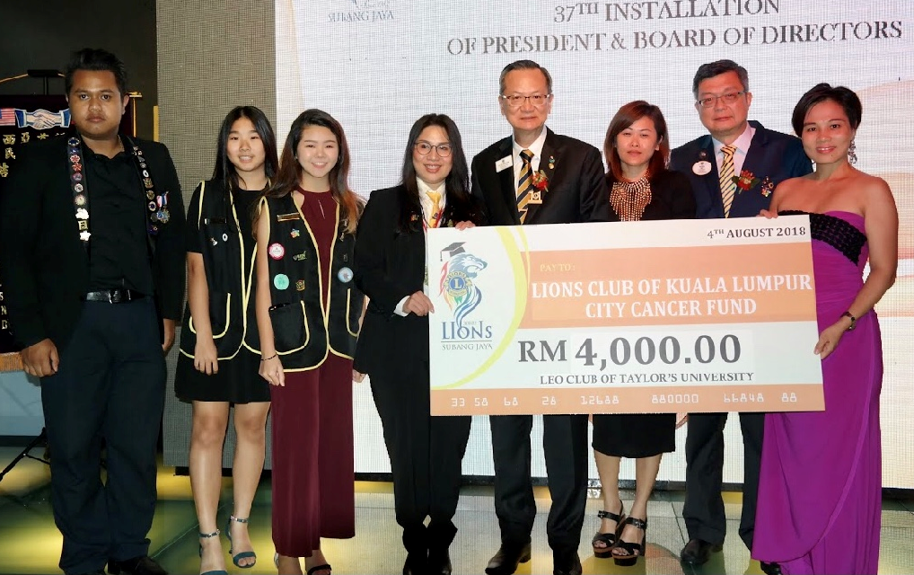
LEADERSHIP
In Malaysia
Reaching out to Lions worldwide
Getting the word out to the
GAT Network through Facebook and Email
Leading fundraising efforts through the Lions Club of Kuala Lumpur City Cancer Fund
Involving Leos and Lions in fundraising and support
Leos in Malaysia fundraise for Jayden’s cause
7
Notes:
Exceptional leadership was demonstrated by our GAT Team throughout multiple levels. In Malaysia, GAT leaders played a huge part by including local Lions and activating Lions around the world to help Jayden.
They emailed several Lions in different countries and worked with GAT staff to serve in helping Jayden. A meeting was organize at the LCI Convention in Las Vegas for the GAT Leaders in New York and Malaysia to meet and plan support for Jayden and his family.

Slide 8
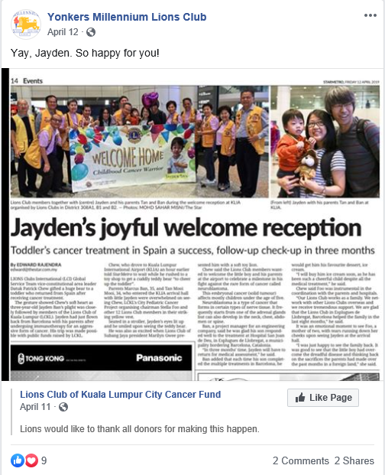
SERVICE
In the US and Singapore
In New York
  Communicating with local hospitals on behalf of Jayden’s family to try to facilitate treatment
  Fundraising for treatment and supplies for Jayden
  Promoting Facebook posts about Jayden to get the word out and help raise funds
In Chicago
  Gathering toys to send to Jayden as Christmas Gifts
In Singapore
  Fundraising at MD Conventions
8
Yonkers Millennium Lions Club uses Facebook as a promotional tool.
Notes:
Service is why Lions become Lions. With Jayden, multiple impactful service projects were conducted in multiple countries with one goals: Support Jayden.
Childhood cancer is one of our global causes, and clubs around the world came together in support of Jayden. This showed that you do not always have to be in the same country as your service.

Slide 9
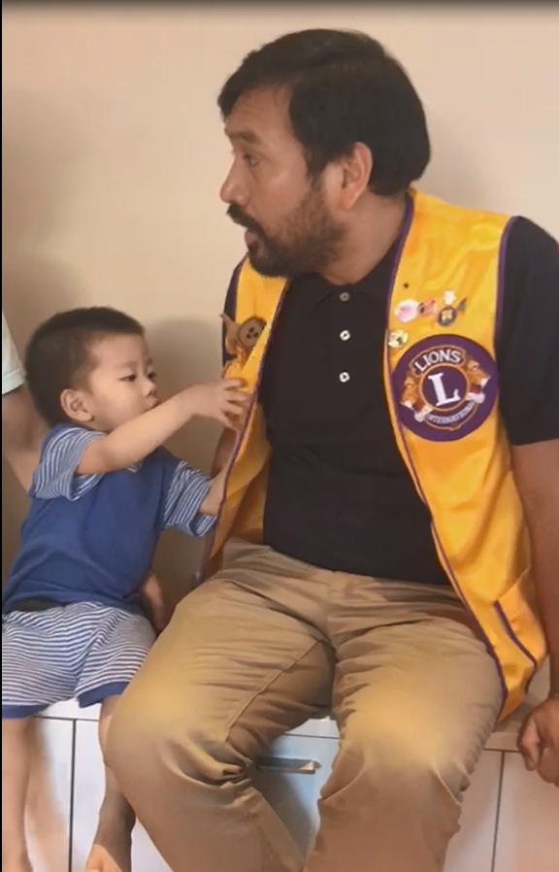
MEMBERSHIP
In Spain
Involving club members in support of Jayden.
Supporting Jayden’s family and their needs while in Barcelona.
Helping Jayden and his family celebrate milestones such as his third birthday and his return home.
Creating positive membership satisfaction.
9
Barcelona Lions visit with Jayden and his family
Notes:
Service projects are what drive people to become, and more importantly, stay Lions. The club level GAT in Barcelona ensured that their members were engaged with visits to the hospital, diaper donations and other forms of local support. The GAT club membership chair ensured that members were active in the project, resulting in positive membership satisfaction.

Slide 10
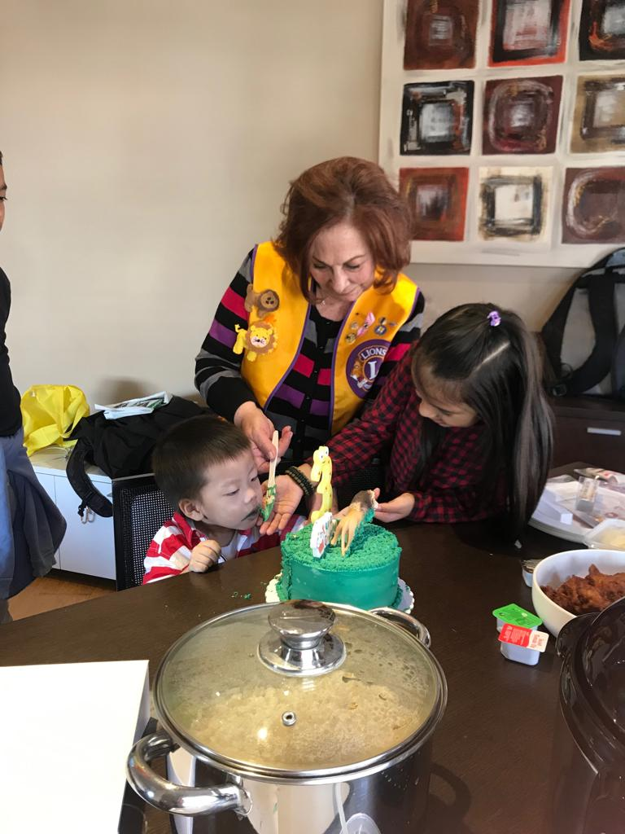
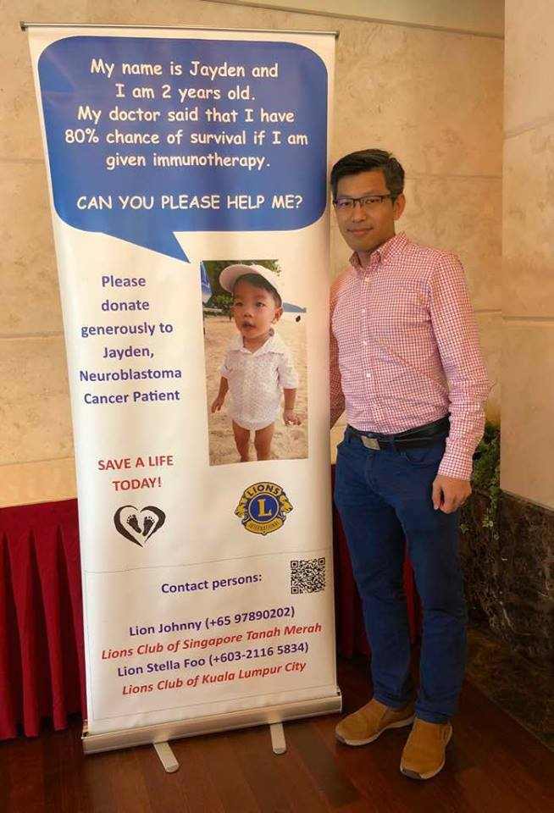
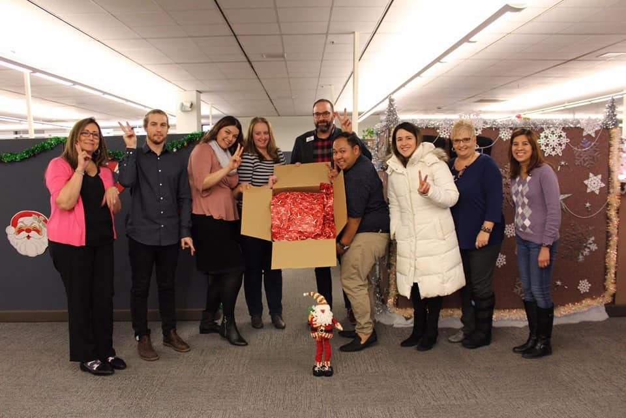
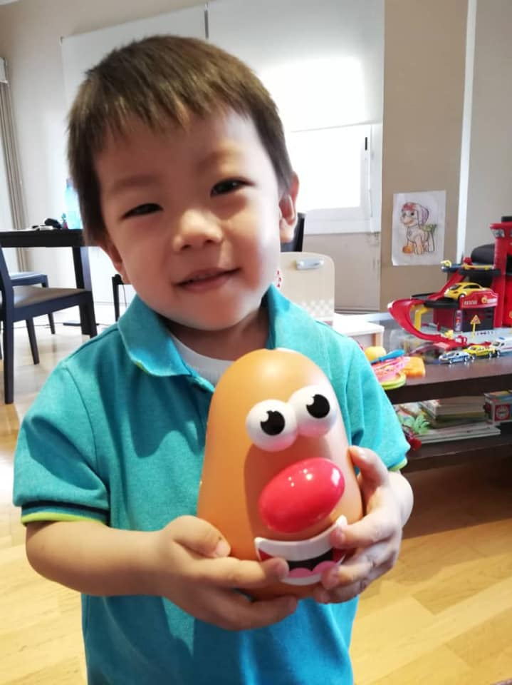
Involved Around the World
Notes:
Through the efforts of Lions across the globe, Jayden was able to receive treatment, and his family got the support they needed to help him through the battle.

Slide 11
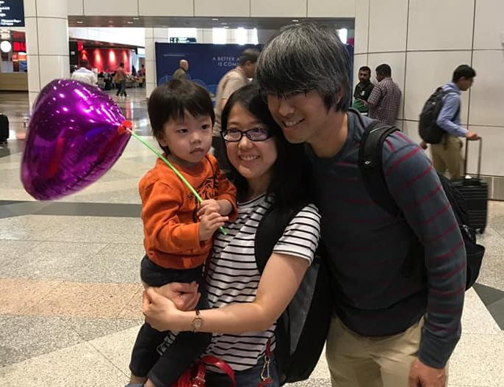
Utilizing the global network
"This is a great example of how the GAT activated the global Lion-to-Lion network. Lions were able to reach across borders in service."
PIP Kajit Habanananda
Global Action Team Chairperson
Jayden and his family arriving home from Barcelona after his treatment
11
Notes:
Jayden’s story has reached every level of Lions. It has been featured in Lions Magazine, various meetings and even at our 2019 international convention.

Slide 12
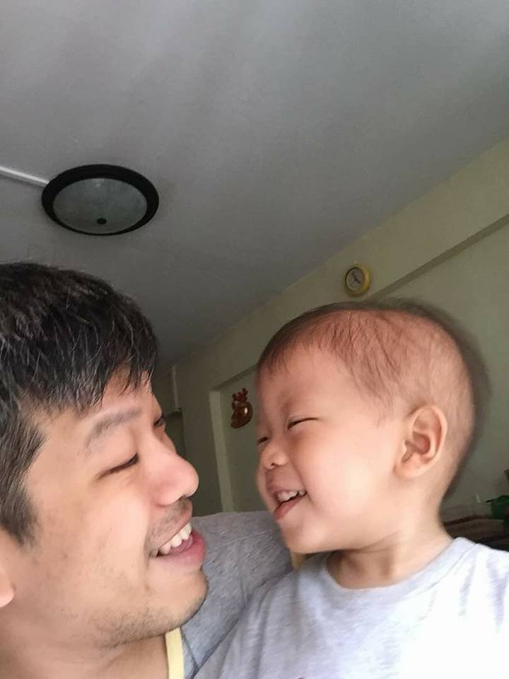
Impact by the Numbers
2018 - 2019
6
4
>65,000
1
Lions Clubs
Countries
US Dollars Raised
Little Boy's Life Saved
12
Notes:
A father's need for Lions activated members around the world to serve one little boy and the family that loved him.
They not only saw the impact of service. They felt it.

Slide 13
Power of Action
Inspire Lions and partners by sharing stories of success
Assess the needs of your community
Utilize the Global Action Team
Seize your moment
Notes:
The impact of service is overwhelming. Service drives membership. And with more Lion members involved in our movement, there is more opportunity for leadership development.
Be inspired by the work being done by Lions around the world.
I encourage you share this success story with Lions in your own district. Through the power of Leadership, Membership and Service, you too can to rally the leaders in your community to make a lasting and sustainable difference.

Slide 14
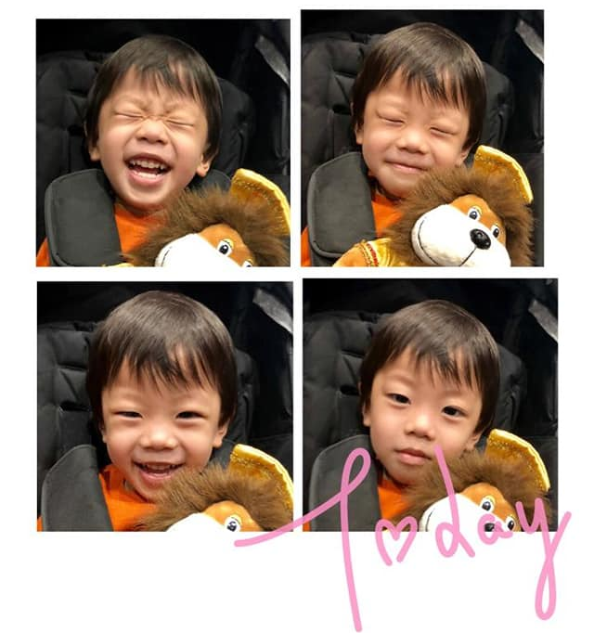
Happy and Healthy
Notes:
Today, Jayden is home in Malaysia with his family, and in full remission.

Slide 15

Thank You
© 2019 Lions Clubs International
9/19 EN

