Slide 1

Lions International Strategic Plan
2022-2023 Update
Notes:
Thank you for joining me today to talk about the global strategy for Lions.

Slide 2
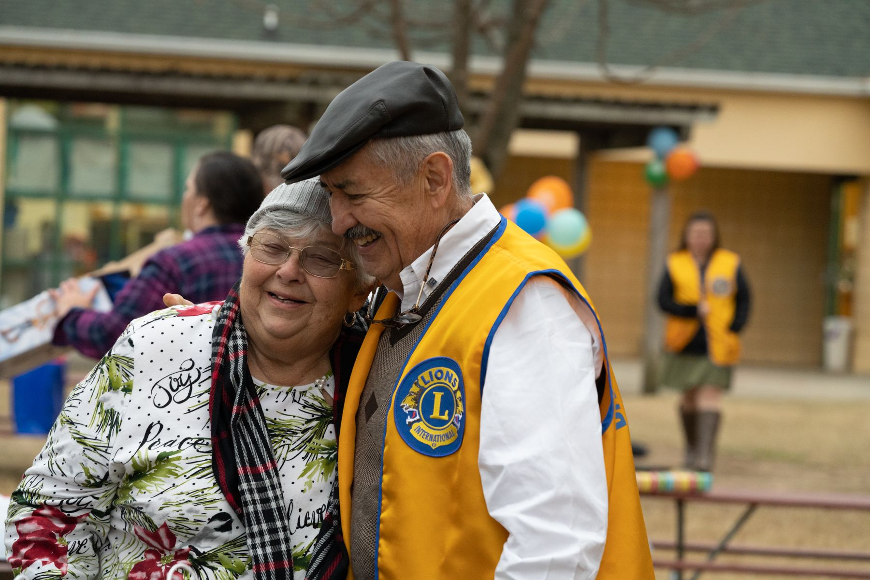
Our past has been defined by our service.
And our future will be too.
Notes:
Before we talk about our strategic plan, let’s talk about why it’s so important.
Over 100 years ago, Lions started with a handful of members and a few clubs. Each year, more and more members joined. And we continued to grow because people embraced the power of service and understood that we can accomplish so much more together.
Today, there are more than 1.4 million members in over 48,000 clubs around the world. We are the largest service organization in the world. And so many communities, and so many people, are depending on our service.
We need a plan so we can continue to be the organization that the world needs us to be.
Now, let’s talk about the steps we’re taking to ensure that we are positioned for success at all levels of Lions.

Slide 3
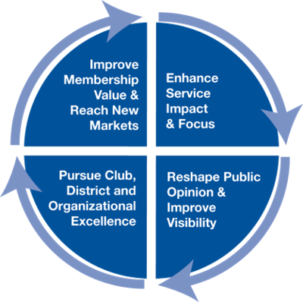
aa
Building our future started with LCI Forward
LCI Forward Plan
Launched in 2015 to guide Lions into our second century of service.
LCI Forward Focus Areas
Our membership, service, operations and global image.
LCI Forward Goal
Serving more than 200M people per year.
LCI Forward Outcomes
New programs and initiatives that positioned us for success.
3
Notes:
In 2015, we launched LCI Forward. This strategic plan was introduced just before our 100th anniversary in 2017 to help ensure that we were ready for our second century of service.
LCI Forward focused on 4 key areas of Lions.
- Strengthening our membership
- Increasing our service impact
- Enhancing our local and global visibility
- Pursuing club, district and organizational excellence
We set an LCI Forward goal of serving 200 million people per year, every year. And we did it. Last year Lions served more than 480 million people!
And we achieved more than just our LCI Forward goal.

Slide 4





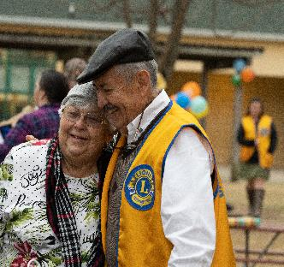


LCI Forward Achievements
Enhanced the new member experience
Including an enhanced New Member Kit and special onboarding emails for new members
Established
global causes
Expanded our
marketing efforts
Launched the
Global Action Team
Launched learning for every Lion
Defined new
membership models
Enhanced the member experience
Enriched digital communications
Launched LCIF’s Campaign 100
4
Notes:
Through LCI Forward, we developed our global causes.
We expanded our marketing efforts and rolled out our Kindness Matters advertising campaign.
We launched the Global Action Team to support our leadership, membership and service.
We started specialty clubs and made online learning available to Lions and Leos.
We focused on making the member experience even better and introduced new digital tools and products.
We launched LCIF’s Campaign 100, and together we exceeded our 300 million dollar goal, raising more than (US) $324 million thanks to you and Lions around the world.
This incredible progress served as the foundation for the Lions International Strategic Plan.

Slide 5

Lions International Strategic Plan
We are united in our global mission of service. This includes every Lion and every club. It includes Lions Clubs International and Lions Clubs International Foundation (LCIF)—we are one.
5
Notes:
The Lions International Strategic Plan keeps us focused on the future so we can continue to grow and thrive.
This includes both Lions Clubs International and Lions Clubs International Foundation—we are one. This includes every Lion and every club.
We are all united in our global mission of service.

Slide 6

Our Vision
To be the global leader in community
and humanitarian service.
Notes:
Our vision is to be the global leader in community and humanitarian service.
It’s an ambitious goal. But we have the best volunteers on earth, and we have a plan to help achieve it.

Slide 7
Our Timeline
Year 1 Year 2 Year 3 Year 4 Year 5
2021-22
2022-23
2023-24
2024-25
2025-26
Notes:
The Lions International Strategic Plan will be implemented over time.
Our first year was focused on building out the plan and advancing some key initial strategies.
We are now in our second year, and we are continuing to advance and execute the plan.
In a moment, we’ll talk about some of our achievements in year one, and what we’re focused on this year.
But first, let’s talk about our global strategy and our approach.

Slide 8
Our Goals
Strengthen the Association & Foundation
Build
new models
for growth
Align goals, governance, organizational support
Notes:
We developed the strategic plan with three goals in mind:
Strengthen the Association & Foundation
We want to increase our impact and provide even better support for members and clubs.
Build new models for growth
The club model always has been, and always will be, the heart of our organization. But we can add to that tradition by developing opportunities for people who are interested in new ways to serve, and by developing new partnerships.
Align goals, governance, and organizational support
With better alignment, structure and processes, we can better support our goals and objectives.

Slide 9
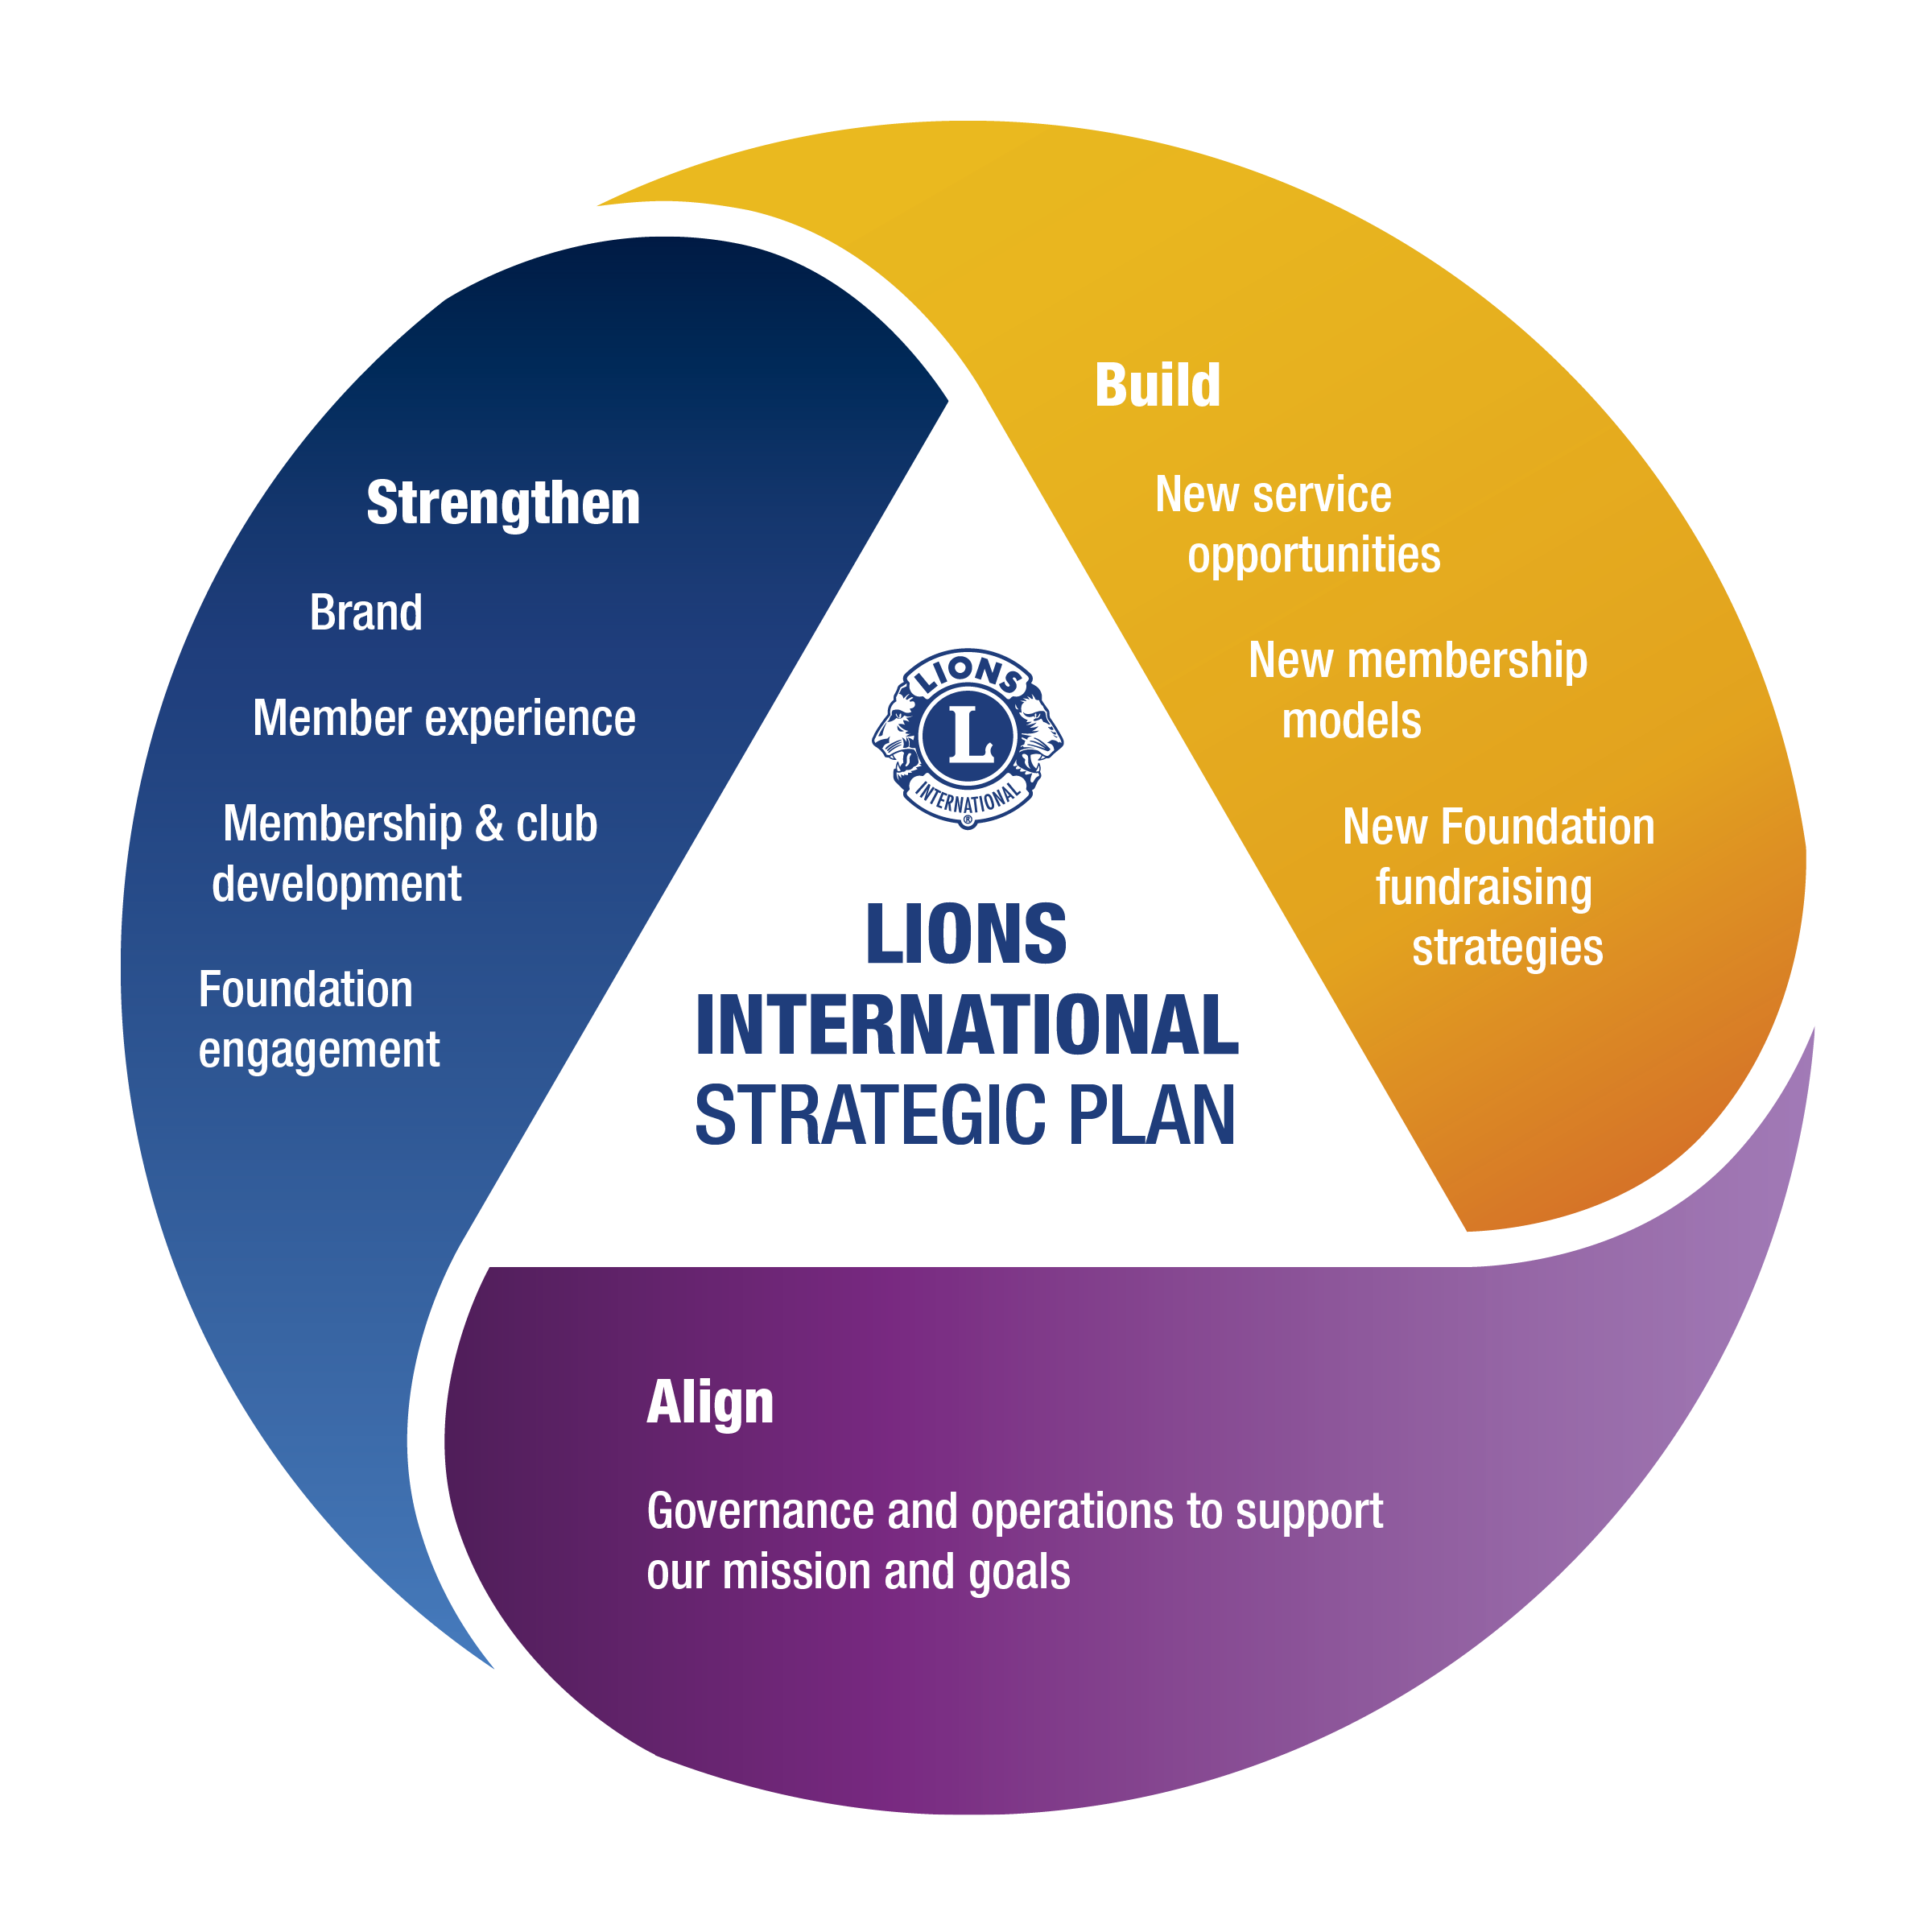
Our
Initiatives
Notes:
Specific initiatives have been developed to achieve each goal.
Our strategic plan graphic helps highlight what we’re focused on achieving.
- Strengthen
- Build
- Align
- Strengthen, Build, Align
Let’s look at each focus area to see why they are important to Lions and our mission of service.

Slide 10

1) Strengthen the Association & Foundation
Unite our association and our global foundation (LCIF) under a single brand name and set of mission pillars.
Ensure new clubs start strong, assist challenged clubs and increase member satisfaction.
Enhance support for new club chartering at the district level.
Create a culture of giving to LCIF.
Notes:
First, to strengthen our Association & Foundation:
We will unite Lions Clubs International and Lions Clubs International Foundation under a single marketing brand to better represent our combined service.
We will also introduce new “mission pillars” to give us a new way to talk about our global causes, our LCIF causes, and the local causes Lions are serving
We will ensure new clubs begin with a strong foundation, provide additional assistance to clubs with challenges, and continue to build the satisfaction of our members.
To help start new clubs around the world, we will add more support for club chartering at the district level.
And we will continue to develop a culture of giving to our Foundation in our clubs to make sure Lions have access to LCIF funding for bigger, more sustainable projects.

Slide 11

2) Build new models for growth
Develop new models for Corporate Social Responsibility (CSR).
Research new service and membership models.
Implement a pilot episodic or “occasional” volunteering program to increase urban engagement.
Notes:
Second, to build new models for growing our association and foundation:
We will expand our partnerships with organizations that are pursuing Corporate Social Responsibility, or CSR, which refers to steps that businesses take to be more socially accountable. This will create new opportunities for joint projects, funding and increased visibility for Lions.
We will also research new service and membership models to add to our club model.
One of those new models is episodic volunteering. These “occasional” volunteers can help increase our impact and lead to new members when they decide to get more involved.

Slide 12

3) Align goals, governance, organizational support
Hold joint virtual board meetings.
Update director and trustee roles.
Explore election improvements for 3VP and directors.
Notes:
Third, we need even better alignment across our entire organization to achieve our goals. To do that:
We will hold annual joint meetings of the LCI Board of Directors and the LCIF Board of Trustees.
We’ll also update the roles of our directors and trustees so they are best able to serve Lions and Leos.
And we’ll explore improvements in the election processes for our international directors and third vice presidents.

Slide 13
So what did we achieve in Year One?
13
Notes:
Although Year One was primarily a building year, we made good progress.
Let’s talk about some of our accomplishments from last year.

Slide 14
Year One – Key Achievements
Strengthen the Association & Foundation
Build
new models
for growth
Align goals, governance, organizational support
Identified new brand name and tagline
Conducted member satisfaction survey
Restructured Membership Development Grants
Secured new corporate partners
Launched partners’ employee giving portal
Episodic volunteering survey
Held initial joint meeting of the boards
Analyzed election process of similar organizations
Notes:
[click] Here are some steps we took to strengthen our association and foundation last year:
We selected our new brand name for our association and foundation: “Lions International”. We’ll talk more about this on the next slide.
We conducted a member satisfaction survey to help us find out what changes members want to see.
We also restructured our Membership Development Grants to maximize their use. So be sure to review our grants if you’re interested in growing your membership.
[click] In building new models, we have:
Secured new corporate partners, including Disney, Enel, BGRS and EverSource.
Launched a giving portal for the employees of our partners, which is already supporting vision exams and Ukraine relief efforts.
And conducted a survey to identify episodic or “occasional” volunteering attitudes and practices in clubs around the world.
[click] In aligning our goals, governance and support, we:
Held the first joint virtual meeting of the LCI and LCIF boards in February 2022.
And started analyzing the election process of similar service organizations to help assess our own.

Slide 15
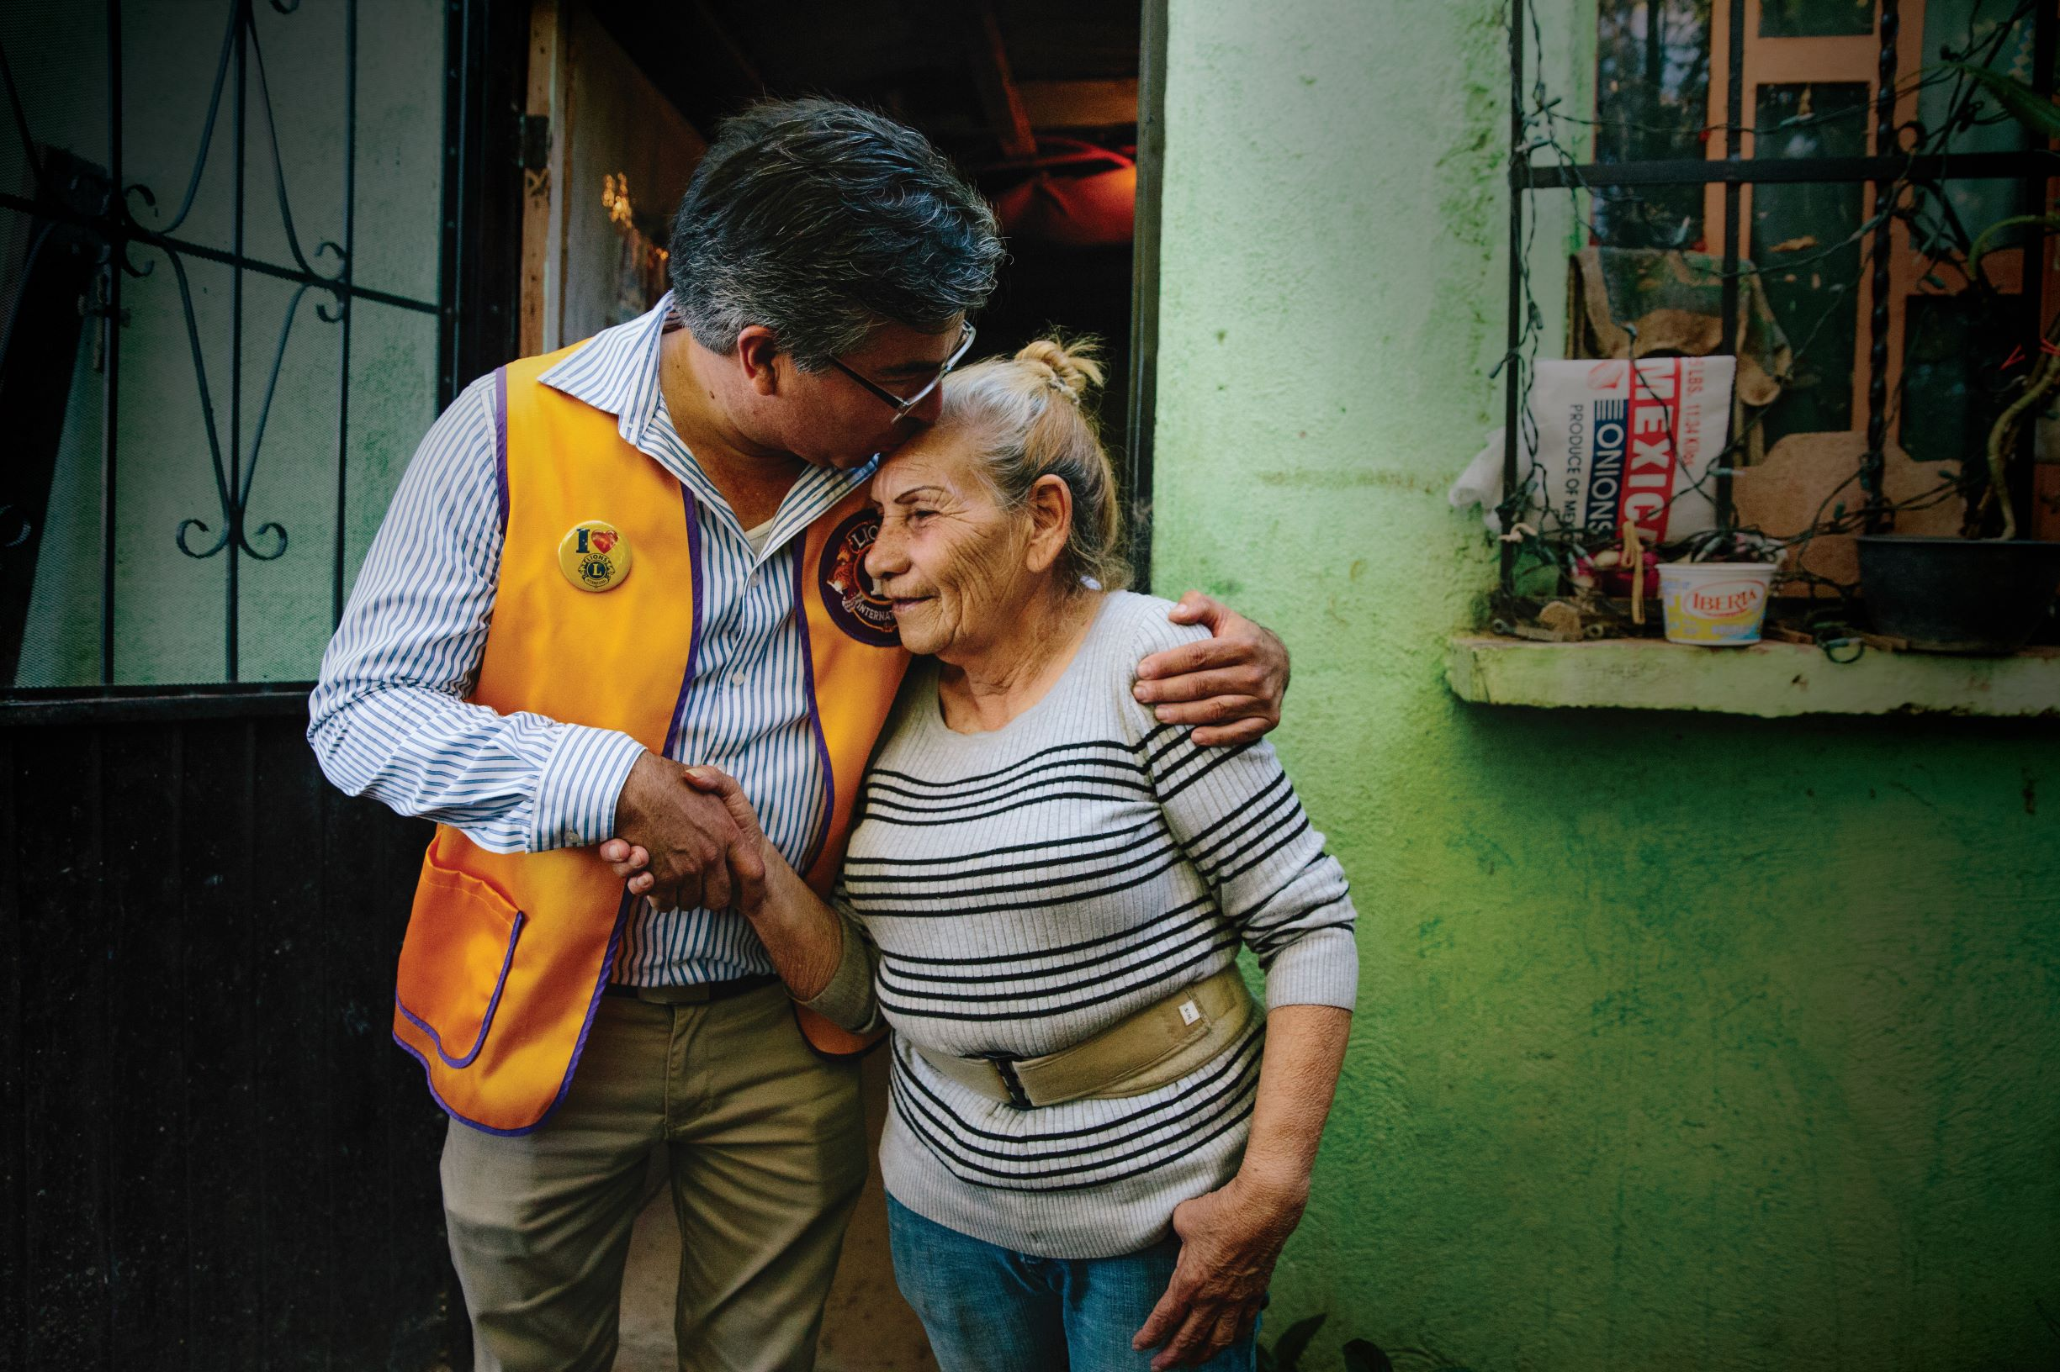


Our Brand
Lions International
Serving a World in Need
15
Notes:
I want to take a moment to talk about our new brand.
We are uniting LCI and LCIF under the “Lions International” brand.
When we say “Lions International,” what we’re really saying is Lions Clubs International and Lions Clubs International Foundation, together.
The Lions International brand will bring both organizations under one “umbrella” brand so we can talk to the world about our collective service and impact.
Because the world sees us as one. They see us as Lions.
And the truth is…we are one.
Our association and foundation will remain separate organizations, and their names won’t change.
Our club model is not changing.
So this move will not change who we are and what we do as Lions. It will simply change the way we speak to the world about both our association and foundation. Together, we are Lions International.
We are also introducing a new tagline for our Lions International brand: Serving a world in need.
This will help the world understand what we do as Lions.

Slide 16
Year Two – Focus Areas
Strengthen the Association & Foundation
Build
new models
for growth
Align goals, governance, organizational support
Launch new brand
Introduce mission pillars
Rebuild clubs
Enhance club chartering
Build on success of Campaign 100
Build out our CSR program
Pilot episodic volunteering events
Partner assessment
Continue joint board meeting
Implement changes for 3VP process
Notes:
This year, we’re continuing to build out and implement key focus areas of our plan.
[click] To help strengthen our association and foundation:
We’ll begin rolling out the new “Lions International” brand and brand guidelines in 2023, and introduce our new mission pillars.
To help rebuild clubs, we’re revising club assessment tools, sharing best practices from successful clubs, and improving the Guiding Lion Program.
To build on the success of Campaign 100, we’re focusing on club and individual giving.
We’re also developing a comprehensive support program for new clubs and survey materials to assess member satisfaction.
[click] To help focus on growth, we are:
Continuing to build our CSR program.
- We’re executing fundraising strategies for CA I, CA II, and India.
- Expanding employee volunteerism among our partners.
- Launching a “CSR Think Tank” to explore new opportunities.
To help engage volunteers in new ways, we’re piloting projects for “occasional” volunteers, and developing resources to help clubs support “occasional” volunteers.
We’re also refining our assessment process for new partners to maximize our resources and our returns.
[click] To help align our goals, governance and support, we are focused on:
Our next virtual meeting of our LCI and LCIF boards in 2023.
Implementing Board Policy changes to formalize the approach for third vice president candidates.

Slide 17
You Can Help
Share news about our strategic plan
Respond to surveys
Focus on member satisfaction in your club
Give regularly to LCIF
Notes:
To help make this plan a success, there are things we can all do to help achieve our goals.
Share information about the plan in your clubs and districts.
Respond to surveys from our international team so you can help shape the future of the plan.
Let’s all work to keep members engaged, serving and happy.
Let’s support our foundation personally, and as a club. And be sure to explore grant opportunities and share your foundation stories.

Slide 18




LEO CLUB PROGRAM
STRATEGIC PLAN
18
Notes:
I’d also like to share a quick overview of our Leo Club Strategic Plan.
Leos are such an important part of our service. And the future of service.
Just like Lions, Leos need a roadmap for their future to stay on track for growth and success

Slide 19


Our GOAL
By 2026, Leo Club membership will grow to 200,000 reported members and the Leos transitioning to Lions will grow to 13,000 reported members, as a result of increased efforts in recruitment and transition and an enhanced membership experience.
19
Notes:
For the Leo program, we are focused on growth.
Our goal is to achieve 200,000 reported Leos and 13,000 reported Leo-Lions.
We started the Leo plan with about 157,500 reported Leos and 4,700 reported Leo-Lions, so the achievement of this goal will reflect exciting growth in both areas.

Slide 20
A Comprehensive Approach
We will strengthen the Leo Club program by making improvements in each of the core areas of the program over the next 5 years.
Recruitment
Membership
Experience
Transition
to Lions
Connect
with LCIF
20
Notes:
We developed 4 objectives to support our goal:
Recruitment – We’ll equip members with recruiting tools and improve the membership structure.
Member experience – We’ll increase the value of Leo membership by expanding opportunities for skill development and training.
Transition to Lions – We’ll provide Leos with positive experiences and a clear path to membership by offering resources to support the transition to Lions.
Connect to LCIF – We’ll strengthen the connection between Leos and our Foundation.

Slide 21

Get Involved
Start a Leo club or expand an existing club
Plan for combined Leo and Lion service and learning activities
Ensure Leos and Leo Club Advisors are reported in MyLCI
Ensure Leos are invited to join Lions clubs OR start a club for young Lions
Visit lionsclubs.org/leos to learn more.
Send questions to leo@lionsclubs.org.
21
Notes:
There are a lot of great ways that you can get involved with Leos.
So consider starting a Leo club, planning projects together and inviting Leos to join your club.
You can find more information and resources on our Leos webpage.

Slide 22
Strategic Plans Summary
Lions
Leos
More positive member experience
More members for more community service
New ways to engage with Lions International
New ways to engage people in our mission








Notes:
In both plans, we’re working to accomplish key things that will benefit our members, our clubs and our communities.
We want everyone to have a great member experience.
We want to grow so we can increase our service impact and do even more good.
We want members to take advantage of the great resources and opportunities that Lions International offers.
And we want to find new ways to get more people involved in our service.

Slide 23
Lions International Strategic Plan
Resources
Webpage
lionsclubs.org/strategicplan
Lions PPT
Talking Points
Email
strategicplan@lionsclubs.org
Notes:
You can visit our strategic plan webpage for more information, or to download this presentation and talking points.
You can also send questions to our strategic plan inbox.

Slide 24

The world needs Lions and Leos.
Our strategic plan will ensure
we stay ready to serve it.
Notes:
The reason we’re focused on the future is simple—the world needs us.
Having a global strategy and a plan for the future is the only way to ensure that we will always be ready to serve our communities and the world.

Slide 25
Thank You
© 2022 Lions Clubs International
Notes:
Thank you for joining me to learn more about our Lions International Strategic Plan and our vision for the future.
Thank you!

