Slide 1
Plan for Your Club’s Success
(Global Membership Approach)

Slide 2
Coming together is a beginning. Keeping together is progress. Working together is success.
- Henry Ford
2

Slide 3
Global Membership Approach for Clubs
1
Build a Team of club leaders
2
Build a Vision, Assess Needs and Set Goals
3
Build a Plan to Achieve our Goals
4
Build Success
3

Slide 4
Build a Team of Club Leaders
Current Leaders: Identify who can carry out and lead the development of the strategy.
Future Leaders: Include Lions who can serve as future leaders. Lions who have held leadership positions, who can provide insight, support and are interested in the future of the club.
Poll the Members: To gain a full perspective of your club’s needs. Look for a cross section of members who represent the club or in smaller clubs involve as many members as possible (established members, new members, young Lions, professionals) to both understand their needs and engage their talent.
4

Slide 5
Build a Vision, Assess Needs and Set Goals
Grow membership within the club
Revitalize your club with new service opportunities
Rejuvenate your club with new members
Excel in leadership development and club operations
Share your club’s achievements with your community
2
3
1
4
5

Slide 6
SWOT Analysis
Leverage our Strengths
Manage our Weaknesses
Take advantage of Opportunities
Minimize impact of Threats
6
Notes:
Use the SWOT Analysis to identify needs and strategize goals.

Slide 7
Introduction to SWOT Analysis
This brief course will support you in building a general understanding of what a SWOT Analysis is and why it is useful in developing a vision, goal or action plan.
7

Slide 8
FOCUS AREAS
8

Slide 9
Focus Area 1
Rejuvenate Club with New Members
Discussion Questions
What opportunities exist to expand membership?
What do we need to do to better recruit members?
Why are members not joining our club?
Why do people join our club?
9

Slide 10
Focus Area 2
Revitalize Clubs with New Service Opportunities
Discussion Questions
Are the club’s service projects relevant to current community needs?
Are members enthusiastic and actively involved in service projects?
Is club leadership receptive to members’ ideas for new service ideas?
Do our service projects attract new members?
10

Slide 11
Focus Area 3
Excel in Leadership Development and Club Operations
Discussion Questions
Do club officers participate in training for their positions?
Are members encouraged to take leadership positions?
Do members regularly attend and participate in club functions?
Do you need to reconsider the format of club meetings?
11

Slide 12
Focus Area 4
Share your Club’s Achievements with your Community
Discussion Questions
Is the club active on social media (Facebook, Instagram, Twitter)?
Does your club have an e-Clubhouse or website?
How are you keeping the public informed of your events?
Do we include welcoming messaging that encourages people to join?
12

Slide 13
Build a Vision, Assess Needs and Set Goals
Assess needs and set goals
From the SWOT Analysis, identify needs and strategize goals to address the needs.
13

Slide 14
aa
Leverage our Strengths
What exists or is currently being done well in these categories to the left?
New Members
Community Projects
Leadership and Club Operations
Share Your Club’s Achievements with your Community
14

Slide 15
aa
Manage our Weaknesses
What exists or is currently being done that can be improved?
New Members
Community Projects
Leadership and Club Operations
Share Your Club’s Achievements with your Community
15

Slide 16
aa
Take Advantage of Opportunities
Where does your club have opportunities to recruit members and expand its service impact by engaging volunteers?
New Members
Community Projects
Leadership and Club Operations
Share Your Club’s Achievements with your Community
16

Slide 17
aa
Minimize Impacts of Threats
What’s happening outside your club which may impact your success?
New Members
Community Projects
Leadership and Club Operations
Share Your Club’s Achievements with your Community
17

Slide 18
Resources
18

Slide 19
Resources
19

Slide 20
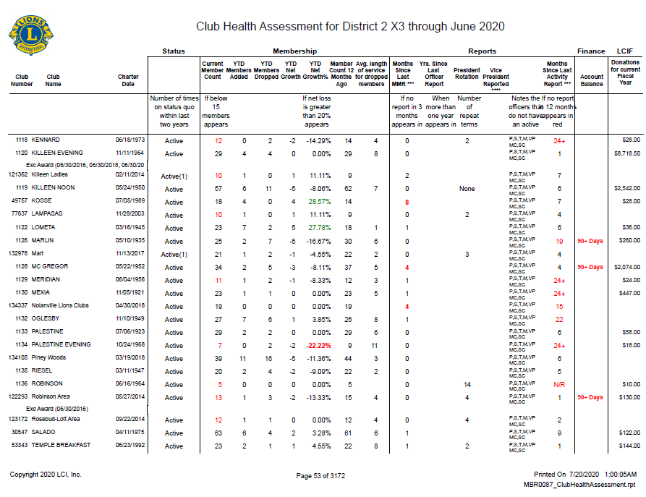
Resources
Club Status
Net membership
LCIF Donations
Officer Rotation
Reporting History
Service Reporting
20

Slide 21
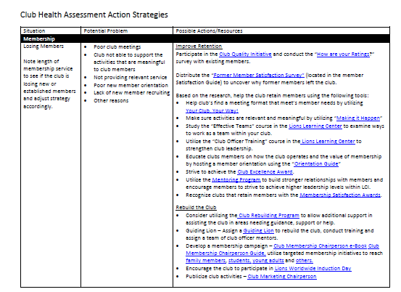
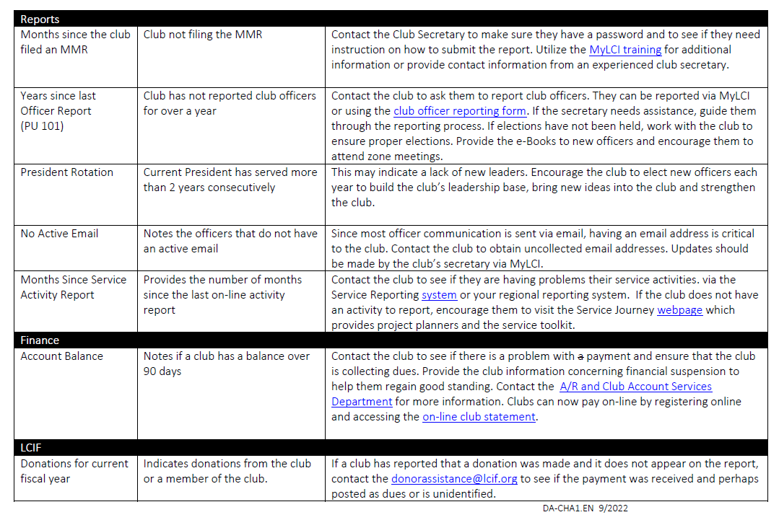
Resources
21

Slide 22
ESTABLISH GOALS
22

Slide 23
Goal Setting Course
Many people do not achieve their goals because they do not establish effective goals. In this course, you will learn how to do just that. You will complete the process of defining goals, writing an action plan, and then managing your goals for the best results. By the end of the course, you will be on the path to achievement.
23

Slide 24
S
M
A
R
T
S
M
A
R
T
pecific
easurable
ctionable
ealistic
ime Bound
Ensure that the objective is clear.
Benchmarks and progress must be measurable.
Each goal must be achievable.
Timeframe that outlines a schedule of progress.
Challenging but not unrealistic.

Slide 25
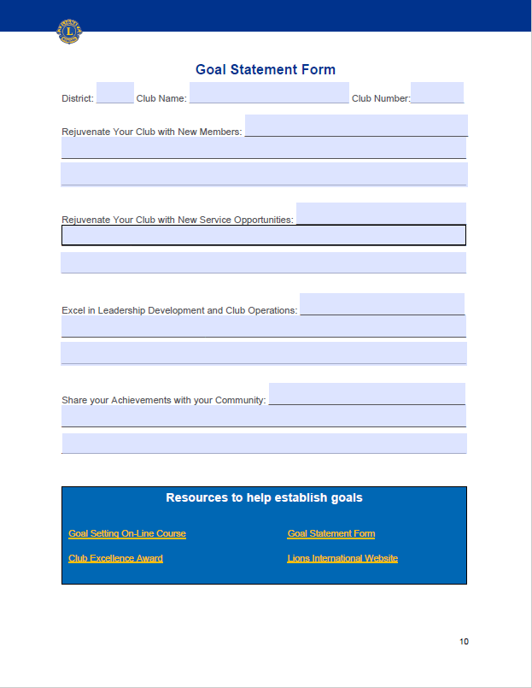
aa
Goal
Statement Form
25

Slide 26
Resources for Goal Setting
Goal Setting Course in Lions Learning Center
Lions International Website
26

Slide 27
BUILD A PLAN TO ACHIEVE OUR GOALS
27

Slide 28
Build A Plan to Achieve Our Goals
For Each Area
What? (Goal Statement)
How? (Action Steps)
When? (Deadline for Completion)
Who? (Person (s) Responsible for Action)
How Will You Know? (How Will You Know It’s Accomplished)
DEVELOP YOUR ACTION PLAN by outlining the steps you will take to achieve your goals.
This step outlines how the goal will be achieved (action steps), when each step will be completed, who will be responsible for the step, and how you can determine each step has been completed. The Action Plan Worksheet is a tool you can use as you develop a plan to achieve each goal. Together, the plans for each goal comprise your Vision.
28

Slide 29
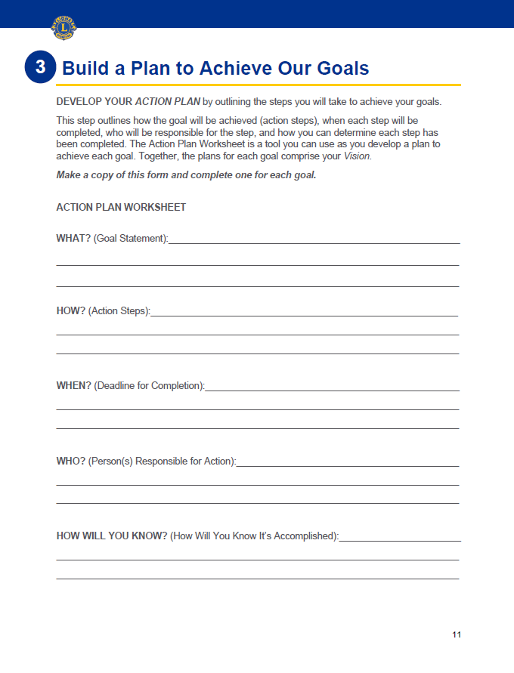
aa
Action Plan Worksheet
Make a copy of this form and complete one for each goal
29

Slide 30
BUILD SUCCESS
30

Slide 31
Build Success
Implement the plan, measure success and don’t forget to celebrate!
Your investment in developing a clearly defined vision will be well worth the effort, as long as this plan is implemented!
Share
Support
Recognize
Evaluate
Change
31

Slide 32
Build Success
To be successful:
SHARE your club’s Vision with all club members so that they are aware of what the club wants to achieve, along with their role in achieving club goals. It is very important to the health and vibrancy of any club that its members feel connected to the club’s success.
SUPPORT the members committed to the plan by ensuring they have the resources they need to succeed. Leaders should check in with members to make sure they feel supported and receive the guidance they need.
RECOGNIZE milestones so members feel valued and know they are moving in the right direction. Every journey was started with a single step. Reassure members frequently to keep them motivated and engaged. Don’t keep your success a secret! Share the success with your community to get like-minded (and prospective members) involved!
Share
Support
Recognize
Evaluate
Change
32

Slide 33
Build Success
To be successful:
EVALUATE the plan. It is also critical to evaluate your plan on a regular basis. As circumstances change, your plan may require revision. The creation of the initial Vision is just the beginning. Keep it alive and relevant by measuring progress and gathering feedback from club members on a routine basis. This is how you will realize your desired results.
CHANGE the Plan. Don’t be afraid to change the plan as opportunities change to keep the plan relevant. Regularly revisit the plan, assess needs and refine action steps. Keep plan members involved in decisions so they stay involved and committed.
Share
Support
Recognize
Evaluate
Change
33

Slide 34
REMEMBER TO CELEBRATE
34

Slide 35
Remember to Celebrate
The LCI Store is an easy way to order certificates, plaques and more to celebrate. If you have further questions regarding club supplies, please email orderdetails@lionsclubs.org.
How will you celebrate?
35

Slide 36
THANK YOU!
36

