Slide 1
Social Media:
Facebook Basics

Slide 2
Presentation Summary
  Why use social media?
  Overview of current LCI social presence
  Deep dive: Facebook
    The basics
    Best practices
    Engagement
    Resources
    Setting up an account

Slide 3


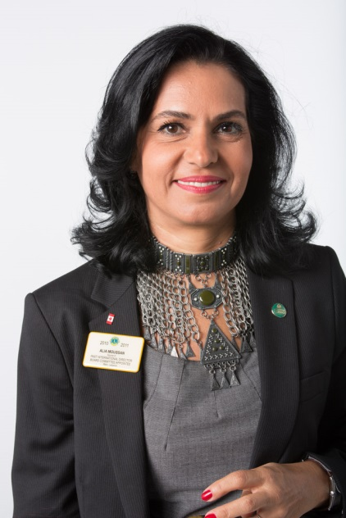
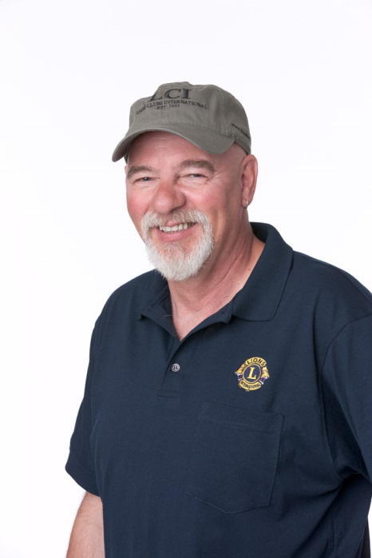
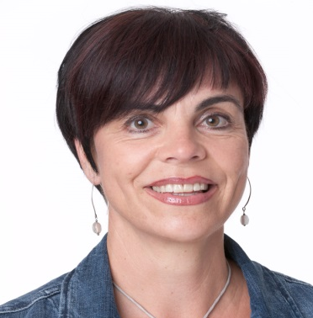




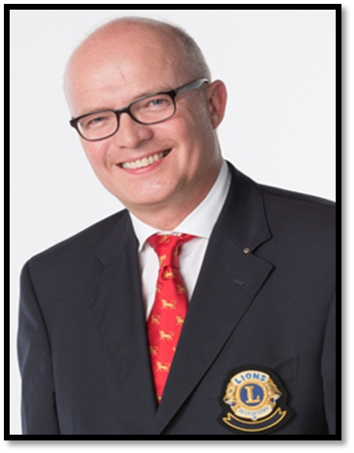

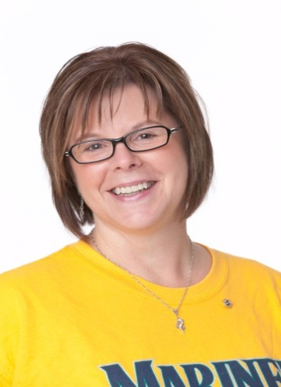







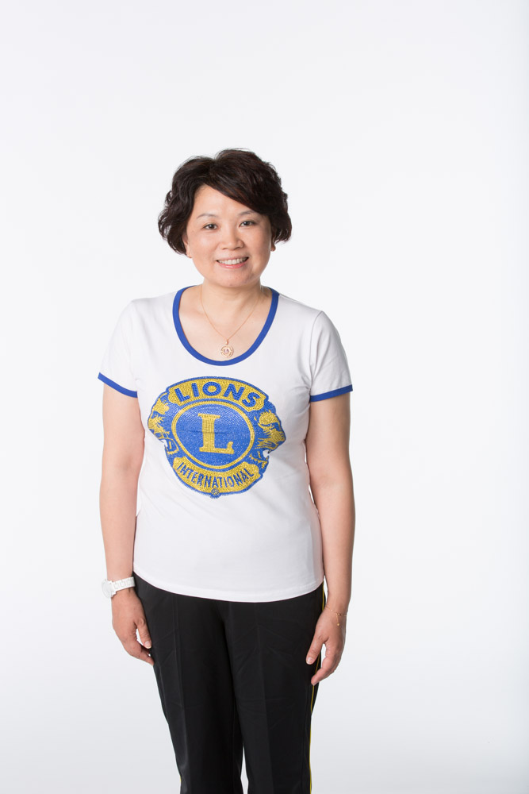
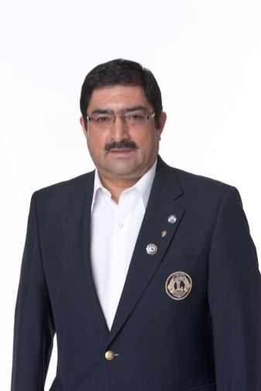
Why Use Social Media?
  Objectives:
  Engage and retain current members
  Empower and leverage large membership to increase storytelling and global visibility
  Improve and increase service worldwide
  Reach potential members
Notes:
Increase visibility – storytelling
If every member is talking about Lions club on Facebook and Twitter, others will take notice
Sharing projects and ideas
Facebook is one of the top referrers to LCI website
Majority of activity referred from FB are first time visits
Non Lions are seeing our content on FB, clicking the links and going to our website because they want to learn MORE

Slide 4











LCI Social Media Overview
  11 social platforms represented
  Facebook most used platform by Lions
  Mainly used to engage/inform current members

Slide 5
Deep Dive: Facebook

Slide 6
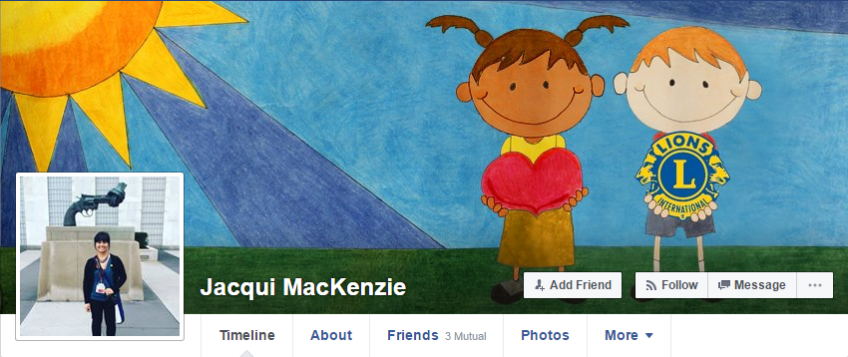

The Basics: Profile vs. Page
Profile
Held under an individual’s name
One profile per person
Max of 5,000 friends, unlimited followers
Page
Must be created/managed by individuals with FB profile
Unlimited pages per profile
Unlimited number of likes
Typically used by companies, organizations, brands and celebrities
Notes:
- Today’s presentation goes over how to set up a profile

Slide 7
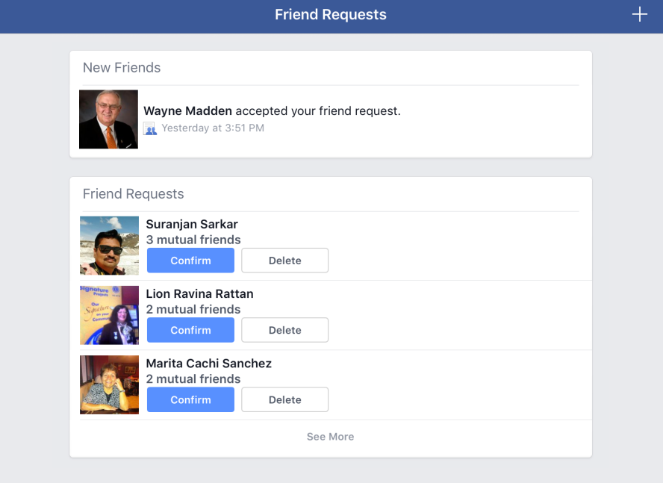
The Basics: Friends vs. Followers
Friends
Friend requests must be ACCEPTED
5,000 friend LIMIT
When you confirm friends, they follow your activity and you automatically follow their activity
Friends may see each other’s PRIVATE posts in News Feed

Slide 8
The Basics: Friends vs. Followers
Followers
Anyone can AUTOMATICALLY follow you – no need to accept a follower request
UNLIMITED number of followers
When someone who is not your friend FOLLOWS you, they’ll see your PUBLIC posts in their News Feed
Why have “Followers”?
You don’t want to manually confirm every friend request
You have reached 5,000 friends
You don’t want to see everyone’s posts in your news feed
You want to keep some posts private for “Friends” only

Slide 9
Facebook Best Practices

Slide 10
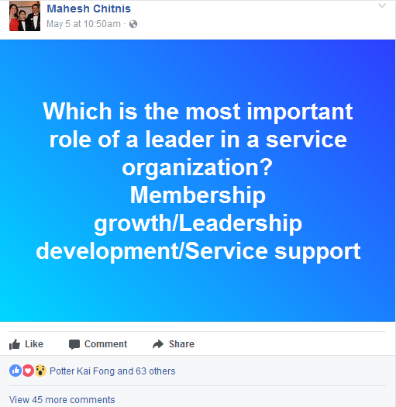
Best Practices: What to Post
Status
Simple text – no photo, videos or links
Provides a brief update on:
  What you’re doing
  How you’re feeling
  Your thoughts on a relevant issue or topic
Opportunity to ask questions, connect with audience
Least engaging type of post – VISUAL content is 40x more likely to get shared on social media than any other types of content
Notes:
Source: http://blog.hubspot.com/marketing/visual-content-marketing-strategy#sm.00000gpyemuodf9ds181pr6z47s7c
Between all of the promotional content, news articles and photos, people want to hear something REAL, from YOU. They want to hear your voice.

Slide 11
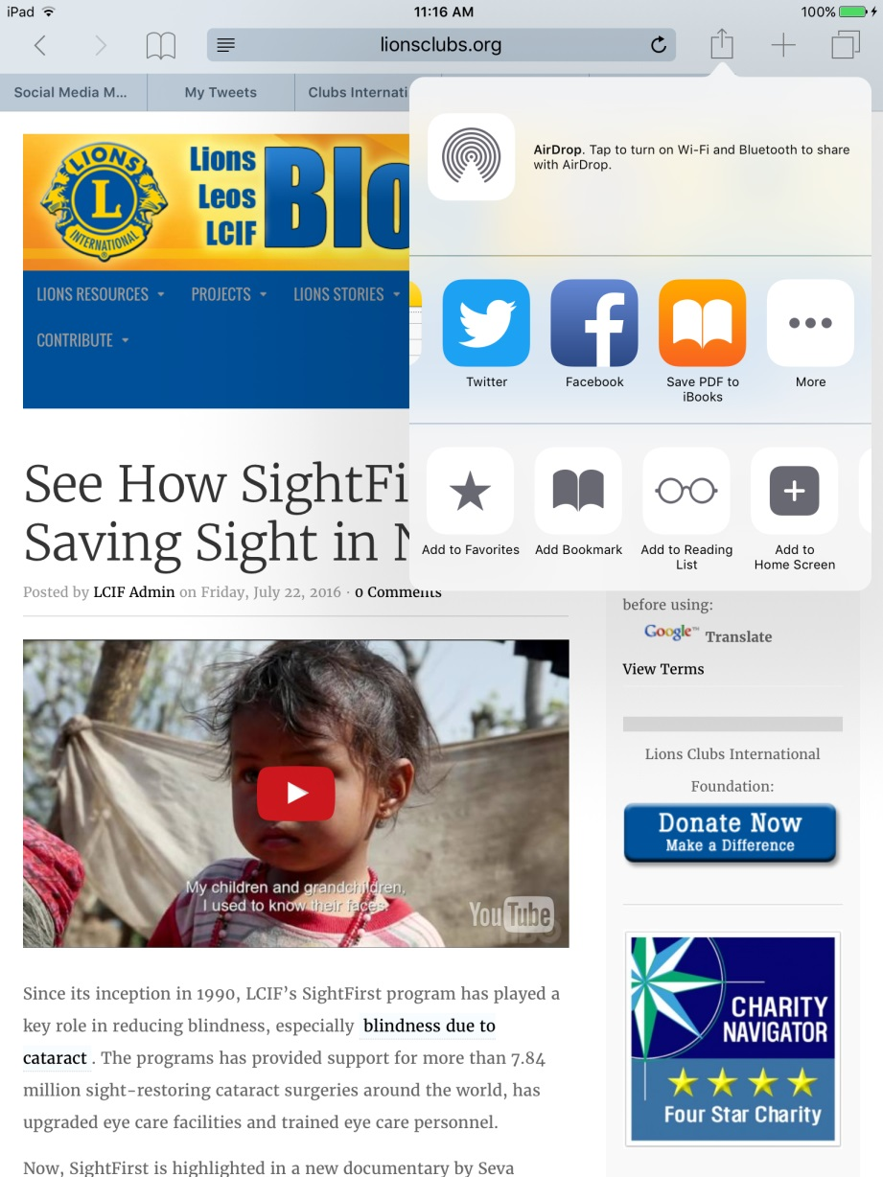
Best Practices: What to Post
Links
Share stories that are relevant and interesting to a broader audience
Stories of impact – How does Lions service impact individuals, families and communities?
Testimonials – How are the lives of Lions and Leos changed?
News articles featuring Lions and volunteering

Slide 12
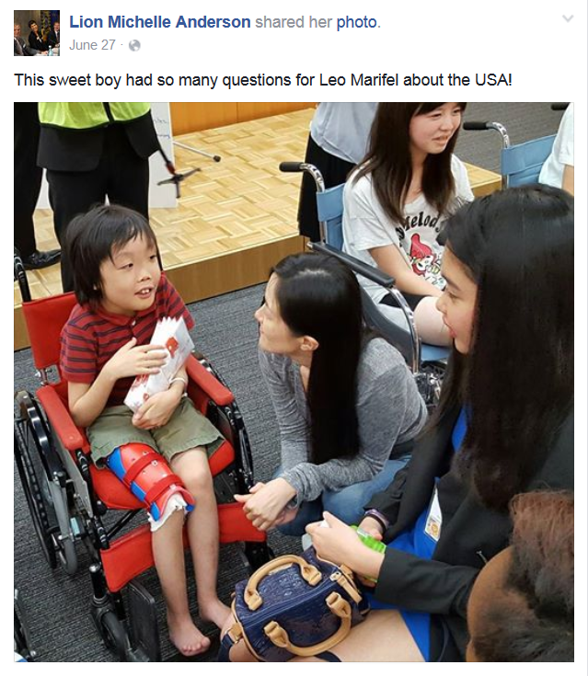
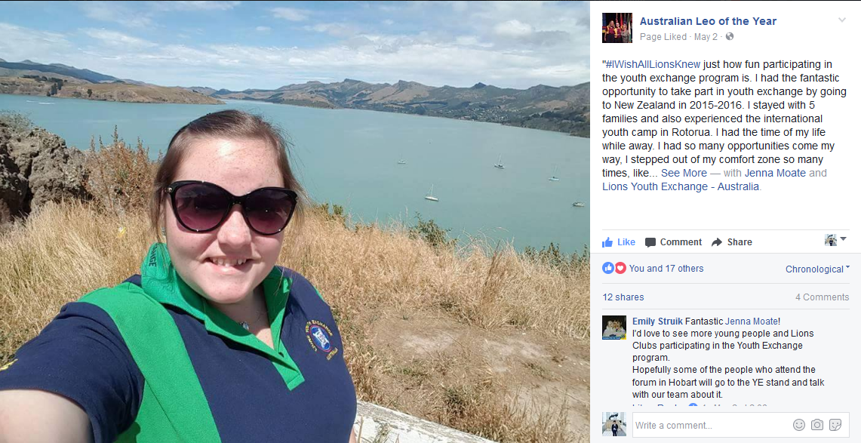
Best Practices: What to Post
Photos
Include description or caption for photos
Most engaging photos tell a story – candids, Lions in action, impact
Image posts get 179% MORE interactions than average Facebook post
Notes:
Source: http://blog.hubspot.com/marketing/facebook-engagement-statistics#sm.00000gpyemuodf9ds181pr6z47s7c

Slide 13
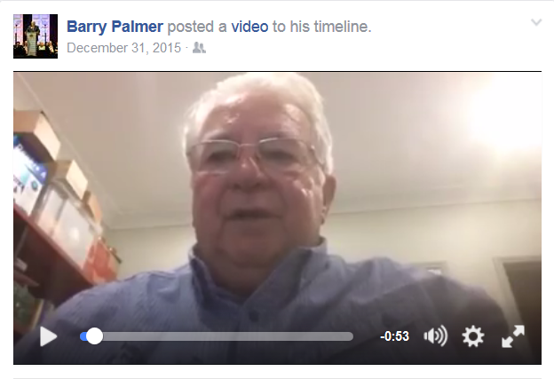

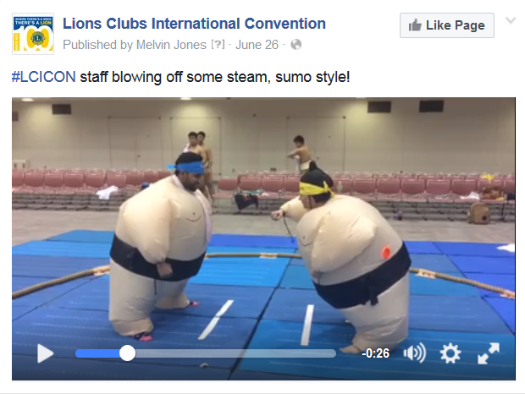
Best Practices: What to Post
Videos
Video posts on the LCI FB page are 3x MORE engaging than status posts
People spend 3x longer watching LIVE video than pre-recorded video
Share LCI-produced videos, take video at event or service activity, talk to your audience
Notes:
Source: LCI Facebook Insights
Source: http://www.socialmediatoday.com/marketing/top-5-facebook-video-statistics-2016-infographic

Slide 14
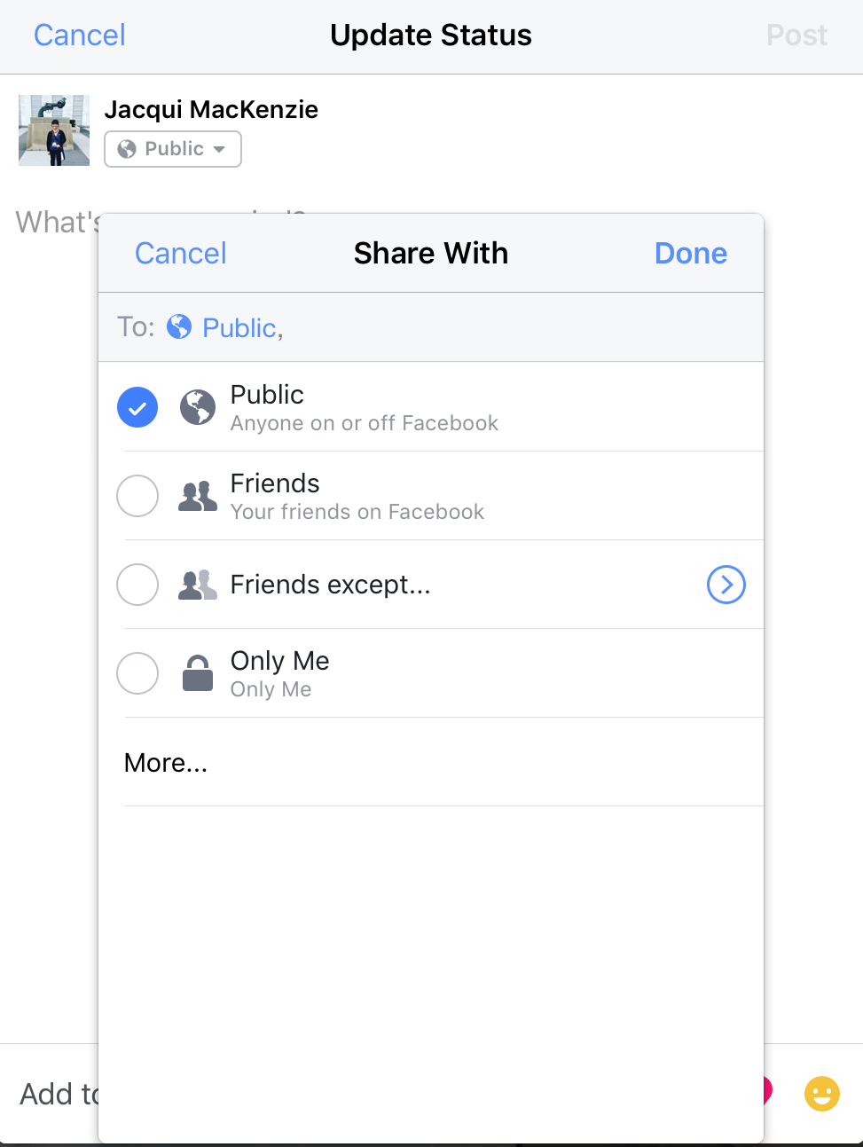
Best Practices: Choose Your Audience
Not all content has to be shared with the general public
Political or religious views
Personal images or videos
Notes:
As Lions leaders, you have a wider audience than most people, so be mindful of what you post

Slide 15

Best Practices: Hashtags
Hashtags help categorize posts and pull them into a larger conversation with a wider audience
Click or search a hashtag to see other posts on that topic
Add a hashtag to your post to join the conversation
Common Lions hashtags:
#LionsClub
#LIONS100
#LCICon
#LDUN
#LionsYouthExchange
#SightFirst
#SightForKids

Slide 16


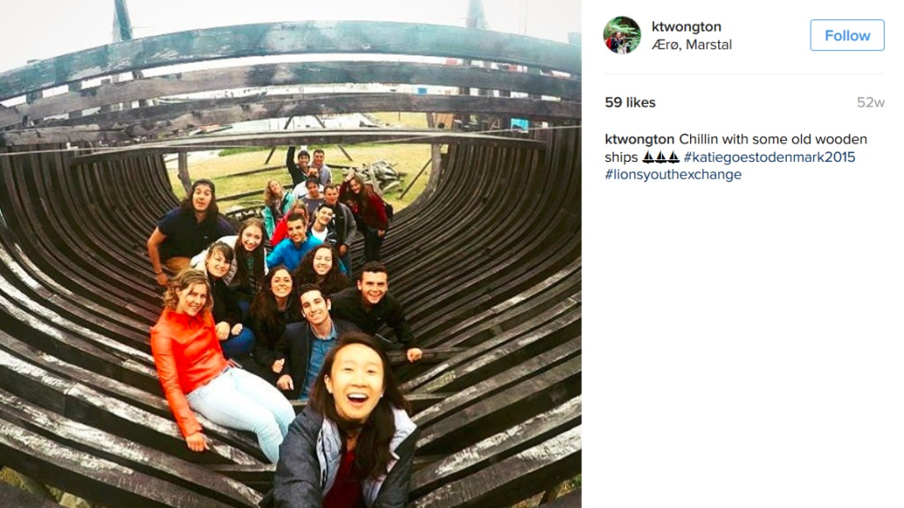

Best Practices: Hashtags
#SightForKids
#SightFirst
#LionsYouthExchange
#LDUN
Notes:
A Lions hashtag is really working when non-Lions start using them

Slide 17
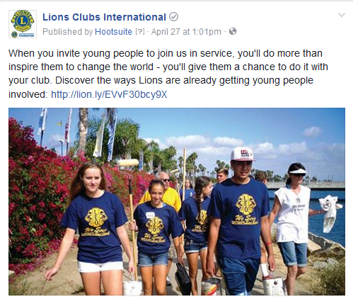

Examples of Top Performing Posts
530+ likes, 185 shares
200+ likes, 500+ shares
Notes:
LCI coin post: 2,000+ likes, 800+ shares, 4,000+ clicks
2nd VP Gudrun post: 200+ likes, 500+ shares
IP Corlew post: 200+ likes, 40+ shares
PIP Yamada post: 400 likes, 200+ shares
PIP Preston post: 13,000+ video views, 200+ likes, 300+ shares
All have great visuals
All provide content that is relevant and interesting to Lions

Slide 18

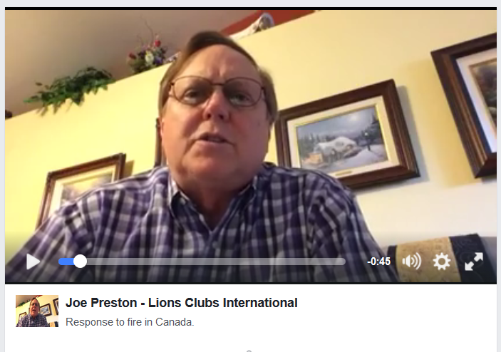
Examples of Top Performing Posts
400 likes, 200+ shares
13,000+ video views
200+ likes, 300+ shares

Slide 19
Use Facebook to Connect

Slide 20
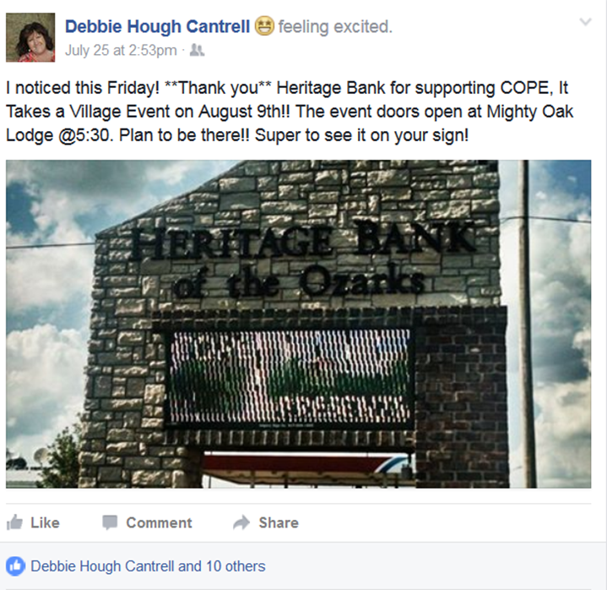
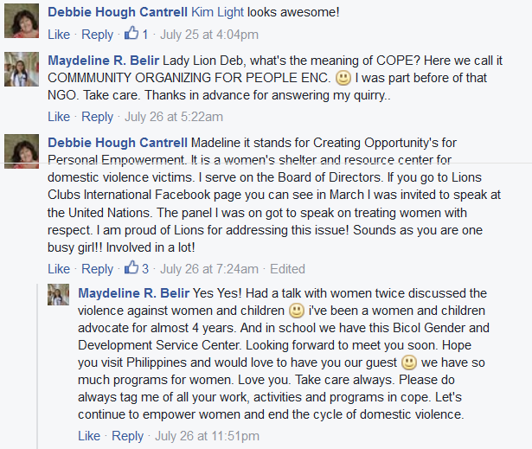
Engagement: Respond to Comments
Comments are an opportunity to:
Answer questions and provide more info
Direct followers to Lions programs or pages
Make friends and connect with other Lions
Notes:
You’ve taken the time to build a following, and your followers have taken the time to look at your content and ask a question… so don’t ignore them!

Slide 21
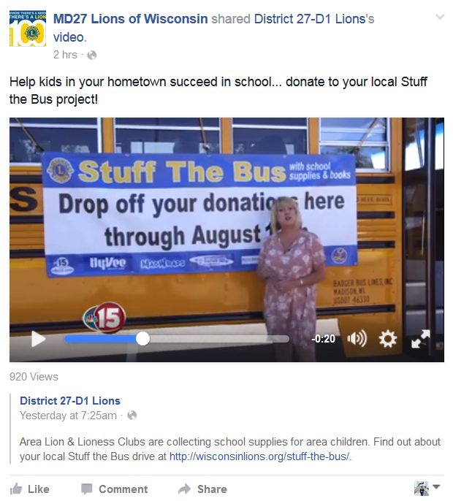
Engagement: Like and Share Content
The more you LIKE and SHARE other Lions’ content, the more people will see it, the more VISIBLE our brand and message becomes.
Notes:
The more you like and share content, the more people will see it on Facebook

Slide 22
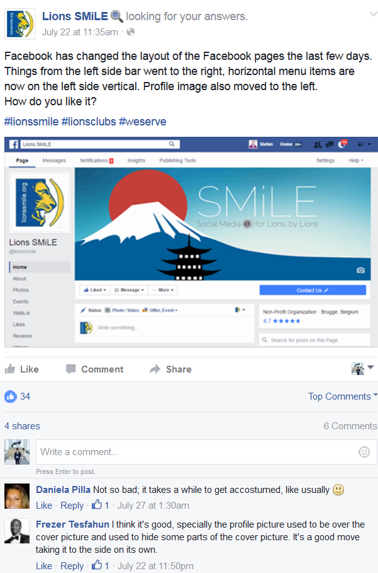
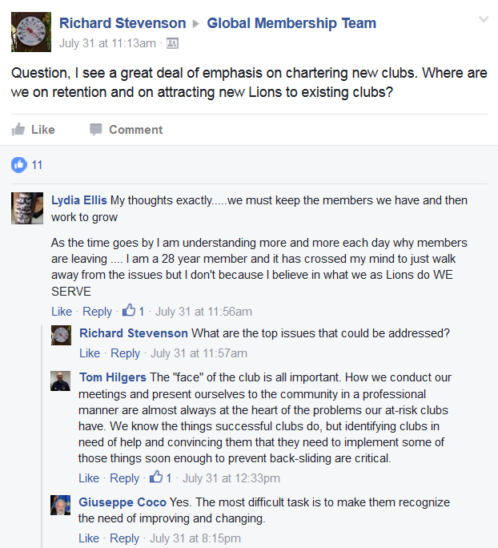
Engagement: Ask Questions
Start a conversation! Ask questions that are:
Easy to answer, OR
Focus on a challenging topic that encourages new ideas and solutions
Notes:
Get people thinking about and discussing key Lions issues

Slide 23





Engagement: Build Community

Slide 24
Resources

Slide 25

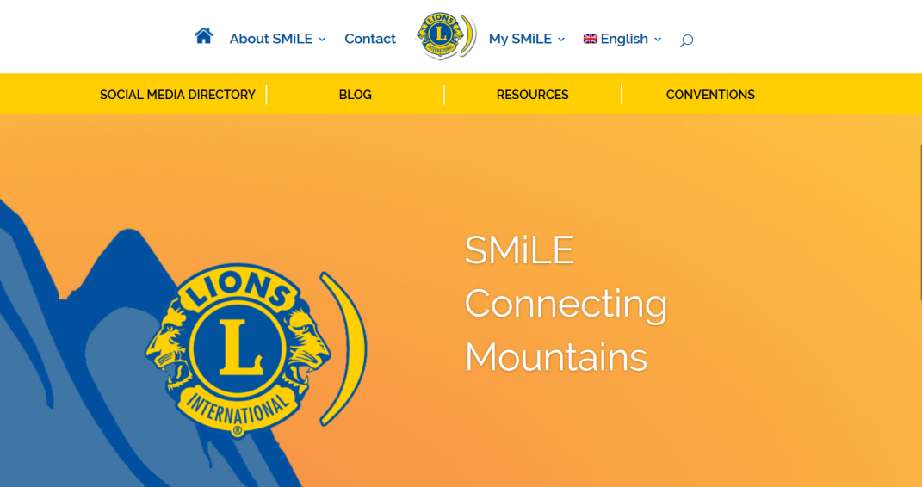
Resources: Lions SMiLE
SMiLE = Social Media including Lions Everywhere
Social media tips, articles and resources for Lions by Lions
LionsSmile.org
Facebook.com/lionssmile/

Slide 26
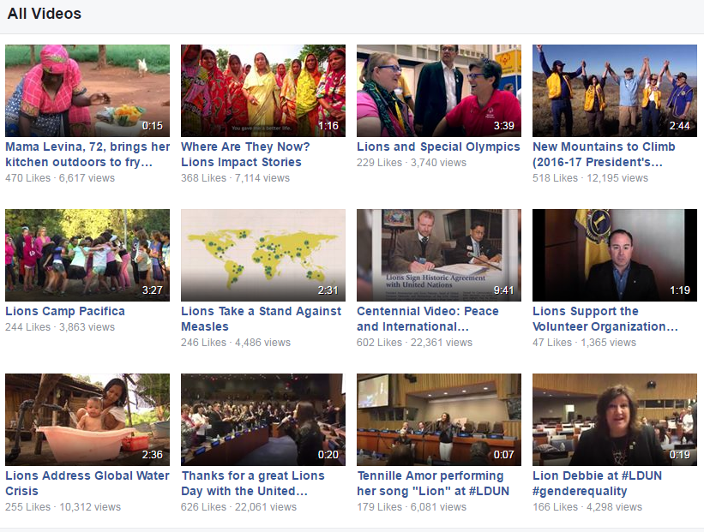

Resources: LCI Facebook Page
Lions news
Stories of impact
Photos
Videos
Facebook.com/lionsclubs

Slide 27
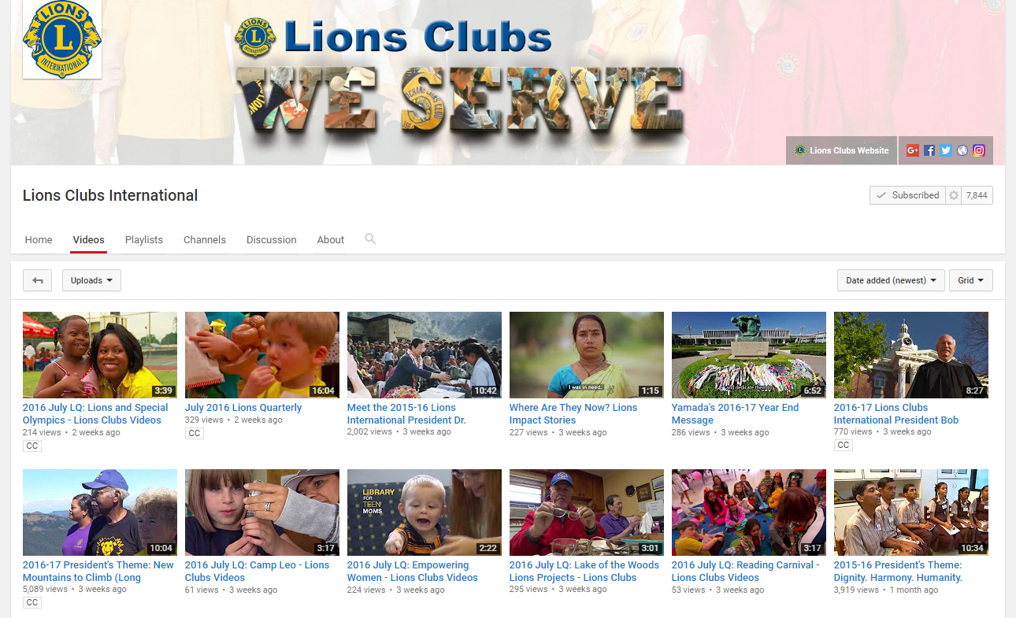
Resources: LCI YouTube Channel
www.youtube.com/lionsclubs

Slide 28
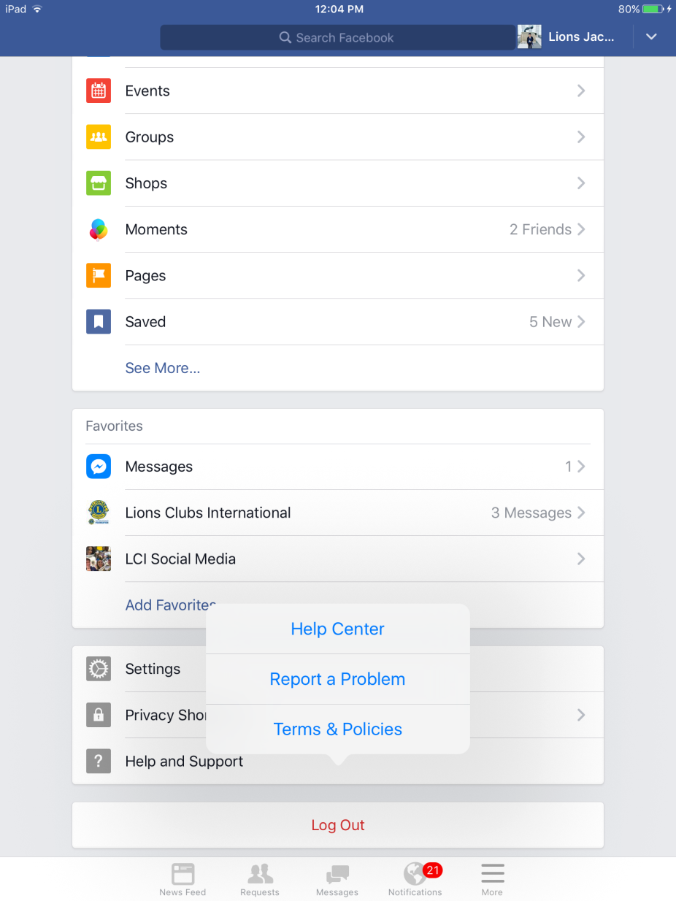
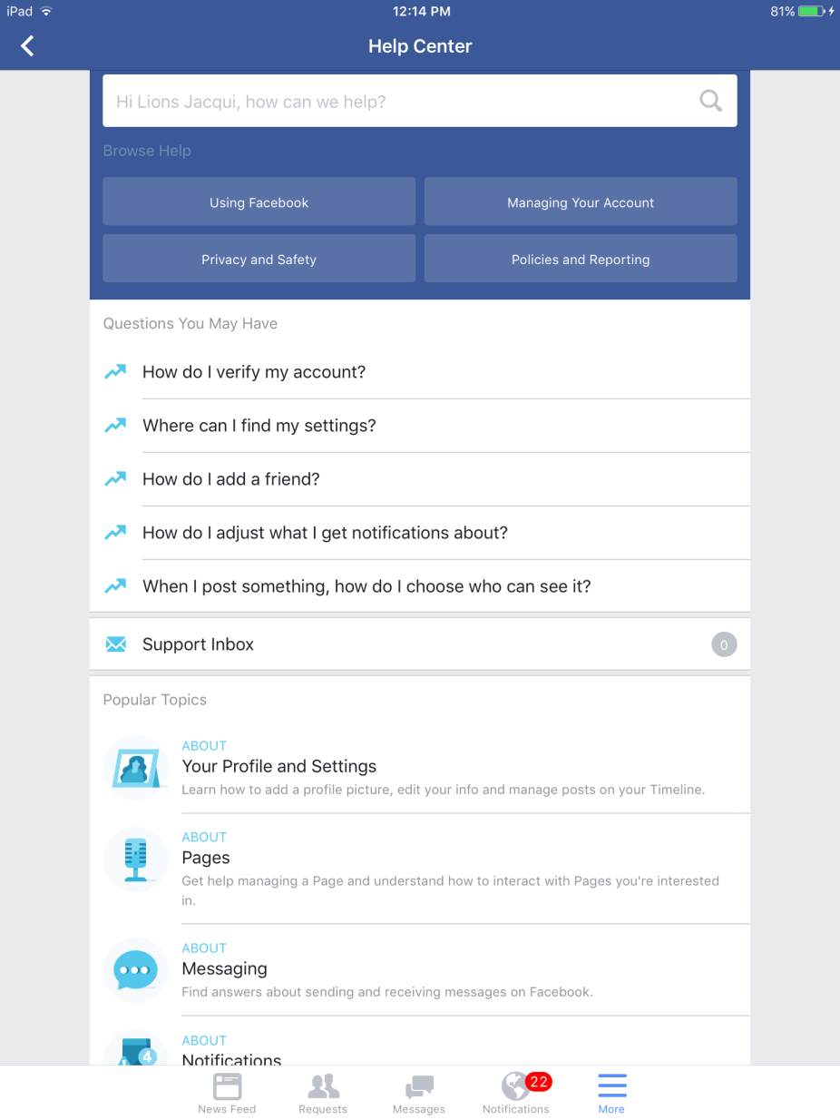
Resources: Facebook Help Center
Facebook.com/help/

Slide 29
Resources
SMiLE = Social Media including Lions Everywhere
Social media tips, articles and resources for Lions by Lions
LionsSmile.org
facebook.com/lionssmile/
facebook.com/lionsclubs
facebook.com/help/
youtube.com/lionsclubs

Slide 30
Getting Started

Slide 31

Getting Started: How?
Notes:
- Download the Facebook app for your iPad or go to www.facebook.com.

Slide 32
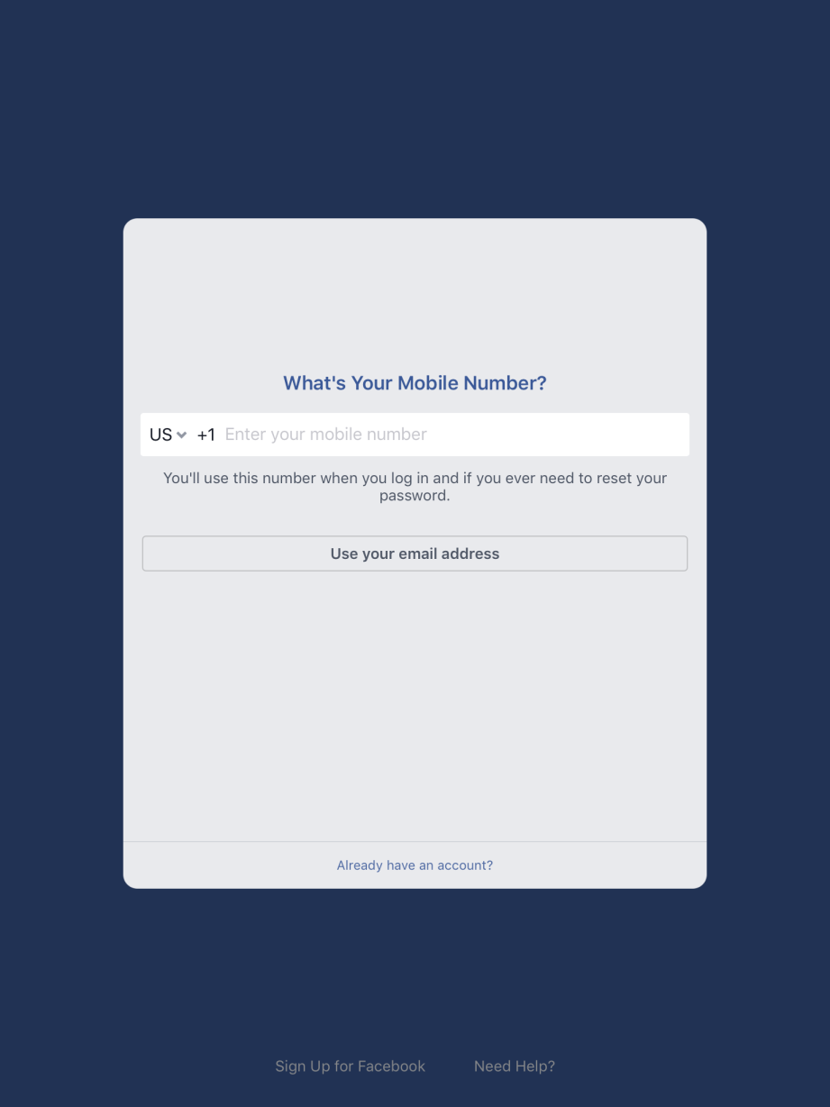
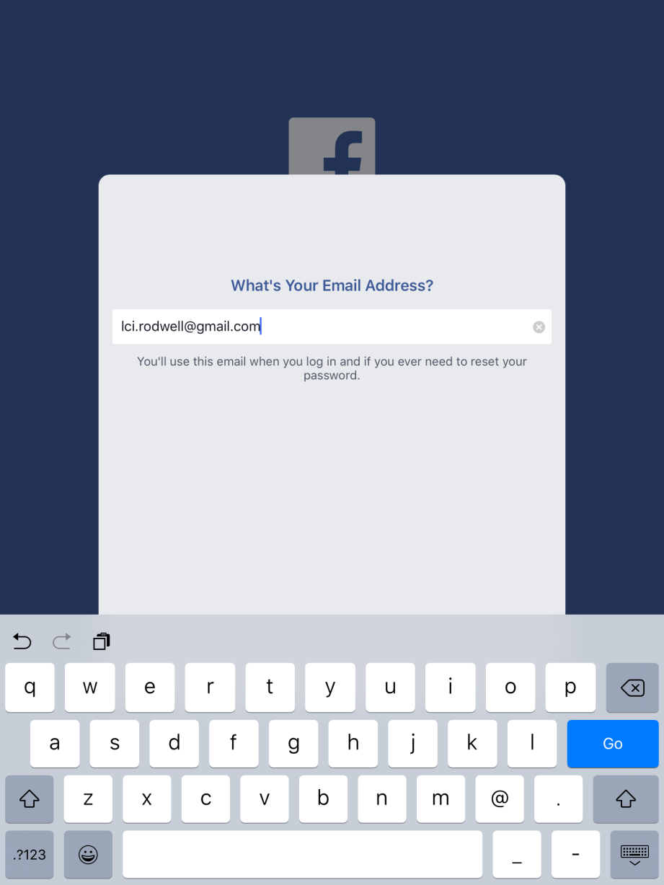
Getting Started: Provide Email Address

Slide 33
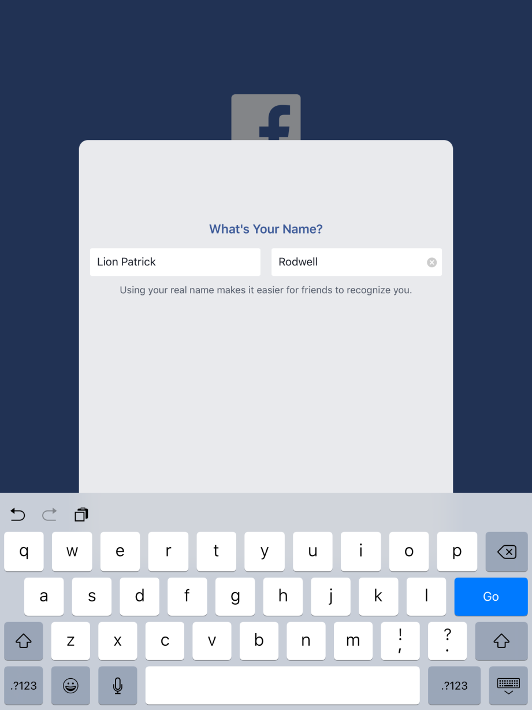
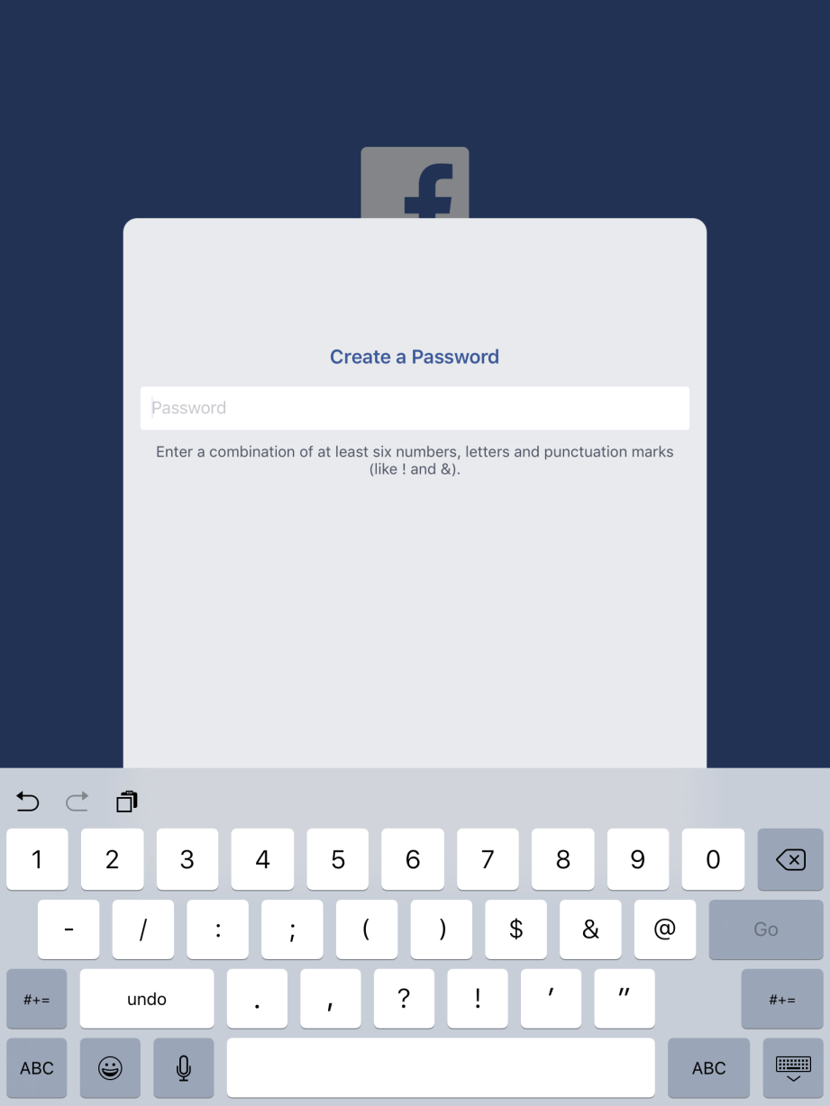
Getting Started: Name and Password

Slide 34
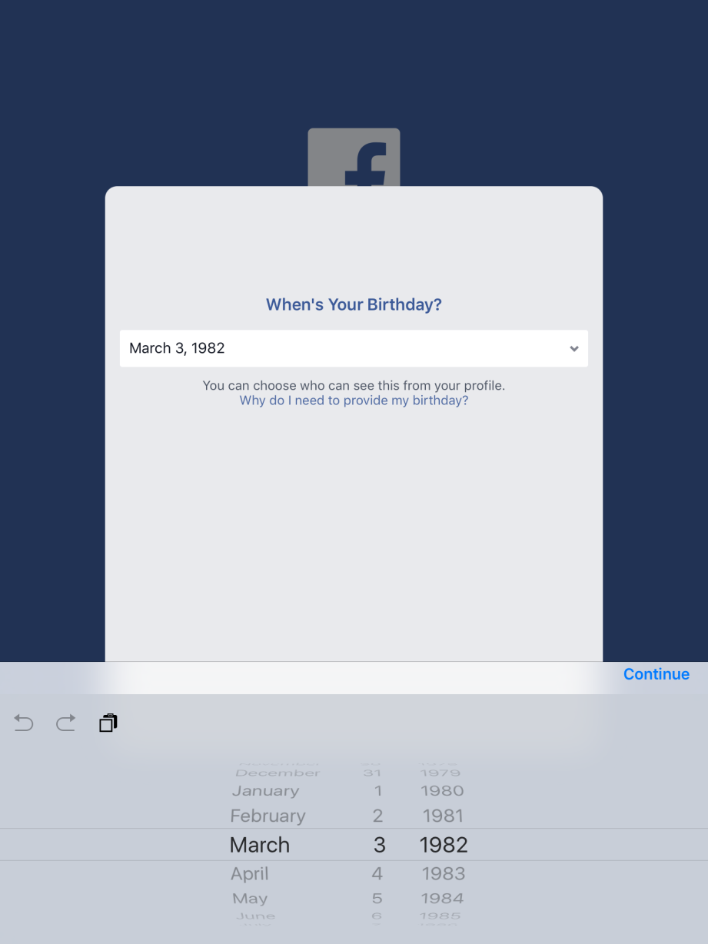
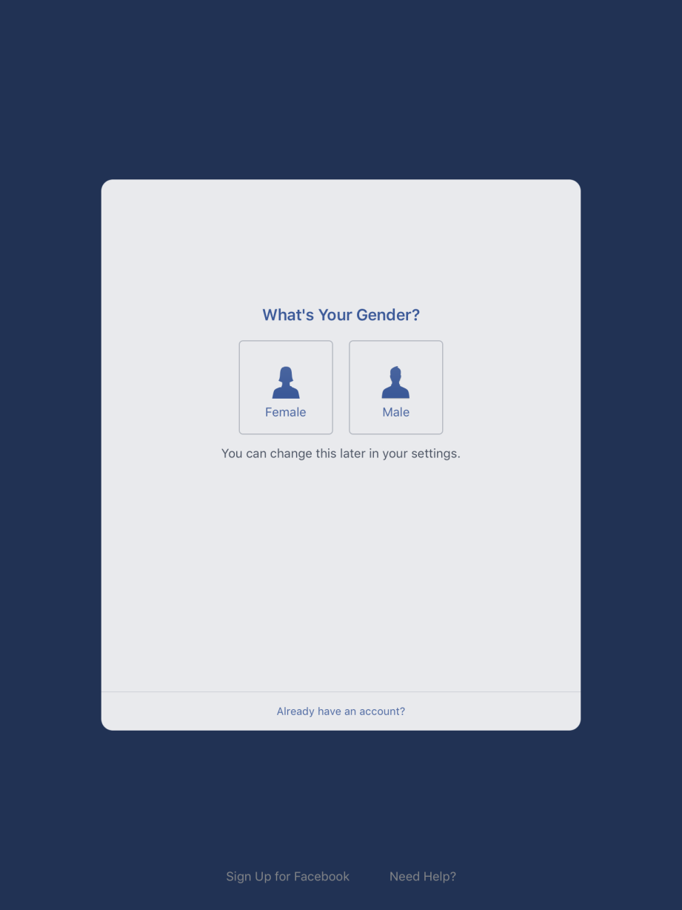
Getting Started: Birthday and Gender

Slide 35

Getting Started: Find Friends
Notes:
Facebook helps you find friends based on the contacts on your device and people you know.
You can also search for friends using the Search Bar.

Slide 36
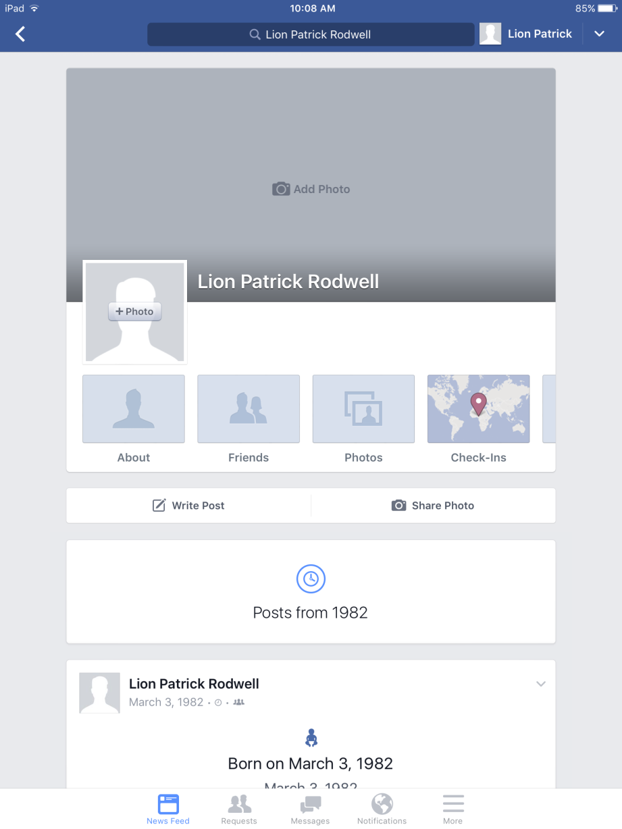
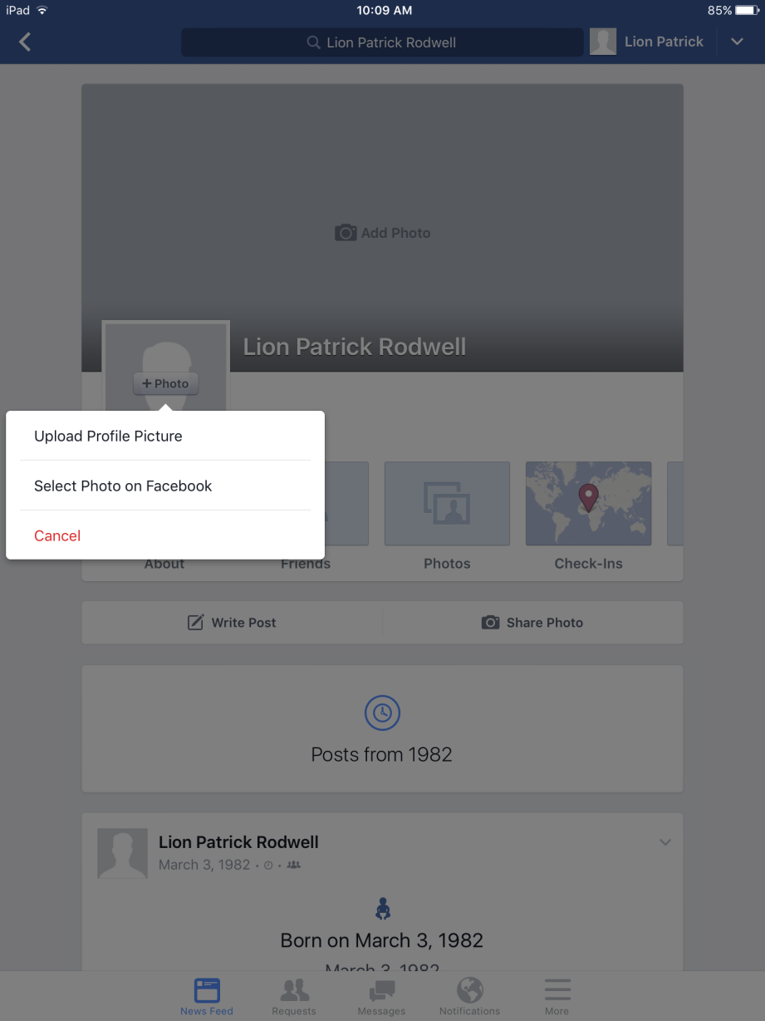
Getting Started: Add Profile Picture
Notes:
Tap on you profile photo to upload an image from your device.

Slide 37
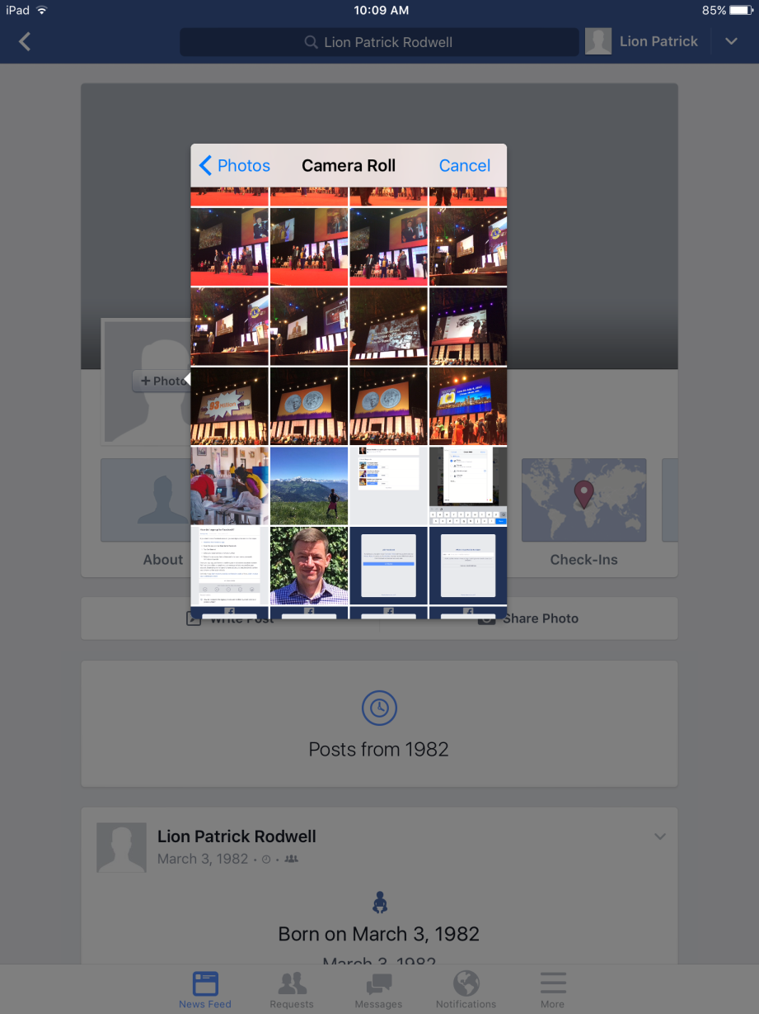
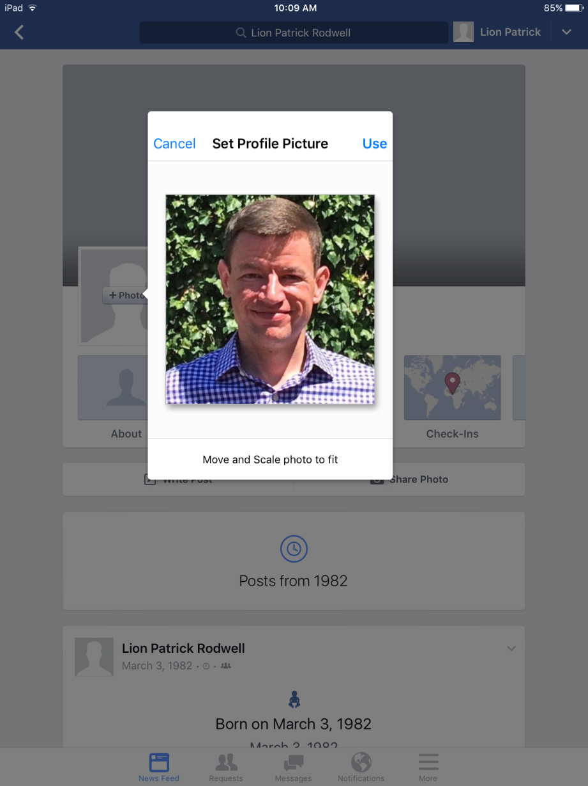
Getting Started: Upload Profile Picture
Notes:
Choose a headshot

Slide 38
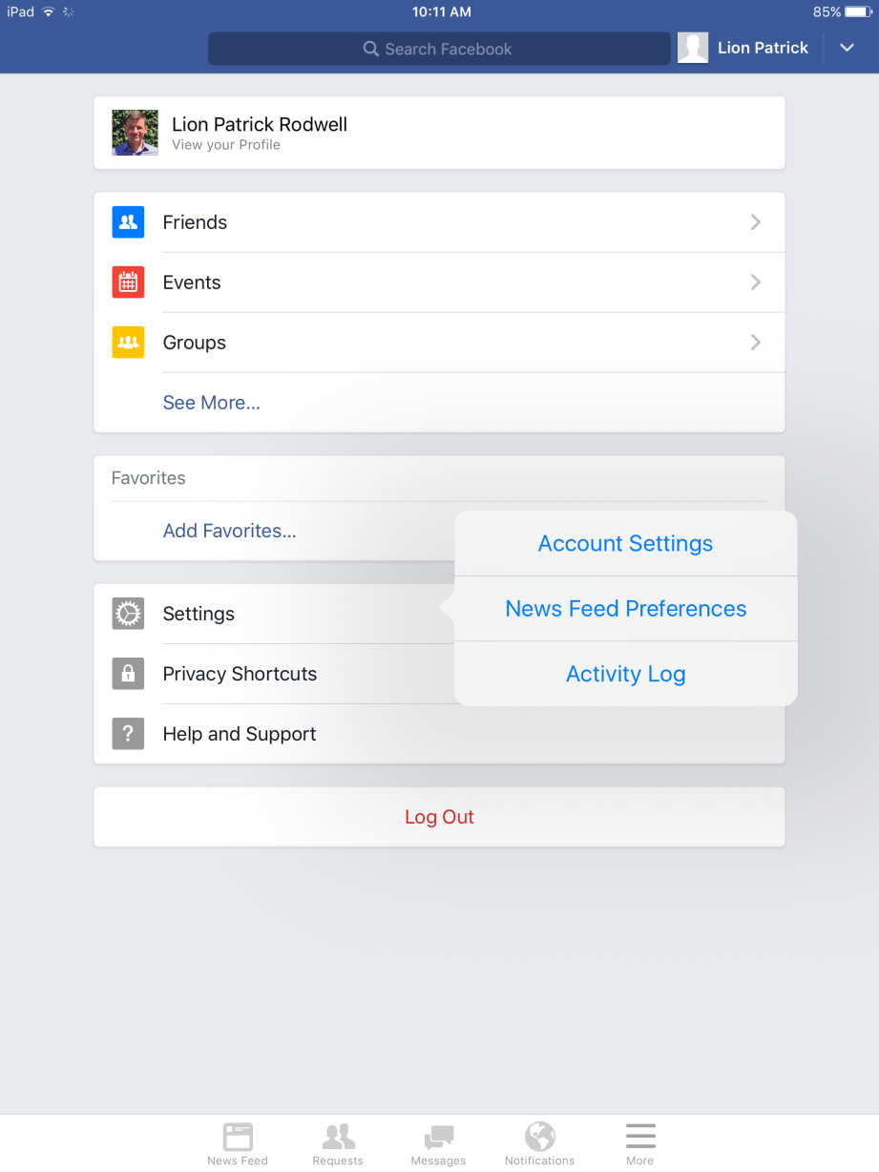
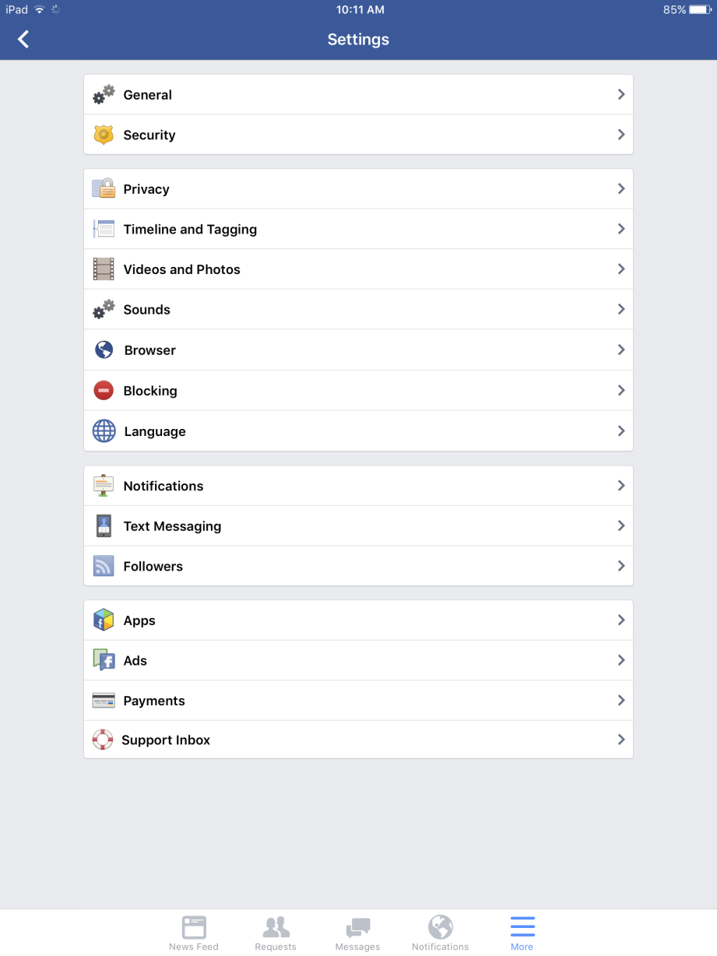
Getting Started: Update Settings
Notes:
Click “More” on the bottom right of your screen and choose “Settings” and “Account Settings.”
From here, you can update your “Privacy” settings.
You can also allow “Followers.”

Slide 39
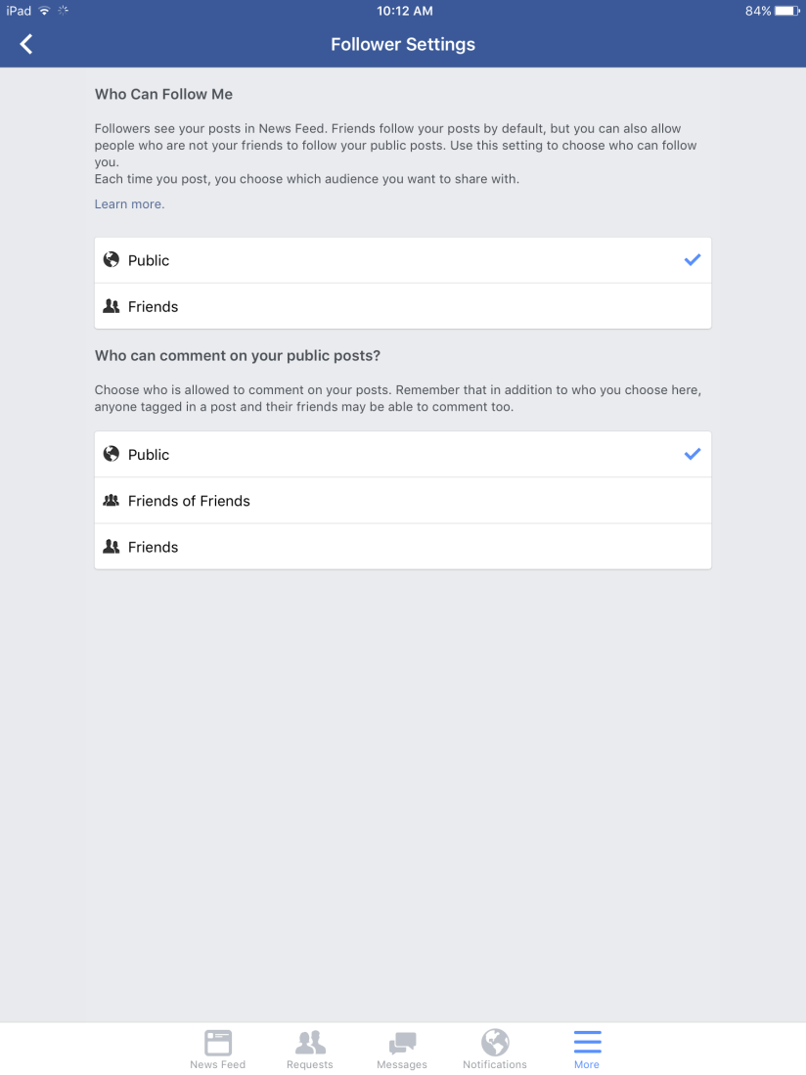
Getting Started: Followers
Notes:
Under “Follower Settings,” choose “Public” for who can follow you and who can comment on your public posts.
This allows people to “Follow” your public posts without having to become your “Friend.”
You can edit the audience of individual posts before publishing in case you are worried about the privacy of certain posts; for example, if you are posting an image of a young family member that you don’t want to share with the public.

Slide 40
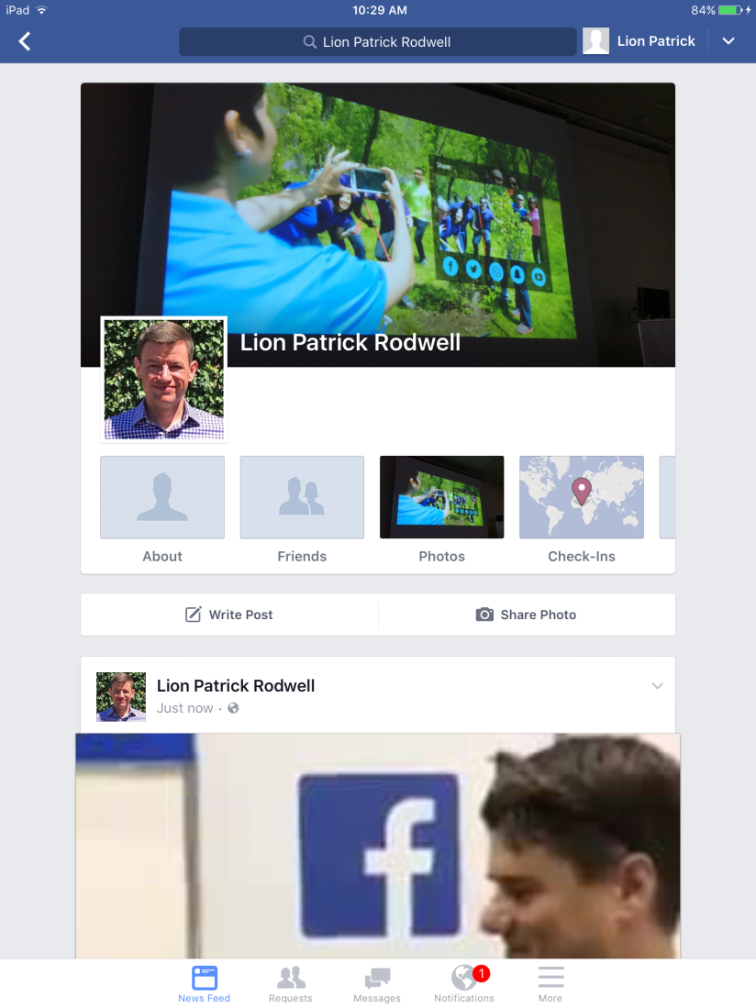
Getting Started: Go!

Slide 41
Questions?

